Slide 1
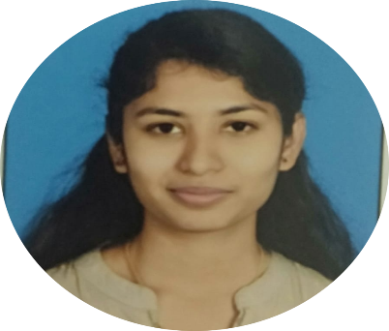
KAVYA SHREE T S
Picture
KAVYA SHREE T S Technical support analyst
Profile Summary
Professional Experience
Knowledge on SQL.
Knowledge on PostgreSQL .
Good understanding of AWS.
Good Knowledge on Core Java.
Good Knowledge on Manual Testing.
Good Knowledge on Automation Testing.
Good Knowledge on Agile Methodology.
.
Completed certification on AWS Level-0.
Preparing for AWS Certification Cloud Practitioner.
Completed Certification on Manual Testing and Automation Testing
A profound listener and communicator and also has a eye for profound analytical skills.
Technical Experience
Technology: Java, SQL,.
Tools: PostgreSQL,.
Database: Oracle 10g, PostgreSQL.

