Slide 1
Udyam Digital
A mobile-friendly website and WhatsApp journey that takes a small business from one sentence to a booked installation, in its own language.
Team NATPAT · TIET, Patiala
Airtel SYNC 2026 · Digital Track
Karandeep Singh Bhasin (102353008) · Armaan Gogoi (102303623)
Notes:
Accel Business sells to small businesses through a field force built for large accounts. Only 7 in 100 small-business leads activate, it takes 17.6 days, and each customer costs about ₹15,000 to win. Udyam Digital is a working product that replaces the visit-led sale with a phone-first journey on the web or WhatsApp: an advisor in 10 languages, a priced bundle, verification in minutes, and a tracker. Partners take only what software cannot close.

Slide 2
7 in 100 leads activate, and a third of the loss is addressable
One quarter of synthetic SMB leads (Apr–Jun 2026). The steepest drop is from needs assessed to quote accepted.
17.6 days
3 calls
34%
3 in 4
lead to live; 12.9 of them hand-offs
per customer, chasing status
of 4,632 drops (1,583) cite reasons a digital journey can address
owners without GST fail KYC after saying yes
Source: smb_leads.csv (5,000 synthetic leads; 368 activations; ₹55.4 lakh acquisition spend). KYC: has_gstin, has_udyam.
Notes:
The funnel loses most between needs assessment and quote acceptance (44% convert). The 34%: 1,583 of the 4,632 dropped leads cite one of nine reasons a digital journey can address: owner had no time for a visit 531, visit not scheduled by sales 296, quote too complex 206, quote took too long 179, installation over 21 days 98, missing GST/Udyam document 94, paperwork too long 79, signatory not available 53, document details mismatch 47. Of the 17.6 days, 12.9 are hand-offs before installation: first contact 2.0, needs visit 3.0, quote 4.1, KYC 3.8; installation is 4.8. Owners without GST accept quotes but only 47 of 190 clear KYC (25%), against 81% with GST; with neither registration it is 21%. Status chasing predicts churn: one call 5.9%, five calls 27.9%.

Slide 3
Today’s buying journeys leave gaps; we close them in one sitting
The three ways a small business buys connectivity today, compared at each step of the journey.
Step | Accel field sales today | Digital-first, single product | Local reseller, many vendors | Udyam Digital
Find the right product | A visit; the executive pitches what is on target | Self-serve, one product at a time | Whatever the shop stocks | Advisor in 10 languages, web or WhatsApp
What you can buy | Products sold one at a time | A single product | Pieces from different vendors | A whole bundle, a reason for every line
Price | Quote in 3–5 days, PDF with product codes | Instant, for that product | Informal | Instant monthly price, add-ons to toggle
Verification | Papers collected in person; 3.8 days | Online sign-up | Varies | Registry + documents read on the phone: minutes
Owners without GST | 1 in 4 clears KYC | Varies | Varies | Free Udyam, guided; or Aadhaar e-KYC + shop proof
Status and support | 3 status calls; billed and supported per product | Per product | No single bill or support number | Dated tracker on WhatsApp; one bill
Where we win: the bundle, one bill, the owner’s language, and a route for the 29% of leads with no GSTIN. A partner steps in when software cannot close.
Where they win, and our answer: a single-product sign-up is quicker for one SIM, so owners can drop any extra line from the quote. Resellers own local trust, so we recruit them as paid partners.
Sources: the case brief and smb_leads.csv. "Varies": not described in the brief, so we make no claim.
Notes:
We compare the three alternatives a small business owner actually has, using only what the case brief and the leads data establish: Accel’s own field sales, digital-first players that the brief says offer instant online sign-up for single products, and local resellers from whom owners buy each piece separately with no single bill. Where the brief is silent we write “varies” rather than guess. Our edge is the combination: a whole bundle priced instantly in the owner’s language, verification in minutes including owners without GST, and one bill with a dated tracker. Where single-product players are faster, the advisor still recommends a single product when that is all the owner needs; resellers become paid partners rather than competitors.

Slide 4
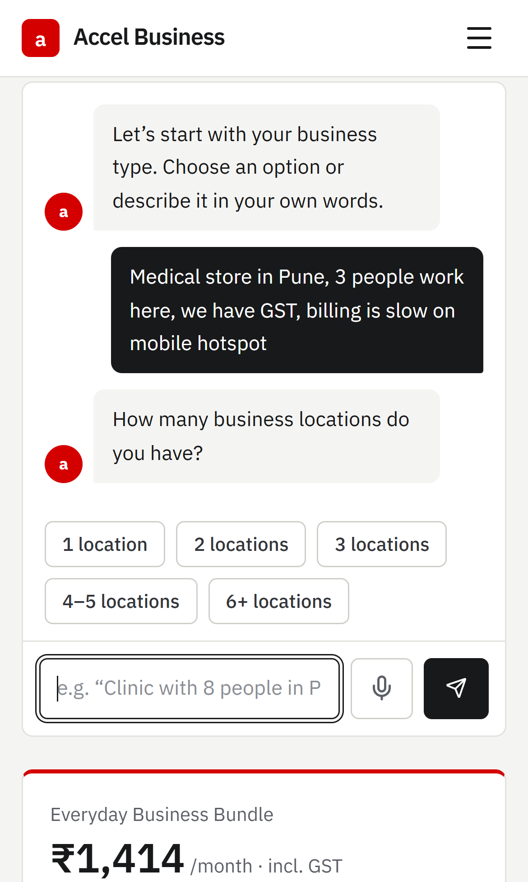
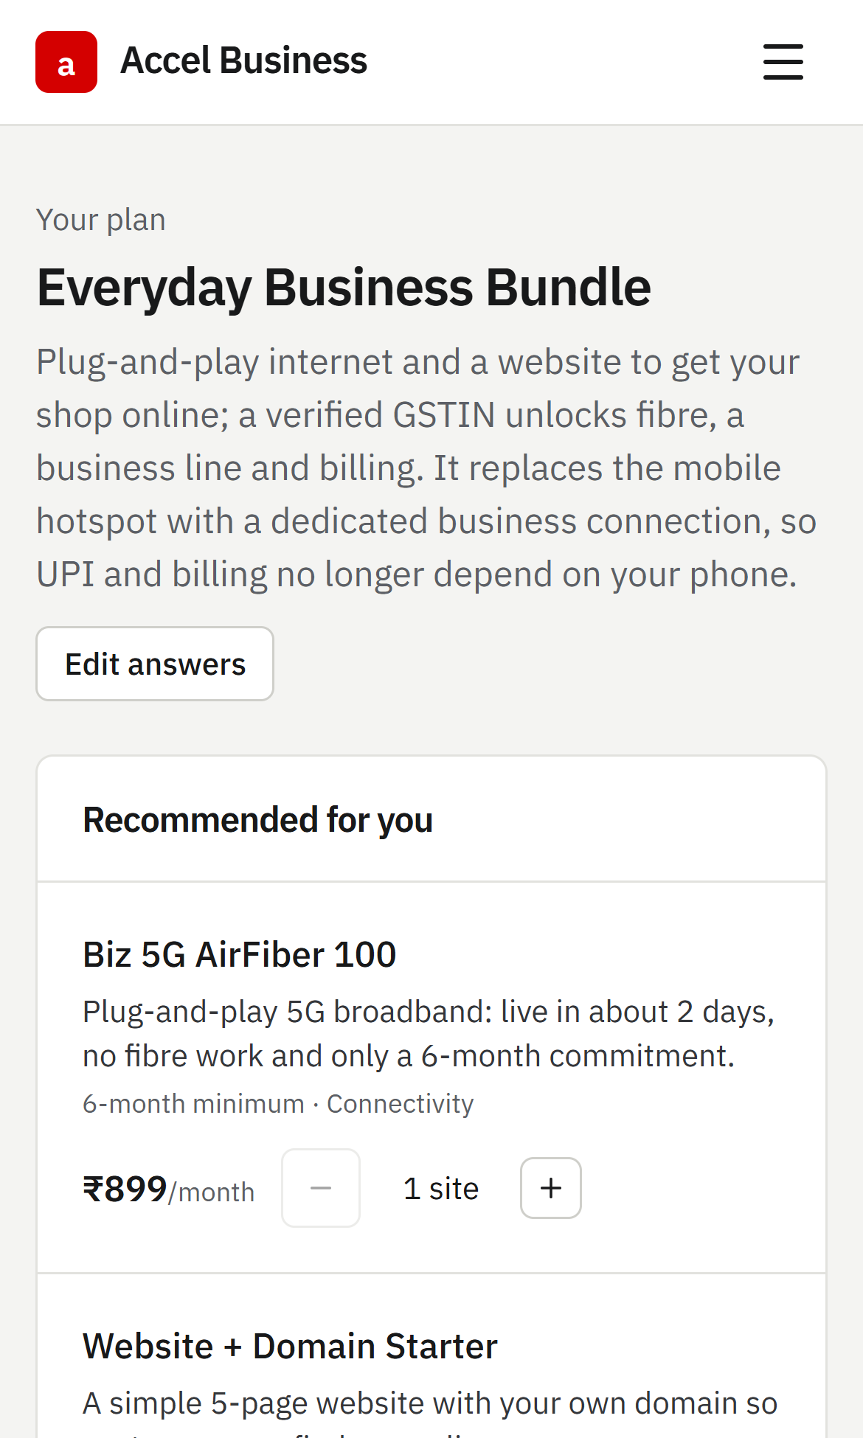
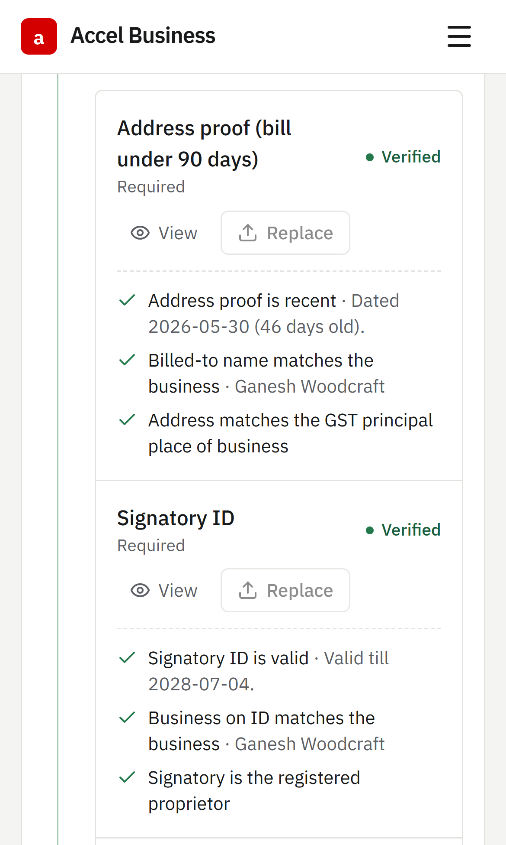
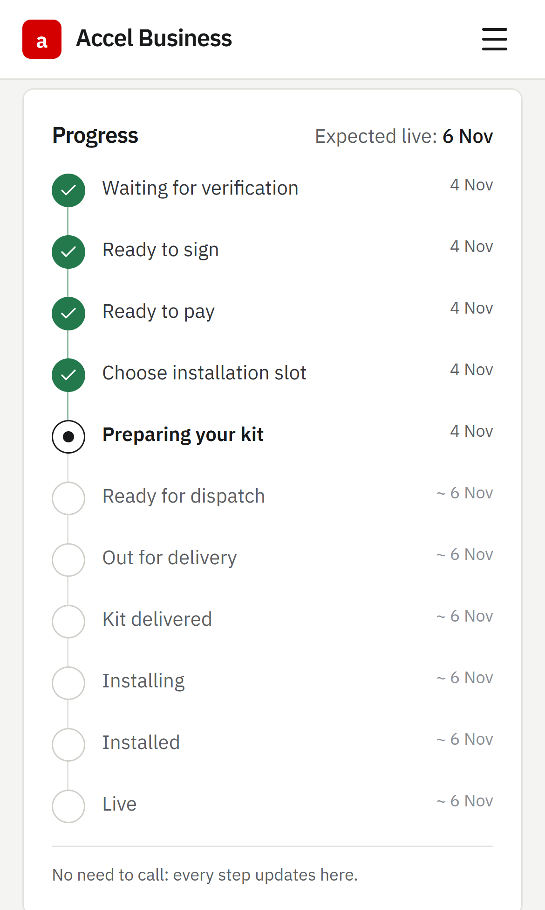
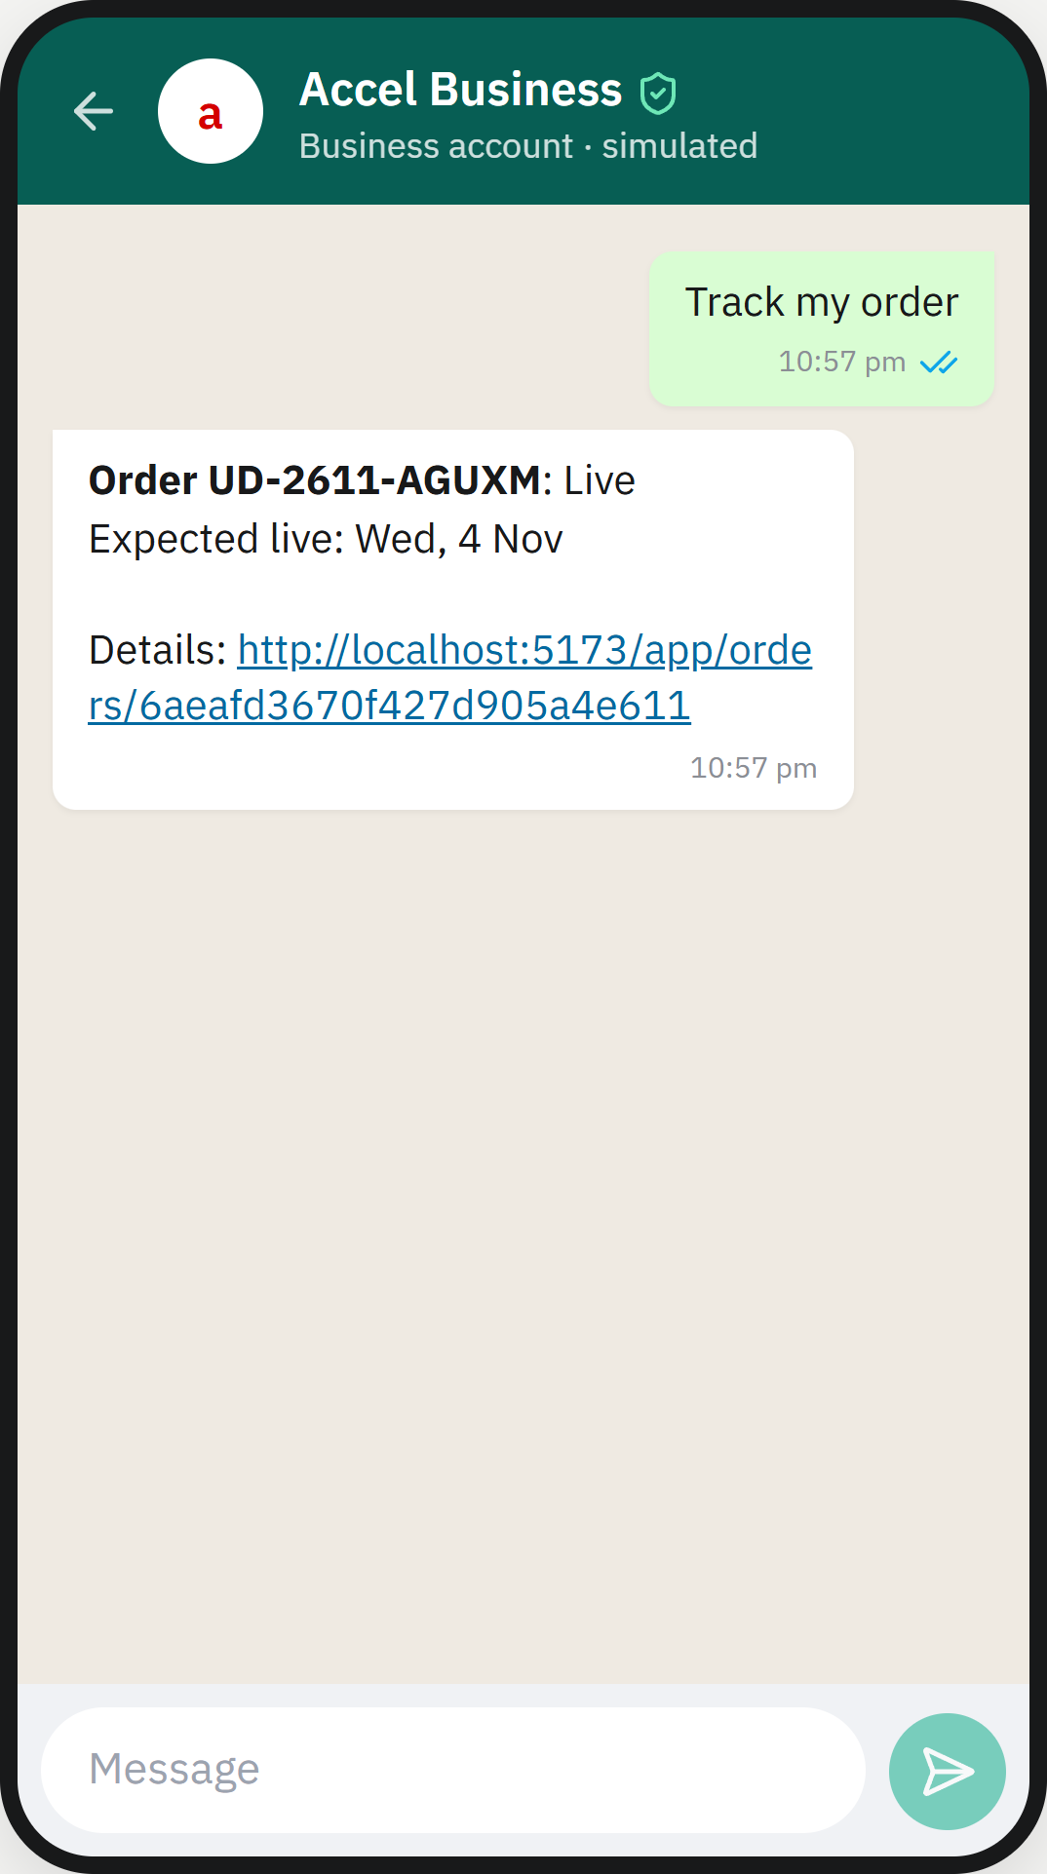
One sentence to a booked installation, without an initial sales visit
Fixes: visits, slow quotes and status chasing (slide 2). Screens from the working build.
1 Describe the business
2 See the price
3 Verify once
4 Track to go-live
5 Or stay on WhatsApp
Owner
BUILT
API
BUILT
Data
BUILT
Connections
BUILT
Web app (React) or WhatsApp, 10 languages
→
Advisor, pricing engine, Smart KYC rules, orders, lead model
→
MongoDB; private Cloudflare R2 document store
→
GST and Udyam registries, Aadhaar e-KYC, UPI, WhatsApp, Claude
The demo runs on the case’s synthetic data, with payments in test mode. Full map: supporting PDF, page 2.
Notes:
These are real screens, not mock-ups. 1: the owner types one sentence; the advisor fills in business type, staff, city and GST and asks only what is missing. Claude understands the sentence; the pricing engine, not the language model, chooses products and prices. 2: one monthly price with a reason for every line; GST-only products stay locked until a GSTIN is verified. 3: registry lookup and documents read on the phone. 4: eleven dated steps from KYC to live, each also sent on WhatsApp. 5: the same advisor and tracking on WhatsApp. All four layers are built. The demo uses the synthetic case data, and payments run in test mode.

Slide 5

Clean applications verified in minutes, including owners with no GST
Fixes: paperwork drops, a 3.8-day KYC stage, and 3 in 4 owners without GST failing KYC (slide 2).
KYC today
3.8 days
Issues identified in sample applications | Caught | The owner is told
GST registration cancelled | ✓ | Use an active GSTIN, or Udyam
Certificate photo too blurred | ✓ | Retake a sharper photo
GSTIN altered or mistyped (2) | ✓ | The registry’s GSTIN
Legal name differs from registry | ✓ | Fix it, or ask a reviewer
Bill 257 days old (limit 90) | ✓ | Upload a recent bill
6 clean applicants | ✓ | Verified; reused for a year
Owners without GST
Automated checks
Minutes
Get Udyam free, guided: details pre-filled; a reminder after a day, a partner’s call after three.
Or verify without registering: Aadhaar e-KYC by OTP, plus a bill and a shop licence or shop photo.
Then: everything that does not need GST can be bought.
Flagged cases: reviewed within 4 hours
1
Consent
one purpose, 30 minutes
2
Registry lookup
GSTIN or Udyam number
DPDP by design
3
Bill and ID read
on the phone, ~1.5 s a page
Consent first: one purpose, 30 minutes
Aadhaar never stored; a typo is caught before any OTP
Files private; every view audited
4
Decision
verified, or exactly what to fix
Sample applicants K01–K12 (47 images); answer key not shared with teams. Details: supporting PDF, page 3.
Notes:
Verification is four steps on the phone: consent, a registry lookup, the bill and ID read on the device, and a decision. The organisers planted problems in the twelve sample applicants and kept the answer key; the build catches every one (K01 cancelled GST, K04 blurred, K06 and K10 altered GSTIN, K07 legal name, K11 old bill) and passes the six clean ones, including K02, a rotated scan. Owners without GST get two routes: free Udyam registration with a guided assistant, or verification without registration through Aadhaar e-KYC and shop proof. Owner-verified businesses can buy everything that does not need GST. Aadhaar e-KYC goes through a licensed UIDAI partner.

Slide 6
Offices and multi-site first; partners and a model take the rest
Priority follows lead volume, cost to win and revenue months. Micro retail stays digital-only.
Segment | Activate | Cost to win | Bundle /mo | Revenue months | Launch offer and channel
1 · Professional offices | 11.1% | ₹10,695 | ₹6,796 | 1.6 mo | Fibre 300, 2 lines, email, backup · self-serve
2 · Small multi-site | 11.0% | ₹15,614 | ₹31,233 | 0.5 mo | Fibre + failover + CCTV per site · digital + partner survey
3 · Small manufacturers | 12.8% | ₹15,324 | ₹19,980 | 0.8 mo | Leased line, firewall, IoT · partner-led, digital KYC
4 · Micro retail | 4.1% | ₹20,007 | ₹2,505 | 8.0 mo | Fibre 100 or 5G AirFiber + POS · WhatsApp only
The lead model
Predicts: how likely a stalled lead is to activate.
Inputs: lead source, segment, city tier, GSTIN, Udyam, team size, sites, spend, turnover, current internet and provider.
Result: logistic regression; AUC 0.705 on held-out leads; the top 10% activate at 16% vs 8.1%.
Changes the work: partners call the best leads first, each shown with its reasons.
Fairness: no names, phone numbers or language; city tier only, never the exact city. Checked quarterly by language and city tier.
Revenue months = cost to win ÷ monthly bundle revenue (the pack has no margins), e.g. ₹10,695 ÷ ₹6,796 = 1.6.
Digital advisor: Every segment self-serves; WhatsApp is cheapest to test (₹4,026 per activation, 10 so far).
Channel partners: Own the live queue: failed payments, KYC help, callbacks. Paid per activation, so they gain.
Field force: Site surveys for multi-site and manufacturers only (₹24,335 per activation).
Source: smb_leads.csv (cost to win = acquisition spend ÷ activations). Model: 3,749 leads to train, 1,251 to test.
Notes:
Professional offices convert at 11%, and 1.6 months of their bundle revenue covers the cost to win them; for multi-site and manufacturers it is under a month. Offices come first anyway: they have 1.7 times the leads of multi-site (1,247 vs 755), the lowest cost to win (₹10,695) and a bundle owners can buy themselves; multi-site and manufacturers need a site survey per location. WhatsApp has the lowest cost per activation, but only 10 activations so far, so we treat it as a channel to test, not a proven one. These are revenue months, not margin payback: the data pack has no margins. Micro retail is half the leads but costs ₹20,000 to win a ₹2,500-a-month customer, so it is served only digitally, mostly on WhatsApp. The lead model is separate from the chat advisor: the advisor talks to owners; the model ranks stalled leads for partners. It is a logistic regression on the lead profile only, never on stage or outcome, validated on a held-out quarter of the data, and combined with transparent rules for drop reason and stage, for example a quote that took too long scores up because the instant quote fixes it.

Slide 7
+237 activations a quarter at 39% lower acquisition cost
Base case: same leads and spend; the journey recovers 15% of the 1,583 digitally addressable drops.
Metric | Today | Month 12 | Why reachable
Lead-to-activation | 7.4% | 12% | Recover 15% of addressable drops
Days to activate | 17.6 | ≤ 7 | 12.9 days of hand-offs removed
Cost to win | ₹15,053 | ≤ ₹9,200 | Same spend, more activations
Status calls | 3.0 | ≤ 0.5 | Dated tracker and WhatsApp
6-month churn | 15.2% | ≤ 10% | One-call customers: 5.9%
Drops recovered | 10% | 15% (base) | 30%
Activations a quarter | 526 | 605 | 843
Cost to win | ₹10,532 | ₹9,156 | ₹6,571
₹1.96 Cr annualised revenue from one quarter’s extra activations (237 × ₹6,900 × 12), before churn. +43 more if 60% of owners without GST clear KYC (25% today): 190 × 60% × 30/47 = 73, vs 30. About 7 overlap the base case.
Risks and mitigations
Recovery below 15%: even 10% adds 158 activations and cuts cost to win by 30%.
Fraud or poor scans: checksum and registry checks; reviewer below 60% confidence.
Channel conflict: partners are paid on assisted activations.
AI mistakes: the catalogue, not the model, sets products and prices.
DPDP and telecom KYC: consent, audit, erasure built; licensed e-KYC partner.
Rollout
Q1 pilot: offices and retail in 2 tier-1 cities; web, WhatsApp, partners.
Q2–Q3 scale: multi-site; GSTN API, DigiLocker, e-sign, live UPI.
Q4 national: manufacturers with partners; tier-2 cities.
Scenario on smb_leads.csv: ₹55.4 lakh acquisition spend held constant; 368 activations a quarter today.
Notes:
Holding acquisition spend at ₹55.4 lakh a quarter, recovering 15% of the 1,583 digitally addressable drops takes activations from 368 to 605 and the cost to win from ₹15,053 to ₹9,156, 39% lower. The range shows the assumption: 10% recovery still adds 158 activations; 30% adds 475. The +43 is separate: 190 owners without a GSTIN accepted a quote last quarter, 47 cleared KYC and 30 activated. If 60% clear (GST owners: 81%) and the same share of those go on to activate, 190 × 60% × 30/47 ≈ 73 activations instead of 30. Overlap with the base case: 48 of the 190 dropped for a missing GST/Udyam document, which is inside the 1,583 pool; the base case recovers 15% of them, about 7, so at most 7 of the 43 are counted twice. Churn and NPS move with status calls: customers who chased five times churned at 27.9%, against 5.9% for one call.

