Slide 1

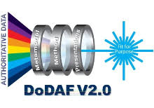

DoW Agentic Process Flow — DoDAF 2.0
This deck illustrates the full agentic workflow and clarifies the role of each stage in the DoDAF 2.0 process.
Ravi Natarajan
Ravi.Natarajan@ibm.com

Slide 2
Document Revision History
Date | Author | Description | Version
11/15/2025 | Ravi Natarajan | Initial Draft | V1.0
11/19/2025 | Ravi Natarajan | Added HIL (yellow rect) in the main flow Added a slide to show how artifacts are collected, produced for final report Added acronyms page | V1.1
11/21/2025 | Ravi Natarajan | Added 1 slide after Intro slide to show the Main Agentic Process flow pipelines – which comprise of DoDAF 2.0, JCDIS, DaU SE pipelines. Ensured, to add WKC (Watsonx Knowledge Catalog) which is the vital component for the DoW Retriever. | V1.2
11/30/2025 | Ravi Natarajan | Ensured that the Knowledge Catalog is generic and need not be WKC but any other product as suitable. | V1.3

Slide 3
Introduction
Purpose of This Deck
Explain the DoW Agentic Process Flow aligned to DoDAF 2.0
Describe how uploaded documents move through the 6 automated stages
Show how supporting components (Docling, Retriever, Neo4J, Rhapsody, PostgreSQL) fit together
Provide a coherent end-to-end view of the system architecture
What This Deck Covers
Full agentic workflow overview
Stage-by-stage walkthrough (1–6)
Supporting subsystem roles
How each component contributes to DoDAF analysis and report generation
slide (4) “Main Agents Process Flow” shows the full flow at high level
slide (20) “DoDAF 6-Stage CrewAI Pipeline” shows crews and list of agents within each crew
Outcome
A clear understanding of how the DoW pipeline automates DoDAF 2.0 architectural processing.
Notes:
“Let me start with a brief introduction to this deck.
The goal of this presentation is to walk through the DoW Agentic Process Flow that we’ve built for DoDAF 2.0.
This includes how documents are ingested, how they trigger processing, how they move through all six stages of analysis, and how the supporting architectural components work together behind the scenes.
We will go step-by-step through the full pipeline, beginning with ingestion and Docling OCR, moving through the six DoDAF stages, and finally showing how data from these stages is assembled into authoritative, structured architectural outputs.
You’ll also see where key subsystems fit in — the DoW Retriever, Neo4J Graph Store, IBM Rhapsody, PostgreSQL databases, and the Report Assembly Agents. Each subsystem has a very specific role, and together they form a complete, automated DoDAF 2.0 workflow.
By the end of the deck, you’ll have a clear picture of how this entire pipeline automates architectural reasoning for DoW and how each stage contributes to the overall architecture.”

Slide 4
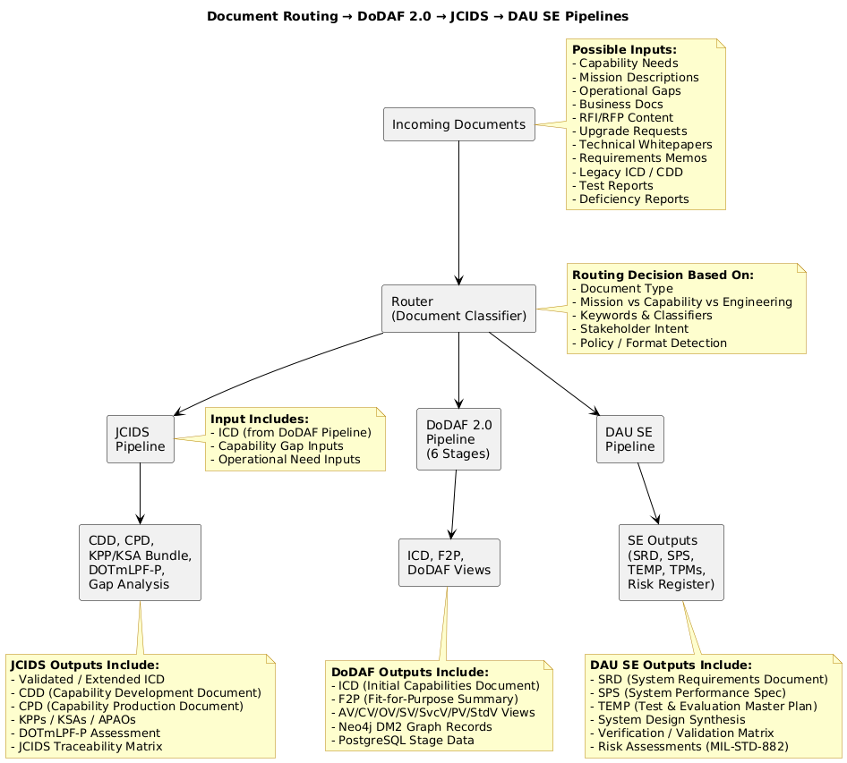
Main Agentic Process Flow
All incoming documents are classified by a Router to determine the correct processing path.
The DoDAF 2.0 pipeline executes first when architectural decomposition or mission/context analysis is required.
DoDAF 2.0 pipeline outputs include the ICD, F2P summary, and full OV/CV/SV/PV/StdV architectural views.
The initial ICD (HIL-approved) is used as key input to the JCIDS pipeline for capability development.
The JCIDS pipeline produces CDD, CPD, KPP/KSA bundles, DOTmLPF-P assessment, and traceability artifacts.
The DAU Systems Engineering pipeline produces SRD, SPS, TEMP, TPMs, and engineering lifecycle deliverables.
Each pipeline independently outputs its own formal documents for decision-making.
The combined structure ensures traceable flow from architecture → capability → systems engineering.
Formal ICD
Initial ICD
The DoW Retriever (not shown in the diagram leverages WKC’s (or similar product) governed metadata and lineage to deliver rich, trusted context to all agents.
Note: This PPT Deck only shows the DoDAF 2.0 6 stages flow

Slide 5
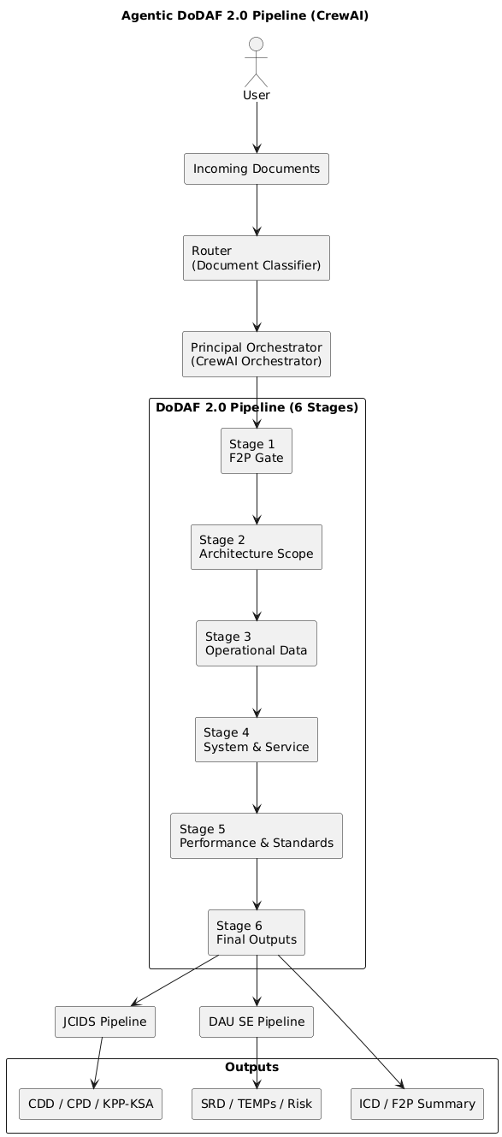
All incoming documents are classified by a router to determine the appropriate processing path.
The DoDAF 2.0 pipeline is triggered when architectural decomposition or mission/context analysis is required.
The DoDAF 2.0 pipeline produces the ICD, F2P summary, and full OV/CV/SV/PV/StdV architectural views.
The initial ICD (HIL-approved) serves as a key input to the JCIDS pipeline for capability development.
The JCIDS pipeline produces CDD, CPD, KPP/KSA bundles, DOTmLPF-P assessments, and traceability artifacts.
The DAU Systems Engineering pipeline generates SRD, SPS, TEMP, TPMs, and other engineering lifecycle deliverables.
Each pipeline independently produces formal outputs to support decision-making.
Together, these pipelines enable a fully traceable flow from architecture → capability → systems engineering.

Slide 6
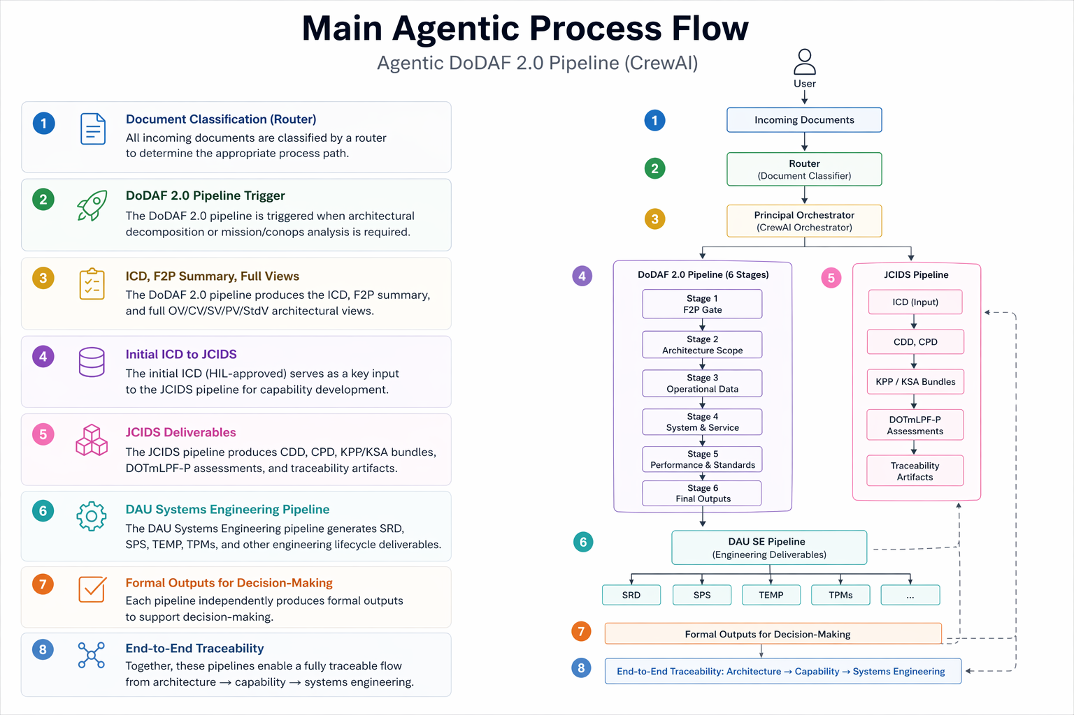

Slide 7
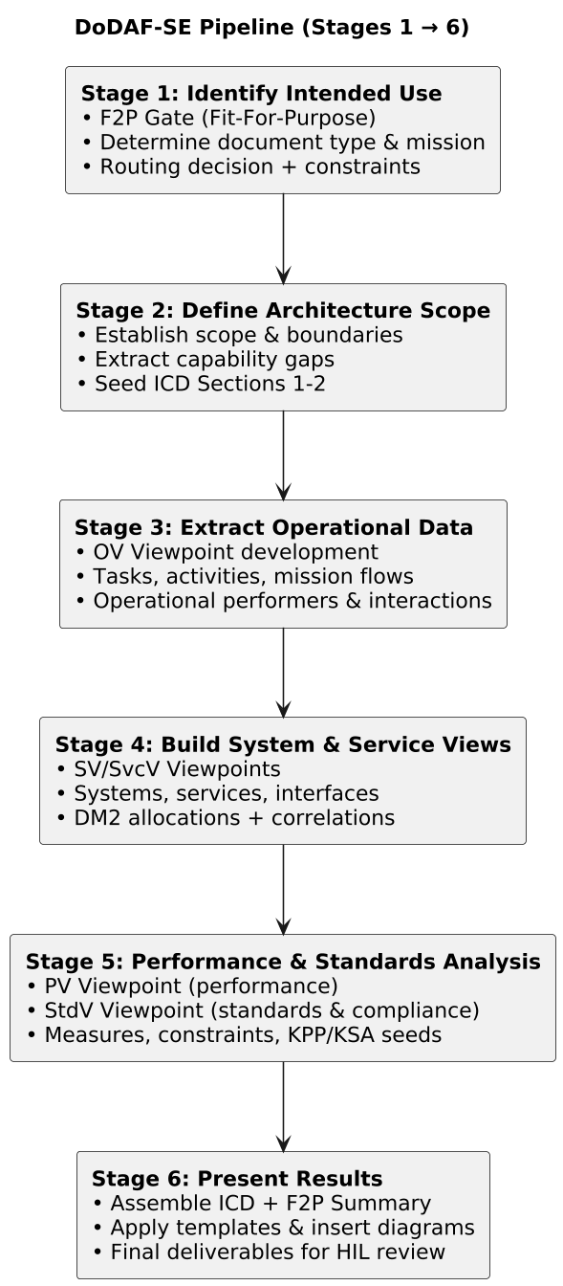
Incoming Docs
Router
Principle Orchestrator

Slide 8


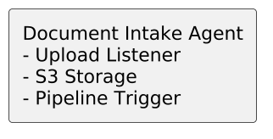


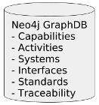



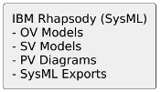




Governed Data Retrieval (Stages 2–5)
Enterprise Queries
User Upload
Knowledge Catalog
Extraction + MD Transform
Rules Evaluation (F2P, ICD, OV, SV, PV)
Write OV Graph (DM2 Notes & Edges)
Write extracted artifacts
Store Stage Output/artifacts
Pipeline
trigger
Generate SysML (SV/SvcV Models)
HIL
Review / Update
Write DM2 Relational Model
Write Stage transactions
Initial ICD
Output Reports
Notes:
Opening Context
“Let me start with the high-level end-to-end agentic process flow.
This diagram shows how the DoW agentic architecture ingests raw documents, processes them through a governed set of agents, and generates DoDAF-compliant architecture outputs across six stages.”
2. User → Intake Layer
“We begin on the far left with the user, usually an analyst, engineer, or mission SME.
Their interaction with the system starts by uploading documents, which can be:
mission need statements
requirements documents
program artifacts
operational concepts
system descriptions
doctrine publications
threat reports
or any PDF/Word/text sources relevant to architecture development.”
3. Document Intake Agent
“These files hit the Document Intake Agent, which performs three critical actions:
Listens for uploads
Places documents into S3/MinIO storage
Sends a pipeline trigger event to Kafka/Redpanda
This event is what officially starts Stage-1 of the DoDAF 2.0 pipeline.”
4. Docling OCR / Extraction
“Immediately after ingestion, the documents go through Docling:
OCR
layout reconstruction
table extraction
image extraction
and conversion to Markdown
Docling produces textual artifacts, which are written back to S3.”
5. Kafka / Redpanda Stream
“KAFKA/Redpanda acts as the control plane for the pipeline.
It manages:
pipeline status
job execution updates
console feed for the UI
and downstream triggers for each stage.”
6. Logging Layer
“All agent logs, orchestrator logs, and pipeline metrics flow into the Logging layer.
This supports observability, traceability, debugging, and audit requirements.”
7. DoDAF-SE Pipeline (Stages 1 through 6)
“This is the heart of the system — the six-stage DoDAF 2.0-aligned agentic pipeline.
Each stage has its own multi-agent Crew, each one producing structured, governed outputs.”

Slide 9
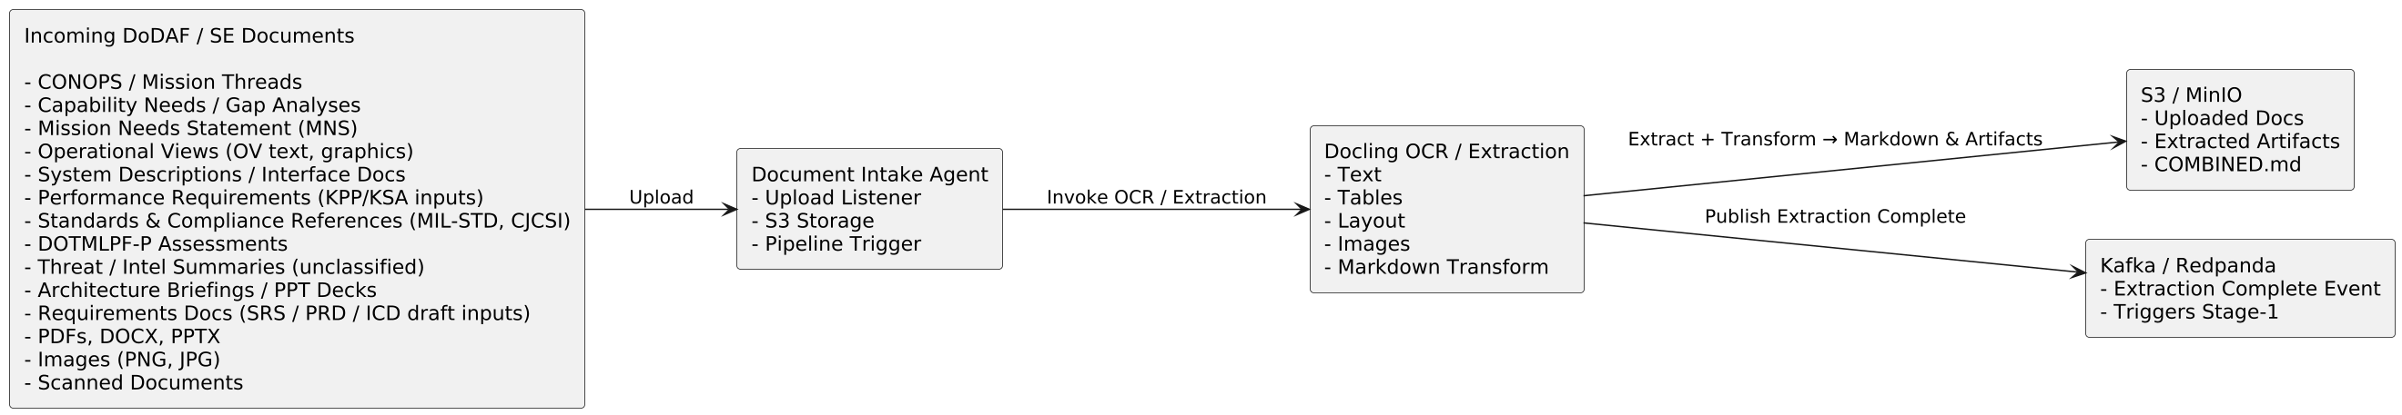
Incoming Documents Flow Intake & Pre-Processing
Markdown output includes:
Extracted text
Hierarchical headings
Tables translated into Markdown table syntax
Bullet lists and callouts
Embedded image references
Metadata (page number, confidence scores, bounding boxes)
Document Intake Agent:
Listens for uploads
Places documents into S3/MinIO storage
Sends a pipeline trigger event to Kafka/Redpanda
Notes:
User → Intake Layer
“We begin on the far left with the user, usually an analyst, engineer, or mission SME.
Their interaction with the system starts by uploading documents,
which can be:
mission need statements
requirements documents
program artifacts
operational concepts
system descriptions
doctrine publications
threat reports
or any PDF/Word/text sources relevant to architecture development.”
Document Intake Agent
“These files hit the Document Intake Agent, which performs three critical actions:
Listens for uploads
Places documents into S3/MinIO storage
Sends a pipeline trigger event to Kafka/Redpanda
This event is what officially starts Stage-1 of the DoDAF 2.0 pipeline.”

Slide 10
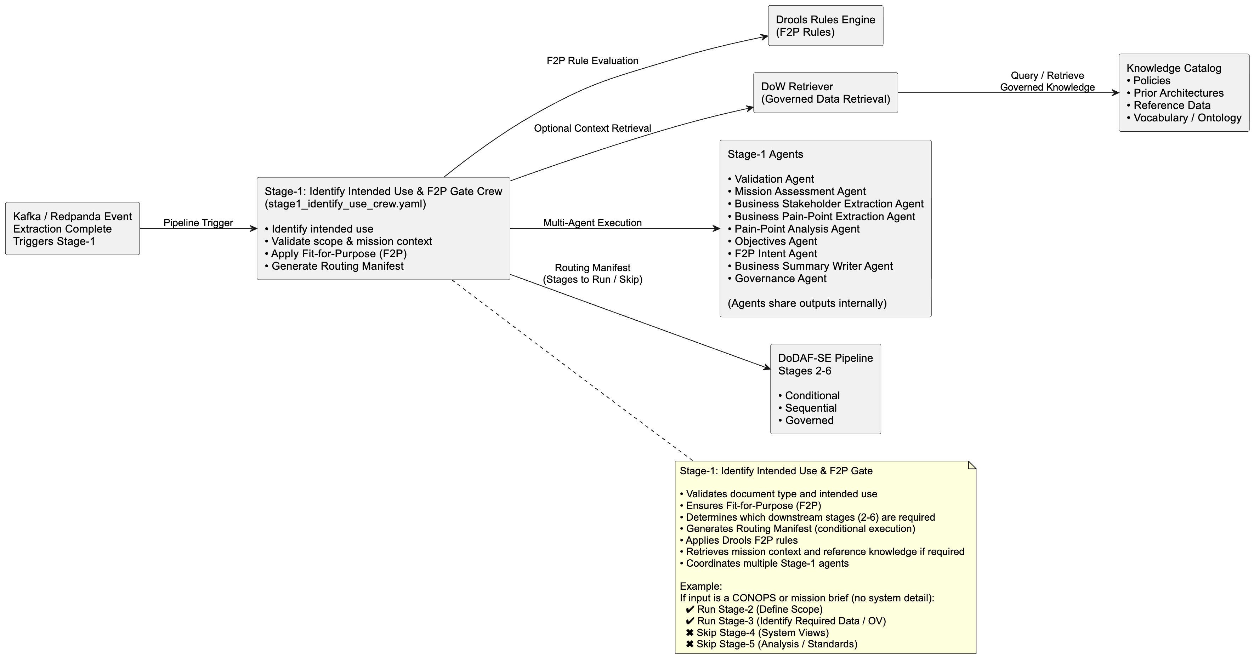
Pipeline Trigger & Stage-1 (F2P Gate)
Fit-for-Processing (F2P)
Not all documents require a full six-stage DoDAF treatment.
For example, a Standards document may not require OV or SV modeling.
Stage-1 ensures architectural efficiency by:
Preventing unnecessary downstream stages from executing
Ensuring only valid, well-formed documents progress through the pipeline
Drools Rules Engine
Evaluates document type, mission context, and intended use
Determines whether the document is fit for processing and which stages apply
Notes:
Stage 1 – Identify Intended Use / F2P Gate
“Stage-1 is the Identify Intended Use step — also known as the Fit-for-Purpose Gate, or F2P Gate.
This is one of the most critical parts of the entire DoW agentic pipeline, because this stage determines whether and how the system will proceed with the remaining DoDAF stages.
When a document enters Stage-1, the system performs several functions:
First, it evaluates whether the input is fit for processing.
Not all documents need a full six-stage DoDAF treatment — for example, a Standards document may not require OV or SV modeling.
Stage-1 ensures we’re not running unnecessary stages, and that only valid, well-formed documents move forward.
Second, Stage-1 identifies the scope, the constraints, and the intended purpose of the incoming material.
This includes assessing whether the document is an ICD, CONOPS, OV-based architecture input, or any of the other mission or capability artifacts.
The agents extract meta-information about what the document represents and what it aims to accomplish.
Third, the system evaluates the document type and routing.
Different document types trigger different logic paths — for example, an ICD will require full OV, SV, and PV analysis, while a brief O&O document might skip some stages.
So in summary, Stage-1 is the intelligent ‘front door’ of the pipeline:
it validates the input, determines intent, and charts the precise processing path for Stages 2 through 6.”

Slide 11
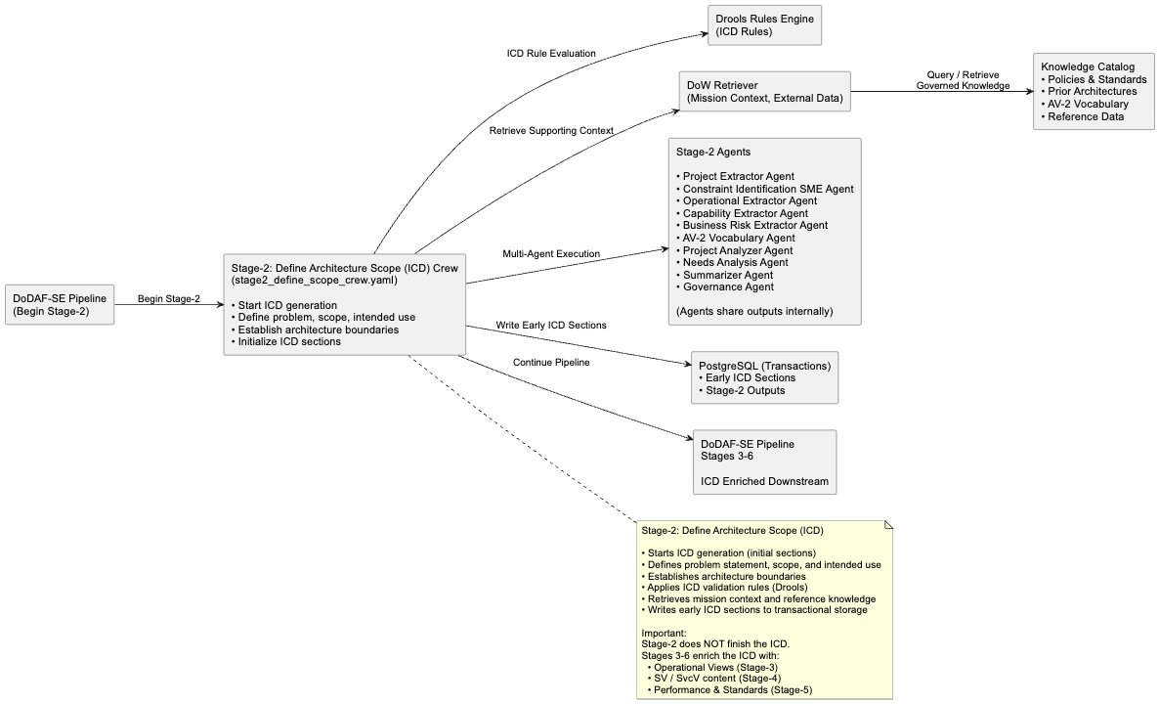
Stage-2: Architecture Scope Definition & Initial ICD Creation
Stage-2 establishes the constraints that shape the architecture, including technical limitations, mission timelines, interoperability requirements, and applicable policy or standards references derived from the input artifacts.
A key outcome of Stage-2 is the initial shaping of the ICD.
Agents generate the early structural sections, including:
high-level purpose,
mission context,
capability gaps,
stakeholder groupings, and
the scope statement.
This forms the architectural foundation that subsequent stages—OV, SV, SvcV, and PV—progressively enrich and complete.
Notes:
Stage-2 is where the pipeline begins generating the Initial Capabilities Document (ICD) structure and defining the architectural scope.
If Stage-1 focused on determining intent and routing, Stage-2 focuses on framing the problem space and establishing architectural boundaries.
Once an input passes the Fit-for-Purpose gate, Stage-2 analyzes the content to determine the capability area, mission context, and system domain involved.
This includes identifying:
the capability being addressed,
key stakeholders,
the operational context, and
the breadth of architecture that must be covered.
Stage-2 also establishes the constraints that shape the architecture.
These may include technical limitations, mission timelines, interoperability requirements, and relevant policy or standards references identified in the input artifacts.
A key outcome of Stage-2 is the initial shaping of the ICD.
The agents populate the early structural sections of the document, including:
high-level purpose,
capability gaps,
mission context,
stakeholder groupings, and
the scope statement.
This creates the architectural foundation that later stages — Operational Views, System and Services Views, and Performance and Standards Views — progressively enrich.
Finally, Stage-2 determines the depth of architectural analysis required downstream.
For example, a document with system-level detail will require deeper SV and SvcV modeling in Stage-4, while a mission-focused input may emphasize operational analysis in Stage-3.
In summary, Stage-2 takes us from intent to structure.
It establishes the architectural frame, initializes the ICD baseline, and defines exactly what the downstream stages need to analyze — without unnecessary processing.

Slide 12
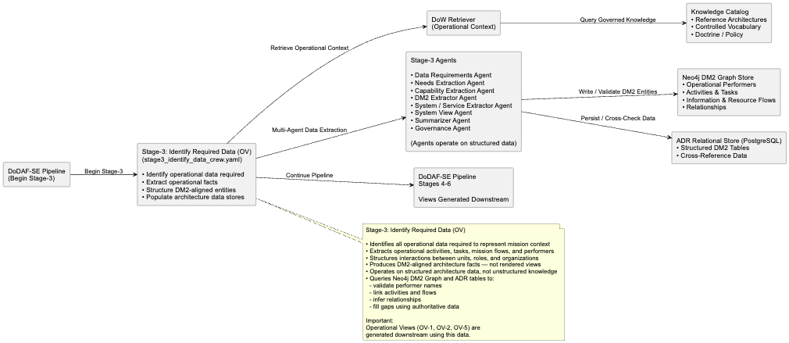
Stage-3: Identify & Structure Operational Data
The goal of Stage-3 is to identify and structure all operational data required to accurately represent the mission context.
Stage-3 does not generate views; it produces the data foundation used to construct views downstream.
This includes extracting operational activities, tasks, mission flows, operational performers (units, roles, organizations), and the interactions between them.
A key distinction is that Stage-3 operates on structured architectural facts, not unstructured knowledge.
Database-layer agents may query the DM2 Graph Store (Neo4j) or ADR relational tables (PostgreSQL) to validate performer names, link activities, infer relationships, and fill gaps using authoritative DM2-aligned data.
Notes:
Stage-3 is where the pipeline shifts from architectural framing into operational understanding.
At this stage, the focus is on capturing how the mission operates, independent of systems or technology.
The goal of Stage-3 is to identify and structure all operational data required to accurately represent the mission context.
This includes extracting:
operational activities and tasks,
mission flows and sequences,
operational performers such as units, roles, or organizations, and
the interactions between them.
The agents analyze the document narrative and any extracted text from Docling to identify OV-related elements, such as those associated with OV-2, OV-5, and OV-6, depending on what information is present.
Even when these elements are not explicitly labeled, the agents infer them using language patterns, standardized task structures, and established DoDAF conventions.
A key distinction in Stage-3 is that it operates on structured architectural facts, not unstructured knowledge.
Database-layer agents may query the DM2 graph store or ADR relational tables to validate performer names, link activities, infer relationships, or fill gaps using authoritative DoD-aligned data.
The outputs of Stage-3 form the operational backbone for subsequent stages.
For example, the tasks and performers identified here become inputs for system allocation and correlation in Stage-4, and for performance and standards analysis in Stage-5.
In summary, Stage-3 establishes the mission-level architectural foundation.
It identifies the operational elements, behaviors, and relationships required to understand how the mission works — before any systems or technologies are introduced.

Slide 13
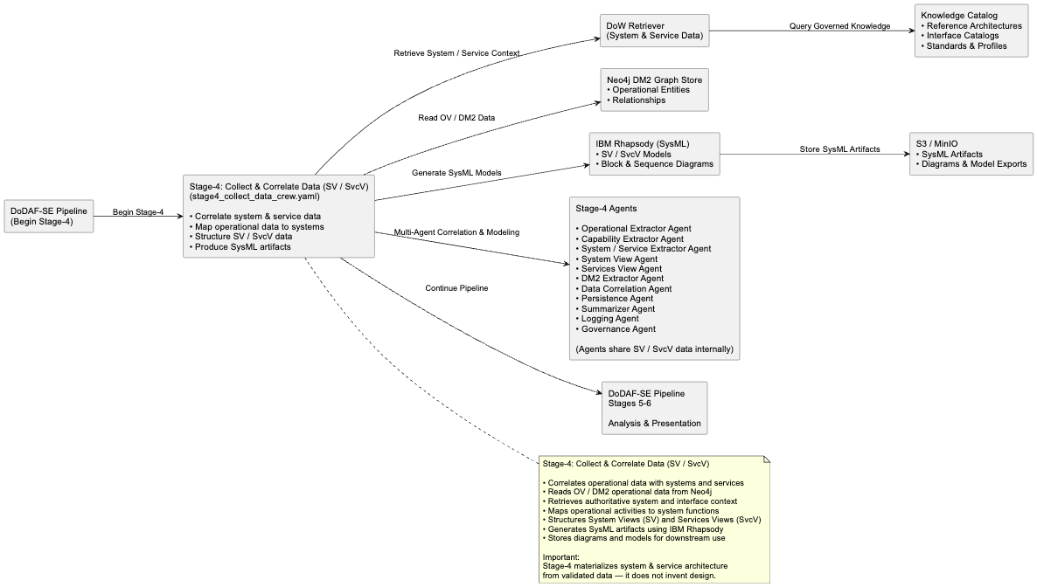
Stage 4: Collect & Correlate Data System/Services Architecture
Stage-4 is strongly DM2-driven.
Database-layer agents query the Neo4j DM2 Graph Store and the ADR relational model to validate system and service names, relate operational tasks to system functions, and confirm interfaces that already exist in authoritative architecture repositories.
This ensures that SV and SvcV artifacts are accurate, complete, and consistent with established DoD system architectures, rather than being derived ad-hoc or inferred from unstructured input.
Notes:
Stage-4 is where the pipeline transitions from the operational domain into the systems and services domain.
Building on the operational data produced in Stage-3, this stage establishes the System and Services Viewpoints (SV / SvcV).
The goal of Stage-4 is to determine what systems and services exist, how they interact, and how they support the operational activities identified earlier.
The agents analyze the extracted document content to identify:
systems and subsystems,
platforms and components,
services and service interfaces,
system functions and capabilities, and
system-to-system or service-to-service interactions.
Stage-4 is strongly DM2-driven.
Database-layer agents query the Neo4j DM2 Graph Store and the ADR relational model to validate system and service names, map operational tasks to system functions, and confirm interfaces that already exist in authoritative DoD architecture repositories.
A key function of Stage-4 is correlation.
Rather than inventing architecture, this stage links systems and services back to the operational performers and activities established in Stage-3.
For example, if Stage-3 defined an operational task such as Target Identification, Stage-4 determines which systems or services perform that task and what interfaces or data exchanges are involved.
Stage-4 also establishes the structural backbone for downstream modeling.
The SV and SvcV data produced here is later used to generate SysML and UML artifacts in tools such as IBM Rhapsody and PlantUML, including:
system block diagrams,
interface descriptions,
service interaction flows, and
system allocations.
In summary, Stage-4 is where the architecture becomes concrete.
It grounds mission-level understanding in real systems, services, and interfaces, establishing a validated SV / SvcV baseline for analysis and presentation.

Slide 14
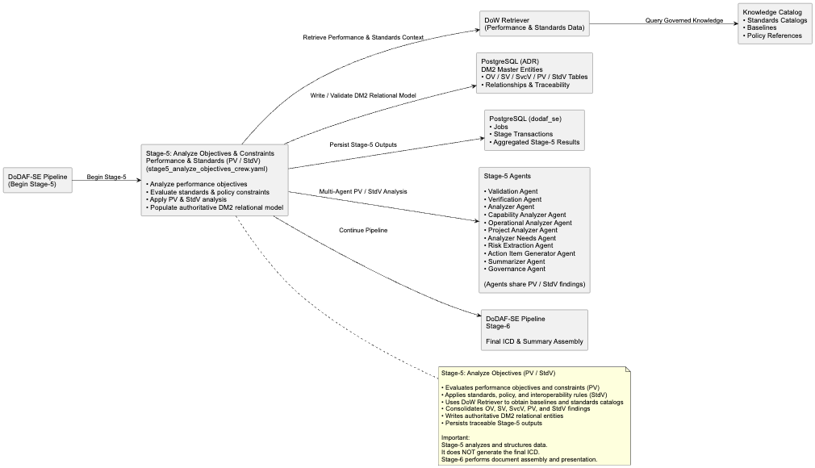
Stage-5: Performance & Standards Analysis
Stage-5 is the primary analytical stage of the DoDAF pipeline.
Its key value lies in the correlation and analysis of architectural data produced in earlier stages.
Stage-5 evaluates how performance measures, metrics, and standards relate to the systems, services, and operational tasks identified in preceding stages.
The result is a comprehensive PV / StdV baseline that captures:
required performance characteristics,
measurable evaluation criteria,
governing standards and compliance constraints, and
technical limits that influence system behavior and design.
Notes:
Stage-5 is where the architecture is analyzed through the lens of performance, measures, and standards.
While Stage-3 established the operational picture and Stage-4 defined the system and service architecture, Stage-5 determines whether the architecture is effective, compliant, and aligned with required performance objectives.
This stage focuses on the Performance Viewpoint (PV) and Standards Viewpoint (StdV) — the views that define the technical, regulatory, and performance environment surrounding the architecture.
The agents begin by identifying:
performance measures and metrics,
required technical standards,
policy and regulatory constraints,
readiness or availability thresholds,
interoperability requirements, and
mandatory DoD specifications referenced in the source material.
Stage-5 draws from multiple sources, including:
extracted content from Docling,
curated knowledge from the DoW Retriever, and
structured architectural data validated through the DM2 graph and ADR relational tables.
The key value of Stage-5 is correlation and analysis.
Performance measures and standards are linked back to the systems, services, and operational tasks identified in earlier stages.
For example, if the architecture includes a communications subsystem, Stage-5 evaluates whether it must conform to specific MIL-STDs, security overlays, timing constraints, or data format standards.
The agents also identify policy-driven constraints, such as interoperability mandates, IA/Cyber requirements, or required compliance thresholds.
The outcome of Stage-5 is a comprehensive PV / StdV baseline that captures:
required performance characteristics,
enforced standards and policies, and
technical constraints that shape system behavior.
In summary, Stage-5 ensures the architecture is not only structurally sound, but also measurable, compliant, and aligned with DoDAF performance and standards objectives.

Slide 15
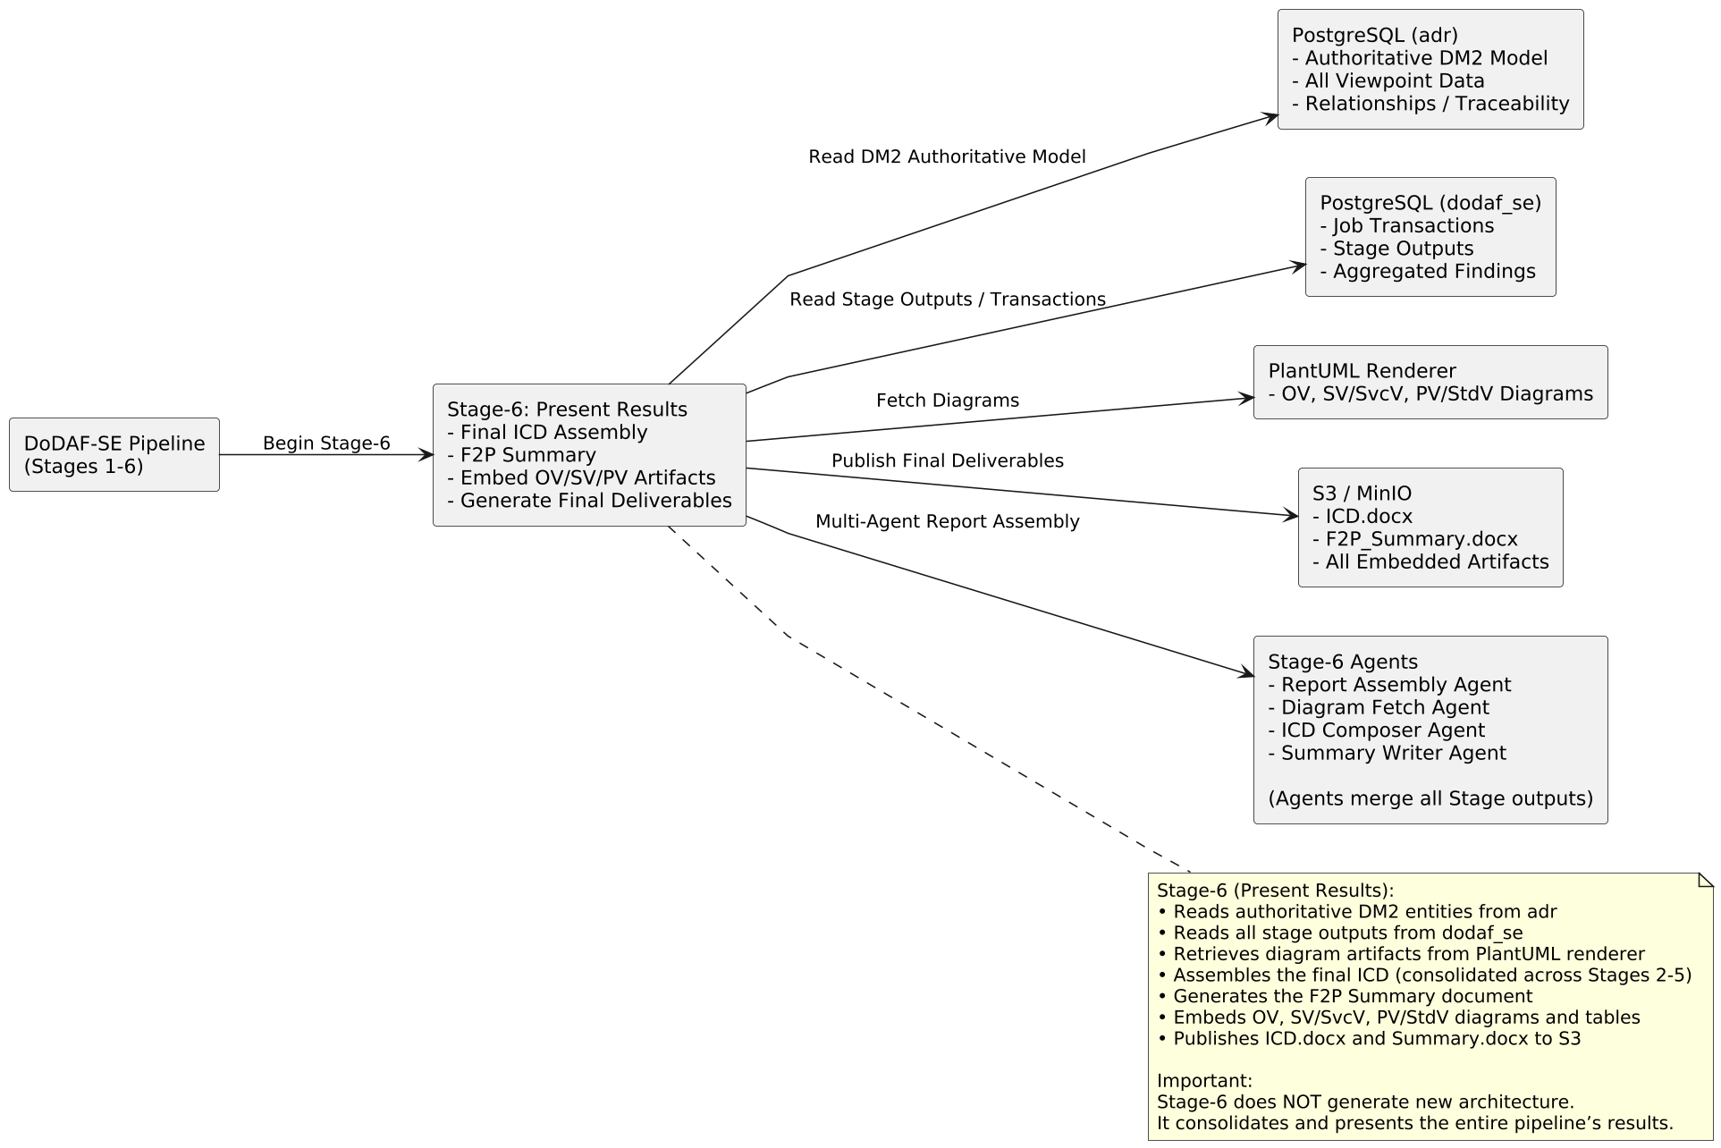
Stage-6: Final Deliverables (ICD & F2P Summary)
Stage-6 is responsible for assembling, formatting, and producing the DoDAF-compliant documents—primarily the Initial Capabilities Document (ICD) and the Fit-for-Purpose Summary.
This stage also embeds all diagrams generated earlier, including:
OV operational flows,
SV/SvcV system and interface models,
PV/StdV performance and standards diagrams, and
any SysML exports produced by Rhapsody.
This Output upon passing HIL review and approval, becomes the input to the JCIDS Pipeline.
Notes:
Stage-6 is the final stage of the DoW agentic pipeline, where all structured outputs from the previous stages are brought together into the final architecture products.
This stage is responsible for assembling, formatting, and producing DoDAF-compliant deliverables, primarily the Initial Capabilities Document (ICD) and the Fit-for-Purpose (F2P) Summary.
The orchestrator retrieves stage outputs from the PostgreSQL transaction tables, pulls diagrams from PlantUML renderings and IBM Rhapsody exports, and merges everything into governed document templates.
This assembly includes:
the executive summary,
capability needs and gaps,
operational context,
system and service architecture,
performance and standards overlays, and
full traceability across OV, SV, SvcV, and PV viewpoints.
Stage-6 embeds all diagrams generated earlier, including:
operational flows from OV analysis,
system and interface models from SV and SvcV,
performance and standards diagrams from PV and StdV, and
any SysML artifacts produced by Rhapsody.
Before finalization, the pipeline performs validation and governance checks to ensure the ICD structure is complete, all placeholders are populated, and required sections are present and consistent.
Finally, Stage-6 publishes the completed documents to S3 / MinIO, making them available to users through the console for review, submission, or downstream use.
In summary, Stage-6 transforms all agent outputs into polished, governed, DoDAF-compliant deliverables, completing the end-to-end architecture generation process in a traceable and reproducible manner.

Slide 16
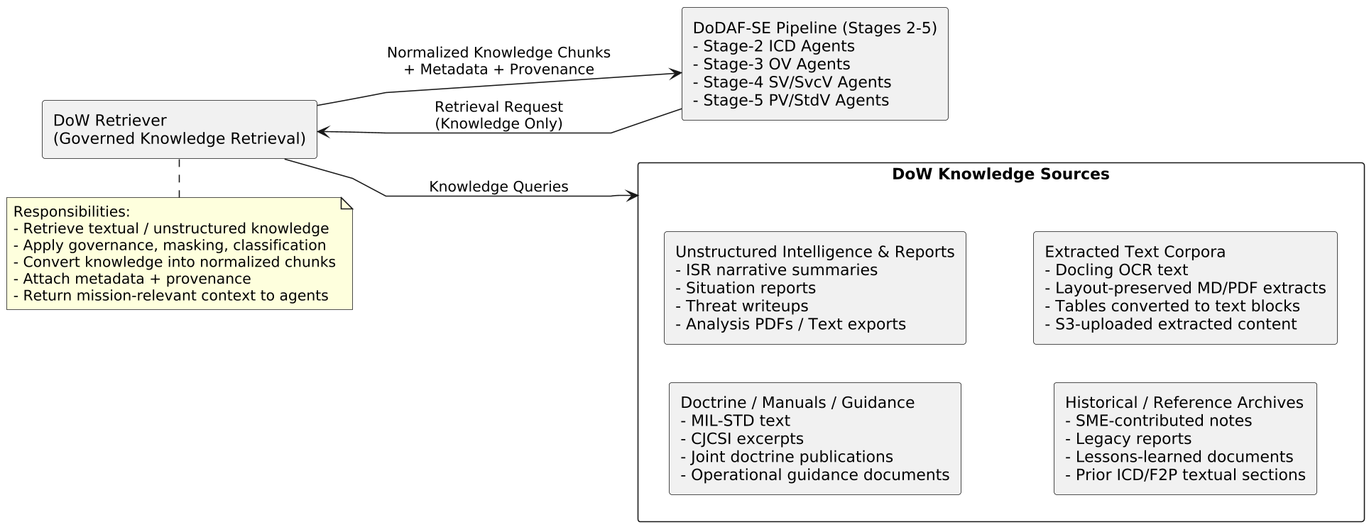
Enterprise Retrieval Layer for DoW Architecture Data
WKC
(Watson Knowledge Catalog)
It performs:
Normalization
Chunking
Masking
Governance
Provenance scoring
Knowledge fusion from multiple knowledge sources
It retrieves:
Knowledge chunks
Textual summaries
Doctrine passages
Unstructured intel
Notes / reports / PDFs converted by Docling
SME-written content
Historical documents
Reference knowledge
Data Sources shown are examples
Notes:
DoW Retriever (Knowledge Retrieval Layer)
“On the upper right is the DoW Retriever.
This component is important, but narrowly scoped:
It retrieves textual knowledge only
Not structured DM2 data
And not database records
It queries knowledge sources, such as doctrine text, reports, historical references, SME notes, and extracted material, then returns normalized knowledge chunks with provenance.”

Slide 17
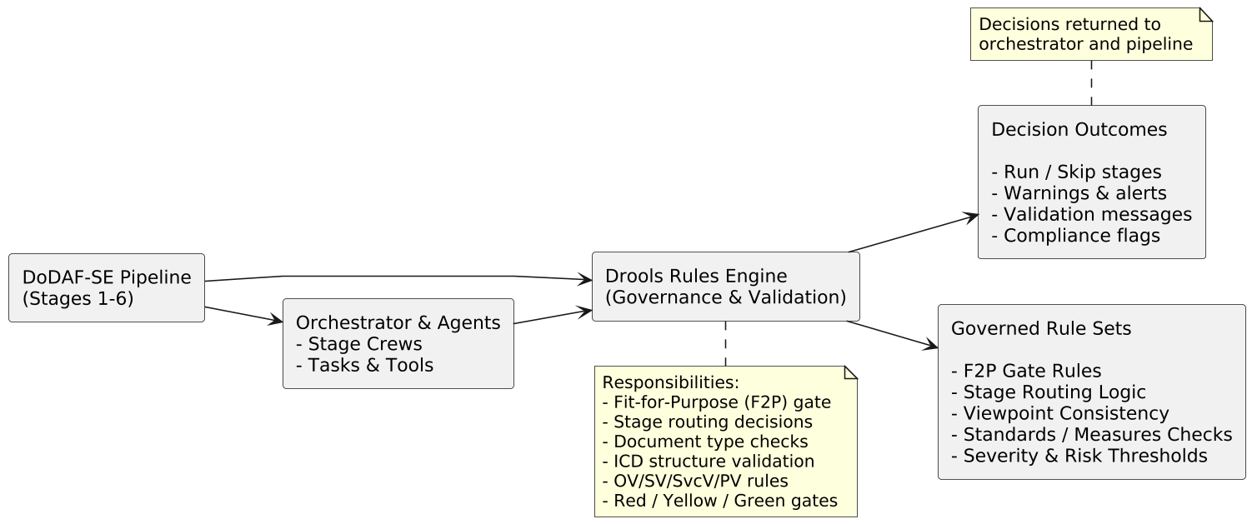
Drools Rules Engine
Purpose
The Drools engine provides deterministic, governed decision logic across the DoW Agentic Pipeline. It ensures validation, routing, consistency, and enforceable rule compliance at each stage.
What Drools Does
Enforces F2P (Fit-for-Purpose) Gate rules
Validates document type, scope, and intended use
Determines required downstream stages (2–6)
Applies DoDAF architectural constraints
Provides ICD structural checks
Governs OV/SV/SvcV/PV rule logic
Supports red/yellow/green gating decisions
Ensures governed, repeatable outputs
Notes:
Rules engine:
“Drools is our governance backbone in the DoW agentic architecture.
While the agents generate content, Drools ensures we remain consistent, compliant, and deterministic throughout the entire process.
The most important application of Drools is in Stage-1, where we run the Fit-for-Purpose gate. Here Drools evaluates document type, mission context, intended use to determine whether the document is valid for processing.
But Drools is not limited to Stage-1.
Throughout the pipeline, agent outputs may be checked against rule sets that enforce DoDAF architectural constraints — for example ensuring that operational activities map to performers

Slide 18
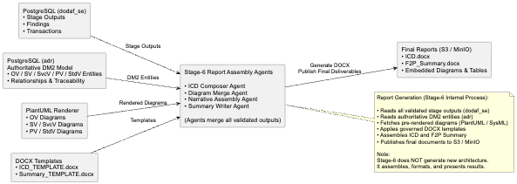
Report Generation Process
Report Output:
The result is a fully generated, publication-ready ICD and Fit-for-Purpose Summary, including:
structured architecture sections synthesized across all stages,
embedded OV, SV, SvcV, PV, and StdV diagrams,
end-to-end traceability with DM2-aligned references, and
consistent formatting with governance-aligned content.
The Report Assembly Agents retrieve structured data from PostgreSQL (dodaf_se and adr), merge it with diagrams produced by PlantUML and Rhapsody, and populate the ICD and Fit-for-Purpose templates.
Notes:
“Now we move into the Report Generation Process, which is the final assembly step that occurs after Stage-6.
This part of the pipeline brings together everything we collected, analyzed, modeled, and generated across all previous stages.
The Report Assembly Agents operate as a coordinated set of workers:
The ICD Composer retrieves structured outputs from the dodaf_se schema in PostgreSQL — this includes findings, stage outputs, and all curated content the agents produced.
The system simultaneously queries the Authoritative DM2 Model from the adr database, ensuring that all models, entities, and relationships are consistent with DoDAF DM2 semantics.
The Diagram Merge Agent fetches all diagrams from the PlantUML renderer — OV, SV/SvcV, PV/StdV — along with any SysML diagrams coming from Rhapsody.
The Narrative Builder assembles multi-agent text contributions into coherent, human-readable sections.
And finally, the Summary Writer creates the Fit-for-Purpose Summary, which distills only the mission-relevant insights for senior stakeholders.
Once all components are gathered, the pipeline applies the ICD and Summary DOCX templates, injecting content into each placeholder.
This ensures a consistent DoDAF structure:
Executive Summary
Capability Needs
Operational Context
System Architecture
Performance + Standards
Traceability Sections
Embedded Diagrams
When the documents are fully constructed, the orchestrator runs a validation pass to confirm completeness, correct section ordering, and template integrity.
The final ICD and F2P Summary documents — along with all diagrams — are then uploaded to S3, where they appear in the console for the user.
In short, this process turns a large set of agent outputs, graphs, templates, diagrams, and DM2 entities into polished, governed, repeatable DoDAF deliverables.”

Slide 19
Artifacts produced at various stages and final Report
Stage | Primary Function | DoDAF Views Produced / Informed | Exportable? | Used In Final Products
Stage-1 | Identify Intended Use (F2P Gate) | No DoDAF views generated (routing + classification only) | N/A | Provides routing + purpose + constraints for ICD
Stage-2 | Define Architecture Scope (ICD Framing) | CV Inputs:• CV-1 (Vision) — partially inferable; SME/HIL needed CV-2 (capability taxonomy seed)• CV-3 (initial dependencies)Not exported, but internally produced as text | Partial | Creates ICD Sections 1–2 foundation
Stage-3 | Operational Viewpoint Extraction | DoDAF Views Produced / Informed: Extract and structure all operational-level data required to inform Operational Views (OVs). Stage-3 does not generate diagrams. Provides the curated operational dataset used downstream to produce OV-1/2/3/5/6 (via PlantUML/Rhapsody generators). | Yes (via PlantUML) | Populates ICD operational context, missions, activities, resource flows, constraints, and gaps.
Stage-4 | System & Service Viewpoint Modeling | SV/SvcV Views:✔ SV-1 (Systems/Services)✔ SV-2 (Interfaces)✔ SV-4 (Functions)✔ SvcV-1/2/3 equivalents✔ SysML diagrams (via Rhapsody), Allocations. | Yes (PlantUML + Rhapsody exports) | Populates ICD architecture sections + diagrams
Stage-5 | Performance / Standards Analysis | PV/StdV Views:✔ PV-1 (Performance Parameters)✔ PV-2 (Performance Constraints)✔ StdV-1 (Standards Profile)✔ StdV-2 (Standards Forecast) | Yes (tables/graphs) | Populates ICD KPP/KSAs, standards, technical constraints
Stage-6 | Present Results / Document Assembly | No new DoDAF views — assembles everything | N/A | Generates → JOBID_ICD.docx + JOBID_F2P_Summary.docx
Final Deliverables (User-Facing): JOBID_ICD.docx, JOBID_F2P_Summary.docx
Notes:
Slide Purpose:
This slide summarizes what each stage produces, which DoDAF views are generated or informed, and how each contributes to the final ICD and F2P Summary outputs.
This slide summarizes which DoDAF views are produced at each stage of the agentic pipeline and how they ultimately feed into the final ICD and F2P Summary. Stages 2–5 generate the full architecture set — capability, operational, system/service, and performance/standards views — while Stage-6 assembles those into user-ready DoDAF-compliant reports. In short, every stage contributes a specific portion of the architecture, and together they produce the complete JOBID_ICD.docx and JOBID_F2P_Summary.docx deliverables.
Stage-1 — Identify Intended Use (F2P Gate)
Stage-1 is strictly a gatekeeping stage.
No DoDAF views are produced here; instead we classify the document, determine Fit-for-Purpose, and generate a routing manifest.
The output guides downstream stages by telling them which views to generate and what constraints apply.
This stage ensures we don’t waste cycles on documents that shouldn’t enter the pipeline.
Stage-2 — Define Architecture Scope (ICD Framing)
Stage-2 starts shaping the ICD foundation.
The system identifies capability taxonomies, high-level missions, constraints, and stakeholders.
CV-1, CV-2, and CV-3 are not fully generated but the seeds are captured as structured text and can be exported if needed.
This stage populates ICD Sections 1–2, establishing the scope and intent of the architecture.
It provides the conceptual backbone needed before operational or system modeling.
Stage-3 — Operational Viewpoint Extraction (OV)
Stage-3 extracts all operational architecture pieces, such as activities, tasks, flows, performers, and interactions.
It generates OV-2, OV-3, OV-5a/b, and OV-6c models.
OV-1 can be generated via PlantUML if a sufficient knowledge base exists.
Stage-3 relies heavily on structured architecture data from the DM2 Graph Store and ADR relational model.
These outputs feed directly into the ICD operational context, mission threads, and capability gap analysis.
Stage-4 — System & Service Viewpoint Modeling (SV/SvcV)
Stage-4 builds all the system and service-level DoDAF views.
SV-1, SV-2, SV-4, and their SvcV equivalents are generated here.
Allocations are computed:
Operational activities → System functions
System functions → System nodes
Interfaces and resource flows confirmed
Rhapsody SysML exports are created here as well.
These outputs form the technical architecture sections of the ICD, including diagrams and system/service descriptions.
Stage-5 — Performance / Standards (PV/StdV)
Stage-5 analyzes performance constraints and applicable standards.
It generates PV-1, PV-2, StdV-1, and StdV-2 equivalents.
These include quantitative parameters, compliance requirements, and technical standards.
These outputs populate the ICD KPP/KSA sections, constraints, and any externally imposed requirements.
Stage-6 — Present Results / Document Assembly
Stage-6 does not create new DoDAF views.
Instead, it merges outputs from Stages 1–5 into the final deliverables:
JOBID_ICD.docx
JOBID_F2P_Summary.docx
It pulls diagrams from PlantUML, SysML from Rhapsody, and tabular/relational data from ADR and the dodaf_se transaction tables.
This stage produces the final polished reports ready for user review and HIL approval.
Stages 2–5 generate actual architecture views (CV, OV, SV/SvcV, PV/StdV).
Stage-6 assembles them into formal documents.
Everything flows into two final deliverables:
ICD
F2P Summary

Slide 20
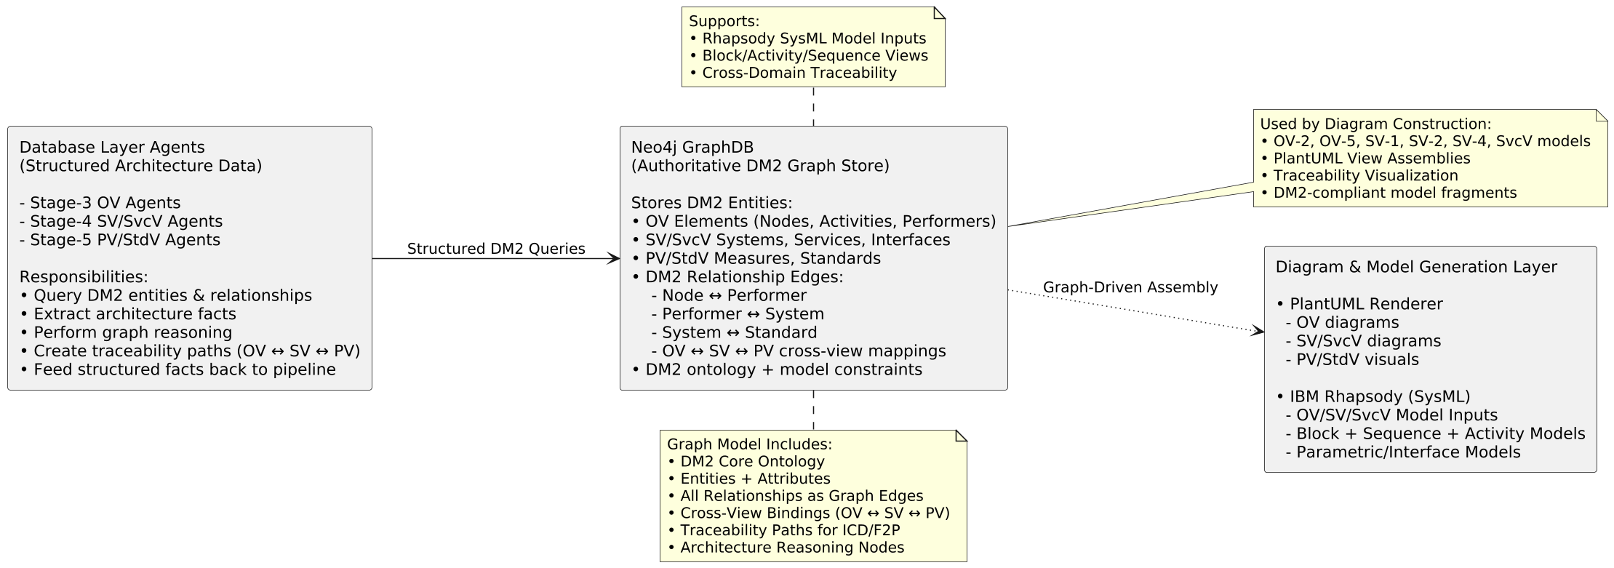
Neo4J GraphDB
When stages 3 through 5 run, they populate Neo4J with:
Operational View entities such as activities, performers, nodes, and exchanges
System and Service View elements, including systems, interfaces, ports, services, and resource flows
Performance and Standards View relationships, such as measures, rules, constraints, and standards applicability
The real power comes from the relationships: OV → SV/SvcV → PV/StdV.
These allow agents to ask questions like:
“Which system supports this operational activity?”
“Which standards constrain this interface?”
“What is the traceability path from an OV mission objective down to a PV performance measure?”
Notes:
“Next, let’s look at how Neo4J GraphDB fits into the DoW agentic workflow.
Neo4J acts as the central reasoning engine for all DM2-aligned architecture data.
Where relational storage captures tabular outputs, Neo4J captures the semantic structure — all the nodes, performers, activities, systems, services, and standards, along with their traceability links.
When stages 3 through 5 run, they populate Neo4J with:
Operational View entities such as activities, performers, nodes, and exchanges
System and Service View elements, including systems, interfaces, ports, services, and resource flows
Performance and Standards View relationships, such as measures, rules, constraints, and standards applicability
The real power comes from the relationships: OV → SV/SvcV → PV/StdV.
These allow agents to ask questions like:
“Which system supports this operational activity?”
“Which standards constrain this interface?”
“What is the traceability path from an OV mission objective down to a PV performance measure?”
The DoW Retriever does not directly use Neo4J — the pipeline’s specialized graph reasoning agents handle these interactions.
These agents issue Cypher queries to extract:
Node/edge structures
Traceability chains
Dependency paths
Constraint relationships
Graph patterns needed for diagrams
From there, the diagram assembly agents use graph output to build OV/SV/PV diagrams through PlantUML, and to format SysML-compatible inputs for IBM Rhapsody.
Finally, Neo4J becomes a source of architectural truth, enabling:
Graph-based reasoning
Traceability visualization
Consistency checking
Automatic viewpoint stitching
Rich contextual retrieval for downstream reports
In short, Neo4J is the knowledge graph backbone of the DoDAF pipeline — connecting architecture elements, enabling traceability, and powering visual and analytical outputs.”

Slide 21
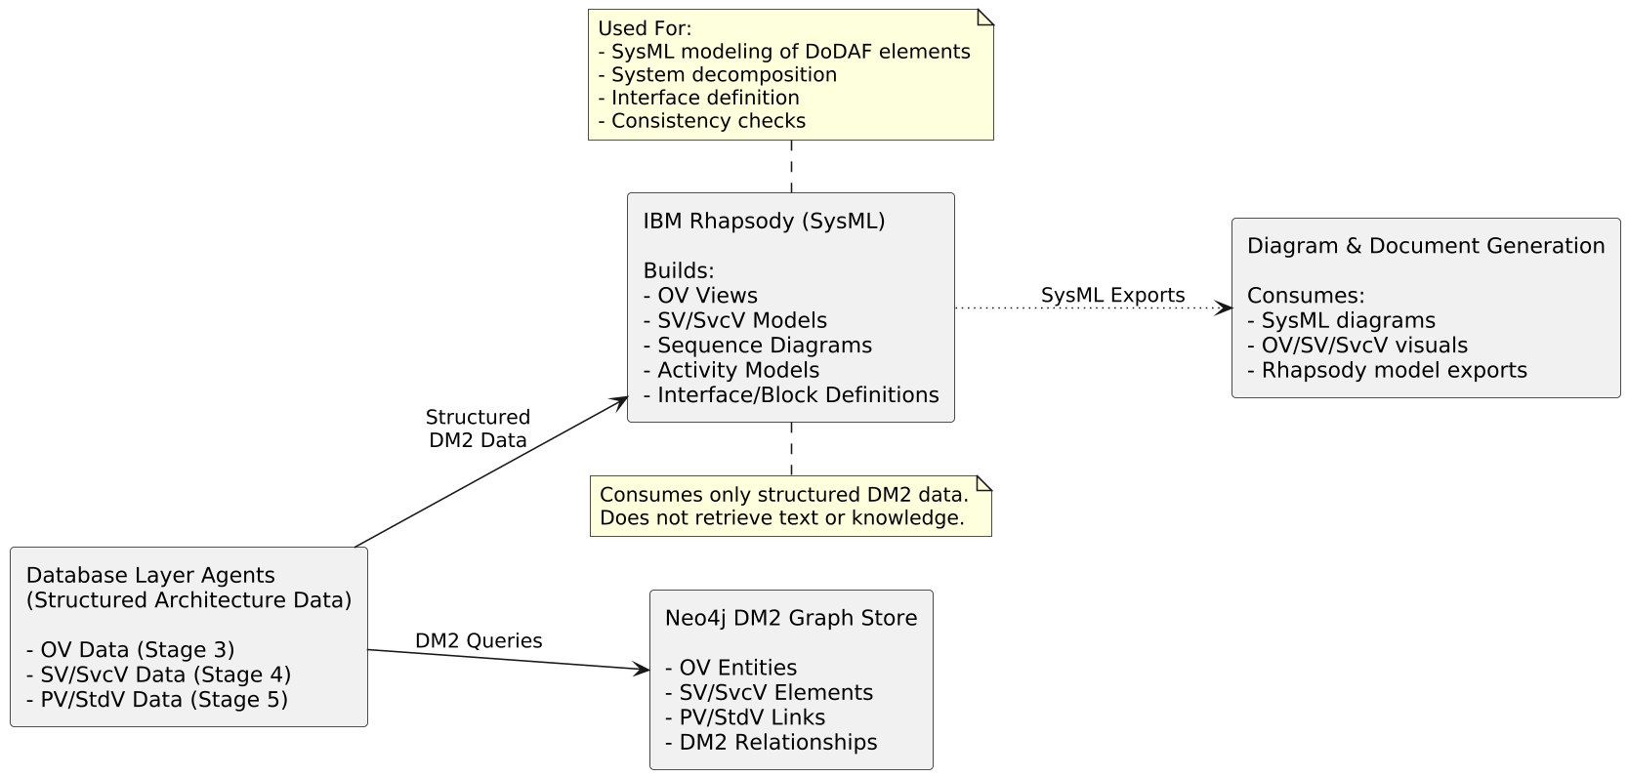
IBM Rhapsody
Rhapsody serves as the SysML modeling environment that receives structured architectural content from earlier stages and transforms it into standards-compliant systems engineering models.
While Neo4J provides semantic relationships and PlantUML generates quick visual diagrams, Rhapsody produces the formal SysML artifacts expected in larger DoD programs.
Notes:
“Now let’s walk through the role of IBM Rhapsody in the DoW agentic workflow.
Rhapsody serves as the SysML modeling environment that receives structured architectural content from the earlier stages and turns that into standards-compliant system engineering models.
While Neo4J provides semantic relationships and PlantUML gives fast visualizations, Rhapsody is where we generate formal SysML artifacts that larger DoD programs expect.
When stages 3, 4, and 5 complete their analysis, the pipeline produces:
Operational nodes, activities, and performer relationships
System resources, interfaces, and component decompositions
Services, flows, and interdependencies
Performance measures, constraints, and standards traces
These are transformed by the diagram assembly agents into Rhapsody-ready model inputs, which represent:
OV structural elements that map to SysML blocks, actors, and interactions
SV/SvcV system and service hierarchies that become block definitions, IBDs, and sequence diagrams
PV/StdV constraints that translate into parametric diagrams and requirement relationships
Rhapsody then becomes the system-of-record modeling engine, enabling:
Formal SysML model creation, compliant with DoDAF 2.0 guidance
Parametric & behavioral modeling, not possible through PlantUML alone
Model simulation for validating system behaviors and interactions
Export back into downstream formats, including images, XMI, and model fragments
Authoritative model storage, which can be pushed back into the DM2 repository
In addition, Rhapsody integrates cleanly with IBM’s lifecycle toolchain, offering:
Versioning
Model governance
Change tracking
Validation against system constraints
This ensures that architecture isn’t just visually represented — it’s rigorously modeled.
So Rhapsody closes the loop:
Neo4J gives us relationships → PlantUML gives quick views → Rhapsody turns those views into formal, executable SysML models.
This is essential for any DoDAF pipeline that needs to move beyond documentation into actual systems engineering and acquisition deliverables.”

Slide 22
Components and brief description
Technology / Product | Role in the Architecture
Docling | OCR + layout extraction of PDFs/Word/images into structured Markdown and text blocks.
Drools Rules Engine | Executes Fit-for-Purpose rules, routing logic, architecture constraints, and validation.
Kafka | Event bus and control plane: triggers stages, streams logs, and synchronizes workflow execution. Pipelines get triggered by events. eg. JCIDS pipeline gets triggered when an event is published to the jcids_in topic with link to input artifacts in the S3 bucket.
S3 | Object storage for uploaded documents, extracted text, diagrams, and final ICD/F2P outputs.
Neo4J GraphDB | DM2-based knowledge graph storing OV/SV/SvcV/PV entities and relationships; supports traceability.
IBM Rhapsody | SysML modeling environment for OV/SV/SvcV/PV views; generates formal engineering diagrams.
PostgreSQL | Structured data storage for stage outputs (dodaf_se) and authoritative DM2 entities (adr).
Knowledge Catalog | Example: WKC unifies business and technical stewardship in one governed platform, enabling our DoW Retriever to provide agents with rich, trusted context. Similar products like WKC as suitable for FedRAMP env.
FastAPI | Backend service layer for orchestrator APIs, job submission, status, console streaming, and report retrieval.
WKC ensures every component operates on governed, trusted, and well-stewarded data—dramatically improving the quality and reliability of agent outputs.
The DoW Retriever leverages WKC’s governed metadata and lineage to deliver rich, trusted context to all agents.

Slide 23
DoDAF 6-Stage CrewAI Pipeline - Crews & Agents
Stage | Agents
stage1_identify_use_crew | validation_agent, mission_assessment_agent, bd_stakeholder_extractor_agent, bd_pain_point_extractor_agent, pain_point_agent, objectives_agent, f2p_intent_agent, bd_summary_writer_agent, governance_agent
Stage2_define_scope_crew | project_extractor_agent, constraint_identification_sme_agent, operational_extractor_agent, capability_extractor_agent, bd_risk_extractor_agent, av2_vocabulary_agent, project_analyzer_agent, analyzer_needs_agent, summarizer_agent, governance_agent
stage3_required_data_crew | data_requirements_agent, extractor_needs_agent, capability_extractor_agent, dm2_extractor_agent, system_service_extractor_agent, system_view_agent, summarizer_agent, governance_agent
stage4_collect_correlate_data_crew | operational_extractor_agent, capability_extractor_agent, system_service_extractor_agent, system_view_agent, services_view_agent, dm2_extractor_agent, data_correlation_agent, persistence_agent, summarizer_agent, logging_agent, governance_agent
stage5_analyze_objectives_crew | validation_agent, verification_agent, analyzer_agent, capability_analyzer_agent, operational_analyzer_agent, project_analyzer_agent, analyzer_needs_agent, bd_risk_extractor_agent, bd_actionitem_generator_agent, summarizer_agent, governance_agent

Slide 24
Acronyms
Acronym | Meaning | Acronym | Meaning
DoDAF | Dept. of Defense Architecture Framework | PV | Performance Viewpoint
DM2 | DoD MetaModel | StdV | Standards Viewpoint
ICD | Initial Capabilities Document | OV-1 | Operational Concept Graphic
F2P | Fit-for-Purpose | OV-2 | Operational Resource Flow
OV | Operational Viewpoint | OV-3 | Operational Event Trace
CV | Capability Viewpoint | OV-5a/b | Activity Model
SV | Systems Viewpoint | OV-6c | State Transition
SvcV | Services Viewpoint | SV-1 | Systems Interface
PV-1 | Performance Parameters | SV-2 | Systems Resource Flow
PV-2 | Performance Constraints | SV-4 | Systems Functionality & Allocations
SvcV-1/2/3 | Service Models / Interfaces / Flows | StdV-1 | Standards Profile
ADR | Authoritative Data Repository | StdV-2 | Standards Forecast
ISR | Intelligence, Surveillance & Reconnaissance | HIL | Human-In-the-Loop
ORBAT | Order of Battle | S3 | Object Storage (MinIO)
OCR | Optical Character Recognition | MCP | Model Context Protocol
API | Application Programming Interface | SysML | Systems Modeling Language

Slide 25
End-to-End DoDAF 2.0 Agentic Workflow - Summary
This architecture delivers an end-to-end, fully agentic DoDAF 2.0 workflow
Automated intake → OCR → structured extraction
Agentic six-stage DoDAF pipeline
Federated knowledge retrieval via DoW Retriever
knowledge base like WKC the retriever would use to fetch domain specific data
Graph-based reasoning with Neo4j
Formal SysML modeling in IBM Rhapsody – or similar products.
Automated diagram generation (OV/SV/PV)
Structured storage in PostgreSQL (dodaf_se + adr)
Automated DOCX report generation (ICD + F2P Summary)
Complete traceability, provenance, and governance
Fully orchestrated and repeatable architecture pipeline
Notes:
“Let me close with a summary of what this architecture accomplishes.
What we’ve built is a complete, automated, agentic DoDAF 2.0 pipeline, starting from raw documents and ending with fully generated DoDAF-aligned deliverables.
It begins with document intake, where any DoDAF/SE artifact — PDFs, Word files, prior ICDs, operational views, requirements — can be uploaded into the system. Docling converts them into structured Markdown and extracted artifacts, ensuring nothing is lost in translation.
The pipeline then flows into the six-stage agentic DoDAF process, where each stage specializes in a specific architectural responsibility: intended use, scope and ICD construction, operational viewpoint development, system/service modeling, performance and standards analysis, and finally the presentation and compilation of results.
Supporting that pipeline is the DoW Retriever, which provides governed, federated access across multiple enterprise data sources. It normalizes data into knowledge chunks, applies masking and governance, and injects mission-relevant context exactly when the agents need it.
The architecture is augmented by a Neo4J DM2 Graph Store, enabling graph-based reasoning, traceability, cross-viewpoint linking, and fast diagram assembly.
For formal systems engineering, IBM Rhapsody transforms the generated architectural content into full SysML models — block diagrams, sequence diagrams, state models, parametrics — providing DoD-grade modeling fidelity.
All stage outputs, DM2 structures, diagrams, and findings are persisted in PostgreSQL repositories — dodaf_se for stage outputs and adr for authoritative DM2 data.
Finally, the report assembly agents merge everything — stage outputs, DM2 data, Rhapsody/PlantUML diagrams, templates — into complete ICD.docx and F2P Summary.docx reports, including embedded diagrams, ensuring fully traceable, production-ready deliverables.
The result is a repeatable, governed, high-fidelity DoDAF automation pipeline that dramatically accelerates architecture development, improves quality, and supports mission-aligned decision-making.”

Slide 26
Questions?
contact: ravi.natarajan@ibm.com

Slide 27


