Slide 1
Bitconometrics with Open Source Software
Kim Neunert – 11.05.2020

Slide 2
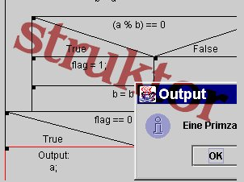

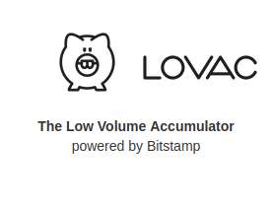

About Me
Studied general education, sociology and psychology
Created and maintained “struktor” used by hundreds of school teachers to teach development-skills without syntax
10 years working in various technical roles for a large software-vendor
Running https://beta.lovac.xyz - stacking sats with the help of bitstamp
Contributing to specter-desktop – multisig Wallet UI on top of Bitcoin-core
Available for consulting
https://bitcoin-devops.com/

Slide 3
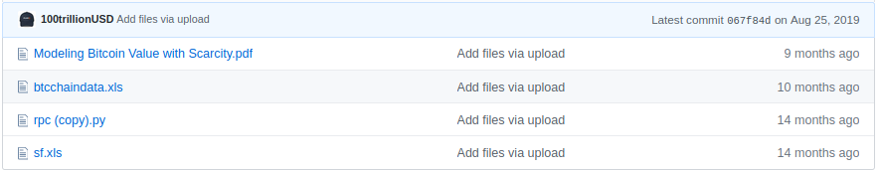
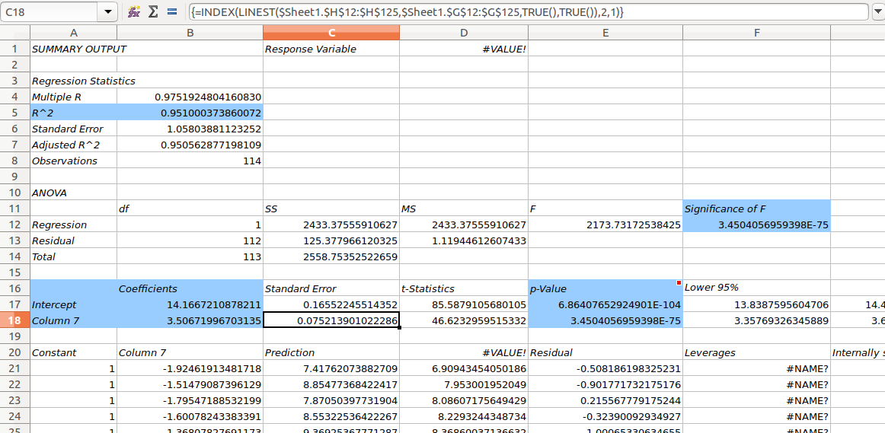
Research vs. publishing tools
PlanB published the regression as Excel-file
Creating that was no fun but increased the potential recipients tremendously
The tool for publishing data-science-results is not necessary the best tool for researching

Slide 4
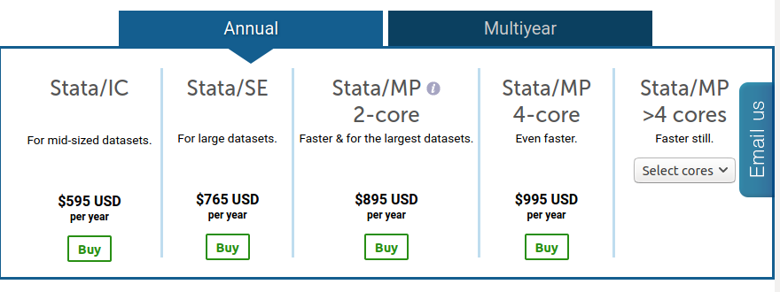
Stata
Stata is quite popular as a tool of choice in economics
It would have been much easier to use ...
But Stata is closed source
… and quite expensive
Not a good alternative for hobby-quants

Slide 5
There are Open Source Alternatives
Python – easy to learn Programming Language
Jupyter – a programmable notebook in the browser
Numpy and pandas – Operating on vectors and matrices efficiently
Statsmodels – provides OLS
Mathplotlib – showing graphs and other visualisations very easily

Slide 6

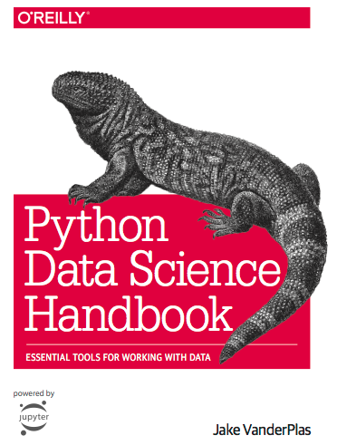
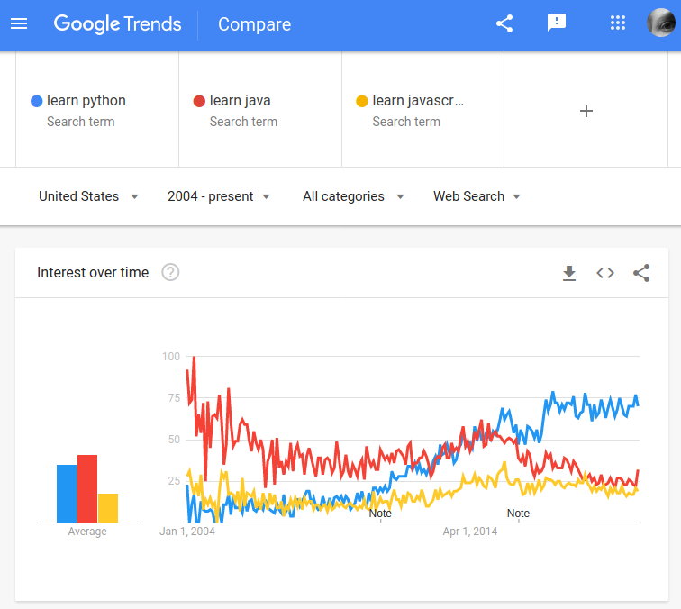
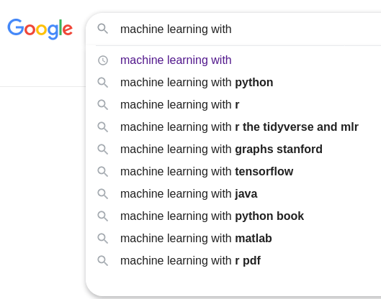
Python
Popular and easy to learn object oriented language, often used in education
Used in data science and visualisation
Machine learning (Tensorflow)
Also for web-development (Flask/Django)

Slide 7
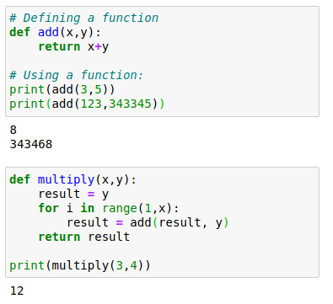
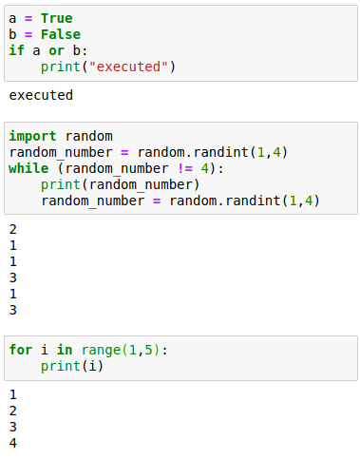
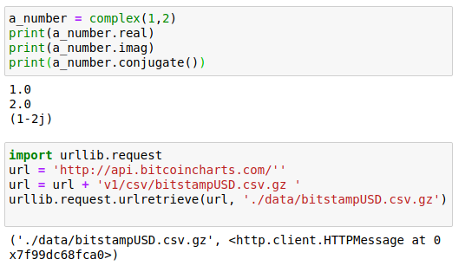
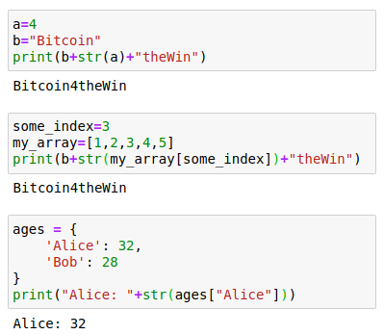
Python Crash Course
Literals, variables, arrays and key/values
Object creation and calling methods
Control-structures: if, while, for and friends
Functions

Slide 8
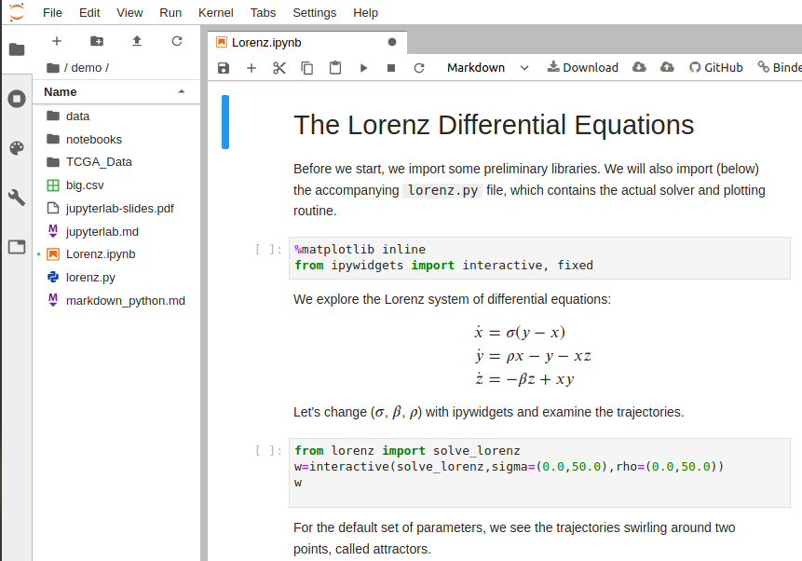
Jupyter
Showing the results of the code directly in the notebook
Rerunning small code snippets quickly for rapid prototyping
Mixing programming with structured text

Slide 9
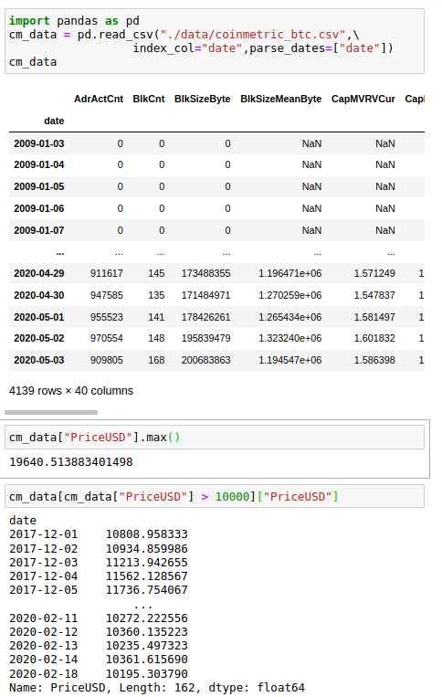
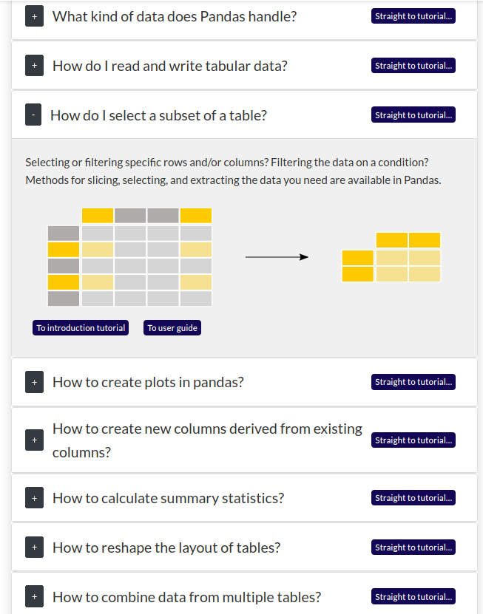
Numpy and Pandas
Pandas is internally using numpy
It’s data-handling on steroids
Very good documentation and tutorials

Slide 10
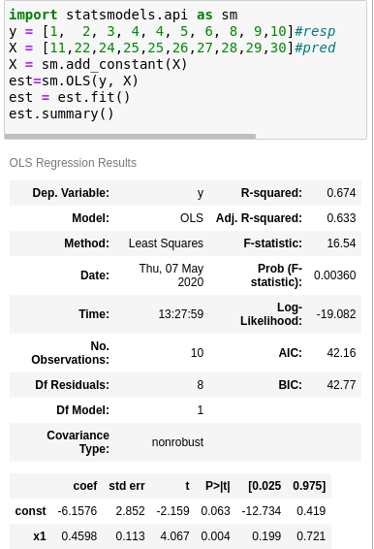
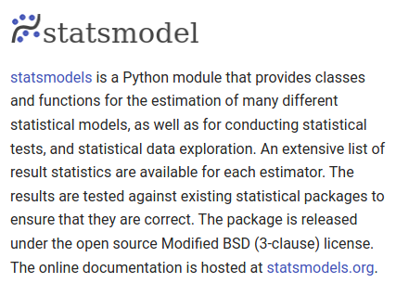
Statsmodels
Statsmodel provides various estimation models
ordinary least square regression is used like this

Slide 11
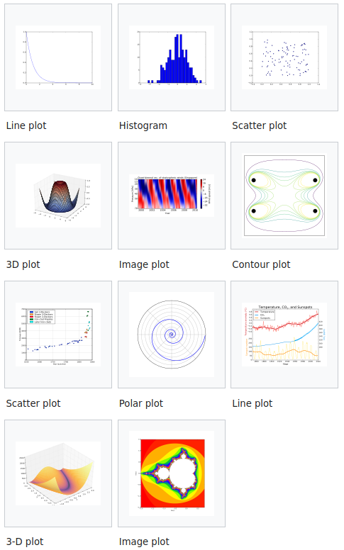
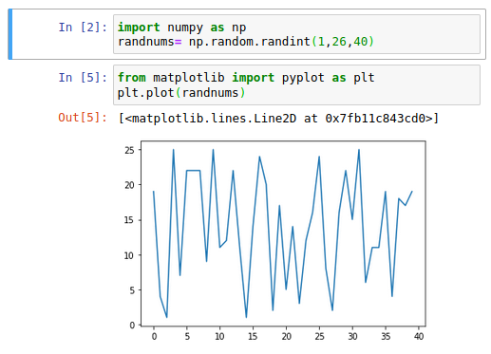
matplotlib
Visualizes any data
Lots of different graphs
Has specific integration with numpy/pandas making it even easier to use

Slide 12

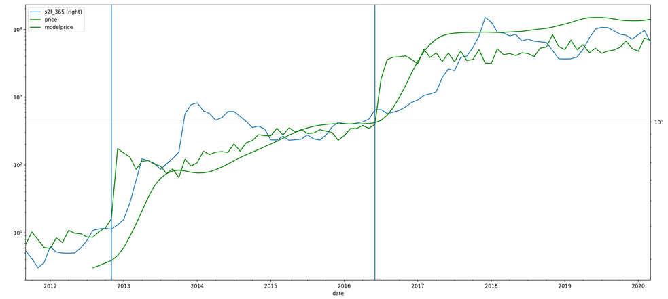
Explaining the scripts
(reproducing PlanB’s S2F)
BTC-Fullnode
http://k9ert.com/s2f/
Coinmetrics.io
01b_download_blockdata
03_extract_pricedata_coinmetric
02_transform_flow_monthly
01_extract_blocks
S2f-monthly/
04_calculation_s2f_monthly
./data/blocks/100000.csv
./data/blocks/200000.csv
...
./data/coinmetrics_btc.csv
./data/coinmetrics_monthly.csv
./data/monthly_flow.csv

Slide 13
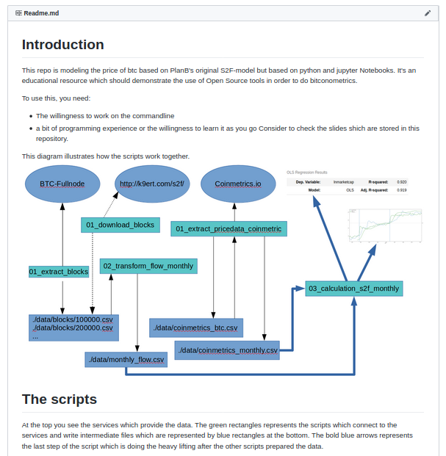
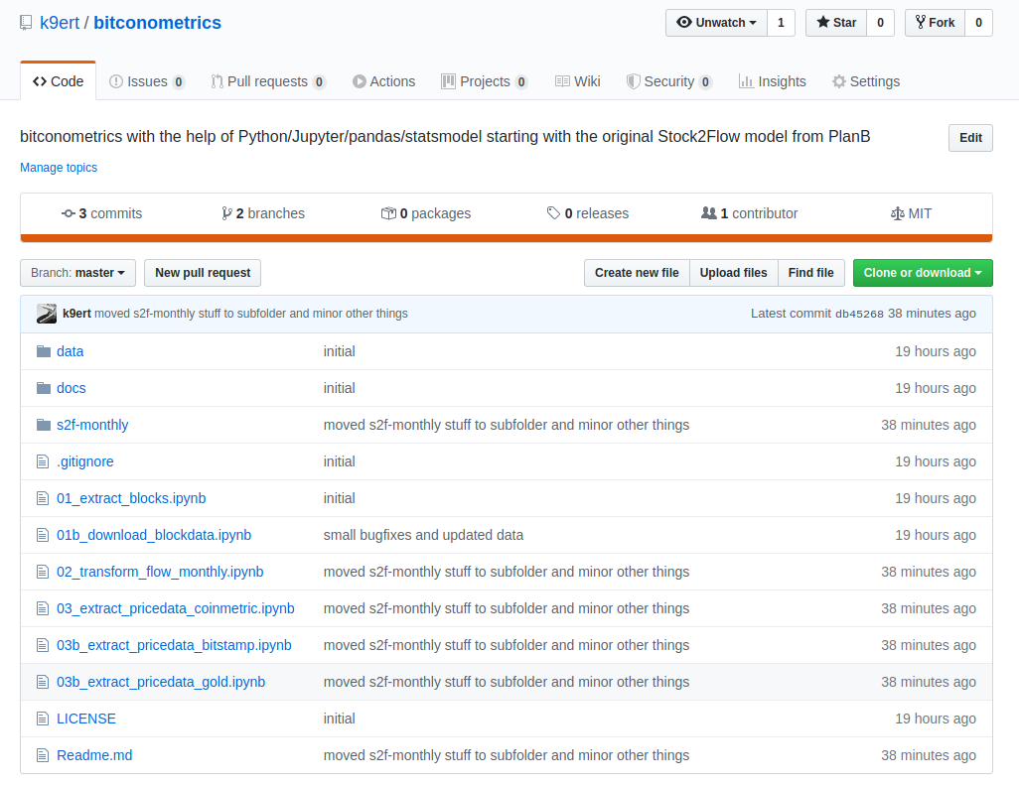
Released on github
https://github.com/k9ert/bitconometrics

Slide 14
Links
Python Crash Course Book https://nostarch.com/pythoncrashcourse2e/
Getting started with Jupyter and pandashttps://medium.com/velotio-perspectives/the-ultimate-beginners-guide-to-jupyter-notebooks-6b00846ed2af
Video Course: Pandas for Data Sciencehttps://github.com/justmarkham/pycon-2018-tutorial
Udacity Course: Machine learning for trading (featuring pandas) https://www.youtube.com/playlist?list=PLAwxTw4SYaPnIRwl6rad_mYwEk4Gmj7Mx

Slide 15
Q&A
Thank you very much
Follow me on Twitter
@k9ert

