Slide 1
HW-swgl-1 transformation & projection
CG19
NCCU
Notes:
2019 software opengl

Slide 2
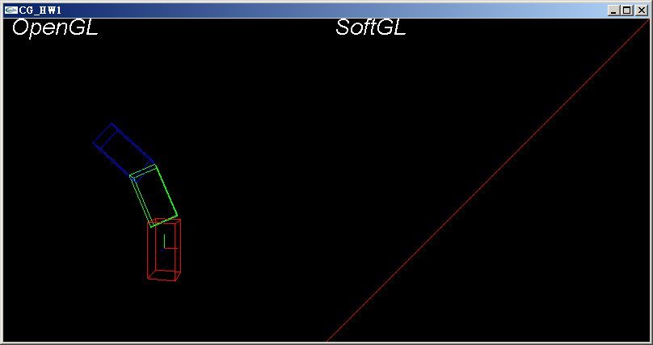
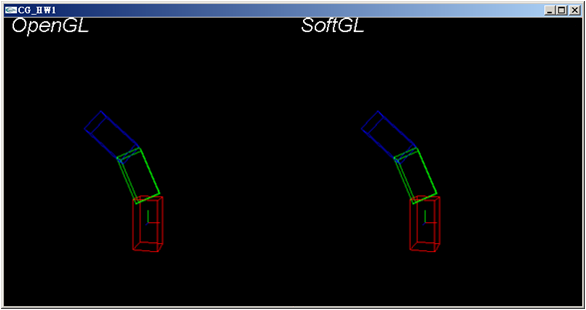
Goal
Implement the functions in swgl.h/swgl.cpp, to making your result(right viewport) correspond to the OpenGL (left viewport)

Slide 3
Implement the functions in swgl.h/swgl.cpp
Implement matrix and vector operation
Implement the transformation compute in swTransformation(h, w), input the vertex in world space(h), compute the vertex in windows space(w)
Uncomment the code in the softPath() in hw1.cpp
Notes:
Implement matrix and vector operation
Use the matrix and vector lib in glm
#include <glm/vec3.hpp> // glm::vec3
#include <glm/vec4.hpp> // glm::vec4
#include <glm/mat4x4.hpp> // glm::mat4

Slide 4
Resource
OpenGL 2.1 Reference Pages
  https://www.khronos.org/registry/OpenGL-Refpages/gl2.1/
Glm: OpenGL math
  https://glm.g-truc.net/0.9.9/index.html

Slide 5
Viewport transformation
View and projection
Transformation
Push/pop matrix

Slide 6
STEP 1

Slide 7
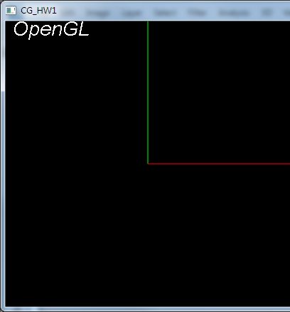
Step 1
//viewport transform
swViewport(winWidth/2, 0, winWidth/2, winHeight);
swMatrixMode(GL_PROJECTION);
swLoadIdentity();
//swuPerspective(60, (GLfloat)(winWidth*0.5)/winHeight, 0.1, 25);
swMatrixMode(GL_MODELVIEW);
swLoadIdentity();
//swuLookAt(5, 5, 20, 0, 5, 0, 0, 1, 0);
//world coordinate
glColor3f(1, 0, 0);
SwglLine(0, 0, 0, 1, 0, 0);
glColor3f(0, 1, 0);
SwglLine(0, 0, 0, 0, 1, 0);
glColor3f(0, 0, 1);
SwglLine(0, 0, 0, 0, 0, 1);

Slide 8
Step 1
void swViewport(GLint x, GLint y, GLsizei width, GLsizei height);
只要把這四個變數儲存起來

Slide 9
void glMatrixMode(GLenum mode);
GLdouble CTM_MV[16]; //Current Transformation Matrix: ModelView
GLdouble CTM_P[16]; //Current Transformation Matrix: Projection
GLdouble *CTM; //Pointer to Current Transformation Matrix

Slide 10
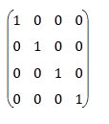
void glLoadIdentity( void);
CTM = I

Slide 11
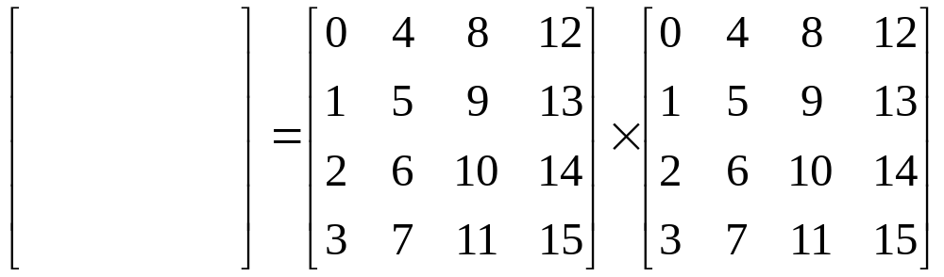
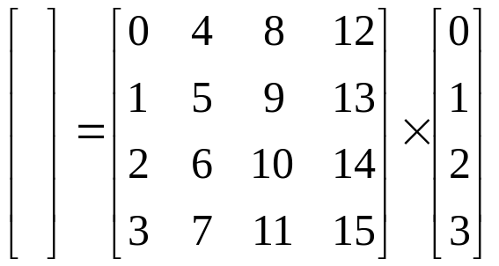
Matrix vector mutilation

Slide 12

Step1-Transformation
bool swTransformation(const GLdouble h[4], GLdouble w[4])
{
//p = CTM_P*CTM_MV*h
//perspective division Xnd = p[0]/p[3]; Ynd = p[1]/p[3];
//viewport transformation
//w[0] = Xw; w[1] = Yw
return true;
}

Slide 13
STEP 2

Slide 14
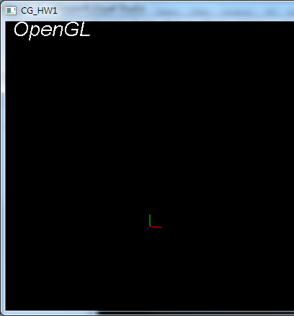
Step 2
//view transform
swViewport(winWidth/2, 0, winWidth/2, winHeight);
swMatrixMode(GL_PROJECTION);
swLoadIdentity();
swuPerspective(60, (GLfloat)(winWidth*0.5)/winHeight, 0.1, 25);
swMatrixMode(GL_MODELVIEW);
swLoadIdentity();
swuLookAt(5, 5, 20, 0, 5, 0, 0, 1, 0);
//world coordinate
glColor3f(1, 0, 0);
SwglLine(0, 0, 0, 1, 0, 0);
glColor3f(0, 1, 0);
SwglLine(0, 0, 0, 0, 1, 0);
glColor3f(0, 0, 1);
SwglLine(0, 0, 0, 0, 0, 1);

Slide 15
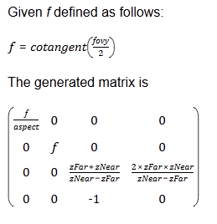
void gluPerspective(GLdouble fovy, GLdouble aspect, GLdouble zNear, GLdouble zFar);
180 degree = 3.1415 Radians (Pi)
對於每個函式計算出對應的矩陣m
再透過swMultMatrixd(m) 與CTM相乘，也就是CTM = CTM*m

Slide 16
Verify matrix
In openglpath()
glMatrixMode(GL_PROJECTION);
glLoadIdentity();
gluPerspective(60, (GLfloat)(winWidth*0.5)/winHeight, 0.1, 25);
glMatrixMode(GL_MODELVIEW);
glLoadIdentity();
gluLookAt(5, 5, 20, 0, 5, 0, 0, 1, 0);
float m[16];
glGetFloatv(GL_PROJECTION_MATRIX, m);
printf("%f %f %f %f \n ", m[0], m[4], m[8], m[12]);
…
float m[16];
glGetFloatv(GL_MODELVIEW_MATRIX, m);
printf("%f %f %f %f \n ", m[0], m[4], m[8], m[12]);
…

Slide 17
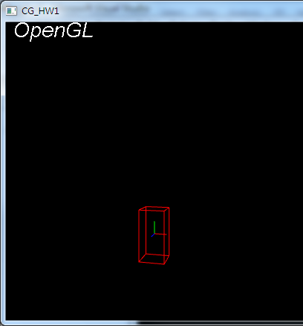
Step 3
swScaled();
swRotated()
swTranslated()
類似prespective

Slide 18
Step4
PushMatrix / PopMatrix
  Hint:
  GLdouble Stack_MV[16][32];
  or
  struct Matrix{
  GLdouble matrix[16];
  };
  stack<Matrix> STACK_MV;
LoadMatrix()

