Slide 1
HW swgl2 rast
nccu cg19
Notes:
2019

Slide 2
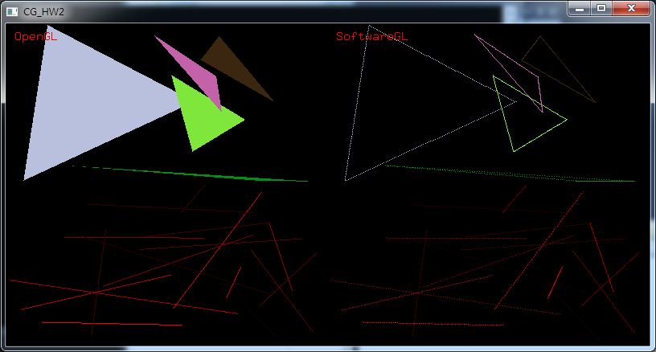
Hw2simple-Goal
Implement the functions in swgl.h/swgl2.cpp, to making your result correspond to the OpenGL (left viewport)

Slide 3
Implement the functions in swgl.h / swgl-hw2.cpp
Using the writepixel() to implement follow functions
  BresenhamLine()
  swTriangle()

Slide 4
Correct the Bresenham alogrithm
bool BresenhamLine(int x1, int y1, int x2, int y2, GLdouble r, GLdouble g, GLdouble b)
{
writepixel(x1, y1, r, g, b);
writepixel(x2, y2, r, g, b);
for(int i=0; i<100; i++) {
float a = 0.01*i;
writepixel(a*x1+(1-a)*x2, a*y1+(1-a)*y2, r, g, b);
}
return true;
}

Slide 5
Correct the swTriangle()
bool swTriangle(GLdouble x1, GLdouble y1, GLdouble z1,
GLdouble x2, GLdouble y2, GLdouble z2,
GLdouble x3, GLdouble y3, GLdouble z3,
GLdouble r, GLdouble g, GLdouble b)
{
writepixel(x1, y1, r, g, b);
writepixel(x2, y2, r, g, b);
writepixel(x3, y3, r, g, b);
BresenhamLine(x1, y1, x2, y2, r, g, b);
BresenhamLine(x2, y2, x3, y3, r, g, b);
BresenhamLine(x3, y3, x1, y1, r, g, b);
return true;
}

Slide 6
Hidden surface remove z buffer algorithm
bool swInitZbuffer(int width, int height);
bool swClearZbuffer();
Extend the writepixel(); to add z buffer function
Notes:
何時需要writepixel?
何時需要呼叫swClearZbuffer()
何時需要建立或改變zbuffer大小

Slide 7
const int PROGRESS = 0;
change according to your progress
  When BresenhamLine() complete, set PROGRESS = 1;
  When swTriangle() complete, set PROGRESS = 2;

Slide 8
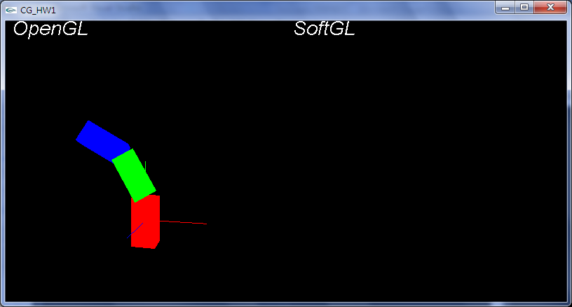
Merge into swgl1
Implement the functions in swgl.h/swgl2.cpp, to making your result correspond to the OpenGL (left viewport)

Slide 9
resource
http://www.opengl.org/sdk/docs/man/
http://en.wikipedia.org/wiki/Bresenham's_line_algorithm

