Slide 1
SWS405 – Applied Artificial Intelligence
YOLOv8-Based Object Detection System
for Traffic Analysis
Team Members
Project Snapshot
Rashed Abdulla Alzeyoudi 202300003336
Model
YOLOv8n (nano)
Ahmed Aljanahi 20210001364
Classes
5 vehicle types
Khalid Almarri 2020001899
Training images
704
Mershad Ahani 20220002469
Validation images
176
Total instances
4,102
Final mAP@50
0.676

Slide 2
Introduction
02
What is object detection?
Object detection finds what objects are in an image and where they are. Unlike classification, which gives one label to a whole image, detection draws bounding boxes around individual objects and labels each one. That makes it useful for traffic monitoring, surveillance, and autonomous vehicles.
Why YOLO?
YOLO (You Only Look Once) treats detection as a single regression in one forward pass, making it far faster than two-stage methods like Faster R-CNN that first generate region proposals and then classify them. YOLOv8 is the latest and most accurate version of this family.
Project aim
Build a traffic object detection system using YOLOv8n trained on a custom dataset of 880 images covering five vehicle classes: Ambulance, Bus, Car, Motorcycle, and Truck. Evaluate with Precision, Recall, mAP@50, mAP@50-95, and per-class confusion matrix.
Why it matters
Accurate, real-time vehicle detection supports smart city traffic management, emergency vehicle prioritisation, road safety monitoring, and autonomous driving systems. A fast, lightweight model like YOLOv8n makes this viable on accessible hardware.

Slide 3
Literature Review
03
Traditional methods
Pre-2014
Haar cascades, HOG, DPM
(Viola & Jones, 2001; Dalal & Triggs, 2005)
Handcrafted features. Brittle to lighting and scale changes.
Two-stage detectors
2014–2017
R-CNN → Fast R-CNN → Faster R-CNN
(Girshick et al., 2014; Ren et al., 2017)
High accuracy but slow. Two-stage pipeline limits throughput.
Single-stage detectors
2016–2020
SSD, YOLOv1–v4
(Liu et al., 2016; Redmon et al., 2016; Bochkovskiy et al., 2020)
Fast and accurate. YOLO predicts boxes in one pass.
YOLOv8
2023
Anchor-free head, improved FPN,
Distribution Focal Loss (Jocher et al., 2023)
Current state of the art. Selected for this project.

Slide 4
Dataset
04
Composition
Classes
Total images
880
• Ambulance
Training (80%)
704
• Bus
• Car
Validation (20%)
176
• Motorcycle
Object classes
5
• Truck
Total instances
4,102
Annotation & preparation
Car instances
~2,742 (66.8%)
Tool: Roboflow (bounding box annotation, format export, versioning)
Format: YOLO — normalised bbox coordinates + class IDs
Variety: multiple angles, lighting conditions, weather, distances
Augmentation: flip, rotation, brightness, Gaussian blur
Class imbalance: Car accounts for ~66.8% of all instances. This likely biases the model toward Car predictions and reduces performance on minority classes.

Slide 5
Methodology: Model Selection and Justification
05
Model | Type | Inference speed | Real-time | Anchor-free | Selected
Faster R-CNN | Two-stage | Slow (~100-200ms) | No | No | No
SSD | Single-stage | Fast (~10ms) | Yes | No | No
RetinaNet | Single-stage | Moderate | Partial | No | No
YOLOv8n | Single-stage | Very fast (~1-5ms) | Yes | Yes | Yes
Why YOLOv8n was selected:
• Anchor-free detection head: no need to predefine anchor sizes, better generalisation to varying object scales
• Improved feature pyramid network: aggregates multi-scale features, helps detect objects at different distances
• Distribution Focal Loss (DFL): models bounding box coordinate distributions for more precise localisation
• Ultralytics API: clean, well-documented framework that reduces implementation complexity significantly
• Nano variant: lightweight enough to train on Google Colab and deploy on edge hardware (Jetson Nano)

Slide 6
Training Setup and Hyperparameters
06
Epochs
Image size
Batch size
50
640 × 640
16
Final run (30-epoch preliminary run discarded)
Balance between detection quality and compute
GPU memory efficient on Tesla T4
Optimizer
GPU
Framework
AdamW
Tesla T4
Ultralytics YOLOv8
Automatically selected by Ultralytics
Google Colab, free-tier GPU environment
Python API, handles training loop end-to-end
Loss functions:
• Bounding box regression loss (CIoU): measures how accurately predicted boxes align with ground truth annotations
• Classification loss (Binary Cross-Entropy): penalises incorrect class label predictions
• Distribution Focal Loss (DFL): improves localisation by modelling the distribution of possible box coordinate values

Slide 7
Evaluation Metrics
07
Precision
TP / (TP + FP)
The fraction of all positive predictions that are actually correct. High precision means few false alarms — the model rarely detects objects that are not there.
Recall
TP / (TP + FN)
The fraction of all real objects in the scene that the model successfully detected. High recall means few missed detections.
mAP@50
Mean AP at IoU ≥ 0.5
The primary benchmark. Averages the area under the precision-recall curve across all five classes at a standard detection threshold. Our main reported metric.
mAP@50-95
Mean AP, IoU 0.5 to 0.95
A stricter version that averages across ten IoU thresholds. Penalises boxes that are correct in class but imprecise in position. Always lower than mAP@50.
Confusion Matrix
Per-class classification table
Shows which classes are confused with which. Diagonal = correct predictions. Off-diagonal = misclassifications. Used for per-class error analysis.

Slide 8
Overall Performance Results — 50-Epoch Final Run
08
0.676
~0.72
~0.59
~0.48
mAP@50
Precision
Recall
mAP@50-95
Primary benchmark
72% of detections correct
59% of real objects found
Strict IoU metric

Slide 9
Per-Class Performance Analysis
09
Class | Precision | Recall | mAP@50 | mAP@50-95 | Notes
Ambulance | 0.846 | 0.833 | 0.804 | 0.677 | Best: distinctive shape and markings
Bus | 0.710 | 0.712 | 0.836 | 0.556 | Best mAP@50: consistent across angles
Car | 0.645 | 0.492 | 0.514 | 0.373 | Weak: dominant class, visually similar to Truck
Motorcycle | 0.698 | 0.455 | 0.725 | 0.309 | Low recall: small object size, frequent misses
Truck | 0.628 | 0.458 | 0.504 | 0.398 | Weak: confused with Car and Bus
Overall | ~0.72 | ~0.59 | 0.676 | ~0.48 | 50-epoch final run
Key observations:
• Ambulance and Bus perform best because they have visually distinctive features that separate them from other classes.
• Car and Truck are the weakest: they share rectangular shapes and the Car class dominates the training data at 66.8%.
• Motorcycle achieves reasonable mAP@50 but has low recall (0.455) because motorcycles are physically small in traffic images.

Slide 10
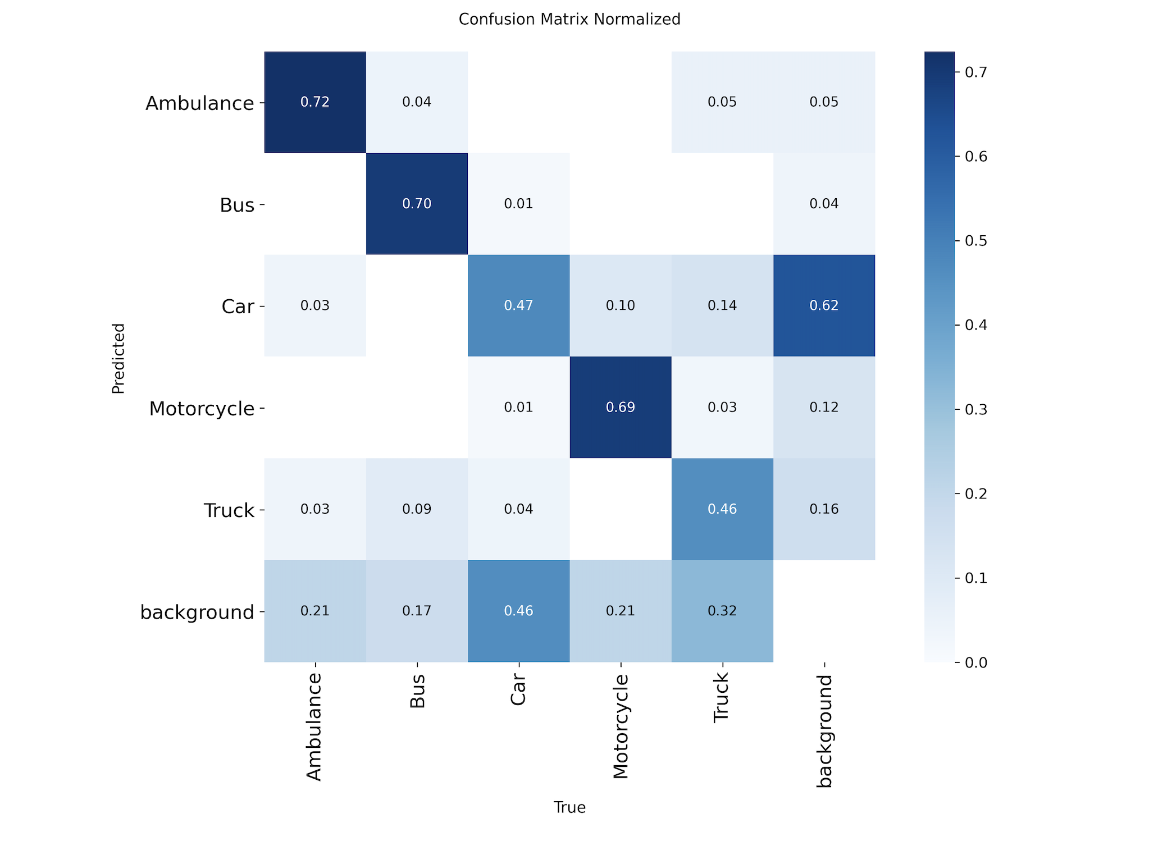
Confusion Matrix Analysis
10
[]
What the matrix shows:
Ambulance and Bus
Well separated. High diagonal values confirm reliable classification.
Car and Truck
Main confusion pair. Similar rectangular shapes at common camera angles.
Bus and Truck
Secondary confusion pair. Both large vehicles with overlapping profiles.
Motorcycle
High background column: many real motorcycles not detected at all.
Root cause
Class imbalance (Car at 66.8%) + visual similarity between heavy vehicles.

Slide 11
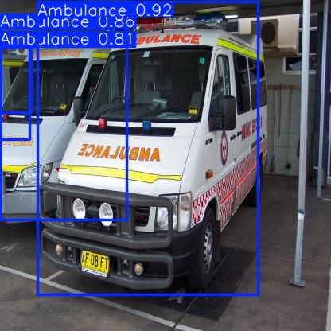
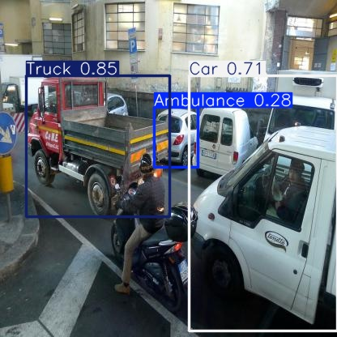
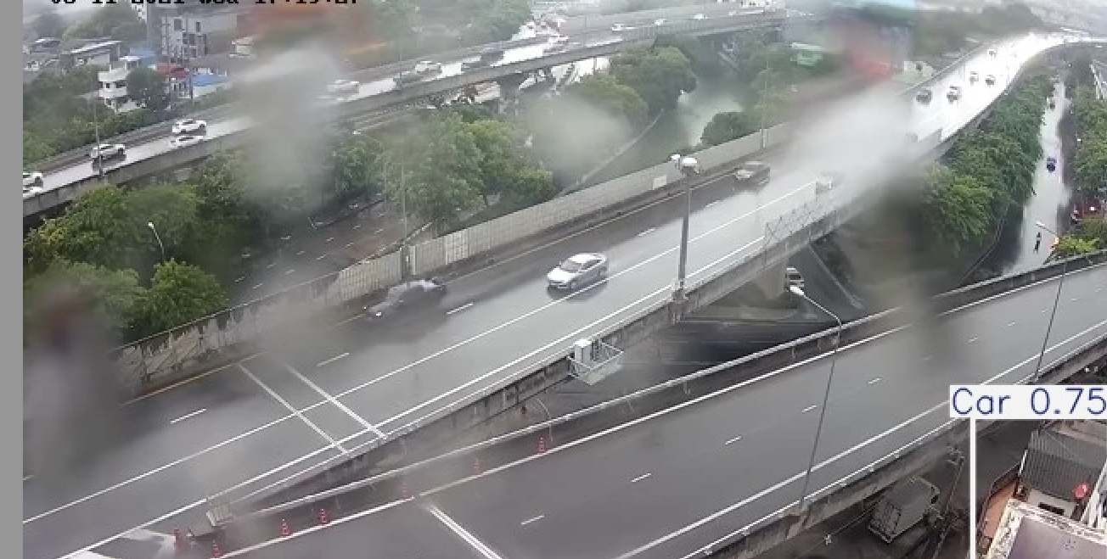
Inference Examples
11
[]
Figure 5. Best single prediction
Figure 6. Multi-object scene
Figure 7. Misclassification example
Ambulance detected at 0.98 confidence with a tight bounding box. Shows strong performance on clear, unoccluded objects.
Multiple vehicles detected simultaneously with correct labels. Confidence scores drop slightly in crowded scenes with partial overlap.
A vehicle labelled incorrectly, e.g. a truck predicted as a bus, consistent with the confusion matrix Car/Truck/Bus confusion.

Slide 12
Ethical Reflection
12
Fairness
Issue: class imbalance creates unequal detection performance. Motorcycles are missed far more than cars.
Impact: in a real system, motorcycle incidents would be underreported, disadvantaging that group of road users.
Mitigation: deliberate dataset balancing and per-class performance auditing before any deployment.
Accountability
Issue: if an ambulance is misclassified as a truck, an emergency corridor might not activate in time.
Impact: automated decisions with safety implications require clear responsibility chains — a model cannot be a black box.
Mitigation: human oversight for safety-critical decisions; model operates in advisory mode only.
Transparency
Issue: users may over-trust confidence scores and not understand where the model fails.
Impact: low-confidence predictions can mislead operators who rely on the output without understanding its limits.
Mitigation: publish confusion matrix, share per-class analysis, apply Grad-CAM visualisations to explain decisions.

Slide 13
Real-World Implementation
13
Hardware
Infrastructure integration
Cloud: NVIDIA T4 / A10G — 30 to 60 fps with YOLOv8n.
Edge: Jetson Nano (4GB) — 15 to 25 fps, sufficient for traffic monitoring.
Optimise with TensorRT or ONNX export for lower latency.
Connect to existing CCTV RTSP streams.
Feed detections to a traffic management dashboard in real time.
Could activate emergency vehicle corridors on Ambulance detection.
Privacy
Limitations to fix before deployment
No face or licence plate capture — compliant with data minimisation.
Real-time processing without persistent video storage.
Access restricted; data retention policy required.
Car/Truck confusion must be reduced via more balanced data.
Night-time and adverse-weather evaluation not yet done.
False positive rate under real conditions not yet characterised.
Human review required before any autonomous operation.

Slide 14
Conclusion and Future Work
14
What was achieved:
• Complete end-to-end pipeline: custom dataset, annotation with Roboflow, 50-epoch training, evaluation, and inference
• YOLOv8n trained on 880 images across 5 vehicle classes using Google Colab with Tesla T4 GPU
• Final mAP@50 = 0.676, Precision ~0.72, Recall ~0.59 — solid baseline for a student project
• Full per-class confusion matrix analysis identifying specific failure modes
• Ethical reflection covering fairness, accountability, and transparency
• Real-world deployment analysis covering hardware, privacy, and current limitations
Future directions:
• Expand and balance the dataset — primary bottleneck for performance improvement
• Test larger YOLOv8 variants (small, medium, large) to assess accuracy gains
• Evaluate on night-time and adverse-weather images
• Add multi-object tracking (BoT-SORT or ByteTrack) for video applications
• Optimise for edge deployment using TensorRT or ONNX

Slide 15
References
15
• Bochkovskiy, A., Wang, C. Y., & Liao, H. Y. M. (2020). YOLOv4: Optimal speed and accuracy of object detection. arXiv:2004.10934.
• Jocher, G., Chaurasia, A., & Qiu, J. (2023). Ultralytics YOLOv8. https://github.com/ultralytics/ultralytics
• Bradski, G. (2000). The OpenCV library. Dr. Dobb's Journal of Software Tools.
• Liu, W., et al. (2016). SSD: Single shot multibox detector. ECCV, 21–37.
• Dalal, N., & Triggs, B. (2005). Histograms of oriented gradients for human detection. CVPR, 886–893.
• Redmon, J., Divvala, S., Girshick, R., & Farhadi, A. (2016). You only look once: Unified, real-time object detection. CVPR, 779–788.
• Girshick, R. (2015). Fast R-CNN. ICCV, 1440–1448.
• Ren, S., He, K., Girshick, R., & Sun, J. (2017). Faster R-CNN: Towards real-time object detection with RPNs. IEEE TPAMI, 39(6), 1137–1149.
• Girshick, R., Donahue, J., Darrell, T., & Malik, J. (2014). Rich feature hierarchies for accurate object detection. CVPR, 580–587.
• Viola, P., & Jones, M. (2001). Rapid object detection using a boosted cascade of simple features. CVPR, 511–518.

