Slide 1
AMCS-Hackathon
Team Members
21PD17 – KAMAL NITHISH
21PD35 - SREENIDHI

Slide 2
Problem Statement
Design and implement a chatbot system capable of ingesting and interpreting uploaded documents (e.g., PDFs) to provide accurate, fact-based responses quickly and reliably. The chatbot should utilize LLM APIs and other retrieval techniques.
Deliverables:
1. Responsive REST APIs connected with Simple UI
Good to have:
a. Support bulk upload and processing
b. Security by design
c. Improved User experience using UI and streaming APIs
d. Employ effective techniques (e.g., prompt engineering, context-verification, or
grounding) to prevent “hallucinations” by verifying that all responses directly
reference the source material.

Slide 3
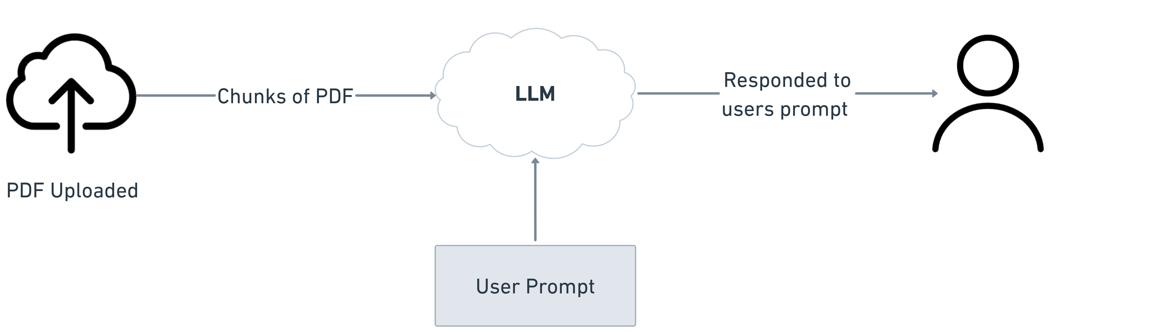
Flow Diagram

Slide 4
WORKFLOW
User Query: Users interact with the system by submitting their queries through the user interface, built with Flask. This interface acts as a bridge between the user and the backend system.
PDF Content Chunks: Uploaded PDFs are divided into smaller, manageable chunks and stored in Qdrant, a high-performance vector database. This database enables efficient similarity searches to identify the most relevant chunks of text based on the user's query.
Chunk Selection: When a user query is submitted, the system retrieves the most similar chunk from Qdrant using vector similarity matching. This step ensures that the LLM receives the most relevant part of the document to process alongside the query.
Prompt Engineering:
To enhance the LLM's performance, a default prompt is combined with the user query and the selected PDF chunk. This default prompt acts as contextual guidance, providing the LLM with background knowledge or instructions about how to interpret the data and formulate responses.

Slide 5
LLM Response Generation:
The combined input (user query + selected chunk + default prompt) is sent to Gemini AI. Gemini processes this input and generates a precise, contextually accurate response, tailored to the user's query and the content of the document.
Frontend Display: The response generated by Gemini AI is transmitted back to the Flask interface, where it is presented to the user seamlessly.

Slide 6
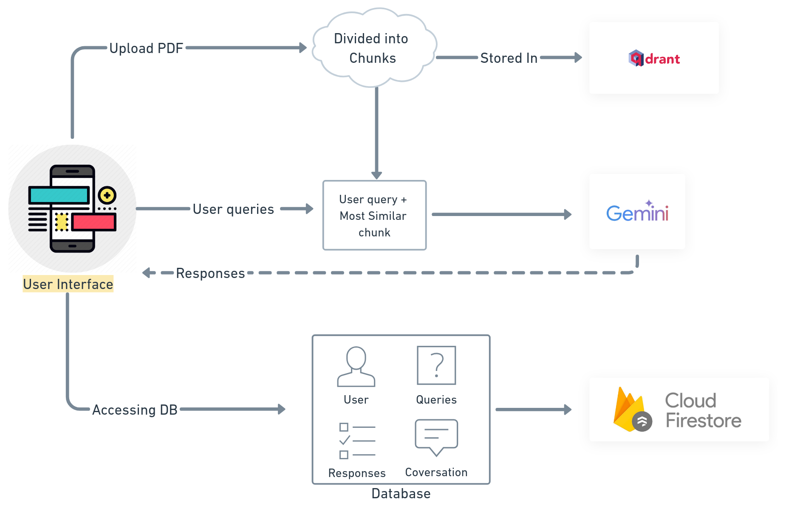
Architecture diagram

Slide 7
Technologies
Frontend
Flask: Lightweight and versatile framework for building the user interface which asks for user Registeration/Login.
Databases
Qdrant: Vector database for storing PDF chunks for a particular PDF.
Key Features: High-performance similarity search, scalability, and efficiency.
Firestore: Purpose: A NoSQL database for storing user data, queries/prompts, responses, and conversation history.
Key Features: Real-time database, easy integration, and secure.
Gemini API Used for advanced language understanding and generating responses based on user queries and relevant content chunks.
Key Features: Context-aware responses and Combines user queries with selected document chunks for precise answers.
Security
Firebase Authentication: Ensures secure user login via SSO or email/password.a seamless and interactive UI/UX.

Slide 8
Core Functionalities of Gemini AI
User Prompt Analysis:
Gemini AI processes user queries and understands their intent using natural language processing (NLP).
It ensures accurate comprehension of complex or ambiguous user inputs.
Context-Aware Chunk Retrieval:
Combines the user query with the most relevant chunk of text extracted from the uploaded PDF.
Identifies the most similar chunk using vector similarity techniques powered by Qdrant.
Default Prompt Integration:
Gemini AI incorporates a default prompt designed to guide and enhance its responses.
This ensures consistent, high-quality outputs tailored to the application's context.
Real-Time Query Resolution:
Responds instantly to user prompts in the frontend.
Provides detailed, context-specific answers based on the combined query and PDF chunk.

Slide 9
THANK YOU

