Slide 1
Project – “Prometheus”
Group 1
Aakash Dhande
Megha Kaushik
Mounika T
Rajkumar Gupta
Suchitra Koganti
Supreetha Bade
Utkarsh Upadhyay
Mentors –
Sangeetha
Shital Patil
Notes:
Add instructor notes here.

Slide 2
Objectives :
Project Understanding
Approach used
Project Execution
Modules
Best Practices
Opportunity for improvement
Demo and Code Walkthrough
Q&A
Notes:
Add instructor notes here.

Slide 3
Project Understanding :
In our education system , teacher student interaction is limited to only one or two hours a day. In that one hour the teacher have to teach his part of the syllabus, he has to solve the queries of his students , he has to allot the homework to his students and also have to check the homework he has allotted to students in his previous lecture.
A Teacher alone has to multitask all these activity within a limited time period, this makes it very tedious task for him.
Notes:
Add instructor notes here.

Slide 4
Project Understanding (Continued) :
So we have created a effective solution for this problem that is PROMETHEUS, it is a homework management system through which a teacher can allot the homework to his students anytime of the day and students don’t have to remember all their homework.
It also allows the teacher to check the homework as per his convenience and give proper remarks to the particular student.
Notes:
Add instructor notes here.

Slide 5
Approach used :
We have used ASP.NET MVC framework for creating this application which uses a Model- View – Controller pattern.
Various functionalities like Session, Partial View, HTML, Style Sheet and JQuery are used.
It doesn’t replace web form . Its an alternate project type.
The view engines used in the ASP.NET MVC frameworks with Razor.
Notes:
Add the notes here.
Add instructor notes here.

Slide 6
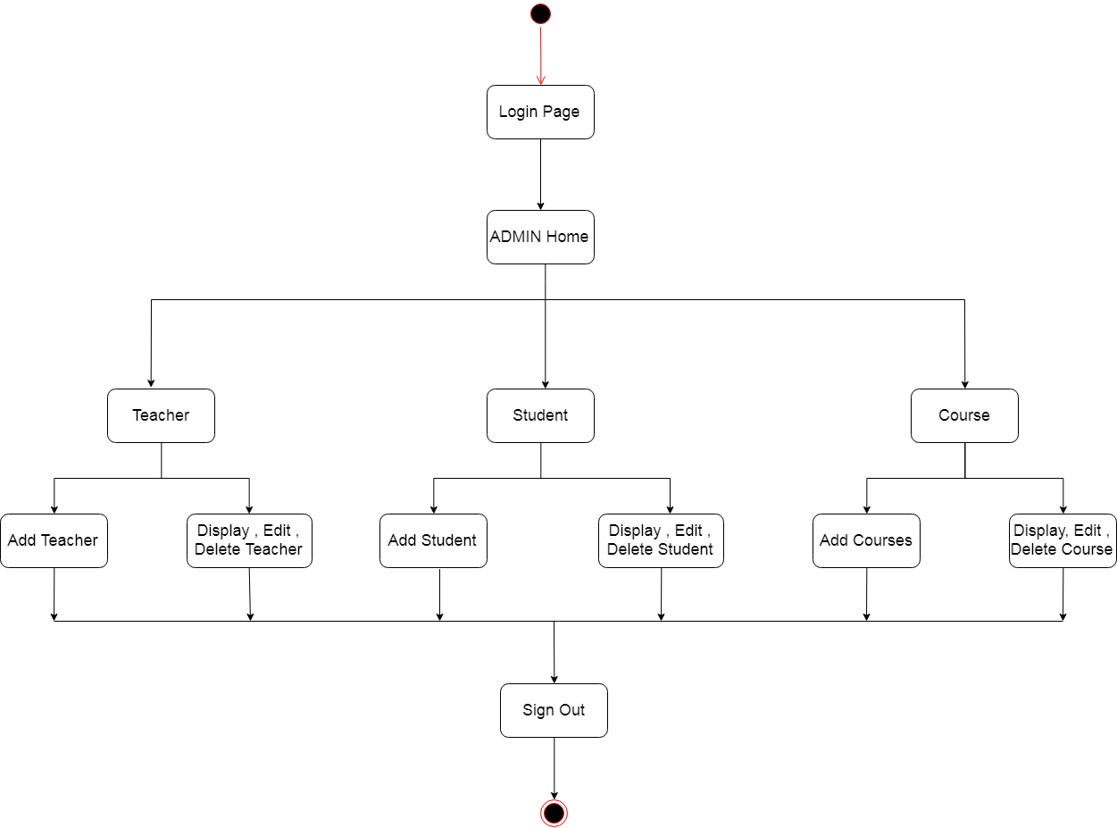
Project Execution
Notes:
Add the notes here.
Add instructor notes here.

Slide 7
Modules :
ADMIN Module :
The ADMIN needs to log in into his account using his UserID and Password .
After that he can add teachers in the database by selecting create teachers option , there he needs to fill all the necessary details of the teacher correctly and add the teacher.
The ADMIN can also add students into the database , by selecting the add student option.
We can also add required courses in the database when situation arises through ADMIN portal.
Notes:
Add the notes here.
Add instructor notes here.

Slide 8
Best Practices
We have applied validations for various input fields.
Also all the fields are marked as compulsory so that the user needs to fill all the fields compulsorily.
The navigation of user is made very easy, the user can navigate from one part of the site to another from single page.
Notes:
Add the notes here.
Add instructor notes here.

Slide 9
Opportunity for improvement :
For further enhancements ,practice tests can be organized on Prometheus where the teacher can allot test to students and appoint a start date and end date to appear for the test. Later teacher can evaluate the test and display the marks on common scoreboard or on personal login page.
The students are able to sort the homework according to the start date and end date and according to subjects.
Notes:
Add the notes here.
Add instructor notes here.

Slide 10
Opportunity for Improvement :
The students can partially complete their homework , save it for time being and then complete the homework and then submit for evaluation.
The students automatically gets reminders before the end date of the assigned homework.

Slide 11
ANY QUESTIONS?
Notes:
Add the notes here.
Add instructor notes here.

Slide 12
THANK YOU
Notes:
Add the notes here.
Add instructor notes here.

