Slide 1




Camera services
Marek Korenciak

Slide 2
Contents
What can we do with camera??
Android camera libraries
Differences between libraries
Code example
Demo

Slide 3
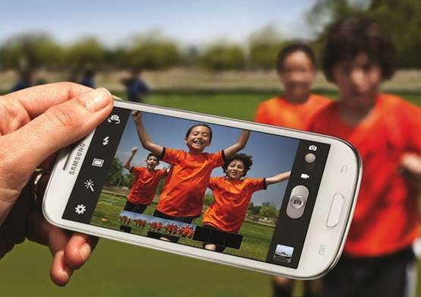

What can we do with camera??
Take pictures and record videos??

Slide 4

Android camera libraries
Camera (android.hardware.Camera):
Deprecated in API 21
Camera 2 (android.hardware.Camera)
Added in API 21

Slide 5
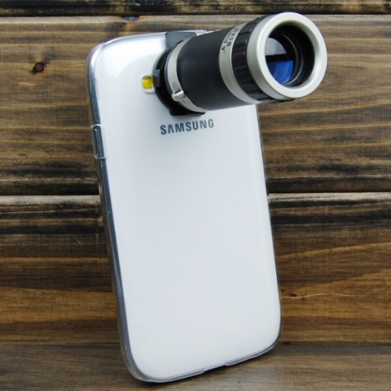
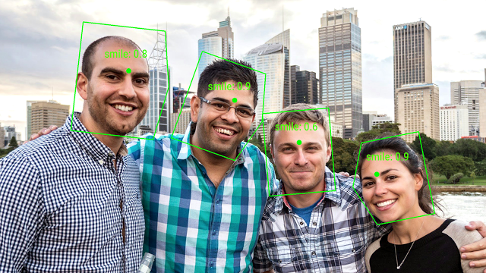
Differences between libraries
Camera 2 - new functionalities:
Burst photos, computational photography, gesture recognition,...
Camera 2 – new structure

Slide 6
Camera API1 code
Open camera:
Camera camera = Camera.open();
Create preview
Take picture:
camera.takePicture(null, null, new camera.PictureCallback() {...)

Slide 7
Camera API2 code
Create surface listener
Open camera (permission accept)
Create listener of camera
Create preview,...
Structure is asynchronous (listeners everywhere)
For actions use requests

Slide 8
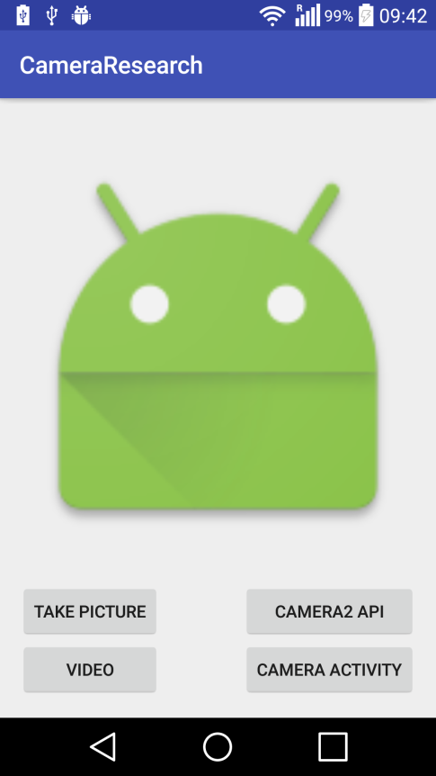
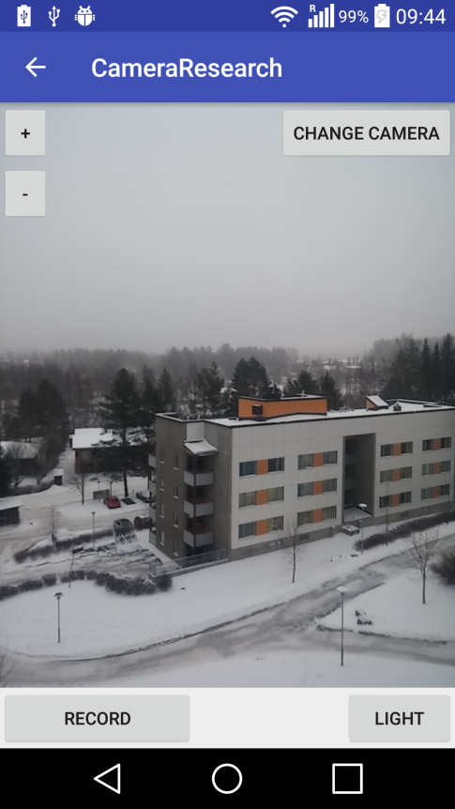
Demo

Slide 9
Thank you

Slide 10
Resources
https://developer.android.com/reference/android/hardware/Camera.html
https://developer.android.com/reference/android/hardware/camera2/package-summary.html
https://www.nigeapptuts.com/android-camera2-api-looknfeel/
http://www.slideshare.net/lbk003/b-kaur-computationalphotographycamera2v3ss

