Slide 1
CLUSTER: PRIVACY PRESERVING NETWORK SECURITY DATA SCIENCE

Slide 2
CRYPTOGRAPHIC PROTECTION WITH NOISE IMAGE AS A UNIQUE CIPHER KEYS

Slide 3
TEAM GUIDE:
Mr. Syed Mujib Rahaman
GROUP MEMBERS:
ANUSHA(319136410081)
PURVIKA(319136410097)
SAMBHAVI (319136410126)
TANU(319136410116)

Slide 4

Everything in today's highly connected digital world is increasingly dependent on instantaneous global data transfers. Internet efficiency facilitates our daily lives. Sharing information online presents significant security dangers and difficulties in the modern day. The use of cryptography is the means through which sensitive information can be protected from various threats. Improved cryptosystems technology is a no-brainer for securing communication networks. An improved cryptosystem is the focus of our research, and to that end we have presented a novel method of data encryption and decryption that guarantees increased efficiency over current best practice. In this project, a noise image encryption and decryption scheme are proposed in which the noise signal is selected randomly to set the initial values for a chaotic system which also enhances the security of the system. for understanding the effectiveness of the proposed system. Experimental results confirm that the proposed chaos based cryptosystem is efficient and suitable for information (image) transmission in a highly secured way. We have created a file encryption system where we save encrypted file and decrypt and download it later. The main difference between the existing and proposed system is the file encryption system is implemented using noise images that stores key values inside it.

Slide 5

Every day, a corporation handles files, so it needs reliable data security methods. 32% of organizations are affected by cybercrime, which costs $6 trillion globally. You need sophisticated security capabilities that interact nicely with your existing platforms and fit within your company budget to mitigate this risk. One of the best security measures is file encryption. With advanced security measures, it protects your business's data. Encrypting a file involves encoding not only the file itself but also any sensitive information that it may contain. This allows the file to be sent via an insecure channel without compromising its integrity. Because of the encoding, nefarious actors are unable to get unauthorized access to the data or modify it in any way. It prevents a file from being accessed by anyone other than the person or individuals for whom it was intended, whether it be one person or multiple people. Encryption of files is a useful solution to this problem. It gives you the ability to make any sensitive information you save unreadable to anybody other than the authorized recipients.

Slide 6

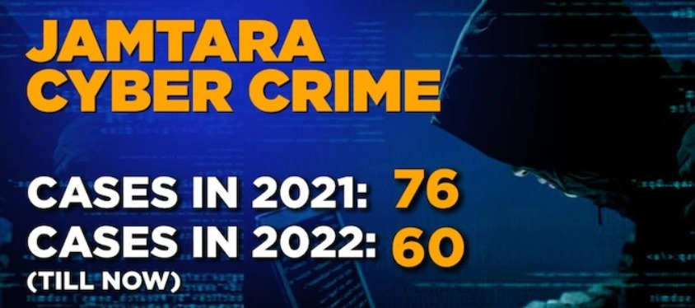

Hackers have stolen the digital information of over 5 million people worldwide, including 6 lakh Indians. Additionally, a ground report from India in Jamtara, one of the most known centers of digital fraud, indicated that scammers have become more planned and cunning.

Slide 7
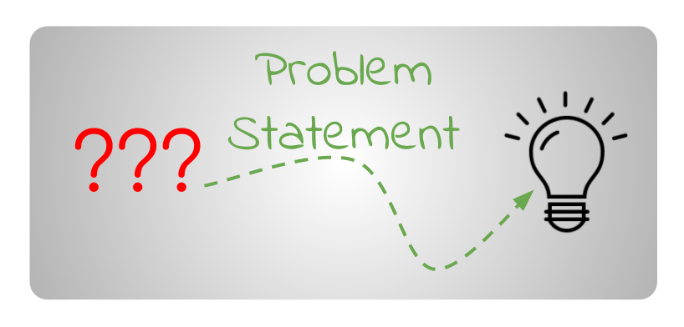
Keeping track of encrypted and non-encrypted files might become a difficult task if too many files are encrypted. Also, if every file in a disk is encrypted using a different key/password, then keeping track of this might also become a tedious task for the device owner. Hence an effective system is required to control and analyse the requirements.

Slide 8

1.Functional Requirement:
The software shall accept the file as input.
The software shall use Advanced Encryption Standard Algorithm(AES) as the main component of the software.

Slide 9
2.Non – Functional Requirements:
Security and Privacy
Maintainability
Performance
Availability
Mobility

Slide 10
3.Hardware requirements:
• Microsoft Server enabled computers
• Higher RAM, of about 4GB or above
• Processor of frequency 1.5GHz or above
4.Software requirements:
• Python 3.6 and higher
• Visual Studio

Slide 11
System Requirement Specification
S.NO | REQUIREMENTS | REQUIREMENT NO. | ESSENTIAL/DESIRABLE | DESCRIPTION
1. | Register | RS1 | Essential | Password should contain special characters and numbers
2. | Login | RS2 | Essential | Credentials are required
3. | File Uploading | RS3 | Essential | Upload a file for encryption

Slide 12
System Requirement Specification
4. | Encryption | RS4 | Essential | The file will be converted into bytecode
5. | Key generation | RS5 | Essential | A noise image(key) will be generated
6. | Decryption | RS6 | Essential | Using a noise image to decrypt the file

Slide 13
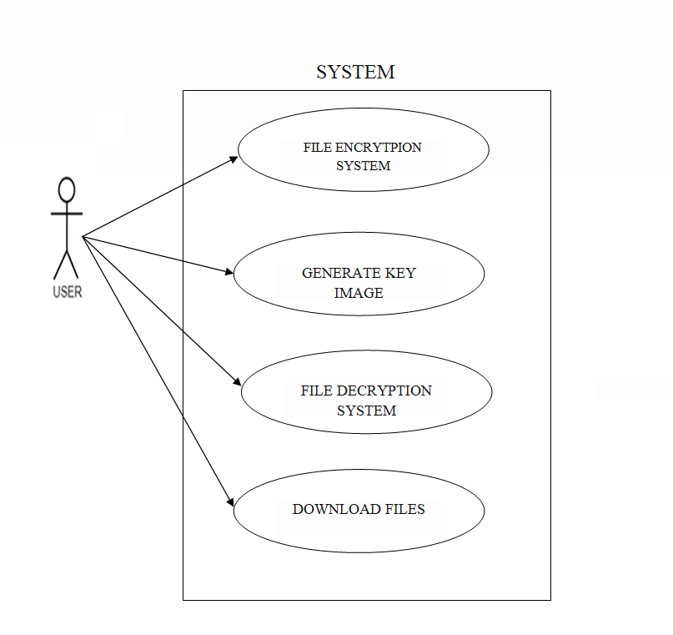
UML Diagrams
1) USECASE DIAGRAM:

Slide 14
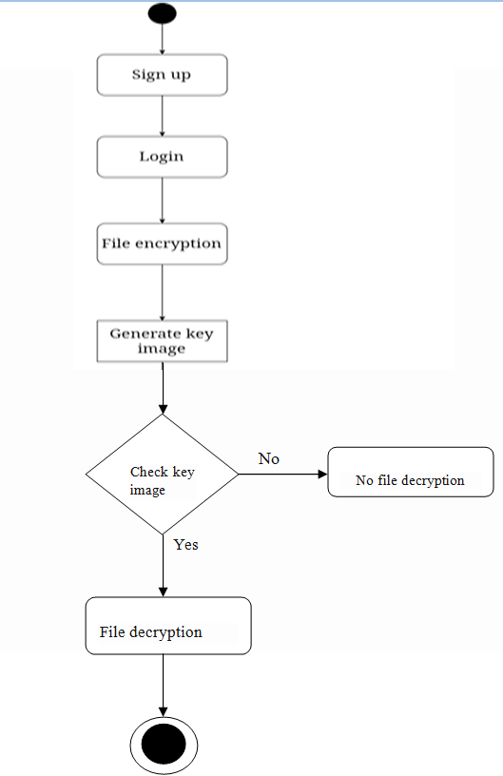
2) ACTIVITY DIAGRAM

Slide 15
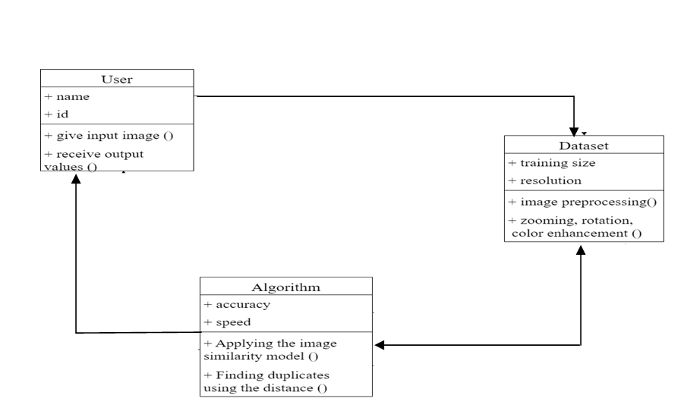
3) CLASS DIAGRAM

Slide 16
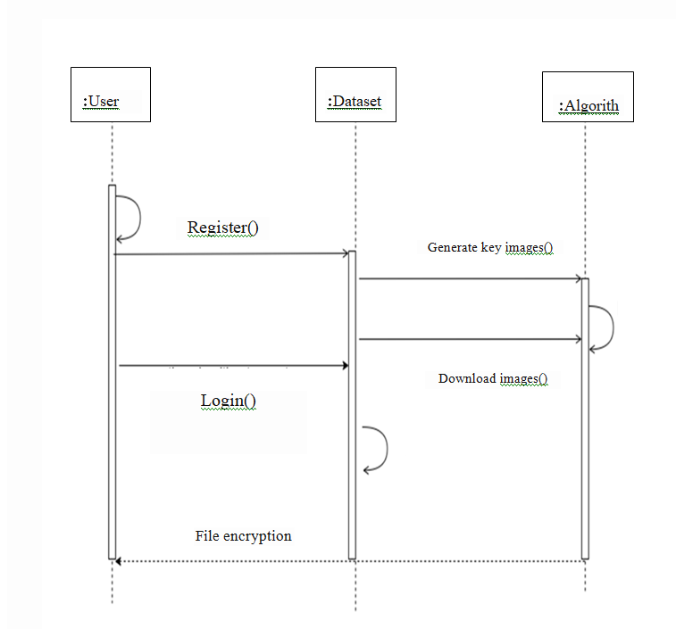
4) SEQUENCE DIAGRAM
:
:

Slide 17
Algorithm Used
AES stands for Advanced Encryption Standard, which is a widely used symmetric-key encryption algorithm. It was selected as the standard for encryption by the US National Institute of Standards and Technology (NIST) in 2001 after a long process of evaluation and analysis.
The AES algorithm uses a symmetric-key approach, which means that the same key is used for both encryption and decryption. It uses block cipher, which means that the algorithm takes a fixed-length block of plaintext and encrypts it into a corresponding ciphertext block of the same length.
AES has three key sizes: 128-bit, 192-bit, and 256-bit. The larger the key size, the stronger the encryption. AES has become the standard encryption algorithm for many applications, including secure communications, digital rights management, and financial transactions. It is widely used in software, hardware, and even in some operating systems to secure data

Slide 18
The AES module in the Crypto.Cipher package provides an implementation of this algorithm.The get_random_bytes function from the Crypto.Random module is used to generate a secure random key of a specified length.
generate_key(filename): this function generates a random key, converts it to a grayscale image, saves the image as a PNG file, and returns the path to the saved file.
encaes(data_file, filename):The data is encrypted using the encrypt_and_digest() method of the AES cipher object. The resulting ciphertext and tag are stored in the ciphertext and tag variables, respectively.
decaes(data_file, filename):this function allows you to decrypt a file that has been encrypted using the encaes function and restore it to its original state.

Slide 19
Testing
Testing is a method to check whether the actual software product matches expected requirements and to ensure that software product is defect free. It involves execution of software/system components using manual or automated tools to evaluate one or more properties of interest. The purpose of software testing is to identify errors, gaps or missing requirements in contrast to actual requirements.
Some prefer saying Software testing definition as a White Box and Black Box Testing

Slide 20
White Box Testing
White Box Testing is a testing technique in which software’s internal structure, design, and coding are tested to verify input-output flow and improve design, usability, and security. In white box testing, code is visible to testers, so it is also called Clear box testing, Open box testing, Transparent box testing, Code-based testing, and Glass box testing.
We have divided it into two basic steps to give you a simplified explanation of white box testing. This is what testers do when testing an application using the white box testing technique:
STEP 1) UNDERSTAND THE SOURCE CODE
STEP 2) CREATE TEST CASES AND EXECUTE

Slide 21
Integration Testing
Integration Testing is defined as a type of testing where software modules are integrated logically and tested as a group. A typical software project consists of multiple software modules, coded by different programmers. The purpose of this level of testing is to expose defects in the interaction between these software modules when they are integrated.

Slide 22
Black Box Testing
Black Box Testing is a software testing method in which the functionalities of software applications are tested without having knowledge of internal code structure, implementation details and internal paths. Black Box Testing mainly focuses on input and output of software applications and it is entirely based on software requirements and specifications. It is also known as Behavioral Testing.

Slide 23
Test Case
S.No | Requirements | Req.No. | Essential/Desirable | Description | Expected output | Actual output | Result
1. | Register | RS1 | Essential | Password should contain special characters and numbers | The user’s credentials will be registered to the system. | The system will store the user's login information | Success
2. | login | RS2 | Essential | Login credentials are required. | The user will be verified | The system will allow the authentic user to login. | Success
3. | Uploading the file | RS3 | Essential | Uploading the file for encryption. | The file will be encrypted. | The encrypted file will be stored in the file list. | Success

Slide 24
Test Case
S.No | Requirements | Req.No. | Essential/Desirable | Description | Expected output | Actual output | Result
4. | Encryption | RS4 | Essential | The file will be converted into bytecode by using AES algorithm. | The noise image will be downloaded in the system. | The key for decryption is generated as noise image. | Success
5. | Decryption | RS6 | Essential | Using noise image to decrypt the file. | Decrypting the file involves uploading the generated key. | Uploading the generated key to decrypt the file. | Success

Slide 25
Conclusion
File encryption is achieved with the use of complex algorithms. If the information contained in a file has been scrambled using an encryption method, the file is said to be encrypted. A scrambled file is unreadable, but there are still many cyber-attacks happening in many ways, posing a threat to the confidentiality of the information. In this work, we addressed noise pictures as the key for file encryption and examined numerous case studies. Experimental results reveal that the suggested noise picture as a key for encryption and decryption procedures is both secure and reliable, opening the door for its use in high-security image communication applications.

Slide 26
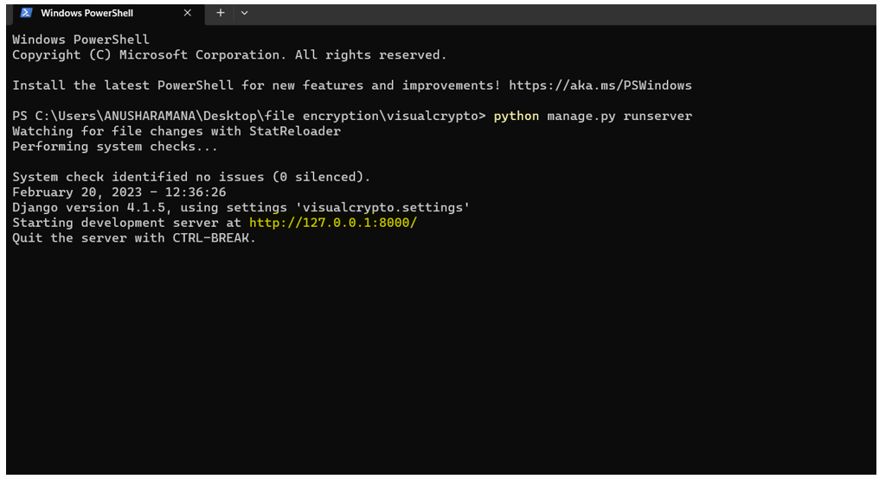
Appendix
Output Screens:

Slide 27
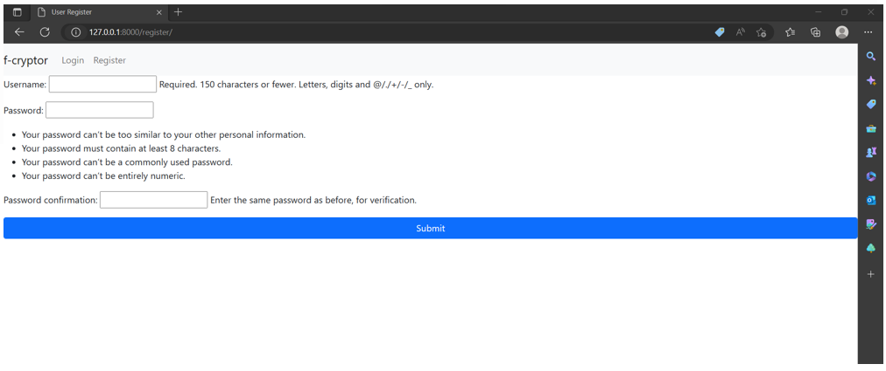

Slide 28
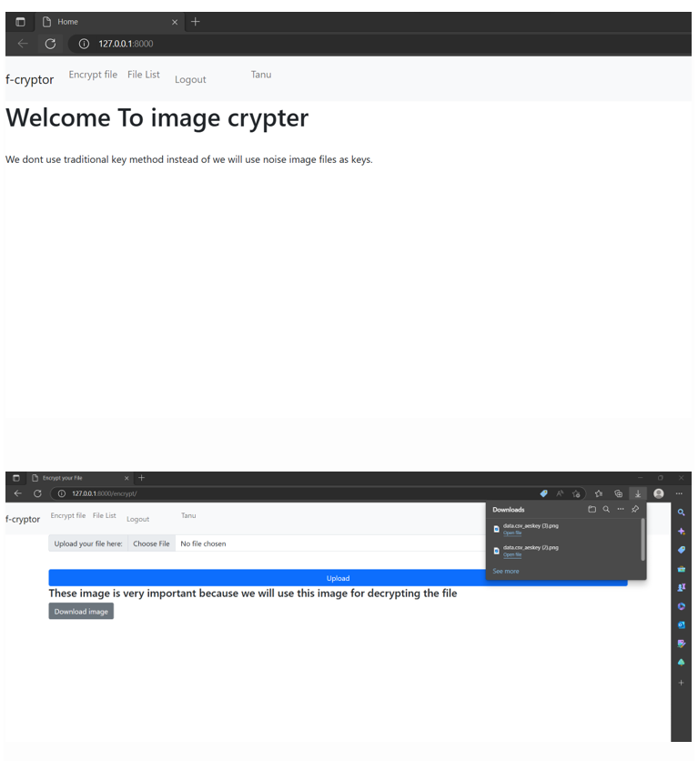

Slide 29
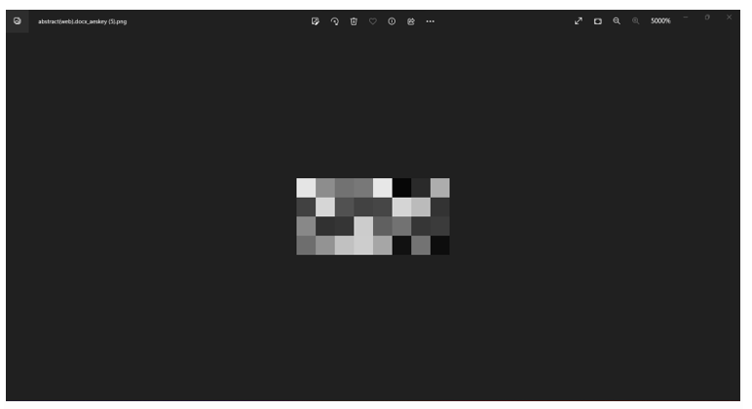

Slide 30
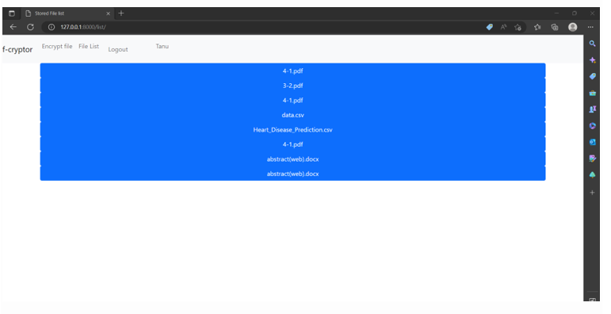

Slide 31
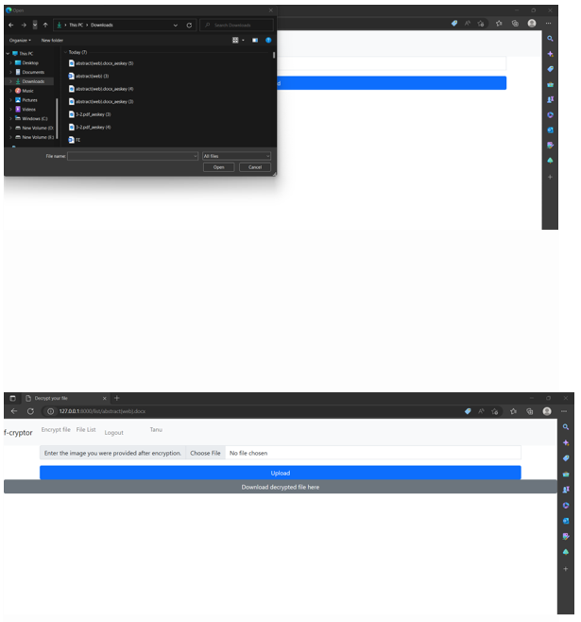

Slide 32
