Slide 1

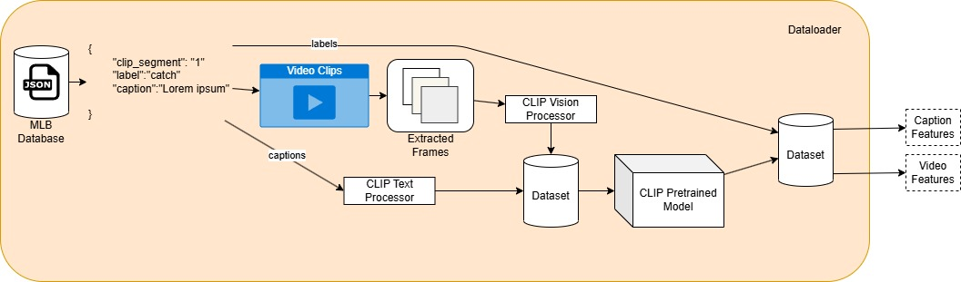
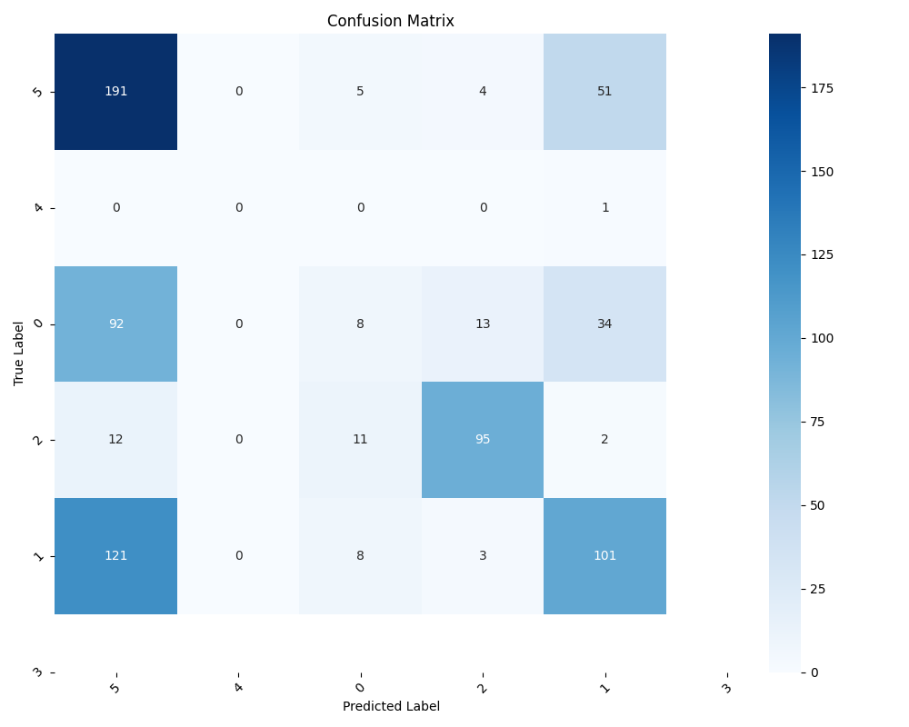
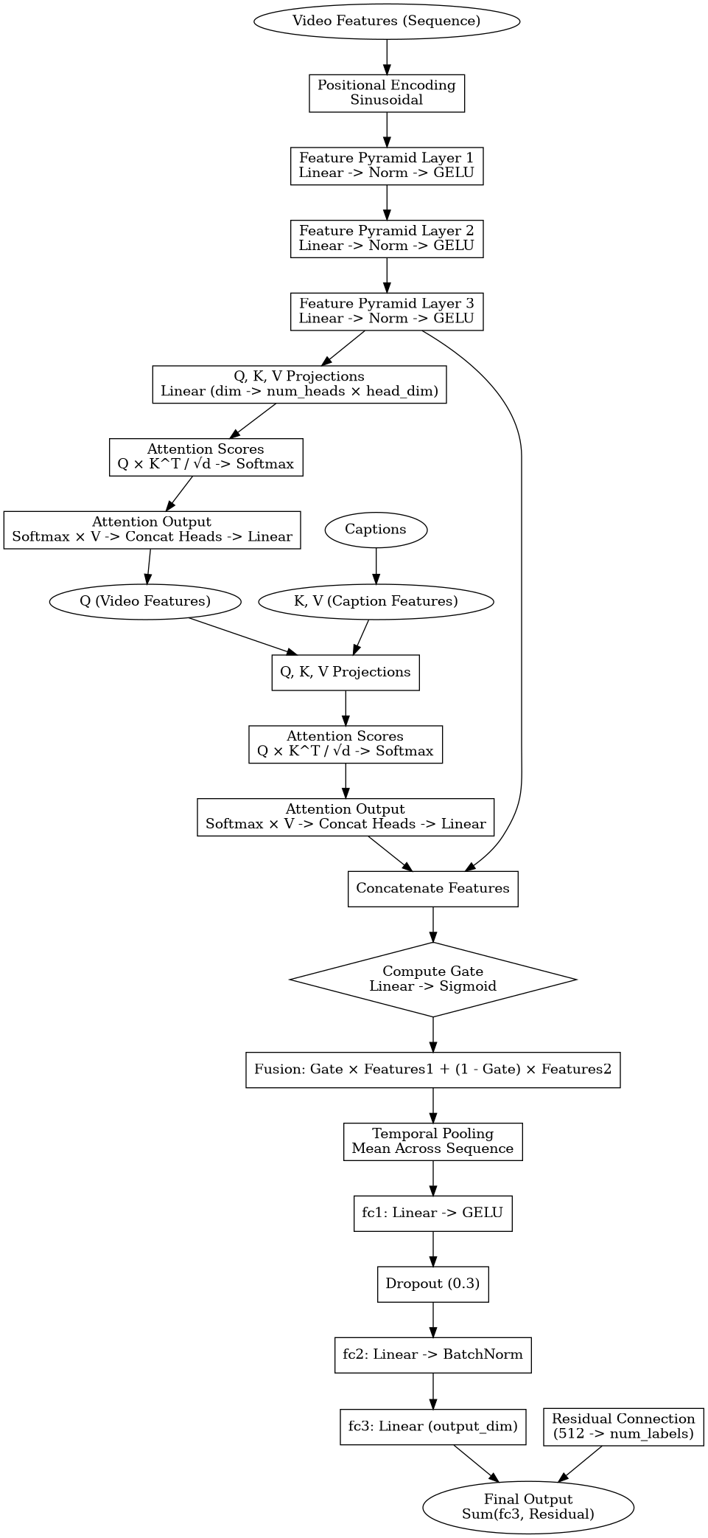

Multi-Modal ML in the MLB : CLIP Classification
Alexander C Yu
Graduate ECE Student
Abstract
Methods
Results/Discussion
This study explores the use of CLIP, a state-of-the-art multimodal pre-trained model for the task of video-text classification using the MLB-YouTube dataset . The dataset includes video segments of baseball games paired with textual captions and labels for predefined event classes. By integrating video and textual features through feature fusion strategies such as attention mechanisms and fine-tuning the CLIP model, this research investigates the efficacy of multimodal learning for sports analytics. The model achieved an accuracy of 0.5253, precision of 0.4995, recall of 0.5253, and an F1-score of 0.4860 on the test set. Despite performing below the baseline accuracy of 0.65 reported for the dataset, the results highlight challenges such as noisy captions and coarse labels. Future directions include improving temporal modeling, addressing caption noise, and leveraging domain-specific pretraining for enhanced performance.
Class 0 (Foul): correctly classified only 8 times.
Class 1 (In Play): The In Play class was correctly classified 101 times.
Class 2 (Ball): The model correctly predicted the Ball class 95 times
Class 3 (Bunt): The model did not classify anything in the test set as a bunt and did not have a representation at all in the set.
Class 4 (Hit by Pitch): The Hit by Pitch class was never correctly classified and was represented once.
Class 5 (Strike): The model correctly predicted the Strike class 191 times.
Background
Current methods for sports event classification rely heavily on supervised learning, which necessitates large datasets of labeled video and audio clips. The primary challenges with this approach include:
Manual Labeling: The need for human annotators to manually label vast quantities of video data makes the process expensive and prone to errors. Moreover, it becomes impractical for large-scale, real-time applications, where the volume of content exceeds the capacity for manual annotation.
Event Complexity: MLB events often involve subtle visual and contextual differences that are difficult to capture using traditional labeling techniques. For example, distinguishing between various pitch types (e.g., fastball vs. curveball) or identifying fielding actions such as a "double play" or a "strikeout" requires domain-specific expertise that is not easily captured in generic labels.
Data Scarcity: While sports data is abundant, labeled datasets are often sparse and insufficient for training deep learning models. In domains like MLB, where nuance plays a critical role, creating comprehensive labeled datasets is particularly challenging.
Future Directions
Data Augmentation
Label Granularity
Caption Refinement
Model Optimization
Notes:
feel free to change background colors & text boxes and use sections for difference purposes!

