Slide 1
Face Mask Detection Alert System Using Keras and Tensor-Flow

Slide 2
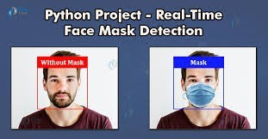
ABSTRACT
1.
The end of 2019 witnessed the outbreak of Coronavirus Disease 2019 (COVID-19),which has continued to be the cause of plight for millions of lives and businesses even in 2020. Corona virus disease 2019 has become a major health problem
Studies have proved that wearing a face mask significantly reduces the risk of viral transmission as well as provides a sense of protection. So to overcome this problem we required an efficient mask monitoring system
By the development of machine learning and image processing analysis many face detection algorithms are introduced. By using image processing analysis and machine learning method we can implement mask
detection technique.
Fig 1: Face Mask detection

Slide 3
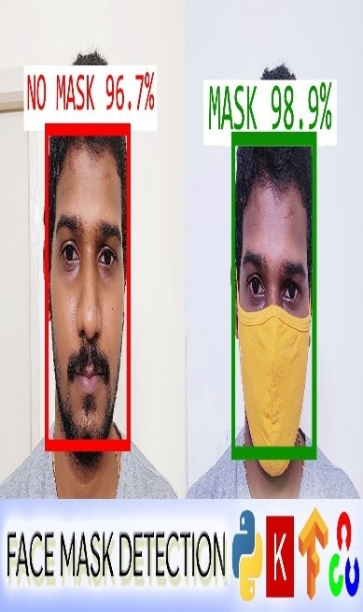
INTRODUCTION
2.
Rapid advancements in the fields of Science and Technology have led us to a stage where we are capable of achieving feats that seemed improbable a few decades ago.
Technologies in fields like Machine Learning and Artificial Intelligence have made ow lives easier and provide solutions to several complex problems in various areas.
Face mask detection is a challenging task. It has been receiving more and more attention in this era due to the spreading of corona virus disease.

Slide 4
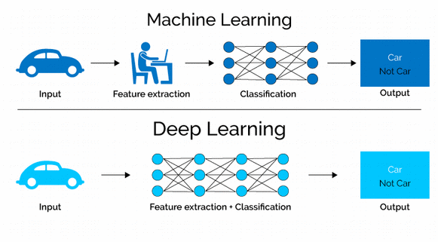
DEEP LEARNING
3.
➢
Deep learning is a particular kind of machine learning that
achieves great power and flexibility by learning to represent the world as a nested hierarchy of concepts.
➢
Deep learning is an AI function that mimics the workings of the human brain in processing data for use in detecting objects, recognizing speech, translating languages, and making decisions.
Fig 3: DEEP LEARNING

Slide 5
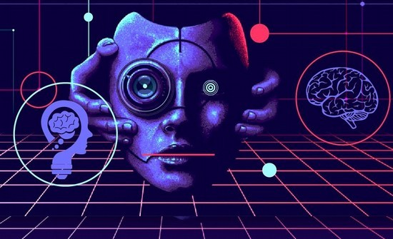
COMPUTER VISION
4.
➢
Computer Vision, often abbreviated as CV, is defined as a field of study that seeks to develop techniques to help computers “see” and understand the content of digital images such as photographs and videos.
➢
It largely remains an unsolved problem based both on the limited
understanding of biological vision and because of the complexity of vision perception in a dynamic and
physical
Fig 4: COMPUTER VISION
nearly infinitely varying world.

Slide 6
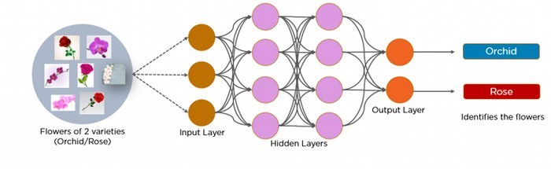
Convolution Neural Network
5.
A convolutional neural network is a feed-forward neural network that is generally used to analyze visual images by processing data with grid-like topology. It’s also known as a Conv-Net. A convolutional neural network is used to detect and classify objects in an image.
A Convolutional Neural Network (CNN) is a Deep Learning algorithm which can take in an input image, assign importance (learnable weights and biases) to various aspects/objects in the image and be able to differentiate one from the other.

Slide 7
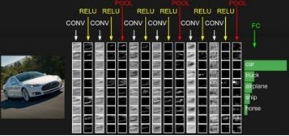
^{6.} Layers in Convolution Neural Network
➢Input Layer: This layer holds the raw input of image
➢Convolution Layer: This layer computes the output volume by computing dot product between all filters and image patch.
➢Activation Function Layer: This layer will apply element wise activation function to the output of convolution layer.
➢Pool Layer: . This layer is periodically inserted in the cov-nets and its main function is to reduce the size of volume which makes the computation fast reduces memory and also prevents from over-fitting
➢Fully-Connected Layer: This layer is regular neural network layer which takes input from the previous layer and computes the class scores and outputs the 1-D array of size equal to the number of classes.
Fig 6: Fully connected layer

Slide 8
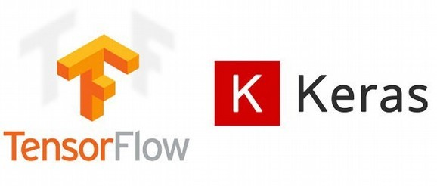
TENSORFLOW KERAS
7.
TensorFlow is a Python library for fast numerical computing created and released by Google.
Tensor-Flow can be used to create Deep Learning models directly or by using wrapper libraries that simplify the process built on top of Tensor-Flow.
Keras is an open-source software library that provides a Python interface for artificial neural networks.
➢
Keras acts as an interface for the
TensorFlow library.
Fig 7: TENSOR FLOW AND KERAS

Slide 9

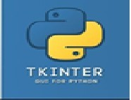
NUMPY AND TKINTER
8.
NumPy is a general-purpose array- processing package. It provides a high- performance multidimensional array object, and tools for working with these arrays.
NumPy is the fundamental package for scientific computing with Python.
Tkinter is the standard GUI library for Python. Python when combined with
Tkinter provides a fast and easy way to create GUI applications.
Tkinter provides a powerful object-
oriented interface to the Tk GUI toolkit.
Fig 6: NUMPY
Fig 8: TKINTER

Slide 10

OPEN-CV
9.
OpenCV-Python is a library of Python bindings designed to solve computer vision problems.
OpenCV is a huge open-source library for computer vision, machine
learning, and image processing. OpenCV supports a wide variety of programming Languages like Python, C++, Java, etc.
It can process images and videos to identify objects, faces, or even the handwriting of a human.
Fig 9: OPEN CV

Slide 11
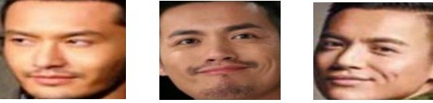
DATA-SETS (WITHOUT MASK)
10.
The data set
consists of 1376 images of faces of different persons.
Out of 1376 and 686 images of persons having no masks.
➢
FIG 10: PERSONS NOT WEARING MASKS

Slide 12
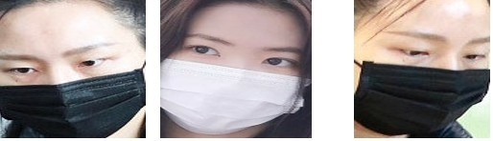
DATA-SETS (WITH MASK)
of
11.
•
Out 1376
images there are 690
images of persons wearing masks
FIG 11: PERSONS WEARING MASKS

Slide 13
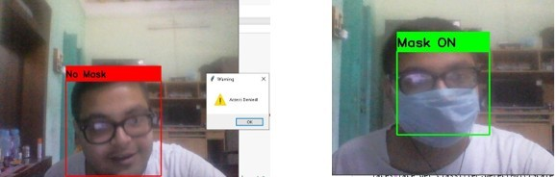
RESULTS
12.
➢We have applied Convolution Neural Network to train the machine so that it can detect whether the person is wearing Mask or not. The machine shows the correct result when it gets an unknown data, that is, the machine has been trained properly.
FIG 12: RESULT OF FACEMASK DETECTOR

Slide 14
CONCLUSION
13.
We have studied the performance of convolutional neural networks in image classification. We found that CNN architectures are capable of learning powerful features from weakly-amount and label of dataset that far surpass feature based methods in performance and that these benefits are robust to details of the hardware of the architectures in time.
Our training results indicate that while the performance is highly sensitive to the architectural details and hardware configuration, especially with GPU processor. However the confidence level is not too much in difference, with only around 0.5% between both scenarios, which in return does not indicate differences in testing result.

Slide 15
FUTURE WORK
14.
This study is very limited and
need broader context of images or videos
specification. Future work such as face directions from 180 degrees horizontal or vertical direction, camera distances, higher resolution for real life industry use cases.
The use of Machine Learning in the field
➢
of mobile deployment is rising rapidly. Hence, we plan to port our models to their respective Tensor-Flow lite versions

Slide 16
THANK YOU

