Slide 1
“A continuum of physics-based lithium-ion battery models reviewed”
By
Brosa Planella et al.
MENG 7891
Battery & Fuel Cell Fundamentals
Presenting by
Khaleda Akter
Notes:
Good morning.

Slide 2
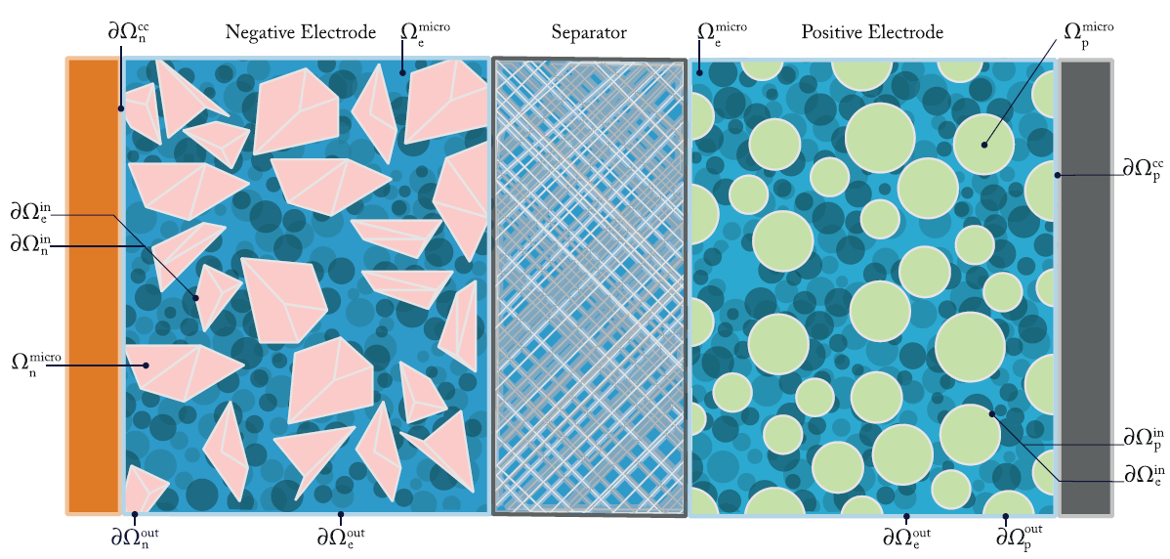
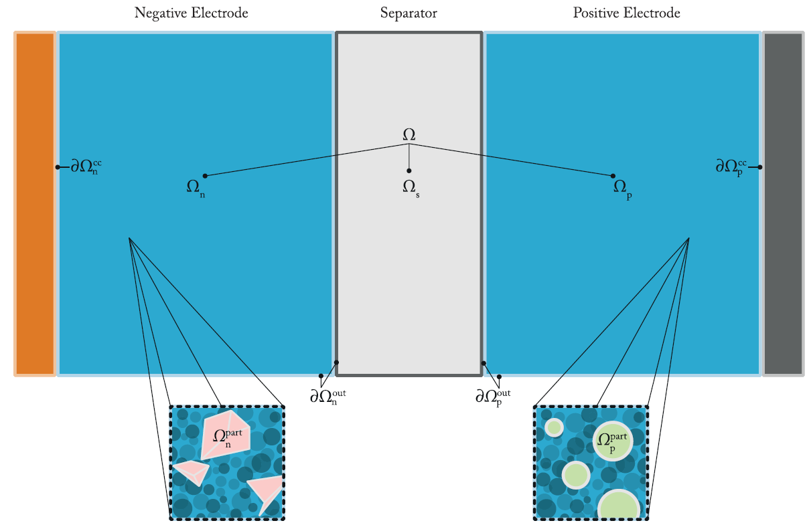
Overview of physics-based Lithium-Ions Battery Models
It provides detailed representations of each component, including electrode particles, electrolyte-filled pores, and conductive binders.
It can model lithium transport, charge conservation, and electrochemical reactions with spatial accuracy.
Computationally expensive
It simplifies the complex microscale geometry (like individual particles and pores) into a continuum represent
- This allows for capturing average properties of the porous electrodes and electrolyte without explicitly modeling every particle.
Key parameters includes effective diffusivity (De), effective conductivity (σe), porosity (ε), surface area (b).
Reduces Computational Cost
Microscale Model
Homogenized Model
Notes:
which incorporates detailed representations of each component, including electrode particles, electrolyte-filled pores, and conductive binders. Although this model is the most detailed, it is also computationally expensive.

Slide 3
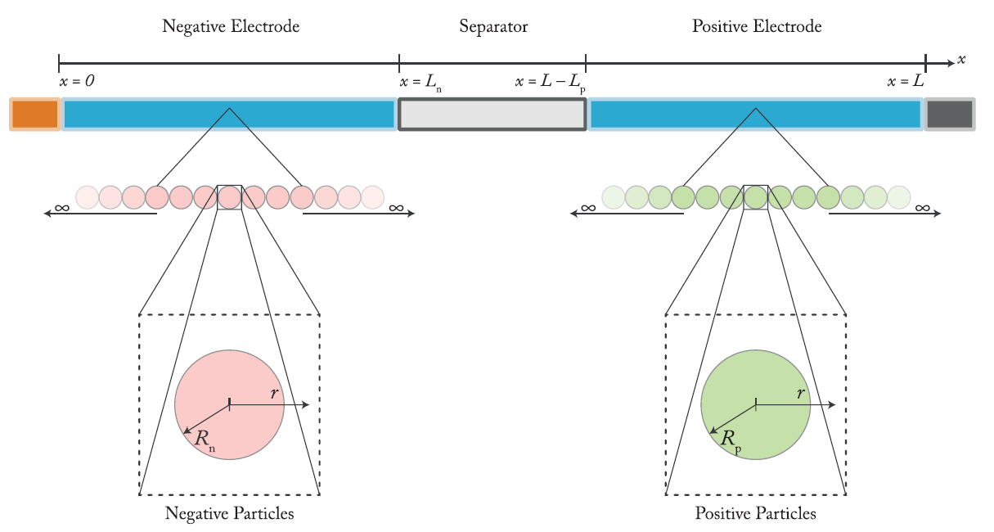
Overview of physics-based Lithium-Ions Battery Models
DFN(Doyle-Fuller-Newman) Model
It simplifies the 3D complexity of a battery’s internal microstructure into a 1D domain that spans across the thickness of the cell.
Within the electrodes, the model assumes a homogenized porous structure, where the active material particles are treated as uniformly distributed and spherical.
This assumption allows the model to capture solid-state lithium diffusion within individual particles and ion transport through the electrolyte and the electrochemical reactions at the interfaces.
DFN model is appropriate for accurate cell-level simulations in research and industry.
Notes:
The Doyle–Fuller–Newman, or DFN, model is one of the most influential and widely used physics-based models for lithium-ion batteries. Developed in the early 1990s, this model represents a major advancement in our ability to simulate and understand battery behavior from a mechanistic perspective. It simplifies the three-dimensional complexity of a battery’s internal microstructure into a one-dimensional domain that spans across the thickness of the cell. This domain is divided into three regions: the negative electrode or anode, the separator, and the positive electrode or cathode. Within the electrodes, the model assumes a homogenised porous structure, where the active material particles are treated as uniformly distributed and spherical. This assumption allows the model to capture solid-state lithium diffusion within individual particles and ion transport through the electrolyte and the electrochemical reactions at the interfaces.
These reactions are governed by the Butler–Volmer equation, which links the overpotential at the interface to the current density produced by the reaction. In addition to electrochemical kinetics, the model solves for conservation of charge in both the solid and electrolyte phases.
The DFN model’s accuracy and comprehensiveness make it ideal for high-fidelity simulations. It’s used extensively in cell and pack-level simulations, thermal management, internal state estimation, and even degradation analysis

Slide 4
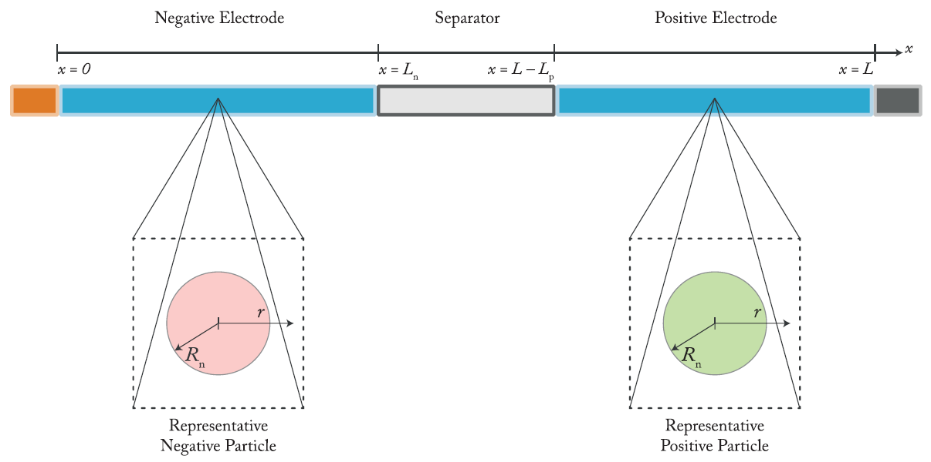
Overview of physics-based Lithium-Ions Battery Models
SPMe Model (Single Particle Model with Electrolyte)
A reduced-order physics-based model derived from the DFN model.
simplifies each electrode by representing it with a single spherical particle.
. These particles capture the lithium diffusion within the solid phase, solving a radial diffusion equation that reflects intercalation and deintercalation processes during battery operation.
It is a simplified version of SPMe
It neglects the potential drops across the electrolyte.
It can be applied with relative accuracy
Ideal for embedded systems or rapid prototyping
SPM Model

Slide 5
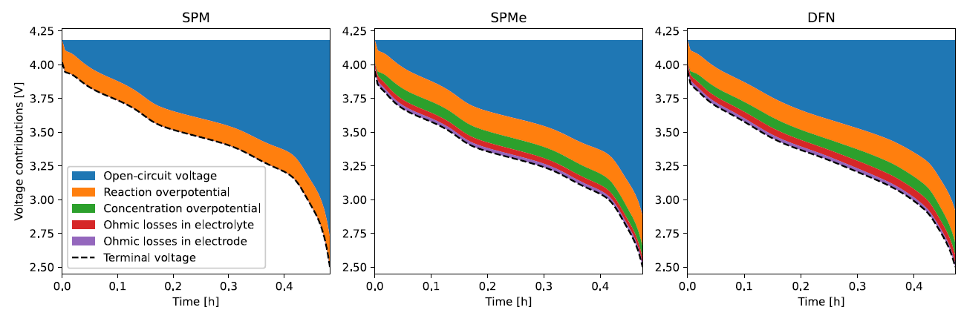
Contributions to the Terminal Voltage with 2C Discharge
SPM
Only includes OCV and reaction overpotential
Assumes ideal transport and no resistive losses
Terminal voltage is overestimated
SPMe :
Includes electrolyte dynamics and ohmic losses
Accounts for concentration gradients and resistances
Terminal voltage matches DFN closely
DFN:
Full physics-based model
Captures all loss mechanisms accurately
Used as reference standard

Slide 6
Coupled Thermal-Electrochemical Models of Lithium-Ions Battery
Why it matters
- As batteries operate, they generate heat. This heat affects how fast ions move, how much energy is lost, and how quickly the battery degrades. If the battery gets too hot or too cold, it won’t perform well or might even become unsafe.
- To simulate real battery behavior more accurately, thermal model is combined with the electrochemical model.
The thermal model tracks how heat moves and changes in the battery
The electrochemical model which tracks lithium-ion movement and reactions.
How it works
Modeling Approaches
Fully Coupled Model – Detailed but computationally heavy. It treats temperature as a variable that influences all battery processes in real-time.
Lumped Model – Simpler and faster. It assumes the whole battery has the same temperature and estimates heat based on total energy input and losses.
Notes:
This is a modified version of microstructure model

Slide 7
Thank You.

