Slide 1
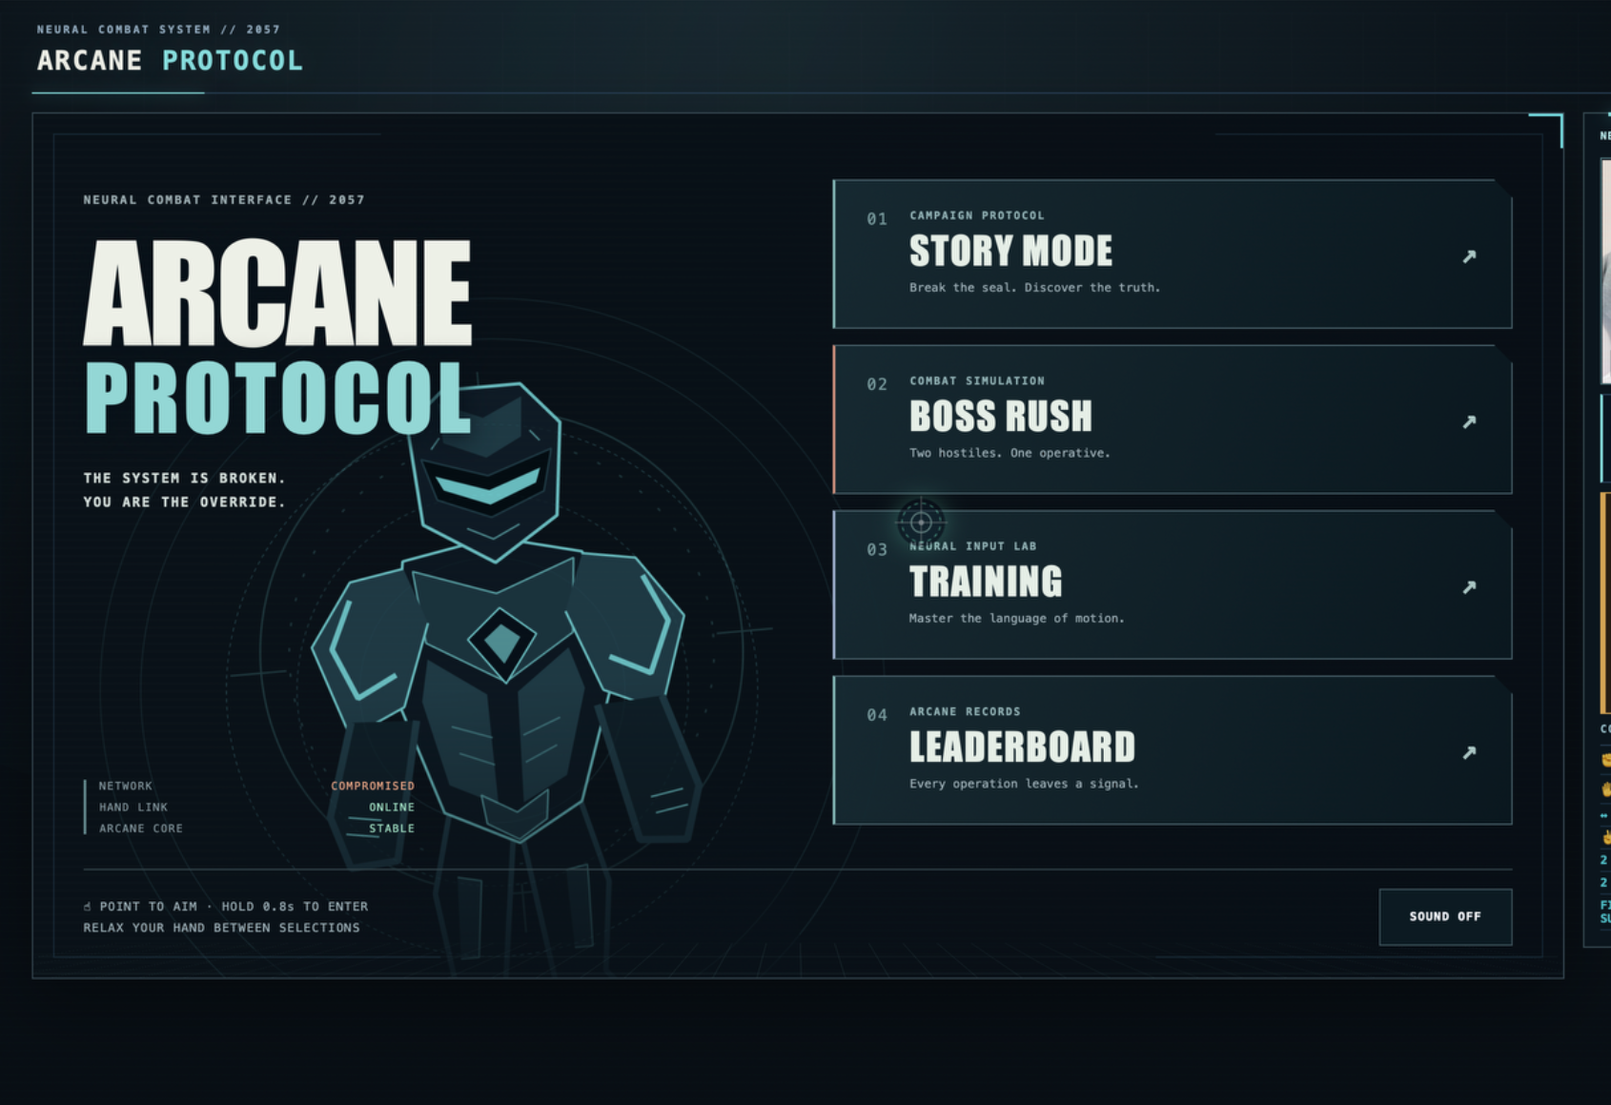
TEAM APEX // MOTION 2026
ARCANE PROTOCOL
ARCANE
PROTOCOL
Gesture-controlled cyberpunk browser game
The webcam becomes the controller — no keyboard or mouse needed for gameplay.
3
6+
2
PLAYABLE HEROES
GESTURES
BOSS FIGHTS
Team Apex
Syrymbet • Mansur
Live main menu — POINT + dwell navigation
LIVE
arcane-protocol.vercel.app
GITHUB
github.com/ka19550218-debug/arcane-protocol

Slide 2
TEAM APEX // MOTION 2026
ARCANE PROTOCOL
01 — THE CHALLENGE
Motion case: turn real body movement into a complete browser experience.
CASE REQUIREMENTS
Real-time movement recognition from a normal webcam.
At least 3 gestures, each mapped to a different action.
Clear feedback showing what the system recognized.
A complete scenario from movement to visible result.
Our answer: a complete game, not a gesture demo.
Story Mode • Boss Rush • Training • Leaderboard
01
MOVE
02
RECOGNIZE
03
REACT
04
RESULT
Team Apex • Syrymbet • Mansur
arcane-protocol.vercel.app
github.com/ka19550218-debug/arcane-protocol

Slide 3
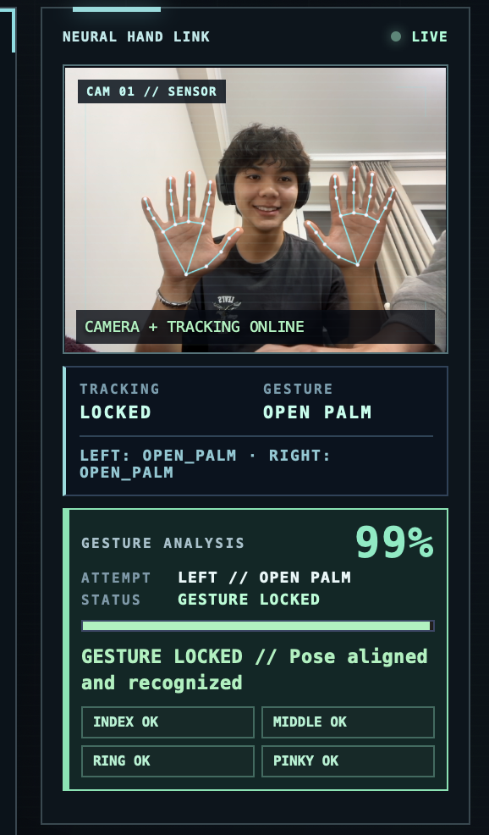
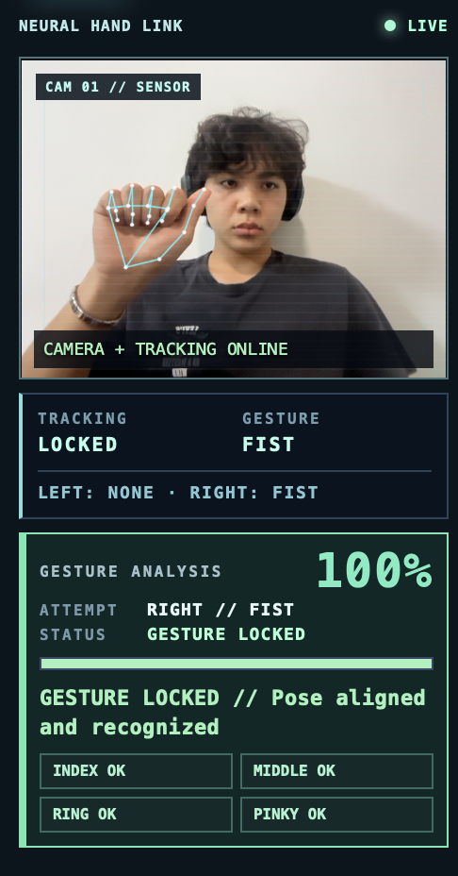
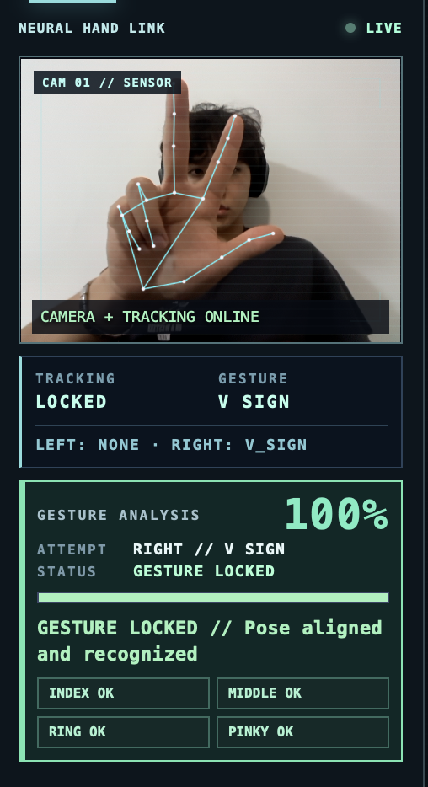
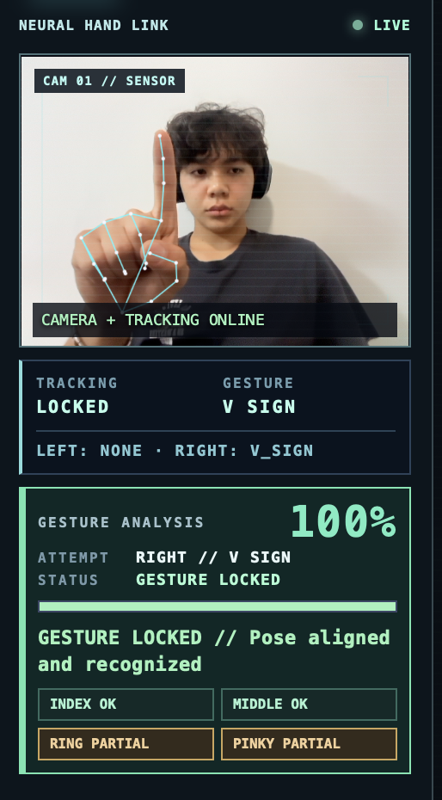
TEAM APEX // MOTION 2026
ARCANE PROTOCOL
02 — GESTURE CONTROL SYSTEM
MediaPipe landmarks + our own gesture rules, quality scoring, stabilization, dwell and combat mapping.
OPEN PALM
FIST
V SIGN
POINT
Defense
Basic attack
Super attack
Cursor + dwell
21 landmarks
→ finger states
→ gesture classifier
→ temporal stabilization
→ UI / combat action
+ two-hand combos
Team Apex • Syrymbet • Mansur
arcane-protocol.vercel.app
github.com/ka19550218-debug/arcane-protocol

Slide 4
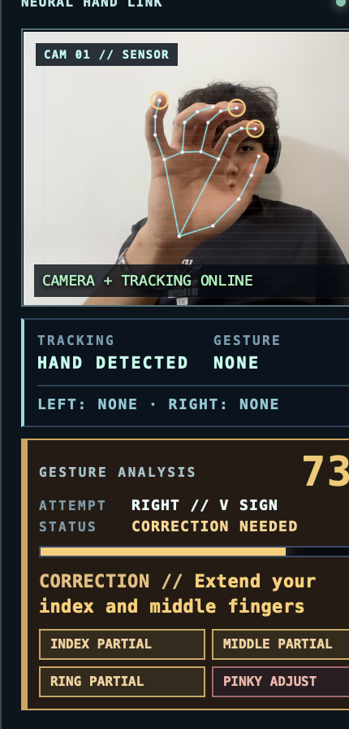
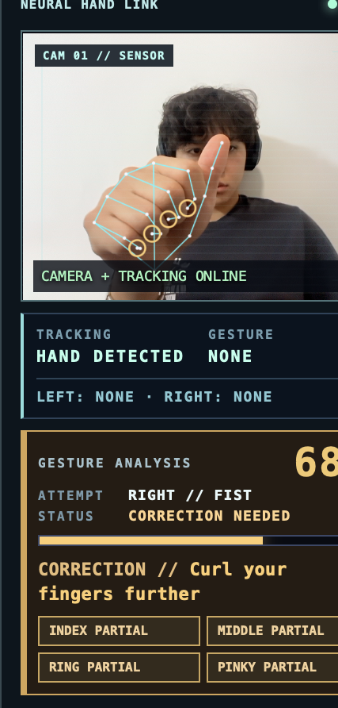
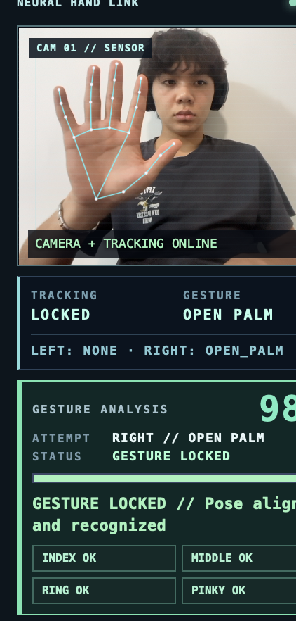
TEAM APEX // MOTION 2026
ARCANE PROTOCOL
03 — ERROR MODE
The required twist: concrete correction instead of “gesture not recognized”.
WHY THIS MATTERS
Specific correction
The system tells the player what to change — not just that the pose failed.
Finger-level feedback
Finger states identify which part of the hand needs adjustment.
Live quality score
Every attempt receives a measurable quality percentage and status.
V SIGN — correction
FIST — correction
OPEN PALM — locked
Team Apex • Syrymbet • Mansur
arcane-protocol.vercel.app
github.com/ka19550218-debug/arcane-protocol

Slide 5
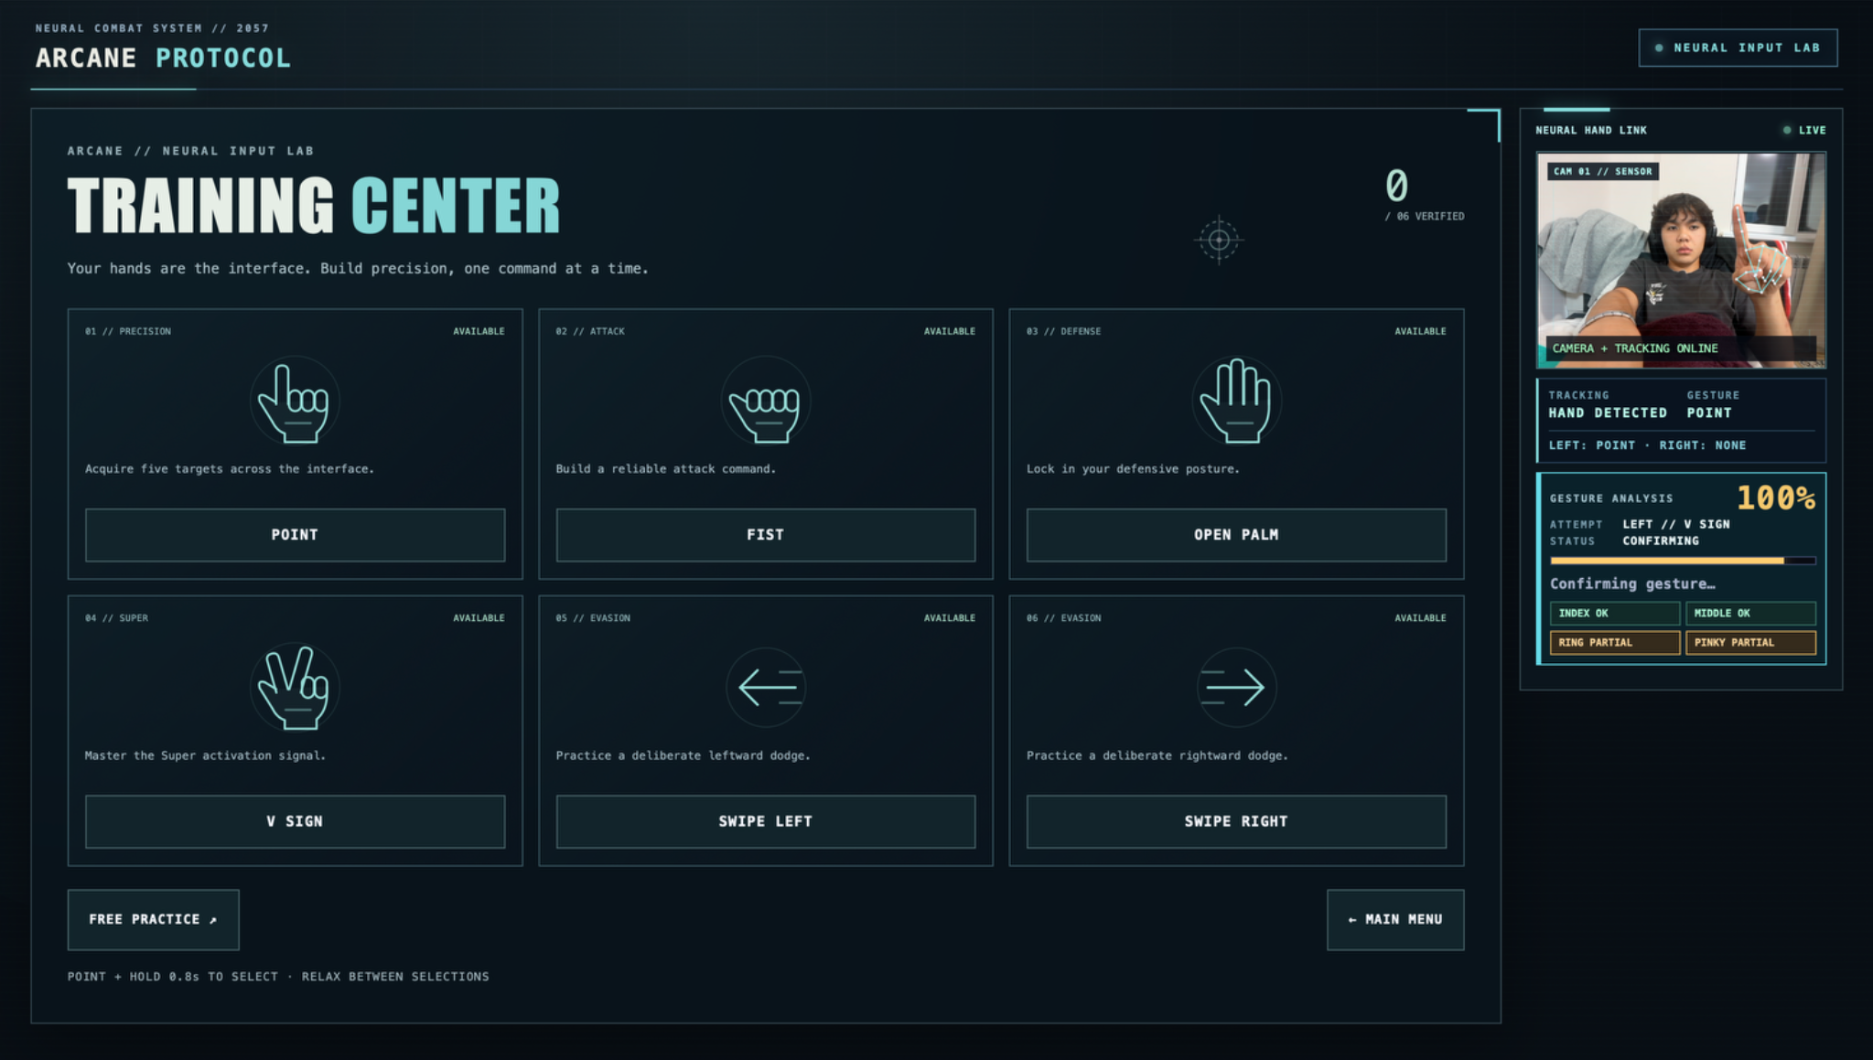
TEAM APEX // MOTION 2026
ARCANE PROTOCOL
04 — TRAINING CENTER
Onboarding that teaches the control language before combat.
6 MODULES
POINT, FIST, OPEN PALM, V SIGN, SWIPE LEFT, SWIPE RIGHT
STABLE REPETITIONS
A gesture must stay valid — one lucky frame is not enough
FREE PRACTICE
Live gesture diagnostics without triggering combat
POINT EXERCISE
Dwell targets teach gesture navigation and cursor control
Six modules + Free Practice
UX value: lowers the learning curve and makes the gesture system easy to demonstrate to judges.
Team Apex • Syrymbet • Mansur
arcane-protocol.vercel.app
github.com/ka19550218-debug/arcane-protocol

Slide 6
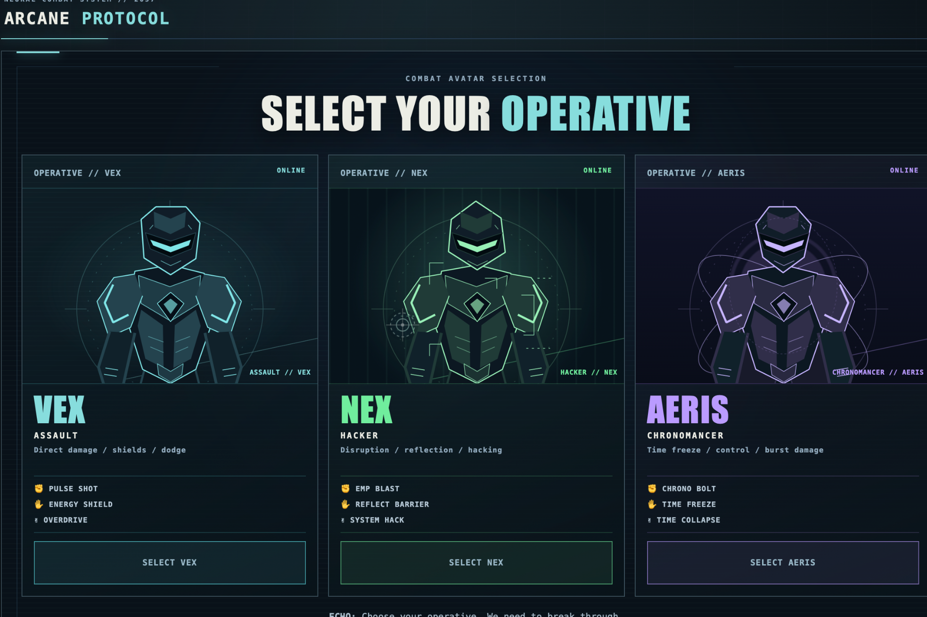
TEAM APEX // MOTION 2026
ARCANE PROTOCOL
05 — MODES & PLAYABLE HEROES
One shared gesture engine, multiple ways to play.
STORY MODE
Full narrative route
BOSS RUSH
Back-to-back boss challenge
TRAINING
Gesture mastery
LEADERBOARD
Local score archive
VEX
Assault • direct damage • shields
Three operatives with distinct ability mappings
NEX • Hacker
AERIS • Time
Team Apex • Syrymbet • Mansur
arcane-protocol.vercel.app
github.com/ka19550218-debug/arcane-protocol

Slide 7
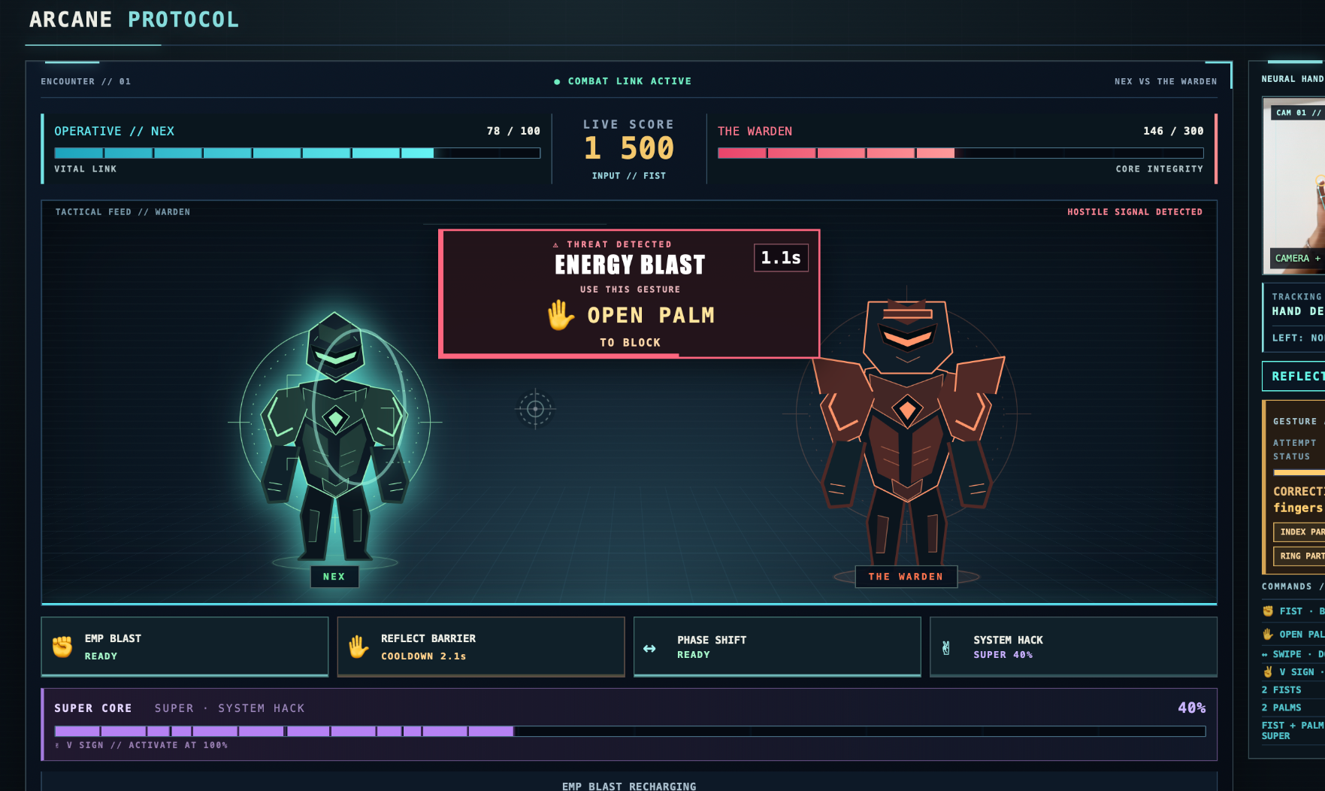
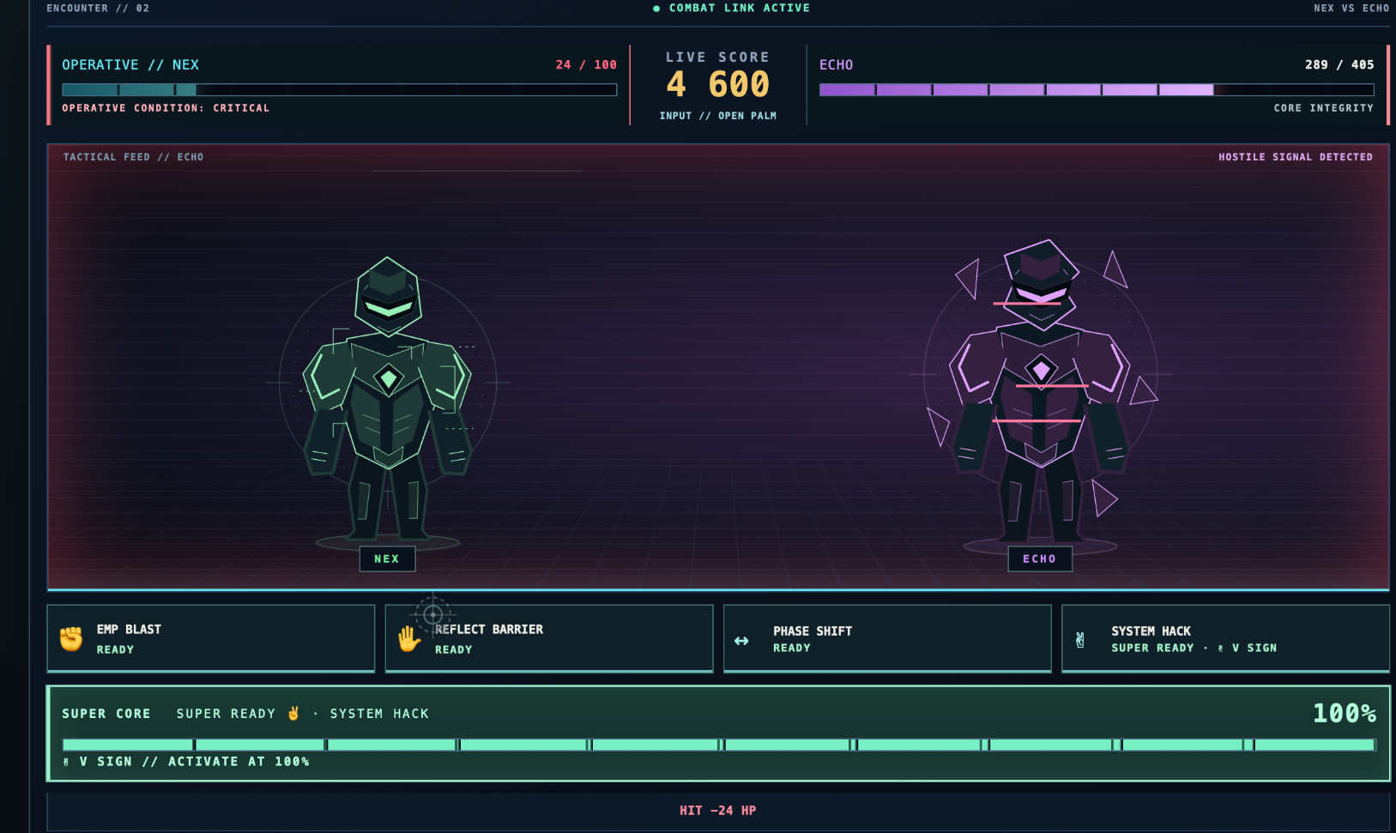
TEAM APEX // MOTION 2026
ARCANE PROTOCOL
06 — COMPLETE COMBAT LOOP
From gesture input to boss fights, score and saved results.
THE WARDEN — contextual threat prompts
ECHO — final corrupted AI encounter
01
SELECT HERO
02
FIGHT WARDEN
03
FACE ECHO
04
SAVE SCORE
Attack • shield • dodge • Super • boss warnings • HP • score • cooldowns • final result
Team Apex • Syrymbet • Mansur
arcane-protocol.vercel.app
github.com/ka19550218-debug/arcane-protocol

Slide 8
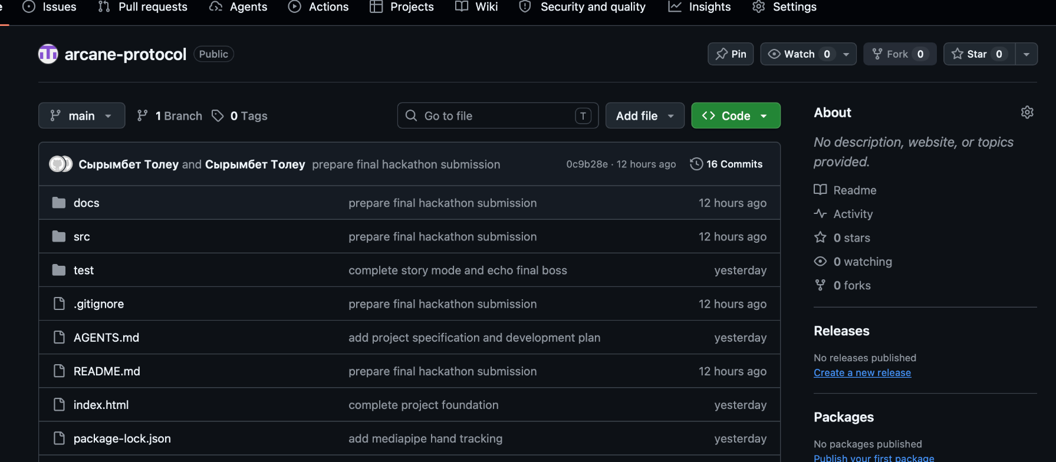
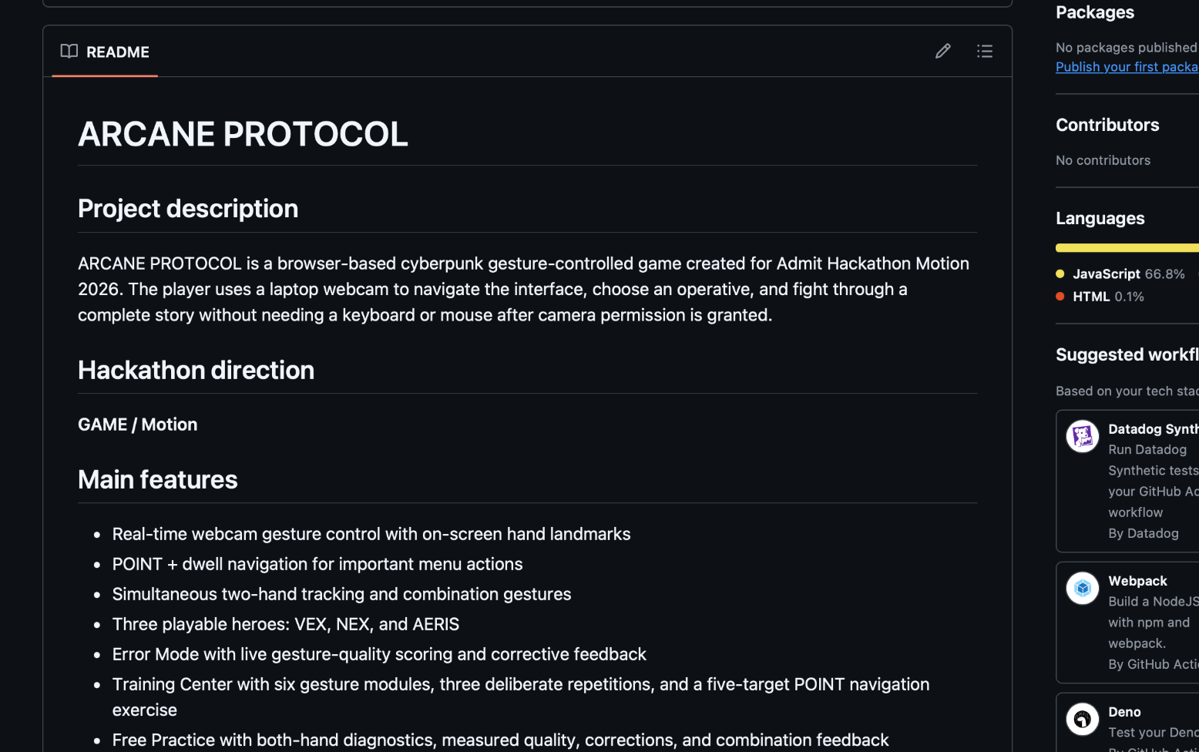
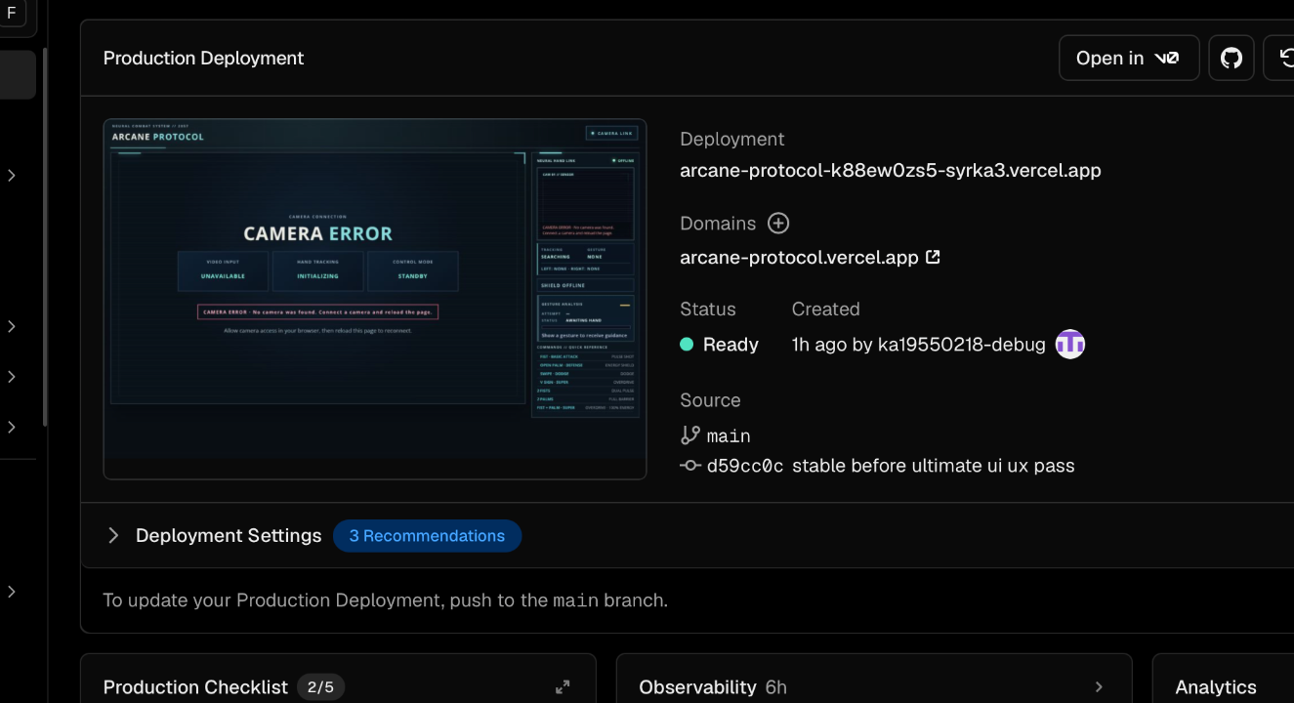
TEAM APEX // MOTION 2026
ARCANE PROTOCOL
07 — TECHNICAL IMPLEMENTATION & DELIVERY
Browser-native stack, public repository, README and live deployment.
TECH STACK
JavaScript / HTML / CSS / Vite
MediaPipe hand tracking
Custom gesture rules + temporal stabilization
Public repository + visible commit history
POINT + dwell virtual cursor
LocalStorage leaderboard / preferences
DELIVERY
Public GitHub • commit history • README • live Vercel deployment
README with feature overview
Production deployment: Ready
Team Apex • Syrymbet • Mansur
arcane-protocol.vercel.app
github.com/ka19550218-debug/arcane-protocol

Slide 9
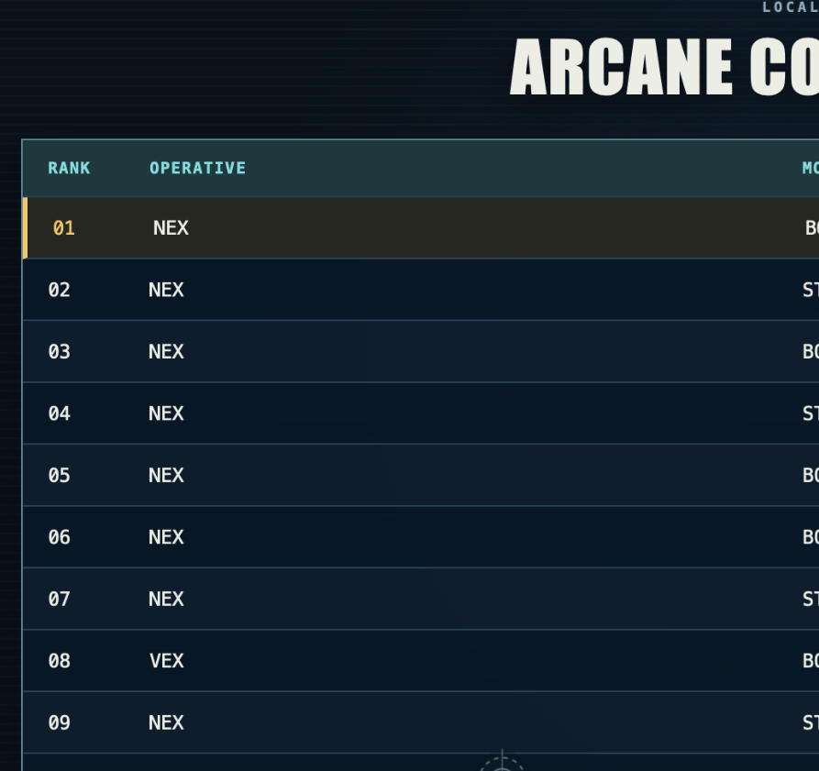
TEAM APEX // MOTION 2026
ARCANE PROTOCOL
08 — CRITERIA COVERAGE
Everything the jury scores is visible in the product.
30
FUNCTIONALITY
6+ gestures, real-time feedback, complete playable browser flow.
20
ERROR MODE
Specific correction, quality score, finger-level guidance.
20
TECHNICAL
Structured codebase, own gesture rules, public GitHub + README.
15
UX & DESIGN
Training, gesture cursor, contextual combat hints, cohesive cyberpunk UI.
Bonus: leaderboard
10
ORIGINALITY
Webcam-controlled cyberpunk RPG with story, heroes and bosses.
GAME / MOTION
5
BONUSES
Own gesture logic, leaderboard, sound/visual effects, two-hand combos.
The webcam is not just a sensor — it is the game controller for navigation, training and combat.
Team Apex • Syrymbet • Mansur
arcane-protocol.vercel.app
github.com/ka19550218-debug/arcane-protocol

Slide 10
TEAM APEX // MOTION 2026
ARCANE PROTOCOL
LIVE DEMO
A 90-second path that shows the strongest parts of the project.
01
Open live link
Camera + landmarks online
05
Fight Warden
Attack, shield, dodge, Super
02
POINT + dwell
Navigate without mouse
06
Reach ECHO
Story twist / Boss Rush
03
Training Center
Show quality + correction
07
Open leaderboard
Show saved result
04
Choose operative
VEX / NEX / AERIS
THE WEBCAM IS THE CONTROLLER.
Team Apex • Syrymbet • Mansur
LIVE
arcane-protocol.vercel.app
GITHUB
github.com/ka19550218-debug/arcane-protocol
Team Apex • Syrymbet • Mansur
arcane-protocol.vercel.app
github.com/ka19550218-debug/arcane-protocol

