Slide 1
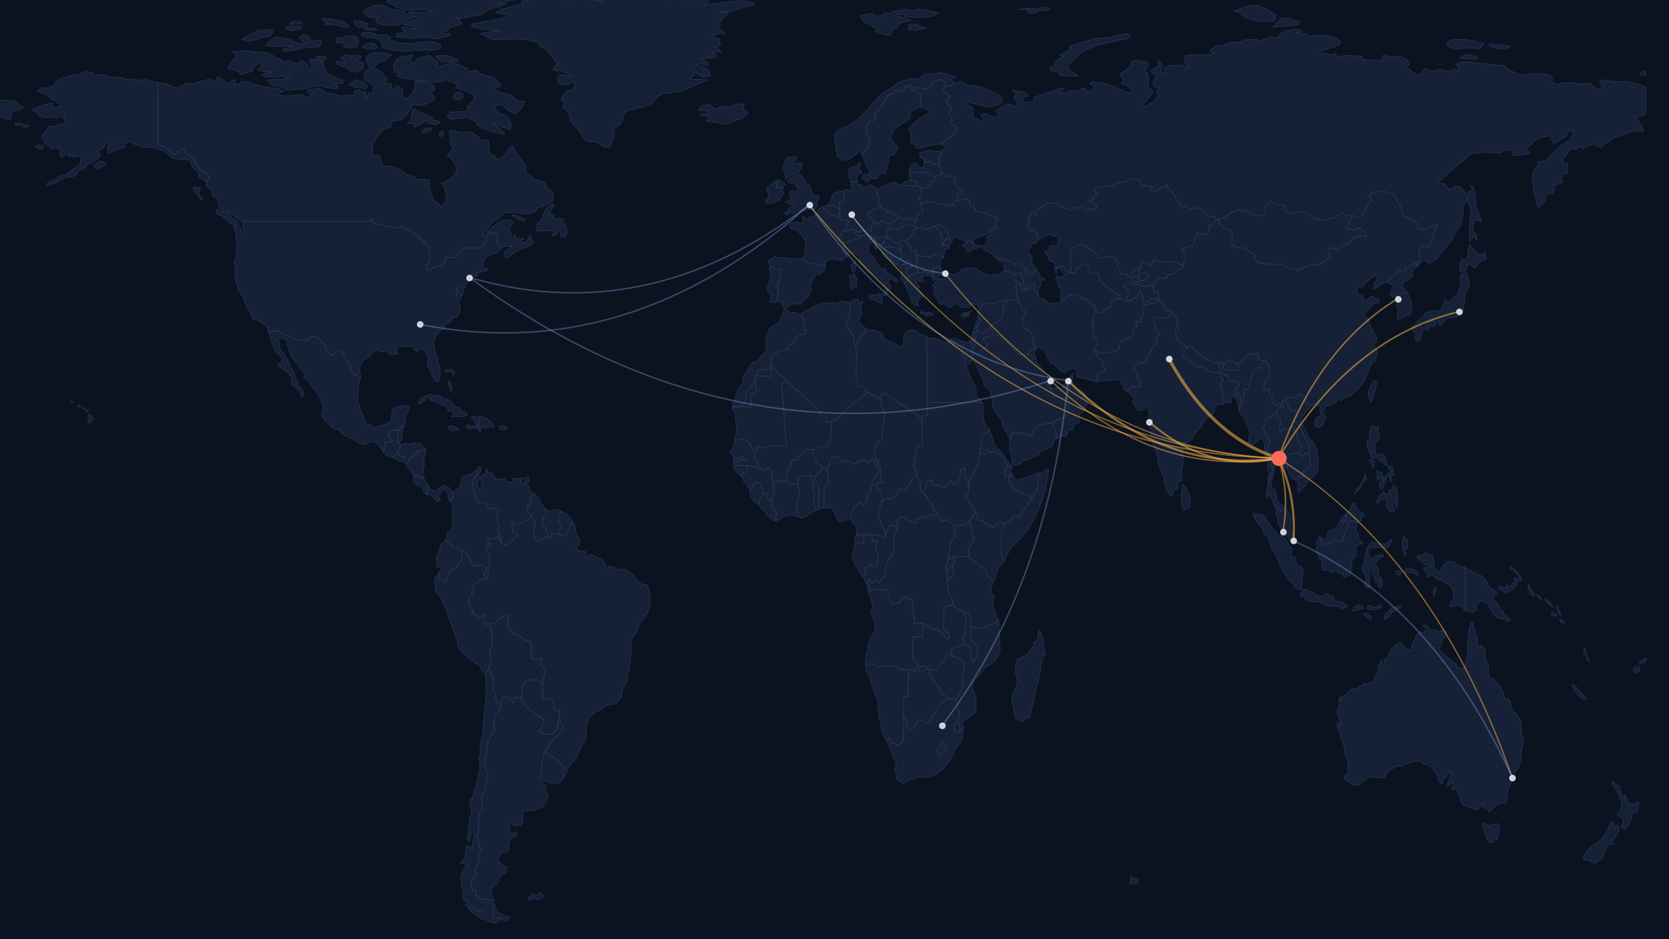
HACKIIITD 2026 · ROUND 1 · OPEN INNOVATION
Team details
EpiRoute
Team name
[Team name]
[Member 1 name] — Team lead
[Role] · [College, year]
[email] · [phone]
Outbreak intelligence that connects live public-health reports to the air-travel network — and shows the probability, the assumptions and the source behind every number.
[Member 2 name]
[Role] · [College, year]
[email] · [phone]
Importation risk
[Member 3 name]
[Role] · [College, year]
[email] · [phone]
Local establishment risk
Sourced outbreak reports
[Member 4 name]
[Role] · [College, year]
[email] · [phone]
Team size 2–4 · edit or delete unused member rows
Map: Natural Earth boundaries; arcs are illustrative, not real traffic.
Notes:
Title + team details (required section). Replace every [bracketed] placeholder before submitting. Product name 'EpiRoute' is a working name.

Slide 2
Outbreak reports and travel data never meet on one screen
Problem statement
Target users
1
Reports are prose, not data
Port & airport health officers, district surveillance teams
WHO Disease Outbreak News has a public API, but case counts, places and dates often sit inside narrative HTML (we checked: its Epidemiology field is frequently empty). Regional and national sources often have no API at all.
Which incoming routes deserve screening attention this fortnight?
2
Maps show where, not who is next
Travel-medicine clinics, university & corporate travel desks
Disease spreads along flight networks. In Brockmann & Helbing's simulated pandemic, network ‘effective distance’ explained arrival times with R² 0.97 vs 0.34 for geographic distance.
What is the sourced situation at a destination, and how fast could it change?
3
Risk is quoted as one opaque score
Journalists, researchers, students
Whether an infected traveller lands and whether an outbreak takes off are different events with different inputs. Merging them hides the assumptions people need to judge them.
A transparent, citable explanation of importation risk instead of a black-box score.
Situational awareness only — not diagnosis, not an official forecast, not individual medical advice. Source: Brockmann D, Helbing D. Science 2013;342:1337 (simulation result). WHO DON API checked 15 Oct 2026.

Slide 3
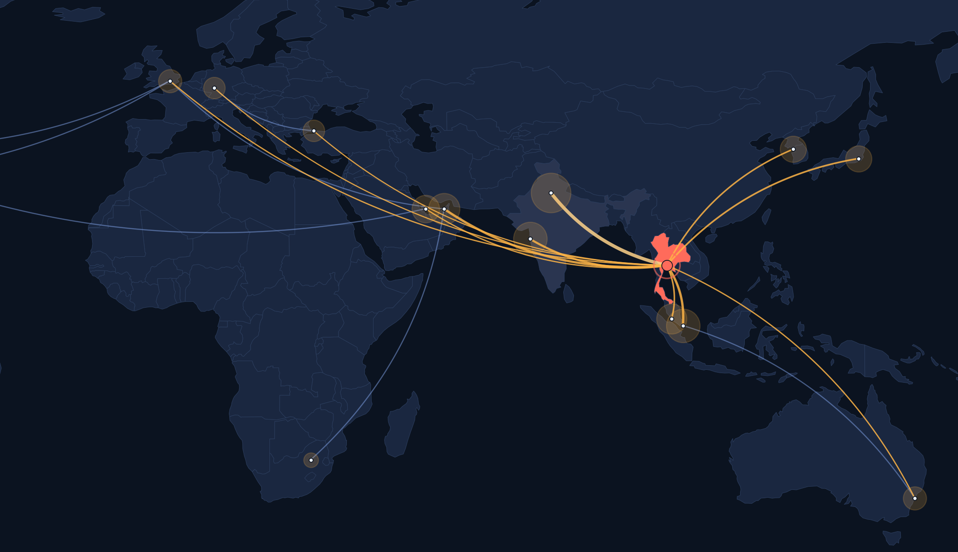
One map: sourced outbreaks, flight links, separate risks
EpiRoute
Pathogen: hypothetical
Horizon: 14 d
Layers: reports · routes · risk
CONCEPT UI · proposed design · illustrative numbers
India · selected destination
No local cases reported · data 2 h old
P(≥1 infected arrival, 14 d)
59%
30–83% · under-reporting 2×–10×
P(sustained local spread, 14 d)
19%
8–34% · R 1.8, k 0.3 (assumed)
Top origin routes: Country A direct · via DXB · via SIN
Screening σ
Reported outbreak (sourced)
Passenger volume
Ring = modelled importation risk
Under-reporting
Via hub (indirect path)
Pick a reported outbreak
See linked routes and hubs
Select a destination country
Move assumptions, watch ranges shift
Notes:
Concept UI built in slides (allowed: Round 1 accepts UI/UX prototypes; no code or deployed links). All numbers are generated by our reference model from illustrative inputs: 300 reported active cases, population 70M, under-reporting 5x (2x-10x band), 6,000 passengers/day, alpha 0.5, sigma 0, R 1.8, k 0.3.

Slide 4
Three probabilities, three different inputs — never one score
Already here?
Will an infected traveller land?
Will it take off locally?
P(present)
P(import, T days) = 1 − e^(−λT)
λ = Σₘ (Iₘ/Nₘ) · Fₘₙ · α · (1 − σ)
P(establish | 1 intro) = 1 − q
q = (1 + R(1 − q)/k)^(−k)
Local case reports + an under-reporting band. Flights are NOT an input — a flight link never implies presence.
Iₘ/Nₘ origin prevalence · F passengers/day · α chance an infectious person still boards · σ screening
Branching process: R reproduction number, k dispersion (cluster-size studies). Vectors / climate decide this for Zika-like pathogens.
Why busy routes ≠ outbreaks
14%
of single introductions establish when R = 2.5, k = 0.1 (COVID-like dispersion). Most chains die out.
Ranking who is next: edge d(m,n) = 1 − ln(Fₘₙ / Fₘ); shortest path over hubs gives effective distance, so Istanbul, Dubai or Singapore transfers count.
Chart: our computation of the Poisson model with α = 0.5, σ = 0 (scenario, not an estimate for any outbreak). Method: briefing note ‘How disease-spread probabilities get their data’ (14 Oct 2026); Brockmann & Helbing, Science 2013; Lloyd-Smith et al., Nature 2005.

Slide 5
How do you plan to integrate the TinyFish API?
TinyFish turns official web pages into validated, sourced records — and fills the model input no free API provides: this week's border-screening policy (σ).
1 Discover
2 Watch
3 Read
4 Extract
Search API
Monitor
Fetch API
Agent API
include_domains: who.int, ecdc.europa.eu, paho.org, africacdc.org · recency filter
Page monitor on WHO DON + ECDC threat-report listings → webhook triggers ingest
Report page → clean markdown/JSON, up to 10 URLs/call, with published_date
POST /v1/automation/run-async with goal + output_schema → pathogen, places, cases, deaths, dates
free
$0.005/run
free ≤1k URLs/day
$0.016/step
Our validation gate — before anything reaches the map
Agent → border-policy flag σ
Grounding check: every extracted number must appear verbatim in the Fetch text, else flagged ‘unverified’
Schema + ISO-3166 country codes, non-negative counts, report date ≤ retrieval date, dedupe by source URL
Provenance on every record: source URL, run_id, retrieved_at, published_at, status
The briefing note says live outbreaks need a manual policy flag (OxCGRT ended in 2022). An Agent run reads official entry-screening / quarantine pages into {measure, date, url}; a human confirms it before σ changes.
Server-side only; API key in env vars, never in the browser or repo. Limits per TinyFish docs/pricing (15 Oct 2026): Agent 2 concurrent runs, new wallets start with $8. TinyFish is an extractor — it is not a source of epidemiological truth or passenger data.

Slide 6
Technical architecture and stack
Sources
Ingest & extract
Validate & store
Model
Serve & show
WHO DON API (JSON)
TinyFish Search · Monitor
Pydantic schemas
Gravity model: seats → passengers
FastAPI JSON endpoints
Official report pages
TinyFish Fetch · Agent
Grounding + dedupe
Effective distance (networkx)
React + TypeScript (Vite)
OpenFlights routes
Bulk CSV loaders
ISO-3 normalisation
Import λ, P(import)
MapLibre GL + deck.gl arcs
BTS T-100 · Eurostat
Scheduler / manual trigger
SQLite + Parquet cache
Branching P(establish)
Scenario sliders · timeline
WorldPop / UN population
Low / central / high bands
OWID · JHU · OxCGRT
Every value carries a type
Works offline
One small service
observed · estimated · modelled · scenario — the UI colours and labels each differently
a cached snapshot of sources lets the demo run if any live API fails
no microservices or paid data; a laptop runs the whole stack

Slide 7
Calibrate on COVID-19, test on outbreaks it never saw
Input | Source | Honest caveat
Live outbreaks | WHO DON API + TinyFish-extracted pages | Narrative counts; reporting lags
Passengers F | BTS T-100 & Eurostat (observed); gravity model elsewhere | No free global O–D bookings → labelled proxy
Route topology | OpenFlights; OpenSky flight counts 2019–22 | Counts flights, not people
Prevalence I/N | OWID / JHU cases ÷ WorldPop or UN population | Testing bias → under-reporting band
Policy σ | OxCGRT (to 2022); TinyFish flag for live | Needs human confirmation
Validation plan (to be run — no accuracy claimed yet)
Fit
COVID-19 first wave: arrival time vs effective distance; fit the passenger coefficient, then freeze it
Test
Delta & Omicron introduction order; H1N1 2009 and SARS 2003 rank correlation, nothing refit
Control
MERS & Ebola: low α must keep international establishment low — if it fires, α is wrong
Better labels than ‘first confirmed case’
Contrast
Zika: high importation, establishment set by mosquito climate, not flights
First official case dates mostly measure who was testing. Where available we use Nextstrain lineage-introduction dates as the arrival label, and we report rank correlation per outbreak — one pandemic cannot prove universal accuracy.
Sources: OWID covid-19-data; JHU CSSE archive; OxCGRT final release; BTS T-100; Eurostat avia; OpenFlights; OpenSky COVID dataset (Zenodo); WorldPop (Huang 2013, Mao 2015); Nextstrain. Plan from the 14 Oct 2026 briefing note.

Slide 8
Scalability, feasibility and use case
P0 · demo in 24 h
P1 · if core works
P2 · after the hackathon
Why it is feasible
Map with real WHO DON records + source links
TinyFish Fetch→Agent extraction with validation gate
Import model with low/central/high bands
Country panel: presence vs import vs establish
Offline cached snapshot
Hub arcs + effective-distance ranking
Gravity-model passenger proxy
TinyFish Monitor webhook ingest
σ policy flags with human confirm
Full COVID calibration + held-out tests
Seats × load factor from live schedules
Sub-national (admin-1) resolution
Licensed O–D bookings if available
Free
every dataset is free; paid feeds are optional upgrades
$8
starter wallet ≈ 500 Agent steps; TinyFish Search and Fetch are free
Offline
cached snapshot keeps the demo alive if APIs fail
How it scales
Countries are nodes and routes are edges (~200 × 200), so recomputing every destination is a sub-second matrix job; new sources are a new extraction goal + schema, not new code.
Use case walk-through
WHO publishes a new outbreak report → Monitor fires → Fetch + Agent extract it → it appears on the map within minutes with its source → an airport health officer selects India, sees the 14-day importation range and the top three origin routes, and drags σ to compare screening options.

Slide 9
Honest by design: safeguards, scenario timeline, roadmap
Safeguards built into the product
Roadmap
Observed, estimated, modelled and scenario values are labelled and coloured differently
No number without inputs: missing data shows ‘not estimable’, never a guess
Ranges, not point values; every assumption is a visible slider
Official WHO / national travel guidance stays the action layer; we link to it
Finale (24 h)
P0 demo with live WHO data and TinyFish ingest
+1 month
COVID calibration and held-out H1N1 / SARS report, published openly
+3 months
Alerts for subscribed destinations; regional sources via new TinyFish goals
Scenario risk-threshold timeline (replaces ‘last safe day to leave’)
References
Import ≥ 50%
Establish ≥ 50%
Local prevalence > reachable places
Brockmann & Helbing. Science 2013;342:1337–42
Lloyd-Smith et al. Nature 2005;438:355–9
Huang et al. PLOS ONE 2013;8:e64317 · Mao et al. J Transp Geogr 2015;48:52–60
WHO DON API: who.int/api/news/diseaseoutbreaknews
OWID covid-19-data · JHU CSSE · OxCGRT · BTS T-100 · Eurostat · OpenFlights · OpenSky · Nextstrain · GLEAM
TinyFish docs: docs.tinyfish.ai (Agent, Fetch, Search, Monitor), accessed 15 Oct 2026
Upper-band inputs (high under-reporting, high R, σ = 0, schedules unchanged) with a user-set threshold. It is a scenario marker, not a safety date; leaving late can export infection to others. Follow WHO and national advisories.

