Slide 1

Selection of an Artist, What matters and what matters the most
ANALYSIS OF DATASET
Group 7
Notes:
How an music artist must be selected, for bes

Slide 2

What music people like?

Slide 3
Let's think
Do you think in choice of music gender of the singer matters?
Do you think you really care about the genre.
Do you think you like music of solo singers or bands (group performances).
What If I tell you in general people really like male bands more than female music bands as per our dataset.

Slide 4
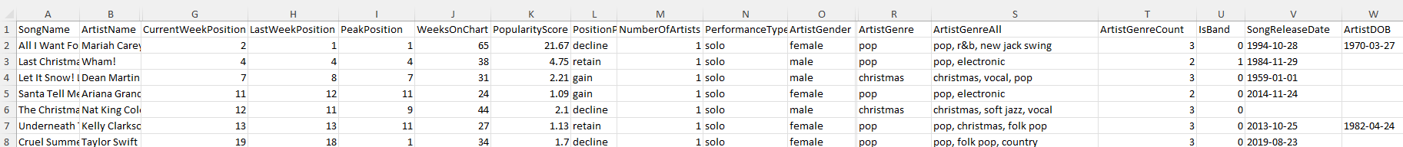
Our Dataset

Slide 5
Intuition behind popularity score (PS)
Popularity Score = Weeks on chart / (Peak position + current week position)

Slide 6
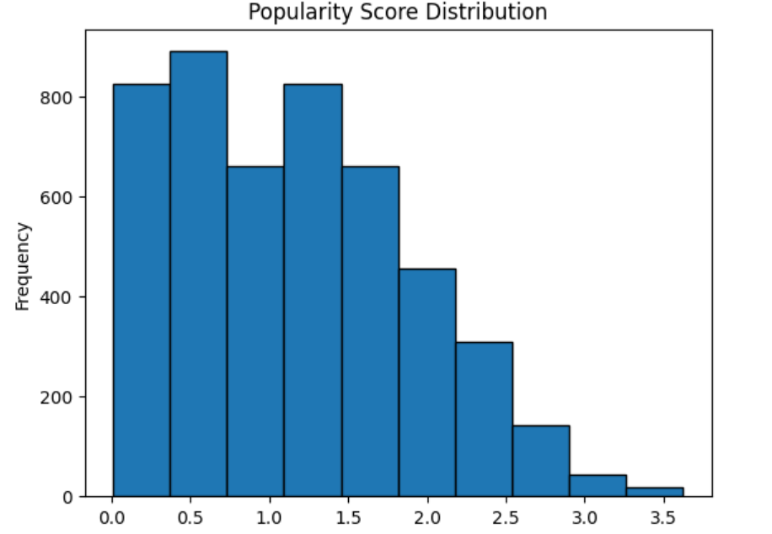
Log transformaiton of PS frequence Distribution
Notes:
Less songs with chance to provide you a hit

Slide 7
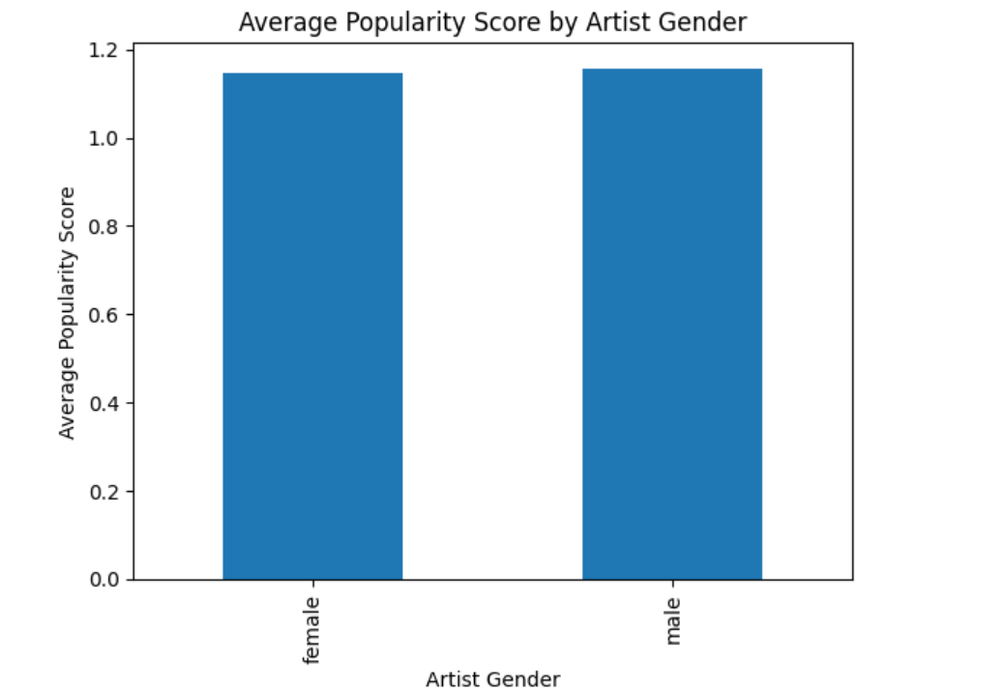
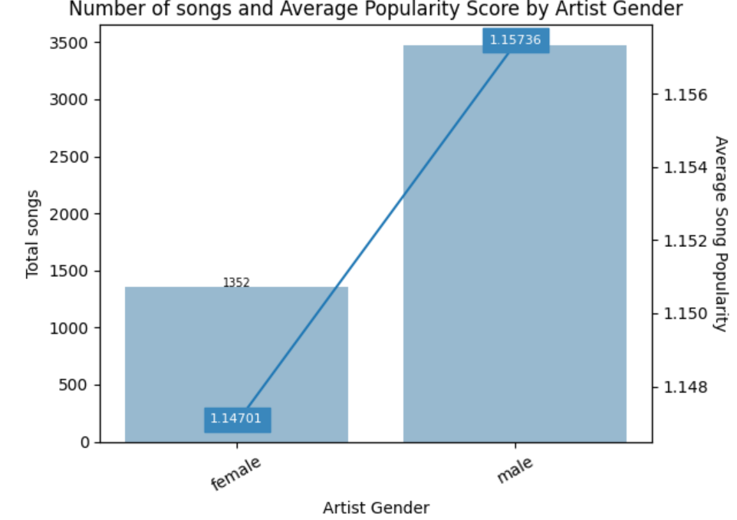
Gender
Notes:
This visuals tell how gender effect the PS. More male singer but gender really does not really alone matter as we have same popularity score
ers

Slide 8
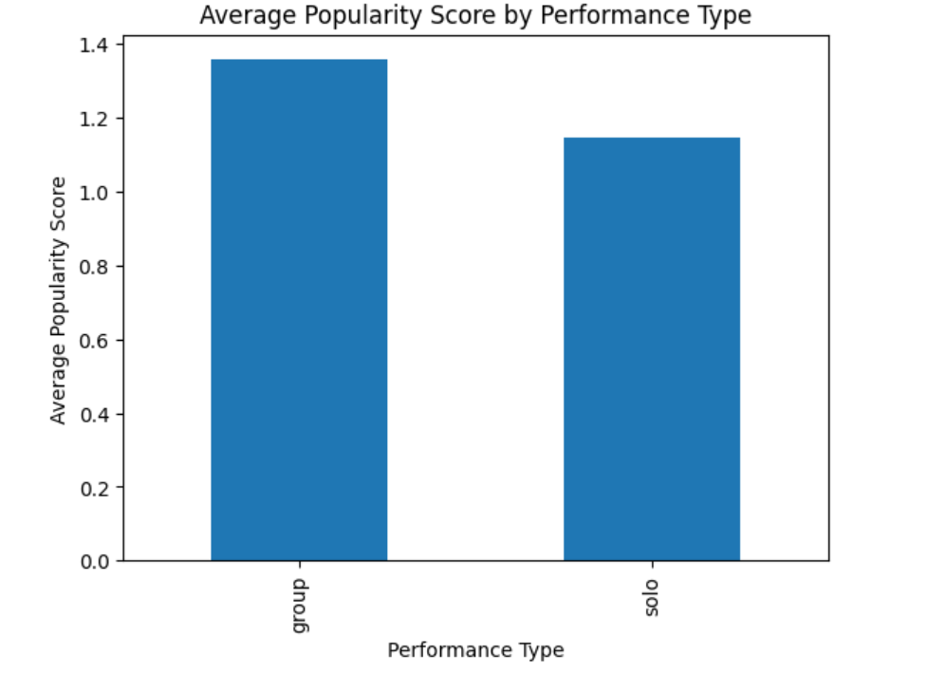
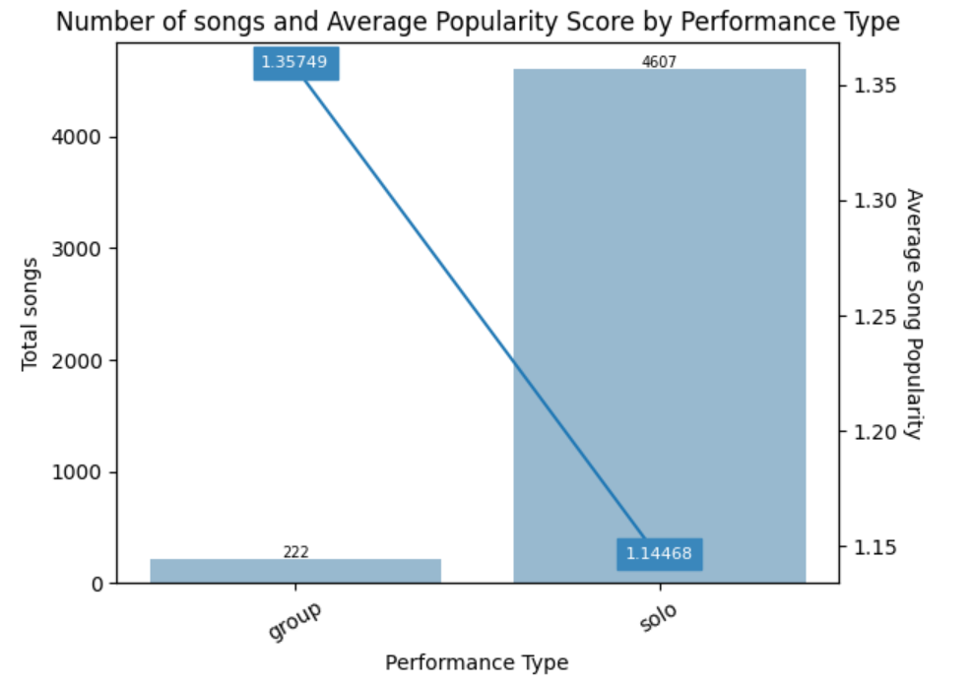
Performance Type
Notes:
Performace type

Slide 9
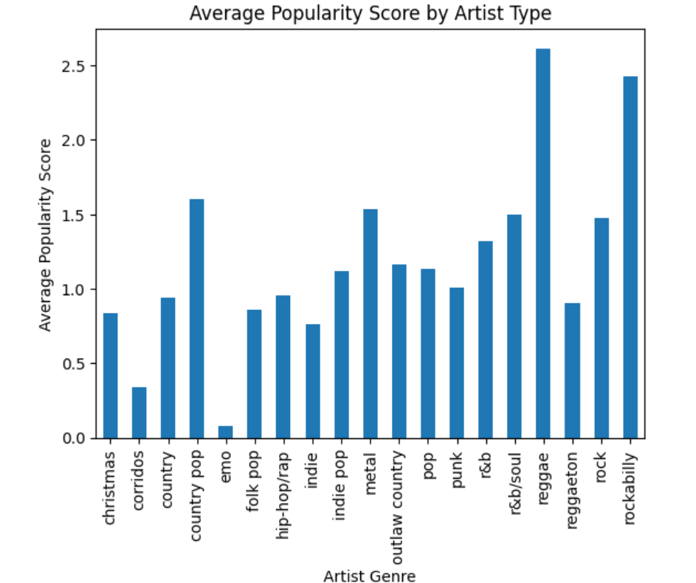
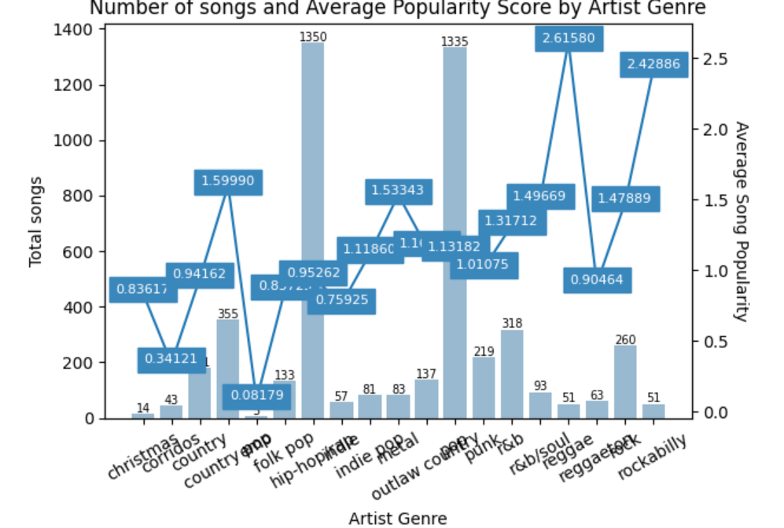
Genre

Slide 10
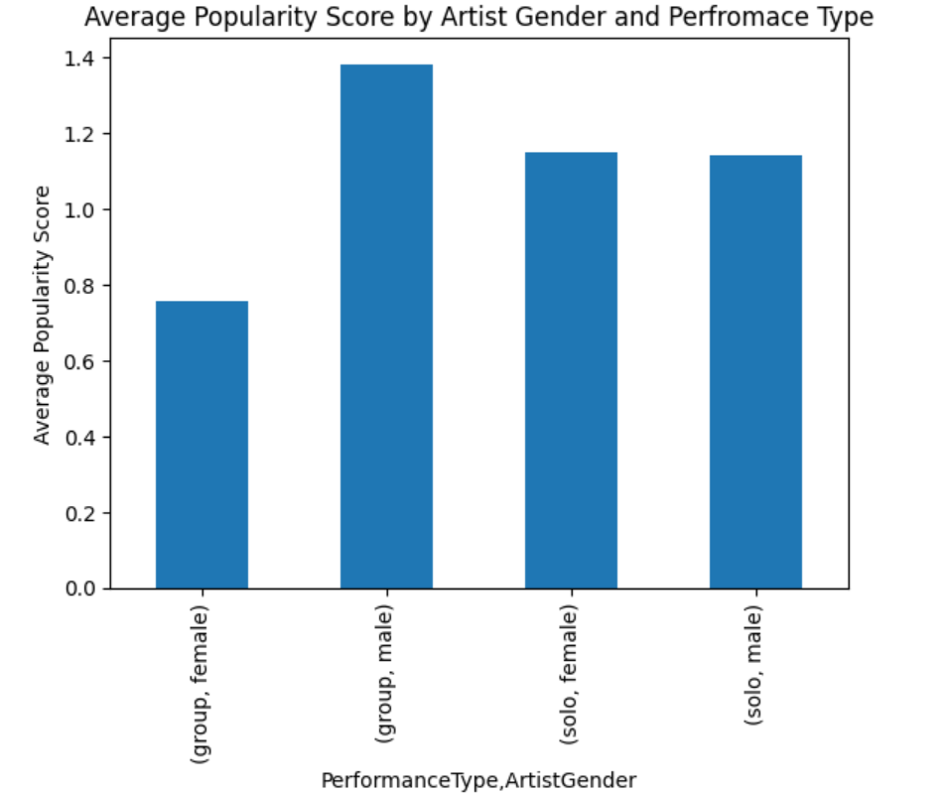
Gender and Performance Type
Notes:
Group male members are good

Slide 11
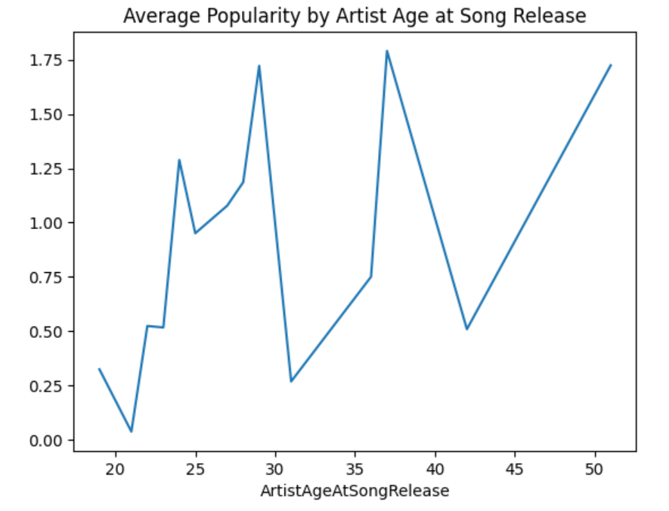
Age
Notes:
Late 20s singers are better choice with 38 as an outlier may be

Slide 12
Ordinary Least Square Model and feature selection
R_Squared
Model 1 0.00039 Artist Gender
Model 2 0.028923 Artist Genre
Model 3 0.030539 Artist Genre + Performance type
Model 4 0.032877 Artist Gender + Artist Genre + Performance type
Model 5 0.038053 Artist Country + Artist Gender + Artist Genre + Performance type

Slide 13
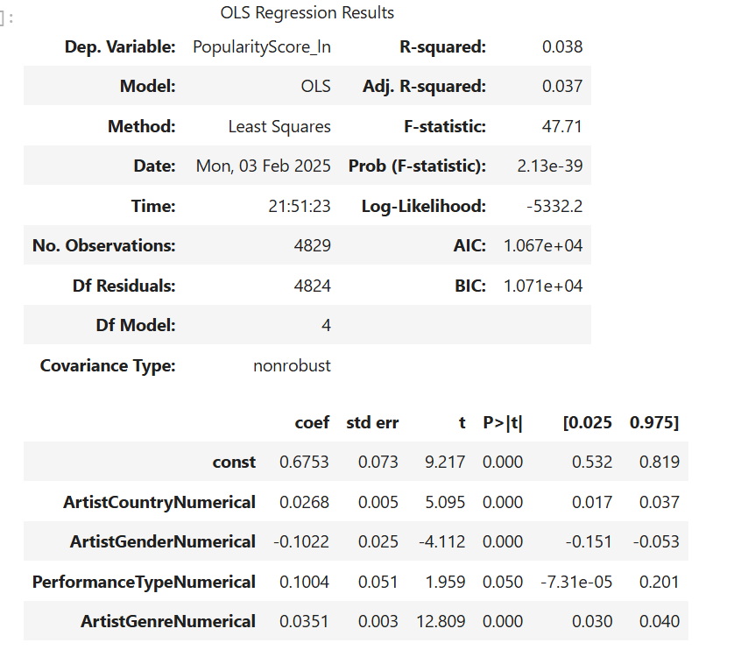
OLS Model 5

Slide 14
Robust Model Random Forest Regressor

Slide 15
Lets conclude till now
No magical formula for an Artist that sing so that everyone love

Slide 16
Conclusions
Group Singers better than Solo singers
Male groups are better than female group singers
Gender in general has no influence although more male singers we have.
Even country of the singer has some influence that gives us better R_squared value.

Slide 17
Questions ?

Slide 18
Thank you !

