Slide 1
Parkinson's Freezing of Gait Prediction
Event detection from wearable sensor data
Karolina Saegner
05 02 2026
Kiel

Slide 2
Project
Parkinson’s disease – progressive neurodegenerative disorder, affecting motor system and gait
Affects ~300 000 people in Germany
Symptoms: tremor, rigidity, slowness, balance and gait problems
Freezing of gait:
Sudden, brief inability to move feet forward
Patient feels "glued to the floor“
Lasts seconds but causes falls, injuries, loss of independence
Three Types: Start Hesitation, Turn, Walking

Slide 3
Project
Acceleration data from a lower back Inertial Measurement Unit
136 patients, age range: 28 - 94 years
2 datasets – collected in the lab and at home
Different patients in both datasets
833 files from 62 patients in the lab dataset
137 files from 45 patients in the home dataset
3 types of FoG (StartHesitation, Turn, Walking):
High class imbalance (Turn FoG > ¾ of all FoG events)
Goal:
To detect FOG episodes for the tdcsfog and defog series
To detect the type of FOG episodes (StartHesitation, Turn , Walking)

Slide 4


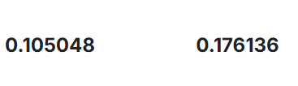
Baseline model
Logistic regression
Validation AP:
StartHesitation: 0.1346
Turn: 0.4116
Walking: 0.0664
Place 1212 / 1379

Slide 5
Feature engineering #1
Raw Data (3):
AccV, AccML, AccAP (direct sensor readings)
Derived (4):
Magnitude: sqrt(AccV² + AccML² + AccAP²)
3 jerk features: rate of change
Total: 7 features, minimal statistical context

Slide 6
LSTM #1
Model: Bidirectional LSTM with Attention
Input: (batch_size = 512, 96, 7):
7 features: 3 raw + 4 derived
Sliding window with 72-step past, 24-step future
Architecture: BiLSTM (256 hidden units, 2 layers)
Attention Mechanism
Dense (256, ReLU)
Dropout (0.4)
Output layer (3) → [StartHesitation, Turn, Walking]
Notes:
Single point prediction: Attention collapses sequence to one prediction per window Raw features: Mostly raw accelerometer data with minimal engineering Short context: 1-second windows capture only immediate patterns Shallow architecture: 2 LSTM layers, relies on attention mechanism

Slide 7
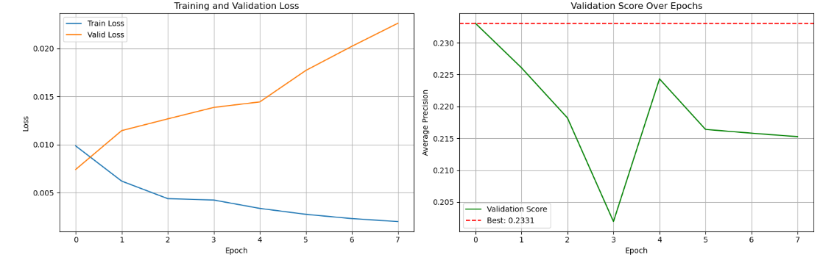

Results (LSTM #1)
Validation Score (AP): 0.2331
Per class AP:
StartHesitation: 0.031
Turn: 0.646
Walking: 0.022
Place 89 / 1379 (bronze)

Slide 8
Feature engineering #2
Whole timeseries compressed to 2048 points
Basic Statistics (5 features × 3 axes = 15):
Mean: Average movement intensity over window
Max: Peak acceleration (sudden movements)
Min: Minimum acceleration (stillness periods)
Median: Central tendency, robust to outliers
Std: Movement variability
Extended Statistics (6 features × 3 axes = 18):
p15, p30, p45, p60, p75, p90
Total: 33 features
Notes:
P15, : Captures baseline low movement
p30: Lower quartile movement
p45: Below-median movement
p60: Above-median movement
p75: Upper quartile movement
p90: Captures peak movements

Slide 9
LSTM #2
Model: Bidirectional LSTM
Input: (batch, 2048, 33):
2048 timesteps (20 seconds @ 100Hz)
33 features: 15 basic statistics + 18 percentile features
Architecture: BiLSTM (1024 units, 4 layers)
Dense (128, SELU)
Output layer (4, softmax) → [StartHesitation, Turn, Walking, NoEvent]
Notes:
Sequence-to-sequence: Predicts class probabilities at EVERY timestep (2048 predictions per sample) Rich features: 33 engineered features capture movement statistics and distribution Long context: 20-second windows capture complete FOG episodes and their buildup Deep architecture: 4 LSTM layers learn hierarchical temporal patterns
Parameters: ~25 millionTraining: 30 epochs, batch size 16Optimizer: Adam with Cosine Decay (lr=3e-4)Loss: Categorical cross-entropy + custom event detection metric
BiLSTM layers: 1024 → 512 → 256 → 128 (per direction, so ×2)

Slide 10
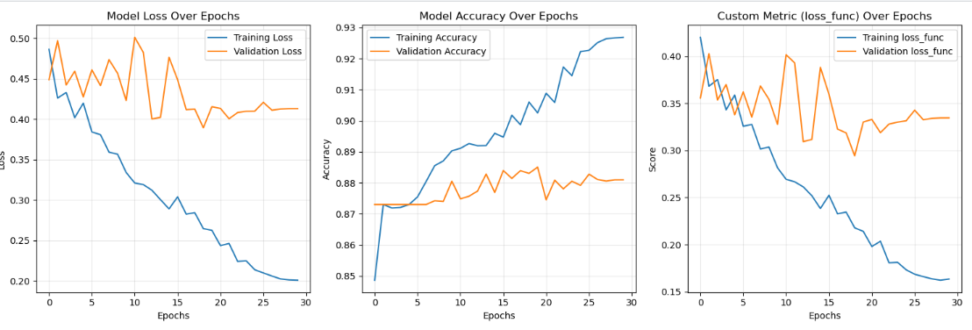

Results (LSTM #2)
Event Detection AP (any FOG): 0.4456
Per class AP:
StartHesitation: 0.0338
Turn: 0.4432
Walking: 0.0264

Slide 11
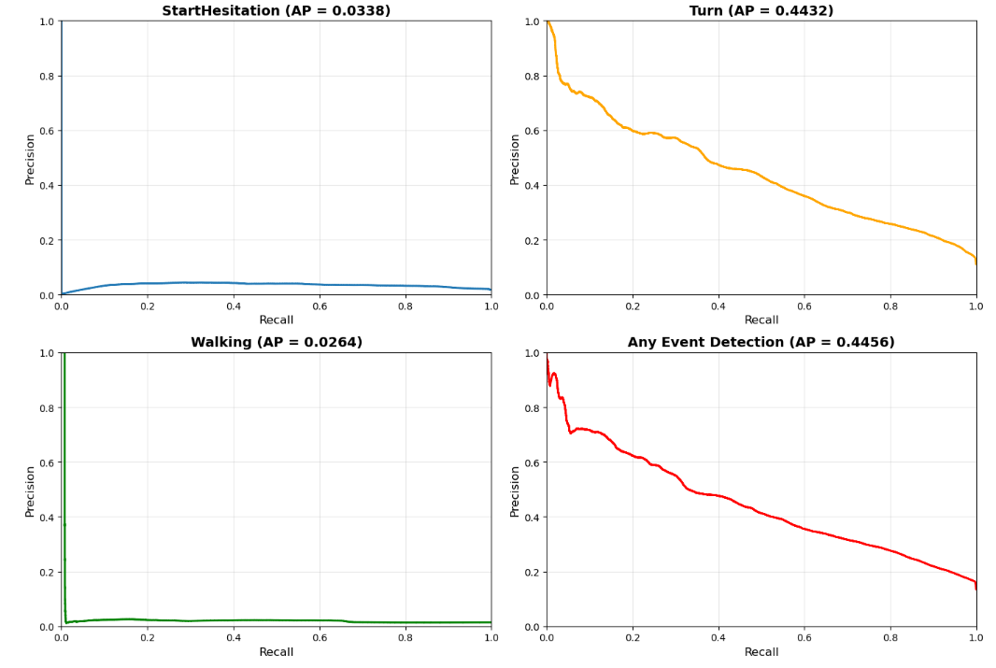
Average precision

Slide 12
Key improvements
Better feature engineering (7 raw data features vs 33 data-derived features)
Temporal context (1 sec window vs whole recording compressed to 20 sec)
Model depth (2 layers vs 4 layers)
Notes:
Represents the ENTIRE recording (could be 2 minutes, 5 minutes, etc.) compressed into 2048 points. Model sees the COMPLETE compressed recording, not a window

Slide 13

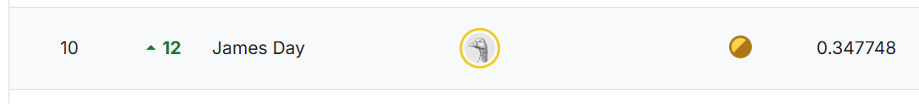
Kaggle ranking
11
karsae
12

Slide 14

What would I do next?
Convert IMU acceleration data to images (Signal-to-Image encoding)
Use machine learning models (e.g., CNNs) for image classification

