Slide 1
部分最小二乗回帰

Slide 2
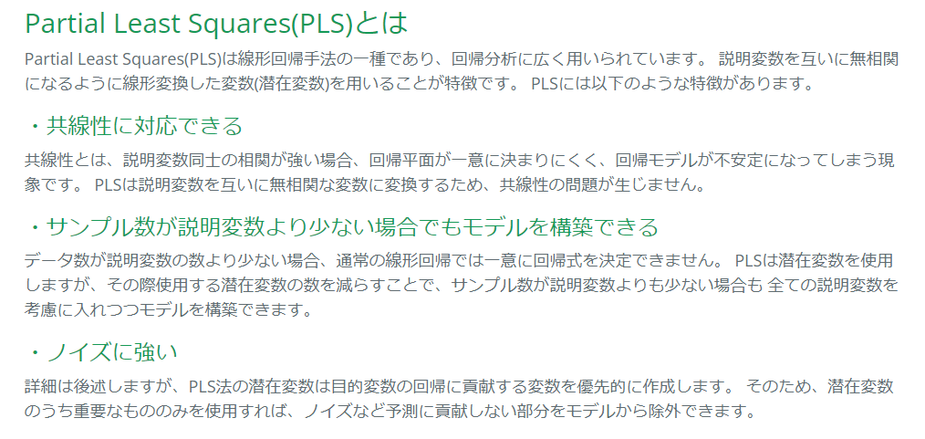
どんなもの？
https://funatsu-lab.github.io/open-course-ware/machine-learning/partial-least-squares/

Slide 3
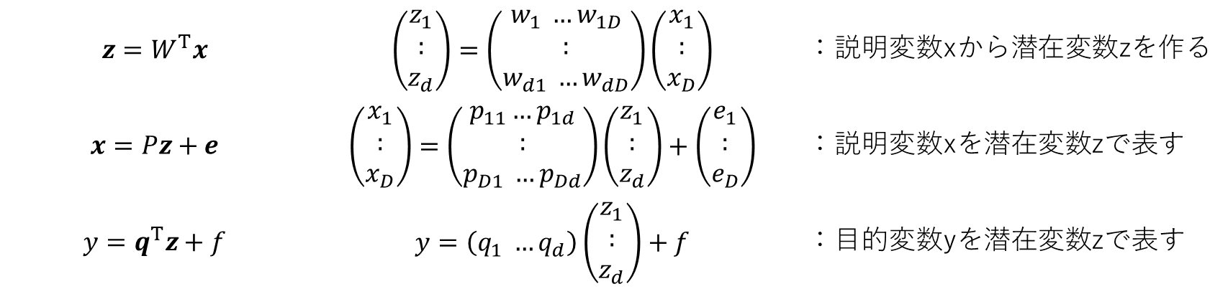
計算
$$z=W^{T}x$$ | $$\left(\begin{aligned}z_{1} \\ : \\ z_{d}\end{aligned}\right)=\left(\begin{aligned}w_{1} …w_{1D} \\ : \\ w_{d1} …w_{dD}\end{aligned}\right)\left(\begin{aligned}x_{1} \\ : \\ x_{D}\end{aligned}\right)$$ | ：説明変数xから潜在変数zを作る
$$x=Pz+e$$ | $$\left(\begin{aligned}x_{1} \\ : \\ x_{D}\end{aligned}\right)=\left(\begin{aligned}p_{11}…p_{1d} \\ : \\ p_{D1} …p_{Dd}\end{aligned}\right)\left(\begin{aligned}z_{1} \\ : \\ z_{d}\end{aligned}\right)+\left(\begin{aligned}e_{1} \\ : \\ e_{D}\end{aligned}\right)$$ | ：説明変数xを潜在変数zで表す
$$y=q^{T}z+f$$ | $$y=\left(q_{1} …q_{d}\right)\left(\begin{aligned}z_{1} \\ : \\ z_{d}\end{aligned}\right)+f$$ | ：目的変数yを潜在変数zで表す
yとzが強く相関するようにWを決定する

Slide 4
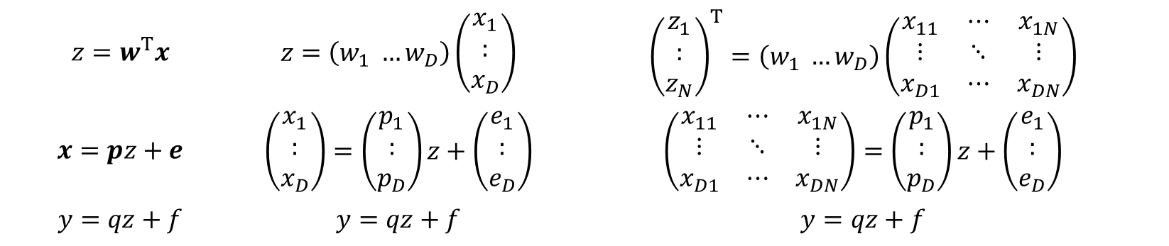

計算
$d=1$のとき(潜在変数が1次元のとき)
$$z=w^{T}x$$ | $$z=\left(w_{1} …w_{D}\right)\left(\begin{aligned}x_{1} \\ : \\ x_{D}\end{aligned}\right)$$ | $${\left(\begin{aligned}z_{1} \\ : \\ z_{N}\end{aligned}\right)}^{T}=\left(w_{1} …w_{D}\right)\left(\begin{matrix}x_{11} & ⋯ & x_{1N} \\ ⋮ & ⋱ & ⋮ \\ x_{D1} & ⋯ & x_{DN}\end{matrix}\right)$$
$$x=pz+e$$ | $$\left(\begin{aligned}x_{1} \\ : \\ x_{D}\end{aligned}\right)=\left(\begin{aligned}p_{1} \\ : \\ p_{D}\end{aligned}\right)z+\left(\begin{aligned}e_{1} \\ : \\ e_{D}\end{aligned}\right)$$ | $$\left(\begin{matrix}x_{11} & ⋯ & x_{1N} \\ ⋮ & ⋱ & ⋮ \\ x_{D1} & ⋯ & x_{DN}\end{matrix}\right)=\left(\begin{aligned}p_{1} \\ : \\ p_{D}\end{aligned}\right)z+\left(\begin{aligned}e_{1} \\ : \\ e_{D}\end{aligned}\right)$$
$$y=qz+f$$ | $$y=qz+f$$ | $$y=qz+f$$

