Slide 1
重回帰分析
多変数で最小二乗法

Slide 2
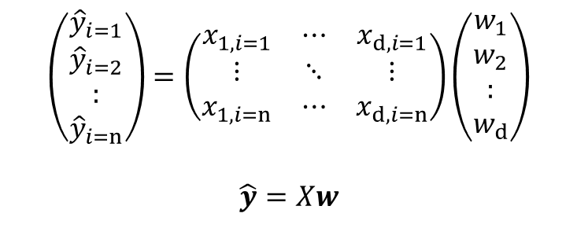
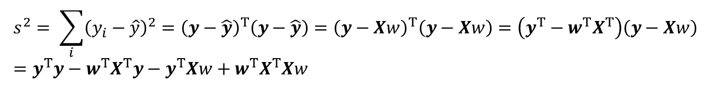
計算
$\hat{y}=w_{1}x_{1}+w_{2}x_{2}+…w_{d}x_{d}$として回帰。サンプルがn個あれば
$$\left(\begin{aligned}{\hat{y}}_{i=1} \\ {\hat{y}}_{i=2} \\ : \\ {\hat{y}}_{i=n}\end{aligned}\right)=\left(\begin{matrix}x_{1,i=1} & ⋯ & x_{d,i=1} \\ ⋮ & ⋱ & ⋮ \\ x_{1,i=n} & ⋯ & x_{d,i=n}\end{matrix}\right)\left(\begin{aligned}w_{1} \\ w_{2} \\ : \\ w_{d}\end{aligned}\right)$$
$$\hat{y}=Xw$$
$$s^{2}= \sum_{i}{{\left(y_{i}−\hat{y}\right)}^{2}}={\left(y−\hat{y}\right)}^{T}\left(y−\hat{y}\right)={\left(y−Xw\right)}^{T}\left(y−Xw\right)=\left(y^{T}−w^{T}X^{T}\right)\left(y−Xw\right) \\ =y^{T}y−w^{T}X^{T}y−y^{T}Xw+w^{T}X^{T}Xw$$
ここで、 $w^{T}X^{T}y$も$y^{T}Xw$もスカラであり、互いに転置関係であることから、値は等しいので
$$s^{2}=y^{T}y−2y^{T}Xw+w^{T}X^{T}Xw$$

Slide 3
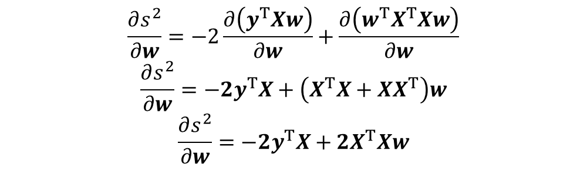

計算
$$s^{2}=y^{T}y−2y^{T}Xw+w^{T}X^{T}Xw$$
$$\frac{∂s^{2}}{∂w}=−2\frac{∂\left(y^{T}Xw\right)}{∂w}+\frac{∂\left(w^{T}X^{T}Xw\right)}{∂w}$$
$$\frac{∂s^{2}}{∂w}=−2y^{T}X+\left(X^{T}X+XX^{T}\right)w$$
$$\frac{∂s^{2}}{∂w}=−2y^{T}X+2X^{T}Xw$$
$$w={\left(X^{T}X\right)}^{−1}y^{T}X$$

Slide 4
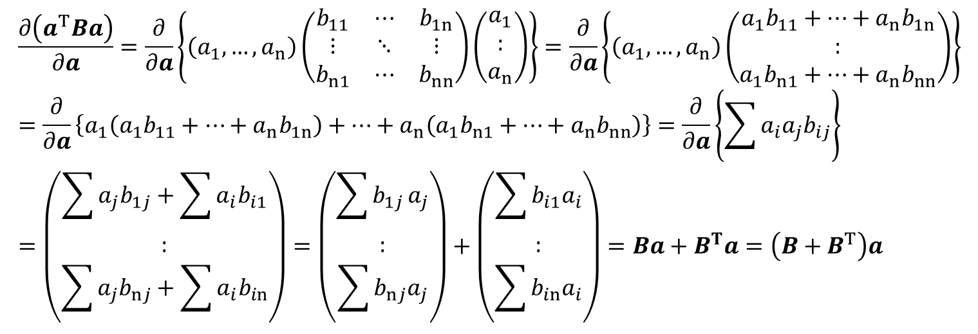
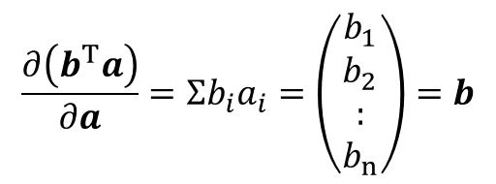
計算
$$\frac{∂\left(b^{T}a\right)}{∂a}=Σb_{i}a_{i}=\left(\begin{aligned}b_{1} \\ b_{2} \\ : \\ b_{n}\end{aligned}\right)=b$$
$$\frac{∂\left(a^{T}Ba\right)}{∂a}=\frac{∂}{∂a}\left\{\left(a_{1},…,a_{n}\right)\left(\begin{matrix}b_{11} & ⋯ & b_{1n} \\ ⋮ & ⋱ & ⋮ \\ b_{n1} & ⋯ & b_{nn}\end{matrix}\right)\left(\begin{aligned}a_{1} \\ : \\ a_{n}\end{aligned}\right)\right\}=\frac{∂}{∂a}\left\{\left(a_{1},…,a_{n}\right)\left(\begin{aligned}a_{1}b_{11}+…+a_{n}b_{1n} \\ : \\ a_{1}b_{n1}+…+a_{n}b_{nn}\end{aligned}\right)\right\} \\ =\frac{∂}{∂a}\left\{a_{1}\left(a_{1}b_{11}+…+a_{n}b_{1n}\right)+…+a_{n}\left(a_{1}b_{n1}+…+a_{n}b_{nn}\right)\right\}=\frac{∂}{∂a}\left\{\sum{a_{i}a_{j}b_{ij}}\right\} \\ =\left(\begin{aligned}\sum{a_{j}b_{1j}}+\sum{a_{i}b_{i1}} \\ : \\ \sum{a_{j}b_{nj}}+\sum{a_{i}b_{in}}\end{aligned}\right)=\left(\begin{aligned}\sum{b_{1j}}a_{j} \\ : \\ \sum{b_{nj}a_{j}}\end{aligned}\right)+\left(\begin{aligned}\sum{b_{i1}a_{i}} \\ : \\ \sum{b_{in}a_{i}}\end{aligned}\right)=Ba+B^{T}a=\left(B+B^{T}\right)a$$

Slide 5
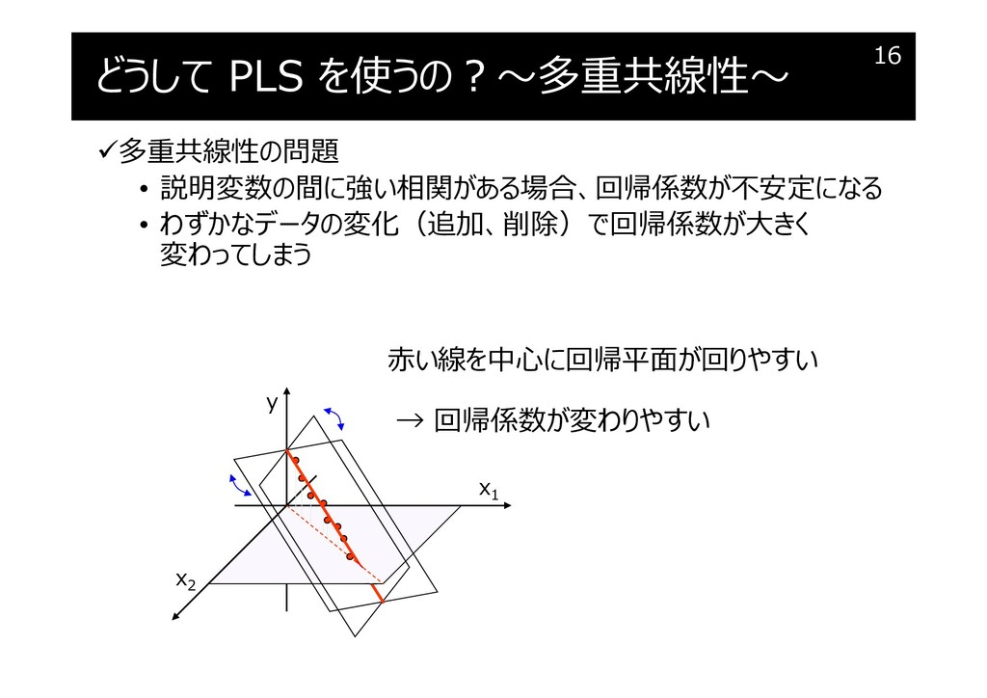
問題
X^{T}Xの逆行列が求められない
①説明変数(d)>サンプル数(n)
②多重共線性
→いわゆる交絡
①,②両方に対して、PCR(主成分回帰)が有効

Slide 6
主成分回帰(PCR)
説明変数で主成分分析(PCA)をして、パラメータを削減＆共線性のあるパラメータも削減

