Slide 1

*Onur Ölmez
*İlhan Mert Çetin
*Kaan Aydın
03.06.2022

Slide 2
Contents Page
Problem Definition
Requirements
Stakeholders
Project Staffing
Process Model
Schedule and Effort
Measurements
Risks
Tools
Needs
GUI
Conculusion

Slide 3
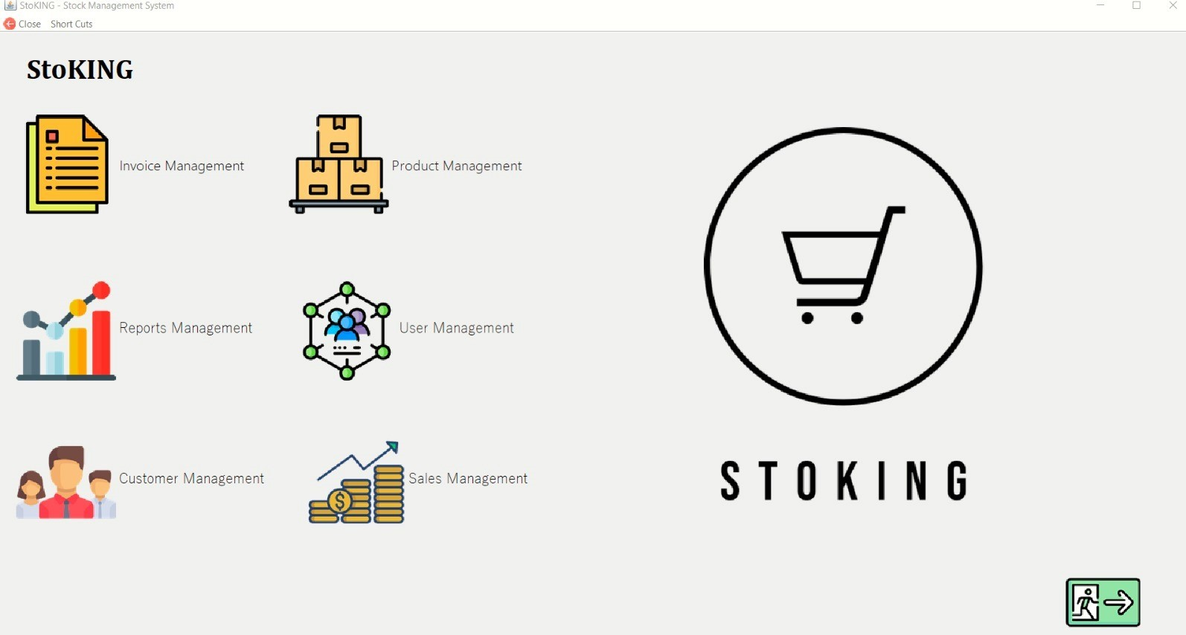
PROBLEM DEFINITION
Manually tracking the enormous number and variety of products in big-scale businesses is nearly impossible. As a result, a stock tracking system was created to save time and material.

Slide 4
Functional Requirements
Non-Functional Requirements
System will automaticlly back up the database when entered the app at 12 a.m
System requires minumum Windows 7 OS and at least 2 GHZ CPU at least 2 GB Ram.
System interface will be user-friendly.
Depending on their username and password, users of the program will see different screens.
System should let you to create, delete and
change the password of the users.
System should allow you to adding, updating,
deleting, searching and filtering of the products.
System should send email notification when the
product got low stock.
System should export the specific data
in pdf and excel format which is chosen by user.

Slide 5


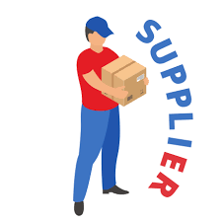


Stakeholders
Team Members
Customers
Suppliers
Company
Sponsor

Slide 6



Project Staffing
DESIGNER
TESTER
DEVELOPER

Slide 7
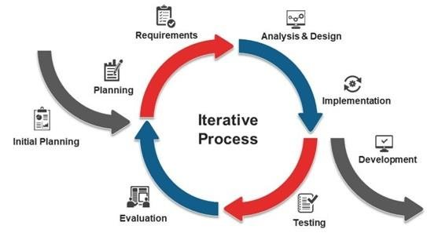
Why did we choose Iterative Model?

Slide 8
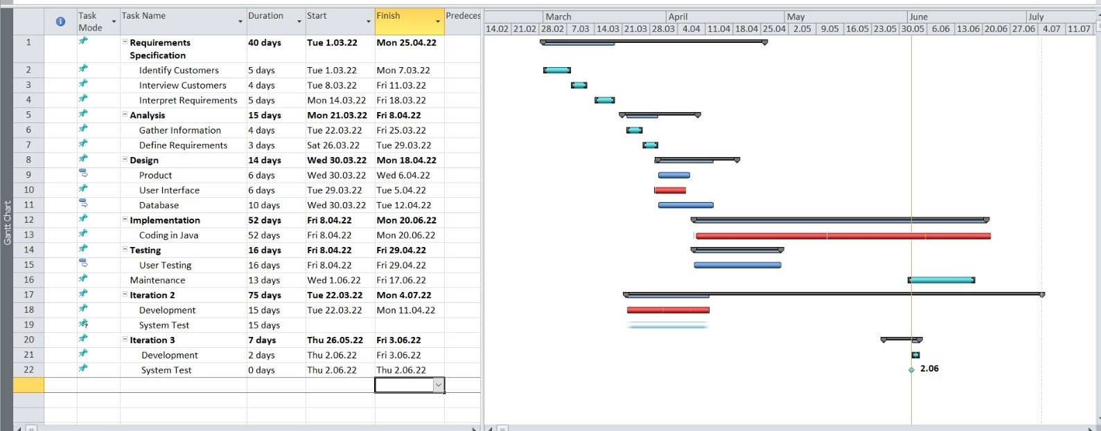
Schedule and Effort

Slide 9
Measurements
The number of lines of codes
Time
Number of Changes
Budget
Number of Users

Slide 10
Project Risks
Project Deadline
Complexity of Design
Changing project’s purposes
Planning
System Failures
Lack of Communication
Product Quality
Training
Poor Management

Slide 11
Software Tools
DATABASE
MySQL (Workbench)
IDE’s
Apache Netbeans
IntelliJ Idea
Visual Studio Code
Notepad++

Slide 12
Project Needs
HARDWARE NEEDS
PC
Mouse
Processor
Memory (RAM)
Hard Drive
SOFTWARE NEEDS
IDE
Windows
MYSQL WORKBENCH
SUPPORT NEEDS
Quantity of the product
Stack Overflow

Slide 13
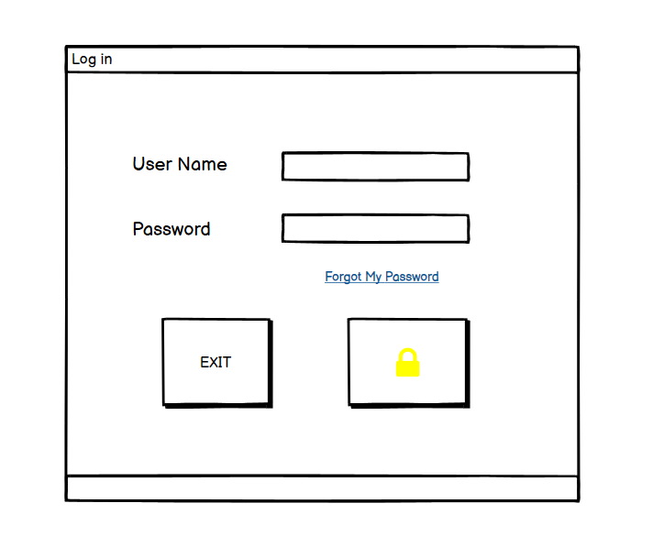
GUI

Slide 14
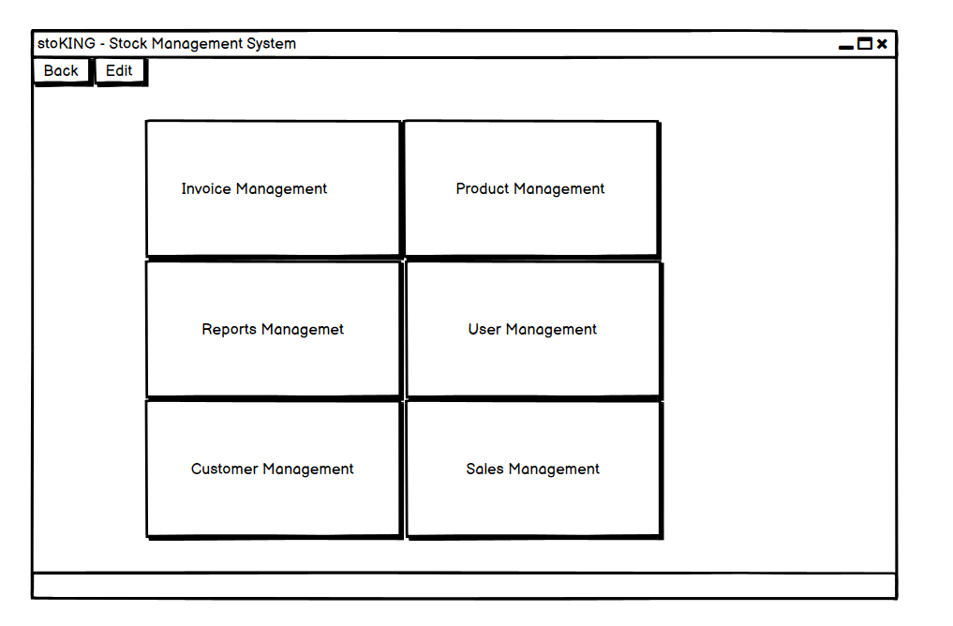
GUI

Slide 15
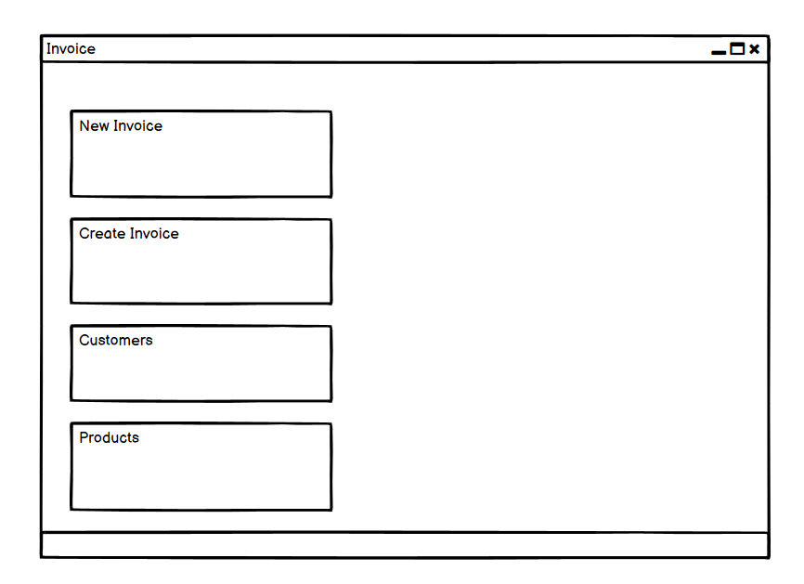
GUI

Slide 16
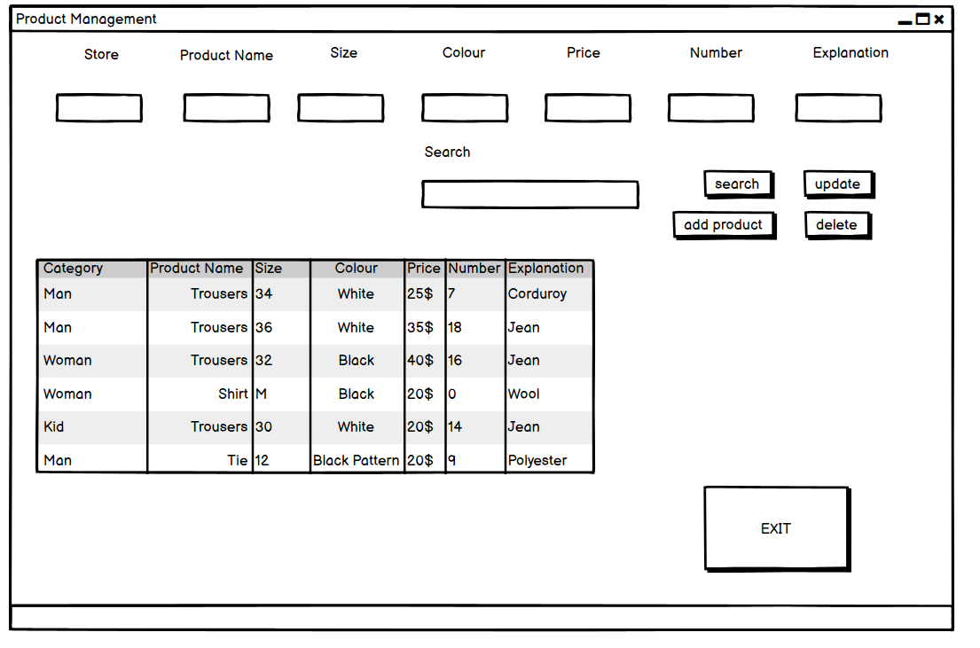
GUI

Slide 17
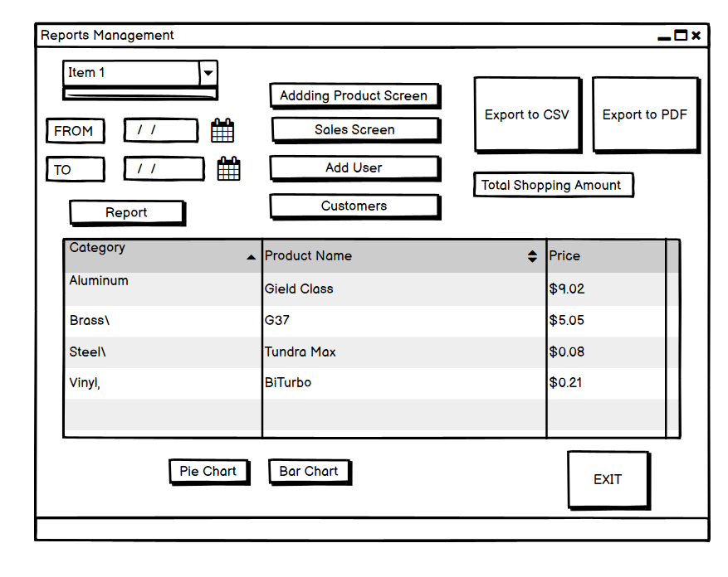
GUI

Slide 18
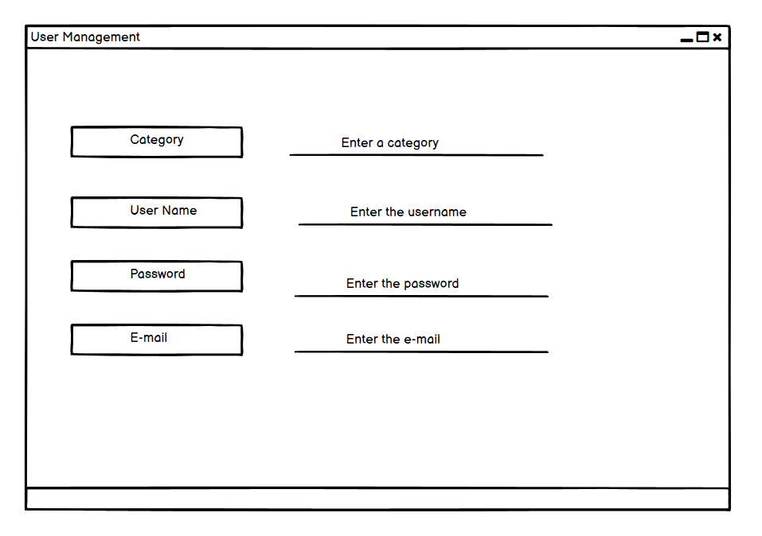
GUI

Slide 19
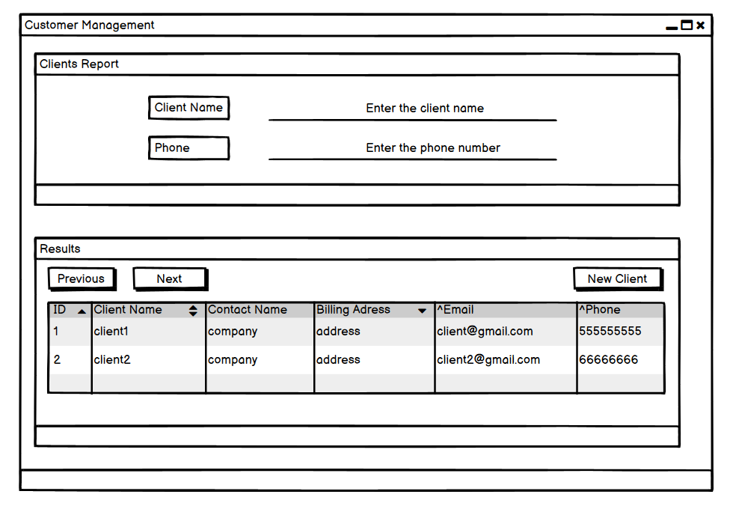
GUI

Slide 20
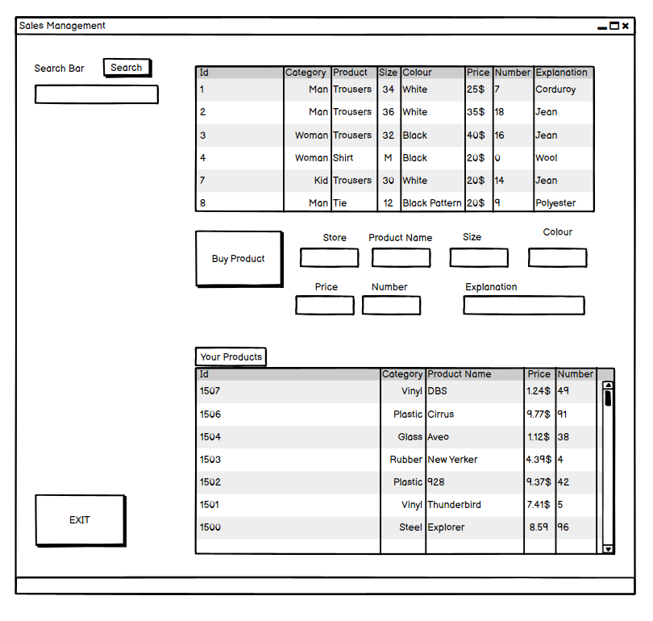
GUI

Slide 21
For more information visit our website:
https://olmezyazilim.net/StoKING/index.html

Slide 22
Conculusion
As a conclusion…

