Slide 1
Analysing London for Opening a Pub

Slide 2
Why London?
London is one of the most multicultural cities in the world. It is a great tourist attraction and busy at all seasons of the year.
The city offers a wide range of restaurants and cuisines.
8.9m people living in the city

Slide 3
Data acquisition and cleaning
Location, Borough, Town, Postcode, 2020 data scraped from https://en.m.wikipedia.org/wiki/List_of_areas_of_London
Latitude/Longitude information from “geopy” library.
In total, 531 rows and 4 features in the raw dataset.
Naming's were adjusted for more accurate location information
Data filtered to central London.

Slide 4
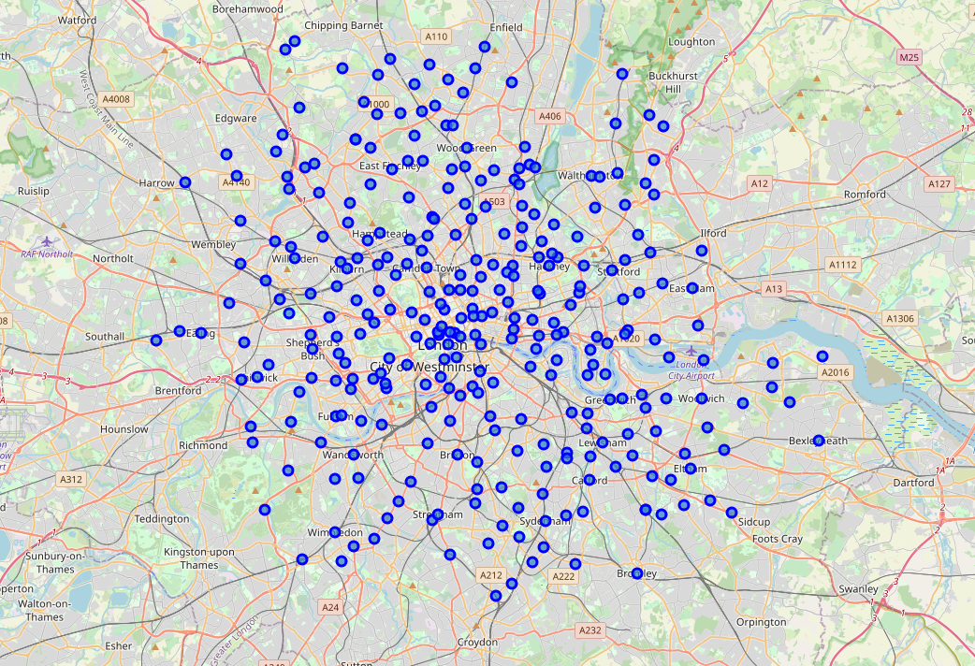
Using folium, London Neighbourhoods

Slide 5
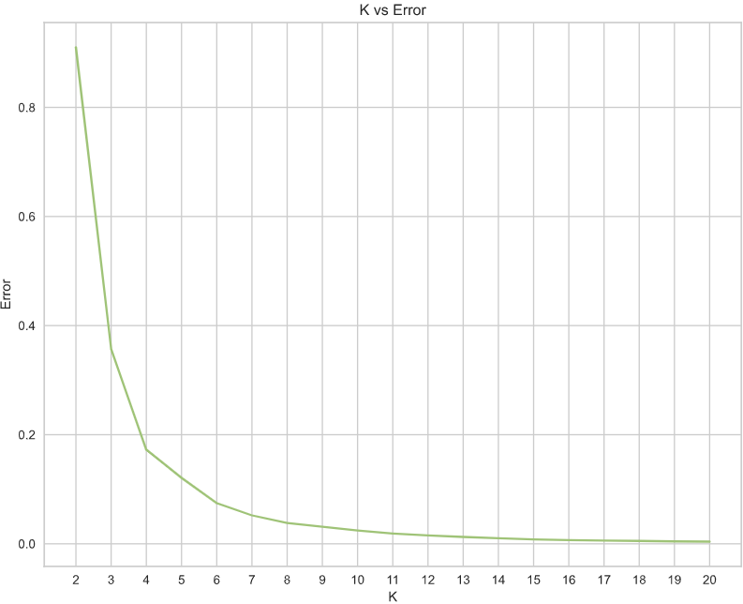
Clustering
Elbow Method was used to determine the optimum number of clusters

Slide 6
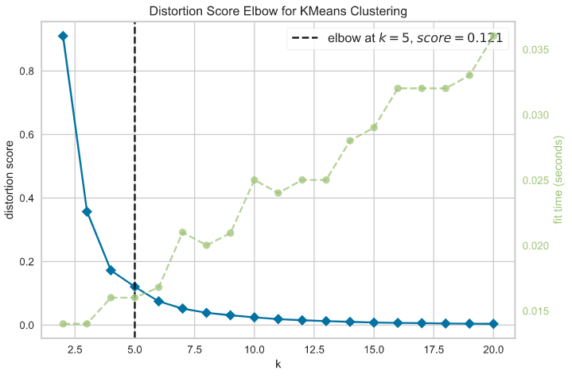
Clustering
The model returned the optimum value to be 5 clusters.

Slide 7
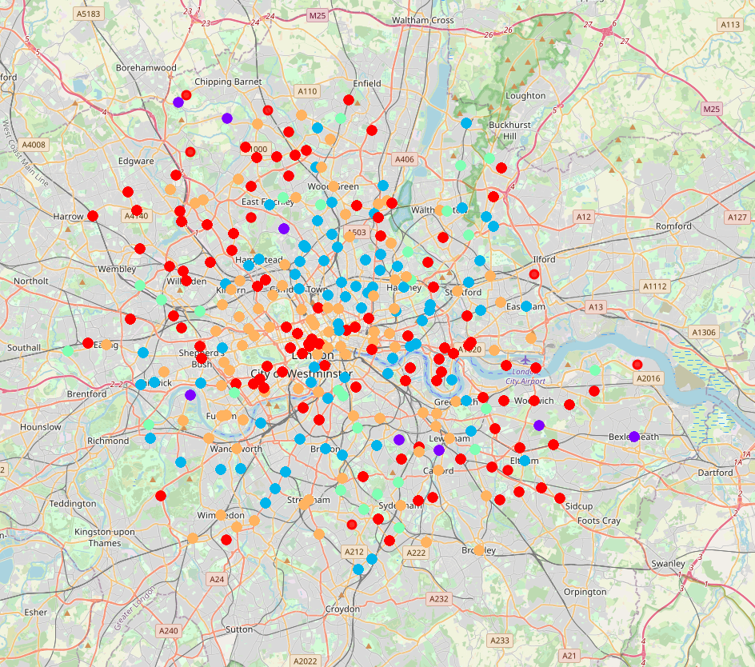
Using folium, London Neighbourhoods clustered
Neighbourhoods clustered according to the occurrence of pubs.

Slide 8
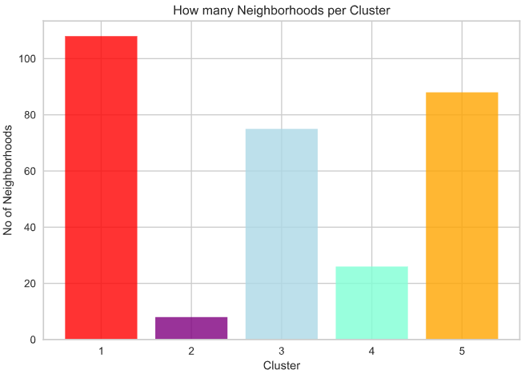
Analysis
Cluster 1 has the highest number of neighbourhoods followed by cluster 5, cluster 3, cluster 4, and cluster 2

Slide 9
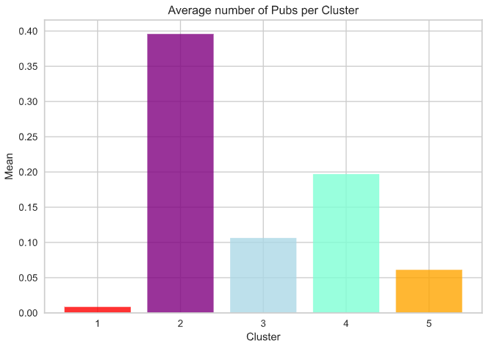
Analysis
Cluster 2 has the highest occurrence of pubs with nearly 40% of the venues within that cluster.
This is followed by Cluster 4 with ~20%.
The least occurrence of pubs are in cluster 1.

Slide 10
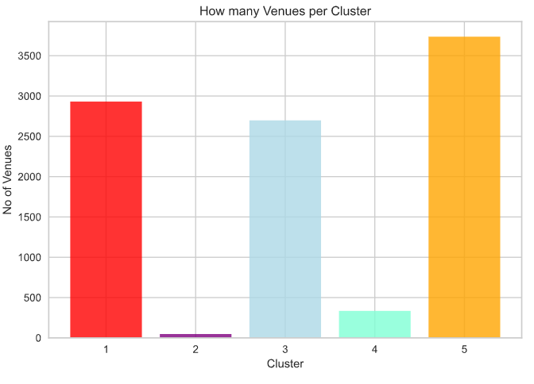
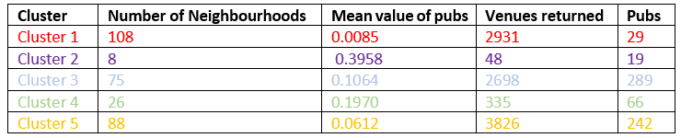
Analysis
Cluster 5 has the highest number of venues, followed by cluster 1
Cluster 1 has 2931 venues but only 29 of them are pubs.
Cluster 2 has only 48 venues but 19 of them are pubs.

Slide 11
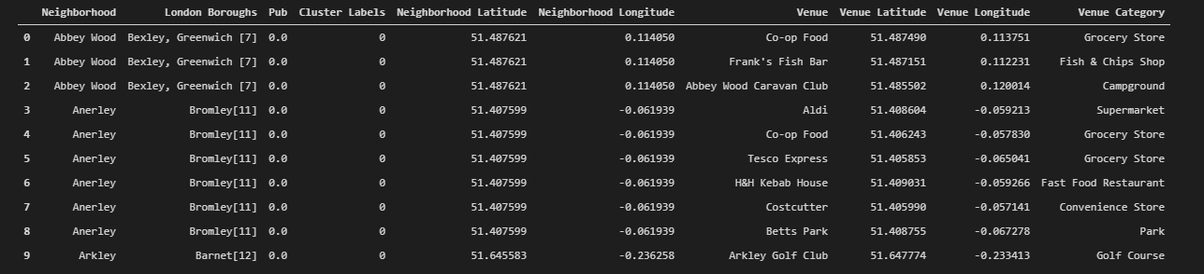
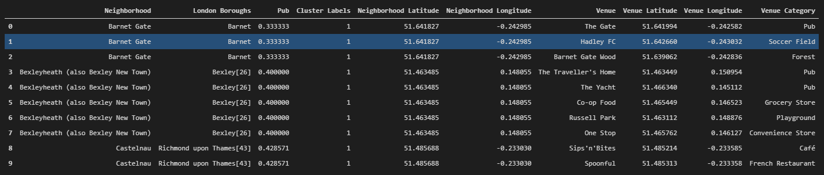
Analysis Clusters
Cluster 1
Cluster 2

Slide 12
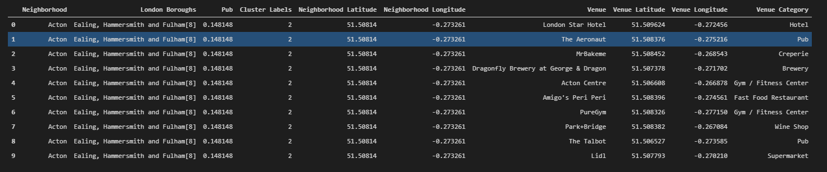
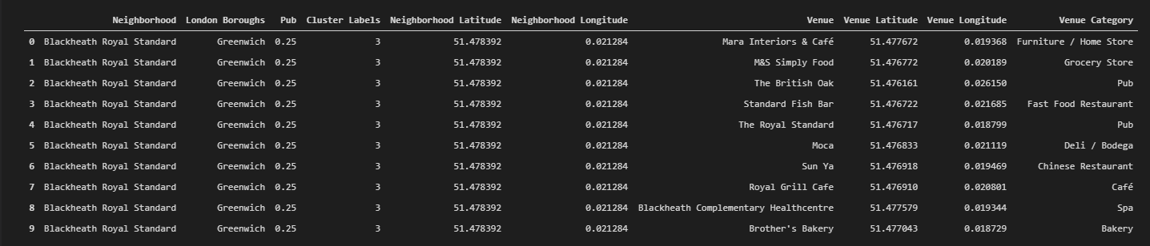
Analysis Clusters
Cluster 3
Cluster 4

Slide 13
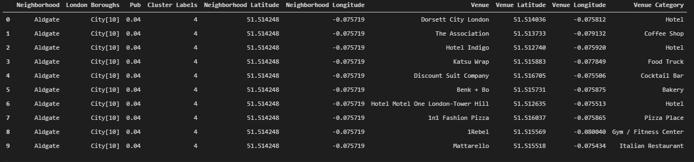
Analysis Clusters
Cluster 5

Slide 14
Conclusion and future directions
In conclusion in this project, central London was swept using the Foursquare API. The areas where put into clusters depending on the occurrence of pubs.
The results were visualized using graphics and maps.
From a business perspective it was concluded that the best area to open a pub would most likely be in cluster 1.
In future the project can be improved by adding in analysis such as; ethnicity, business locations, pricing

