Slide 1





A Centralized Platform
for Educational and Career Opportunities
Explore internship and job opportunities in one place.
Group 5
Doruk Yaşar 20230602514
Kaan Dönmez 20210601202
Selin Tay 20230601069
Ömer Şen 20240601071
Baran Deniz Aydın 20230601011
Salih Batuhan Şener 20250601294
Hilal Seray Ortan 20240601059
EXPLORE

Slide 2

Our project is a centralized platform that gathers academic and career opportunities in one place, helping students quickly find relevant internships, courses, research programs, and projects through personalized profiles and AI-based recommendations while avoiding missed deadlines.
Why Choose Us?
✅All opportunities in one platform
✅ AI-based personalized recommendations
✅ Deadline reminders
✅ Only active and updated listings
✅ Less time wasted searching
✅Real user experiences and feedback
✅Helpful for students’ career growth

Slide 3

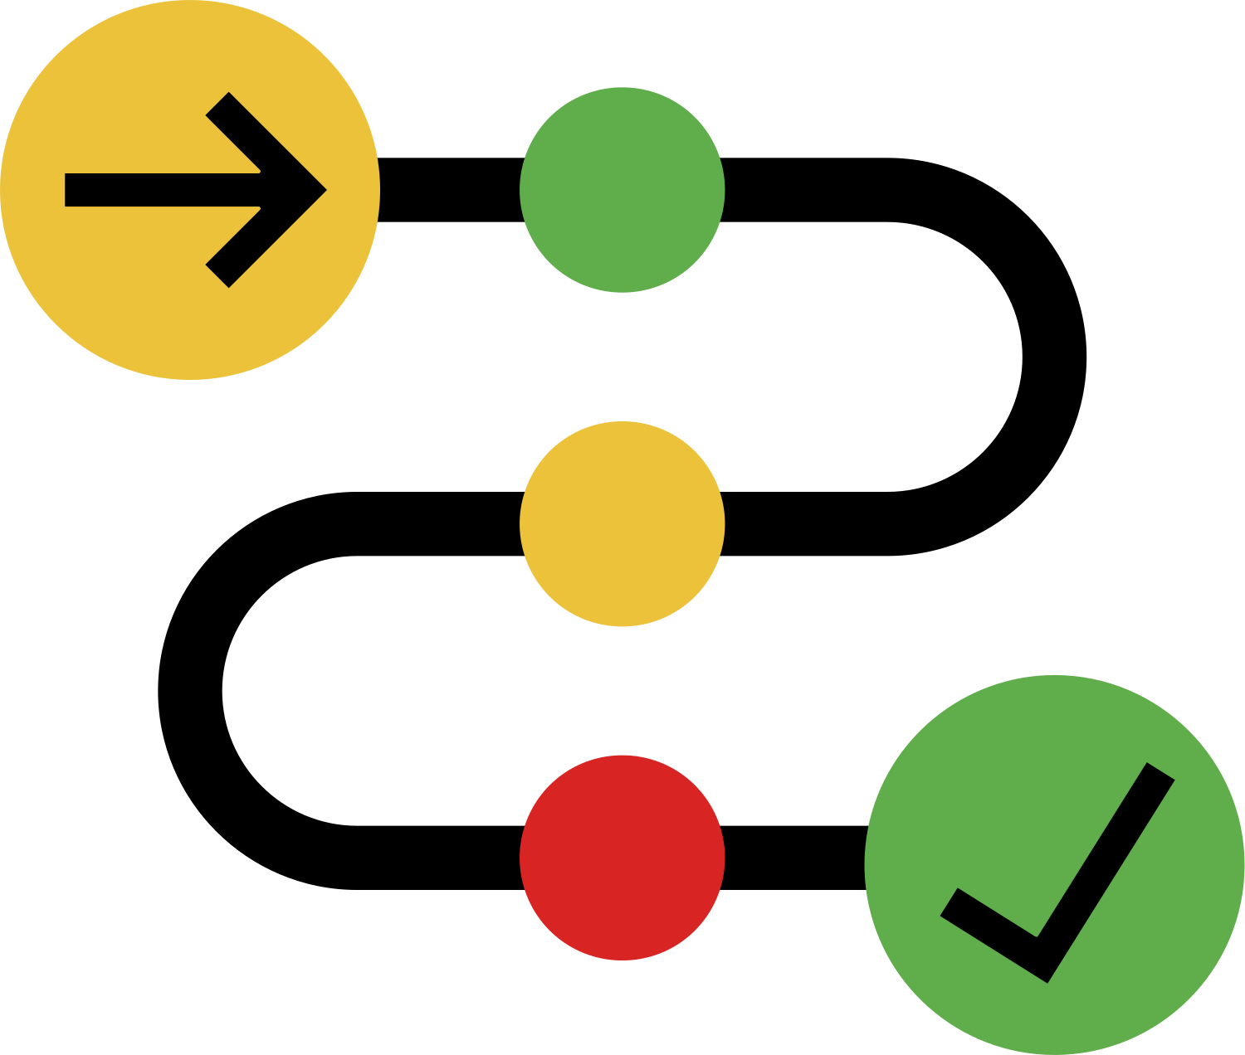

Functional Requirements
User Registration & Login
Users can create an account and log in with email and password.
Personalized Opportunity Feed
The system shows internships, jobs, scholarships, courses, summer schools, and research programs based on the user profile.
AI-Based Recommendations
The system recommends the most relevant opportunities using user interests, profile data, and past interactions.
Search & Filtering
Users can search and filter opportunities by location, date, event type, and required skills.
Favorites List
Users can save opportunities to view or apply later.

Slide 4
Functional Requirements
Email & Push Notifications
Users receive notifications when new matching opportunities are posted.
Deadline Reminder
The system reminds users 24 hours before the deadline of saved opportunities.
Schedule Conflict Prevention
Users cannot register for two trainings at the same date and time.
Experience Sharing
Users can share feedback about programs they attended.
Review Access
Users can read reviews from people who previously joined similar programs or opportunities.

Slide 5
Non-Functional Requirements
Fast Loading Time
Opportunity listings should load within 3 seconds.
Mobile Compatibility
The system should work smoothly on Android 15+ and iOS 17.0+ devices.
Multi-Language Support
The platform supports Turkish, English, German, and Spanish.
Privacy Compliance
The system must comply with KVKK and GDPR.
Data Security
User data and login credentials must be encrypted.

Slide 6
Non-Functional Requirements
Quota Notification
If an opportunity is full, the system shows a “Quota Full” message within 2 seconds.
High Availability
The system should provide at least 99% uptime with health-check and auto-restart scripts.
Bot Protection
Human verification and rate-limiting prevent fake accounts and spam reviews.
Concurrent User Support
The system should support at least 1000 users at the same time.
Accessibility
The platform should follow WCAG 2.1 accessibility standards.

Slide 7
Stakeholder Analysis
Main Stakeholders
End Users
Benefit from easier access to personalized academic and career opportunities.
Universities & Educational Institutions
Promote their programs and reach a wider student audience.
Platform Administrators
Manage the platform and ensure smooth system performance.
Government & Regulatory Authorities
Ensure privacy, security, and legal compliance.
Companies & Employers
Find qualified candidates for jobs, internships, and programs.
Development Team
Gain technical experience, recognition, and career growth.

Slide 8
Stakeholder Analysis
Supporting Stakeholders
External Content Providers
Increase visibility and traffic for their opportunities.
Project Sponsors / Investors
Gain value from the platform's growth and success.
Rival / Competitive Businesses
Are affected by the platform's success in the market.
Alumni & Experienced Users
Share experiences and help users make informed decisions.
Data / Statistic Organizations
Analyze educational and career trends using platform data.
Advertisers / Marketing Firms
Reach a targeted audience interested in education and careers.

Slide 9
SOFTWARE PROCESS MODEL
SCRUM
Scrum is an agile project management framework that focuses on collaboration, flexibility, and continuous improvement throughout the development process. In our project, Scrum helps the team manage tasks efficiently by dividing the work into sprints and delivering features step by step.
Product Owner
Scrum Master
Development Team
Defines priorities and manages requirements
Supports the team and ensures the Scrum process is followed
Develops and implements the platform features
Scrum Practices
Sprint Planning
Daily Meetings
Reviews
Retrospectives
These practices help improve communication and ensure the successful development of our educational and career opportunity platform.

Slide 10
Sprint 1 - System Foundation
Sprint Planning
16.02 - 25.02
Database Design & Planning
Opportunity Data Setup
User Registration & Authentication
Role & Access Management
API Integration Research
Sprint 2 - Core Features
26.02 - 05.03
Search & Filter System
Personalized Feed System
Application Tracking System
Favorites / Bookmark System
User Profile Management

Slide 11
Sprint 3 - Smart Features
Sprint Planning
07.03 - 18.03
AI Recommendation Engine
Notification System
Deadline Reminder System
Duplicate Application Prevention
Analytics & Reporting System
Sprint 4 - Final Development & Testing
19.03 - 30.03
Review & Feedback System
Interview & Video Interaction System
Multi-Language Support
Advanced Security & Data Protection
Testing

Slide 12
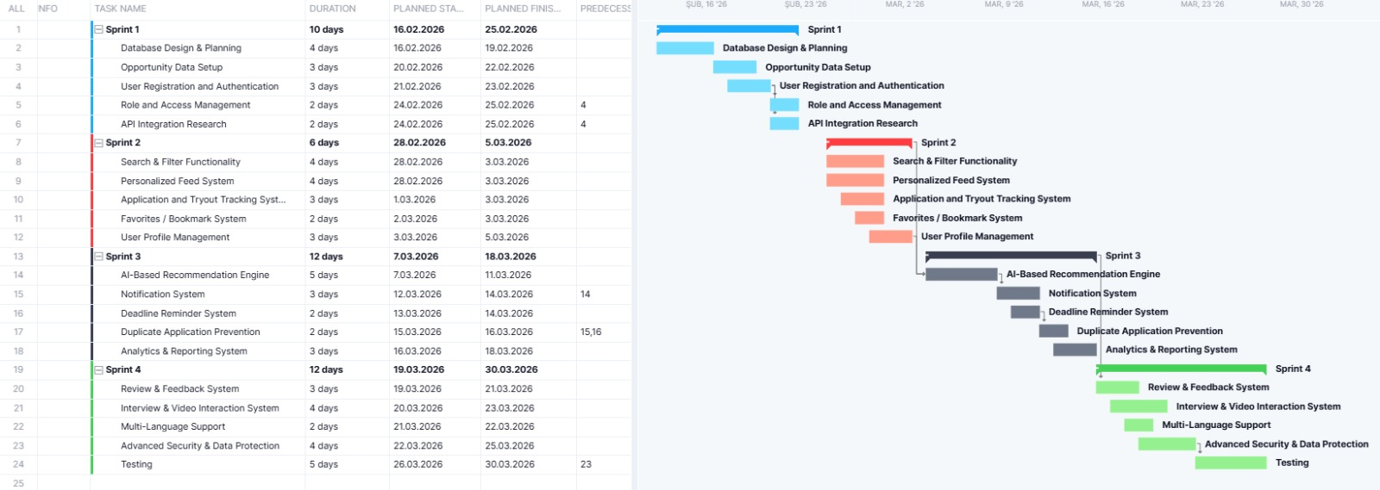

Slide 13
SCHEDULE AND EFFORT
Key Points From the Project Schedule
Development process divided into 4 structured sprints
Task dependencies and workflow order were considered
Project duration: 42 workdays
Timeline: 16 February 2026 – 30 March 2026

Slide 14
PROJECT RİSKS
Why We Analyze Risks?
To ensure platform reliability and data quality
To identify technical, security, and operational threats
To prepare proactive solutions before problems affect users
To improve user satisfaction and overall system performance

Slide 15
HIGH-PRIORITY RISKS
Top Risks Identified
Inconsistent Data Sources: Data from different sources may be incompatible or inconsistent.
Opportunity Normalization Failure: Data cannot be standardized into a common usable format.
AI Recommendation Inaccuracy: The AI system may suggest irrelevant opportunities.
Duplicate Detection Complexity: Same opportunity may appear differently across sources.
Performance & Scalability Issues: System may slow down under high user load.
Incorrect Opportunity Matching: System may incorrectly merge different opportunities.

Slide 16
SOFTWARE TOOLS
“Technology Stack & Tool Selection”
Different software tools were evaluated for each system component.
The selected technologies were chosen based on functionality, cost, scalability, integration capability, and ease of development.
Cost Efficiency
Integration
Scalability
Functionality

Slide 17
SOFTWARE TOOLS
Task
Selected Tool
Development of the Mobile App Using Flutter | Android Studio
Database Management System | PostgreSQL
Location Filtering | PostGIS
Backend Framework | NestJS

Slide 18
WHY THESE TOOLS?
Selection Criteria & Justification
•Cost Efficiency: Most selected tools are open-source and reduce project expenses
•Scalability: The selected technologies support future system growth.
•Integration: All tools work well together within the same architecture.
•Functionality: The tools provide strong technical capabilities for project requirements.

Slide 19
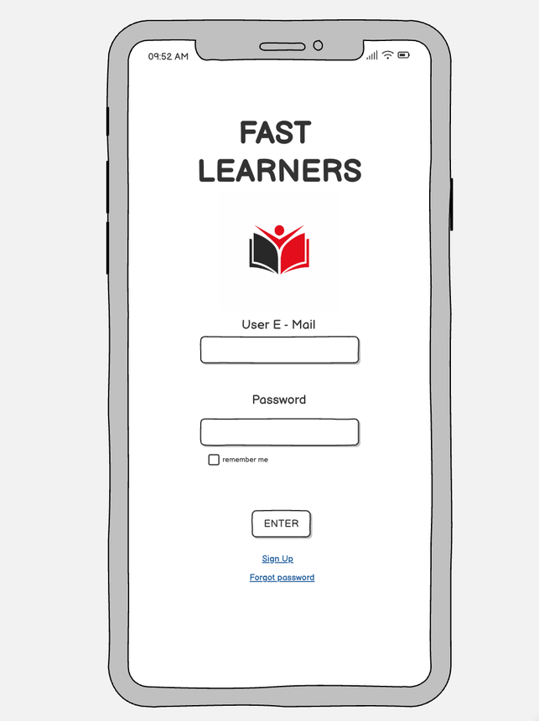
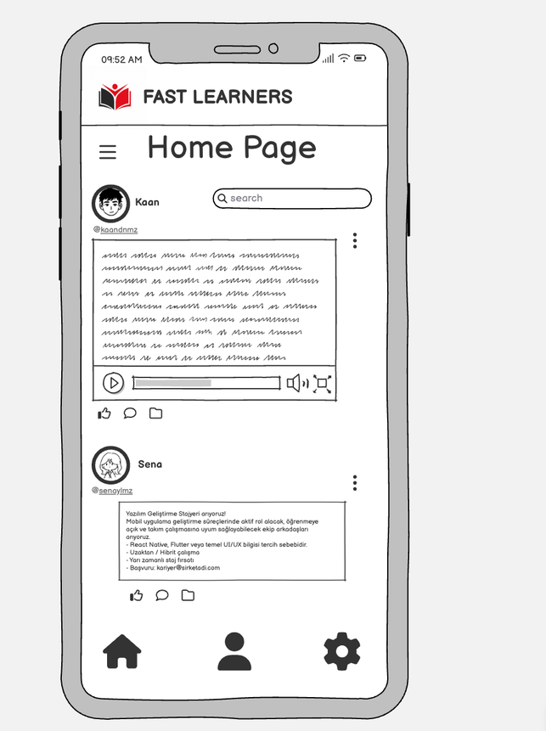
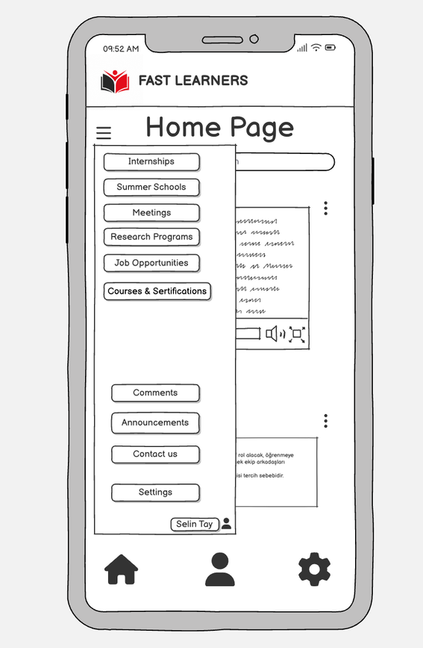
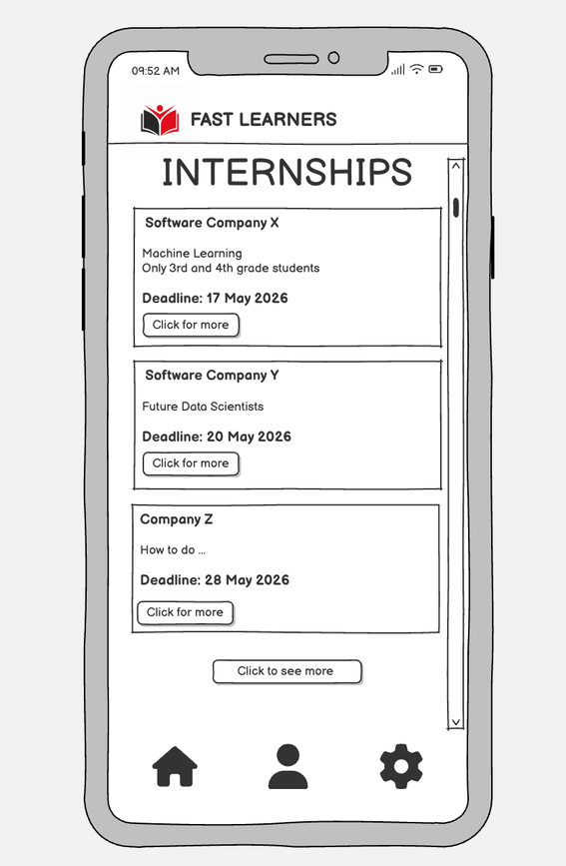
GUI

Slide 20

THANK YOU FOR LISTENING!
Any Questions?

