Slide 1

CASE Deliverables:

Slide 2



Slide 3





Slide 4



Slide 5

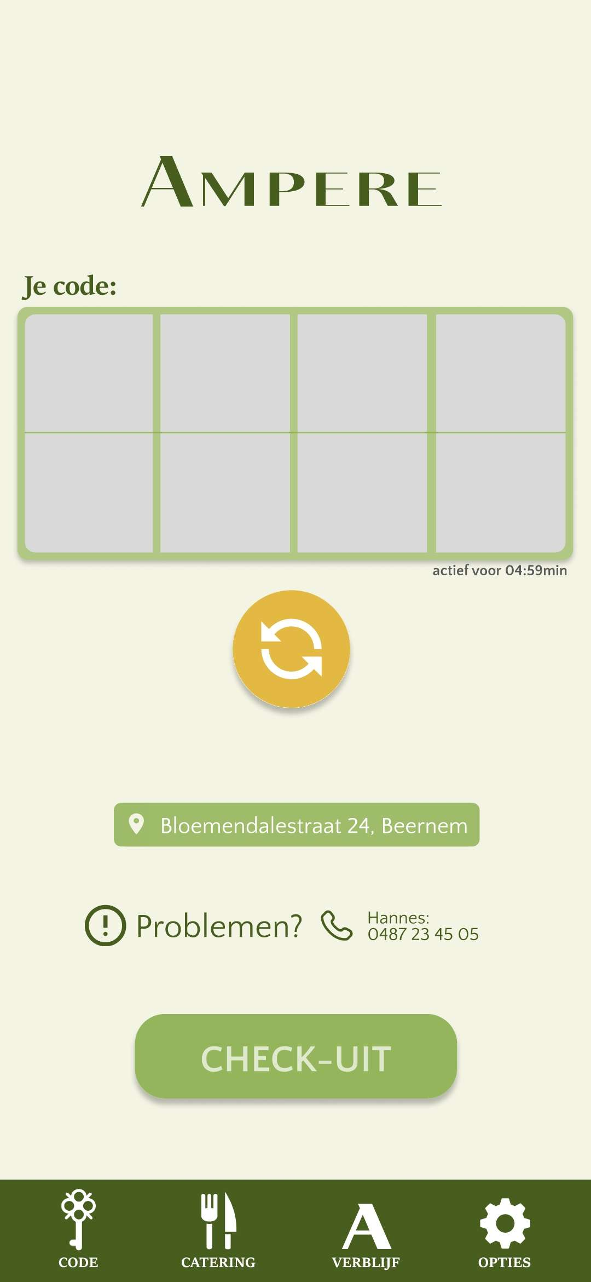
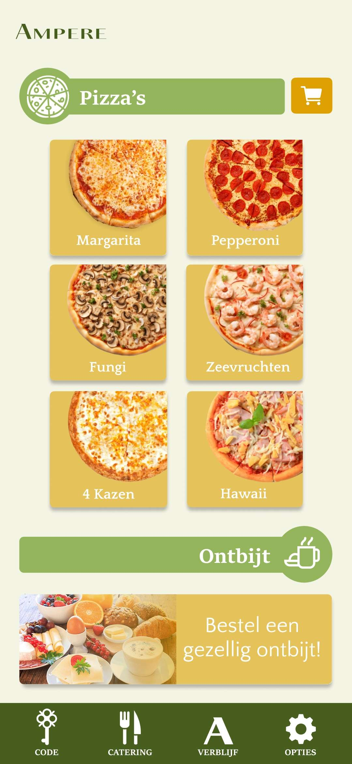

Slide 6


