Slide 1

Kaan Işıldak Mathematics Engineer Analyst Intern @B/S/H Home Appliances Group Istanbul, Turkey
Wolt Business Intelligence Summer Internship Application

Slide 2
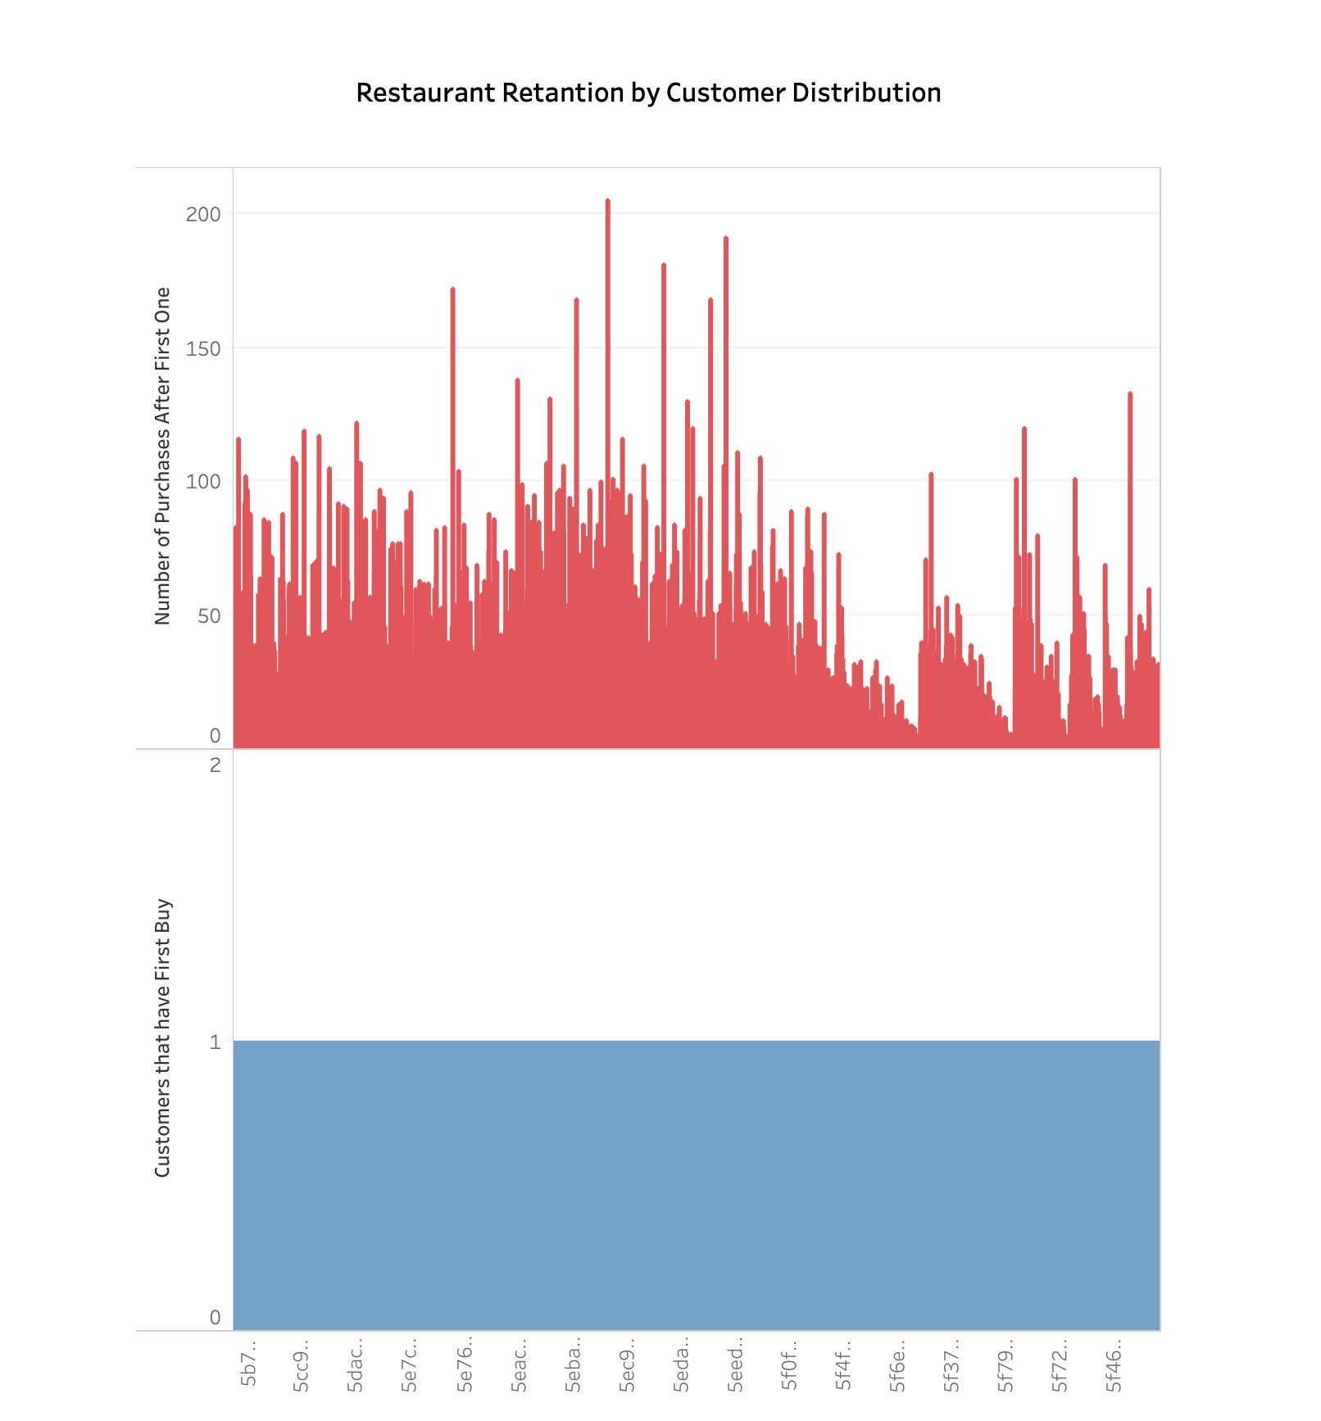
Here, we can detect which customers are purchasing and how many times they do this action and hence which ones are providing us more revenue in terms of Restaurants.

Slide 3
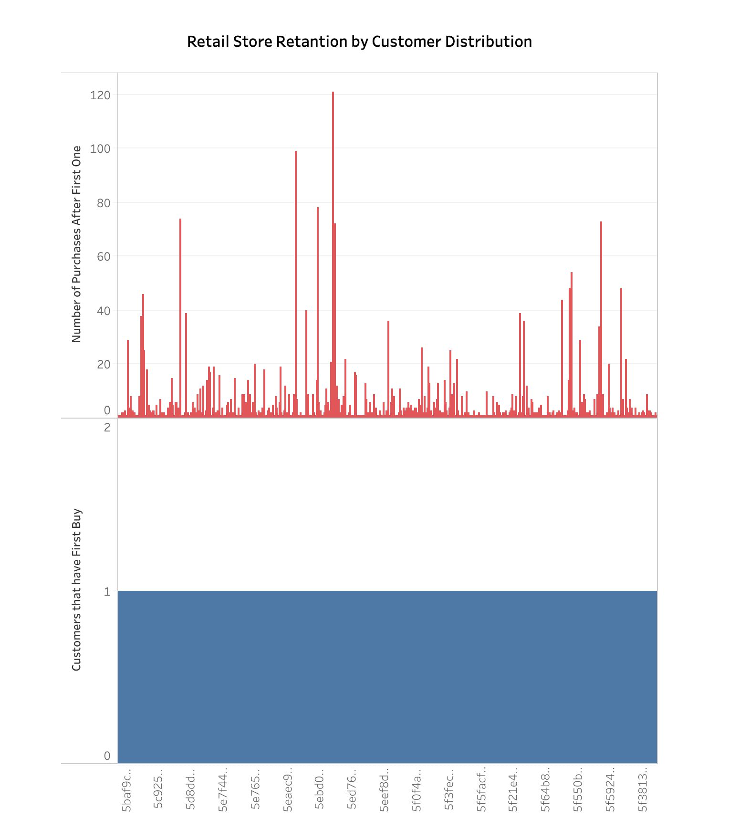
Here, we can detect which customers are purchasing and how many times they do this action and hence which ones are providing us more revenue in terms of Retail Stores.

Slide 4
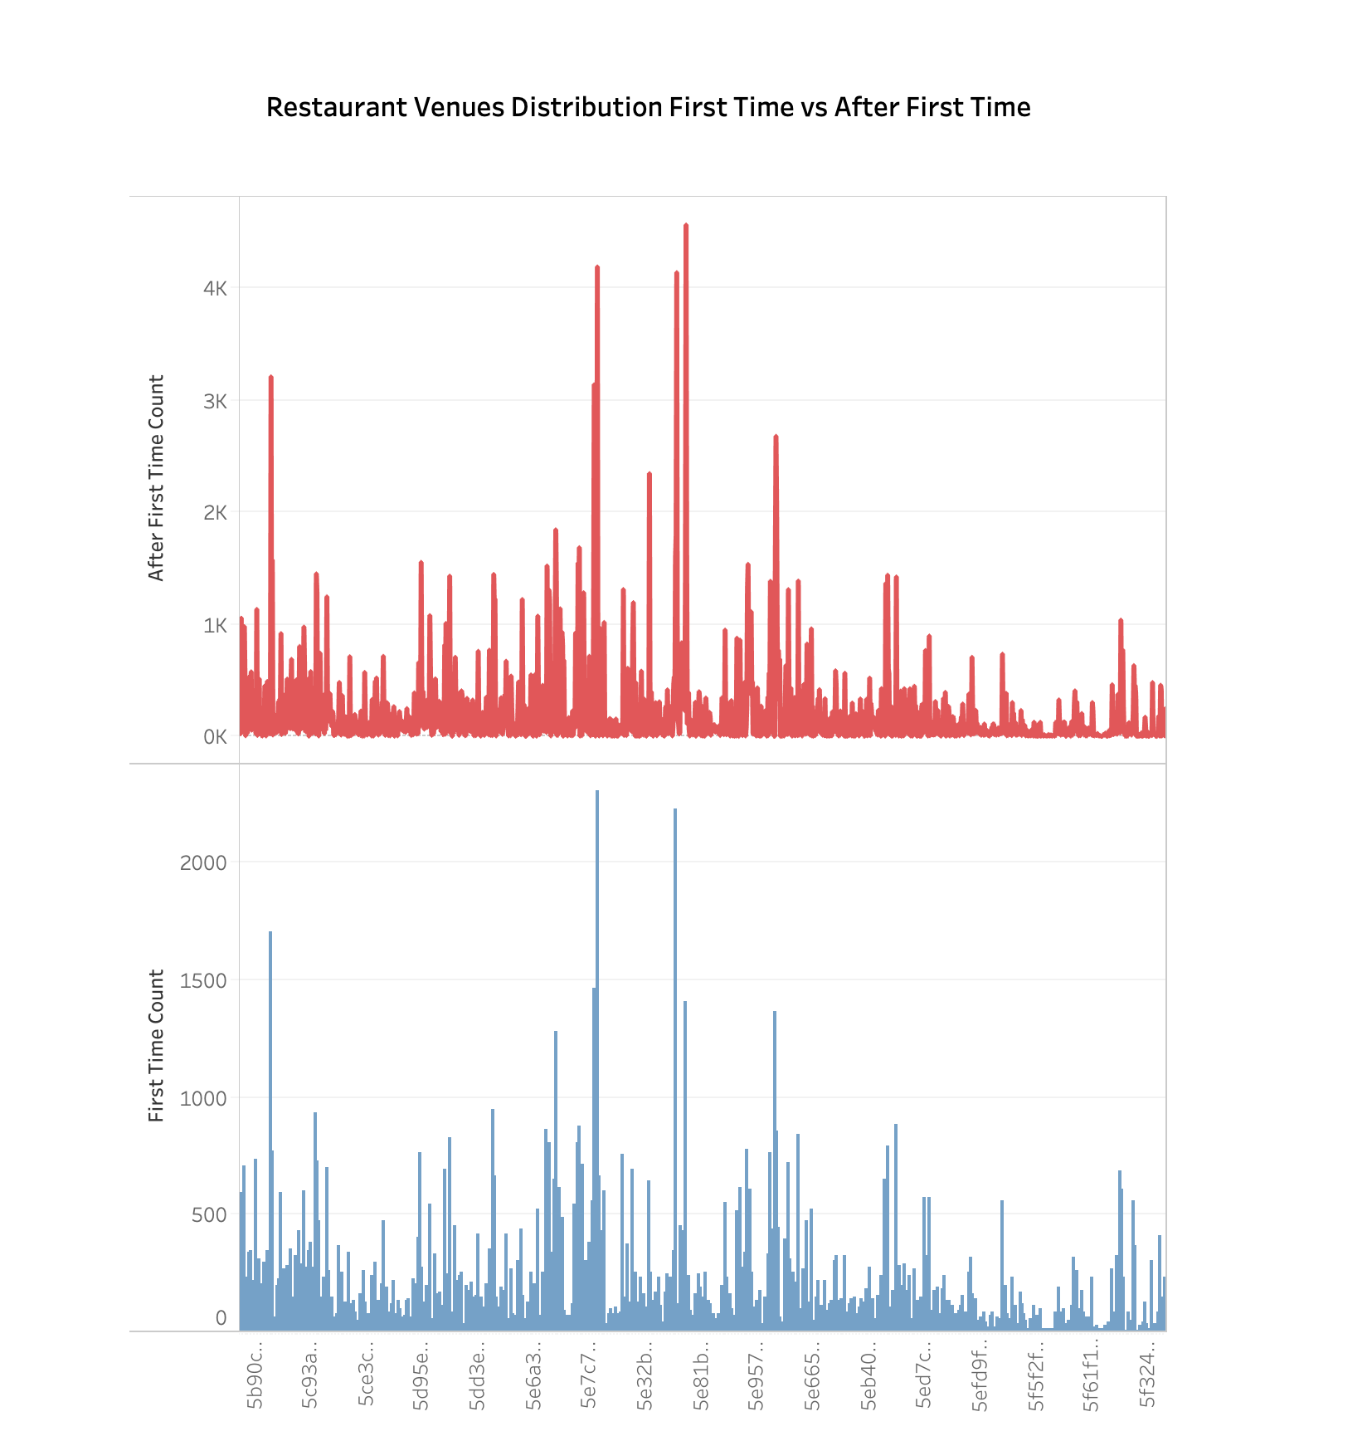
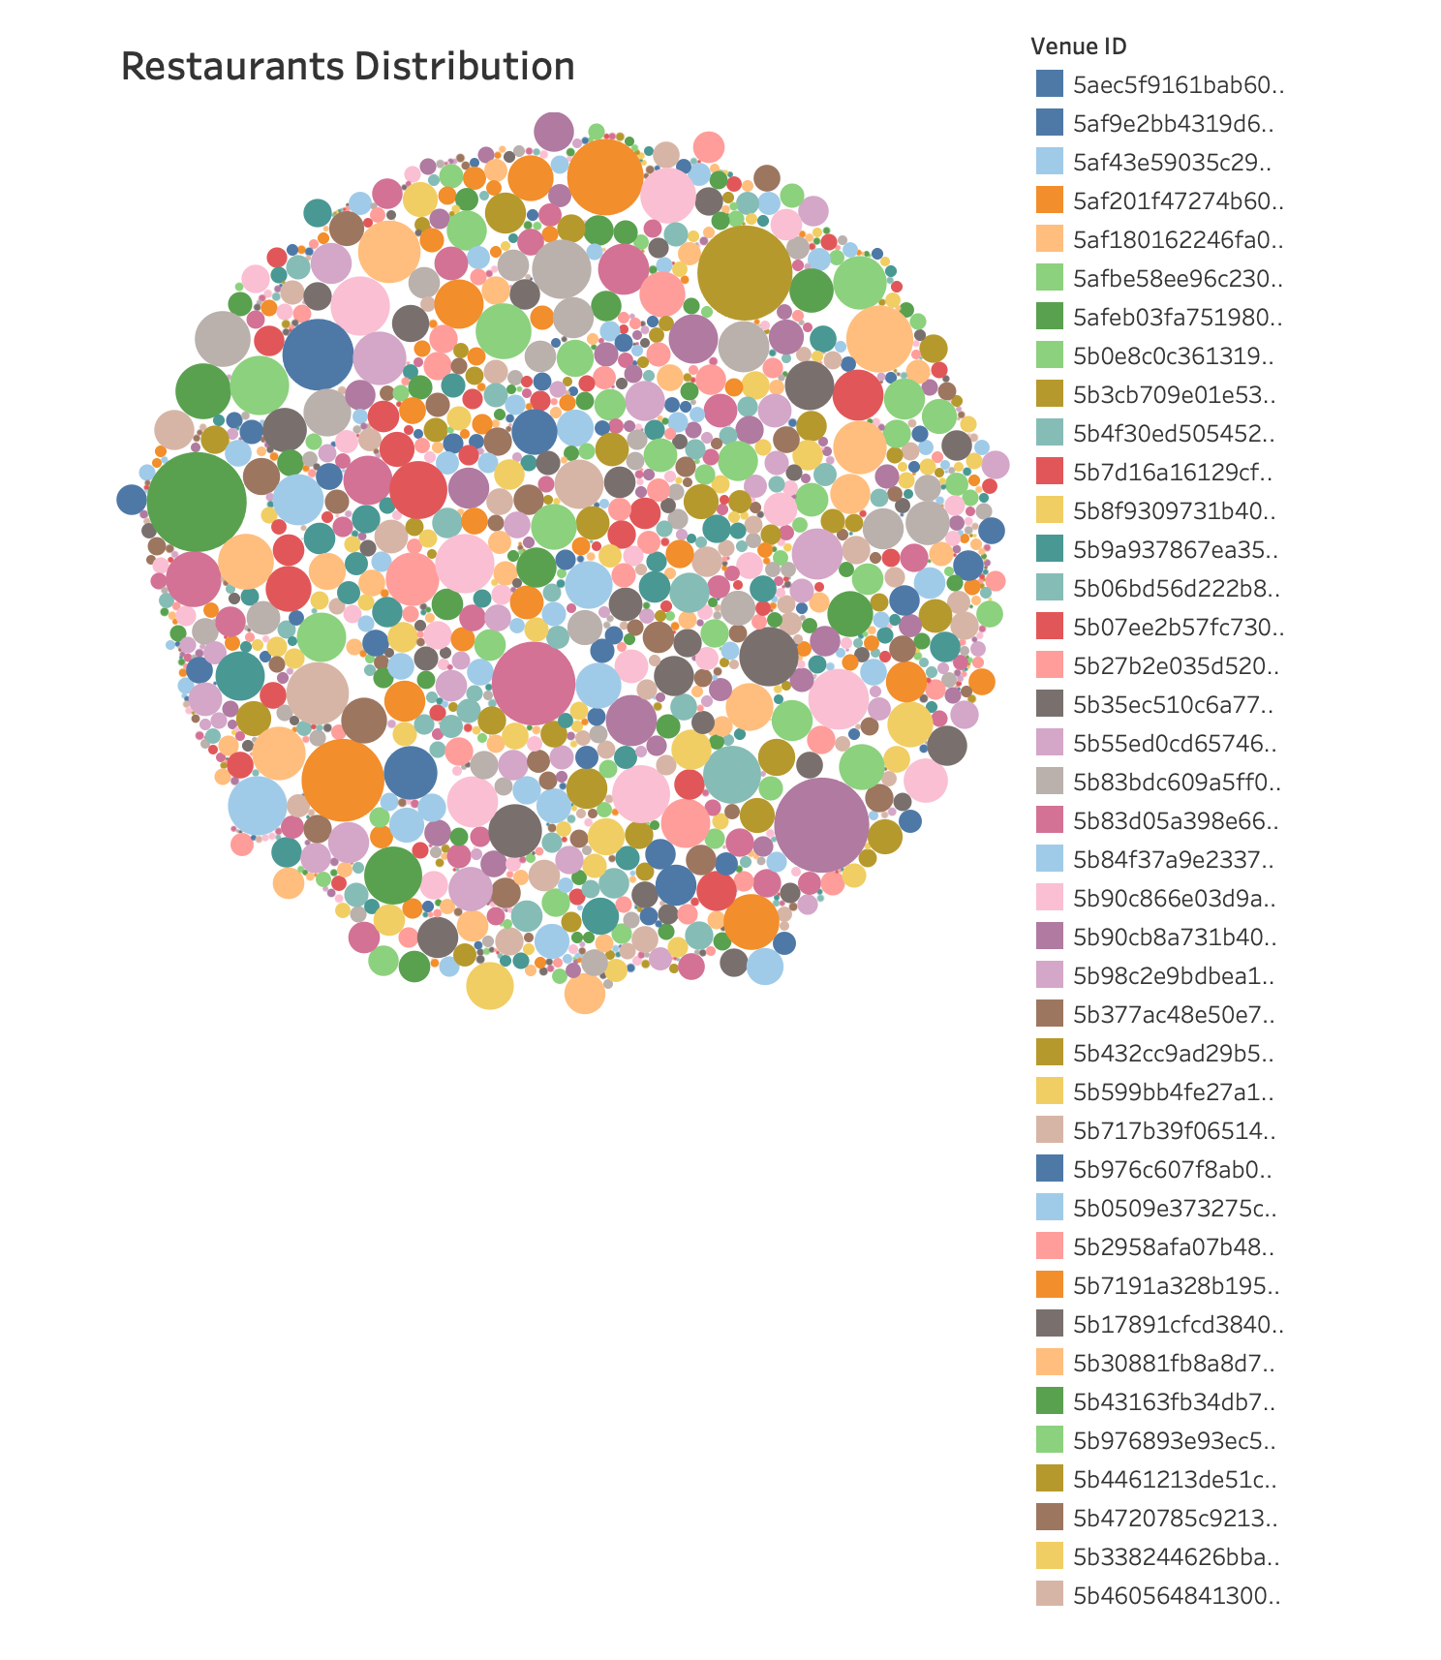
Here, we can detect which venues are populer among others and hence which ones are providing us more revenue in terms of Restaurants.
Here, we see the distribution of our Restaurants according to the number of purchases are made from them and hence are able to detect which ones are more popular and offers more revenue.

Slide 5
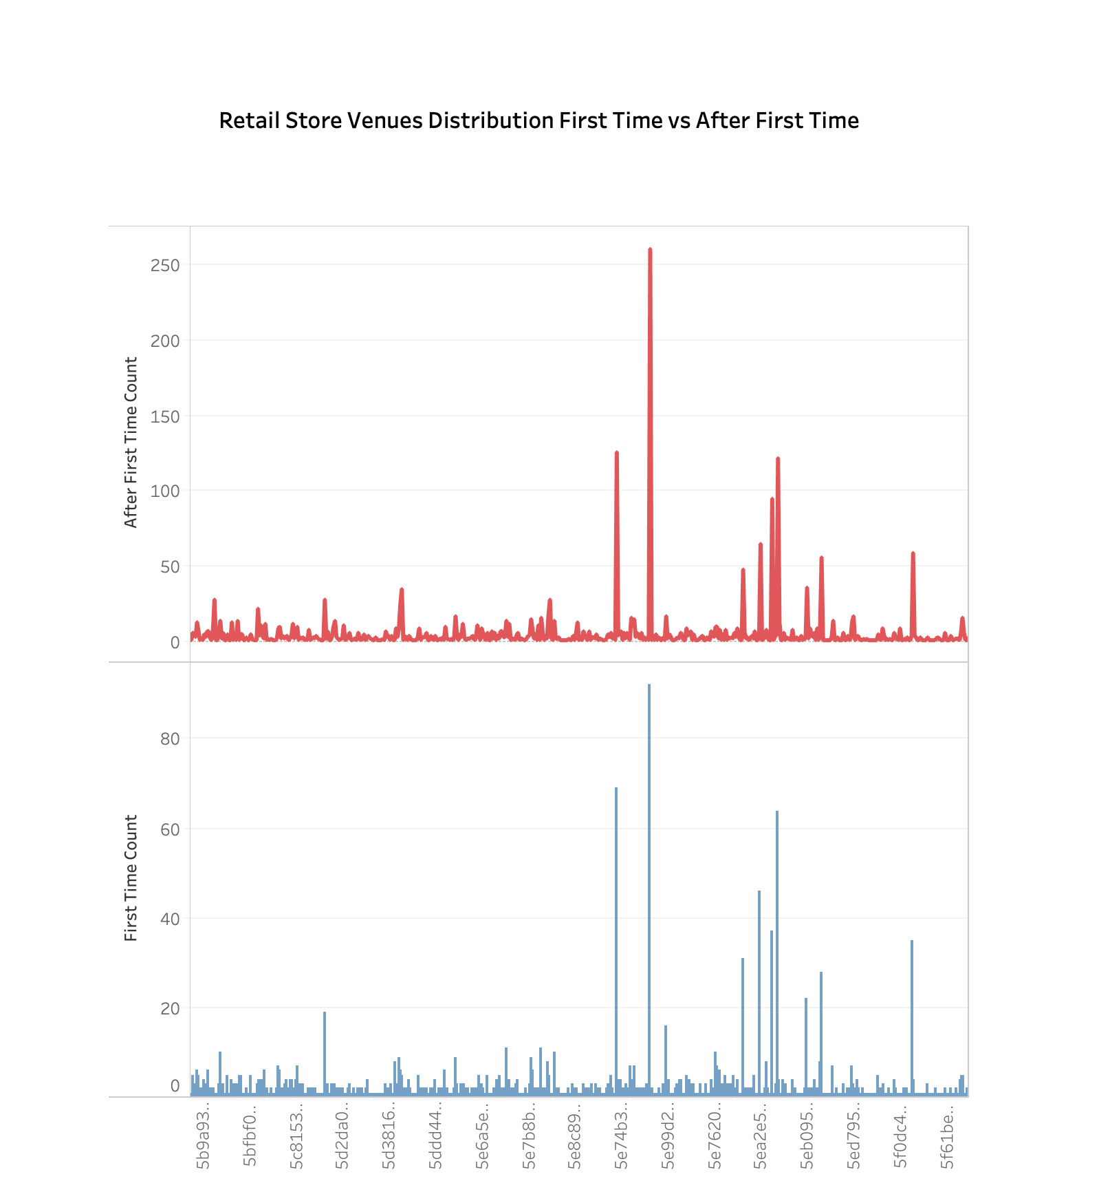
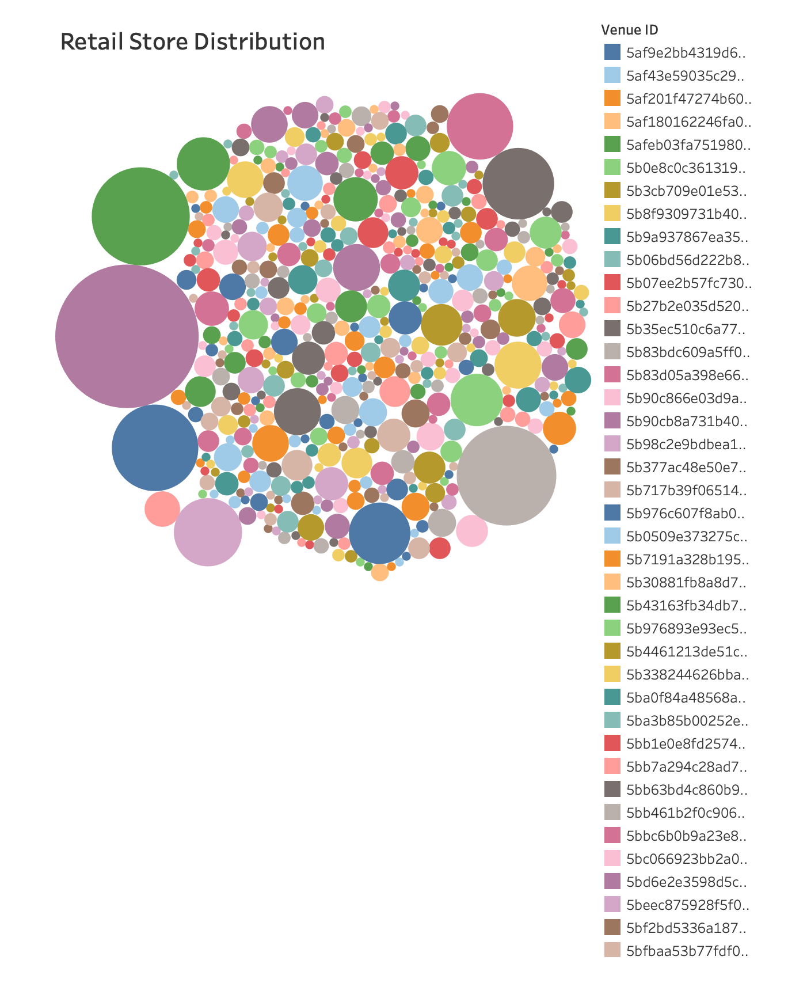
Here, we can detect which venues are populer among others and hence which ones are providing us more revenue in terms of Retail Stores.
Here, we see the distribution of our Retail Stores according to the number of purchases are made from them and hence are able to detect which ones are more popular and offers more revenue.

Slide 6
● What assumptions about the data have you made to produce the retention charts?
- I believed that the User ID, Venue ID​ and Product Line​ represent the same orders and customers meaning they are linked.
Was there anything problematic in the data?
- I had a very small amount of time to focus on this work since i just came across with internship opportunity.
● What other measures than retention would you look at when analysing customers' satisfaction to a product/service?
- The time of their purchases, amount of money they are willing to offer and perhaps clustering around the ProductIDs and finding the number of sales of each product may help us decide what to invest our resources to, perhaps giving more advertisement resource to a particular product or venues in our case.

