Slide 1
Social Prediction Error Signals During the Trust Game in Patients with Schizophrenia: An fMRI Study

Slide 2
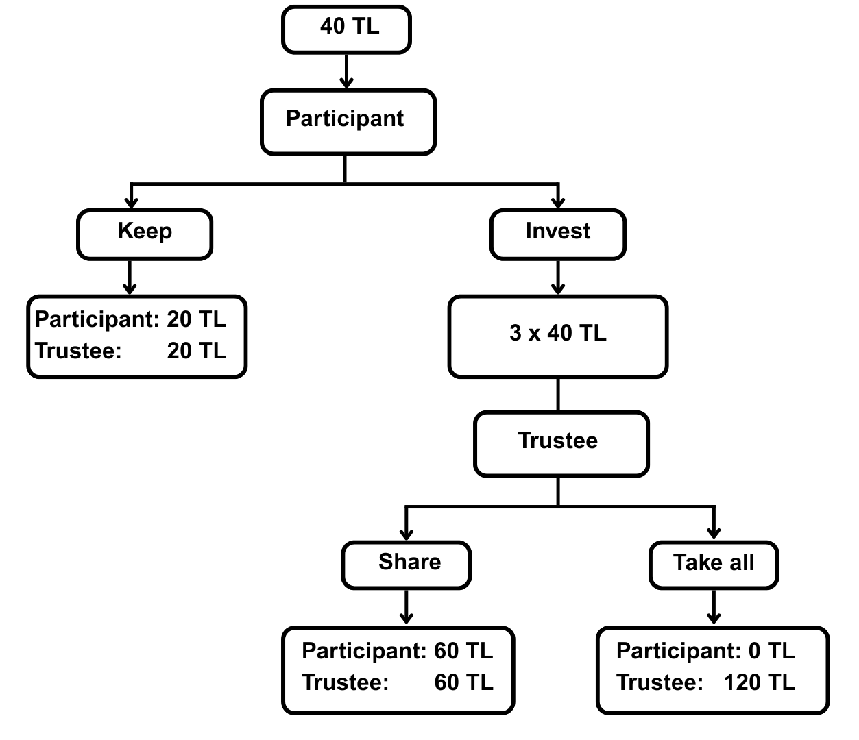

Slide 3
Phase 1: 20 (80%) – Phase 2: 20 (50%) – Phase 3: 20 (80%)

Slide 4
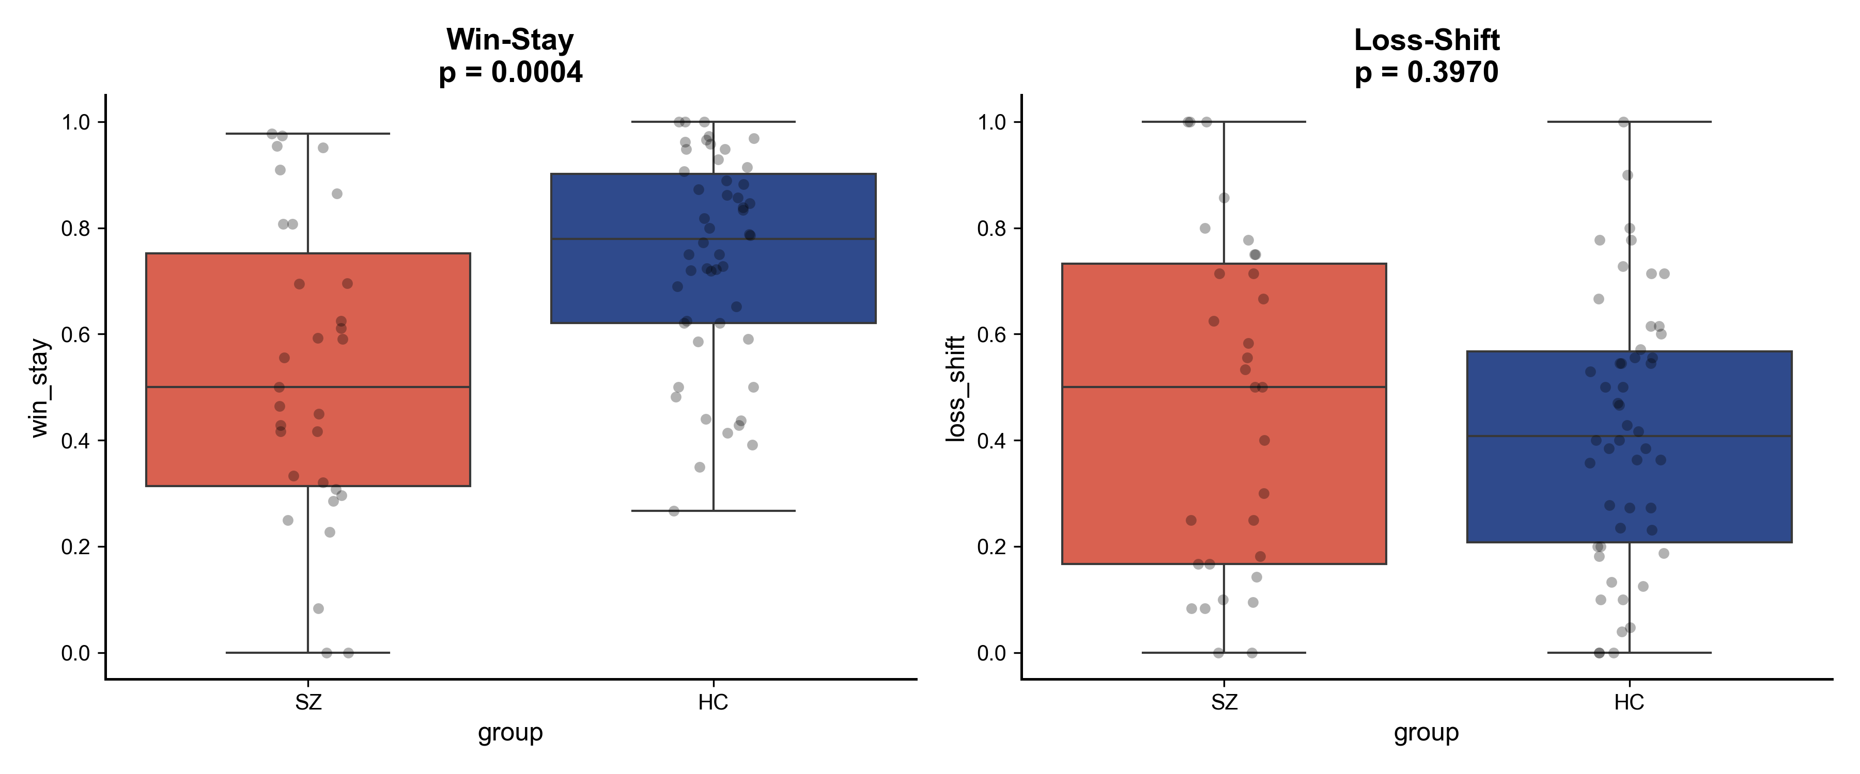
Behavioral Differences
Following a positive outcome, SZ is significantly less likely to repeat the successful choice.
Both cohorts exhibit similar, adaptive tendencies to shift their choices following negative feedback.

Slide 5
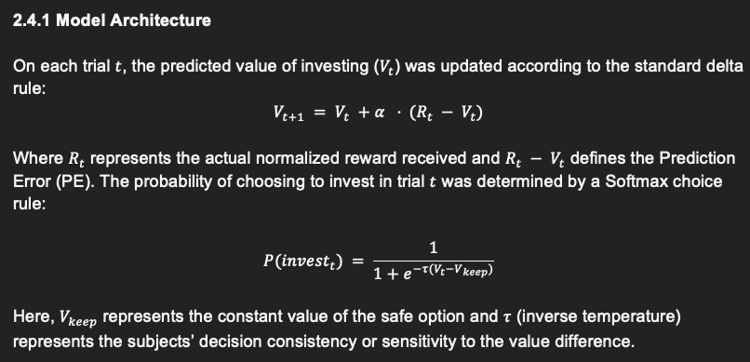
Reinforcement Learning Model

Slide 6
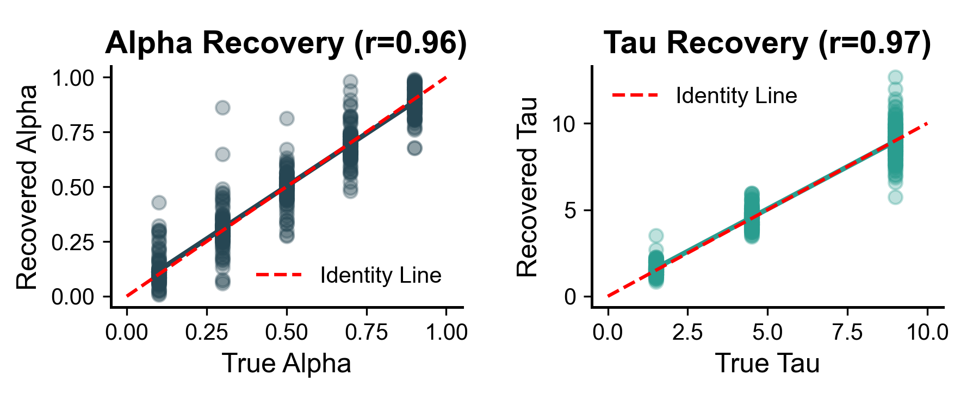
Control Analysis : Parameter Recovery

Slide 7
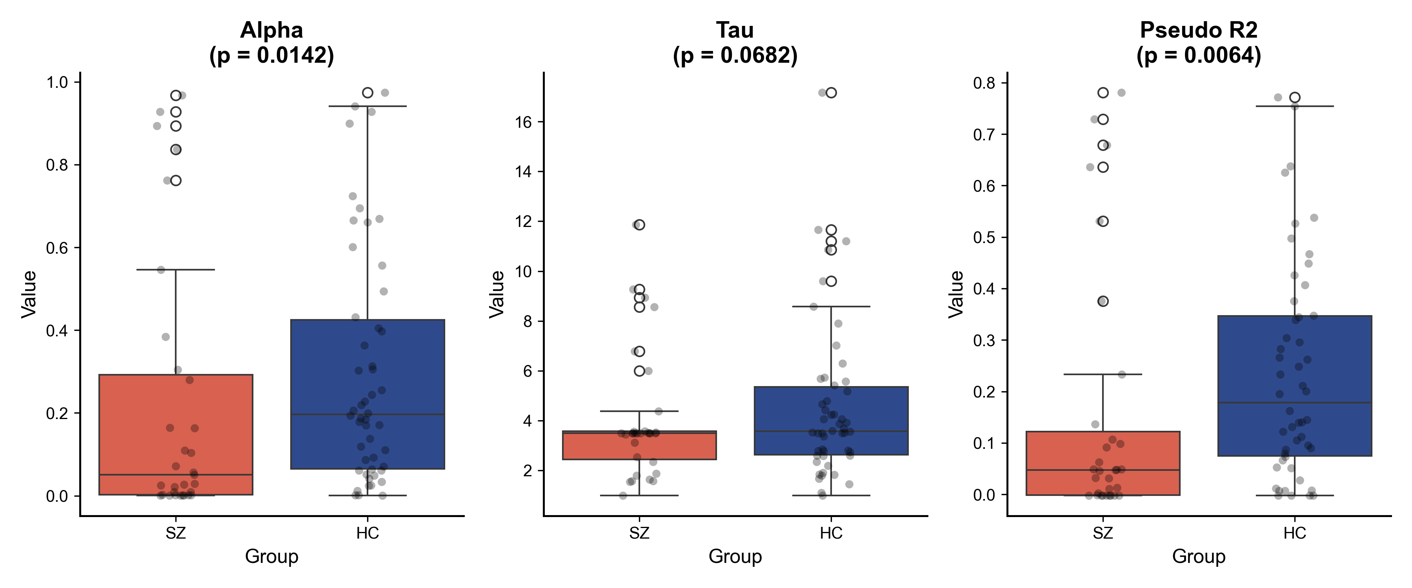
Computational Parameters

Slide 8
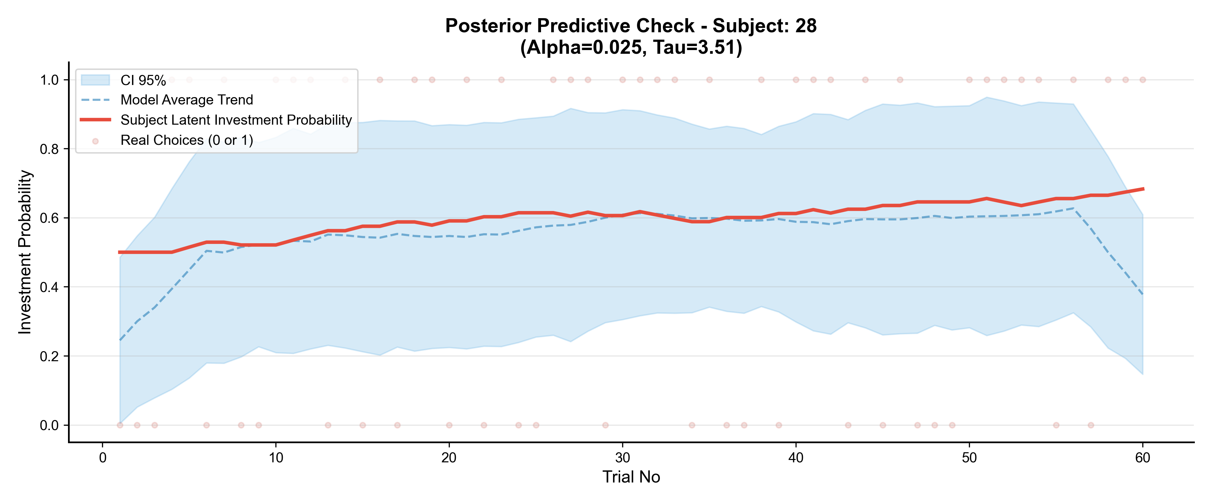
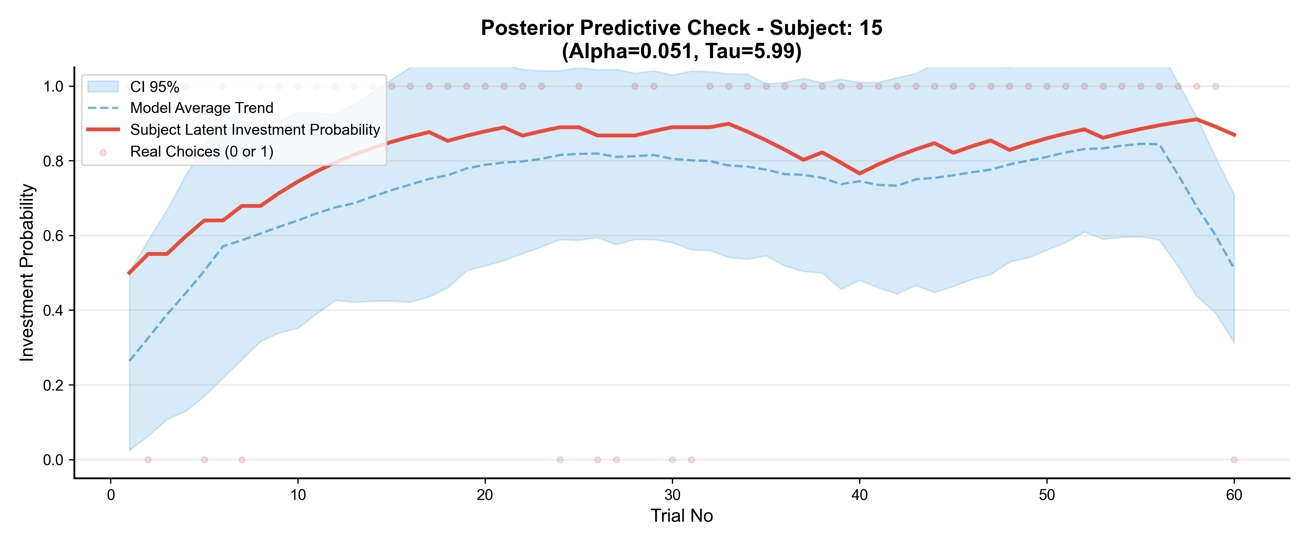
Control Analysis : Predictice check of parameters

Slide 9
Parameters relation to clinical features (in SZ)
1. alpha ~ DOI + PANSS_pos_z
2. log_tau ~ DOI + PANSS_pos_z
- Beta_PANSS_pos = -0.5256, p = 0.019).
- Meaning: Patients with more severe positive symptoms (delusions/hallucinations) have significantly lower decision temperatures. They make more deterministic, rigid choices based on their internal values and explore less.
- DOI: Beta = 0.0194, p = 0.082.
- Meaning: Suggesting patients with longer illness duration might explore slightly more, but this is not fully significant.

Slide 10
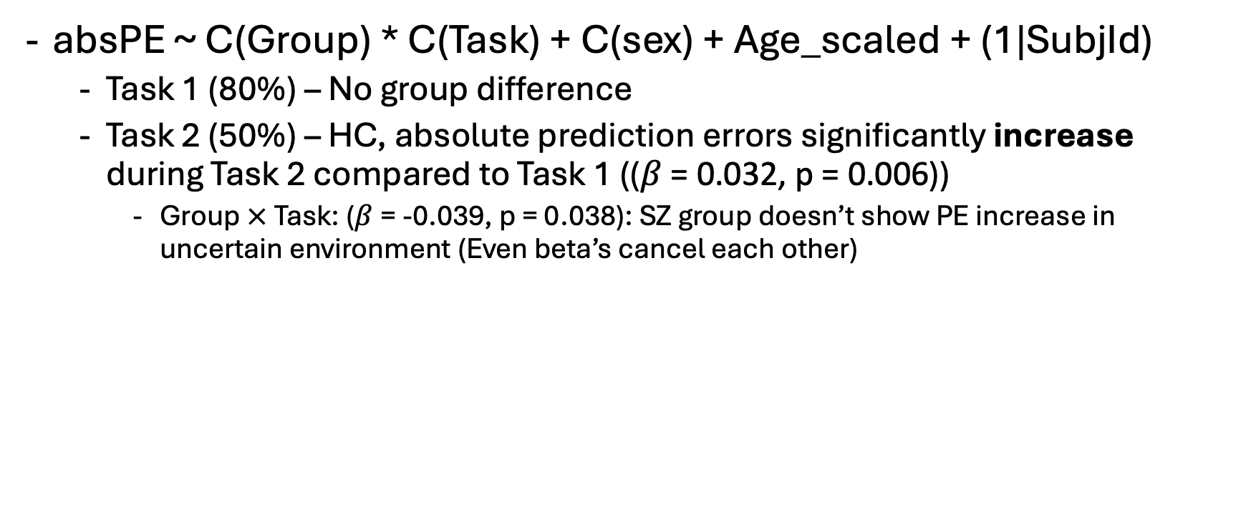
PE statistics
absPE ~ C(Group) * C(Task) + C(sex) + Age_scaled + (1|SubjId)
Task 1 (80%) – No group difference
Task 2 (50%) – HC, absolute prediction errors significantly increase during Task 2 compared to Task 1 (($β$= 0.032, p = 0.006))
Group $×$Task: ($β$= -0.039, p = 0.038): SZ group doesn’t show PE increase in uncertain environment (Even beta’s cancel each other)

Slide 11
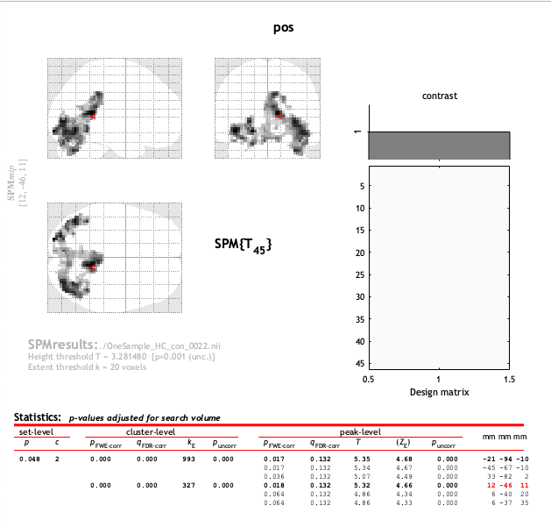
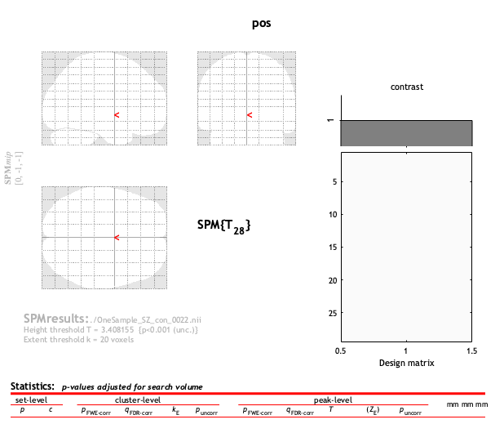
How PE related with BOLD signal ?
One sided: Precuneus + PCC + Fusiform gyrus only for HC

Slide 12
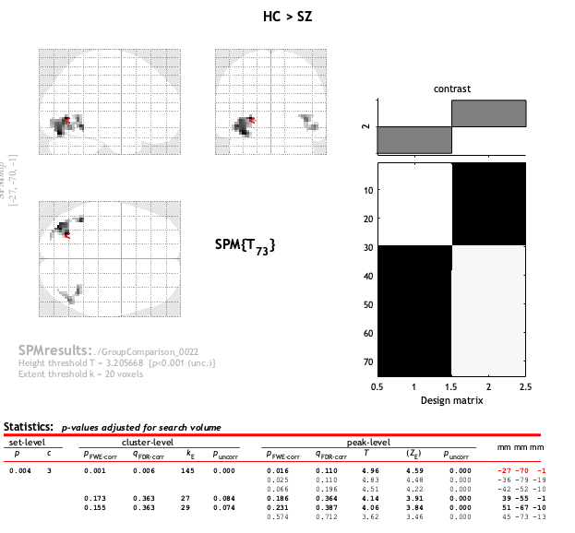
In contrast analysis only fusiform gyrus

Slide 13
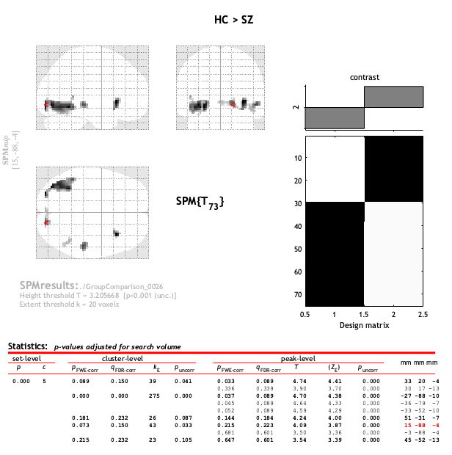
Only to stimuli independent from the PE

