Slide 1
STELLAR DEVELOPERS MEETING · [DATE]
USDT0 on Stellar
Tether's USDT delivered over LayerZero's OFT standard: how it works on Stellar, what a developer can read, send and track, and nine live demos you can fork.
Kaan Kacar · Stellar Development Foundation
kaankacar.github.io/stellar-layerzero-demos
Notes:
Open with the one-liner: USDT0 is Tether's USDT delivered over LayerZero's OFT standard, built and operated by Everdawn Labs, live on Stellar mainnet since 2 September 2026. Today: how it works, what you can build against it, and a live tour of nine demos. About 25 minutes plus questions.

Slide 2
WHAT USDT0 IS
One USDT supply, many chains, one message layer
USDT0 is Tether's USDT delivered over LayerZero's Omnichain Fungible Token (OFT) standard. Canonical USDT stays locked in an adapter on Ethereum; every other chain holds USDT0 minted against it. Everdawn Labs builds and operates USDT0. USDT itself is Tether's asset.
23 networks
Live on Stellar mainnet
Mainnet only
Listed at docs.usdt0.to (checked 10 September 2026). Stellar is one of them. HyperCore is listed but has no LayerZero endpoint id.
Announced 2 September 2026. The issuer was created on 21 July, its admin handed to a contract on 26 July, and then the issuer key was locked.
There is no USDT0 on Stellar testnet. Anything called USDT0 there is somebody's mock. The LayerZero endpoint is live on testnet, so your own test OFTs work there.
Sources: docs.usdt0.to · developers.stellar.org/docs/tokens/usdt0-layerzero
Notes:
Attribution matters: USDT0 is built and operated by Everdawn Labs, USDT is Tether's asset. Stress the mainnet-only point early, because every testnet demo later uses a mock called tUSDT0 and people will ask.

Slide 3
STELLAR · 28 SEPTEMBER 2026
Where USDT0 on Stellar stands today
23,717
2.58M
21 of 21
7
accounts hold a USDT0 trustline
USDT0 on Stellar
networks with an endpoint id are wired as peers
DVN operators registered on Stellar mainnet
13,561 on 11 September
2.57M of it inside 23 contracts
read from the OFT's peer(eid)
USDT0 requires 3 of them
USDT0 is the anchor tenant, not the only one: of the last 50 LayerZero messages out of Stellar, 38 were USDT0. The rest came from OApps that LayerZero Scan labels PayPal and Ethena.
Sources: Horizon /assets, OFT peer() via simulateTransaction, LayerZero registry and Scan, all read on 28 September 2026. The Inspector page reads the same values live.
Notes:
Exact figures, 28 Sept 2026: 23,717 authorized trustlines (Horizon accounts.authorized); 2,565,274 USDT0 in 23 contracts plus 10,952 in accounts plus 239 in liquidity pools, about 2,576,465 total; every one of the 21 USDT0 networks with an EID has a peer set on the OFT; the registry lists 7 active DVN operators on Stellar mainnet: LayerZero Labs, Horizen, Nethermind, Canary, USDT0, Paxos and Canary Sponsored. Trustlines grew 75 percent in 17 days. Scan's latest-50 lists show USDT0 plus OApps it names PayPal and Ethena; say only what Scan labels. For volume, point to the Dune dashboard and the Omnichain Dashboard page.

Slide 4
MECHANICS
Each leg has its own mechanism
Stellar · OFT type MintBurn
Ethereum · OFT Adapter
Send: your USDT0 is burned through the SAC
Receive: the SAC-manager mints to the recipient
Supply on Stellar always equals what was bridged in
Send: canonical USDT is locked in the adapter (approval required)
Receive: USDT is unlocked to the recipient
Nothing is ever minted on Ethereum
LayerZero message
Invariant: USDT0 minted across every other chain equals USDT locked in the Ethereum adapter. Never promise burn-and-mint on both ends of a route.
Read live on the Inspector: OFT.oft_type() = MintBurn on Stellar; adapter.approvalRequired() = true on Ethereum.
Notes:
Why MintBurn on Stellar: there is no pre-existing USDT to lock, and a classic asset whose admin is a contract can mint and burn. No honeypot of locked tokens sits on Stellar. The invariant is the whole security story of an OFT.

Slide 5
MECHANICS
Shared decimals: 7 on Stellar, 6 on the wire
Chains disagree on decimals (Stellar 7, USDT on Ethereum 6). OFTs agree on a shared precision of 6 and put a u64 on the wire. Everything below 0.000001 is dust and stays with the sender.
Step | Value
You type | 1.2345678 USDT0
amount_ld (7 decimals, what you pass to the OFT) | 12345678 stroops
decimal_conversion_rate | 10^(7-6) = 10
amount_sd (6 decimals, on the wire) | 1234567
Dust removed before the message is built | 8 stroops = 0.0000008 USDT0
amount_received_ld on a no-fee route | 1.234567 USDT0
quote_oft returns the exact amount_received_ld. Use it as min_amount_ld, or the send fails on slippage.
Notes:
The 6 decimal shared precision is USDT0's choice; the OFT stores it as shared_decimals with decimal_conversion_rate 10 on Stellar. The Explainer page has an interactive version of this table. Verified on mainnet: quote_oft of 10000001 stroops returns amount_sent_ld 10000000.

Slide 6
MECHANICS
How a message reaches Stellar
1 · Send
2 · Verify
3 · Commit
4 · Execute
5 · Mint
The source OFT calls the endpoint. A packet with nonce, source and destination EIDs, sender, receiver and payload is emitted.
Each required DVN independently attests the packet header and payload hash on the destination ULN302.
Once the required set has attested, the verification is committed on the receive ULN. Anyone can call this.
An executor calls lz_receive on the destination OFT with the payload. Anyone can be the executor.
The OFT asks the SAC-manager to mint USDT0 to the recipient under MINTER_ROLE.
USDT0's send config from Stellar to Ethereum, read live on the Inspector: three required DVNs (LayerZero Labs, Canary and USDT0) and 320 Stellar confirmations before they attest. The library default for that pathway is a placeholder; production OApps set their own.
Notes:
The Explainer page animates this. Key point for a Stellar audience: verification is a configurable committee per application, not a single bridge operator, and steps 3 and 4 are permissionless. That is what lets the Tracker page offer a deliver-it-yourself button when an executor lags.

Slide 7
MECHANICS
The Stellar twist: three contracts, one token
On EVM chains one contract is both the token and the OApp. On Stellar the token is a classic asset with a Stellar Asset Contract, and the LayerZero logic lives in a separate OFT contract that mints through a SAC-manager.
Classic asset USDT0
Stellar Asset Contract (SAC)
GATISXX6BZ6N…S6KXJHN6Q
CBSJZEIO5C7K…JKM4R26YF
Issuer key locked: master weight 0, no signers
Flags: auth_revocable and auth_clawback_enabled
No home_domain, so no stellar.toml
SEP-41 interface: balance, transfer, burn
7 decimals, symbol USDT0
admin() is the SAC-manager, not a key
SAC-manager
OFT contract (the OApp)
CA3GUWLOS3QK…L3KZYWGJ
CBOWOLFSDM5P…XINKUMMF6
Holds the SAC admin role
Mints only for MINTER_ROLE holders: the OFT
Owned by a OneSig multisig (CBCZ5CET…)
quote_oft, quote_send, send, lz_receive
Peers, enforced options, oft_type MintBurn
token() = SAC · endpoint() = EndpointV2
Notes:
Full addresses are on the Inspector page, which re-verifies the relationships live: OFT.token() equals the SAC, SAC.admin() equals the SAC-manager, the issuer has weight 0 and no signers. Why the issuer is locked: a payment from the issuer is minting, so a live issuer key could bypass MINTER_ROLE. The OneSig multisig owns both the OFT and the SAC-manager.

Slide 8
BUILDING
Reading USDT0 needs no key and no signature
Horizon (classic ledger)
Soroban RPC · simulateTransaction
GET /assets?asset_code=USDT0&asset_issuer=GATI… → supply split, holder count, issuer flags
GET /accounts/GATISXX6… → signers and thresholds (master weight 0 = locked), home_domain
OFT.token() · oft_type() · peer(eid) · is_paused()
OFT.quote_oft(p) · quote_send(p, pay_in_lz_token)
SAC.admin() · ULN302.effective_send_ul_config(…)
Simulate with any funded G account as the source. Nothing is signed, no API key.
The registry is the source of truth: GET metadata.layerzero-api.com/v1/metadata/deployments gives endpoint, ULN, executor and DVN addresses per chain. The Stellar testnet endpoint was redeployed in August 2026; every hardcoded address from before is stale.
stellar contract invoke --network mainnet --source-account <any G> --id CBOWOLFS… -- peer --eid 30101
Notes:
Same calls from the CLI: stellar contract invoke with any G account as source-account runs a simulation without signing. The Inspector page shows every request and response behind each card. Prefer RPC over Horizon; Horizon is only needed for the aggregate asset stats.

Slide 9
BUILDING
Sending USDT0 from Stellar
Build the SendParam: dst_eid, to (32 raw bytes), amount_ld, min_amount_ld, extra_options, compose_msg.
quote_oft returns amount_received_ld. Use it as min_amount_ld.
quote_send returns the native fee in XLM (plus an lz_token fee, unused by USDT0).
send: the OFT burns your USDT0 through the SAC and the endpoint emits packet_sent with the GUID.
Track the GUID on LayerZero Scan until it reads Delivered.
Fund-critical details
to is 32 raw bytes: the Ed25519 key of a G address or the id of a C address, never the strkey string.
A G recipient on Stellar needs a USDT0 trustline before the message lands.
The OFT combines enforced options for you. USDT0 enforces 80,000 gas for lzReceive on Ethereum.
Dust below 0.000001 never leaves your account.
Source: the OFT crate in the LayerZero monorepo. The Quotes and Playground pages show the exact XDR each step produces.
Notes:
The send is a normal Soroban invocation: the wallet authorizes the OFT to burn on its behalf and pays the LayerZero native fee in XLM. On delivery the destination OFT checks the peer and mints or unlocks. If the recipient is a G account without a trustline, the message will not deliver until one exists, so quote and check before sending real value.

Slide 10
BUILDING
Tracking a message, and finishing it yourself
Source tx
DVN attestations
Commit
Delivered
LayerZero Scan API, no key
Delivery is permissionless
/v1/messages/tx/{hash}
/v1/messages/guid/{guid}
/v1/messages/latest?srcChainIds=30600
Stellar testnet messages appear under the GUID first; the source tx link can lag by minutes. Read the GUID from the packet_sent event via RPC.
Once the required DVNs have attested, anyone can finish the message.
EVM: ReceiveUln302.commitVerification, then EndpointV2.lzReceive
Stellar: ULN302.commit_verification, then the OApp's lz_receive with you as the executor
The Tracker page has a button for it; execute-sepolia.ts and execute-stellar.ts do the same from the CLI.
The first tUSDT0 transfer in the repo was delivered this way. The testnet executor took 8 to 90 minutes on recent messages.
Notes:
Demo moment: paste a delivered mainnet hash into the Tracker and walk the lifecycle. On testnet, show the deliver-it-yourself button and explain that it is the same commitVerification plus lzReceive pair the executor would call, signed by MetaMask.

Slide 11
CONTEXT
Two stablecoins on Stellar, two bridge models
 | USDC via CCTP | USDT0 via LayerZero OFT
Standard | Circle's Cross-Chain Transfer Protocol | LayerZero V2 Omnichain Fungible Token
Who verifies | Circle's attestation service | The DVN set each app configures. USDT0 requires 3 of the 7 registered on Stellar
Token model | Native USDC on every chain: burn on the source, mint on the destination | Canonical USDT locked in an Ethereum adapter; USDT0 minted on every other chain
Who operates | Circle | Everdawn Labs (USDT0); LayerZero Labs and other DVN operators
Demo to fork | ElliotFriend/stellar-cctp-demo | kaankacar/stellar-layerzero-demos
Both have a page in the Stellar docs Tokens section. Many apps will end up holding both.
Notes:
This slide exists because the first question from a Stellar developer is usually how this differs from CCTP. Keep it neutral: one has a single trusted attester run by the issuer, the other has a configurable committee chosen per application. Both settle as real burns and mints, not wrapped IOUs.

Slide 12
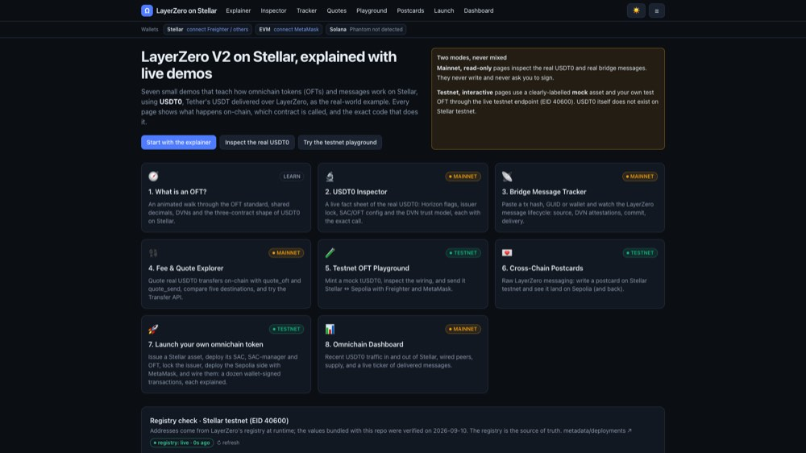
THE DEMO SITE
Nine demos, two modes, one static site
Mainnet · read-only
Inspector, Tracker, Quotes, Dashboard. They read the real USDT0 through Horizon, RPC simulation, the registry and Scan. They never ask you to sign.
Testnet · interactive
Playground (mock tUSDT0), Postcards (raw messages), Launchpad (your own OFT), Compose (a Soroban vault driven only from MetaMask). Freighter and MetaMask sign through the live endpoint; the EVM side is Arbitrum Sepolia.
Every page has the same shape: what is happening, the demo, and the real code it just ran, extracted from the repo at build time.
kaankacar.github.io/stellar-layerzero-demos · no backend, no secrets in the bundle; every panel degrades to a bundled snapshot when an API is down.
Notes:
Switch to the browser here. The badge in the top right tells the audience which mode a page is in, so nobody mistakes the mock tUSDT0 for the real asset. The ninth page, Compose, was added on 29 September: an OFT transfer with a compose message lands in a Soroban vault that credits the sender's EVM address, and the same MetaMask key withdraws with a personal_sign signature verified by secp256k1_recover on Stellar.

Slide 13
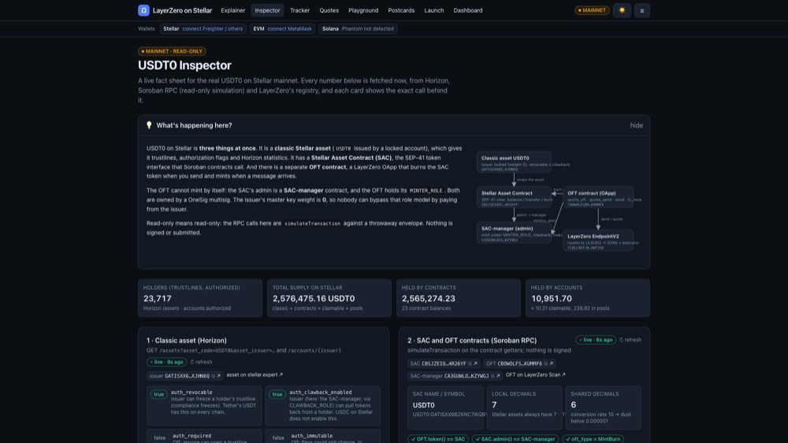
LIVE DEMO
Run order, about 18 minutes
Testnet demo: mock tUSDT0, no real funds
Inspector, 3 min: live facts, the three-contract check, 21 wired peers, the required DVN set.
Tracker, 2 min: pick a message delivered today and walk source, DVN attestations, commit, executed.
Quotes, 2 min: quote_send to five destinations on-chain, the fee in XLM, the dust calculator.
Playground, 4 min: faucet drip of tUSDT0, send Stellar to Arbitrum Sepolia with Freighter, track it. If the executor lags, deliver it ourselves.
Compose, 4 min: MetaMask only. Deposit tUSDT0 into the Soroban vault with a compose message, watch lz_compose credit the EVM address, then withdraw with a MetaMask signature.
Launchpad, 2 min: the twelve steps of a LockUnlock launch, pre-recorded or replayed by the e2e script.
Backups
e2e-testnet-send.ts and e2e-compose.ts sign the same flows with script keys. The EVM side moved to Arbitrum Sepolia on 29 September because the testnet DVN attests that pathway in seconds; Sepolia to Stellar testnet is still stuck.
Notes:
Before the call: Freighter on Test Net with XLM, MetaMask on Arbitrum Sepolia with a little ETH, a faucet drip already claimed (one hour cooldown), and the Tracker open on a delivered mainnet message. A real USDT0 one from 28 Sept, Stellar to Arbitrum, delivered: befef45e200af596169e24639e9a0e2befc5f72bc5e1c4f7ccfa76554f687d47. The Tracker's Try chips also list the latest live examples, but some are PayPal or Ethena OApps, so check the label. If the LayerZero Scan API is slow, the pages fall back to snapshots and say so; keep talking. Total 18 minutes leaves room for questions in a 45-minute slot.

Slide 14
PITFALLS
Six things that bit us on testnet
Symptom | Cause | Fix
Addresses from older guides fail | The Stellar testnet endpoint was redeployed in August 2026 | Resolve every address from the registry; compare OFT.endpoint() before sending
send fails with #1213 after quote succeeds | The ULN default config still names a deprecated DVN | Per-OApp set_config (types 2 and 3) naming the active DVN
A bare OApp send fails with #1114 | Empty options passed straight to the endpoint | Call combine_options before quote and send; the OFT does this internally
Scan returns 404 for a Stellar tx for minutes | Scan indexes Stellar testnet messages by GUID first | Read the GUID from the packet_sent event and query /messages/guid
Sepolia to Stellar testnet waits on the DVN for weeks | The LayerZero Labs testnet DVN has not attested that pathway since 9 September | Moved the EVM side to Arbitrum Sepolia (EID 40231) on 29 September: inbound attested in seconds
Delivery takes 8 to 90 minutes | Testnet executor lag | Deliver it yourself: commitVerification then lzReceive, from the Tracker or a script
Notes:
Every row is documented in the README with the exact error code and the fix in code. Row 3 was found by the end-to-end script, not by the compiler: the Postcard OApp shipped once without combine_options. Row 5 is why the whole testnet side now runs against Arbitrum Sepolia; the Sepolia contracts stay deployed but unused.

Slide 15
NEXT
Fork it, then build one of these
Links
Composed messages, the other way
Live site (MIT, no backend)
The Compose page does EVM to Stellar. Build the mirror: a Solidity composer that reacts to a tUSDT0 transfer sent from Stellar with compose_msg, and render Scan's destination.lzCompose in the Tracker.
kaankacar.github.io/stellar-layerzero-demos
Repository
github.com/kaankacar/stellar-layerzero-demos
Solana leg with Phantom
Stellar docs · Tokens · USDT0
Deploy the Solana OFT program on devnet and peer EID 40168 as a third chain. The wallet slot and the Phantom adapter are already in the repo.
developers.stellar.org/docs/tokens/usdt0-layerzero
LayerZero on Stellar
docs.layerzero.network/v2/developers/stellar
Stuck-message alert bot
USDT0 deployments · Dune
docs.usdt0.to · dune.com/stellar/stellar-layerzero-oft-volume
Poll /messages/status/INFLIGHT for Stellar pathways and post to Slack or Discord with a Tracker deep link. A GitHub Action on a cron is enough.
Notes:
CONTRIBUTING.md lists five extension ideas with the exact files to start from. The three shown here are the ones that fit a weekend. The repo has no backend and no secrets in the bundle, so a fork deploys to GitHub Pages as-is.

Slide 16
Questions?
Slides, code and every address are in the repo. Sent a real USDT0 message during the call? Paste the hash into the Tracker and we will watch it land.
Kaan Kacar · Stellar Development Foundation
kaankacar.github.io/stellar-layerzero-demos
Notes:
Leave this up during Q&A. Likely questions: fees in XLM versus destination gas, what happens if a DVN goes offline (the message waits; nothing is lost), whether USDT0 will come to testnet (no, mock it), and how this compares with CCTP (comparison slide).

