Slide 1
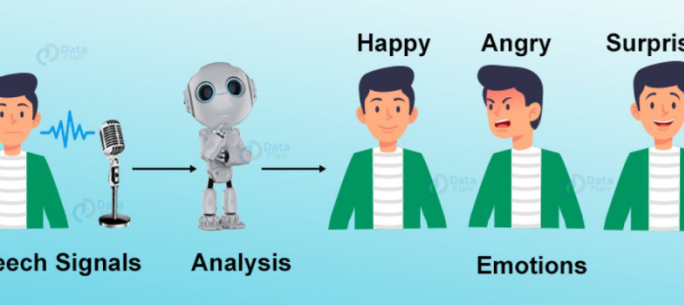
Speech Emotion Recognition Machine Learning for Signal Processing Term Project
Osman Kaan Kurtça – 040160090
Aziz Gündoğdu - 040160112

Slide 2
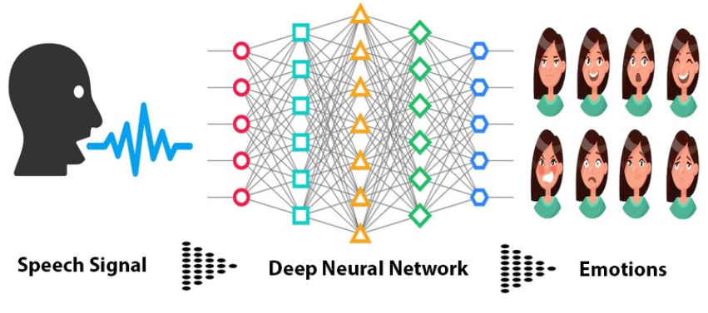
What we have done:
İmporting Human Speech Dataset including different emotions (RAVDESS)
Feature Extraction (MFCC, Chroma, MEL)
Data Preprocessing ( Normalization, Dimensionality Reduction (PCA), One-Hot and Label Encoding)
Determining the ML&DL models to be used. Training the dataset with models.
Evaluation of Test results and Determination of the best model.

Slide 3
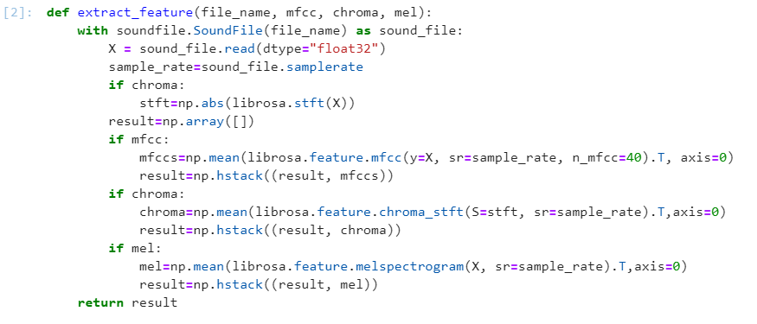
Feature Extraction
We have handled the RAVDESS dataset and converted the audio files into a matrix by extracting features of audio files. While each row of the matrix represents a different human speech, each column except the last one represents a feature. The last column represents the class of the data.

Slide 4

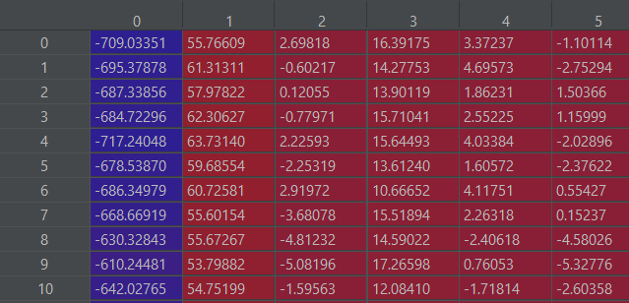
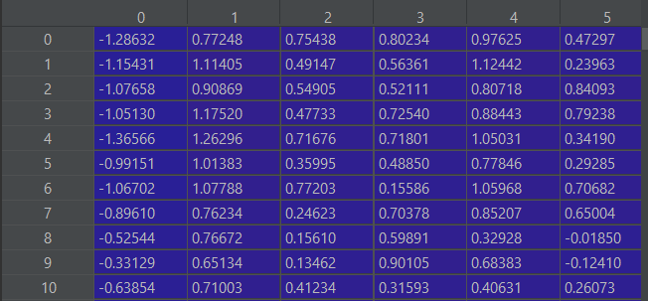
Data Preprocessing
Standard Scaler: The Standard Scaler assumes your data is normally distributed within each feature and will scale them such that the distribution is now centered around 0, with a standard deviation of 1. The mean and standard deviation are calculated for the feature and then the feature is scaled based on:
First 5 features of dataset before and after Normalization

Slide 5
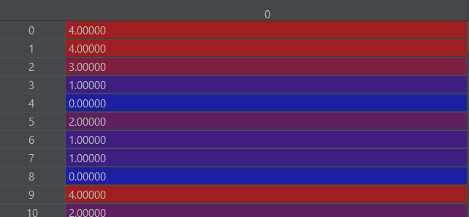
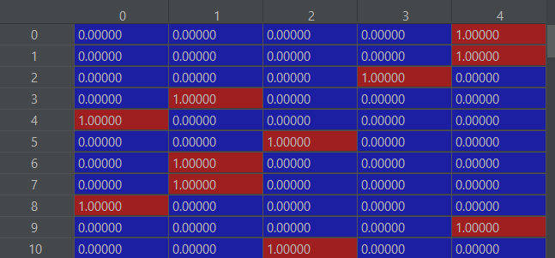


Dimensionality Reduction (PCA), One-Hot and Label Encoding
We applied principal component analysis (PCA) to reduce the dimension of our dataset.
Since our labels types are string, we should encode these as a numerical value. We will use one-hot or label encoding according to our model.
Label Encoding One-Hot Encoding

Slide 6

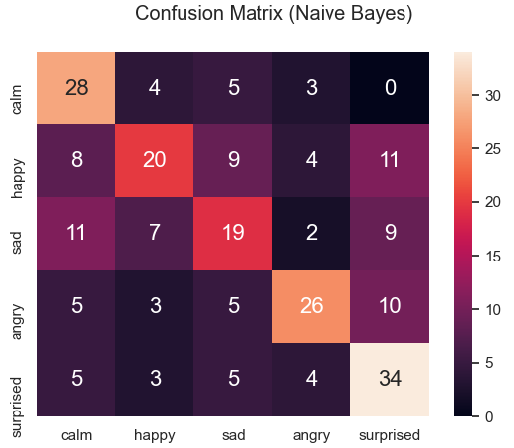
Naive Bayes Classifier
Naive Bayes classifiers are a collection of classification algorithms based on Bayes’ Theorem. It is not a single algorithm but a family of algorithms where all of them share a common principle, i.e. every pair of features being classified is independent of each other.
We got an accuracy rate of just over %50, and we observed that some emotions were likened to each other (‘calm’ vs. ‘sad’) and wrong predictions were made. It's hard to say it's a good estimate rate.
In Confusion Matrix, while column names refer to the actual classes, row names refer to the predicted classes.

Slide 7
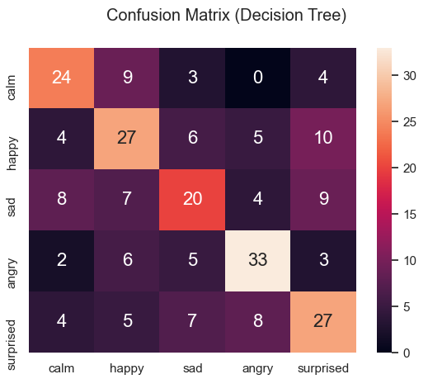
Decision Tree Classifier
Decision tree learning is one of the predictive modelling approaches used in statistics, data mining and machine learning. It uses a decision tree (as a predictive model) to go from observations about an item (represented in the branches) to conclusions about the item's target value (represented in the leaves). Tree models where the target variable can take a discrete set of values are called classification trees; in these tree structures, leaves represent class labels and branches represent conjunctions of features that lead to those class labels.
We see that our accuracy rate has increased and there are more accurate predictions in the error matrix than the naïve bayes classifier but our accuracy rate is still just over %50.

Slide 8
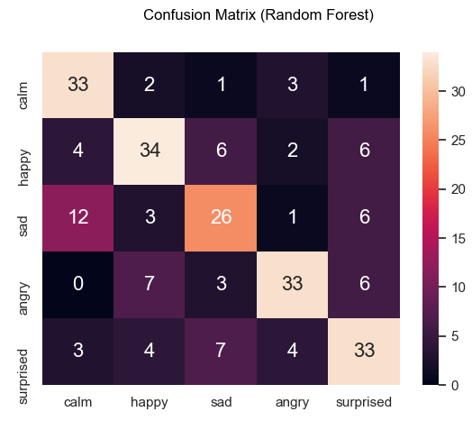
Random Forest Classifier
Random forests or random decision forests are an ensemble learning method for classification, regression and other tasks that operate by constructing a multitude of decision trees at training time and outputting the class that is the mode of the classes (classification) or mean/average prediction (regression) of the individual trees. Random decision forests correct for decision trees' habit of overfitting to their training set. Random forests generally outperform decision trees.
We see that we have significantly increased our accuracy rate but we can say that the model still does not predict ‘sad’ and ‘calm’ emotions well.

Slide 9
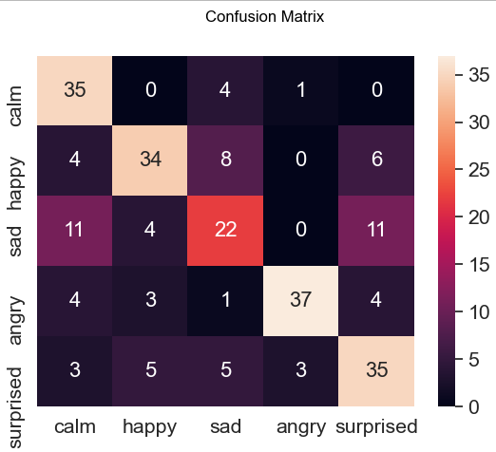
Support Vector Machines
The objective of the support vector machine algorithm is to find a hyperplane in an N-dimensional space (N — the number of features) that distinctly classifies the data points. To separate the two classes of data points, there are many possible hyperplanes that could be chosen. Our objective is to find a plane that has the maximum margin. Maximizing the margin distance provides some reinforcement so that future data points can be classified with more confidence.
We got a slightly better result than the Random Forest Classifier but when we examine the error matrix, we observe the same problem here. Now, we will use deep learning model for better results.

Slide 10
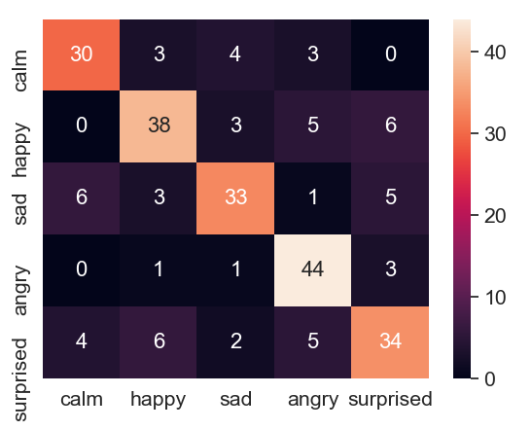
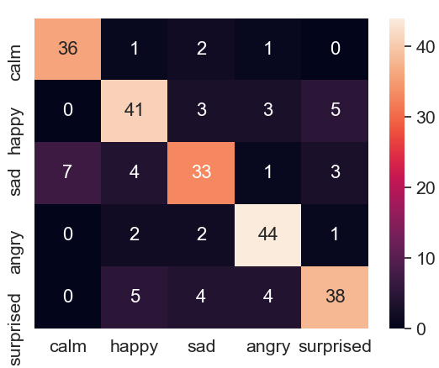
Multilayer Perceptron
A multilayer perceptron (MLP) is a class of feedforward artificial neural network (ANN). An MLP consists of at least three layers of nodes: an input layer, a hidden layer and an output layer. Except for the input nodes, each node is a neuron that uses a nonlinear activation function. MLP utilizes a supervised learning technique called backpropagation for training. Its multiple layers and non-linear activation distinguish MLP from a linear perceptron. It can distinguish data that is not linearly separable.

Slide 11

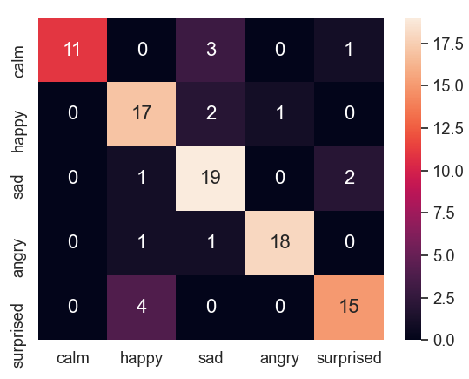
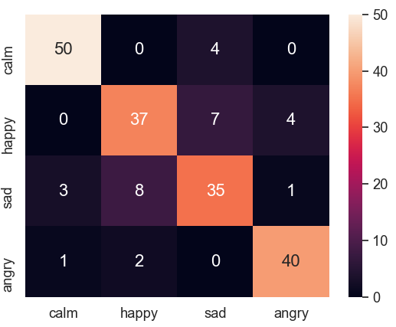
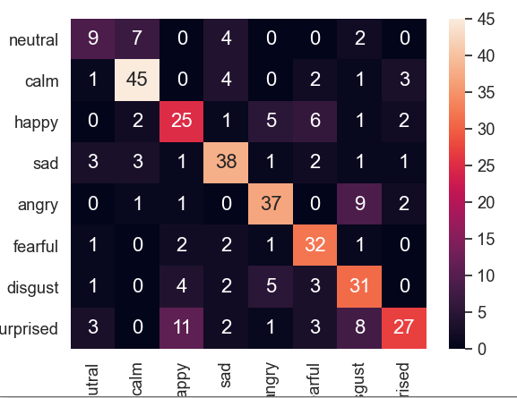
Conclusion
Our final accuracy score is 0.80. This is not a perfect accuracy rate, but we can say the this is best result compared to other models we use. We are able to predict 4 out of every 5 test data correctly.
As a result, we obtained an accuracy rate better than the accuracy of the study taken as the source (0.71) and we classified for more emotion. 5 emotions were used as label instead of 4.
Bonus
Confusion matrix for 0.1 Test set rate
Confusion matrix for 4 emotions
Confusion matrix for all emotions (8)

Slide 12
References
https://data-flair.training/blogs/python-mini-project-speech-emotion-recognition/
https://www.geeksforgeeks.org/naive-bayes-classifiers/
https://en.wikipedia.org/wiki/Decision_tree
https://towardsdatascience.com/understanding-random-forest-58381e0602d2
https://en.wikipedia.org/wiki/Training,_validation,_and_test_sets
https://en.wikipedia.org/wiki/Multilayer_perceptron
https://towardsdatascience.com/support-vector-machine-introduction-to-machine-learning-algorithms-934a444fca47
https://www.wikiwand.com/en/Support-vector_machine

