Slide 1
Age Detection Using Convolutional Neural Networks
Kaan Hamurcu 21902012
Ahmet Batuhan Sancak 21902087
Ömer Özaltan 21902973
Cemhan Kaan Özaltan 21902695
Efser Efe Kantik 21901418

Slide 2
Steps of the Project
Problem Definition
Age Detection as a Classification Task
Methods
Dataset Description
Results
Discussion
Conclusion
References

Slide 3
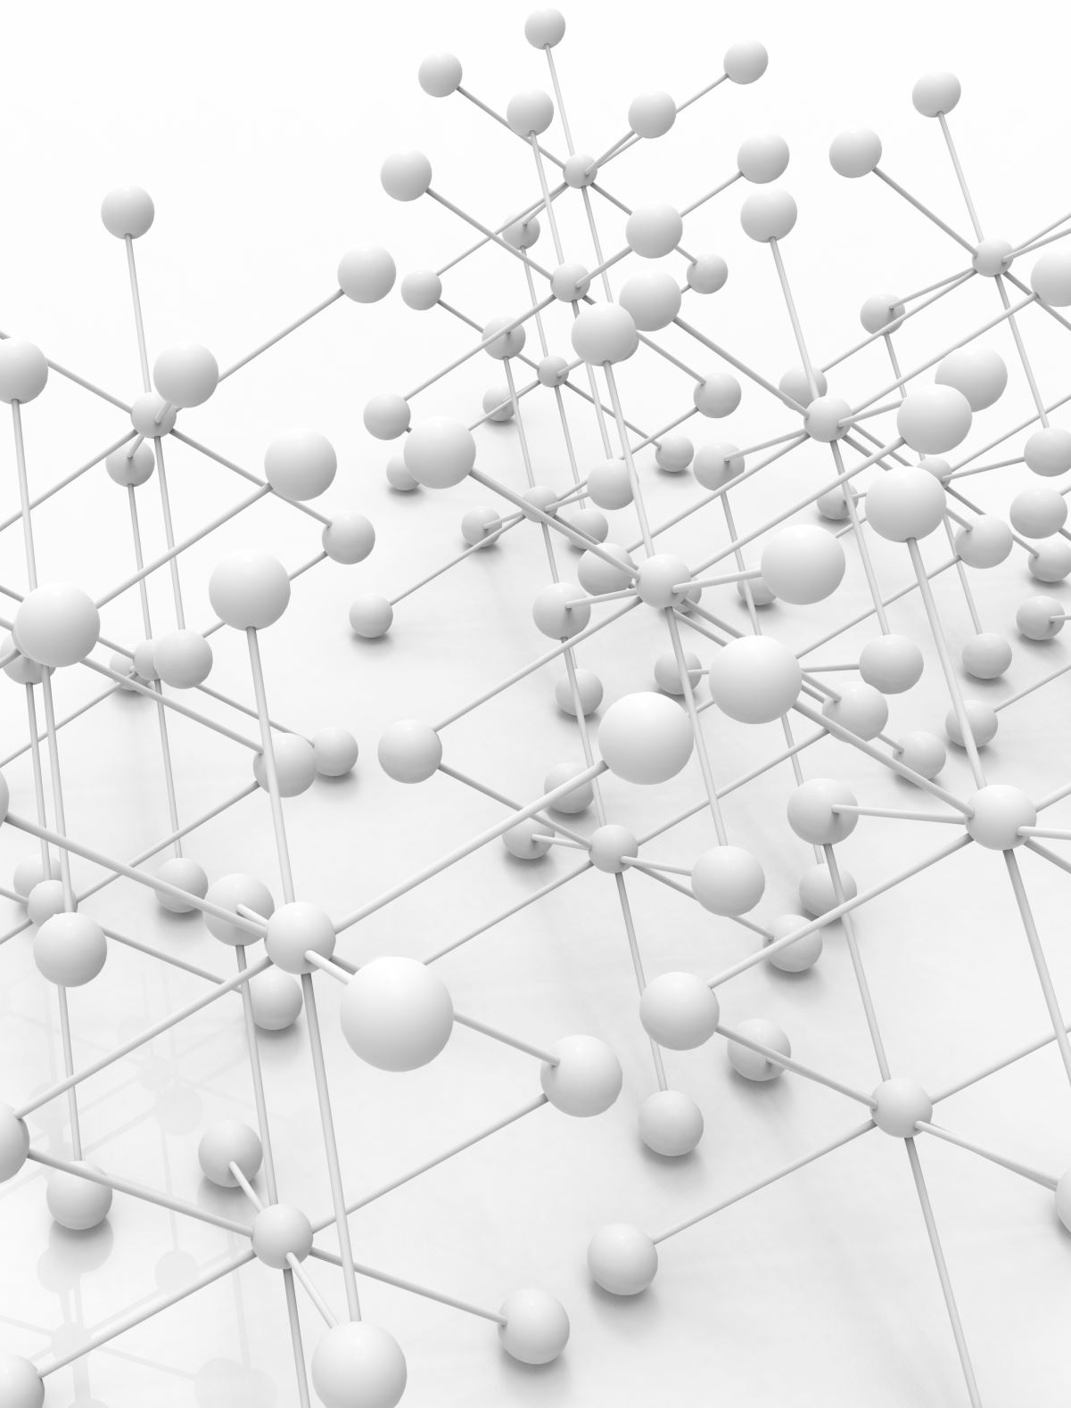
Problem Definition
Goal: Predict age interval of faces of individuals.
Proposed Solution: A convolutional neural network architecture will be utilized. Age intervals will be the outputs of classification.

Slide 4
Age Detection as a Classification Task
The outlined problem was identified as a classification task rather than regression to achieve a better accuracy for two reasons:
The first reason is that the dataset has some imbalances as mentioned. By combining ages into groups, a more balanced dataset can be obtained.
The second reason is that facial appearance does not vary across ages close to each other.
That is to say, for instance, the facial appearance of a person who is 27 would not differ much from their appearance when they were 25. Furthermore, people age at different rates. Therefore, facial patterns emerge in age groups more noticeable than at individual ages.

Slide 5
Methods
We have used Convolutional Neural Networks in our task.Our network consisted of 6 blocks; where each block contained a convolution layer, ReLU (rectified linear unit) activation layer and pooling layer (max-pooling).
All the layers will be connected through a forward pass layer.
Channel sizes of our convolutional layers will be 16, 32, 64, 128, 256, 512.
We used 3x3 kernel for convolution.
Stride for convolution layer was 1, whereas padding was also 1.
Batch size for our epochs was 32.
Our learning rate was 0.01.
We have used a weight decay of 0.0005.
Loss function that was used at the training was cross entropy loss.
Our optimizer was SGD (stochastic gradient descent).

Slide 6
Methods
According to [3], age intervals should be devised such that they will be 2-3, 4-6, 7-8, 9-11, 12-20, 21-35, 36-50 and 51-80; corresponding to infancy, early childhood, middle childhood, late childhood, adolescence, early adulthood, midlife and mature adulthood age.
Nonetheless, our dataset also had images for individuals outside these ranges. Therefore the ranges were updated to the following:
Class 0 for 1<= x <= 3
Class 1 for 4 <= x <= 6
Class 2 for 7 <= x <= 8
Class 3 for 9 <= x <= 11
Class 4 for 12 <= x <= 20
Class 5 for 21 <= x <= 35
Class 6 for 36 <= x <= 50
Class 7 for 51 <= x <= 80
Class 8 for 81 <= x <= 116

Slide 7
Methods
Moreover, other than training our CNN model; we have also utilized a pretrained model which is ResNet-18. ResNet-18 has 11.7 million parameters [4]. The comparison between our CNN model that was trained from scratch and the model making use of transfer learning will be made.

Slide 8
Dataset Description
Our dataset comprises of the “facial age” dataset [1] and the “UTK Face” dataset [2]. They contain 9778 and 23,708 colored images, respectively.
The images in both of these datasets are of human faces and are composed of 200x200 pixels. Moreover, all of them are labeled with ages ranging from 1 to 110 and 1 to 116, respectively. The ages are mostly balanced throughout this interval except for a spike at age 26, where there is an intensity of available samples. Furthermore, the concentration of samples is lower for ages larger than 65.

Slide 9
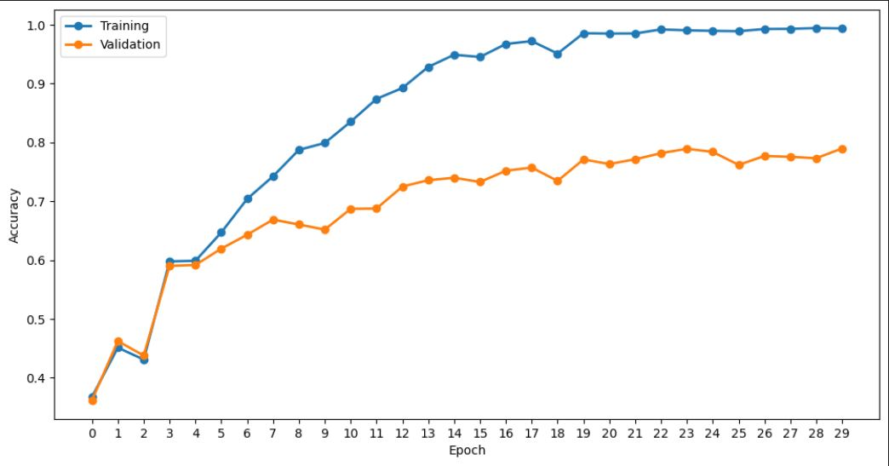
Results (CNN Model)

Slide 10
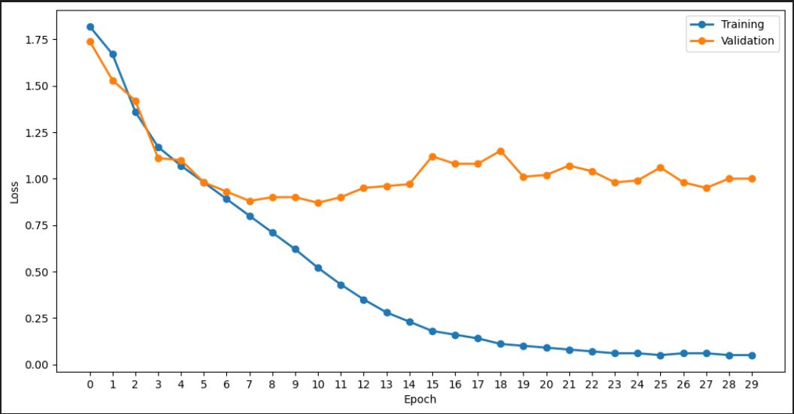
Results (CNN Model)

Slide 11
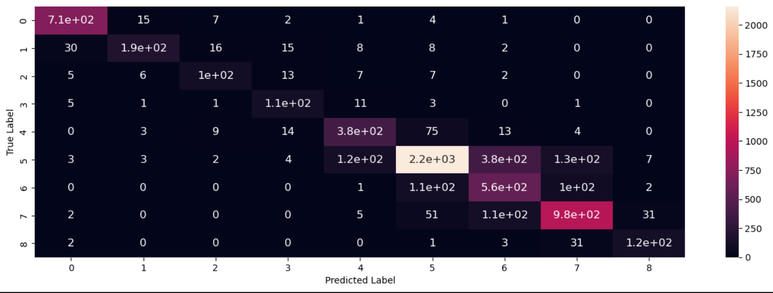
Results (CNN Model)

Slide 12
Results (CNN Model)
Accuracy = 0.7933403016275944
Precision = 0.7850767576539593
Recall = 0.7679550345754199
F1 = 0.772336344261469

Slide 13
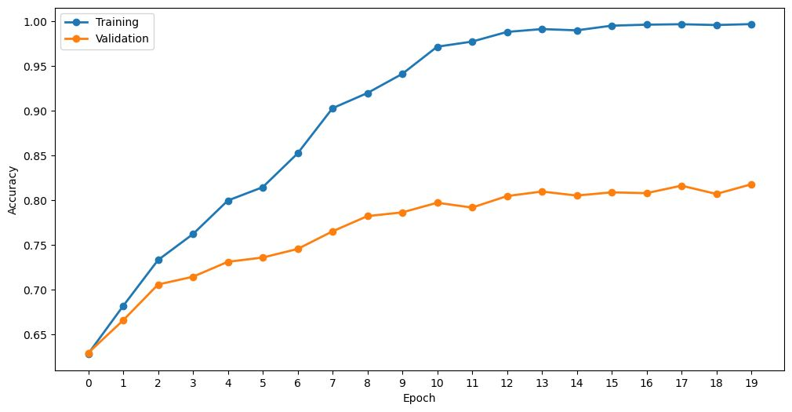
Results (Transfer Learning Model)

Slide 14
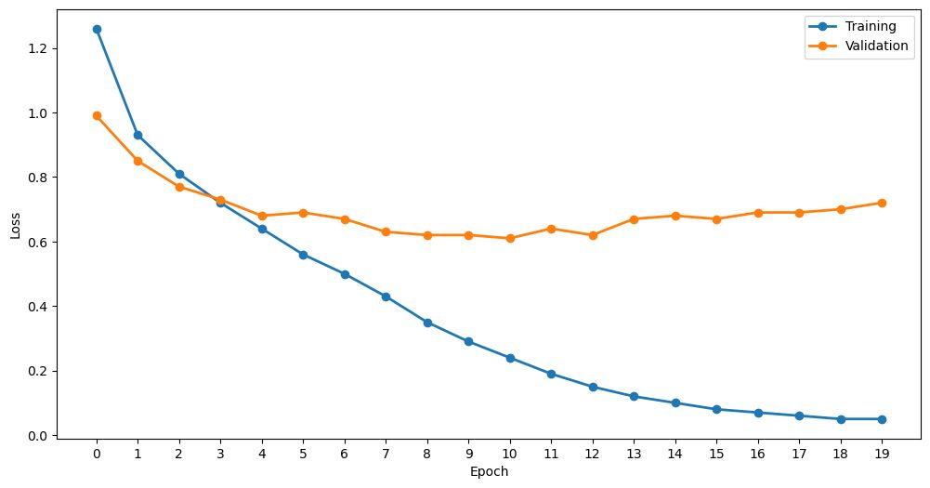
Results (Transfer Learning Model)

Slide 15
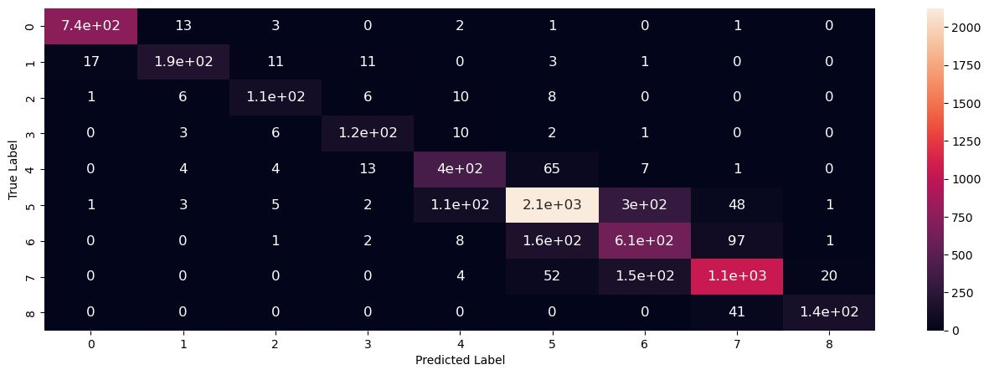
Results (Transfer Learning Model)

Slide 16
Results (Transfer Learning Model)
Accuracy = 0.8187248021502165
Precision = 0.8139262149701497
Recall = 0.8116376144529407
F1 = 0.8112803139740907

Slide 17
Discussion
At first glance, there is only a slight increase in accuracy from CNN trained from scratch and the CNN utilizing ResNet-18 weights. Augmentation of precision, recall and F1 score metrics is also modest.
Still, solely observing the increase in these metrics is not sufficient. The competence of the model to assign individuals to age intervals can be better understood via inspecting the number of false predictions whose actual and predicted value distance is larger than two classes.
In first CNN model, the number of false predictions whose actual and predicted value distance is larger than two classes is 69.
In CNN with transfer learning, the number of false predictions whose actual and predicted value distance is larger than two classes is 39.

Slide 18
Discussion
Making a %70 training, %10 validation and %20 test split, our test dataset consisted of 6681 samples.
In the first CNN, the ratio of false predictions whose actual and predicted value distance is larger than two classes was 69/6681 = 0.01032779524.
For the CNN with transfer learning, the ratio of false predictions whose actual and predicted value distance is larger than two classes was 39/6681= 0.00583744948.
It can be seen that using pretrained weights decreased the number of more problematic false predictions by half.

Slide 19
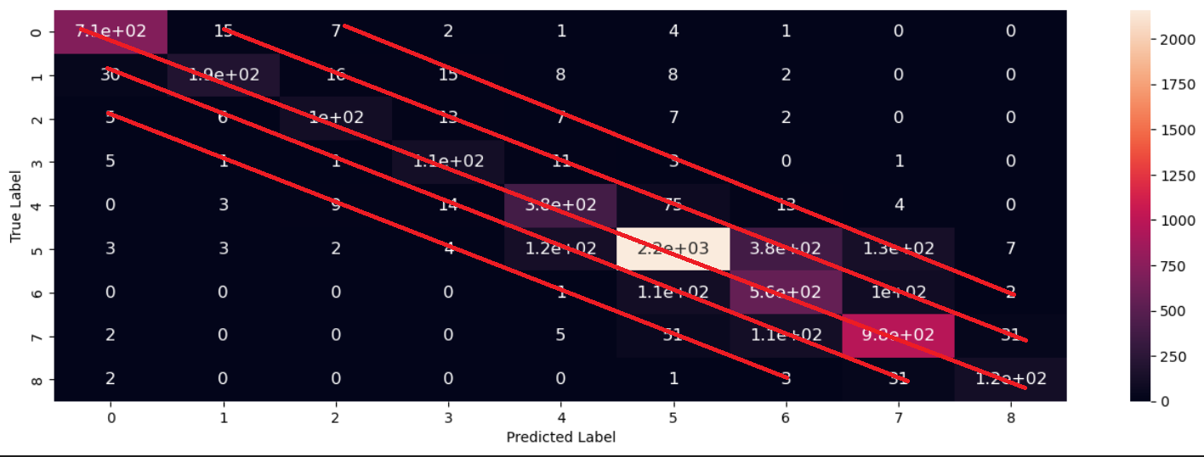
Discussion (Confusion Matrix for First CNN)

Slide 20
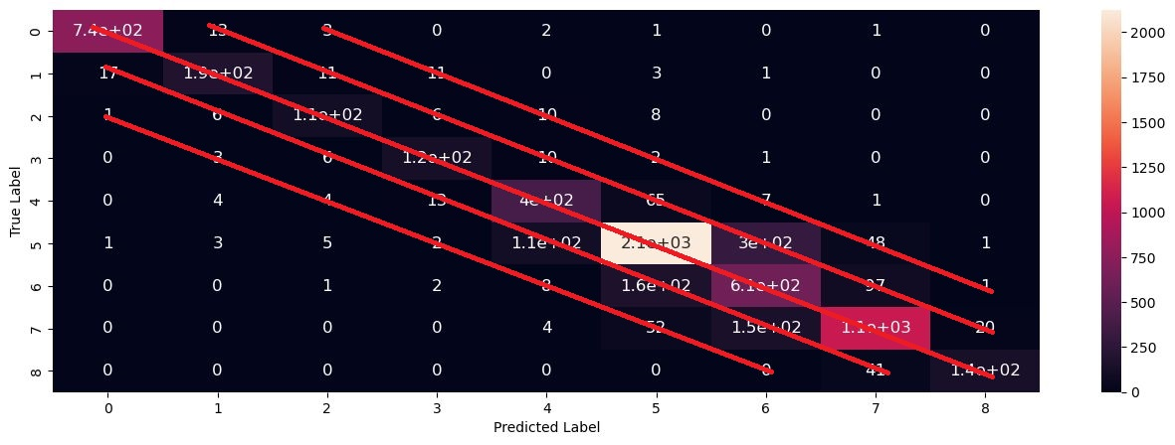
Discussion (Confusion Matrix for CNN with Transfer Learning)

Slide 21
Conclusion
Final accuracy for our first CNN model was 0.7933403016275944, whereas the CNN with transfer learning obtained 0.8187248021502165.
In our epoch vs. loss plot; even if training loss kept on decreasing, validation loss stayed more or less the same. We can observe this also in the epoch vs. accuracy plot. Because of this, our model has slightly overfitted the dataset. Notwithstanding; our model has performed successfully on the test dataset accordingly with accuracy, precision, recall and F1 score.

Slide 22
Work Division
Kaan Hamurcu: Prepared the dataset for reading and made it available for operations. Worked in the process of building the convolutional neural network layers and their effective operation.
Efser Efe Kantik: Conducted research on age classification. Worked in the process of building the convolutional neural network layers and their effective operation.
Cemhan Kaan Özaltan: Provided hands-on experience regarding the multiple libraries of Python. Worked in the process of building the convolutional neural network layers and their effective operation.
Ömer Özaltan: Worked in the process of building the convolutional neural network layers and their effective operation, prepared the dataset for reading and made it available for operations.
Ahmet Batuhan Sancak: Worked in the process of building the convolutional neural network layers and their effective operation. Implemented transfer learning to the model. Took place in hyperparameter tuning.

Slide 23
References
[1] F. Rabbi, “Facial age,” Kaggle, 25-Jan-2019. [Online]. Available: https://www.kaggle.com/datasets/frabbisw/facial-age. [Accessed: 01-December-2022].
[2] “UTKFace,” Utkface. [Online]. Available: https://susanqq.github.io/UTKFace/. [Accessed: 01-December-2022].
[3] Mustapha, M. F., Mohamad, N. M., Osman, G., & Ab Hamid, S. H. (2021). Age group classification using Convolutional Neural Network (CNN). Journal of Physics: Conference Series, 2084(1), 012028. https://doi.org/10.1088/1742-6596/2084/1/012028
[4] “Models and pre-trained weights,” Models and pre-trained weights - Torchvision main documentation. [Online]. Available: https://pytorch.org/vision/stable/models.html. [Accessed: 17-Dec-2022].

