Slide 1
COURSE ACTIVITIES / 2026
3D Graphics — WSB Merito Wrocław
3D Graphics — Lessons 2 to 4
Lesson 2 · 3 · 4
Activity Results
Screenshots of each task implemented in Python + OpenGL (PyOpenGL + GLFW), as required by the course.
Kaan Yazıcıoğlu
SD1 · 97364

Slide 2
02
Transformations
Five exercises on translation, scaling, rotation, camera viewing and a hierarchical cube example.
3D Graphics — WSB Merito Wrocław
Kaan Yazıcıoğlu · SD1 · 97364

Slide 3

LESSON 02 · TRANSFORMATIONS
Kaan Yazıcıoğlu · SD1 · 97364
TASK 1
Translation
The triangle is moved with glTranslatef(). Its position oscillates over time using sin / cos so the translation along X and Y is visible as smooth motion.
lesson2_task1_translation.py
lesson2_task1_translation.png

Slide 4

LESSON 02 · TRANSFORMATIONS
Kaan Yazıcıoğlu · SD1 · 97364
TASK 2
Scaling
The triangle pulses using glScalef(scale, scale, 1) — its size oscillates between small and large via sin(t·2), demonstrating uniform scaling.
lesson2_task2_scaling.py
lesson2_task2_scaling.png

Slide 5

LESSON 02 · TRANSFORMATIONS
Kaan Yazıcıoğlu · SD1 · 97364
TASK 3
Rotation
Continuous rotation around the Z axis using glRotatef(angle, 0, 0, 1). The angle is driven by glfw.get_time() so the triangle spins at a constant 60° per second.
lesson2_task3_rotation.py
lesson2_task3_rotation.png

Slide 6

LESSON 02 · TRANSFORMATIONS
Kaan Yazıcıoğlu · SD1 · 97364
TASK 4
Camera / View Transform
The triangle stays still at the origin while the camera orbits around it using gluLookAt() under a perspective projection — this is the viewing transformation pattern.
lesson2_task4_camera.py
lesson2_task4_camera.png

Slide 7
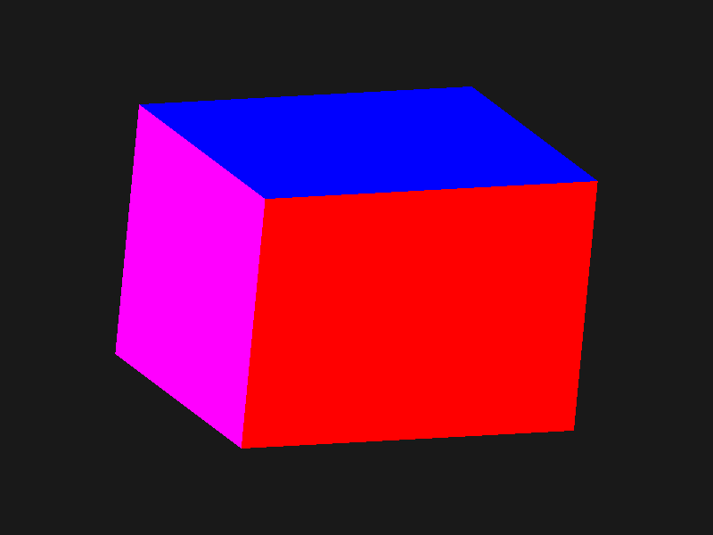
LESSON 02 · TRANSFORMATIONS
Kaan Yazıcıoğlu · SD1 · 97364
TASK 5 (BONUS)
Hierarchical Cube
A single square() function draws one face. The cube is built by rotating that one face into six positions using glPushMatrix / glPopMatrix — the matrix-stack / hierarchical-modelling pattern.
lesson2_cube.py
lesson2_cube.png

Slide 8
03
Materials, Lighting & Animation
Six exercises on diffuse colour, shininess, moving lights, matte surfaces, camera presets and animation speed.
3D Graphics — WSB Merito Wrocław
Kaan Yazıcıoğlu · SD1 · 97364

Slide 9
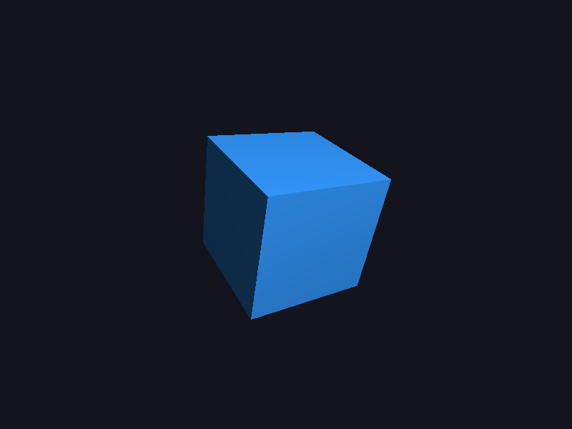
LESSON 03 · MATERIALS & LIGHTING
Kaan Yazıcıoğlu · SD1 · 97364
TASK 1
Change Object Color
The diffuse colour of the cube's material is changed via glMaterialfv. The same cube is now rendered light-blue under the scene's point light.
lesson3_task1_color.py
lesson3_task1_color.png

Slide 10
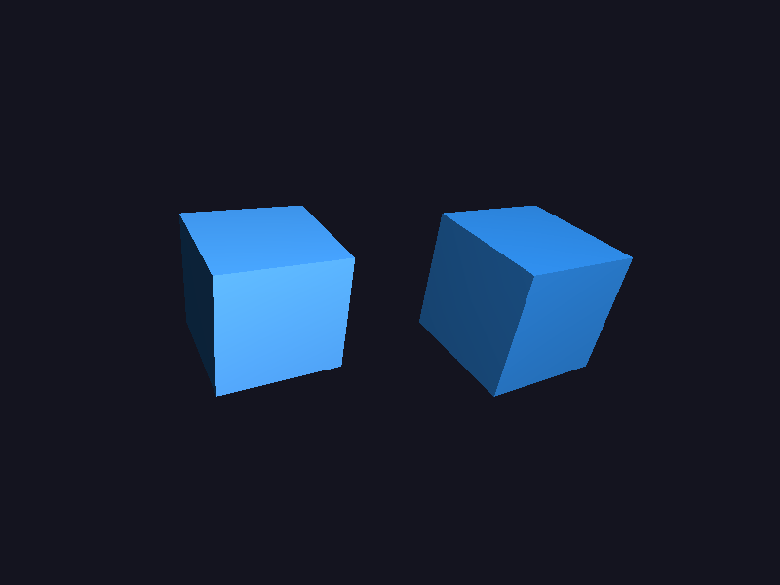
LESSON 03 · MATERIALS & LIGHTING
Kaan Yazıcıoğlu · SD1 · 97364
TASK 2
Shininess
Two cubes side by side, same colour, same light. Left cube has a low GL_SHININESS value (wide diffuse highlight); right cube has a high value (small, sharp specular).
lesson3_task2_shininess.py
lesson3_task2_shininess.png

Slide 11

LESSON 03 · MATERIALS & LIGHTING
Kaan Yazıcıoğlu · SD1 · 97364
TASK 3
Move the Light Source
The point light orbits around a stationary cube. Different faces light up over time, demonstrating how illumination depends on the geometry-to-light direction.
lesson3_task3_light_move.py
lesson3_task3_light_move.png

Slide 12
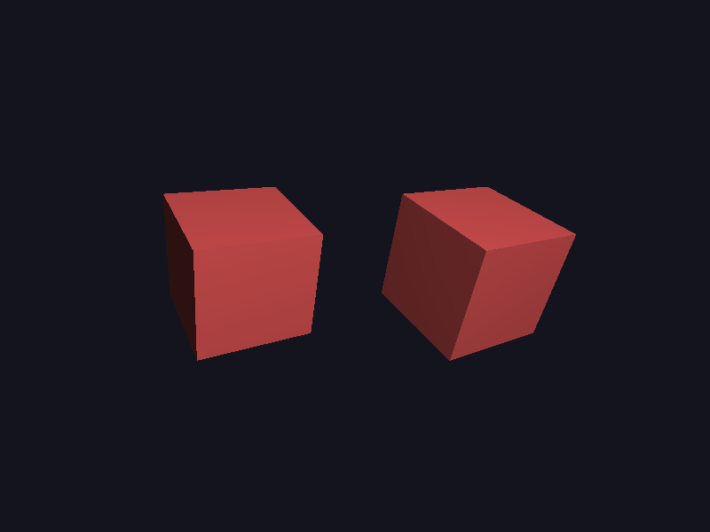
LESSON 03 · MATERIALS & LIGHTING
Kaan Yazıcıoğlu · SD1 · 97364
TASK 4
Matte vs Shiny
Side-by-side comparison: matte cube (zero specular) on the left, shiny cube (high specular + shininess) on the right, under the same lighting setup.
lesson3_task4_matte.py
lesson3_task4_matte.png

Slide 13
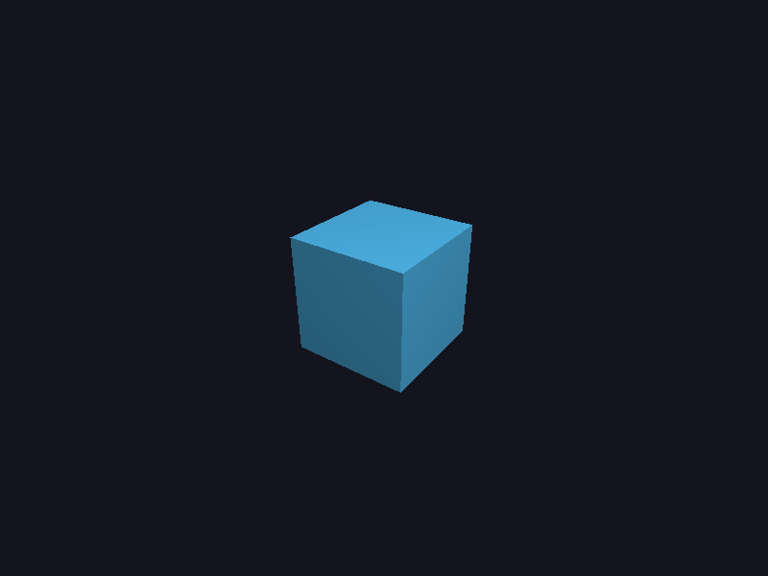
LESSON 03 · MATERIALS & LIGHTING
Kaan Yazıcıoğlu · SD1 · 97364
TASK 5
Camera Position
Four camera presets — Front, Top-down, Side, Diagonal — switchable at runtime via keys 1-4. Each preset calls gluLookAt with a different eye position.
lesson3_task5_camera.py · keys: 1 / 2 / 3 / 4
lesson3_task5_camera.png

Slide 14

LESSON 03 · MATERIALS & LIGHTING
Kaan Yazıcıoğlu · SD1 · 97364
TASK 6
Animation Speed
Rotation speed of an animated lit cube is integrated from delta-time and controllable at runtime: UP arrow speeds up, DOWN slows down, R resets to the default.
lesson3_task6_speed.py · keys: UP / DOWN / R
lesson3_task6_speed.png

Slide 15
04
Mesh · Voxel · Analytical
Five exercises on polygon mesh editing, mesh connectivity, voxel resolution, voxel shape predicates and analytical surfaces.
3D Graphics — WSB Merito Wrocław
Kaan Yazıcıoğlu · SD1 · 97364

Slide 16
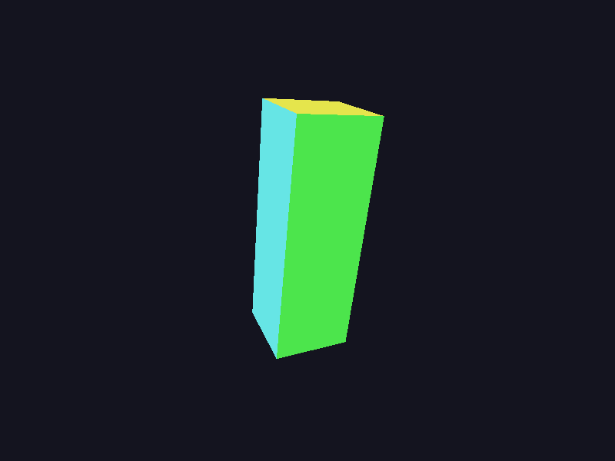
LESSON 04 · MESH / VOXEL / ANALYTICAL
Kaan Yazıcıoğlu · SD1 · 97364
TASK 1
Mesh → Rectangular Box
Same cube mesh (same face indices), but vertex coordinates are scaled per axis. SIZE_X · SIZE_Y · SIZE_Z = 0.5 · 1.5 · 0.5 turns the cube into a tall box.
lesson4_task1_box.py
lesson4_task1_box.png

Slide 17

LESSON 04 · MESH / VOXEL / ANALYTICAL
Kaan Yazıcıoğlu · SD1 · 97364
TASK 2
Extra Triangular Faces
A new vertex (apex) and four new triangle faces are appended to the cube's face list. The result: a pyramid tip rises out of the cube's top face — same vertex list, more faces.
lesson4_task2_extraface.py · 9 verts, 16 triangles
lesson4_task2_extraface.png

Slide 18
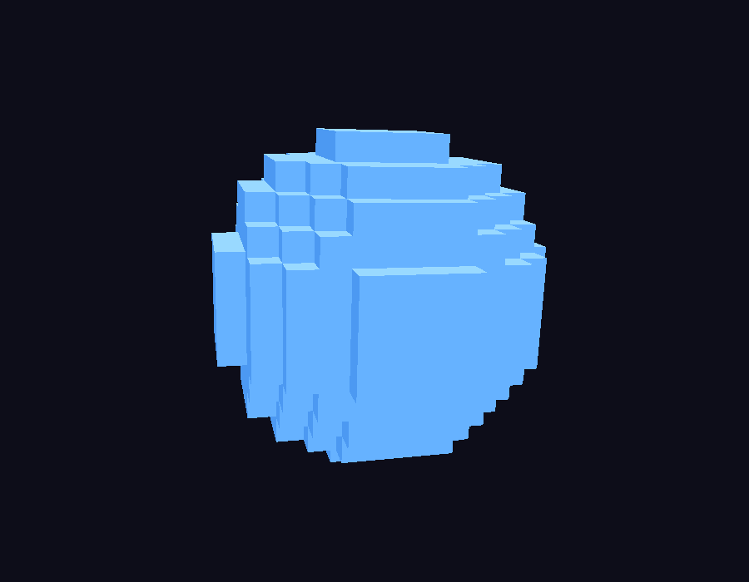
LESSON 04 · MESH / VOXEL / ANALYTICAL
Kaan Yazıcıoğlu · SD1 · 97364
TASK 3
Voxel Sphere Resolution
Voxel sphere built from cubes whose centres satisfy x² + y² + z² ≤ r². Switch resolution at runtime with keys 1-4 (6³ → 32³). Higher resolution gives a smoother sphere.
lesson4_task3_voxelres.py · keys: 1 / 2 / 3 / 4
lesson4_task3_voxelres.png

Slide 19
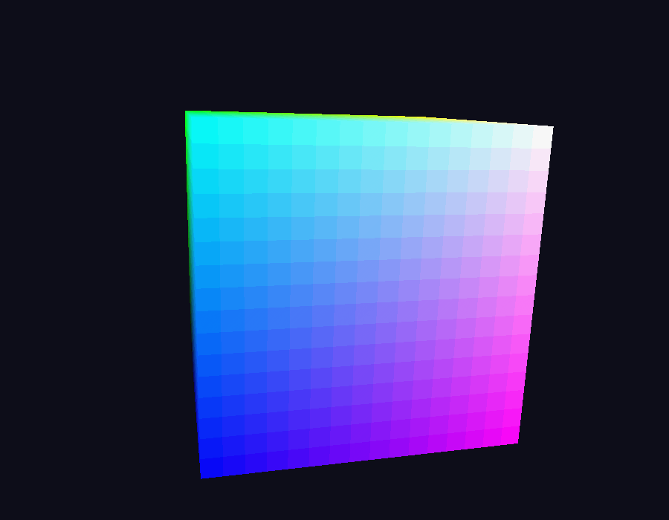
LESSON 04 · MESH / VOXEL / ANALYTICAL
Kaan Yazıcıoğlu · SD1 · 97364
TASK 4
Voxel Cube (predicate swap)
Same voxel grid, different predicate. Swap the spherical condition for max(|x|,|y|,|z|) ≤ s and the very same generator produces a voxel cube. Toggle with S / C keys.
lesson4_task4_voxelcube.py · keys: S / C
lesson4_task4_voxelcube.png

Slide 20
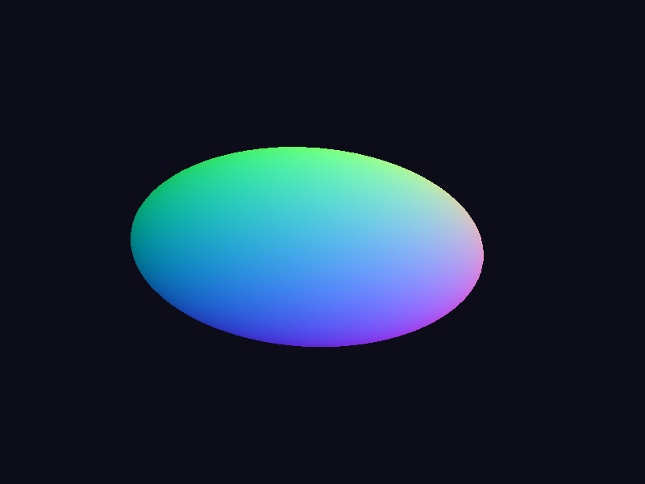
LESSON 04 · MESH / VOXEL / ANALYTICAL
Kaan Yazıcıoğlu · SD1 · 97364
TASK 5
Analytical Ellipsoid
The analytical sphere parameterisation is generalised with three independent radii — x = Rx·sin φ·cos θ, y = Ry·cos φ, z = Rz·sin φ·sin θ. Rx ≠ Ry ≠ Rz gives an ellipsoid.
lesson4_task5_ellipsoid.py · Rx = 1.4, Ry = 0.7, Rz = 1.0
lesson4_task5_ellipsoid.png

Slide 21
Thank you.
Kaan Yazıcıoğlu · SD1 · 97364 · 3D Graphics — WSB Merito Wrocław

