Slide 1
FINAL PROJECT / 2026
3D Graphics — WSB Merito Wrocław
Blender + Python (bpy)
Procedural
Solar System
A single Python script — run inside Blender — that builds the Sun, six planets, Saturn's rings, an asteroid belt and a star field from scratch, with no manual modelling.
Kaan Yazıcıoğlu
SD1 · 97364

Slide 2
01 · THE SCENE & 3D OBJECTS
What is on screen.
The scene contains ten+ distinct 3D objects floating in a procedurally-generated deep-space background.
Sun
UV-sphere at the origin with an emission shader and a noise-driven surface — the bright centre that lights the rest of the scene.
Planets (×6)
Mercury, Venus, Earth, Mars, Jupiter and Saturn — each its own UV-sphere at a distinct orbital radius and size.
Saturn rings
A multi-band torus system parented to Saturn — B-ring, A-ring, and a faint outer dust ring with a Cassini-style gap.
Asteroid belt
Around 280 small ico-sphere rocks distributed in a thin ring between Mars and Jupiter, each instance sharing one mesh.
Background
A procedural star-field rendered into the world shader — Voronoi distance with a tight threshold gives pinpoint stars.

Slide 3
02 · HOW THE OBJECTS WERE BUILT
Geometry + procedural materials.
All geometry comes from Blender's built-in mesh primitives, and all surfaces use procedural noise nodes — no image textures.
Geometry
bpy.ops.mesh.primitive_uv_sphere_add for the Sun and planets, primitive_torus_add for the rings, primitive_ico_sphere_add shared between asteroid instances.
Rocky surfaces
Mercury & Mars — Voronoi-driven crater bump map combined with noise-driven colour variation. High roughness.
Gas giants
Jupiter & Saturn — Wave Texture along the Z axis creates horizontal bands, distorted by noise for the wavy feel.
Earth & Venus
Earth — noise-thresholded continent mask + polar ice from the Z coordinate. Venus — two layered noise textures form cloud swirls.
Sun
Emission shader with a noise-driven brightness variation producing a subtle sunspot pattern.

Slide 4
03 · HOW THE ANIMATION WAS DONE
Parented empties + keyframed rotation.
Every planet orbits the Sun, the asteroid belt drifts slowly, and the whole scene is exported as a 10-second video.
Orbit pivots
Each planet is parented to its own empty placed at the origin. Rotating that empty around its Z axis makes the planet orbit.
Keyframes
Two linear-interpolation keyframes per pivot — angle = 0 at frame 1, angle = 2π · (total_frames / period) at the last frame.
Per-planet period
Each planet has its own period_frames value (60-290), so inner planets orbit faster than outer ones.
Asteroid belt
The whole belt is parented to a single empty; that empty has its own slow orbit (one revolution per 360 frames).
Video output
animation.mp4 — 240 frames at 24 fps, H.264 in MP4 = a 10-second clip, written by bpy.ops.render.render(animation=True).

Slide 5
04 · HOW THE SCENE WAS BUILT
Lighting, camera and render.
With the geometry in place, a single light, a cinematic camera and a procedural sky finish the scene.
Lighting
One point light at the Sun's position (energy ≈ 17 000). The Sun mesh has its own shadow casting disabled so the light is not blocked from inside.
Camera
A perspective camera placed at (0, -40, 24) with a Track-To constraint locked on the origin — the camera always frames the Sun no matter what.
World
Procedural star-field replaces the default flat background. Voronoi F1 distance + ColorRamp + dark space colour = stars.
Render
Blender Eevee Next (with Eevee/Cycles fallback), 1600 × 900, written to render.png next to the script.
Reproducible
clear_scene() runs first, so every time the script is executed the scene is rebuilt from zero — same input, same output.

Slide 6
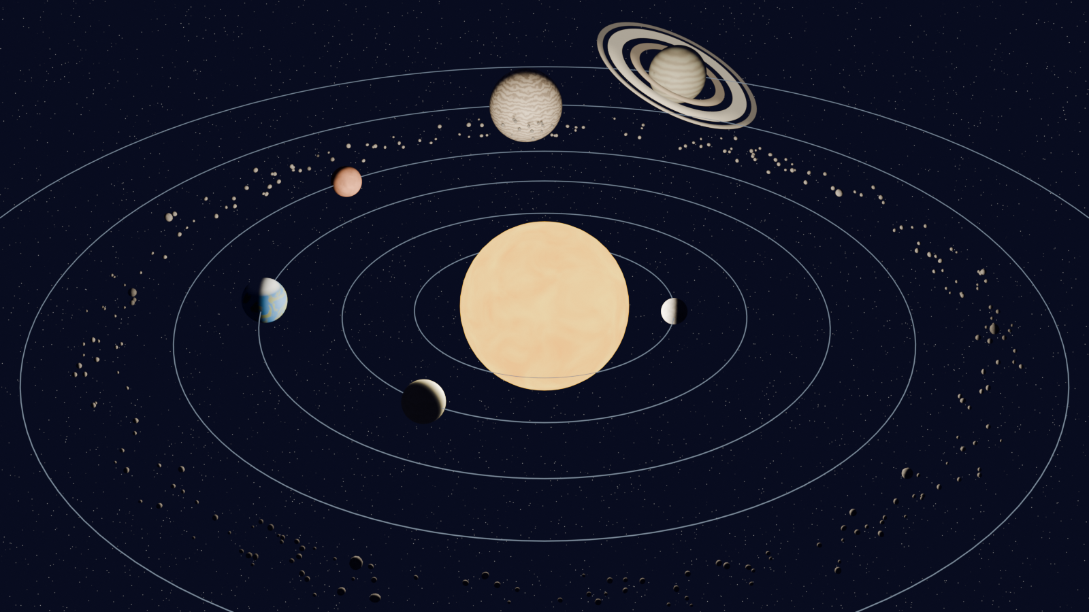
05 · RESULT
One script, one render, one video.
render.png (still) · animation.mp4 (10 s, 24 fps) · click ▶ to play
Thank you.
Kaan Yazıcıoğlu · SD1 · 97364 · 3D Graphics — WSB Merito Wrocław

