Slide 1
Beyond the Logo
Visual clues that trigger brand recognition without a logo
How shapes, colors, and packaging help us identify brands
Kaan Yazıcıoğlu & Caner Akcasu
Notes:
Speaker: Kaan | Timing: 30s (Cumulative: 00:30 / 12:00)
[Stage Directions]
Brief optional pause.
[Spoken Script]
Hi, I’m Kaan, and this is Caner. Today we’ll look at how we recognize brands without their names. Sometimes a color, a shape, or a package is enough. In daily life, we rarely read every logo on a shelf. Instead, we spot familiar bottles and colors. We’ll explore four famous examples to see how this works.
[Citations & References]
- [S1] Evidence concerning the importance of perceived brand differentiation (Australasian Marketing Journal / Ehrenberg-Bass Institute for Marketing Science): https://assets.marketingscience.info/different.pdf

Slide 2
Visual Quiz: Can Color Alone Identify a Brand?
Classroom illustration: Four plain color swatches with no logos
Solid red, yellow, turquoise, and blue without shapes
Can you name the brand behind each color?
Sources: [S1]
Beyond the Logo · Slide 2 of 25
Notes:
Speaker: Kaan | Timing: 45s (Cumulative: 01:15 / 12:00)
[Stage Directions]
Brief optional pause.
[Spoken Script]
Let’s start with a quick quiz. Here are four plain colors: red, yellow, turquoise, and blue. There are no names and no shapes here. Color alone is not always enough to identify a brand. Many different companies share red or blue. Without a shape or context, not everyone will recognize them.
[Citations & References]
- [S1] Evidence concerning the importance of perceived brand differentiation (Australasian Marketing Journal / Ehrenberg-Bass Institute for Marketing Science): https://assets.marketingscience.info/different.pdf

Slide 3
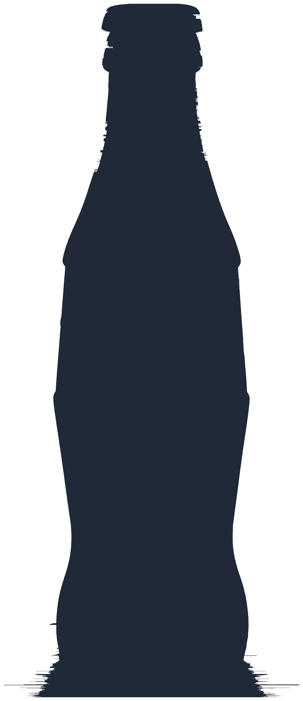
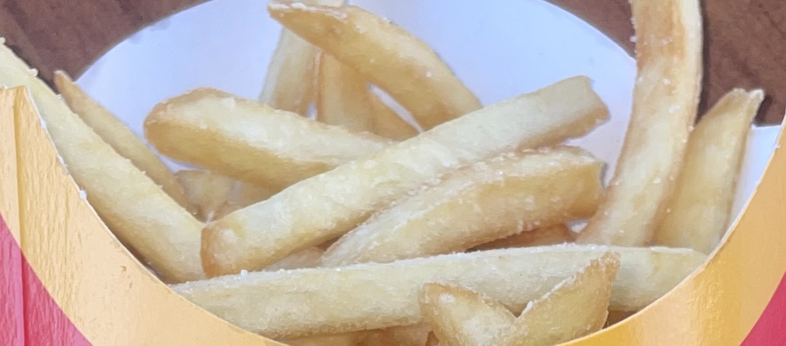
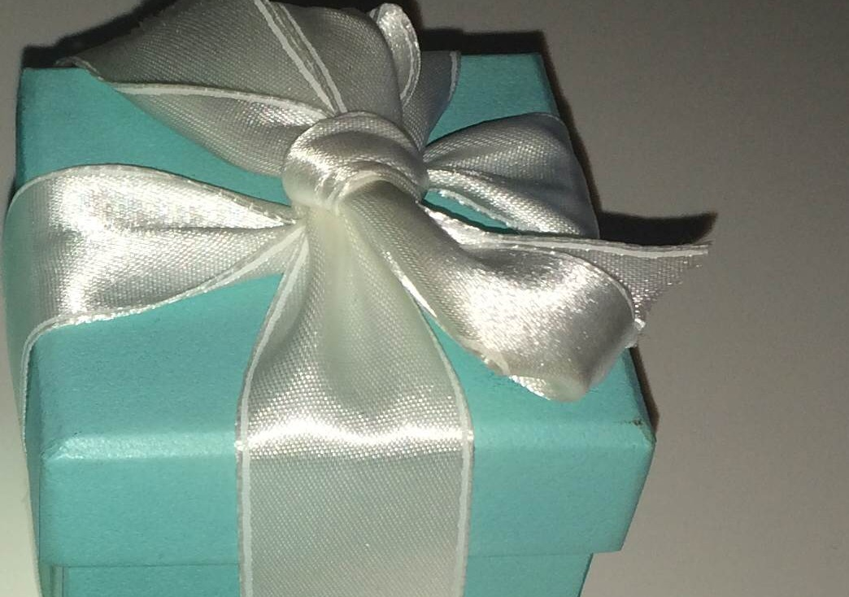
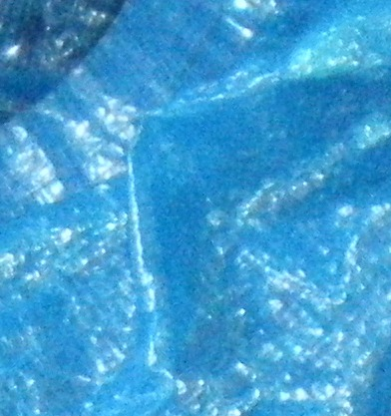
Visual Quiz: Adding Product Shapes to Colors
Classroom illustration: Silhouette and cropped packaging textures
A bottle silhouette alongside fry carton, gift box, and tote textures
Adding packaging shapes and textures narrows down the choices
Sources: [S1], [S2]
Beyond the Logo · Slide 3 of 25
Notes:
Speaker: Kaan | Timing: 45s (Cumulative: 02:00 / 12:00)
[Stage Directions]
Brief optional pause.
[Spoken Script]
Now look at these new clues. Here is a black bottle silhouette, plus packaging textures from three items. We see fry packaging, a gift box, and a bag. Adding a physical shape changes everything. Shape turns a plain color into a real product. The choices become much clearer right away.
[Citations & References]
- [S1] Evidence concerning the importance of perceived brand differentiation (Australasian Marketing Journal / Ehrenberg-Bass Institute for Marketing Science): https://assets.marketingscience.info/different.pdf
- [S2] Q&A: Seven Costly Sins of Brand Identity (Ehrenberg-Bass Institute for Marketing Science): https://assets.marketingscience.info/Brand-Identity-QA.pdf
[Image Credits & Permissions]
- Coca-Cola Classic Contour Glass Bottle | Creator: Ralf Roletschek | License: Public domain | Source: https://commons.wikimedia.org/wiki/File:15-09-26-RalfR-WLC-0098_-_Coca-Cola_glass_bottle_(Germany).jpg
- McDonald's French Fries in Red Carton | Creator: Filippos Fragkogiannis | License: CC BY-SA 4.0 | Source: https://commons.wikimedia.org/wiki/File:McDonald%27s_French_Fries_(2024).jpg
- Tiffany & Co. Blue Gift Box with Ribbon Bow | Creator: Adriana Górak | License: CC BY-SA 3.0 | Source: https://commons.wikimedia.org/wiki/File:Tiffany_blue_box_1.jpg
- IKEA Blue FRAKTA Shopping Bag | Creator: Andrea014 | License: CC BY-SA 3.0 de | Source: https://commons.wikimedia.org/wiki/File:IKEA-Tasche.JPG

Slide 4
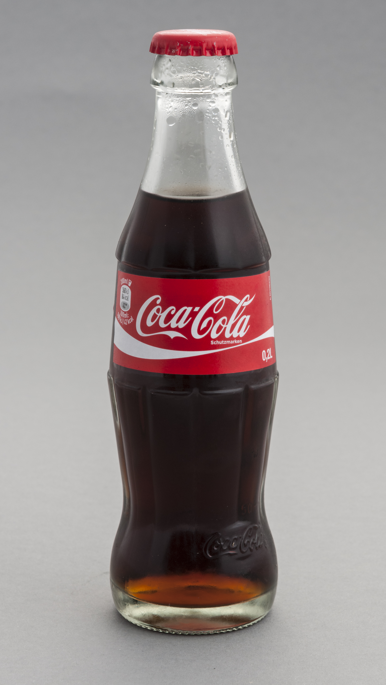
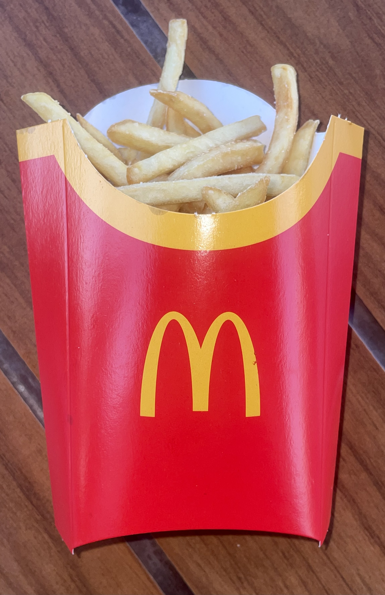
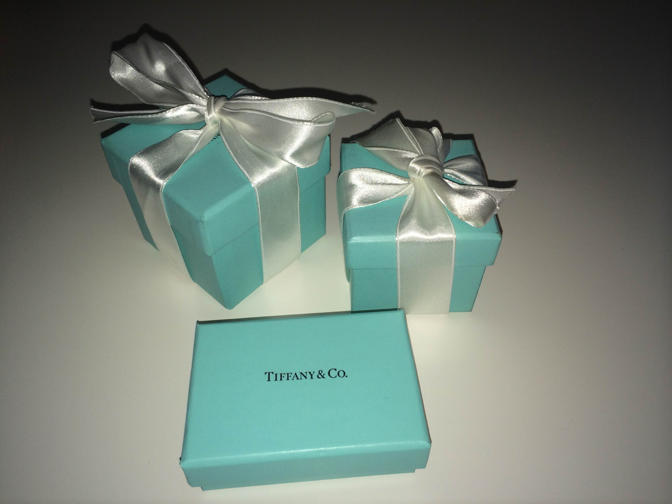
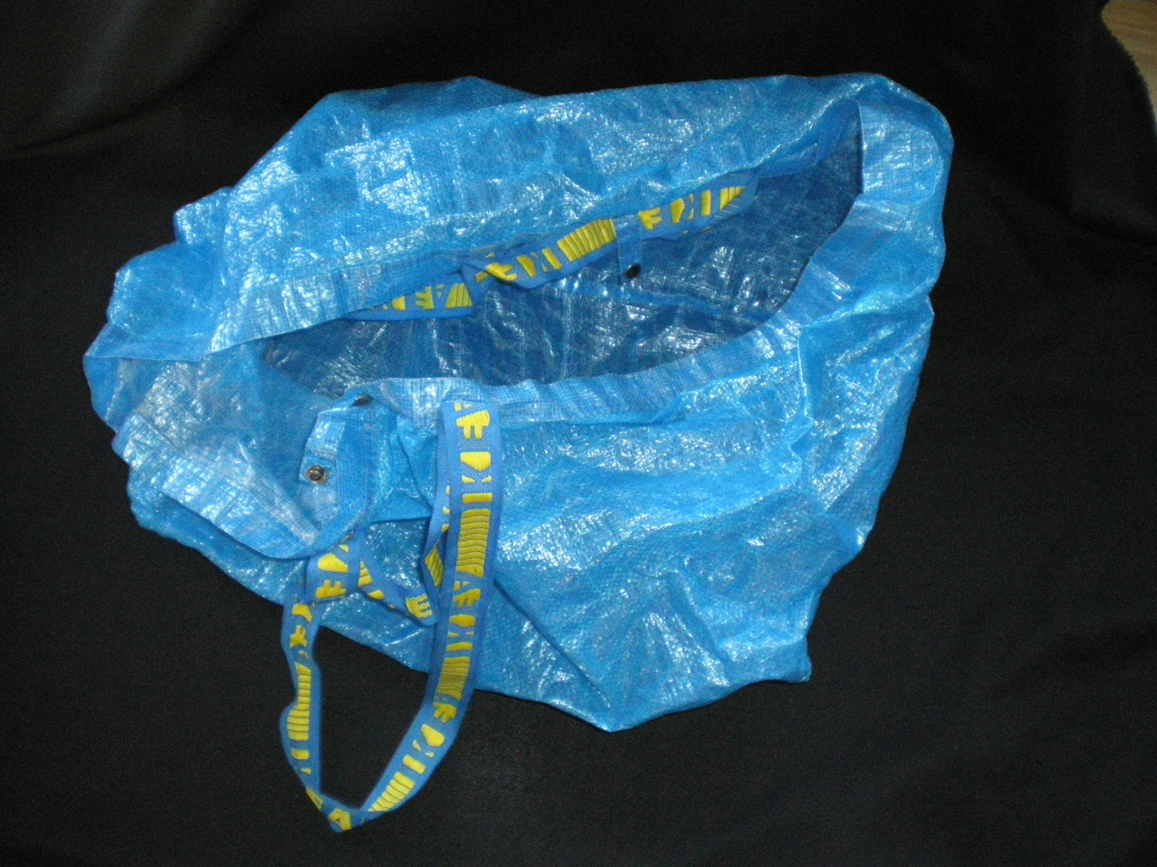
The Reveal: Learned Brand Connections in Daily Life
Recognition comes from repeated exposure during everyday shopping · Familiar shapes and colors trigger brand memory without names
Coca-Cola
McDonald's
Tiffany & Co.
IKEA
Contour Glass Bottle
Red Fry Packaging
Tiffany Blue Box
FRAKTA Shopping Bag
Sources: [S1], [S2]
Beyond the Logo · Slide 4 of 25
Notes:
Speaker: Kaan | Timing: 30s (Cumulative: 02:30 / 12:00)
[Stage Directions]
Brief optional pause.
[Spoken Script]
Here is the reveal: Coca-Cola, McDonald’s, Tiffany, and IKEA. We did not know these brands from birth. Instead, we learned them by seeing them again and again. We spot them in shops, ads, and street signs. Over time, a familiar shape becomes an easy shortcut. That is how these brands stick in our memory.
[Citations & References]
- [S1] Evidence concerning the importance of perceived brand differentiation (Australasian Marketing Journal / Ehrenberg-Bass Institute for Marketing Science): https://assets.marketingscience.info/different.pdf
- [S2] Q&A: Seven Costly Sins of Brand Identity (Ehrenberg-Bass Institute for Marketing Science): https://assets.marketingscience.info/Brand-Identity-QA.pdf
[Image Credits & Permissions]
- Coca-Cola Classic Contour Glass Bottle | Creator: Ralf Roletschek | License: Public domain | Source: https://commons.wikimedia.org/wiki/File:15-09-26-RalfR-WLC-0098_-_Coca-Cola_glass_bottle_(Germany).jpg
- McDonald's French Fries in Red Carton | Creator: Filippos Fragkogiannis | License: CC BY-SA 4.0 | Source: https://commons.wikimedia.org/wiki/File:McDonald%27s_French_Fries_(2024).jpg
- Tiffany & Co. Blue Gift Box with Ribbon Bow | Creator: Adriana Górak | License: CC BY-SA 3.0 | Source: https://commons.wikimedia.org/wiki/File:Tiffany_blue_box_1.jpg
- IKEA Blue FRAKTA Shopping Bag | Creator: Andrea014 | License: CC BY-SA 3.0 de | Source: https://commons.wikimedia.org/wiki/File:IKEA-Tasche.JPG

Slide 5
How Brand Memory Works: Context Beats Color Myths
Popular assumptions claim colors carry fixed commercial meanings
Marketing research shows brand recognition comes from consistent use
Context and learned familiarity turn colors into reliable shortcuts
1. Repeated Exposure
↓
2. Familiar Visual Clue
↓
3. Possible Brand Recognition
Sources: [S1]
Beyond the Logo · Slide 5 of 25
Notes:
Speaker: Kaan | Timing: 30s (Cumulative: 03:00 / 12:00)
[Stage Directions]
Brief optional pause before handing over to Caner.
[Spoken Script]
We often hear that red creates hunger and blue builds trust. But a color does not mean the same thing to everyone. With brands, we learn these links by seeing the same colors again and again. So using a color consistently matters. Caner will show you some examples.
[Citations & References]
- [S1] Evidence concerning the importance of perceived brand differentiation (Australasian Marketing Journal / Ehrenberg-Bass Institute for Marketing Science): https://assets.marketingscience.info/different.pdf

Slide 6
Case 1: Coca-Cola and the 1915 Bottle Challenge
Soft drinks in 1915 used plain straight-sided bottles
Design brief asked for a bottle recognized by touch
Goal: recognize the bottle without seeing its label
Original contour glass bottle
Sources: [S4]
Beyond the Logo · Slide 6 of 25
Notes:
Speaker: Caner | Timing: 36s (Cumulative: 03:36 / 12:00)
[Stage Directions]
Brief optional pause.
[Spoken Script]
Our first case study is Coca-Cola. In the early 1900s, sodas used plain glass bottles. Local competitors copied them very easily. Paper labels also peeled off in cold water coolers. In 1915, Coca-Cola asked designers for help. They wanted a bottle you could recognize by touch in the dark.
[Citations & References]
- [S4] The History of the Coca-Cola Contour Bottle (The Coca-Cola Company): https://www.coca-colacompany.com/about-us/history/the-history-of-the-coca-cola-contour-bottle
[Image Credits & Permissions]
- Coca-Cola Classic Contour Glass Bottle | Creator: Ralf Roletschek | License: Public domain | Source: https://commons.wikimedia.org/wiki/File:15-09-26-RalfR-WLC-0098_-_Coca-Cola_glass_bottle_(Germany).jpg

Slide 7
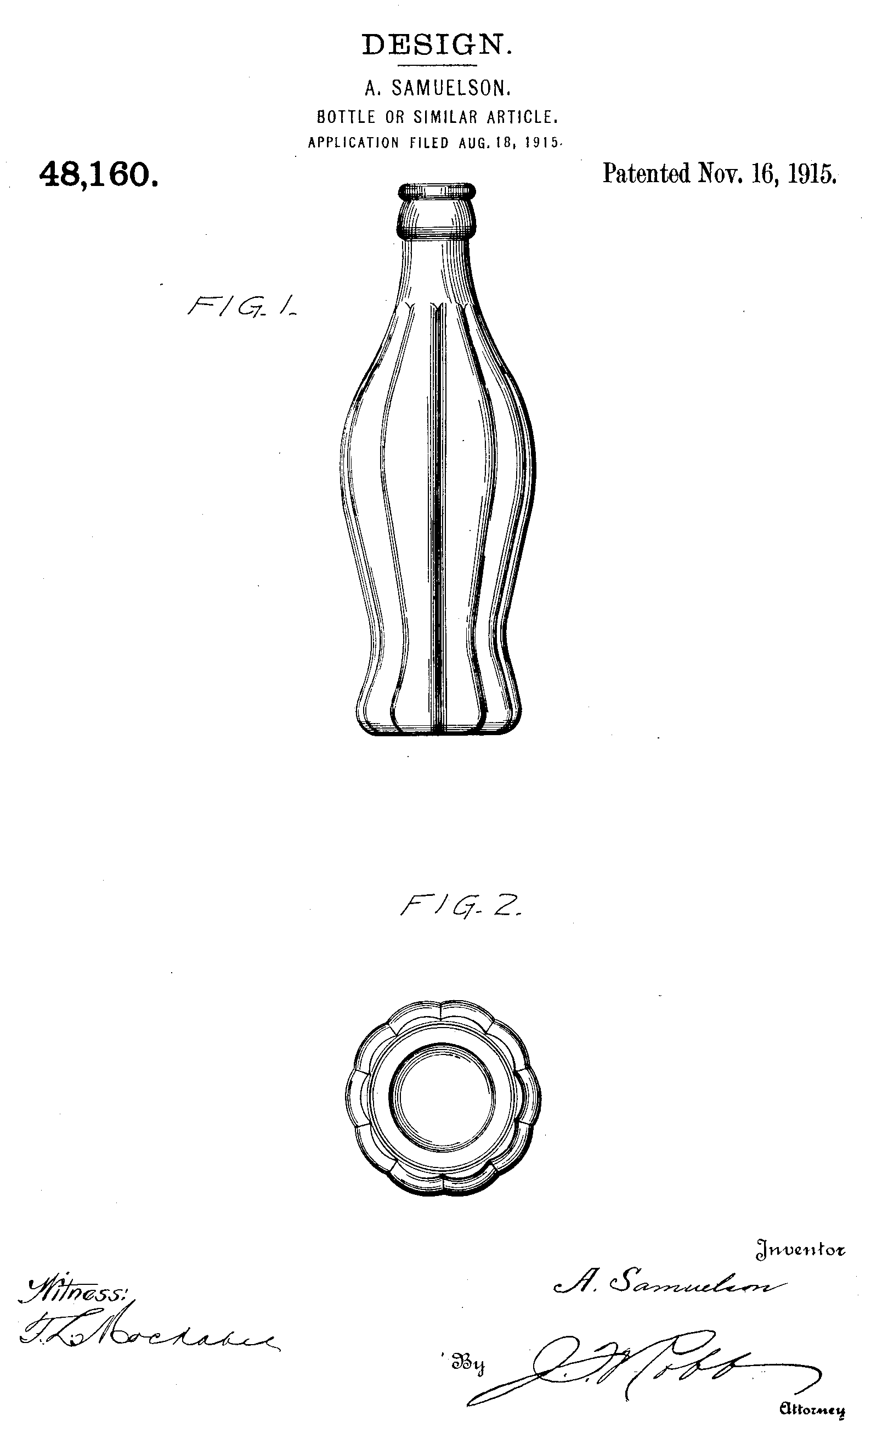
Coca-Cola: The 1915 Fluted Bottle Design
Original patent granted on November 16, 1915
Design inspired by the curved lines of a cocoa bean
Vertical ribs and curved sides create a clear shape
US Design Patent D48,160 (Nov 16, 1915)
Sources: [S4]
Beyond the Logo · Slide 7 of 25
Notes:
Speaker: Caner | Timing: 36s (Cumulative: 04:12 / 12:00)
[Stage Directions]
Brief optional pause.
[Spoken Script]
The Root Glass Company in Indiana answered the challenge. While researching, designers saw a sketch of a cocoa bean. It had rounded ribs and curved lines. Cocoa was not in the recipe, but the grooves inspired them. Alexander Samuelson patented this fluted shape on November 16, 1915.
[Citations & References]
- [S4] The History of the Coca-Cola Contour Bottle (The Coca-Cola Company): https://www.coca-colacompany.com/about-us/history/the-history-of-the-coca-cola-contour-bottle
[Image Credits & Permissions]
- 1915 Coca-Cola Contour Bottle Original US Patent Drawing | Creator: Alexander Samuelson / Chapman J. Root / US Patent Office | License: Public domain | Source: https://commons.wikimedia.org/wiki/File:Coke_bottle_patent.png

Slide 8
Shape Still Matters Without Color
Comparing the bottle silhouette with the patent drawing
The fluted bottle silhouette stays recognizable in black and white
A familiar shape can remain a useful clue
Photo-derived silhouette
1915 drawing
Sources: [S4]
Beyond the Logo · Slide 8 of 25
Notes:
Speaker: Caner | Timing: 36s (Cumulative: 04:48 / 12:00)
[Stage Directions]
Brief optional pause.
[Spoken Script]
Here we compare a photo-derived silhouette with the 1915 patent drawing. Both images are in black and white. There is no red color and no brand name. Yet the curved bottle remains easy to spot. This shows that shape works as a clue all by itself. You do not need color to identify this container.
[Citations & References]
- [S4] The History of the Coca-Cola Contour Bottle (The Coca-Cola Company): https://www.coca-colacompany.com/about-us/history/the-history-of-the-coca-cola-contour-bottle
[Image Credits & Permissions]
- Coca-Cola Classic Contour Glass Bottle | Creator: Ralf Roletschek | License: Public domain | Source: https://commons.wikimedia.org/wiki/File:15-09-26-RalfR-WLC-0098_-_Coca-Cola_glass_bottle_(Germany).jpg
- 1915 Coca-Cola Contour Bottle Original US Patent Drawing | Creator: Alexander Samuelson / Chapman J. Root / US Patent Office | License: Public domain | Source: https://commons.wikimedia.org/wiki/File:Coke_bottle_patent.png

Slide 9
McDonald’s: More Than Red and Yellow
Red fry carton paired with bright yellow french fries
Simple packaging shape works together with brand colors
Color combination and packaging create a familiar visual clue
Red paperboard fry carton
Sources: [S1], [S3]
Beyond the Logo · Slide 9 of 25
Notes:
Speaker: Caner | Timing: 36s (Cumulative: 05:24 / 12:00)
[Stage Directions]
Brief optional pause.
[Spoken Script]
Our second case study is McDonald’s. The logo is visible here. But imagine covering it. The red box and fries still give us clues. The curved red carton and yellow fries work together. Not everyone will recognize it, of course. Still, packaging shape and color support each other well.
[Citations & References]
- [S1] Evidence concerning the importance of perceived brand differentiation (Australasian Marketing Journal / Ehrenberg-Bass Institute for Marketing Science): https://assets.marketingscience.info/different.pdf
- [S3] Brands of Distinction (Ehrenberg-Bass Institute for Marketing Science / UniSA Business Magazine): https://marketingscience.info/news-and-insights/brands-of-distinction
[Image Credits & Permissions]
- McDonald's French Fries in Red Carton | Creator: Filippos Fragkogiannis | License: CC BY-SA 4.0 | Source: https://commons.wikimedia.org/wiki/File:McDonald%27s_French_Fries_(2024).jpg

Slide 10
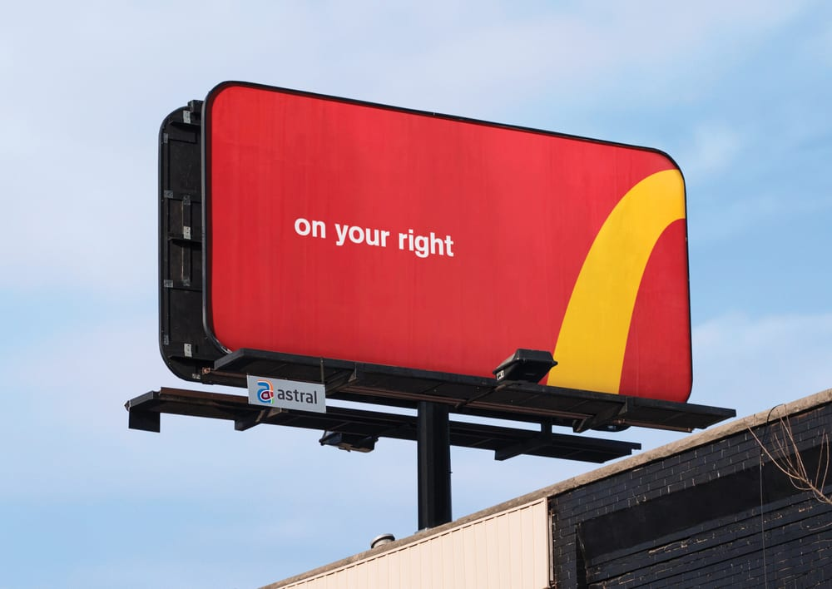
McDonald’s: European Green and Cropped Arches
Some European restaurants changed red background to deep green (reported 2009)
Golden arches stayed unchanged while background colors changed
Cropped arches are logo fragments with text, not color-only
Follow the Arches campaign (Cossette, 2018)
Sources: [S8], [S9]
Beyond the Logo · Slide 10 of 25
Notes:
Speaker: Caner | Timing: 36s (Cumulative: 06:00 / 12:00)
[Stage Directions]
Brief optional pause.
[Spoken Script]
McDonald’s also shows how visual clues adapt. In 2009, some European restaurants changed red backgrounds to green. The golden arches stayed the same. In 2018, Canadian billboards used cropped pieces of the arches. They pointed drivers toward nearby restaurants. These ads used parts of a familiar logo, not color alone.
[Citations & References]
- [S8] McDonald’s rolling out green logo in Europe (NBC News / The Associated Press): https://www.nbcnews.com/id/wbna34111784
- [S9] Cossette and McDonald's deconstruct the iconic Golden Arches to direct people to the nearest restaurant (Cossette): https://www.cossette.com/en/blog/__temp_icoufkdgyfmhfyeayjfwwthtvmmmmbyghnhu
[Image Credits & Permissions]
- McDonald's 'Follow the Arches' Highway Directional Billboard | Creator: Cossette / McDonald's Restaurants of Canada Limited | License: Copyrighted; no reuse license stated; included for classroom commentary | Source: https://www.cossette.com/en/blog/__temp_icoufkdgyfmhfyeayjfwwthtvmmmmbyghnhu

Slide 11
Case 3: Tiffany Blue and Luxury Packaging
Signature turquoise color chosen in the nineteenth century
Famous gift box is tied with a white satin ribbon
Customers connect the box color with special jewelry gifts
The Tiffany Blue Box
Sources: [S5]
Beyond the Logo · Slide 11 of 25
Notes:
Speaker: Caner | Timing: 36s (Cumulative: 06:36 / 12:00)
[Stage Directions]
Brief optional pause.
[Spoken Script]
Our third case study is Tiffany and Co. They built strong recognition around one signature color. In the 1800s, the founder picked robin’s-egg blue for a catalogue. Soon, the blue box with a white satin ribbon appeared. People learned to connect this color with luxury jewelry gifts. The box itself became as famous as the jewelry.
[Citations & References]
- [S5] Tiffany Blue: A Color So Famous, It's Trademarked (Tiffany & Co.): https://press.tiffany.com/our-story/tiffany-blue/
[Image Credits & Permissions]
- Tiffany & Co. Blue Gift Box with Ribbon Bow | Creator: Adriana Górak | License: CC BY-SA 3.0 | Source: https://commons.wikimedia.org/wiki/File:Tiffany_blue_box_1.jpg

Slide 12
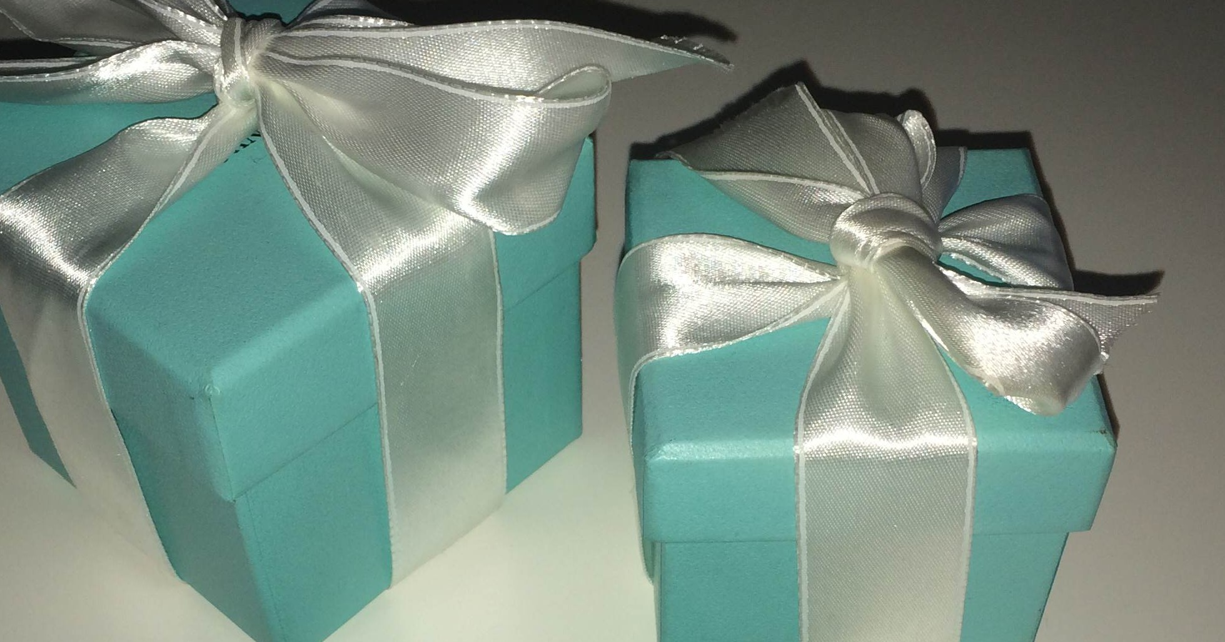
Tiffany: Store Rules and Presentation
Strict store presentation policies protect the blue gift box
Company lore cites 1906 report: boxes given only with purchases
Keep the blue consistent across boxes and shopping bags
Sources: [S5]
Beyond the Logo · Slide 12 of 25
Notes:
Speaker: Caner | Timing: 36s (Cumulative: 07:12 / 12:00)
[Stage Directions]
Brief optional pause.
[Spoken Script]
Tiffany protected this blue box through strict presentation rules. An old 1906 report said you could never buy an empty box. It only came with a real jewelry purchase. That is Tiffany’s own account, not independent research. Still, it shows how carefully they protected the packaging.
[Citations & References]
- [S5] Tiffany Blue: A Color So Famous, It's Trademarked (Tiffany & Co.): https://press.tiffany.com/our-story/tiffany-blue/
[Image Credits & Permissions]
- Tiffany & Co. Blue Gift Box with Ribbon Bow | Creator: Adriana Górak | License: CC BY-SA 3.0 | Source: https://commons.wikimedia.org/wiki/File:Tiffany_blue_box_1.jpg

Slide 13
Tiffany: Standard Color and Trademark Scope
Registered Tiffany Blue as a color trademark in 1998
Standardized custom color with Pantone as 1837 Blue
Protection covers luxury jewelry boxes, not all turquoise products
Approximate screen color — not the official Pantone standard. No exact color guarantee.
Sources: [S5]
Beyond the Logo · Slide 13 of 25
Notes:
Speaker: Caner | Timing: 36s (Cumulative: 07:48 / 12:00)
[Stage Directions]
Brief optional pause.
[Spoken Script]
To keep the color consistent, Tiffany worked with Pantone in 2001. They created a custom standard called 1837 Blue. The color on this screen is only an approximation. Tiffany also trademarked the color for packaging in 1998. That rule applies to luxury boxes, not every blue product.
[Citations & References]
- [S5] Tiffany Blue: A Color So Famous, It's Trademarked (Tiffany & Co.): https://press.tiffany.com/our-story/tiffany-blue/
[Image Credits & Permissions]
- Tiffany & Co. Blue Gift Box with Ribbon Bow | Creator: Adriana Górak | License: CC BY-SA 3.0 | Source: https://commons.wikimedia.org/wiki/File:Tiffany_blue_box_1.jpg

Slide 14
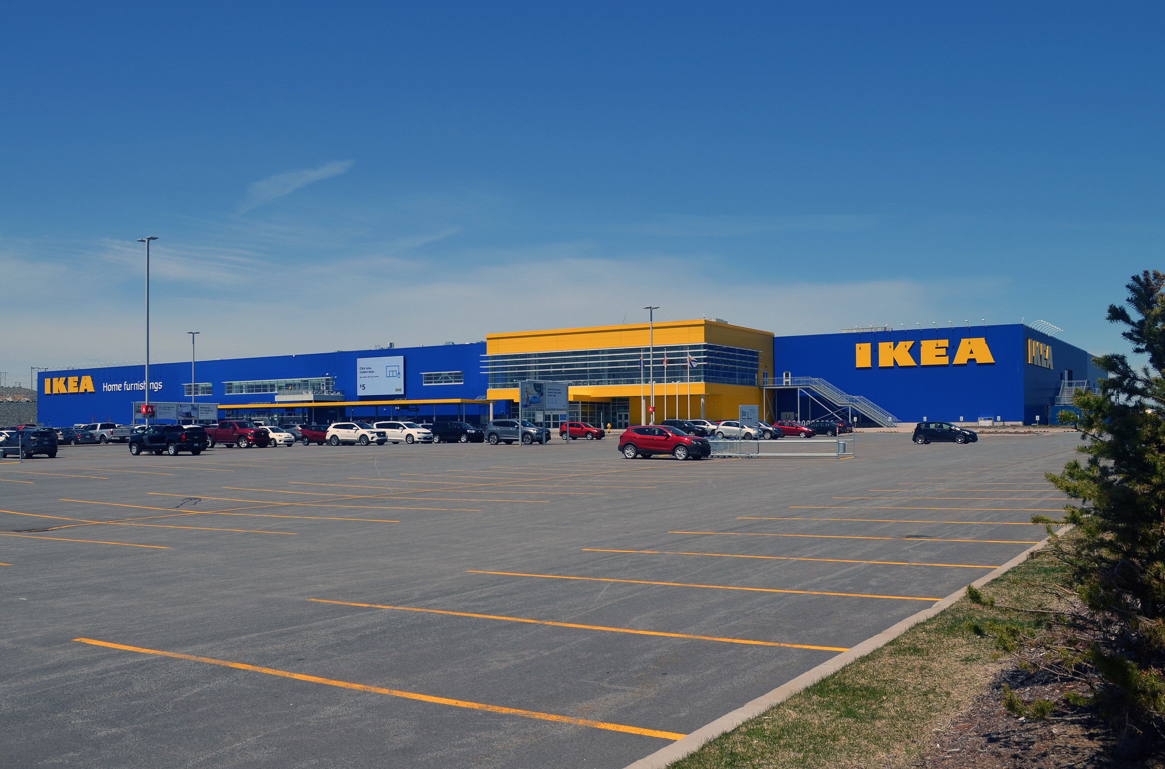
Case 4: IKEA and Store Color Standardization
First brand manual in 1984 set clear identity rules
Red-and-white logos stayed in Scandinavia for many years
Blue warehouse buildings with yellow signs spread from 1991
Standardized warehouse architecture (from 1991)
Sources: [S6]
Beyond the Logo · Slide 14 of 25
Notes:
Speaker: Caner | Timing: 36s (Cumulative: 08:24 / 12:00)
[Stage Directions]
Brief optional pause before handing back to Kaan.
[Spoken Script]
Our fourth case study is IKEA. We all know their blue and yellow buildings today. But standardizing these colors took many years. In 1984, IKEA published its first brand manual. From 1991, they built blue warehouse stores with yellow signs. Now, back to Kaan.
[Citations & References]
- [S6] History of the logotype: The small steps of evolution (IKEA Museum / Inter IKEA Systems B.V.): https://ikeamuseum.com/en/explore/the-story-of-ikea/history-of-the-logotype/
[Image Credits & Permissions]
- IKEA Blue and Yellow Warehouse Store Exterior | Creator: Ben MacLeod | License: CC BY-SA 4.0 | Source: https://commons.wikimedia.org/wiki/File:IKEA_Halifax_2019.jpg

Slide 15
IKEA: The Blue FRAKTA Shopping Bag
Durable blue shopping bag created for carrying home products
Blue woven handles feature bright yellow brand lettering
Everyday practical use turned the bag into a familiar clue
FRAKTA shopping bag
Sources: [S7]
Beyond the Logo · Slide 15 of 25
Notes:
Speaker: Kaan | Timing: 36s (Cumulative: 09:00 / 12:00)
[Stage Directions]
Brief optional pause.
[Spoken Script]
Thanks, Caner. IKEA created another famous clue: the blue FRAKTA bag. In 1986, shoppers got tired carrying heavy goods. IKEA tested yellow bags in 1989, but checkout got confusing. So yellow bags stayed inside for borrowing. Blue bags were sold to take home. That durable bag became a familiar household clue.
[Citations & References]
- [S7] Beloved bag: The story of FRAKTA (IKEA Museum / Inter IKEA Systems B.V.): https://ikeamuseum.com/en/explore/the-story-of-ikea/beloved-bag/
[Image Credits & Permissions]
- IKEA Blue FRAKTA Shopping Bag | Creator: Andrea014 | License: CC BY-SA 3.0 de | Source: https://commons.wikimedia.org/wiki/File:IKEA-Tasche.JPG

Slide 16
Limits of Single Colors: Shared Brand Clues
Single colors are shared by many competing commercial brands
Red is shared by Coca-Cola, Target, and McDonald's
Yellow is shared by IKEA, Shell, and DHL
Shared Red
Red is shared by Coca-Cola, Target, and McDonald's
Shared Yellow
Yellow is shared by IKEA, Shell, and DHL
Sources: [S1], [S3]
Beyond the Logo · Slide 16 of 25
Notes:
Speaker: Kaan | Timing: 36s (Cumulative: 09:36 / 12:00)
[Stage Directions]
Brief optional pause.
[Spoken Script]
What do these examples teach us about design? First, color alone is rarely enough. Many big companies use the same basic colors. Red is used by Coca-Cola, Target, and McDonald’s. Yellow is shared by IKEA, Shell, and DHL. Without context, one color can suggest several brands.
[Citations & References]
- [S1] Evidence concerning the importance of perceived brand differentiation (Australasian Marketing Journal / Ehrenberg-Bass Institute for Marketing Science): https://assets.marketingscience.info/different.pdf
- [S3] Brands of Distinction (Ehrenberg-Bass Institute for Marketing Science / UniSA Business Magazine): https://marketingscience.info/news-and-insights/brands-of-distinction

Slide 17
Combining Visual Clues: Color, Shape, and Context
Visual clues work best when supporting each other together
Pairing color with shape reduces confusion for shoppers
Recognition depends on shopper familiarity and daily habits
Color and Shape
+
Familiarity and Habits
= Easier Brand Recognition
Sources: [S1], [S2], [S3]
Beyond the Logo · Slide 17 of 25
Notes:
Speaker: Kaan | Timing: 36s (Cumulative: 10:12 / 12:00)
[Stage Directions]
Brief optional pause.
[Spoken Script]
This is why visual clues work best together. A plain bottle outline could be any drink. A solid red square could mean many brands. But when you pair shape with color, recognition becomes easy. Not everyone will spot every clue instantly. Still, multiple clues support each other during shopping.
[Citations & References]
- [S1] Evidence concerning the importance of perceived brand differentiation (Australasian Marketing Journal / Ehrenberg-Bass Institute for Marketing Science): https://assets.marketingscience.info/different.pdf
- [S2] Q&A: Seven Costly Sins of Brand Identity (Ehrenberg-Bass Institute for Marketing Science): https://assets.marketingscience.info/Brand-Identity-QA.pdf
- [S3] Brands of Distinction (Ehrenberg-Bass Institute for Marketing Science / UniSA Business Magazine): https://marketingscience.info/news-and-insights/brands-of-distinction

Slide 18
Redesign Risks: Protecting Familiar Visual Clues
Brand assets are long-term investments built over many years
Shoppers rely on fast visual habits when browsing shelves
Rapid redesigns risk breaking familiar memory connections
Long-Term Brand Assets
Rapid Redesign Risks
Sources: [S2]
Beyond the Logo · Slide 18 of 25
Notes:
Speaker: Kaan | Timing: 36s (Cumulative: 10:48 / 12:00)
[Stage Directions]
Brief optional pause.
[Spoken Script]
Our next lesson is about the risk of redesigns. Design teams often want to change packaging for new trends. But shoppers rely on quick visual habits in store aisles. If a company changes colors or shapes too fast, customers get confused. Protecting familiar clues keeps existing buyers happy.
[Citations & References]
- [S2] Q&A: Seven Costly Sins of Brand Identity (Ehrenberg-Bass Institute for Marketing Science): https://assets.marketingscience.info/Brand-Identity-QA.pdf

Slide 19
Practical Guidelines for Distinctive Design
01
Rule 1: Build clear shapes recognizable without color
02
Rule 2: Pair colors with distinctive packaging silhouettes
03
Rule 3: Core cues can evolve with testing, grounded in consistency
Sources: [S1], [S2], [S3]
Beyond the Logo · Slide 19 of 25
Notes:
Speaker: Kaan | Timing: 36s (Cumulative: 11:24 / 12:00)
[Stage Directions]
Brief optional pause.
[Spoken Script]
Here are three practical tips for designers. First, build clear shapes that work in black and white. Second, pair colors with unique packages and fonts. Third, stay consistent over long periods of time. You can evolve cues carefully, but test before changing them. Consistency turns simple designs into lasting memory shortcuts.
[Citations & References]
- [S1] Evidence concerning the importance of perceived brand differentiation (Australasian Marketing Journal / Ehrenberg-Bass Institute for Marketing Science): https://assets.marketingscience.info/different.pdf
- [S2] Q&A: Seven Costly Sins of Brand Identity (Ehrenberg-Bass Institute for Marketing Science): https://assets.marketingscience.info/Brand-Identity-QA.pdf
- [S3] Brands of Distinction (Ehrenberg-Bass Institute for Marketing Science / UniSA Business Magazine): https://marketingscience.info/news-and-insights/brands-of-distinction

Slide 20
Conclusion: Distinctive Clues in Daily Life
•
Logos confirm a brand, but visual clues guide discovery
•
Packaging and colors help shoppers spot products quickly
•
Recognition grows through patient consistency and daily familiarity
Sources: [S1]
Beyond the Logo · Slide 20 of 25
Notes:
Speaker: Kaan | Timing: 36s (Cumulative: 12:00 / 12:00)
[Stage Directions]
Brief optional pause to conclude.
[Spoken Script]
To wrap up, logos still matter at the final moment. But in crowded places, shapes and colors catch our attention first. Bottles, fry cartons, and gift boxes guide us without words. Thank you very much for your time. Caner and I are happy to take any questions.
[Citations & References]
- [S1] Evidence concerning the importance of perceived brand differentiation (Australasian Marketing Journal / Ehrenberg-Bass Institute for Marketing Science): https://assets.marketingscience.info/different.pdf

Slide 21
Thanks for Listening to Us!
Any questions or observations?
Presented by
Kaan Yazıcıoğlu & Caner Akcasu
Beyond the Logo · Slide 21 of 25
Notes:
Reference slide — not part of timed speech.
Speaker: None | Timing: 0s (Cumulative: 12:00 / 12:00)
[Stage Directions]
Closing slide displayed during audience questions and discussion.

Slide 22
References: Research Studies and Corporate Archives
[S1] Brand differentiation research
Australasian Marketing Journal / Ehrenberg-Bass Institute for Marketing Science
[S2] Seven Costly Sins of Brand Identity
Ehrenberg-Bass Institute for Marketing Science
[S3] Brands of Distinction
Ehrenberg-Bass Institute for Marketing Science / UniSA Business Magazine
[S4] The Coca-Cola Contour Bottle
The Coca-Cola Company
[S5] Tiffany Blue
Tiffany & Co.
Beyond the Logo · Slide 22 of 25
Notes:
Reference slide — not part of timed speech.
Speaker: None | Timing: 0s (Cumulative: 12:00 / 12:00)
[Stage Directions]
Keep visible during questions for academic citations.
[Citations & References]
- [S1] Evidence concerning the importance of perceived brand differentiation (Australasian Marketing Journal / Ehrenberg-Bass Institute for Marketing Science): https://assets.marketingscience.info/different.pdf
- [S2] Q&A: Seven Costly Sins of Brand Identity (Ehrenberg-Bass Institute for Marketing Science): https://assets.marketingscience.info/Brand-Identity-QA.pdf
- [S3] Brands of Distinction (Ehrenberg-Bass Institute for Marketing Science / UniSA Business Magazine): https://marketingscience.info/news-and-insights/brands-of-distinction
- [S4] The History of the Coca-Cola Contour Bottle (The Coca-Cola Company): https://www.coca-colacompany.com/about-us/history/the-history-of-the-coca-cola-contour-bottle
- [S5] Tiffany Blue: A Color So Famous, It's Trademarked (Tiffany & Co.): https://press.tiffany.com/our-story/tiffany-blue/

Slide 23
References: Museum Archives, News and Agency Records
[S6] History of the IKEA Logotype
IKEA Museum / Inter IKEA Systems B.V.
[S7] The Story of FRAKTA
IKEA Museum / Inter IKEA Systems B.V.
[S8] McDonald’s Green Backgrounds
NBC News / The Associated Press
[S9] Follow the Arches
Cossette
Beyond the Logo · Slide 23 of 25
Notes:
Reference slide — not part of timed speech.
Speaker: None | Timing: 0s (Cumulative: 12:00 / 12:00)
[Stage Directions]
Keep visible during questions for archival citations.
[Citations & References]
- [S6] History of the logotype: The small steps of evolution (IKEA Museum / Inter IKEA Systems B.V.): https://ikeamuseum.com/en/explore/the-story-of-ikea/history-of-the-logotype/
- [S7] Beloved bag: The story of FRAKTA (IKEA Museum / Inter IKEA Systems B.V.): https://ikeamuseum.com/en/explore/the-story-of-ikea/beloved-bag/
- [S8] McDonald’s rolling out green logo in Europe (NBC News / The Associated Press): https://www.nbcnews.com/id/wbna34111784
- [S9] Cossette and McDonald's deconstruct the iconic Golden Arches to direct people to the nearest restaurant (Cossette): https://www.cossette.com/en/blog/__temp_icoufkdgyfmhfyeayjfwwthtvmmmmbyghnhu

Slide 24
Appendix: Image Credits and Attributions (Part 1)
McDonald's French Fries in Red Carton
Creator: Filippos Fragkogiannis
License: CC BY-SA 4.0
Source · License
McDonald's 'Follow the Arches' Billboard
Creator: Cossette / McDonald's Restaurants of Canada Limited
License: Copyrighted; no reuse license stated; included for classroom commentary
Source / rights information
Coca-Cola Classic Contour Bottle
Creator: Ralf Roletschek
License: Public domain
Source · Rights information
1915 Coca-Cola Contour Bottle Patent Drawing
Creator: Alexander Samuelson / Chapman J. Root / US Patent Office
License: Public domain
Source · Rights information
Beyond the Logo · Slide 24 of 25
Notes:
Reference appendix — not part of timed speech.
Speaker: None | Timing: 0s (Cumulative: 12:00 / 12:00)
[Stage Directions]
Reference appendix documenting full image credits, licenses, and source repositories. Display during Q&A and archival review; not part of timed spoken presentation.
[Image Credits & Source Metadata]
- Title: McDonald's French Fries in Red Carton
Asset ID: mcdonalds-fries-packaging
Creator: Filippos Fragkogiannis
License: CC BY-SA 4.0
License URL: https://creativecommons.org/licenses/by-sa/4.0
Source Page: https://commons.wikimedia.org/wiki/File:McDonald%27s_French_Fries_(2024).jpg
Direct Download: https://upload.wikimedia.org/wikipedia/commons/e/eb/McDonald%27s_French_Fries_%282024%29.jpg
Description: Close-up photograph of french fries in a red paperboard carton packaging placed on a wooden restaurant table. Used as a classroom visual aid to analyze how color combination and packaging shape function without logo visibility.
- Title: McDonald's 'Follow the Arches' Highway Directional Billboard
Asset ID: mcdonalds-follow-the-arches-billboard
Creator: Cossette / McDonald's Restaurants of Canada Limited
License: Copyrighted; no reuse license stated; included for classroom commentary
License URL: https://www.cossette.com/en/blog/__temp_icoufkdgyfmhfyeayjfwwthtvmmmmbyghnhu
Source Page: https://www.cossette.com/en/blog/__temp_icoufkdgyfmhfyeayjfwwthtvmmmmbyghnhu
Direct Download: https://cdn.cossette.com/cdn-cgi/image/width=1000,quality=82,format=auto,fit=cover/production/images/Blogue-Articles/Blogue-articles-2018/Arches-McDo/Copy-of-Follow-The-Arches-On-Your-Right.jpg
Description: Photograph of a highway directional billboard from the 2018 'Follow the Arches' campaign created by Cossette for McDonald's Canada. Features a cropped section of the Golden Arches curve indicating a highway exit with the caption 'on your right' on a red background. Used as a classroom visual aid demonstrating that the campaign utilizes cropped segments of an existing trademarked logo rather than color alone.
- Title: Coca-Cola Classic Contour Glass Bottle
Asset ID: coca-cola-contour-bottle
Creator: Ralf Roletschek
License: Public domain
Source Page: https://commons.wikimedia.org/wiki/File:15-09-26-RalfR-WLC-0098_-_Coca-Cola_glass_bottle_(Germany).jpg
Direct Download: https://upload.wikimedia.org/wikipedia/commons/e/e8/15-09-26-RalfR-WLC-0098_-_Coca-Cola_glass_bottle_%28Germany%29.jpg
Description: Studio photograph of a chilled 0.2-liter Coca-Cola glass contour bottle with surface condensation droplets, crown cap, and vertical fluted ribs. Used as a classroom visual aid to examine the physical contour bottle silhouette and tactile glass design.
- Title: 1915 Coca-Cola Contour Bottle Original US Patent Drawing
Asset ID: coca-cola-bottle-patent-1915
Creator: Alexander Samuelson / Chapman J. Root / US Patent Office
License: Public domain
Source Page: https://commons.wikimedia.org/wiki/File:Coke_bottle_patent.png
Direct Download: https://upload.wikimedia.org/wikipedia/commons/8/8f/Coke_bottle_patent.png
Description: Technical patent drawing illustrating the fluted glass bottle geometry submitted for US Design Patent D48,160, granted on November 16, 1915 to Alexander Samuelson of the Root Glass Company. Used as a classroom visual aid for historical shape analysis. The patent drawing illustrates the physical shape; the famous design requirement (a bottle recognizable in the dark or broken on the ground) comes from Coca-Cola company history and commissioning lore, not the patent document itself.

Slide 25
Appendix: Image Credits and Attributions (Part 2)
Tiffany & Co. Blue Gift Box
Creator: Adriana Górak
License: CC BY-SA 3.0
Source · License
IKEA Warehouse Store Exterior
Creator: Ben MacLeod
License: CC BY-SA 4.0
Source · License
IKEA Blue FRAKTA Shopping Bag
Creator: Andrea014
License: CC BY-SA 3.0 de
Source · License
Beyond the Logo · Slide 25 of 25
Notes:
Reference appendix — not part of timed speech.
Speaker: None | Timing: 0s (Cumulative: 12:00 / 12:00)
[Stage Directions]
Reference appendix documenting full image credits, licenses, and source repositories. Display during Q&A and archival review; not part of timed spoken presentation.
[Image Credits & Source Metadata]
- Title: Tiffany & Co. Blue Gift Box with Ribbon Bow
Asset ID: tiffany-blue-box
Creator: Adriana Górak
License: CC BY-SA 3.0
License URL: https://creativecommons.org/licenses/by-sa/3.0
Source Page: https://commons.wikimedia.org/wiki/File:Tiffany_blue_box_1.jpg
Direct Download: https://upload.wikimedia.org/wikipedia/commons/e/e1/Tiffany_blue_box_1.jpg
Description: Photograph of a turquoise / light blue gift box tied with a light, silver-toned ribbon bow. Used as a classroom visual aid to discuss trademarked brand color and packaging presentation. The photograph shows visual appearance under ambient lighting rather than standardizing the exact proprietary Pantone 1837 formula.
- Title: IKEA Blue and Yellow Warehouse Store Exterior
Asset ID: ikea-store-exterior
Creator: Ben MacLeod
License: CC BY-SA 4.0
License URL: https://creativecommons.org/licenses/by-sa/4.0
Source Page: https://commons.wikimedia.org/wiki/File:IKEA_Halifax_2019.jpg
Direct Download: https://upload.wikimedia.org/wikipedia/commons/3/36/IKEA_Halifax_2019.jpg
Description: Daylight photograph of an IKEA store building exterior in Halifax, Canada. Shows the blue warehouse exterior wall paired with the yellow entrance canopy, used as a classroom visual aid to analyze architectural color blocking and large-scale structural color application.
- Title: IKEA Blue FRAKTA Shopping Bag
Asset ID: ikea-frakta-bag
Creator: Andrea014
License: CC BY-SA 3.0 de
License URL: https://creativecommons.org/licenses/by-sa/3.0/de/deed.en
Source Page: https://commons.wikimedia.org/wiki/File:IKEA-Tasche.JPG
Direct Download: https://upload.wikimedia.org/wikipedia/commons/a/ac/IKEA-Tasche.JPG
Description: Close-up photograph of a blue IKEA FRAKTA polypropylene carrier bag with woven yellow handles. Used as a classroom visual aid to examine utilitarian material texture, functional design, and blue-and-yellow color pairing.

