Slide 1
Неправильные глаголы
Начальная форма | Past simple | Перевод
be | was / were | быть
Become | became | становиться
begin | began | начинать
break | broke | ломать
build | built | строить
buy | bought | покупать
come | came | приходить
cut | cut | резать
do | did | делать
draw | drew | рисовать
drink | drank | пить
eat | ate | есть
fall | fell | падать

Slide 2
Начальная форма | Past simple | Перевод
feel | felt | чувствовать
find | found | находить
fly | flew | летать
give | gave | давать
go | went | идти
have | had | иметь
hear | heard | слышать
hide | hid | прятаться
know | knew | знать
lay | laid | класть
leave | left | покидать
make | made | делать
meet | met | встречаться

Slide 3
Начальная форма | Past simple | Перевод
pay | paid | платить
put | put | класть
read | read | читать
ride | rode | Ездить верхом
rise | rose | подниматься
run | ran | бежать
say | said | сказать
see | saw | видеть
sell | sold | продавать
send | sent | отправлять
shake | shook | трясти
shine | shone | сиять
sing | sang | петь

Slide 4
Начальная форма | Past simple | Перевод
sit | sit | сидеть
sleep | slept | спать
smell | smelt | пахнуть
speak | spoke | говорить
spend | spent | тратить
split | split | разделять
stand | stood | стоять
steal | stole | воровать
swim | swam | плавать
take | took | брать
teach | taught | учить
tell | told | рассказывать

Slide 5
Начальная форма | Past simple | Перевод
think | thought | думать
throw | threw | бросать
understand | understood | понимать
wake | woke | будить
wear | wore | носить
win | won | побеждать
write | wrote | писать

Slide 6
The jackal and the elephant

Slide 7
The jackal lived in a very untidy old house.
He didn’t want to clean or repair it. He was lazy and never took care of his house.
That is why the roof of his house had holes in it.
One day an elephant was walking past the jackal’s house. The elephant was very, very large and heavy. He tripped on the stone, fell right on top of jackal’s house and broke the roof. The jackal cried, «Oh, my house! It’s broken! What can I do ? Where will I live ?”
The elephant said, “I’m sorry for that! I’ll make a new strong roof for your house!” The elephant worked hard to make a new beautiful roof for the jackal’s house. But the jackal wasn’t happy.

Slide 8
He thought, “The elephant is afraid of me! He said, he was sorry and he’s making a new roof now . So, he’s afraid of me! A huge elephant is afraid of me! I’ll tell him to make a new house for me!” Soon the new roof was ready. The elephant wanted to go home but the jackal didn’t let him do it . He said, “Hey, you ! Do you think that a new roof is enough? No, it’s not enough ! I want a new house ! You must build a new house for me!” It wasn’t fair and the elephant was really angry with the jackal . He came to the jackal’s house and sat on it with all his huge heavy body. The house with its new beautiful roof was broken. The elephant didn’t say a word and left.
The jackal never understood why the elephant did so.

Slide 9
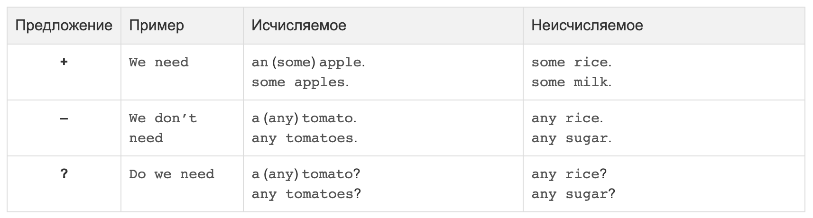
Употребление some, any и no

Slide 10
Exercise 2. Write in a, an, some, any.
There's ____an__angel on the top.
There are ___some___ornaments on the tree.
Are there ___any___lights on the tree?
There isn't ___any___Christmas tree in the house.
There's __some____ jam on the wooden table.
Is there ___any___bread in the basket?
There aren't ___any___ vegetables in the fridge.

Slide 11
Exercise 3. Complete the sentences with some/any/no.
There is _______ tea in the crystal glass, but it is very hot.
There is _______ fresh milk in the fridge. I can't make porridge.
Are there ________ tasty apples in the bag?
There isn't _______ jam on the round plate.
There are _______ bananas on the wooden table. They are yellow.
There is ________ butter on the plate.
There is ________ cheese on the table, but there’re ____________ cheese sandwiches.
There isn't _________ sausage on the table.
There are ____________ potatoes in the bag.
There aren't ______________ bananas on the table, but there are ________ cucumbers there.

Slide 12
Exercise 4. Complete the sentences with the words
Cucumbers, carrots
There is some fresh cabbage on the wooden table. There aren't any apples in the big bag, but there are some carrots there. There are no green cucumbers on the table, but there are some tasty red tomatoes there.

Slide 13
Exercise 6. Choose the correct item.
Is there some/any butter in the fridge?
There isn't any/no bread in the bag.
There are some/any cucumbers on the table.
There are any/no potatoes in the box.
There is/are some cheese on the shelf.

Slide 14
Exercise 9. Correct the sentences.
Are there any milk in the fridge?
There is no tomatoes in the salad.
Is there some sugar in this coffee?
There are some hamburger on the menu.
I'd like any potatoes, please.
There are some jam on the bread,
There's some fly in my soup.
We've got some banana.
There isn't some money in my pocket.
There is some posters on the wall.
Is there a salt in this soup?

Slide 15
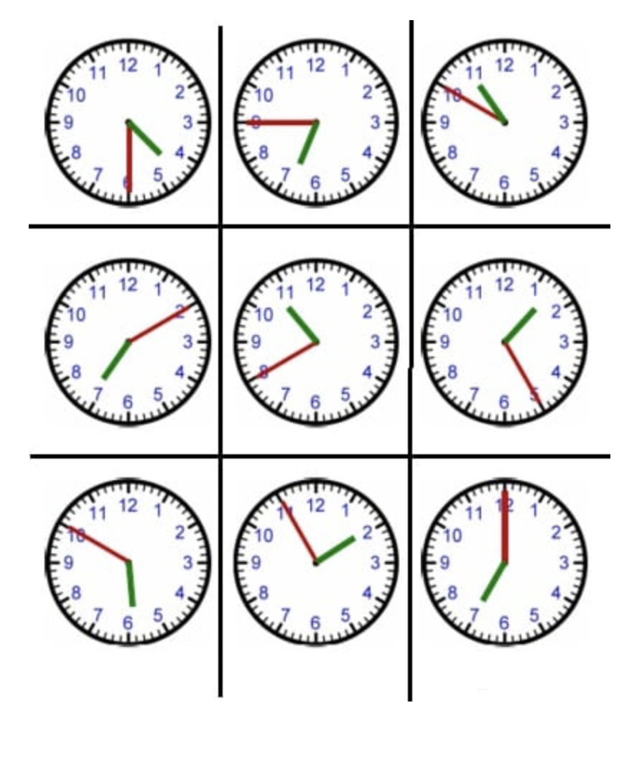
Сколько времени?
It’s a quarter to five.
It’s twenty to one.
It’s half past six.
It’s three o’clock.
It’s ten past five.
It’s twenty-five to three.
It’s five to ten.
It’s five past twelve.
It’s twenty-five past eight.
It’s a quarter past seven.
3:30
5:50
2:15
11:45
12:40
8:30
11:05
3:35
9:00
10:10

Slide 16
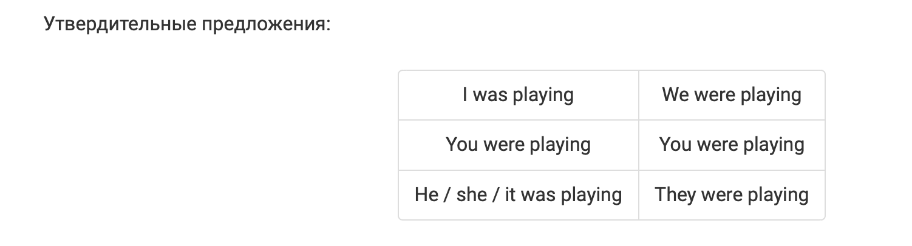
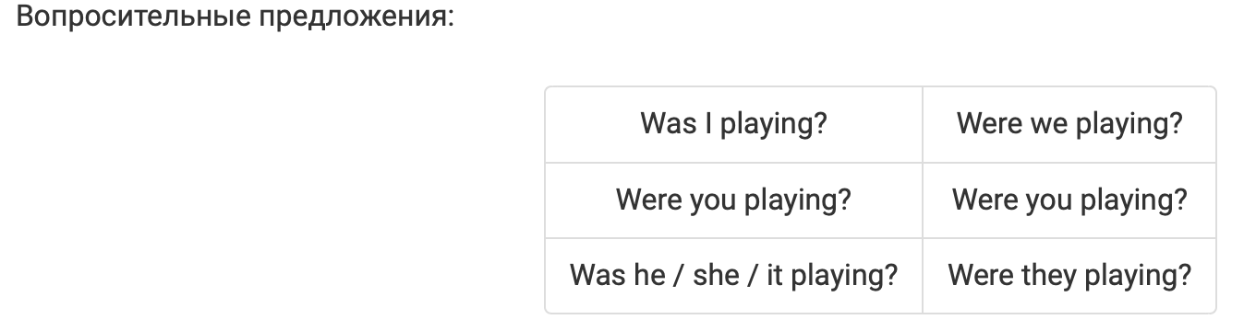
Past Continous

Slide 17
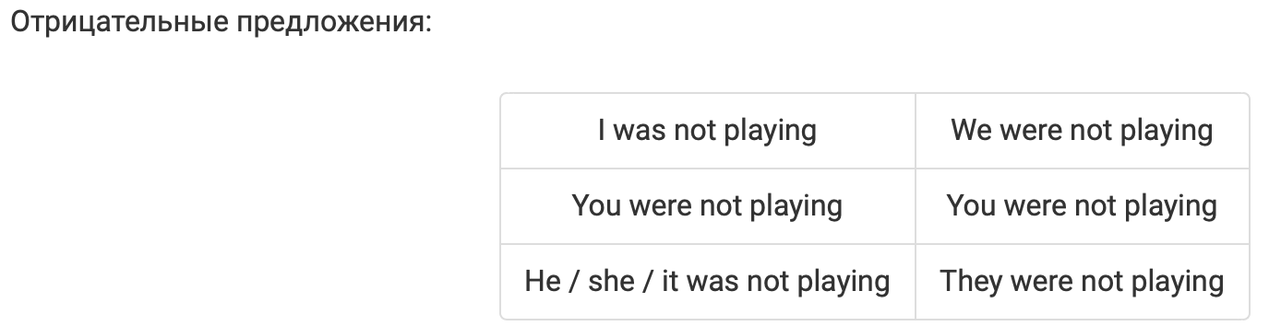
Past Continous

Slide 18
I (to write) an English exercise now. I (to write) an English exercise at that time yesterday.
My little sister (to sleep) now. My little sister (to sleep) at that time yesterday.
My friends (not to do) their homework now. They (to play) volley­ball.
My friends (not to do) their homework at seven o’clock yesterday. They to play) volleyball.
What you (to do) now? — I (to drink) tea. you (to drink) tea at that time yesterday? — No, I (not to drink) tea at this time yesterday, I (to eat) a banana.

Slide 19
Упражнения на past simple
I didn’t ride a bicycle.
I didn’t pick mushrooms.
I didn’t open a book.
I didn’t play any game.
I didn’t sit by the river.
I didn’t write letters.
I didn’t meet my friends.
I didn’t visit my relatives.

