Slide 1
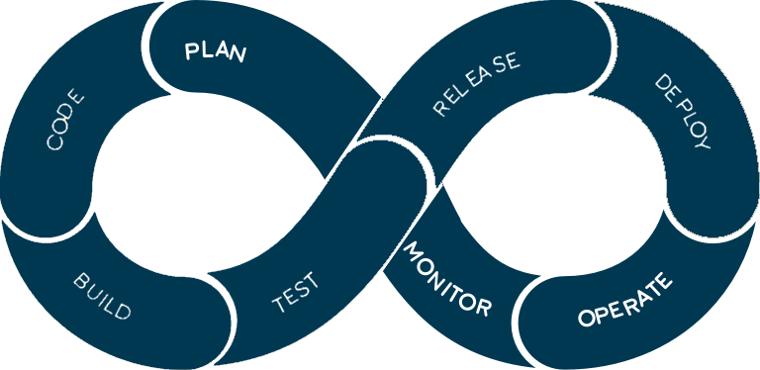
CI CD
The best practice for DevOps and agile development.

Slide 2
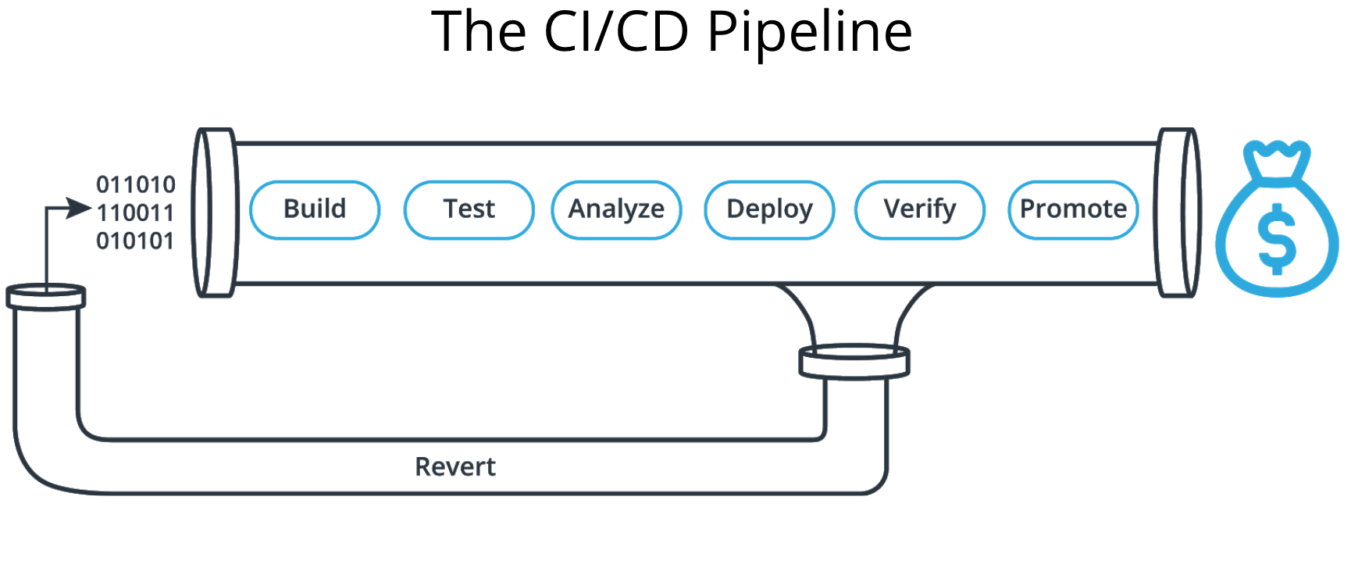
Introduction
CI/CD is a set of methods that enables application developers to deliver code changes more frequently to customers using automation.
By automating integration and delivery, CI/CD lets software development teams focus on meeting business requirements while ensuring code quality and software security.

Slide 3
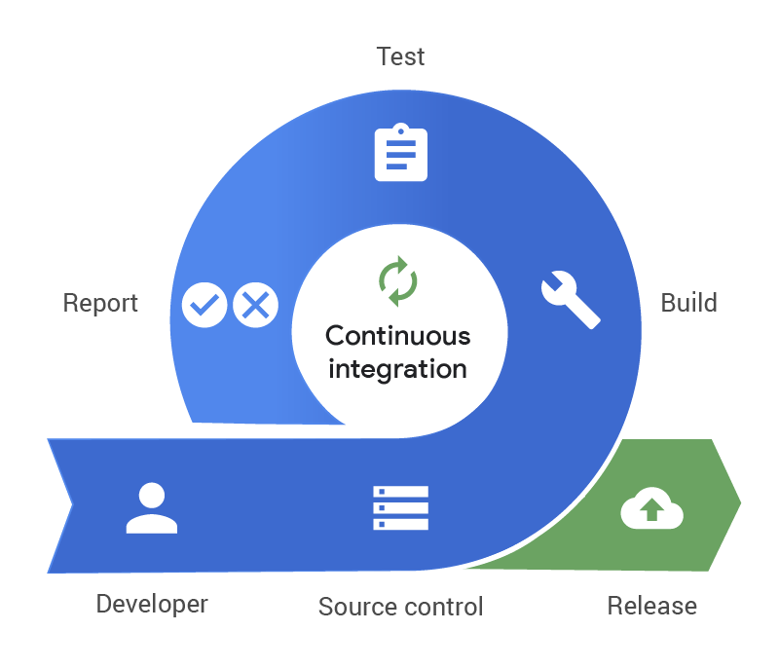
Continuous Integration
Continuous integration (CI) helps developers merge their code changes back to a shared branch, more frequently.
It's the process of "Making". Everything related to the code fits here, and it all culminates in the ultimate goal of CI: a high quality, deployable artifact!
Once changes to an application are merged, they are validated by automatically building the application and running automated tests.
Some CI related tasks are:
Build >
Unit Test >
Static Analysis >
Store artifact

Slide 4
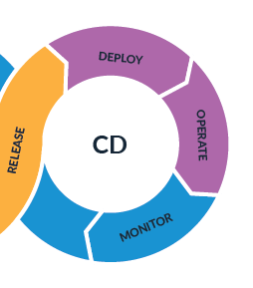
Continuous Deployment
A software engineering approach in which the value is delivered frequently through automated deployments.
Everything related to deploying the artifact fits here. It's the process of "Moving" the artifact from the shelf to the spotlight.
It automates releasing an app to production and relies heavily on well-designed test automation
Some CD related tasks are:
Create infrastructure >
Provision servers >
Configure >
Verify >
Promote >
Rollback

Slide 5

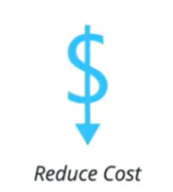
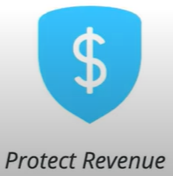
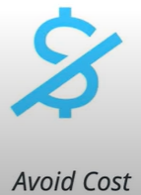
Why CI/CD ?
When it comes to the question, why CI/CD ?
We need to think in terms of business value CI/CD can provide.

Slide 6
Benefits Of CI/CD
CI/CD can help us achieve the best business efficiency in a lot of ways. Here is some examples on what CI/CD can do.
Automate Infrastructure Cleanup
Which means > Less infrastructure costs from unused resources.
Catch Unit Test Failures
Which means > Less bugs in production and less time in testing.
Faster and More Frequent Production Deployments
Which means > New value-generating features released more quickly.
Automated Rollback Triggered by Job Failure
Which means > Quick undo to return production to working state.

Slide 7

Thank Y U

