Slide 1



IPL Analysis Power BI Report
View in Power BI
Last data refresh:
4/2/2024 5:14:32 PM UTC
Downloaded at:
4/4/2024 5:00:38 AM UTC

Slide 2
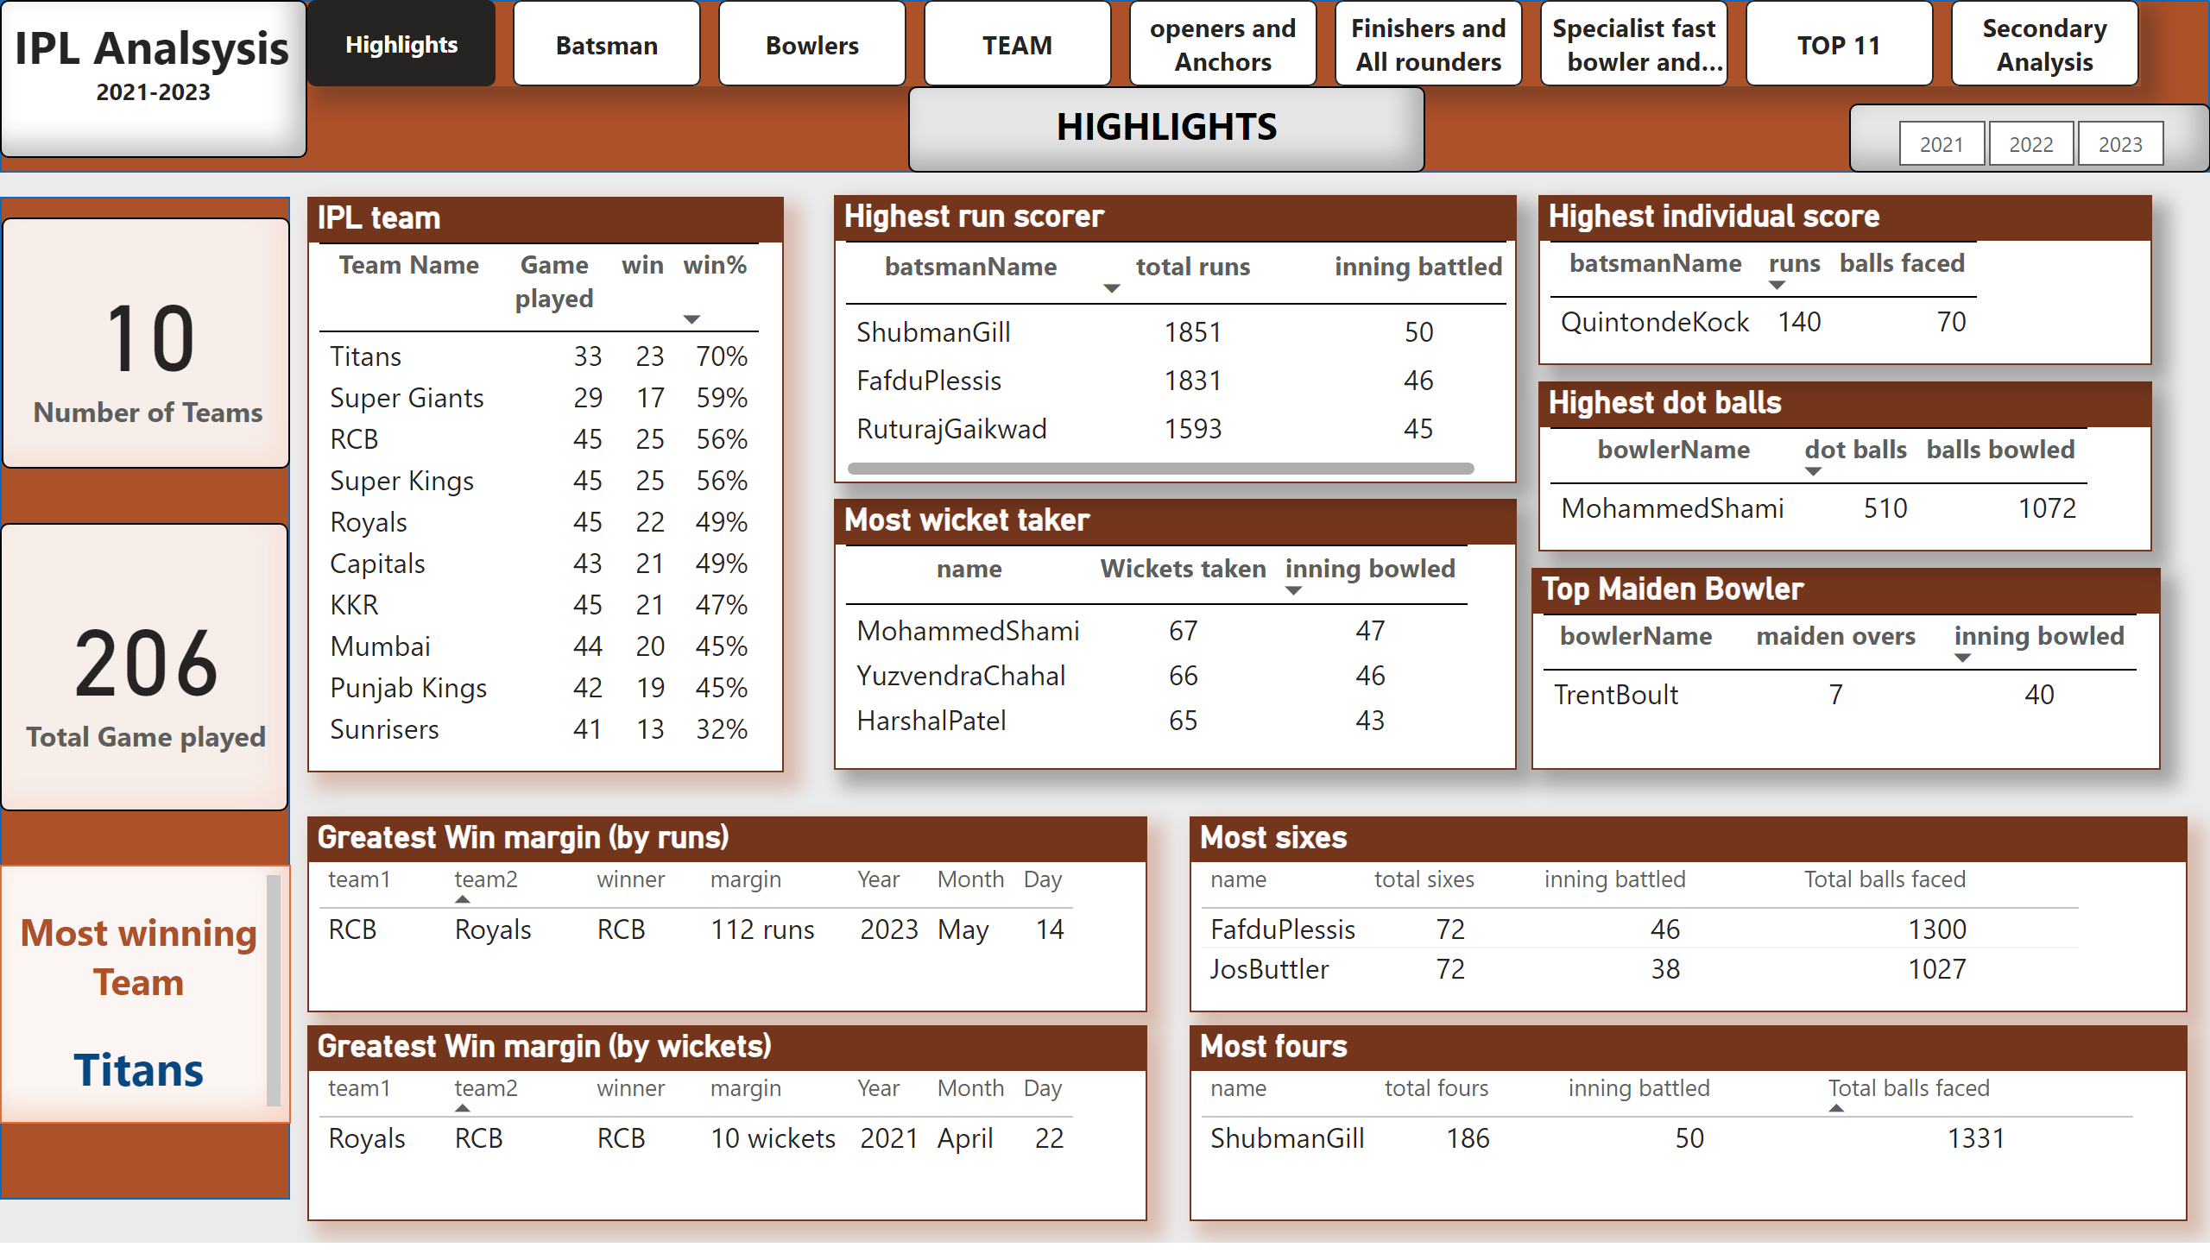
Highlights
Notes:
IPL team
No alt text provided
shape
No alt text provided
textbox
No alt text provided
pageNavigator
No alt text provided
textbox
No alt text provided
Most wicket taker
No alt text provided
Highest run scorer
No alt text provided
Top Maiden Bowler
No alt text provided
Greatest Win margin (by runs)
No alt text provided
Greatest Win margin (by wickets)
No alt text provided
Most sixes
No alt text provided
Most fours
No alt text provided
shape
No alt text provided
textbox
No alt text provided
slicer
No alt text provided
card
No alt text provided
Highest dot balls
No alt text provided
Highest individual score
No alt text provided
card
No alt text provided

Slide 3
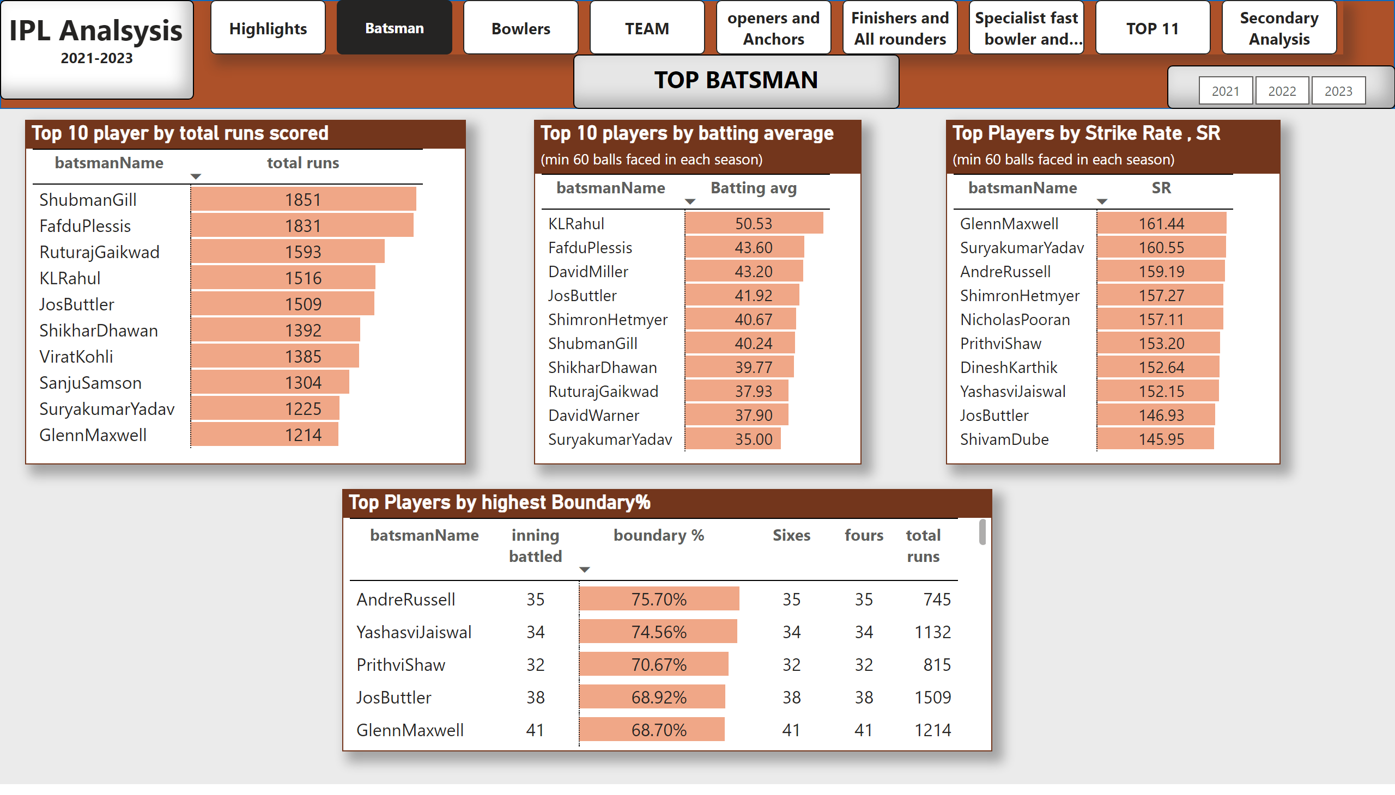
Batsman
Notes:
shape
No alt text provided
textbox
No alt text provided
pageNavigator
No alt text provided
textbox
No alt text provided
Top 10 player by total runs scored
No alt text provided
Top 10 players by batting average
No alt text provided
Top Players by Strike Rate , SR
No alt text provided
Top Players by highest Boundary%
No alt text provided
slicer
No alt text provided

Slide 4
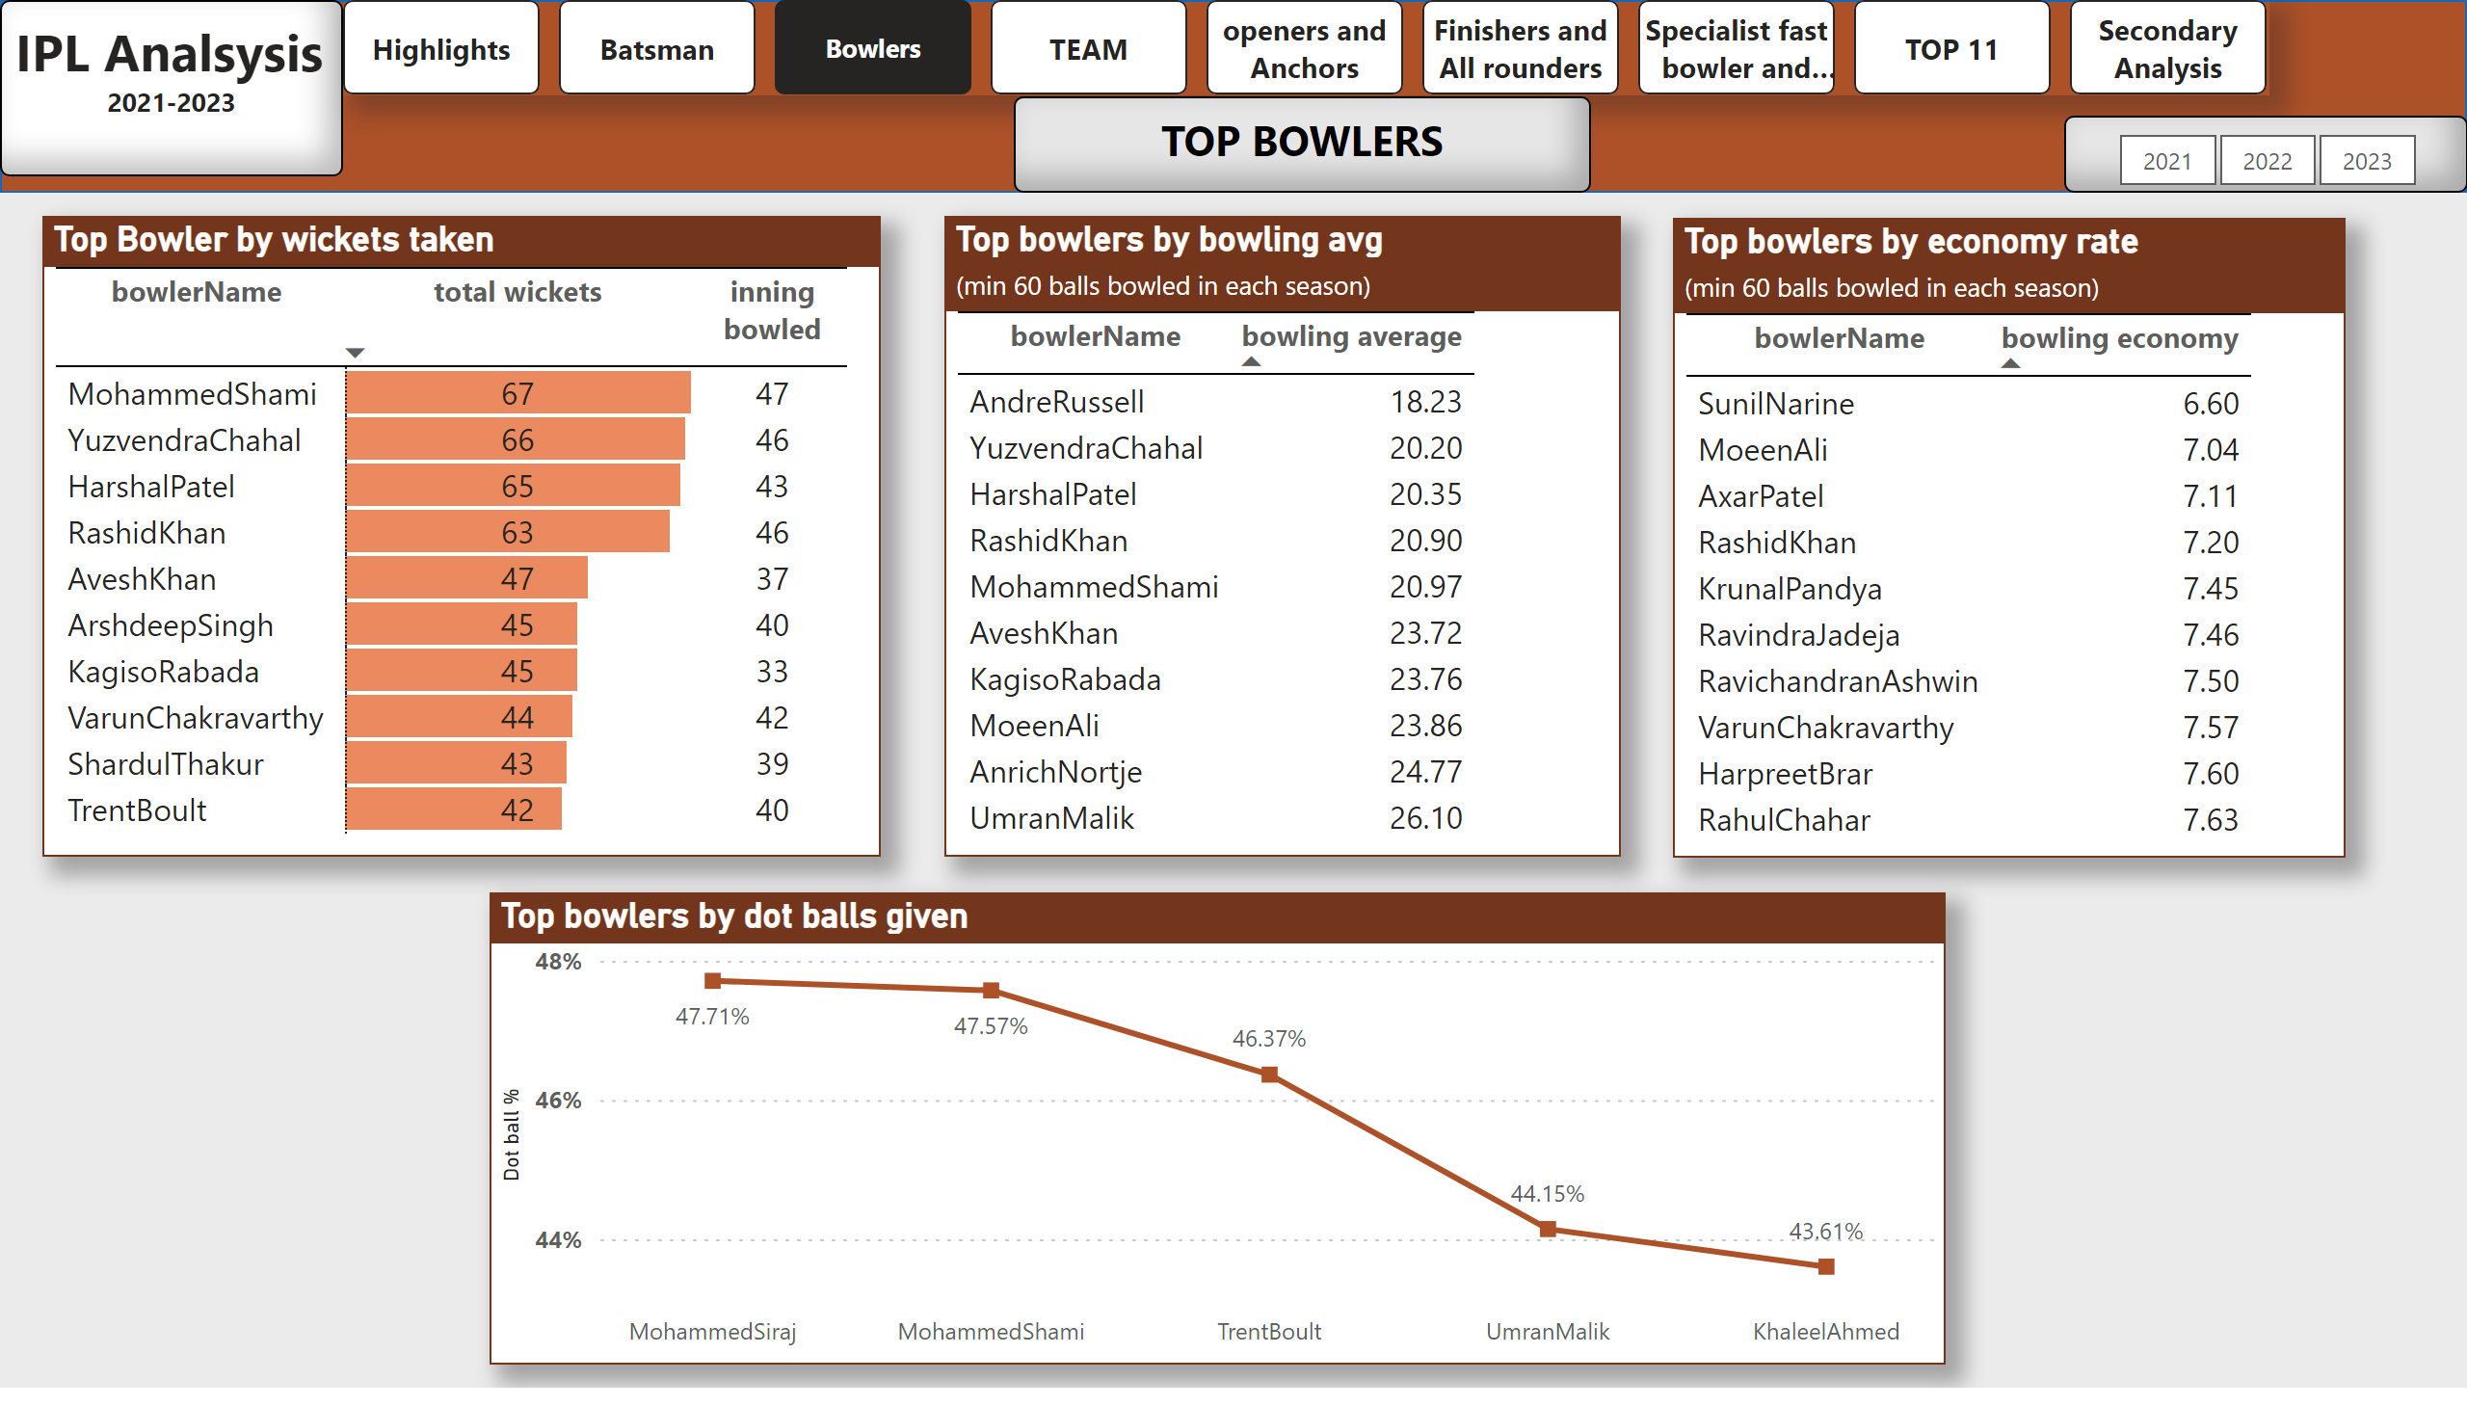
Bowlers
Notes:
shape
No alt text provided
textbox
No alt text provided
pageNavigator
No alt text provided
textbox
No alt text provided
Top Bowler by wickets taken
No alt text provided
Top bowlers by bowling avg
No alt text provided
Top bowlers by economy rate
No alt text provided
Top bowlers by dot balls given
No alt text provided
slicer
No alt text provided

Slide 5
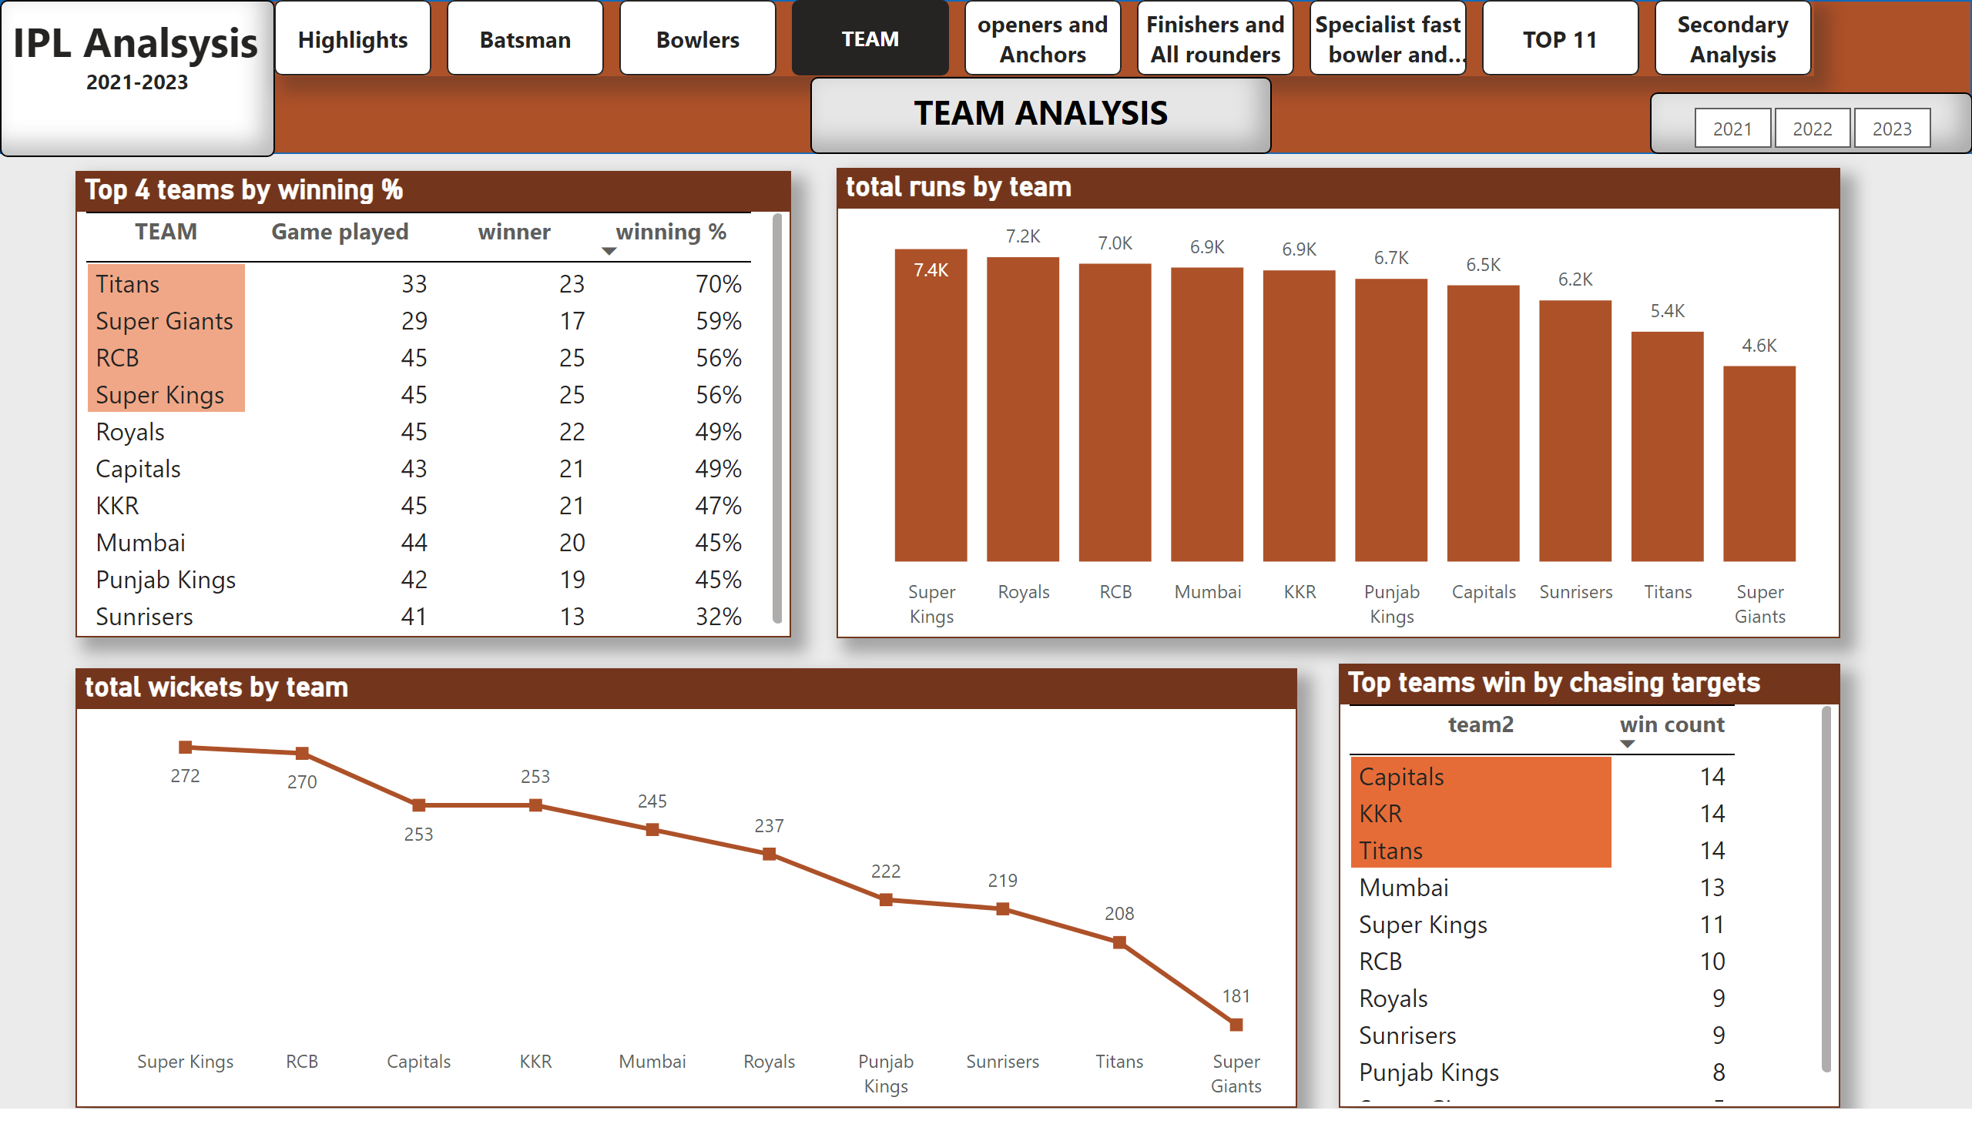
TEAM
Notes:
slicer
No alt text provided
columnChart
No alt text provided
lineChart
No alt text provided
Top teams win by chasing targets
No alt text provided
Top 4 teams by winning %
No alt text provided
textbox
No alt text provided
pageNavigator
No alt text provided
textbox
No alt text provided
shape
No alt text provided

Slide 6
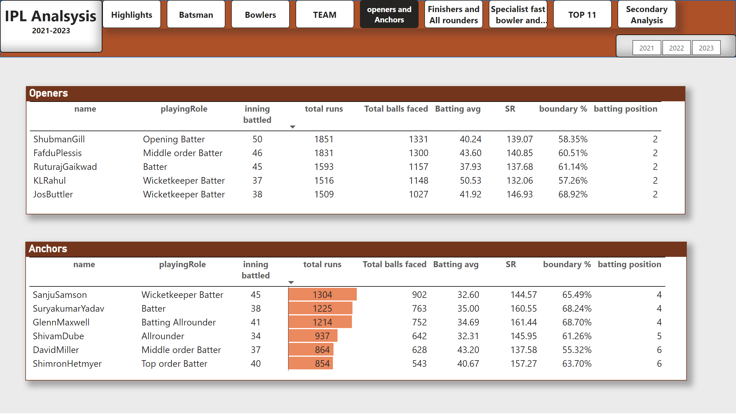
openers and Anchors
Notes:
shape
No alt text provided
textbox
No alt text provided
pageNavigator
No alt text provided
Openers
No alt text provided
Anchors
No alt text provided
slicer
No alt text provided

Slide 7
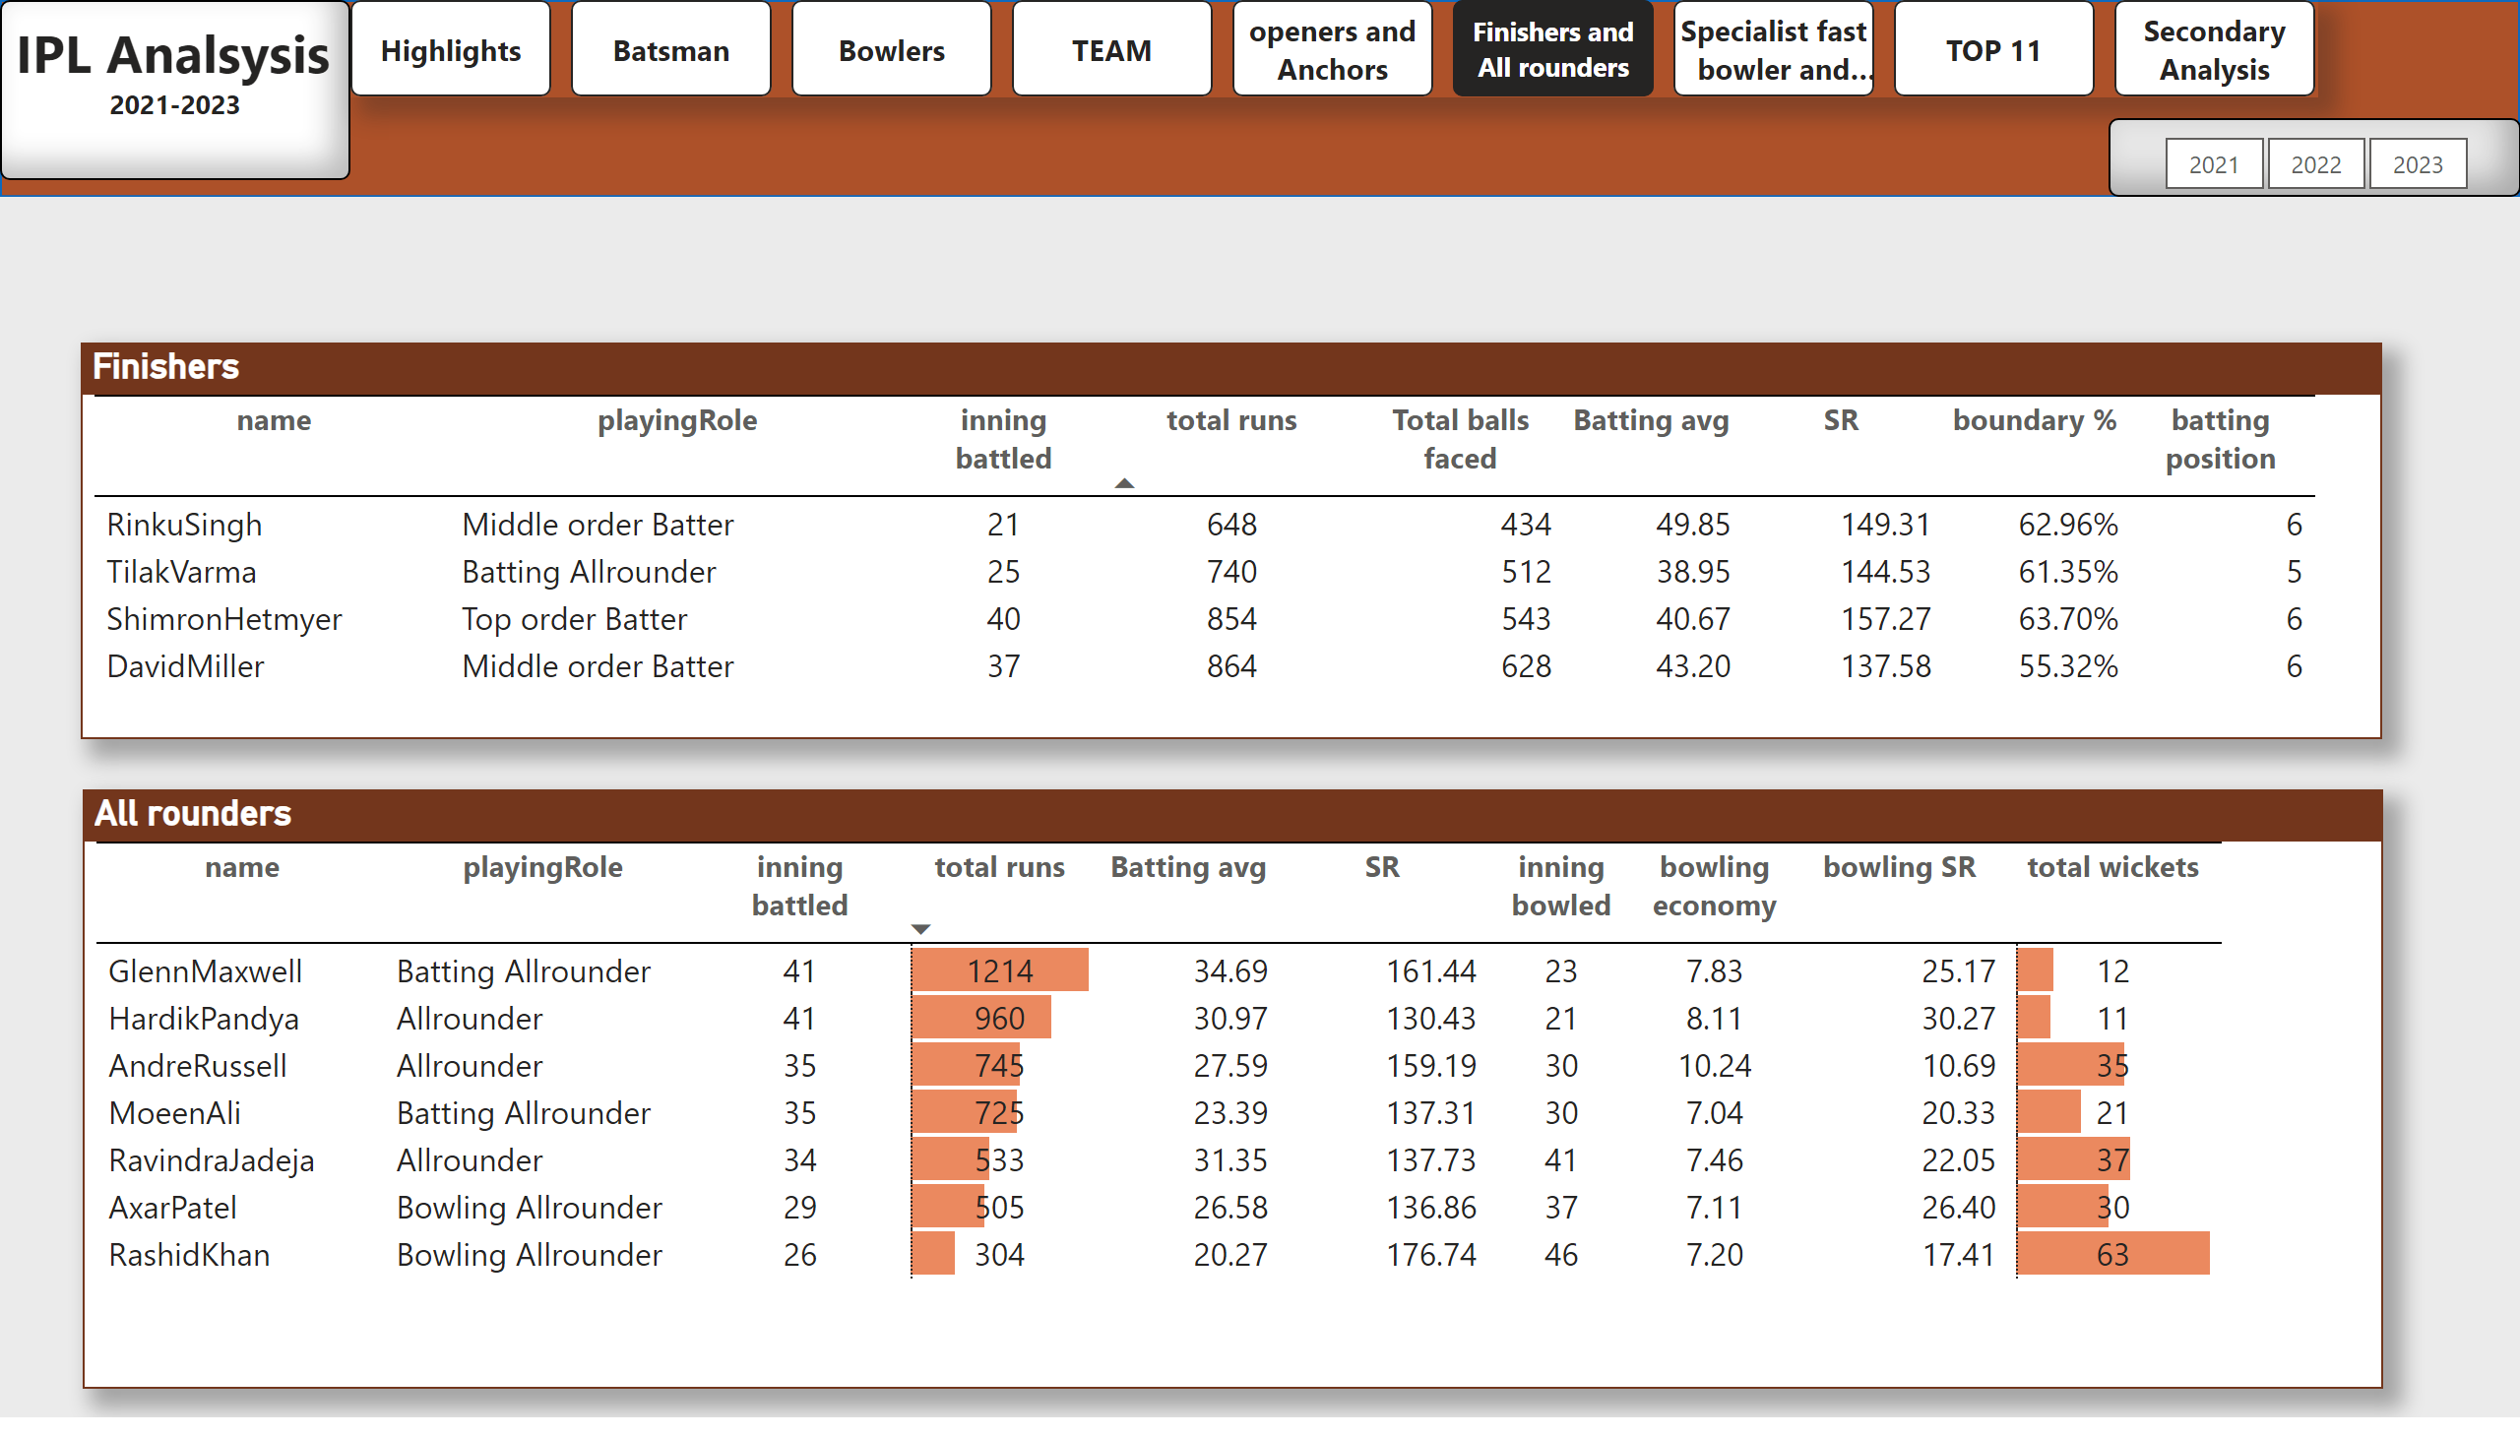
Finishers and All rounders
Notes:
shape
No alt text provided
textbox
No alt text provided
pageNavigator
No alt text provided
Finishers
No alt text provided
All rounders
No alt text provided
slicer
No alt text provided

Slide 8
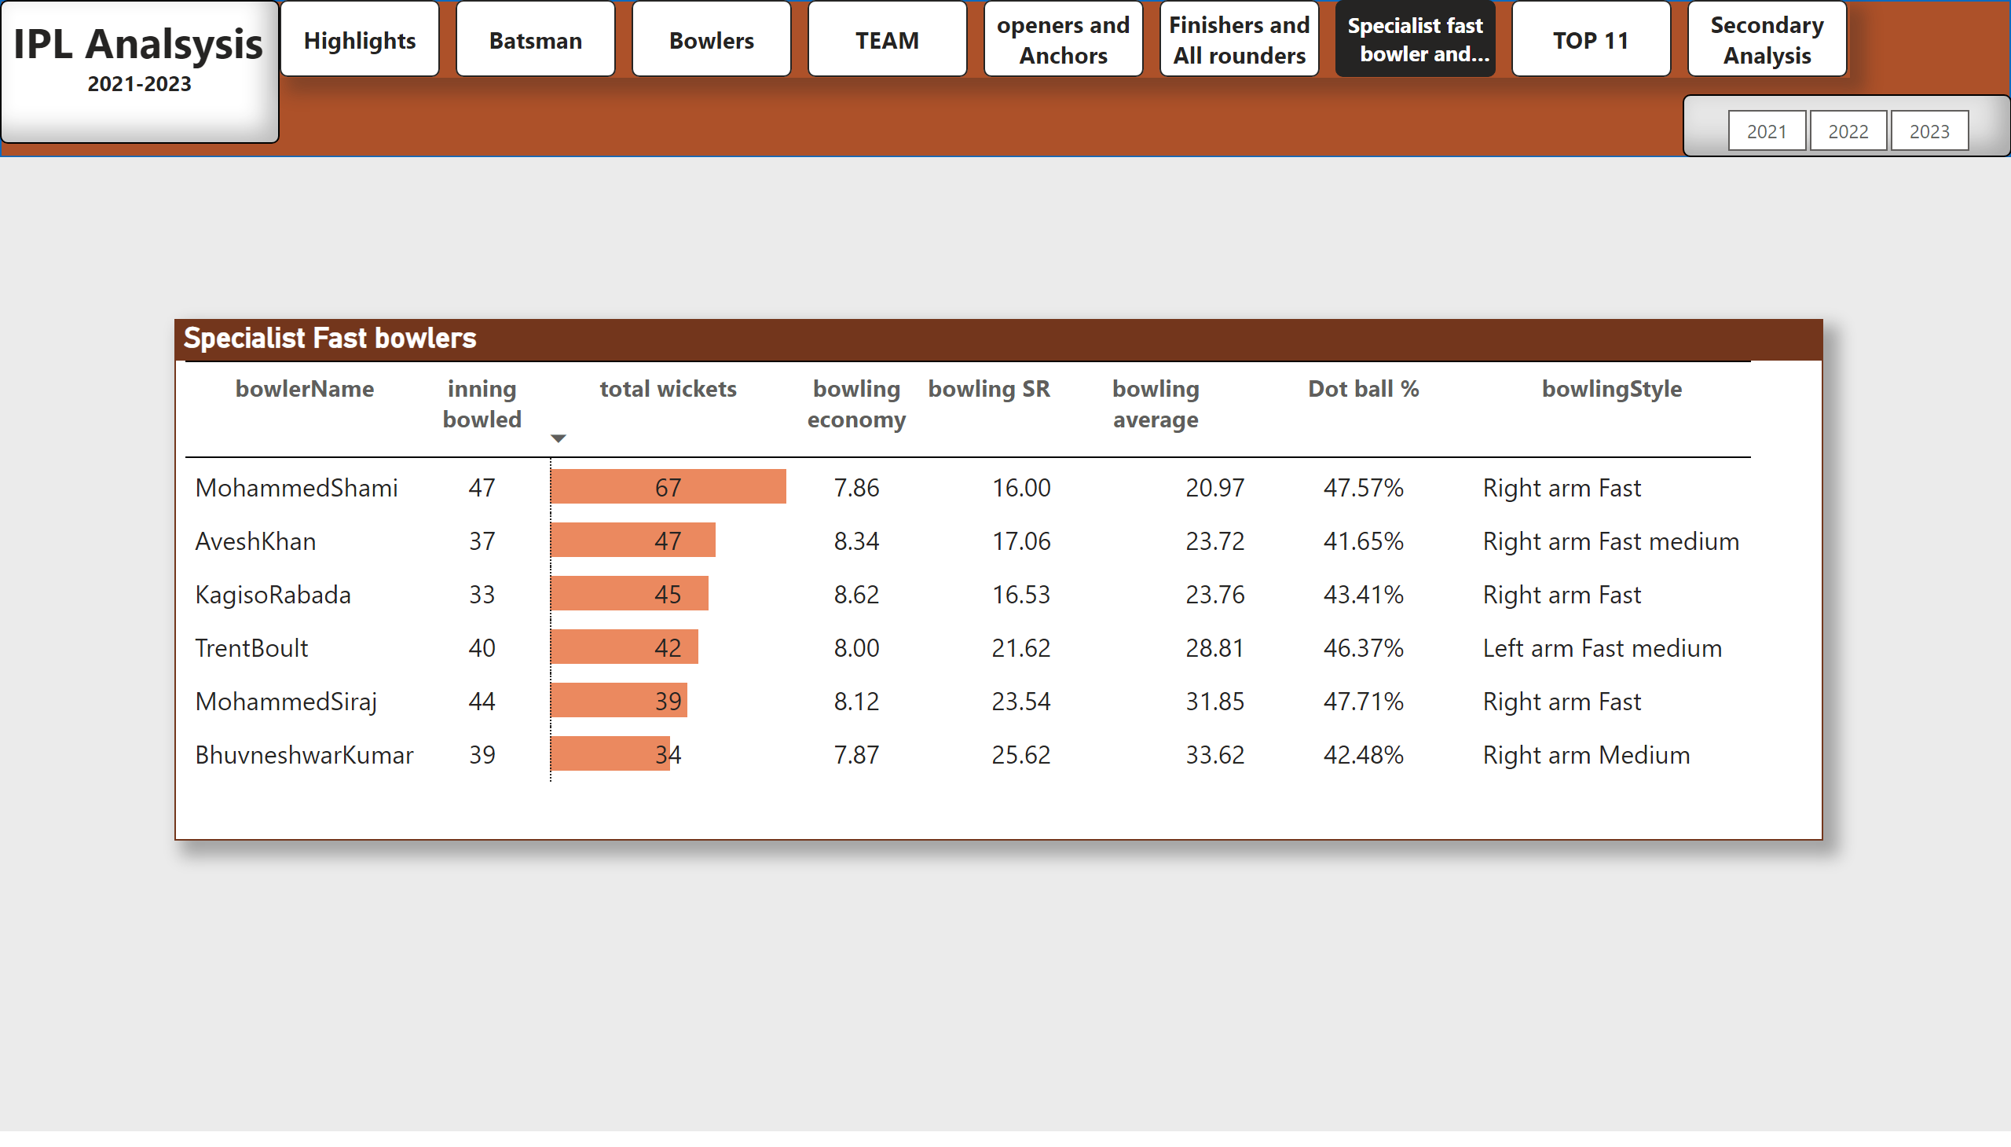
Specialist fast bowler and Spinner
Notes:
shape
No alt text provided
textbox
No alt text provided
pageNavigator
No alt text provided
slicer
No alt text provided
Specialist Fast bowlers
No alt text provided

Slide 9
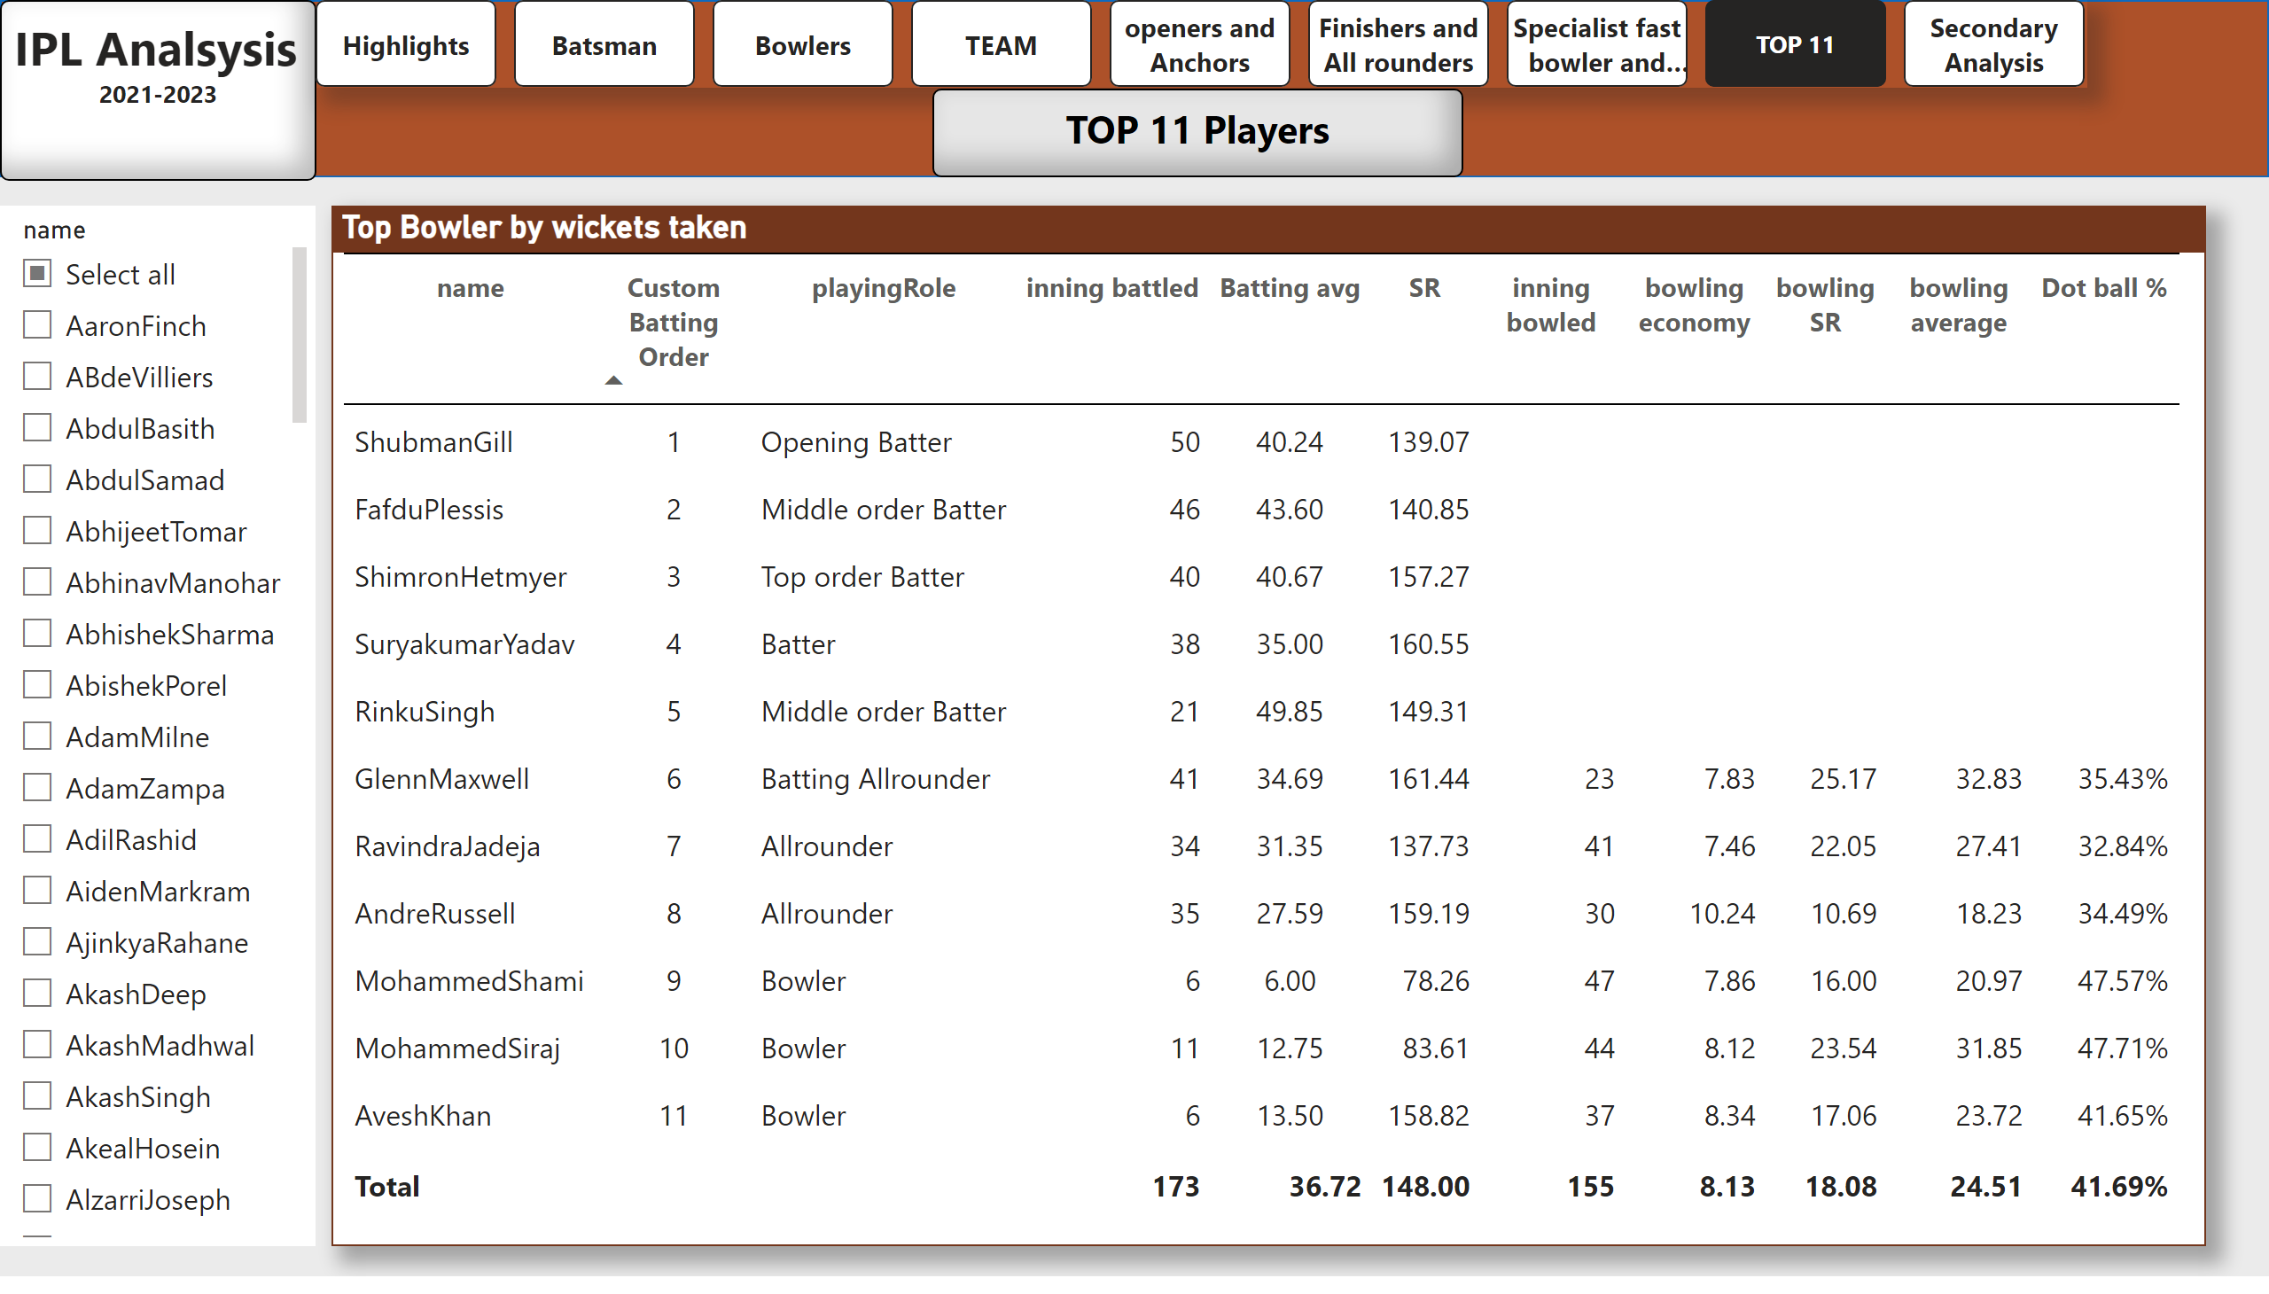
TOP 11
Notes:
shape
No alt text provided
textbox
No alt text provided
pageNavigator
No alt text provided
textbox
No alt text provided
Top Bowler by wickets taken
No alt text provided
slicer
No alt text provided

Slide 10
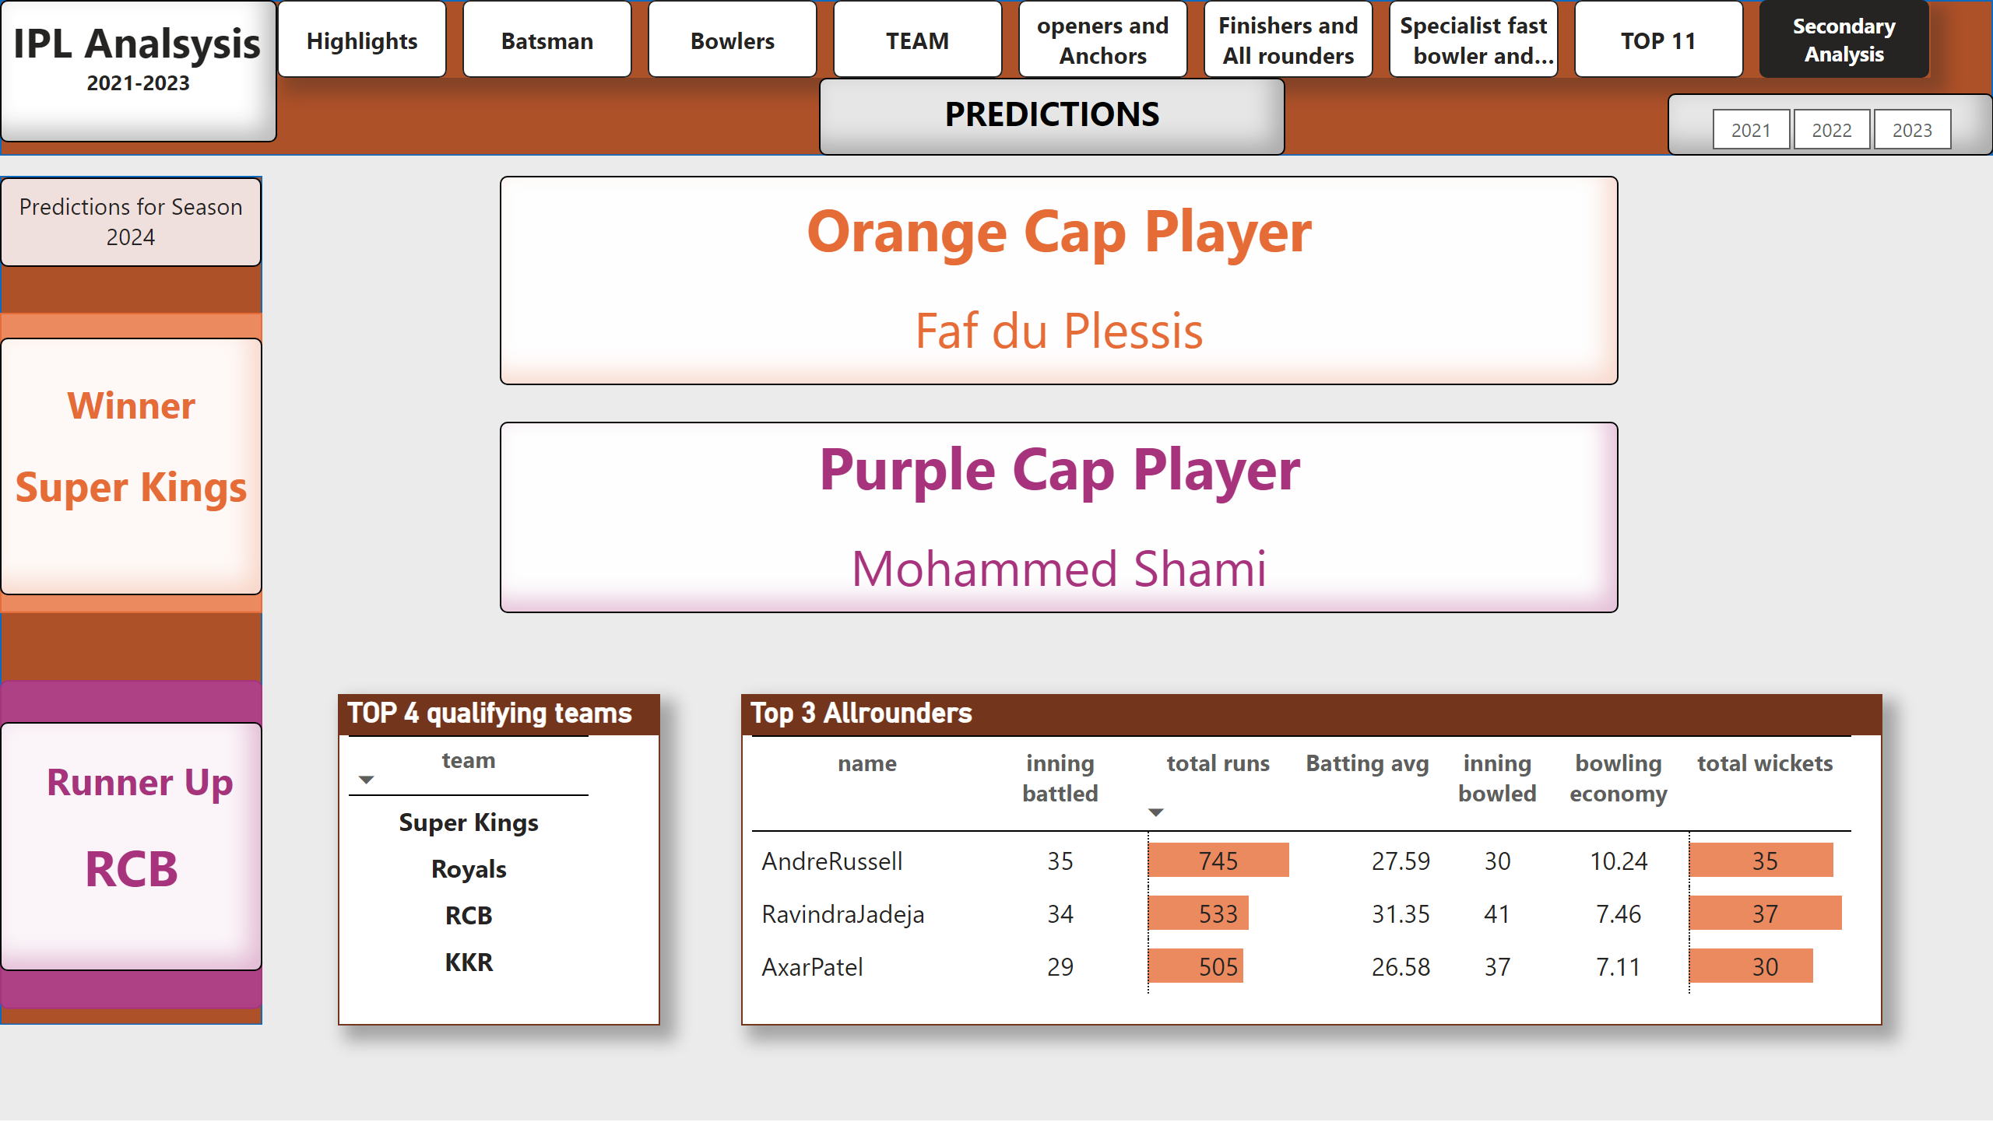
Secondary Analysis
Notes:
TOP 4 qualifying teams
No alt text provided
shape
No alt text provided
textbox
No alt text provided
pageNavigator
No alt text provided
textbox
No alt text provided
shape
No alt text provided
textbox
No alt text provided
textbox
No alt text provided
shape
No alt text provided
shape
No alt text provided
textbox
No alt text provided
slicer
No alt text provided
Top 3 Allrounders
No alt text provided
textbox
No alt text provided
textbox
No alt text provided

