Slide 1
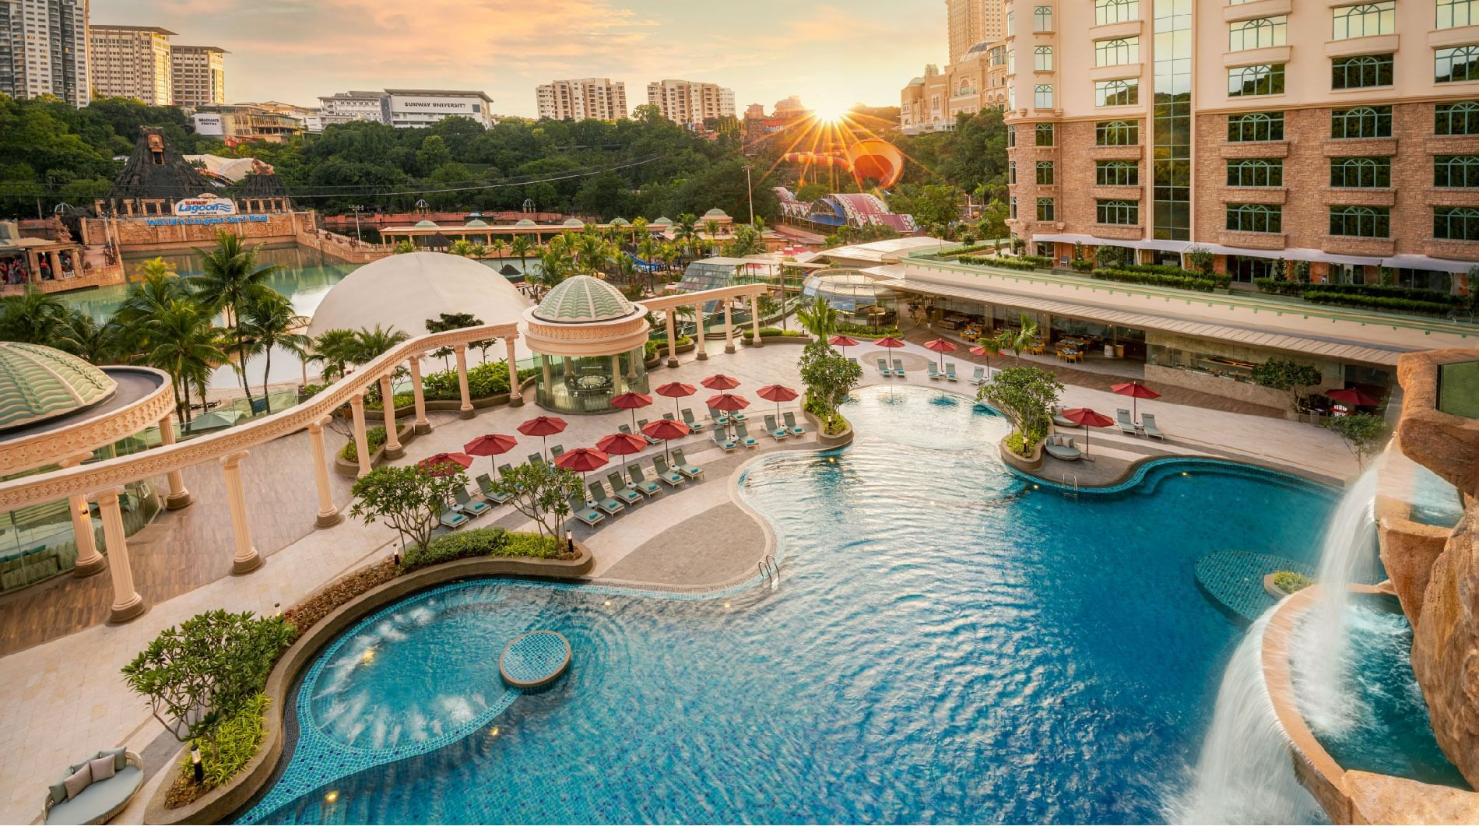
HOTEL BOOKING ANALYSIS
KAARJALA LAKSHMIKANTH

Slide 2
PROBLEM STATEMENT
Mostly cancellation of hotel bookings. This is the main reason of problem.
Analyze booking trends across different seasons, weekdays, and room types to identify peak and off-peak periods
Segment guests based on demographics and travel patterns to understand their preferences and spending habits.
Compare cancellation rates across different segments and identify factors that contribute to cancellations.
the effectiveness of different marketing channels in attracting high-value guests.
Develop recommendations for targeted marketing campaigns and pricing strategies to maximize revenue during peak periods.

Slide 3
OBJECTIVE
Data have 32 columns (variables).
There are 119390 rows (observations).
Data have some missing information’s.
This data's about hotel bookings - both city and resort hotels.
We get info like booking dates, how long guests stay, family size, and parking.
We'll use Python to explore this data and learn from it.
Maybe we'll see which hotel's busier, or when people book most.
Ultimately, we want to understand hotel booking behavior better.
So, with Python as our tool, let's dive into this hotel booking mystery!

Slide 4
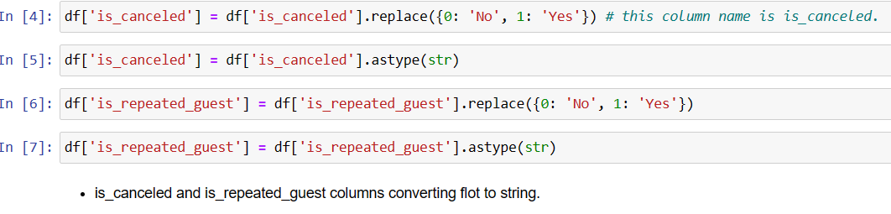
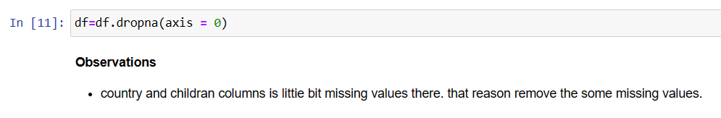
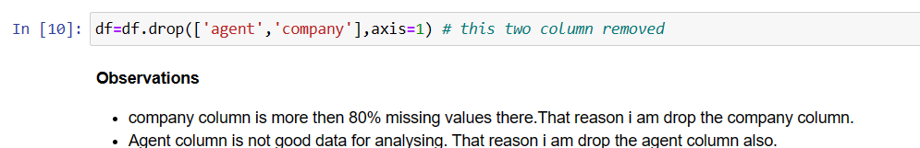
Data Cleaning & Pre processing
Checking for Null values
Converting float to string
Handling Null values
Dropping unwanted columns

Slide 5
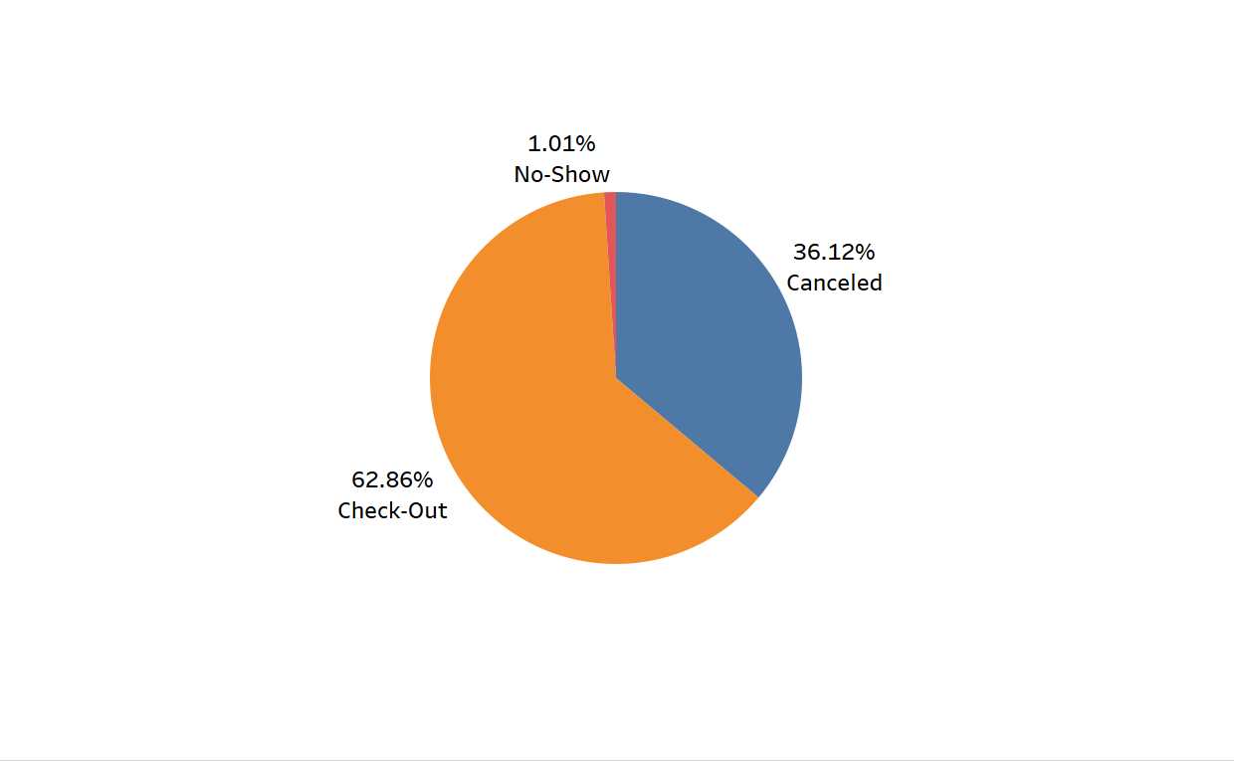
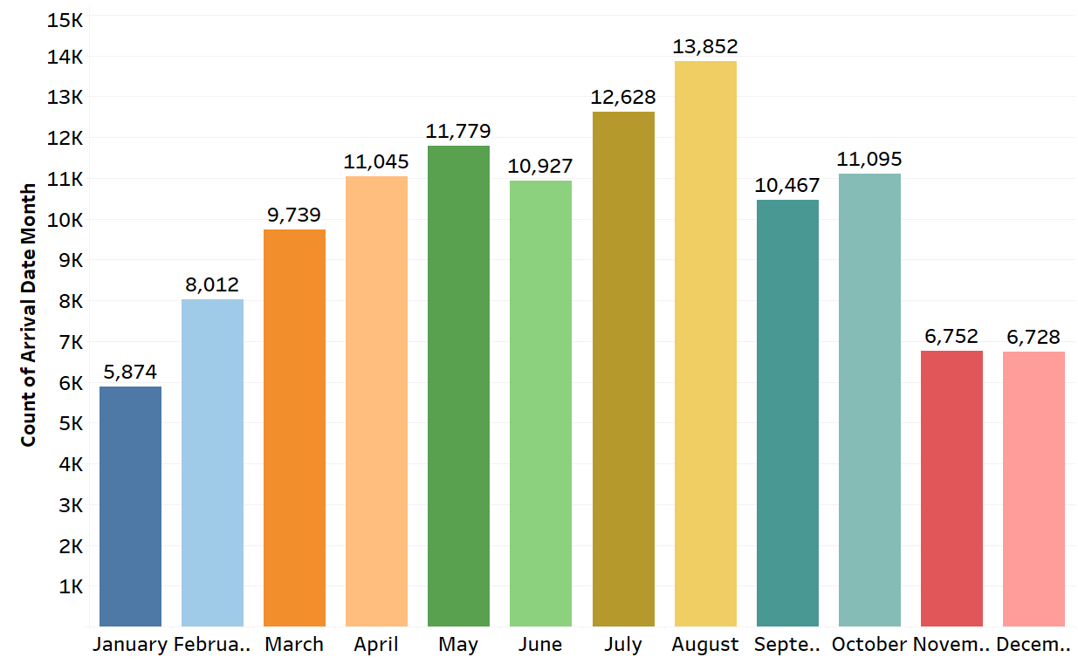
DISTRIBUTION OF THE RESERVATION STATUS
MONTH WISE ARRIVALS
OBSERVATIONS:-
The distribution of reservation
statuses for 36.12% were cancellations.
OBSERVATIONS:-
August 13,852 members arrivals and January 5,874.

Slide 6
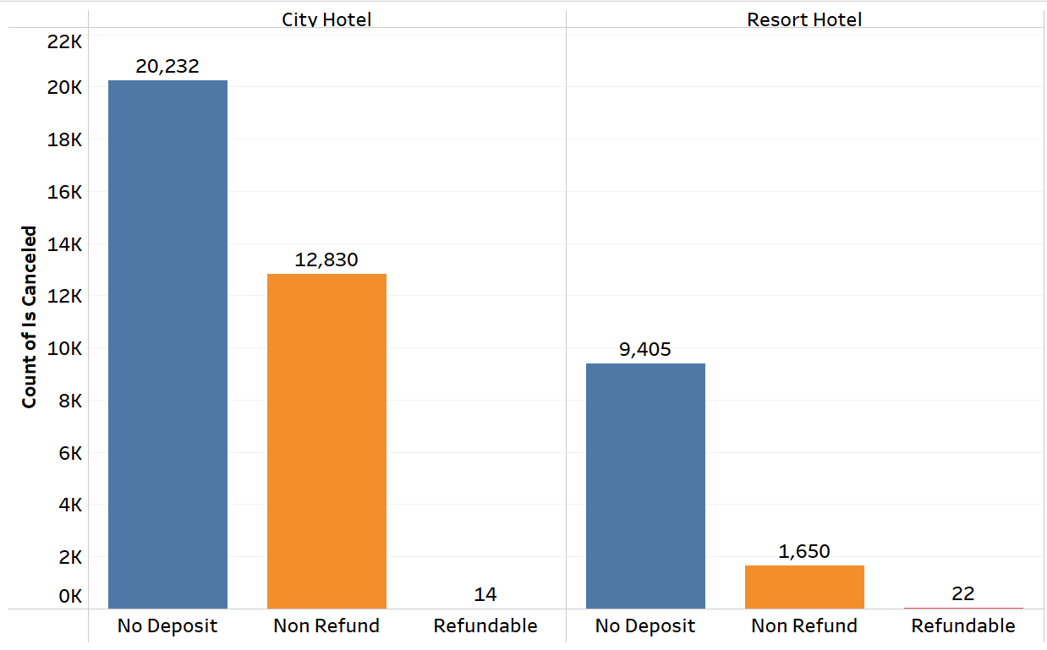
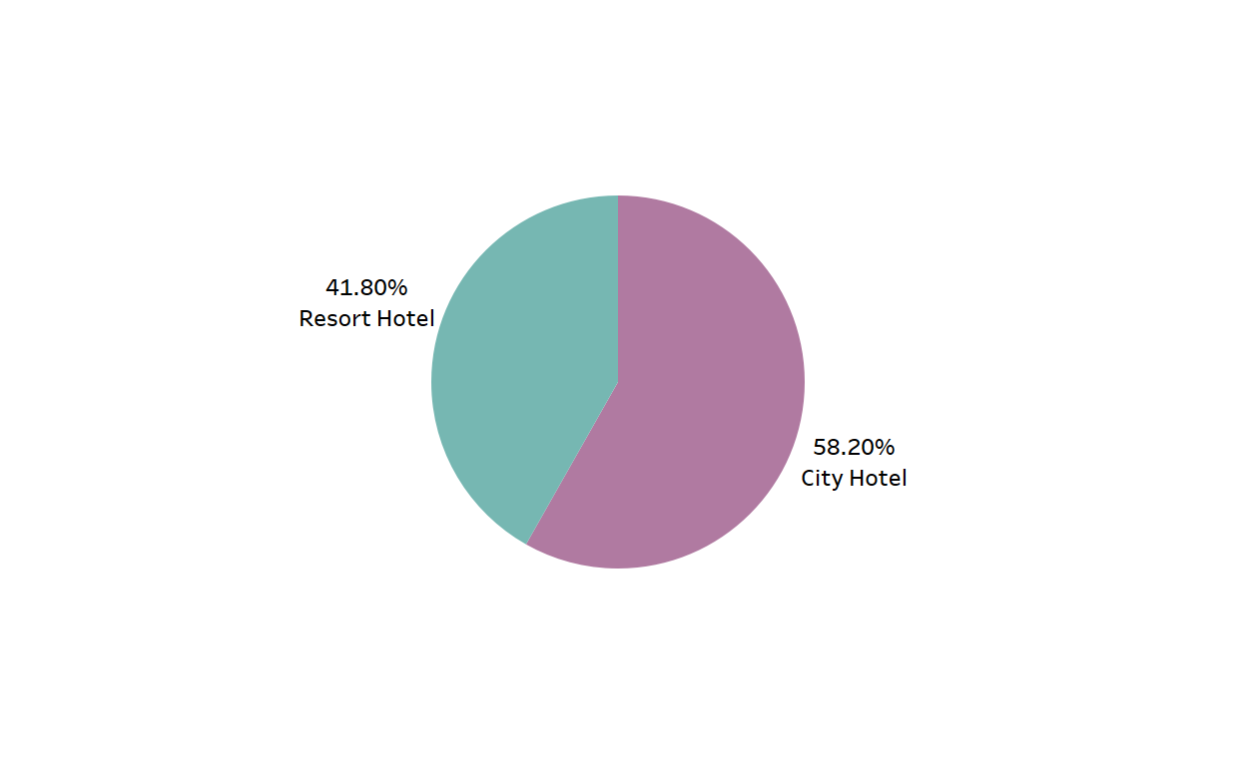
HOTEL WISE PREVIOUS BOOKING CANCELLATION
DEPOSIT WISE HOTEL CANCELATION
OBSERVATIONS:-
Mostly cancelation is No deposits and City hotel 20,212 not deposits there.
OBSERVATIONS:-
The 61.06% of the 10,361 hotel stays were at resort hotels, while 38.94% were at city hotels.

Slide 7
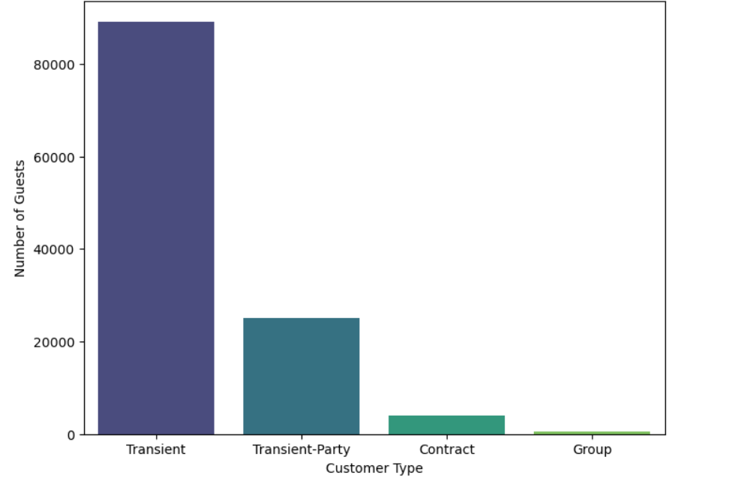
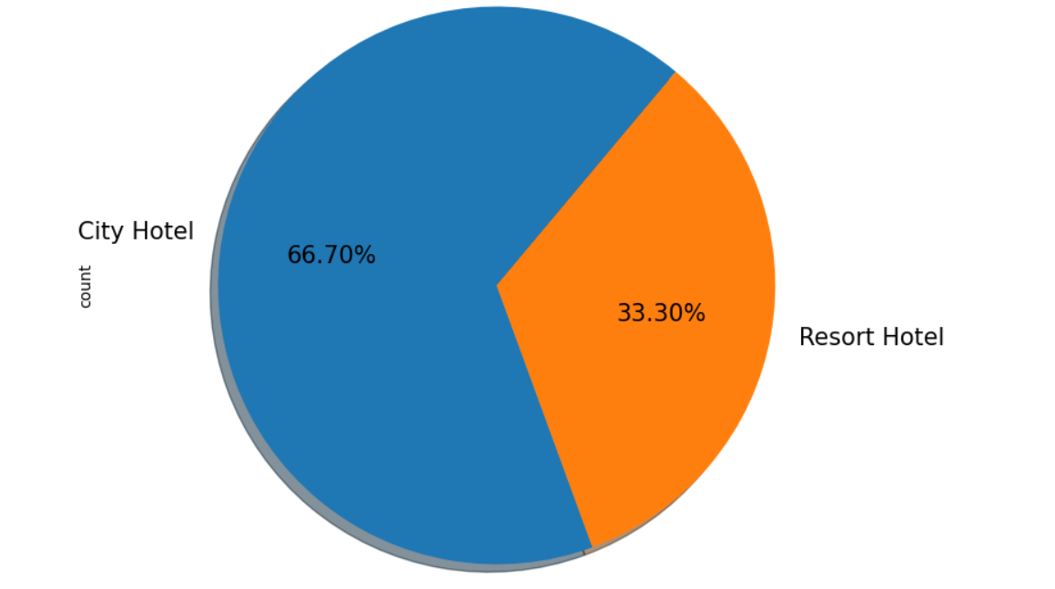
DISTRIBUTION WISE CUSTOMER TYPES
Hotel Wise Booking
OBSERVATIONS:-
Transient customers in 60% of the total. Group customers in 5% of the total.
OBSERVATIONS:-
66.7% of hotel bookings are for city hotels, while only 33.3% are for resort hotels.

Slide 8
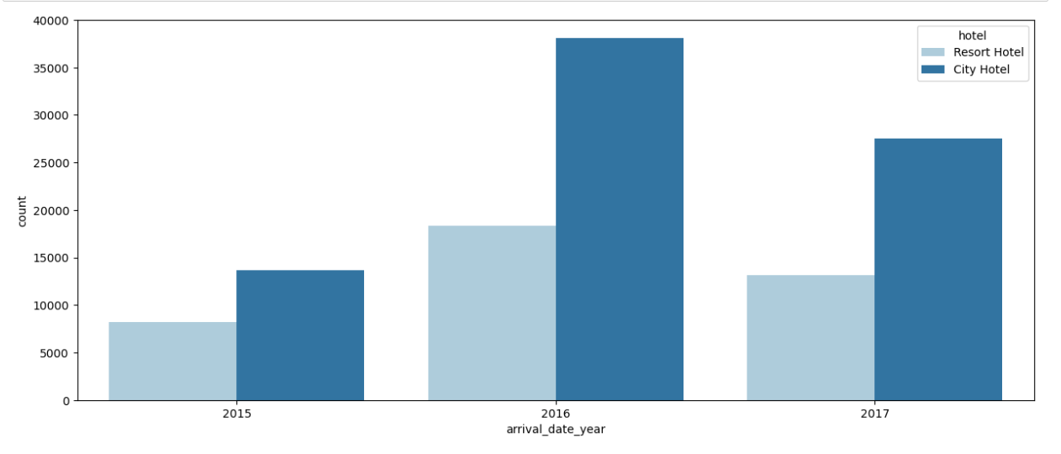
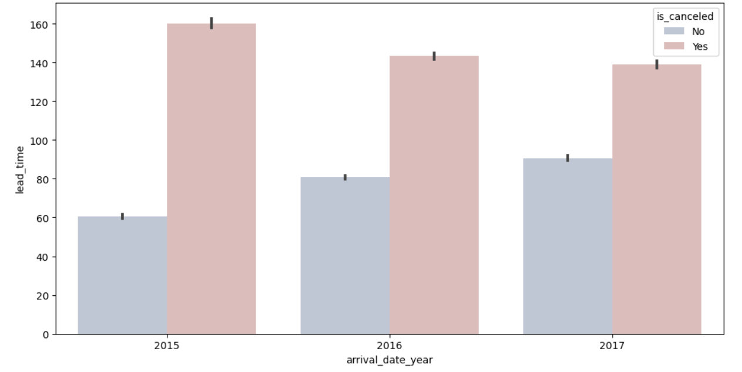
YEAR WISE HOTEL
YEAR WISE LEAD TIME
OBSERVATIONS:-
2016 highest booking in city hotel.
OBSERVATIONS:-
2015 highest cancellation there.

Slide 9
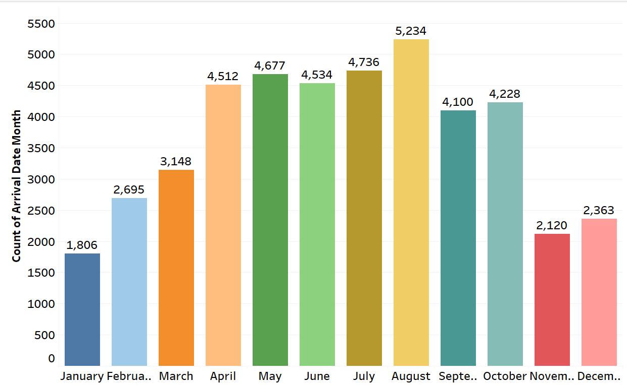
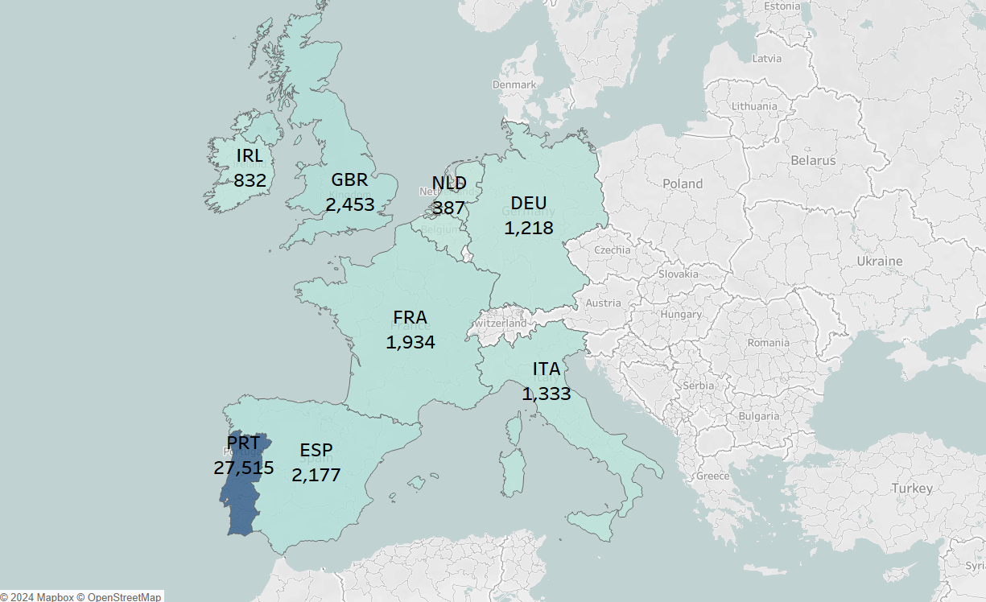
MONTHLY WISE CANCELLATION
COUNTRY WISE HIGHEST CANCELLATION
OBSERVATIONS:-
PRT country is highest cancellation there.
OBSERVATIONS:-
August month 5,234 cancellations there.

Slide 10
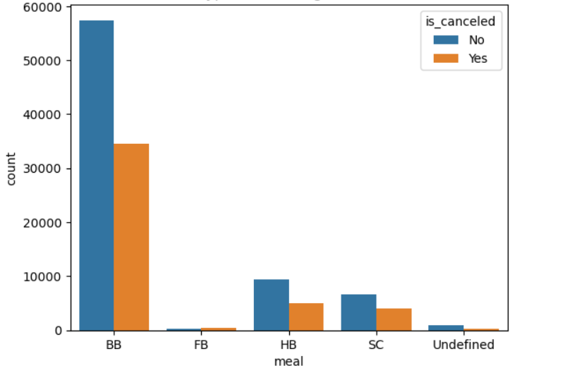
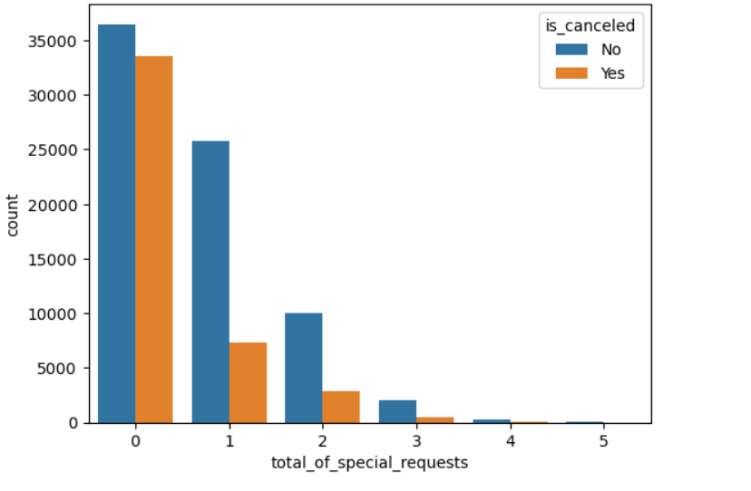
MEAL TYPE WISE BOOKINGS
SPECIAL REQUESTS WISE BOOKINGS
OBSERVATIONS:-
The highest booking and cancellation BB.
OBSERVATIONS:-
0 special request is highest booking and cancellation.

Slide 11
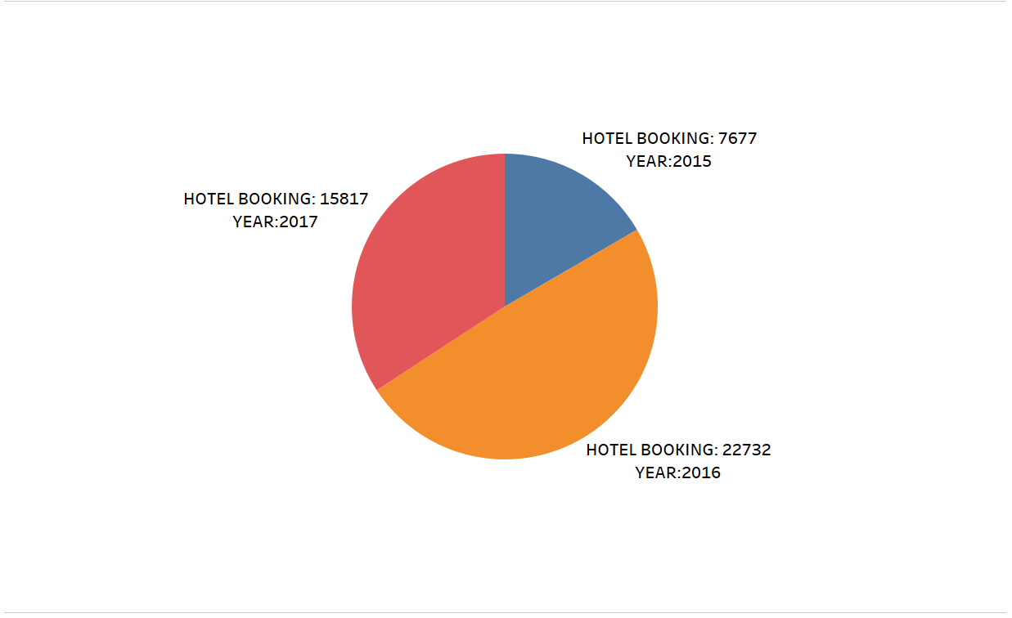
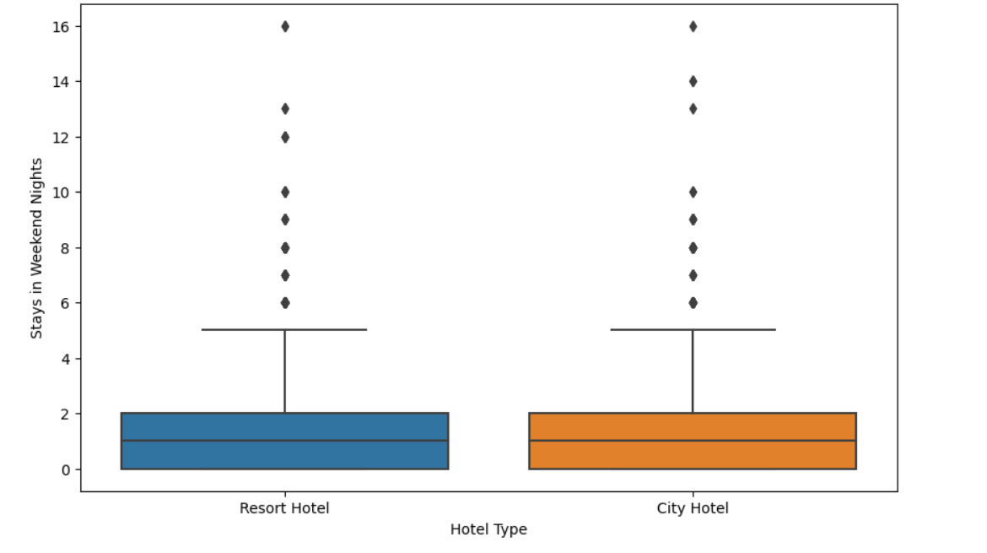
YEAR WISE HOTEL BOOKINGS
STAY IN WEEKEND NIGHTS FOR DIFFERENT TYPES OF HOTELS
OBSERVATIONS:-
Highest bookings in 2016 year.
OBSERVATIONS:-
Resort hotels typically have longer stays than city hotels.

Slide 12
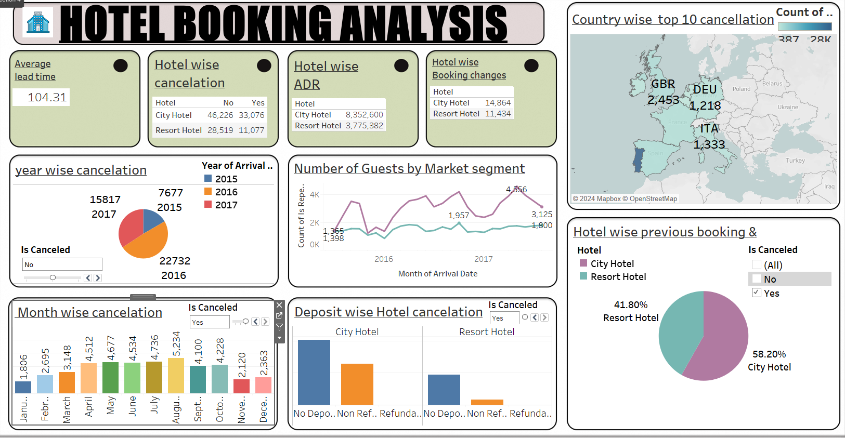
DASH BOARD

Slide 13
SUMMARY
The majority of the advertising budget to promote city hotels, as they are the most booked.
Mostly highest booking in city hotel.
Transient highest bookings more then 60% customers.
Number of car parking spaces required by the guest.
Number of days the booking was in the waiting list before it was confirmed
Number of adults, children, and babies included in the booking.
Number of days between booking and the arrival date.

Slide 14
CONCLUSION
The dataset includes information on different hotels.
Further analysis can be done to understand booking patterns for each type of hotel.
Analyze cancellation rates to identify trends and potential influencing factors.
Longer lead times may suggest a more planned or organized customer base.
Understanding average stay lengths can help in resource planning.

Slide 15


KAARJALALAKSHMIKANTH

