Slide 1
Connecting Timor’s 780 Villages to the Grid
What interconnection is worth — and what it does to the village solar programme
780
366 MW
$1.6 M/yr
villages · 437,000 households
village solar under a carbon cap
saved by wires, carbon-neutral

Slide 2
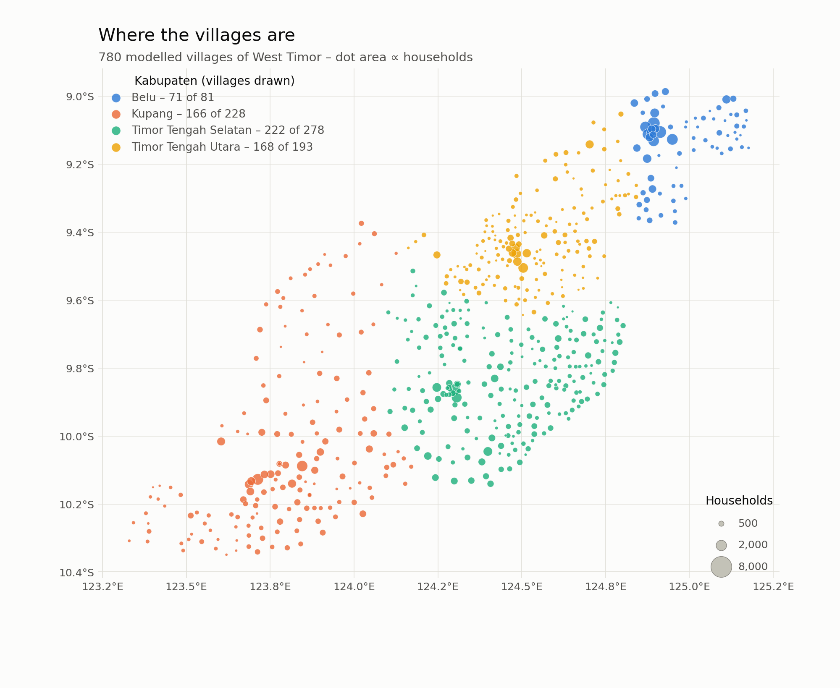
780 villages, 437,000 households across West Timor

Slide 3
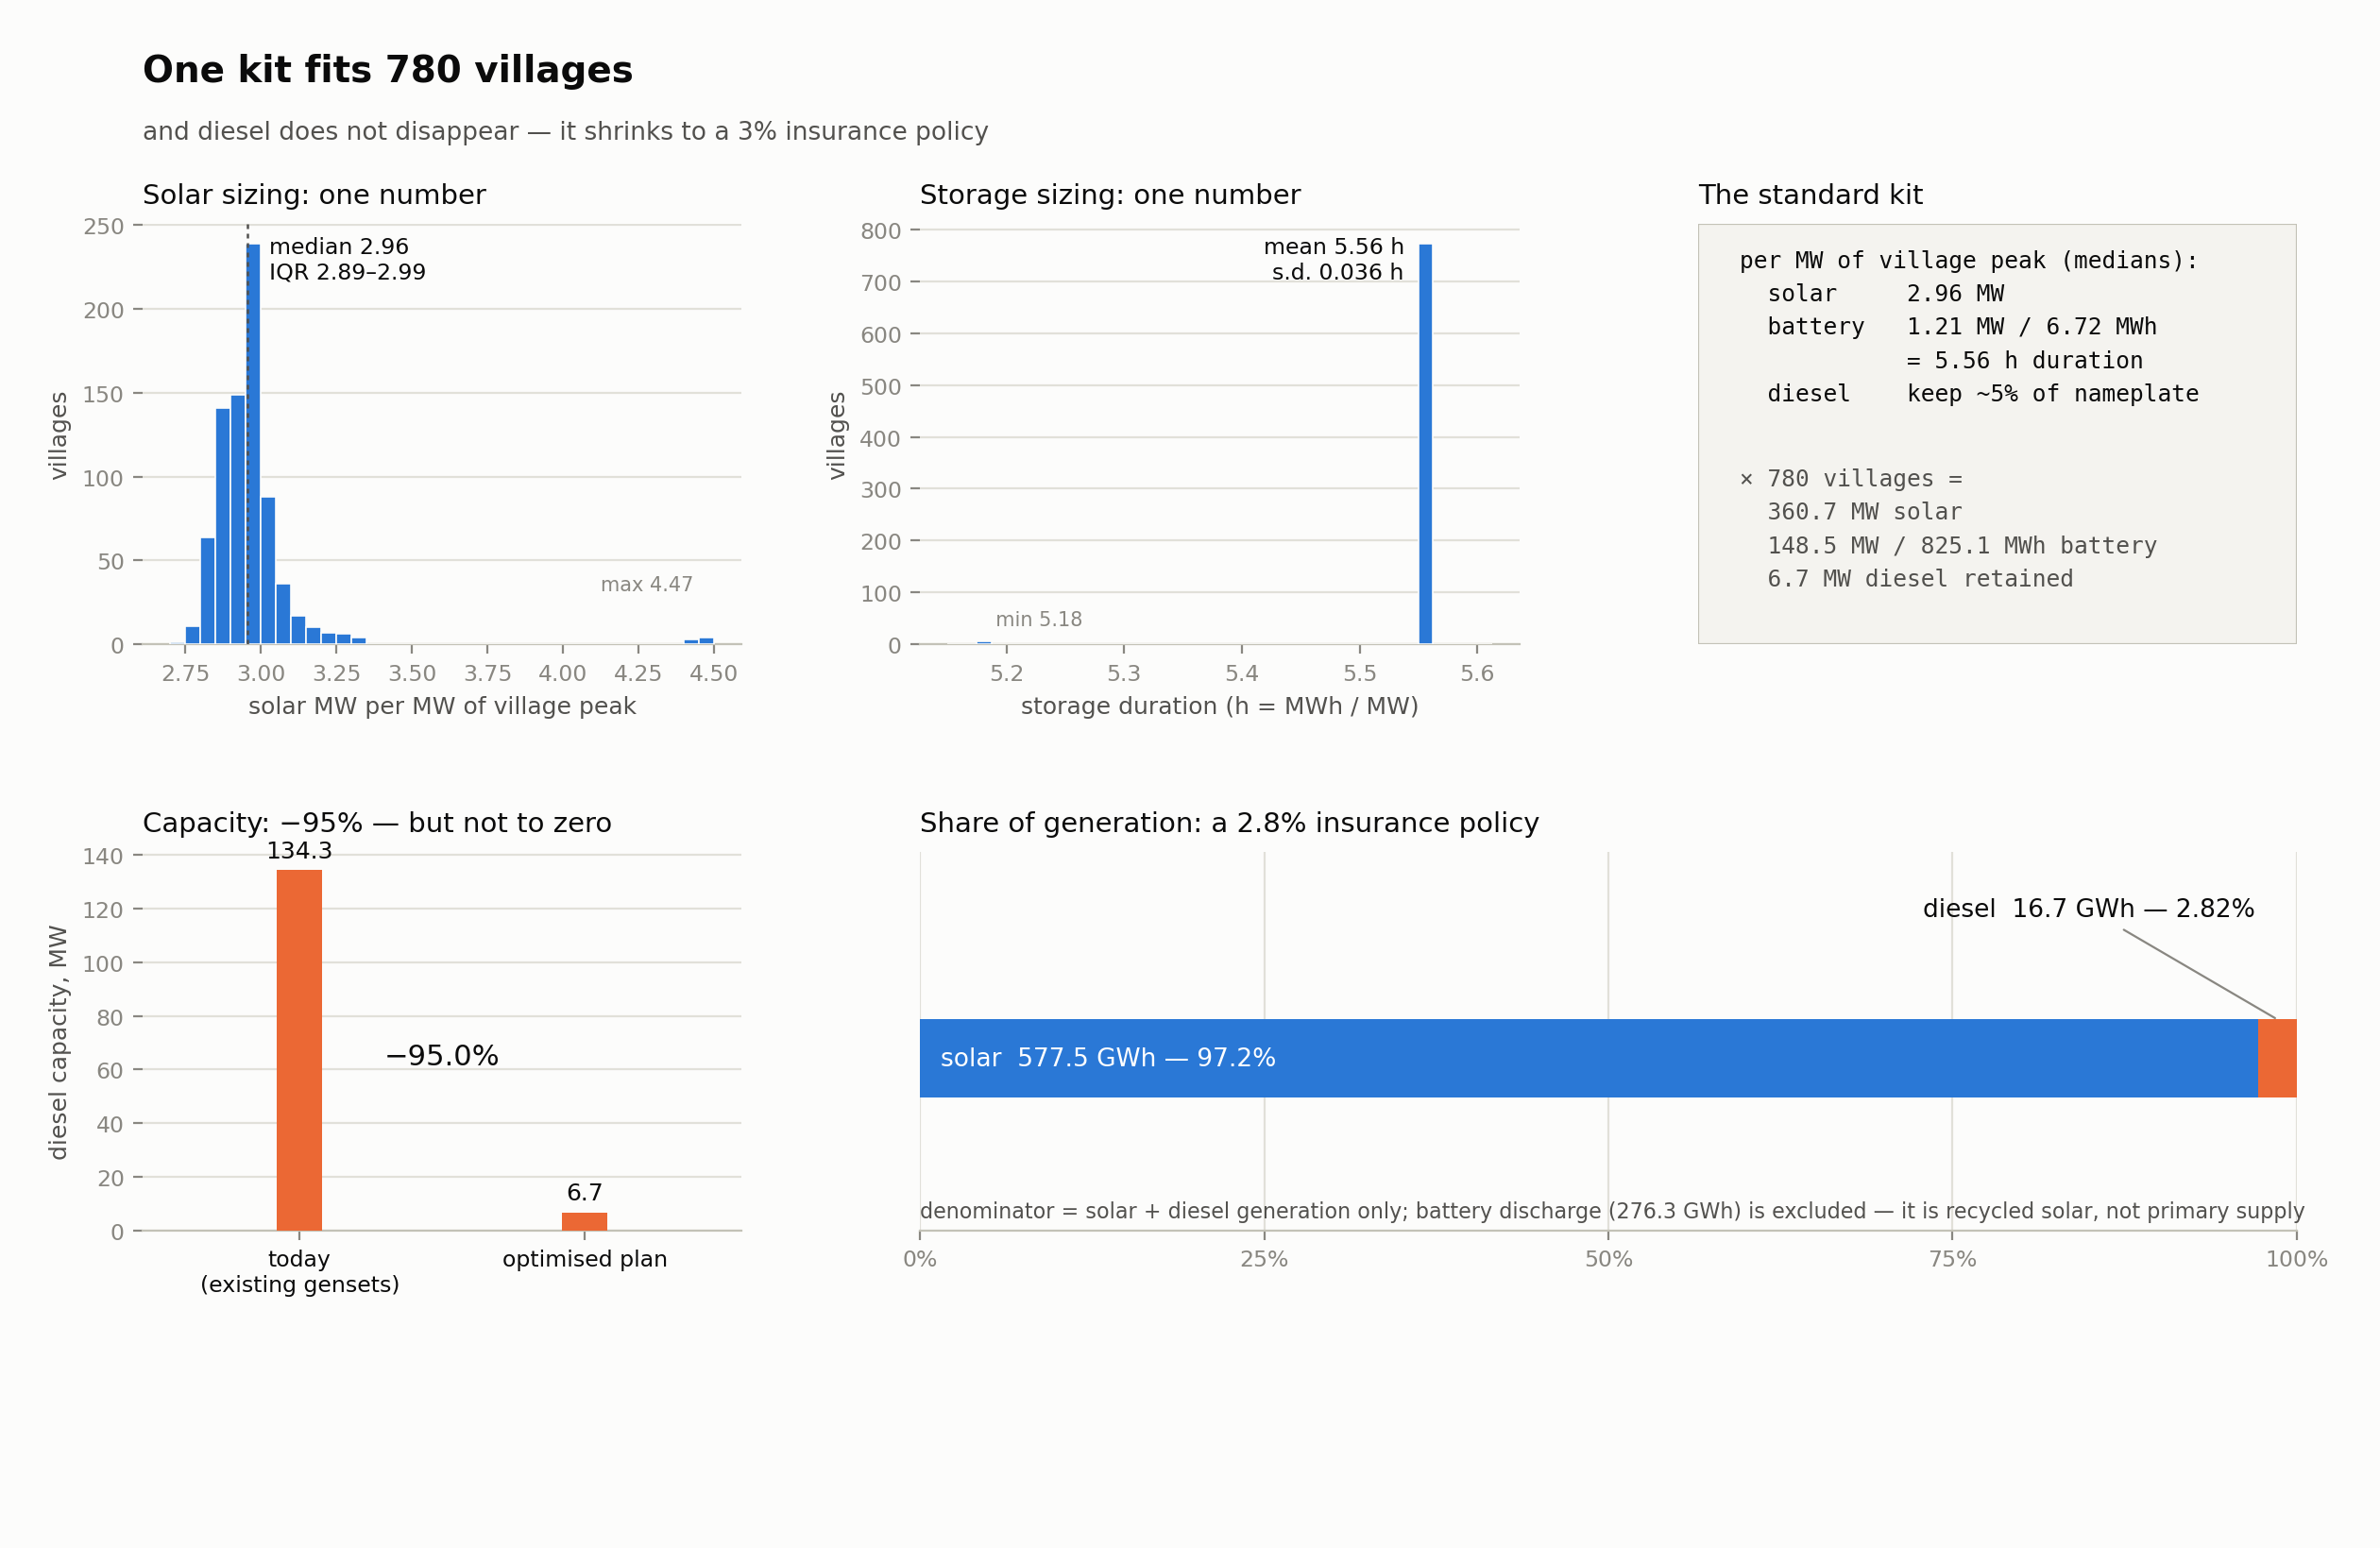
One standard kit serves every village — diesel shrinks to a 3% backup

Slide 4
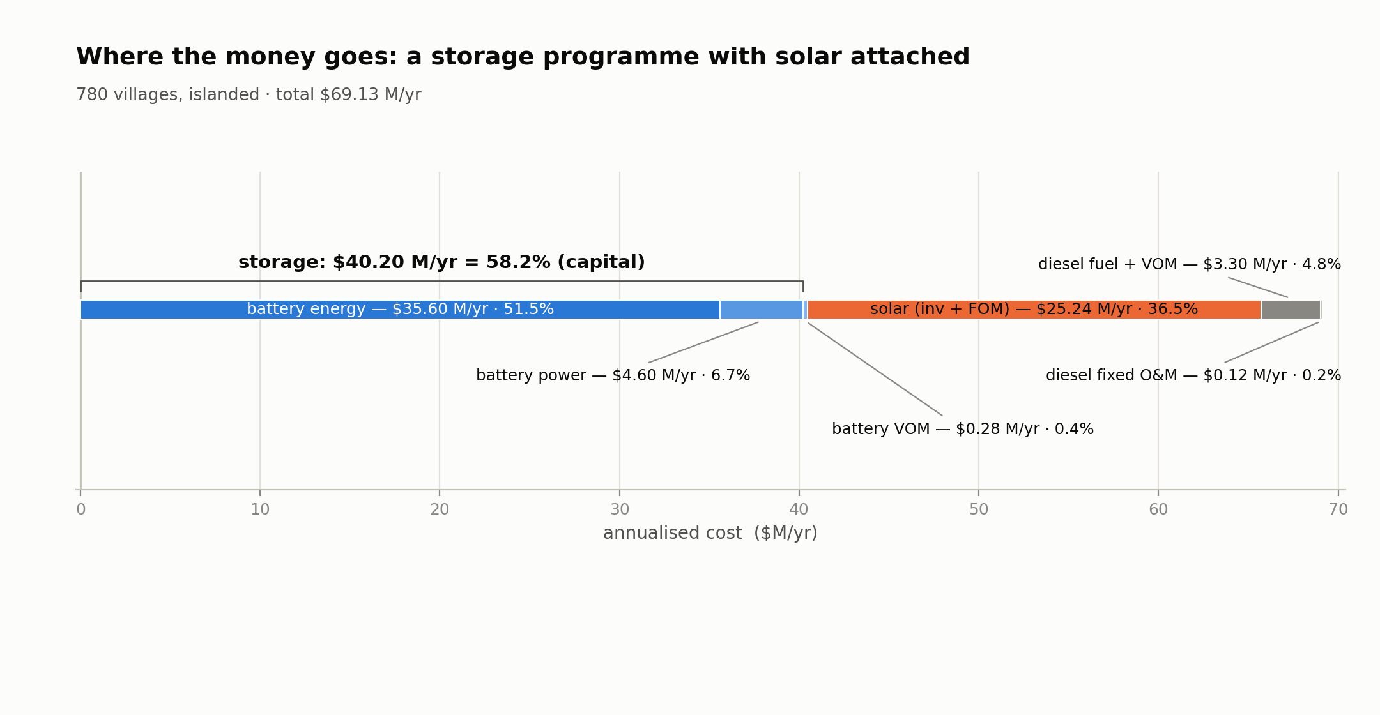
The islanded programme is mostly a battery purchase

Slide 5
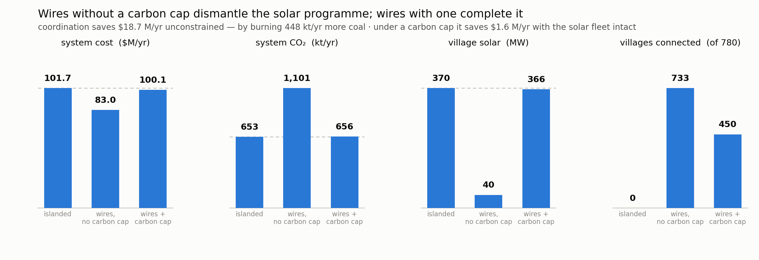
The carbon cap decides what the wires do

Slide 6
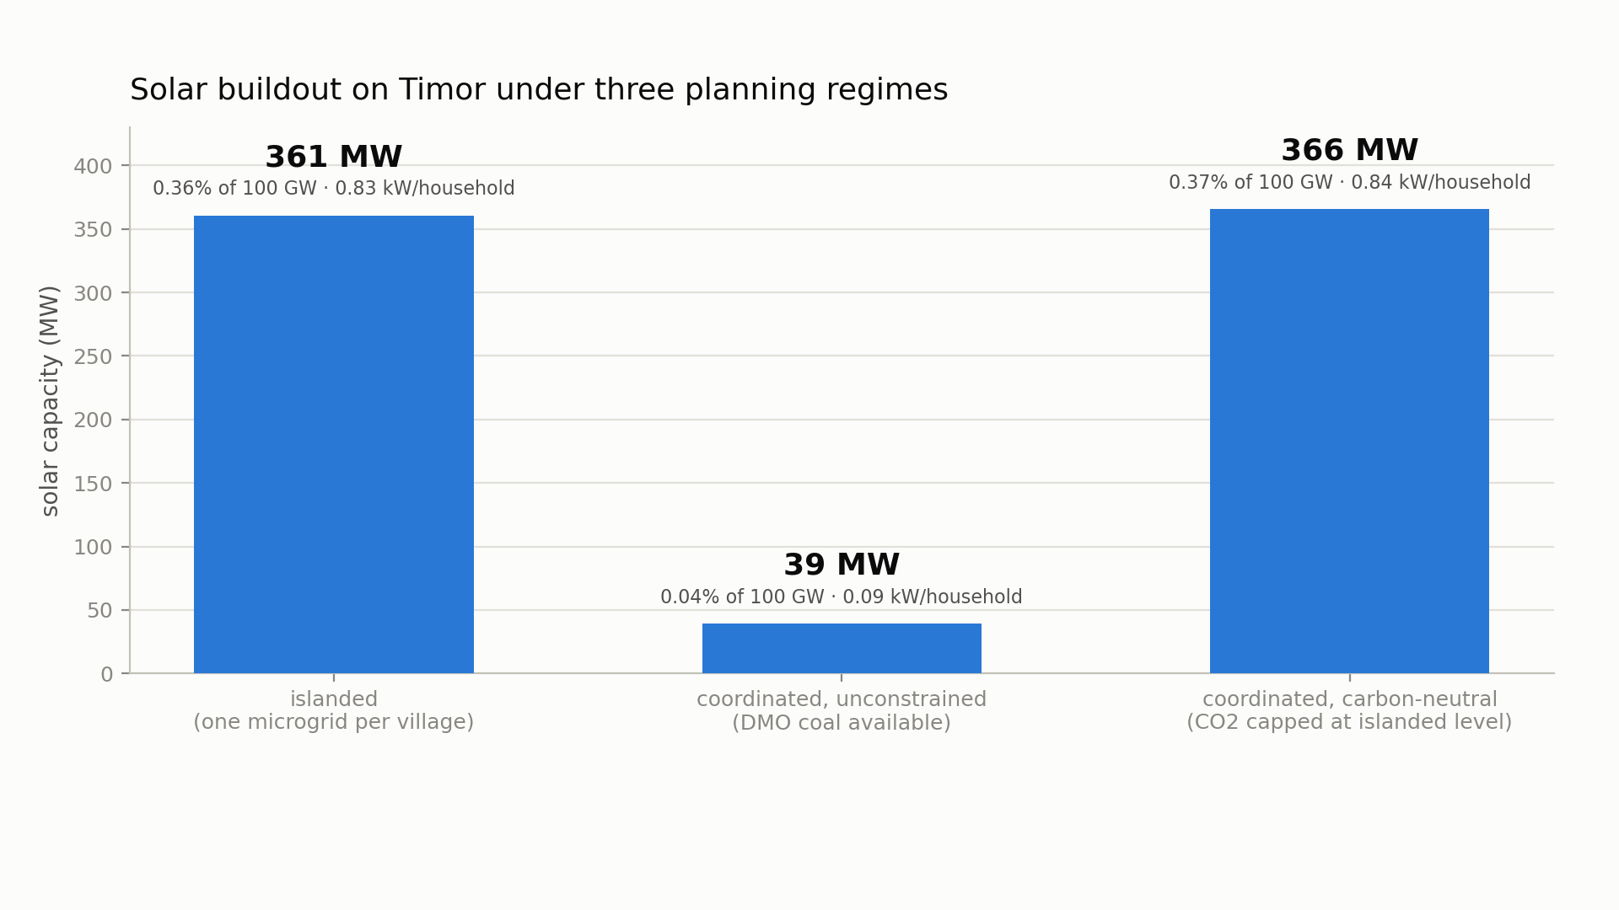
With a carbon cap, the wires complete the solar programme

Slide 7
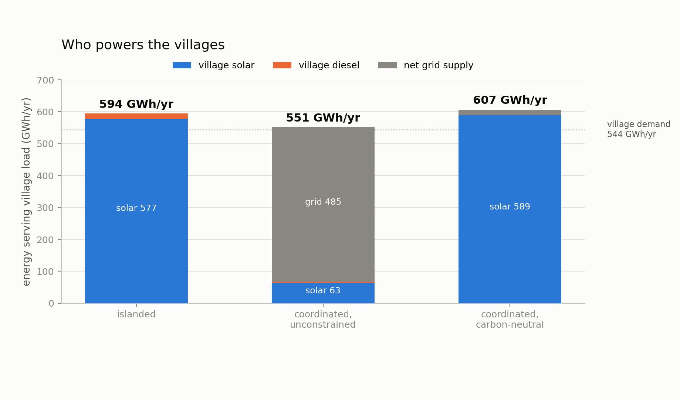
Who powers the villages under each plan

Slide 8
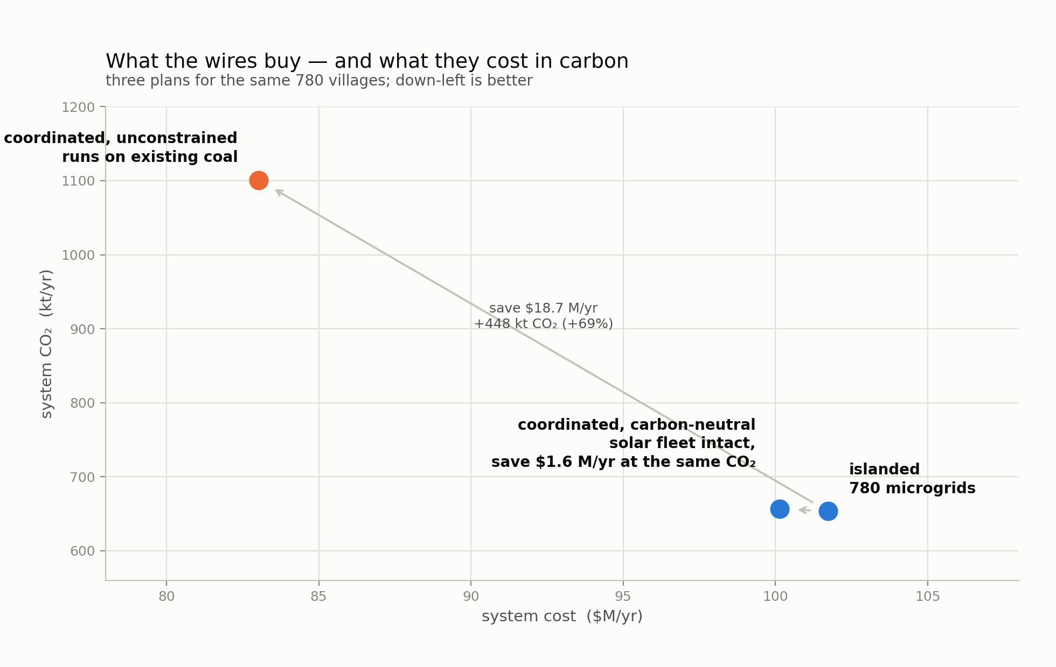
The trade-off: cheaper with coal, or carbon-neutral

Slide 9
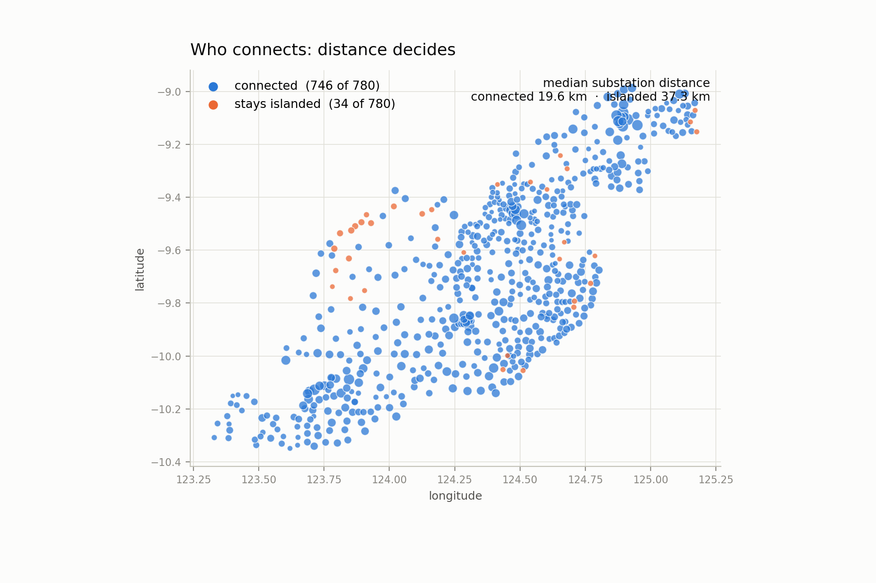
Distance decides who connects

Slide 10
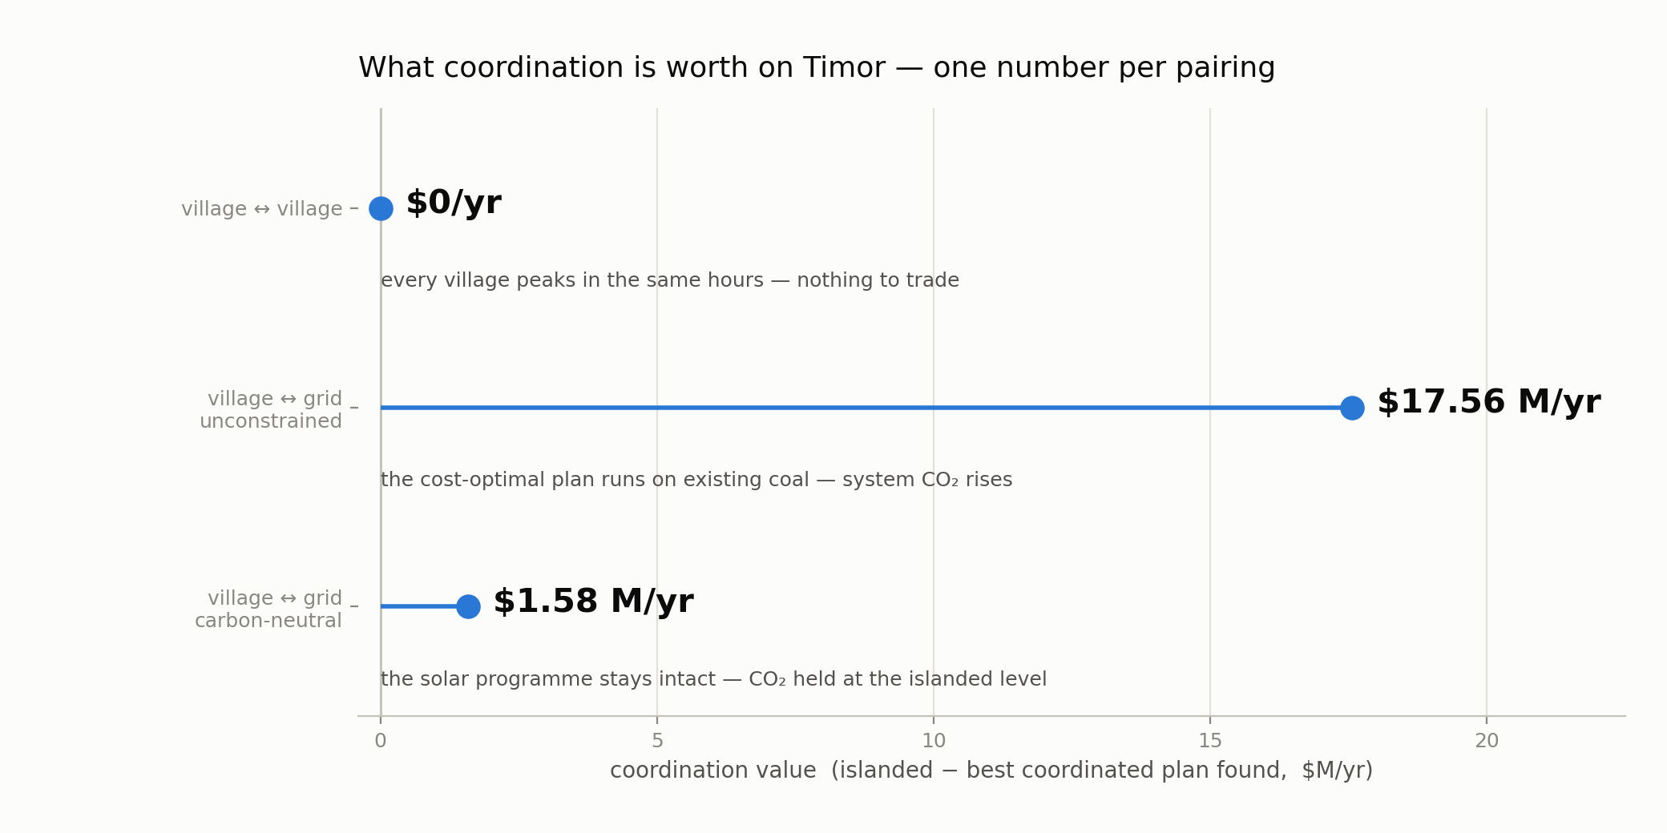
What coordination is worth

