Slide 1
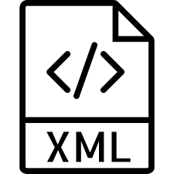
eXtensible Markup Language
KAARTHIK S KUMAR

Slide 2
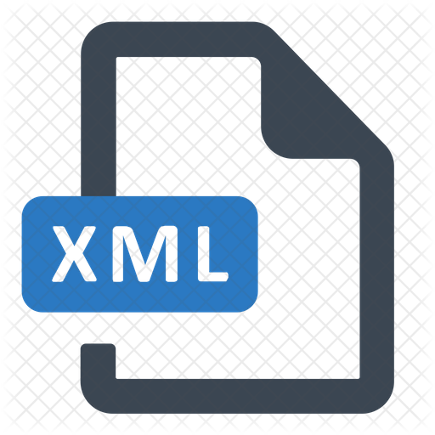
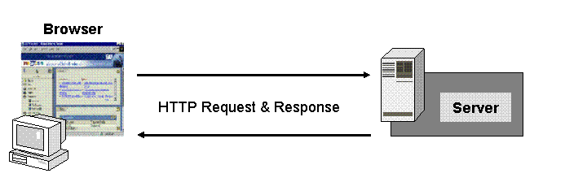
XML
XML was designed to store and transport data.
XML was designed to be both human- and machine-readable.
XML stores data in plain text format. This provides a software- and hardware-independent way of storing, transporting, and sharing data.
With XML, the data can be stored in separate XML files.

Slide 3
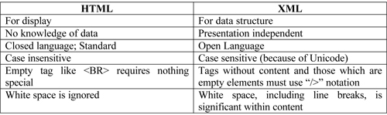
XML AND HTML
XML is a markup language much like HTML
XML was designed to carry data - with focus on what data is
HTML was designed to display data - with focus on how data looks

Slide 4
XML Syntax
XML documents are formed as element trees.
An XML tree starts at a root element and branches from the root to child elements.
All elements must have a opening and closing tag
XML tags are case sensitive. The tag <Letter> is different from the tag <letter>.
All elements can have sub elements (child elements):
<root>
<child>
<subchild>.....</subchild>
</child>
</root>
The syntax for writing comments in XML is similar to that of HTML:
<!-- This is a comment -->

Slide 5
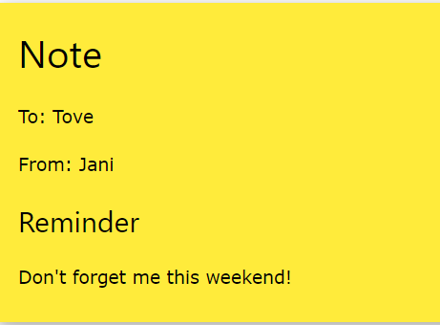
Example
<note> <to>Tove</to> <from>Jani</from> <heading>Reminder</heading> <body>Don't forget me this weekend!</body> </note>
The XML language has no predefined tags.
The tags in the example (like <to> and <from>) are not defined in any XML standard.
These tags are "invented" by the author of the XML document.
The XML is quite self-descriptive:
It has sender information.
It has receiver information
It has a heading
It has a message body.

Slide 6
XML Elements
An element can contain:
text
attributes
other elements
or a mix of the above <gender>female</gender>
XML Attributes
XML elements can have attributes, just like HTML.
Attributes are designed to contain data related to a specific element. <person gender="female">
<person> <gender>female</gender> <firstname>Anna</firstname> <lastname>Smith</lastname> </person>
<person gender="female"> <firstname>Anna</firstname> <lastname>Smith</lastname> </person>

Slide 7
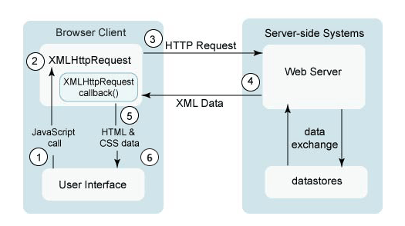
XML HttpRequest
The XMLHttpRequest object can be used to
Update a web page without reloading the page
Request data from a server - after the page has loaded
Receive data from a server - after the page has loaded
Send data to a server - in the background

Slide 8
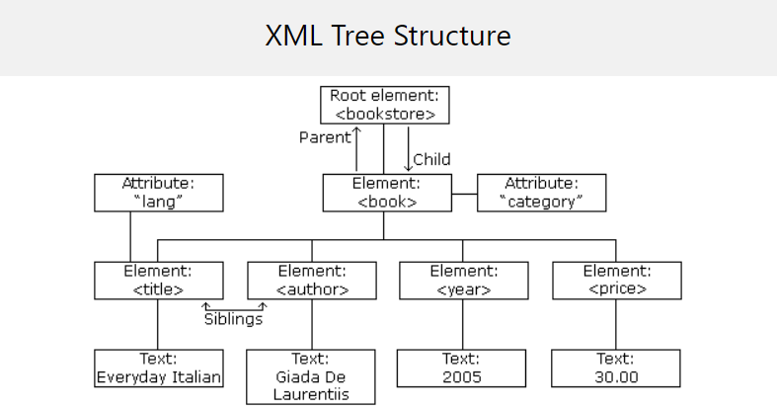
XML DOM
The XML DOM (Document Object Model) defines the properties and methods for accessing and editing XML. It presents an XML document as a tree-structure.

Slide 9
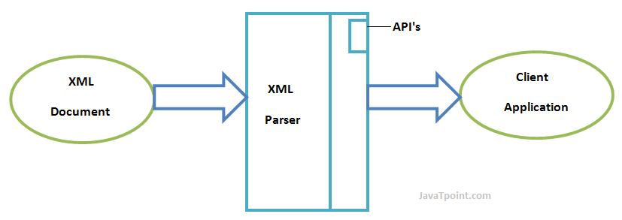
Xml parser
Before an XML document can be accessed, it must be loaded into an XML DOM object.
All modern browsers have a built-in XML parser that can convert text into an XML DOM object.
The XMLHttpRequest Object has a built in XML Parser.

Slide 10
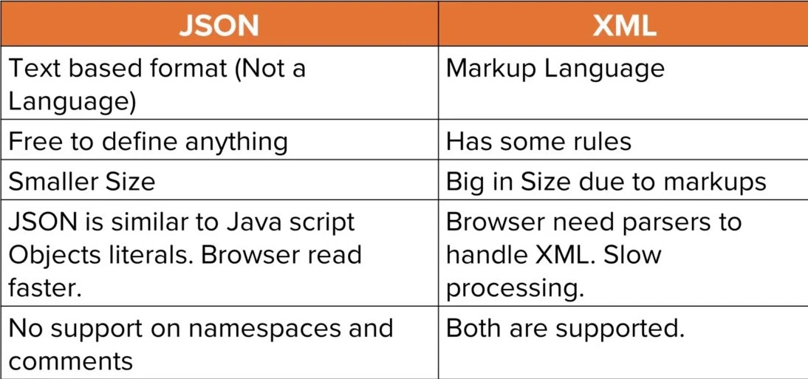
xml vs json
Both JSON and XML can be used to receive data from a web server.

Slide 11
XML :
<employees> <employee> <firstName>John</firstName>
<lastName>Doe</lastName> </employee> <employee> <firstName>Anna</firstName>
<lastName>Smith</lastName> </employee> <employee> <firstName>Peter</firstName>
<lastName>Jones</lastName> </employee> </employees>
JSON :
{"employees":[ { "firstName":"John", "lastName":"Doe" }, { "firstName":"Anna", "lastName":"Smith" }, { "firstName":"Peter", "lastName":"Jones" } ]}

Slide 12


