Slide 1
Emotion Prediction System
Project Title: Emotion Prediction System
Course: AD23402 – Computer Vision

Slide 2

Team Members:
Karthick Raja . P – 2023510004
Yuvarani . S – 2023510028
Nitin Pranav . S – 2023510049

Slide 3

Introduction
Understanding human emotions through facial expressions has become increasingly important in today’s digital world. Whether it's used in mental health monitoring, interactive learning platforms, or customer support systems, the ability to detect emotions automatically can significantly improve how machines interact with people. Traditional methods, such as manual observation, are often time-consuming, inconsistent, and not scalable.
To address this, we’ve developed an Emotion Prediction System that can recognize facial expressions using a machine learning approach. The system is built using Support Vector Machine (SVM) combined with Histogram of Oriented Gradients (HOG) for feature extraction, providing a lightweight and efficient solution for emotion classification.

Slide 4
Motivation & Societal Impact
Mental Health Monitoring: Early distress detection.
Smart Education: Adaptive learning based on engagement.
Customer Sentiment: Real-time feedback analysis.
Human-Computer Interaction: Emotion-aware responses.

Slide 5
Methodology Overview
Image Preprocessing: Resize to 48x48 px, grayscale.
Feature Extraction: HOG to capture edge features.
Normalization: Using StandardScaler.
Model Training: SVM with RBF kernel.
Evaluation: Accuracy, confusion matrix, classification report.

Slide 6
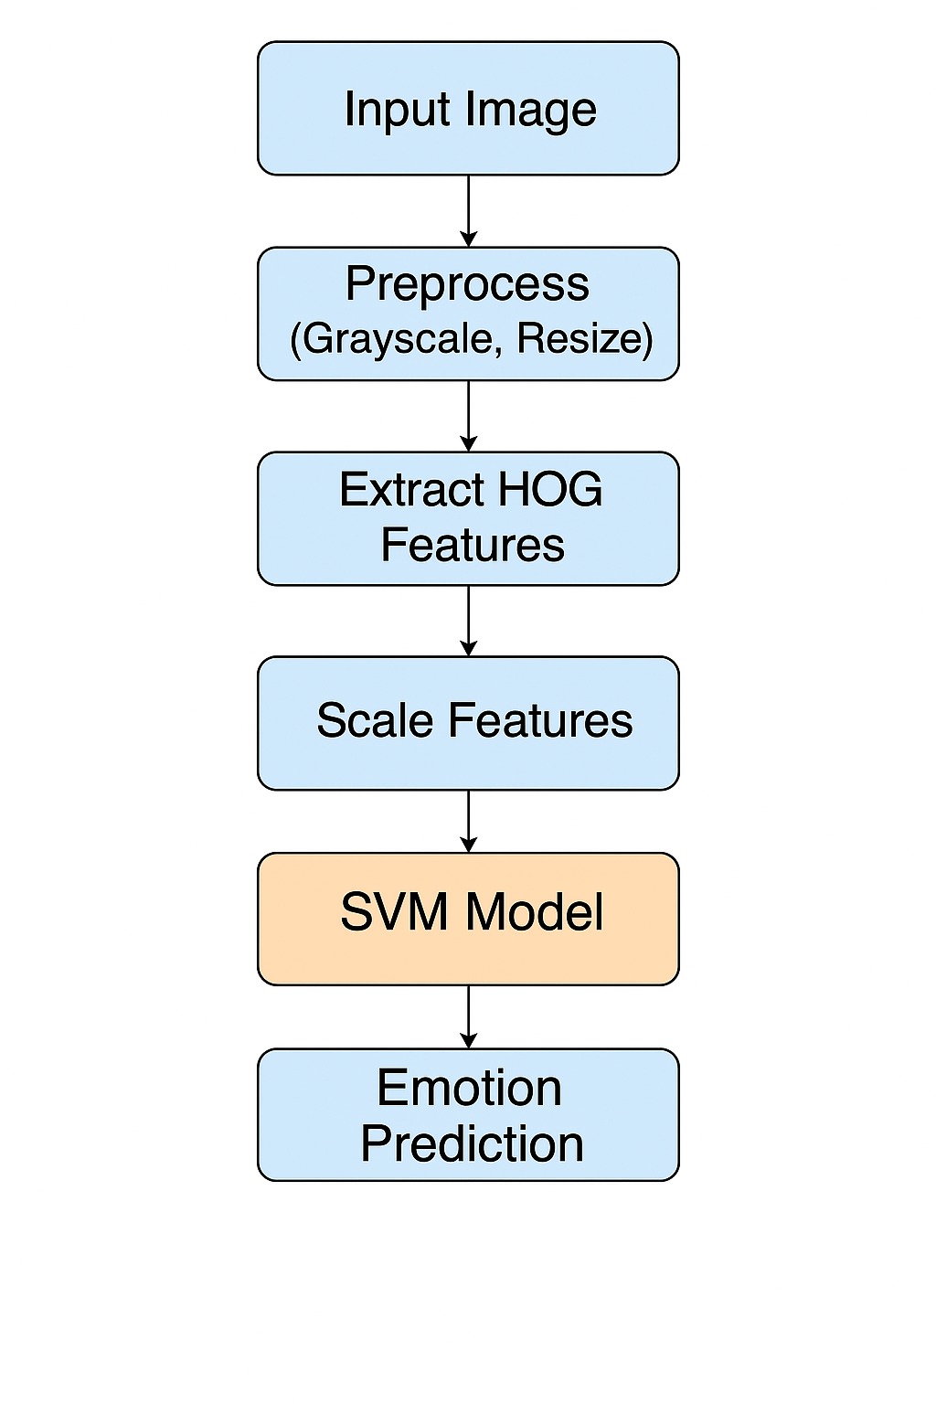
Methodology – System Architecture and Explanation

Slide 7

Dataset Description
Name: FER2013 (Kaggle)
Total Images: 35,000
Train/Test Split: 28,000 / 7,000
Classes: Angry, Disgust, Fear, Happy, Sad, Surprise, Neutral
Image Specs: 48x48 pixels, grayscale

Slide 8

How It Works:
Image Preprocessing:
Each image is resized to 48x48 pixels and converted to grayscale to reduce complexity.
Feature Extraction:
HOG is used to extract important features from facial images, focusing on edges and texture patterns that define expressions.
Normalization:
Features are scaled using StandardScaler to ensure they’re on the same scale before training.
Model Training:
An SVM model with an RBF kernel is trained to recognize patterns in the extracted features and classify emotions.
Prediction & Evaluation:
The trained model is tested on new images and evaluated using metrics like accuracy, confusion matrix, and classification report.

Slide 9
Model Comparison (Ablation Study)
SVM + HOG (HOG): 80.15%
KNN + HOG (HOG): 72.3%
Random Forest + HOG (HOG): 74.5%
Basic CNN (Raw Pixels): 83.6%
Pretrained VGG-16 (Raw Pixels): 88.9%

Slide 10
Justification
SVM + HOG: High efficiency, lightweight, good feature capture.
KNN/RF: Less robust, more data-dependent.
CNN/VGG-16: Higher accuracy, but computationally expensive.

Slide 11
Accuracy Metrics:
Model | Feature Extraction | Accuracy
SVM + HOG (our model) | HOG | 80.15%
KNN + HOG | HOG | 72.3%
Random Forest + HOG | HOG | 74.5%
Basic CNN | Raw Pixels | 83.6%
Pretrained VGG-16 | Raw Pixels | 88.9%

Slide 12
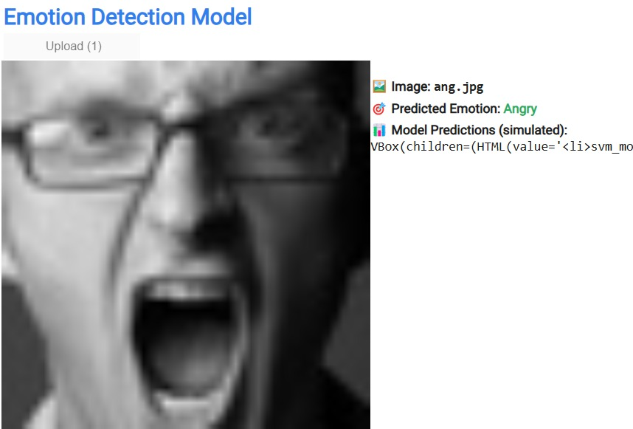
Sample Output:

Slide 13
Conclusion & Future Work
Achieved 80%+ accuracy on FER2013.
Applications in healthcare, education, customer service.
Future plans: real-time video processing, hybrid ML/DL models.

