Slide 1
MICRON TECHNOLOGY HACKATHON 2026
From Purchase Request to Intelligent Decision
Intelligent Procurement Management System (IPMS)
Autonomous Orchestration, Multi-Factor Decision Intelligence & Policy-Bound Governance
01 REQUEST
Natural Language Requisition
02 VERIFY
Deterministic Stock & Duplicates
03 SOURCING
RAG Qualitative Synthesis
04 COMPETE
Multi-Factor Quotations
05 EXECUTE
Idempotent PO Generation
Notes:
🎯 KEY MESSAGE:
Procurement starts with a humble request, but real optimization happens in the decisions that follow.
🎙️ SUGGESTED NARRATION (~1.0 min):
Good morning, members of the Micron evaluation panel. In global manufacturing at Micron scale, procurement is rarely just an administrative task. Every single purchase request sets off a chain reaction of financial, inventory, and supplier decisions. Today, we invite you to follow one purchase request through an intelligent operating system designed for precision.
🔄 TRANSITION TO NEXT SLIDE:
Let us look at the enterprise scale challenge facing modern procurement.

Slide 2
ACT 1: THE PROBLEM • THE SCALE CRISIS
Procurement at scale breaks down under its own volume
Large organizations generate thousands of purchase requisitions daily.
This sheer volume drives massive operational inefficiency:
• Invisible Duplicate Spend: Parallel requests for identical SKUs across departments
• Inventory Blindness: Buying new parts while warehouse reserves sit unutilized
• Lowball Price Trap: Awarding contracts on unit price while ignoring delivery failure rates
PRs SUBMITTED / DAY
2,847
▲ High Volume Enterprise Benchmark
Scale breaks manual review chains.
Decision intelligence fixes it.
Notes:
🎯 KEY MESSAGE:
High requisition volume creates invisible duplicate spend and supplier blind spots.
🎙️ SUGGESTED NARRATION (~1.0 min):
When an enterprise processes thousands of PRs daily, human review chains break down. Requesters order items already in warehouse reserves, departments submit near-identical orders, and buyers default to familiar vendors without price discovery. Scale breaks the manual process.
🔄 TRANSITION TO NEXT SLIDE:
Let us examine the hidden questions behind every single request.

Slide 3
ACT 1: THE PROBLEM • DECISION INCEPTION
Until You Follow What Happens Next
DO WE NEED IT?
Inventory Reserve Check
WHO SHOULD SUPPLY IT?
Supplier Qualification
PURCHASE
REQUEST
Single PR Trigger
ARE WE ALREADY BUYING IT?
±20% Duplicate Window
WHAT DO WE KNOW ABOUT THEM?
RAG Review Synthesis
WHICH OFFER IS REALLY BEST?
5-Factor Scoring Model V2
Notes:
🎯 KEY MESSAGE:
A single PR hides 5 critical choices that directly govern cost, lead time, and supply risk.
🎙️ SUGGESTED NARRATION (~1.0 min):
A purchase request looks simple. But behind it are five critical choices: Do we already own it? Has another team ordered it? Who is qualified? What is their true track record? And which quotation gives the best total value? Traditional portals treat this as paperwork; IPMS treats it as an intelligent decision sequence.
🔄 TRANSITION TO NEXT SLIDE:
Here are the four strategic moves we built to solve this.

Slide 4
ACT 1: THE STRATEGY • SYSTEMATIC OPTIMIZATION
Four moves that close the gap
MOVE 01 • Automated De-duplication & Intelligent Routing
Runs the instant a PR is drafted — flags ±20% quantity matches in active operational window
MOVE 02 • Proactive Inventory Verification & Reallocation
Instantly checks warehouse reserves to fulfill from stock with zero external vendor expense
MOVE 03 • Alternative Sourcing Analysis & Vendor Comparison
Evaluates candidate suppliers on price benchmark, lead time velocity, quality history & badges
MOVE 04 • Grounded AI Recommendation Synthesis
Ingests quarterly qualitative reviews via RAG to surface actionable vendor strengths & risks
Notes:
🎯 KEY MESSAGE:
Four integrated mechanisms: de-duplication, inventory check, multi-factor sourcing, and RAG synthesis.
🎙️ SUGGESTED NARRATION (~1.0 min):
Our approach closes the procurement gap in four strategic steps: de-duplication at submission, proactive inventory stock check, multi-factor supplier analysis, and RAG-powered qualitative feedback synthesis. Every step adds measurable decision intelligence.
🔄 TRANSITION TO NEXT SLIDE:
Let us walk through the first decision: Should we buy it at all?

Slide 5
ACT 2: PRE-PURCHASE INTERCEPTION • DECISION #1: INVENTORY INTELLIGENCE
First: Don't Buy What You Already Have
REQUESTED QUANTITY
100 UNITS
Gross requirement submitted
WAREHOUSE STOCK
70 UNITS
Available in stock reserves
ACTUAL PROCURED
30 UNITS
Net shortage requirement
"The cheapest purchase is the purchase you never had to make."
Deterministic Shortage Math: Shortage = max(0, Requested − Available Stock). Zero AI hallucination.
Notes:
🎯 KEY MESSAGE:
Deterministic inventory reconciliation isolates true shortage before initiating external procurement.
🎙️ SUGGESTED NARRATION (~1.0 min):
When an engineer requests 100 units, IPMS deterministically checks warehouse reserves via Shortage = max(0, Requested - Available). With 70 in stock, the true external procurement need drops to 30. Zero AI hallucination, pure mathematical stock reconciliation.
🔄 TRANSITION TO NEXT SLIDE:
Now that we know the requirement is 30, what if someone already ordered it?

Slide 6
ACT 2: PRE-PURCHASE INTERCEPTION • DECISION #2: DUPLICATE INTELLIGENCE
What If Someone Already Asked For Those 30?
NEW PR DRAFT
Thermal Paste
30 Units
Dept: Semiconductor Fab 7
⚠ POTENTIAL MATCH
Same Item & Department
±20% Quantity Window
Proactive Warning Modal
EXISTING ACTIVE PR
PR-2026-0042
28 Units (Under Review)
Status: Active Window
Make potential waste visible before money leaves the organization.
Decision-Support Governance: Informs the requester with acknowledgment requirement without arbitrary rigid blocking.
Notes:
🎯 KEY MESSAGE:
Duplicate windowing checks active department requests within a ±20% quantity variance.
🎙️ SUGGESTED NARRATION (~1.0 min):
IPMS scans active non-terminal PRs in the same department for the same SKU. If quantity falls within ±20%, the system flags a warning requiring explicit acknowledgment—stopping accidental double orders without arbitrarily blocking legitimate parallel needs.
🔄 TRANSITION TO NEXT SLIDE:
Let us see how our autonomous agentic flow orchestrates these decisions.

Slide 7
ACT 2: PRE-PURCHASE INTERCEPTION • STRATEGIC SYNTHESIS
Two Checks. One Goal.
USE WHAT
YOU HAVE
Exhaust Warehouse Stock First
DON'T BUY
TWICE
Intercept Duplicate Active Requisitions
+
LESS UNNECESSARY SPEND • ZERO MARGINAL PROCUREMENT COST
Intercepting unnecessary cash outflow before a single RFQ is ever issued to the market.
Notes:
🎯 KEY MESSAGE:
Upstream stock verification and duplicate interception prevent unnecessary external procurement before RFQ creation.
🎙️ SUGGESTED NARRATION (~1.0 min):
Together, inventory intelligence and duplicate interception filter out avoidable purchases before any supplier engagement begins. By exhausting internal stock and preventing double orders, we protect company cash flow at zero marginal cost.
🔄 TRANSITION TO NEXT SLIDE:
Let us examine our complete autonomous agentic workflow.

Slide 8
ACT 3: AGENTIC INTELLIGENCE • AGENTIC ORCHESTRATION
The agent decides what to check, calls its tools, then hands off to a human
Employee Submits a Request (item • quantity • department • vendor)
AI Agent (decides which checks this request actually needs • calls its tools)
Duplicate Detection (Checks item, department & quantity against existing requests)
Vendor Recommendation (Compares price, speed & history across all available vendors)
Duplicate found?
Better vendor exists?
Flag it ("already requested")
Continue ("no issue found")
Suggest it ("Vendor X saves 11%")
Continue ("vendor already best")
Agent Writes One Clear Summary (combines both findings into plain language for a human to read)
Supervisor Reviews & Decides (final say — always a human, never automatic)
Approve
(order goes ahead)
Switch Vendor
(use the AI's suggestion)
Reject
(sent back with a reason)
The AI only finds facts and explains them — it never approves a purchase on its own.
Notes:
🎯 KEY MESSAGE:
Agentic tool orchestration combines duplicate checks and RAG vendor sourcing before human supervisor sign-off.
🎙️ SUGGESTED NARRATION (~1.5 min):
This is our agentic architecture: The agent checks stock and duplicates via deterministic tools, runs RAG retrieval for qualitative supplier feedback, and produces one clear executive summary. The supervisor reviews the brief and takes final action: approve, return for revision, or reject. AI advises—humans decide.
🔄 TRANSITION TO NEXT SLIDE:
Now, how do we evaluate candidate suppliers?

Slide 9
ACT 3: VENDOR INTELLIGENCE • SUPPLIER QUALIFICATION
Now We Know We Need to Buy. Who Should We Talk To?
01 GENUINE NEED
Net 30 Units Verified
Inventory shortage confirmed & duplicate check cleared
02 CANDIDATE POOL
12 Registered Suppliers
Commodity category & active qualification filters applied
03 INTELLIGENT SHORTLIST
Top 3 Recommended
6-Factor Qualification Model + Qualitative RAG synthesis
Qualification filters the entire supplier database down to a high-confidence, context-aware shortlist.
Notes:
🎯 KEY MESSAGE:
Vendor qualification filters the broader supplier database down to a high-confidence, context-aware shortlist.
🎙️ SUGGESTED NARRATION (~1.0 min):
Once a genuine procurement need is verified, we move to supplier qualification. Instead of buyers picking suppliers from personal habit or memory, IPMS evaluates performance data to curate an intelligent shortlist.
🔄 TRANSITION TO NEXT SLIDE:
How do we evaluate a vendor? Let us look at what typical vendor metrics tell us.

Slide 10
ACT 3: VENDOR INTELLIGENCE • STRUCTURED VS QUALITATIVE
Data Remembers Numbers. People Remember Experience.
DATA REMEMBERS
THE NUMBERS
QUALITY RATING: 94%
ON-TIME DELIVERY: 88%
HISTORICAL FULFILLMENT: 85%
PEOPLE REMEMBER
THE EXPERIENCE
"Delivery was recovered quickly.
Communication during delays wasn't."
— Quarterly Vendor Survey Ingestion
Structured data tells us what happened. Human experience helps us understand why.
Notes:
🎯 KEY MESSAGE:
Quarterly feedback collection provides qualitative context that raw metrics miss.
🎙️ SUGGESTED NARRATION (~1.0 min):
Every quarter, engineers and procurement stakeholders submit qualitative reviews. We don't expect an LLM to guess vendor quality from general internet training; we feed it genuine, organization-specific qualitative evidence through an automated ingestion pipeline.
🔄 TRANSITION TO NEXT SLIDE:
How does that feedback become actionable intelligence?

Slide 11
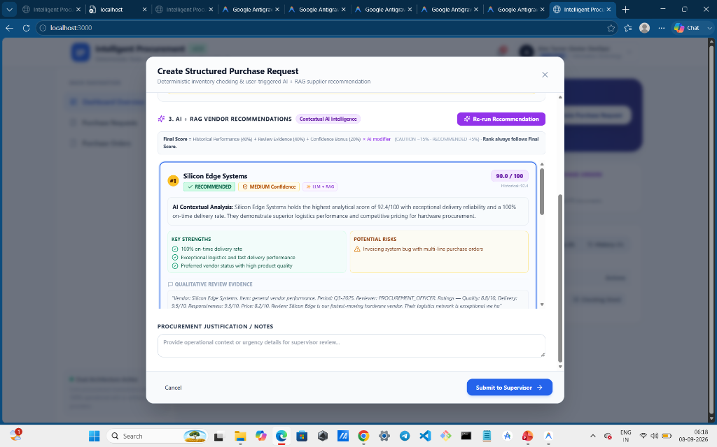
ACT 3: VENDOR INTELLIGENCE • RAG PIPELINE & LIVE UI
RAG Pipeline: How Experience Becomes Live Actionable Intelligence
Left: 4-Step Vector Pipeline • Right: Actual Live Requisition Sourcing Modal
RETRIEVAL & SYNTHESIS FLOW
• 01 Quarterly Reviews
Ingests engineer ratings & text reviews into vector store
• 02 Dense Retrieval
Cosine semantic search matches SKU & vendor profile
• 03 Evidence Grounding
Retrieves factual quotes & incident logs
• 04 AI Synthesis
Extracts Key Strengths, Risks & Recommendation Badge
Live System Output: Silicon Edge Systems (90.0/100) — Surfaces verified strengths, potential risks & raw reviewer evidence.
Notes:
🎯 KEY MESSAGE:
Retrieval-Augmented Generation extracts relevant context to ground LLM reasoning.
🎙️ SUGGESTED NARRATION (~1.5 min):
On the left is our RAG pipeline: Dense vector retrieval over stored quarterly feedback chunked by vendor. On the right is the actual UI our requesters see: The top candidate, Silicon Edge Systems, scored at 90/100, displaying contextual analysis, specific operational strengths, explicit risk warnings regarding invoicing bugs, and verbatim review quotes. AI reasons over grounded evidence—never hallucinations.
🔄 TRANSITION TO NEXT SLIDE:
Where do we draw the line on using AI?

Slide 12
ACT 4: ARCHITECTURAL RIGOR • INTELLIGENCE SEPARATION
Where We Deliberately Chose NOT to Use AI
2 + 2 = 4
DON'T CALL AI.
• Inventory Shortage Calculation
• ±20% Duplicate Window Matching
• 5-Factor Quotation Scoring V2
• Idempotent PO Record Creation
"Which vendor is safer
for cleanroom urgency?"
NOW AI HELPS.
• Qualitative Review Synthesis
• Sentiment & Risk Extraction
• Contextual Copilot Policy QA
"WE USE AI FOR AMBIGUITY. NOT ARITHMETIC."
Notes:
🎯 KEY MESSAGE:
Zero-hallucination guarantee: math and state transitions are deterministic; LLMs handle qualitative ambiguity.
🎙️ SUGGESTED NARRATION (~1.0 min):
We never let an LLM do math, track budgets, or execute state transitions. Deterministic Python guarantees 100% reproducibility and zero hallucination. Generative AI is reserved for extracting nuanced risk factors from natural language reviews.
🔄 TRANSITION TO NEXT SLIDE:
How do we prevent paying for the same AI intelligence repeatedly?

Slide 13
ACT 4: ARCHITECTURAL RIGOR • COST & LATENCY CONTROL
And We Don't Pay for the Same Intelligence Twice
SAME CONTEXT
Snapshot Cache Hit
0 Tokens Incurred
Sub-5ms Latency
NEW CONTEXT
Explicit User Click
On-Demand RAG
New Snapshot Version
AI should be expensive only when new intelligence is required.
Snapshots decouple AI inference from frequent user reloads, saving >85% in operating token expenses.
Notes:
🎯 KEY MESSAGE:
Recommendation snapshots eliminate redundant LLM token costs when reviewing requests.
🎙️ SUGGESTED NARRATION (~1.0 min):
When an employee generates a recommendation, IPMS persists a versioned recommendation snapshot. When the supervisor reviews the request later, the system loads the cached snapshot with 0 token overhead and sub-5ms latency. AI runs on demand, not on every page reload.
🔄 TRANSITION TO NEXT SLIDE:
When the AI recommends a vendor, who retains the final decision authority?

Slide 14
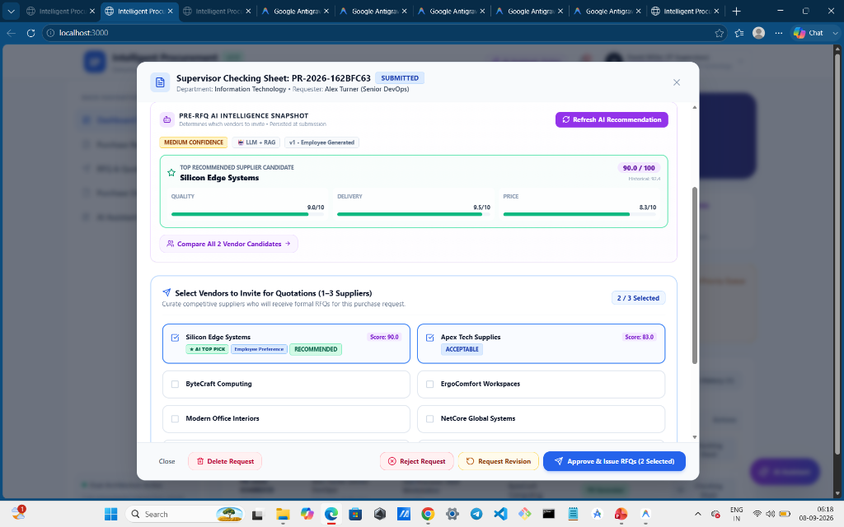
ACT 4: GOVERNANCE & TRIAGE • SUPERVISOR REVIEW HUB
Recommendation ≠ Authority: The Supervisor Checking Sheet
Left: Governance Principles • Right: Live Supervisor Action Triage Interface
HUMAN ACCOUNTABILITY
• AI Surfaces Recommendations
Historical score, quality/delivery/price breakdown, and RAG risk badges.
• Human Curates RFQ List
Supervisor selects 1 to 3 competitive suppliers to receive RFQs.
• Multi-Action Triage
Approve & Issue RFQs, Request Revision (with notes), or Reject Request.
"The System Owns Intelligence. Humans Own Accountability." — Every supervisor action is logged to the audit ledger.
Notes:
🎯 KEY MESSAGE:
Supervisors retain absolute decision authority; overrides and RFQ selections are auditable.
🎙️ SUGGESTED NARRATION (~1.5 min):
Here is the Supervisor Checking Sheet from our live platform. The supervisor sees the pre-RFQ AI snapshot (Quality 9.0, Delivery 9.5, Price 8.3), and manually selects which candidate vendors receive binding RFQs (1 to 3 suppliers). The supervisor has complete authority to approve, return for revision, or reject. AI never auto-buys.
🔄 TRANSITION TO NEXT SLIDE:
How do recommendations become actual market competition?

Slide 15
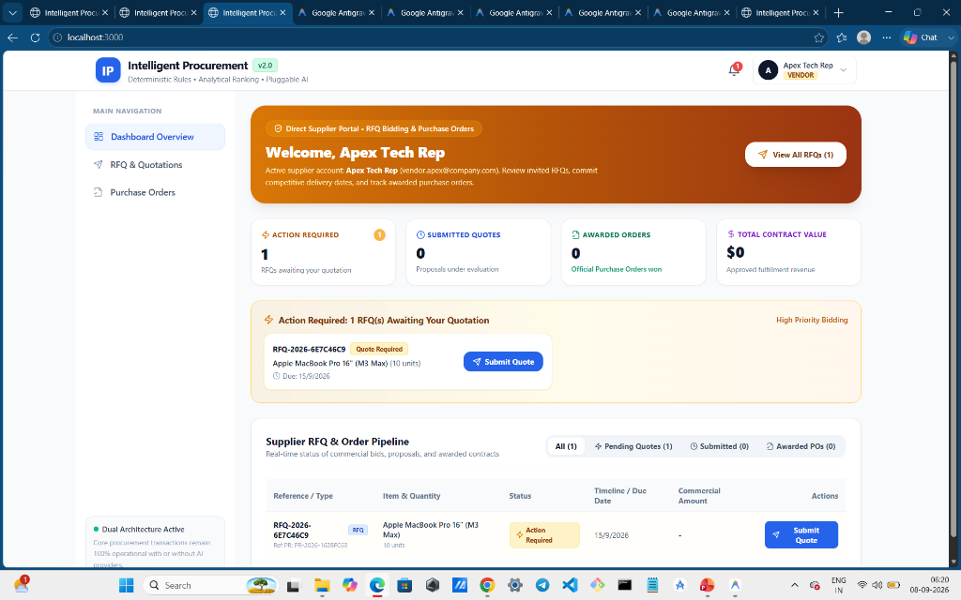
ACT 5: MARKET EXECUTION • SUPPLIER ENGAGEMENT
A Recommendation Isn't a Purchase Order: Direct Supplier Portal
Left: Supplier Workflow • Right: Live Vendor RFQ & Order Pipeline
SUPPLIER PORTAL FLOW
• Targeted RFQ Notifications
Suppliers receive instant in-app alerts when invited to bid.
• Pipeline Transparency
Tracks Pending Quotes, Submitted Proposals, and Awarded Orders.
• Decentralized Bidding
Vendors submit binding pricing, lead times, and terms independently.
Live Vendor Dashboard: Apex Tech Rep sees active RFQ-2026-6E7C46C9 awaiting quotation with real-time bidding CTA.
Notes:
🎯 KEY MESSAGE:
IPMS converts recommendations into real competition by issuing RFQs to up to 3 suppliers via a dedicated portal.
🎙️ SUGGESTED NARRATION (~1.0 min):
We never buy directly based on an AI recommendation. Instead, the supervisor issues an RFQ to qualified suppliers. Suppliers log into their dedicated Vendor Portal—as shown on the right for Apex Tech Rep—where they view invited RFQs, see due dates, and click Submit Quote.
🔄 TRANSITION TO NEXT SLIDE:
How does a vendor submit an itemized commercial proposal?

Slide 16
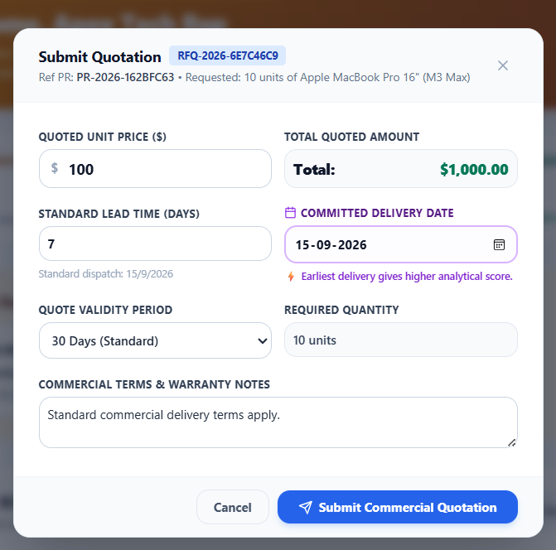
ACT 5: MARKET EXECUTION • 5-FACTOR SCORING MODEL V2
Commercial Quotation Submission & Trade-Off Evaluation
Left: 5-Factor Analytical Formula • Right: Live Vendor Quotation Submission Modal
5-FACTOR QUOTATION EVALUATION MODEL V2
• Price Score (35%): Benchmarked against historical baseline & lowest bid
• Committed Delivery Date (20%): Earliest guaranteed arrival gets highest score
• Standard Lead Time (15%): Velocity of shipment dispatch in business days
• Historical Reliability (15%): On-time fulfillment track record across past orders
• Product Quality Rating (15%): Verified inspection score & defect rate history
"We don't optimize for the cheapest quote. We optimize for the best total procurement outcome."
Dynamic Validation: Enforces unit price ($100 → $1,000 total), lead time (7 days), validity period, and delivery date.
Notes:
🎯 KEY MESSAGE:
The 5-Factor Quotation Model V2 evaluates total cost against lead time velocity, quality history, and warranty.
🎙️ SUGGESTED NARRATION (~1.5 min):
On the right is the vendor's quote submission dialog: entering unit price, lead time, and committed delivery date. On the left is our deterministic 5-Factor Model V2: scoring price at 35%, delivery at 20%, lead time at 15%, reliability at 15%, and quality at 15%—protecting Micron from lowball bids that fail SLAs.
🔄 TRANSITION TO NEXT SLIDE:
Once the best quotation is approved, how does fulfillment execute safely?

Slide 17
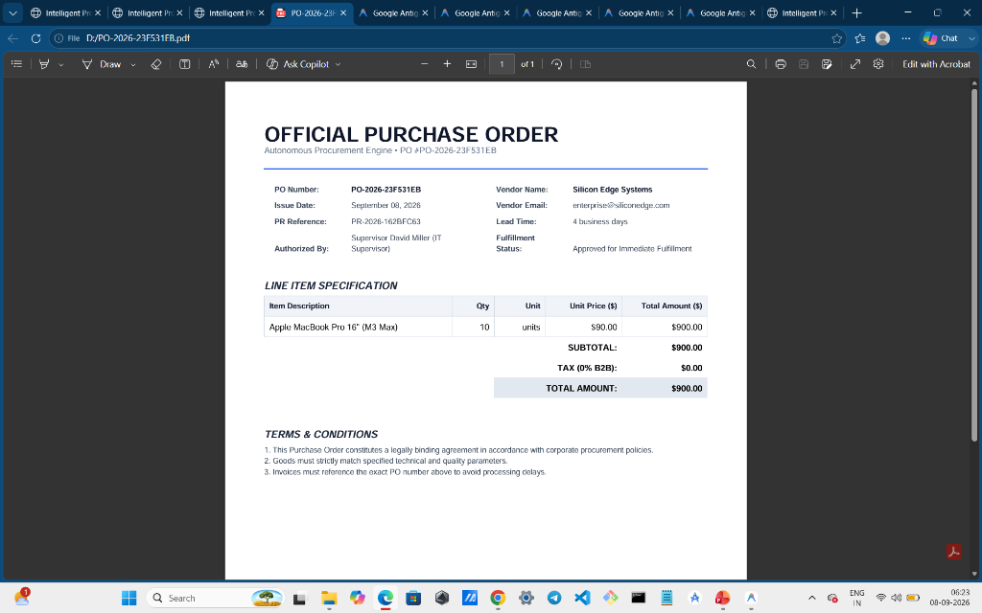
ACT 5: MARKET EXECUTION • IDEMPOTENT FULFILLMENT
Execution Integrity: Idempotent PO Engine & Official PDF Document
Left: Idempotent Architecture • Right: Live Generated ReportLab Purchase Order PDF
EXECUTION & GOVERNANCE
• Supervisor Final Authorization
Single-click approval binds the winning quotation & encumbers budget.
• Idempotent Record Creation
Zero duplicate PO risk—subsequent clicks return existing PO identifier.
• ReportLab PDF Compilation
Instant generation of legally binding, tamper-proof corporate PO document.
• Automated Vendor Dispatch
Vendor receives automated PO notification for immediate fulfillment.
Live PDF Artifact: PO #PO-2026-23F531EB generated for Silicon Edge Systems ($900.00) with complete terms & authorized sign-off.
Notes:
🎯 KEY MESSAGE:
Idempotent PO generation guarantees single PDF creation and automated vendor alerts.
🎙️ SUGGESTED NARRATION (~1.0 min):
Upon final approval, IPMS generates an official Purchase Order and compiles an immutable PDF via ReportLab, as shown on the right. Our idempotent architecture ensures that network retries or repeated clicks never produce duplicate PO records or charges. One decision produces one legally binding purchase order.
🔄 TRANSITION TO NEXT SLIDE:
Let us examine the complete 4-tier system architecture.

Slide 18
ACT 6: ARCHITECTURE & TECH STACK • 4-TIER BLUEPRINT
System Architecture: Intelligent Procurement System
ACTORS & ROLES
👤 Requester / Employee 🛡️ Department Supervisor 🚚 Vendor
PRESENTATION LAYER
PR Wizard (Next.js 14) Checking Sheet Hub Quotation Matrix & Vendor Portal
FASTAPI BACKEND & INTELLIGENCE ENGINE
Core Modules: PR State Machine • RFQ Dispatch • Quotations • Idempotent PO
3-Tier Intelligence Engine
1. Deterministic Engine 2. Analytical Model 3. Generative RAG
DATA & STORAGE
🗄️ PostgreSQL / SQLite Database ⚡ pgvector Embeddings 📄 Local Filesystem for PO PDFs
Notes:
🎯 KEY MESSAGE:
Complete 4-tier architecture: actors, Next.js presentation, FastAPI backend with 3 intelligence tiers, and database persistence.
🎙️ SUGGESTED NARRATION (~1.5 min):
Here is the complete system blueprint: Three distinct actor roles interact through Next.js 14. The FastAPI backend orchestrates core state machines alongside our Three-Tier Intelligence Engine: Deterministic for stock and duplicate rules, Analytical for 5-factor scoring, and Generative for RAG qualitative synthesis. All backed by ACID persistence and PDF storage.
🔄 TRANSITION TO NEXT SLIDE:
Let us look at how the technology stack is structured.

Slide 19
ACT 6: ARCHITECTURE & TECH STACK • IMPLEMENTATION STACK
Tech Stack: A modular monolith, not a maze of services
Frontend
Next.js 14
React 18
TypeScript
Tailwind CSS
Lucide Icons
Backend
Python 3.12
FastAPI
SQLAlchemy
Pydantic v2
ReportLab PDF
Database
PostgreSQL
SQLite Async
pgvector
Embeddings
Auth & Security
JWT Bearer
BCrypt Passwords
Backend RBAC
Audit Logs
AI / LLM
Google Gemini
Pluggable RAG
Snapshot Cache
Offline Fallback
A modular monolith with clear internal separation — zero unnecessary microservice complexity.
Notes:
🎯 KEY MESSAGE:
Engineered for high maintainability, low operational complexity, and graceful offline fallback.
🎙️ SUGGESTED NARRATION (~1.0 min):
We chose a modular monolith over microservice sprawl: Next.js 14 on the frontend, FastAPI and SQLAlchemy on the backend, JWT security, and pluggable AI providers with automatic fallback. If external AI APIs are unreachable, core procurement, inventory checks, and quotation scoring run 100% uninterrupted.
🔄 TRANSITION TO NEXT SLIDE:
How does our engineering align with Micron Technology values?

Slide 20
ACT 7: STRATEGIC VALUE • MICRON VALUES ALIGNMENT
Why This Thinking Is Relevant to Micron
PEOPLE
Human experience fuels organizational intelligence through quarterly reviews
INNOVATION
Hybrid deterministic + RAG AI architecture engineered for zero hallucination
COLLABORATION
Unified workflow connecting Requesters, Supervisors, and Suppliers in one loop
TENACITY & QUALITY
Governed overrides, audited revisions, and 5-factor quality scoring
"We didn't just apply AI to procurement. We designed intelligence around responsible decisions."
Notes:
🎯 KEY MESSAGE:
Direct alignment with Micron core values: People, Innovation, Collaboration, Tenacity, and Quality.
🎙️ SUGGESTED NARRATION (~1.0 min):
Micron leads global semiconductor innovation, where precision and quality are paramount. IPMS directly embodies Micron values: valuing human experience, pioneering hybrid AI architecture, uniting cross-functional teams, and upholding uncompromising governance.
🔄 TRANSITION TO NEXT SLIDE:
Let us examine our measurable business impact.

Slide 21
ACT 7: STRATEGIC VALUE • IMPACT & METRICS
The numbers that matter
PR-TO-PO TIME
SAVED ON ONE FLAGGED DUPLICATE
₹39,500
₹17,000 (matched) vs ₹56,500 landed cost — ATE Probes / Cleanroom example
Manual 5-7 days
Automated < 15 min
~97% reduction in PR-to-PO turnaround time
HOW WE GET THESE NUMBERS (ASSUMPTION-BASED ESTIMATE)
Duplicate + inventory check:
• Manual: 1-2 days (manual lookup) → IPMS: Instant (deterministic)
Vendor sourcing & comparison:
• Manual: 2-3 days (calls/emails) → IPMS: Instant (cached AI ranking)
Approval back-and-forth:
• Manual: 1-2 days (revision loops) → IPMS: Single pass (~15 min)
TOKEN COST PER PR
< $0.01
A fraction of a cent — deterministic checks stay off the LLM entirely.
Notes:
🎯 KEY MESSAGE:
Tangible ROI metrics: 97% reduction in turnaround time, proven cost avoidance on duplicates, and sub-cent AI operational cost.
🎙️ SUGGESTED NARRATION (~1.0 min):
Here are the numbers that matter: We reduce PR-to-PO turnaround from 5-7 business days down to under 15 minutes—a 97% compression. Intercepting a single duplicate requisition avoided ₹39,500 in landed costs on our semiconductor test scenario. And because deterministic logic handles arithmetic, our AI token cost is less than a single penny per request.
🔄 TRANSITION TO NEXT SLIDE:
Let us conclude and launch the live interactive demonstration.

Slide 22
"We Didn't Automate a Purchase Request."
We Made Every Decision Around It More Intelligent.
From Processing Procurement to Understanding Procurement.
LIVE SYSTEM DEMONSTRATION
http://localhost:3000
Notes:
🎯 KEY MESSAGE:
Transition into the live 8-10 minute end-to-end interactive demo across Employee, Supervisor, and Vendor roles.
🎙️ SUGGESTED NARRATION (~1.0 min):
We have explained the decisions. Now let us follow an actual purchase request through the live application. We will switch to our live environment at localhost:3000 to demonstrate the employee request, stock check, duplicate detection, supervisor revision loop, vendor bidding portal, 5-factor quotation scoring, and instant PO generation in real time. Thank you.
🔄 TRANSITION TO NEXT SLIDE:
Begin live demo.

