Slide 1
App Store

Slide 2
Objectives
In todays world a major population of humans rely and depend on mobile applications for their day to day needs.
In such a case, choosing the right application to download and use it in their smartphones is a matter of concern.
To cope up with this problem our AppStore dataset contains details of 7168 applications that includes user ratings, its price and other details which the user might find handy.
In this way, people can easily choose the appropriate and the correct application for their needs.

Slide 3
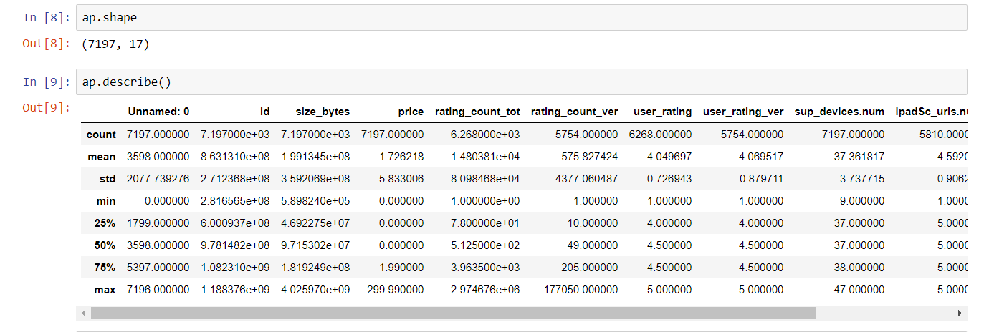
DESCRIPTION OF DATASET
Total number of columns :
1. Numerical columns : 12
2. Categorical columns : 5
Total number of rows : 7197
Data as missing values and NaN : 6172(5.3%)

Slide 4
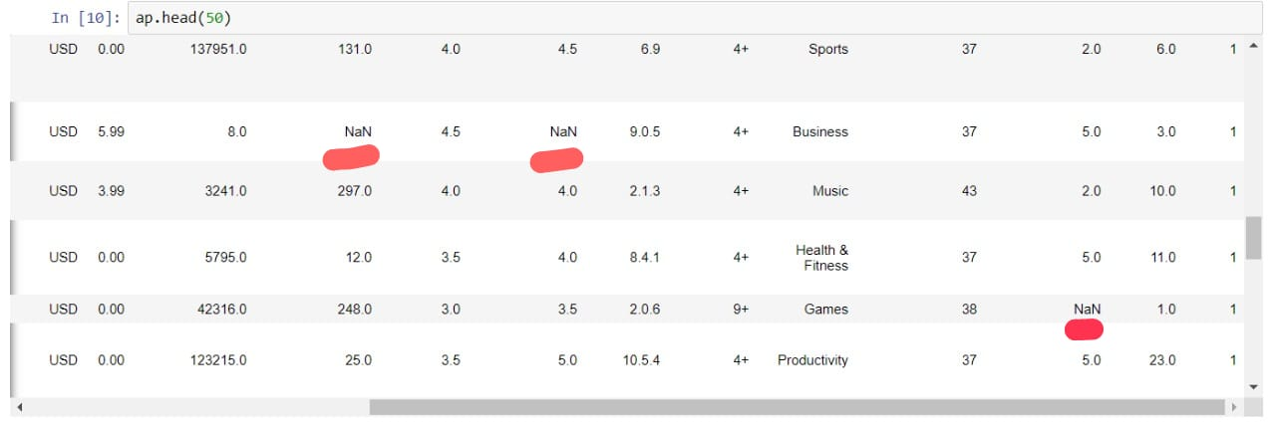
1. Data Cleaning This process is done in order to replace the null values with some meaningful values.

Slide 5
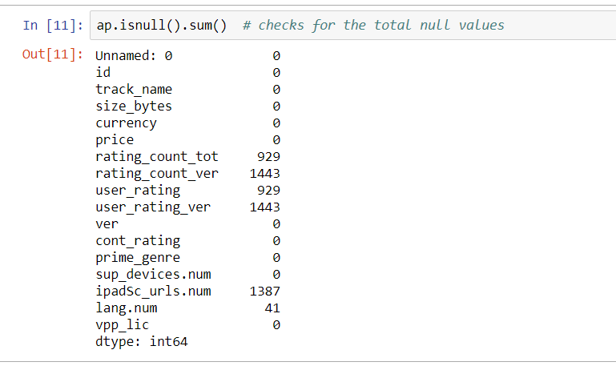
a. To check the total number of NULL or NaN values in the dataset.

Slide 6
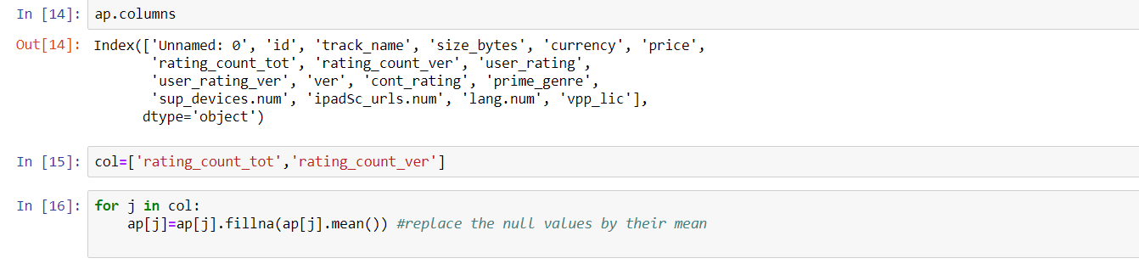
b. NaN values in the numerical columns are replaced with the mean of that particular column.

Slide 7
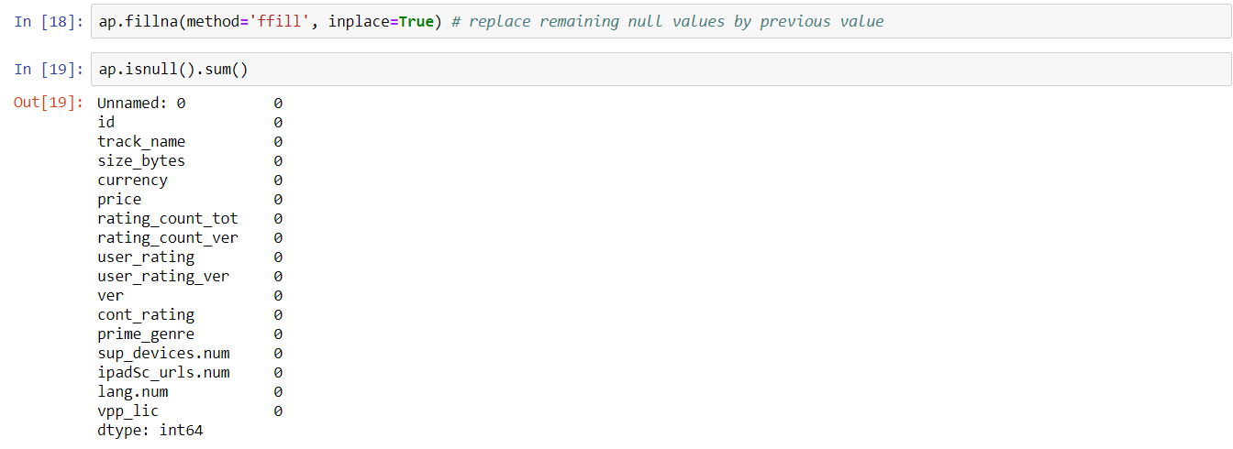
c. NaN values of categorical columns are replaced by the previous value in that particular column.

Slide 8
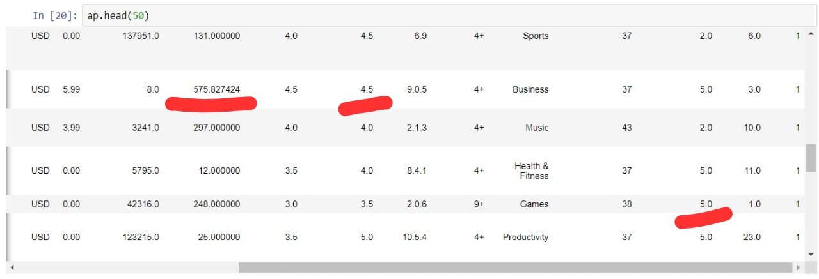
Before Data Cleaning
After Data Cleaning

Slide 9
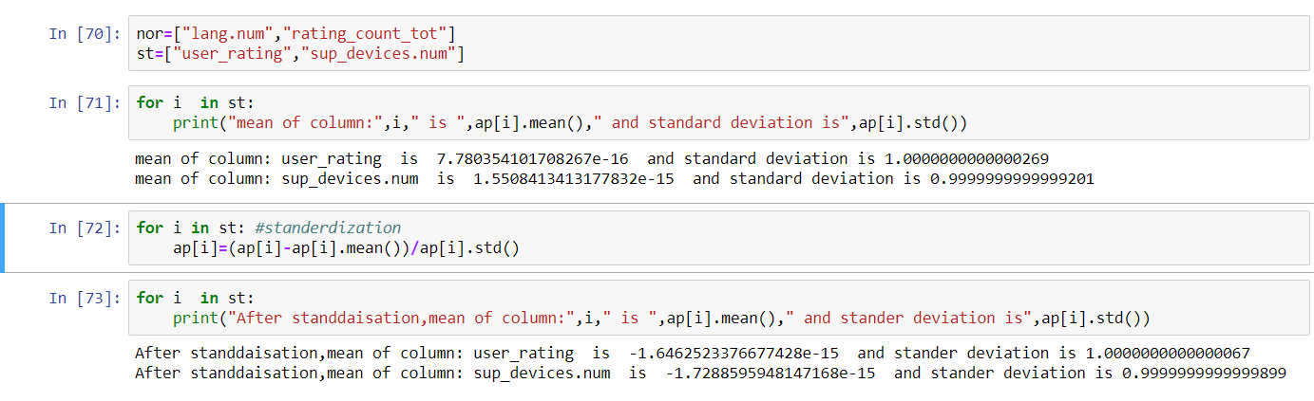
2. Standardisation Re-scaling the distribution of values, so mean of observed values is 0 and standard deviation is 1

Slide 10
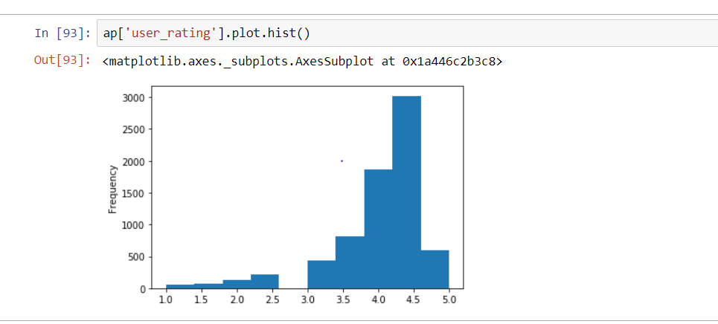
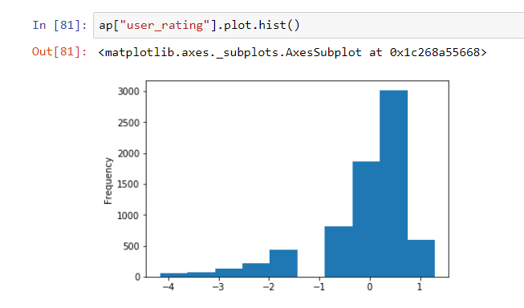
Before Standardisation After Standardisation

Slide 11
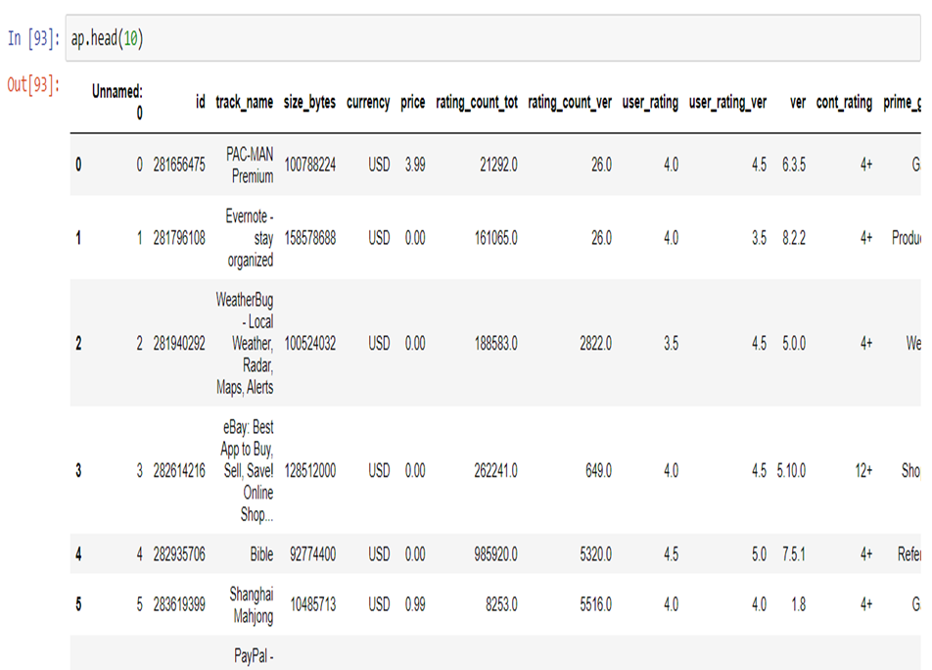

Slide 12
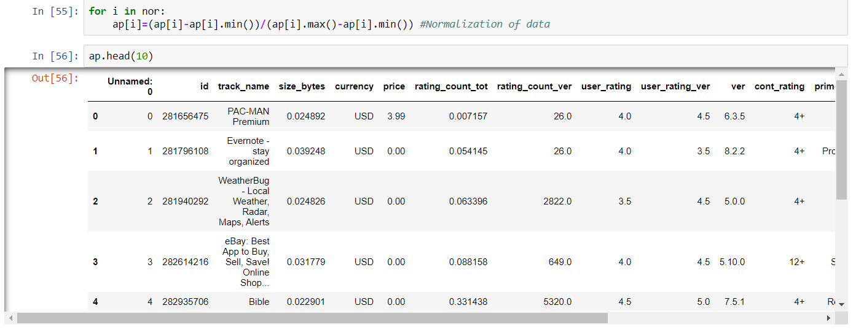
3. Normalization Typically rescales the values into a range of [0,1]. To change the values of numeric columns in dataset to a common scale, without distorting range values.

Slide 13
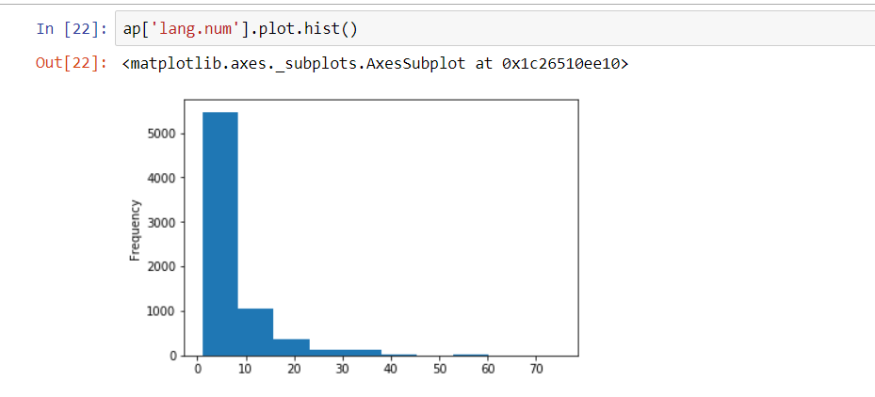
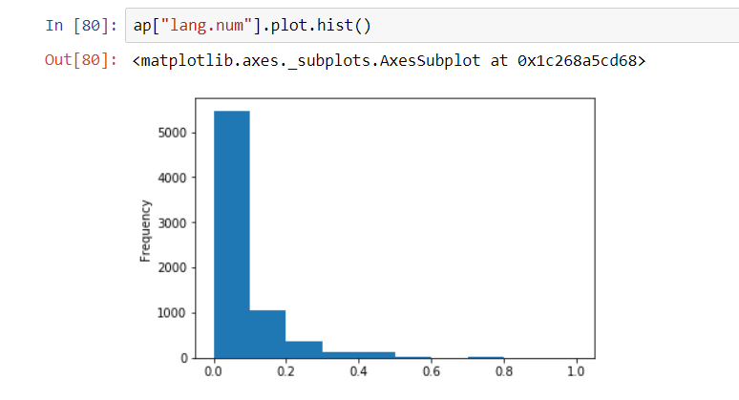
Before Normalisation After Normalisation

Slide 14
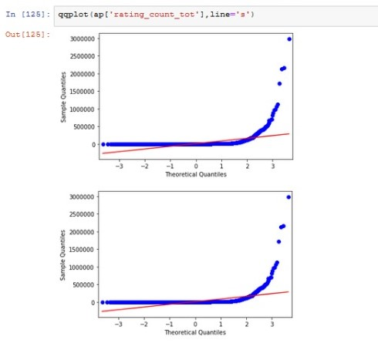
Before and after Normalisation

Slide 15
Importance of Normalisation
Normalization helps to reduce data redundancy and complexity of data.
In machine learning Normalization makes training less sensitive to scale of features.
The use of a normalization method will improve analysis from multiple models.
Normalization of data will make sure that data doesn’t vary more.
it get rid of a number of anomalies that make analysis of data more complicate.
Visualization of data would be difficult without normalization of data. Normalization changes the values of numeric columns in the dataset to a common scale without distorting differences In the ranges of values.

Slide 16
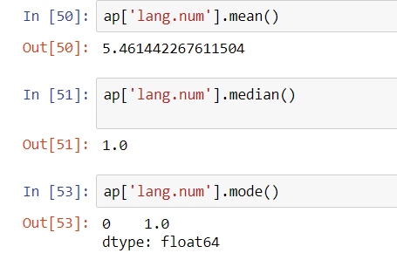
4. Visualization of Data
0.06028976037312782
a. Histogram
Histogram is used to summarize discrete or continuous data
Here the graph opening ply shows
Positive skewed (most data falls to right) where
Mode < median <mean

Slide 17
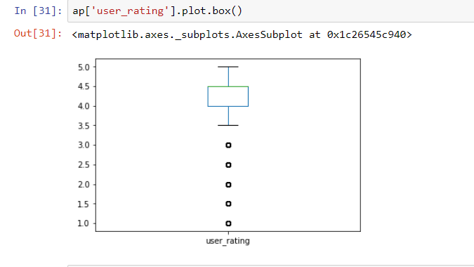
b. Box-Plot
Box-Plot is used to check if there is any outliers. The given box plot is negitively skewed

Slide 18
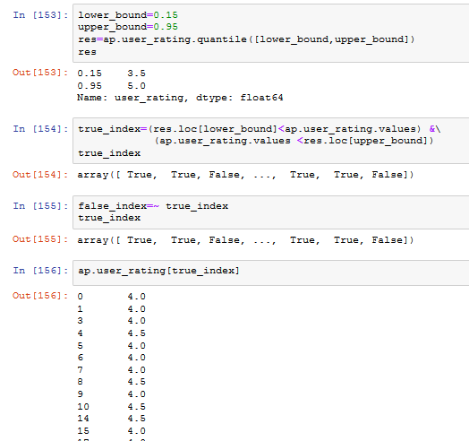

Slide 19
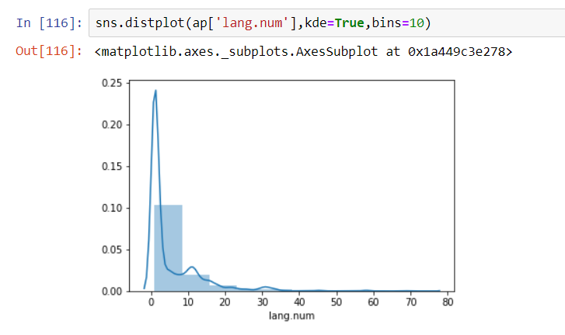
c. Distribution Plot

Slide 20
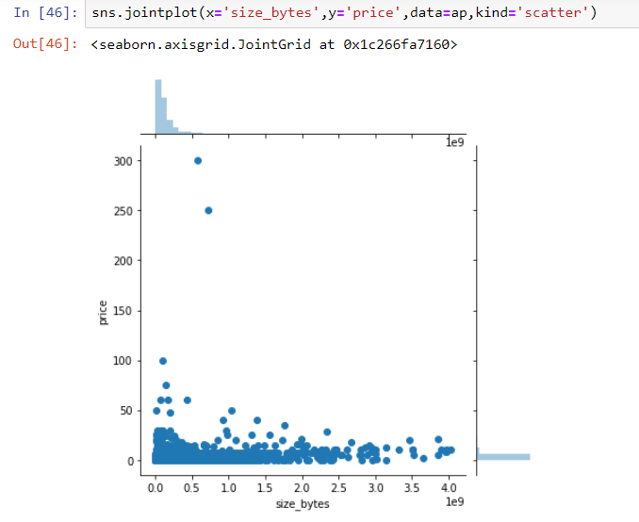
d. Scatter-Plot
It is a mathematical representation.
Dots are used to represent values of variables.

Slide 21
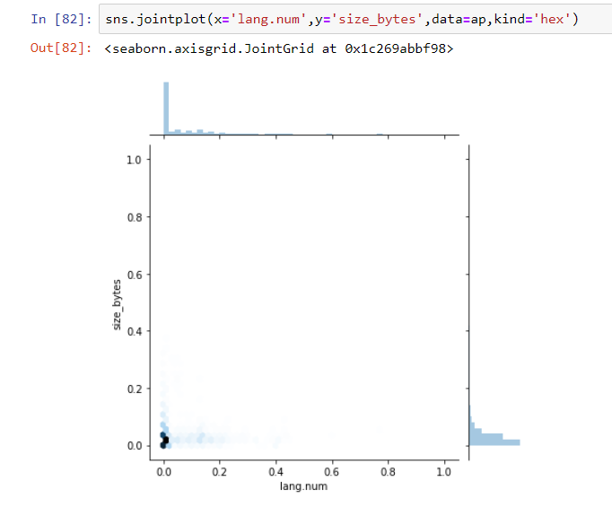
e. Hex-Plot

Slide 22
5. Hypothesis Testing
Hypothesis testing is a statistical procedure that uses sample data to determine, whether a statement about the value of a population parameter should or should not be rejected.
Here we do hypothesis testing for the column user_rating_ver.
Our population mean was 4.067 so we assume that the sample mean is same as population mean.
Thus our Null Hypothesis will be that
H0 : mu = 4.067
H1 : mu != 4.067

Slide 23
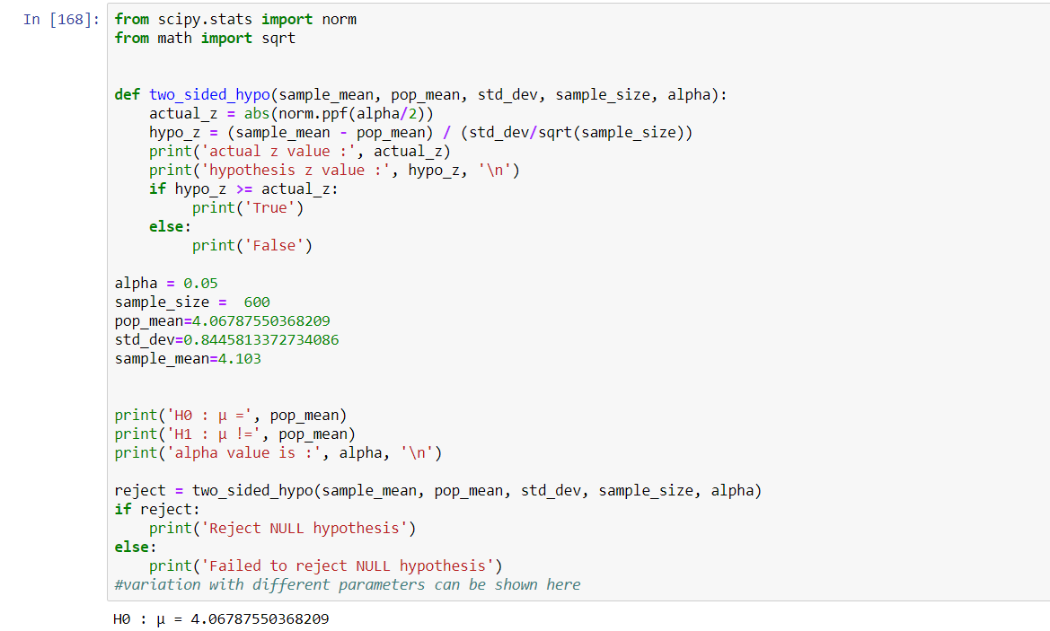
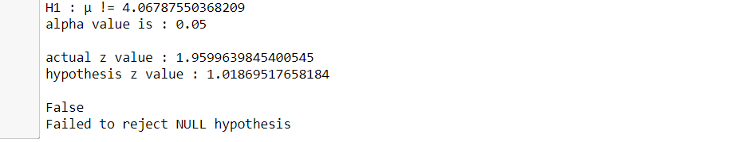

Slide 24
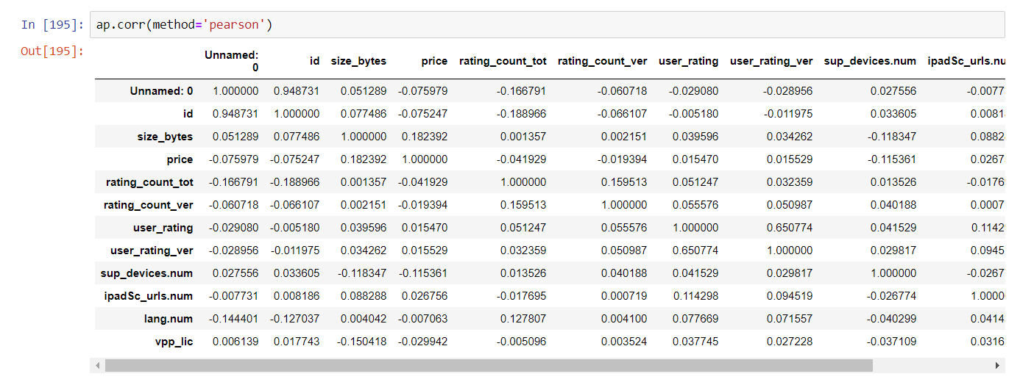
6. Correlation
It measures the strength and direction of a linear relationship between two variables on a scatterplot the value always lie between -1 to 1.

Slide 25
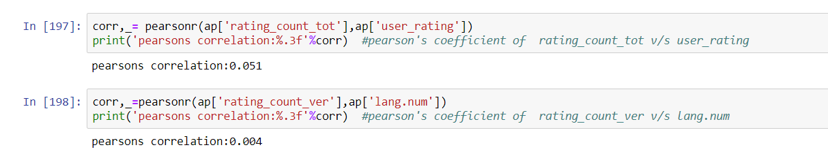

Slide 26
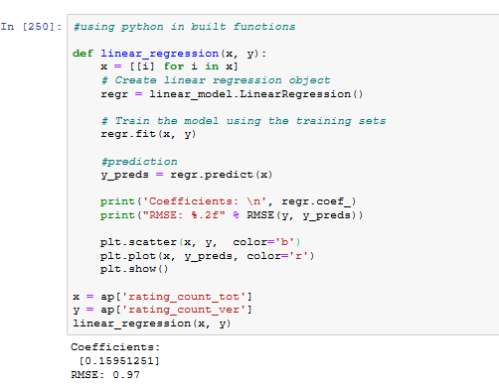

Slide 27
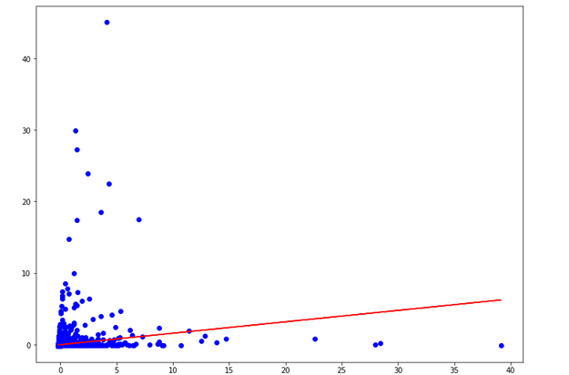

Slide 28
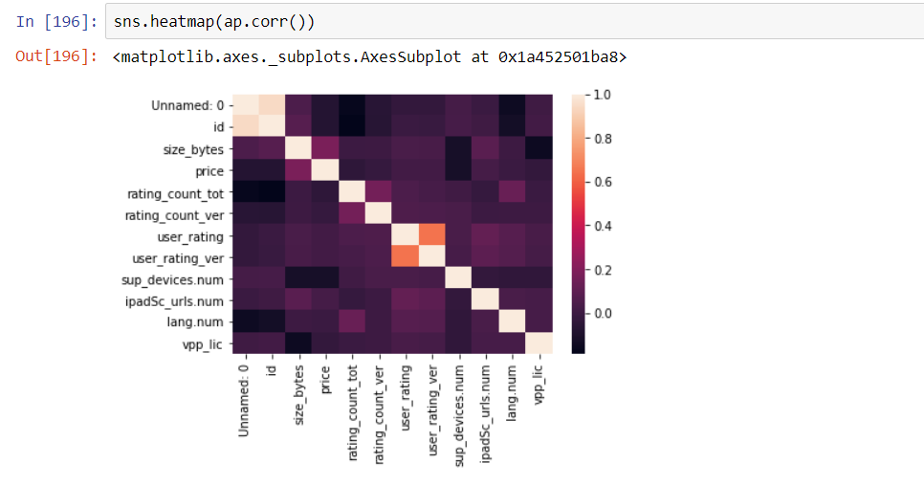

Slide 29


THANK YOU

