Slide 1
Blinkit leads Zepto by 34.5 NPS points in Jul to Sep 2026, and quality and freshness and missing or wrong items explain 10.3 of them
NPS proxy, Jul to Sep 2026: Blinkit 44.4 (±0.5), Instamart 43.8 (±1.1), Zepto 10.0 (±1.3).
Of the 34.5 point gap, 14.2 comes from Blinkit's higher share of 5 star reviews and 20.3 from Zepto's heavier detractor complaints.
The biggest complaint gaps are quality and freshness (6.0 points), missing or wrong items (4.4) and support and rider behaviour (3.5).
The app ranking is the same in 7 of 7 quarters when 3 star reviews count as passive. The first place lead over second is only 0.7 points against a ±1.2 margin, so treat it as a tie.
Source: Google Play reviews, India, English, 1,112,946 reviews, Jan 2025 to Sep 2026; outputs/ in the repo.

Slide 2
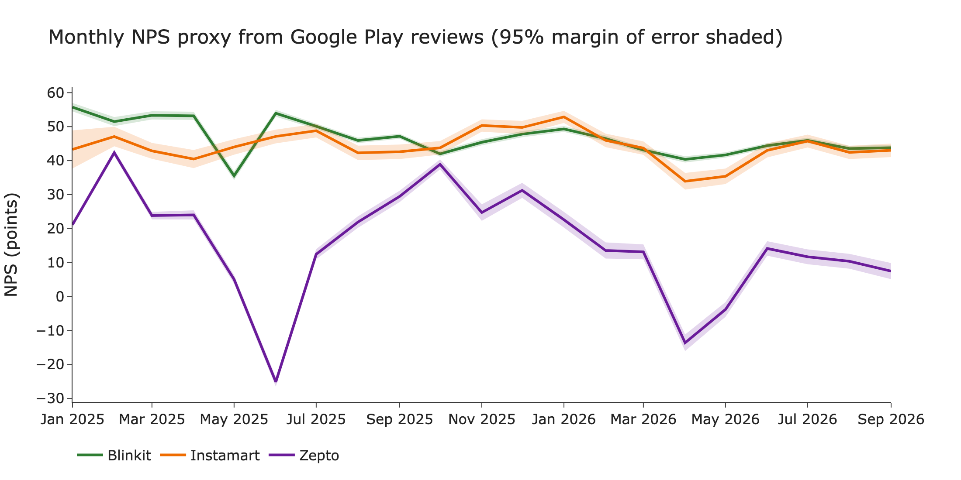
Blinkit and Instamart stayed between 34 and 56 NPS points for 21 months while Zepto swung from -25 to 42 and ended at 7
Source: Google Play reviews, India, English, 1,112,946 reviews, Jan 2025 to Sep 2026; outputs/ in the repo.

Slide 3
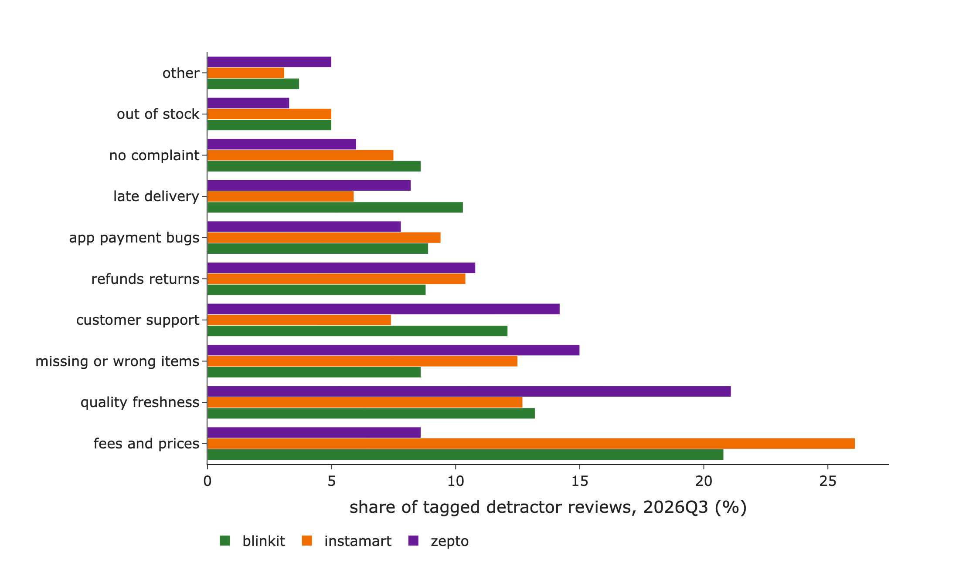
Fees and prices lead the complaints at Blinkit (21%) and Instamart (26%), but quality and freshness lead at Zepto (21%)
Top three complaints by share of tagged detractors
Blinkit: fees and prices 21%, quality and freshness 13%, support and rider behaviour 12%
Instamart: fees and prices 26%, quality and freshness 13%, missing or wrong items 12%
Zepto: quality and freshness 21%, missing or wrong items 15%, support and rider behaviour 14%
Source: Google Play reviews, India, English, 1,112,946 reviews, Jan 2025 to Sep 2026; outputs/ in the repo.

Slide 4
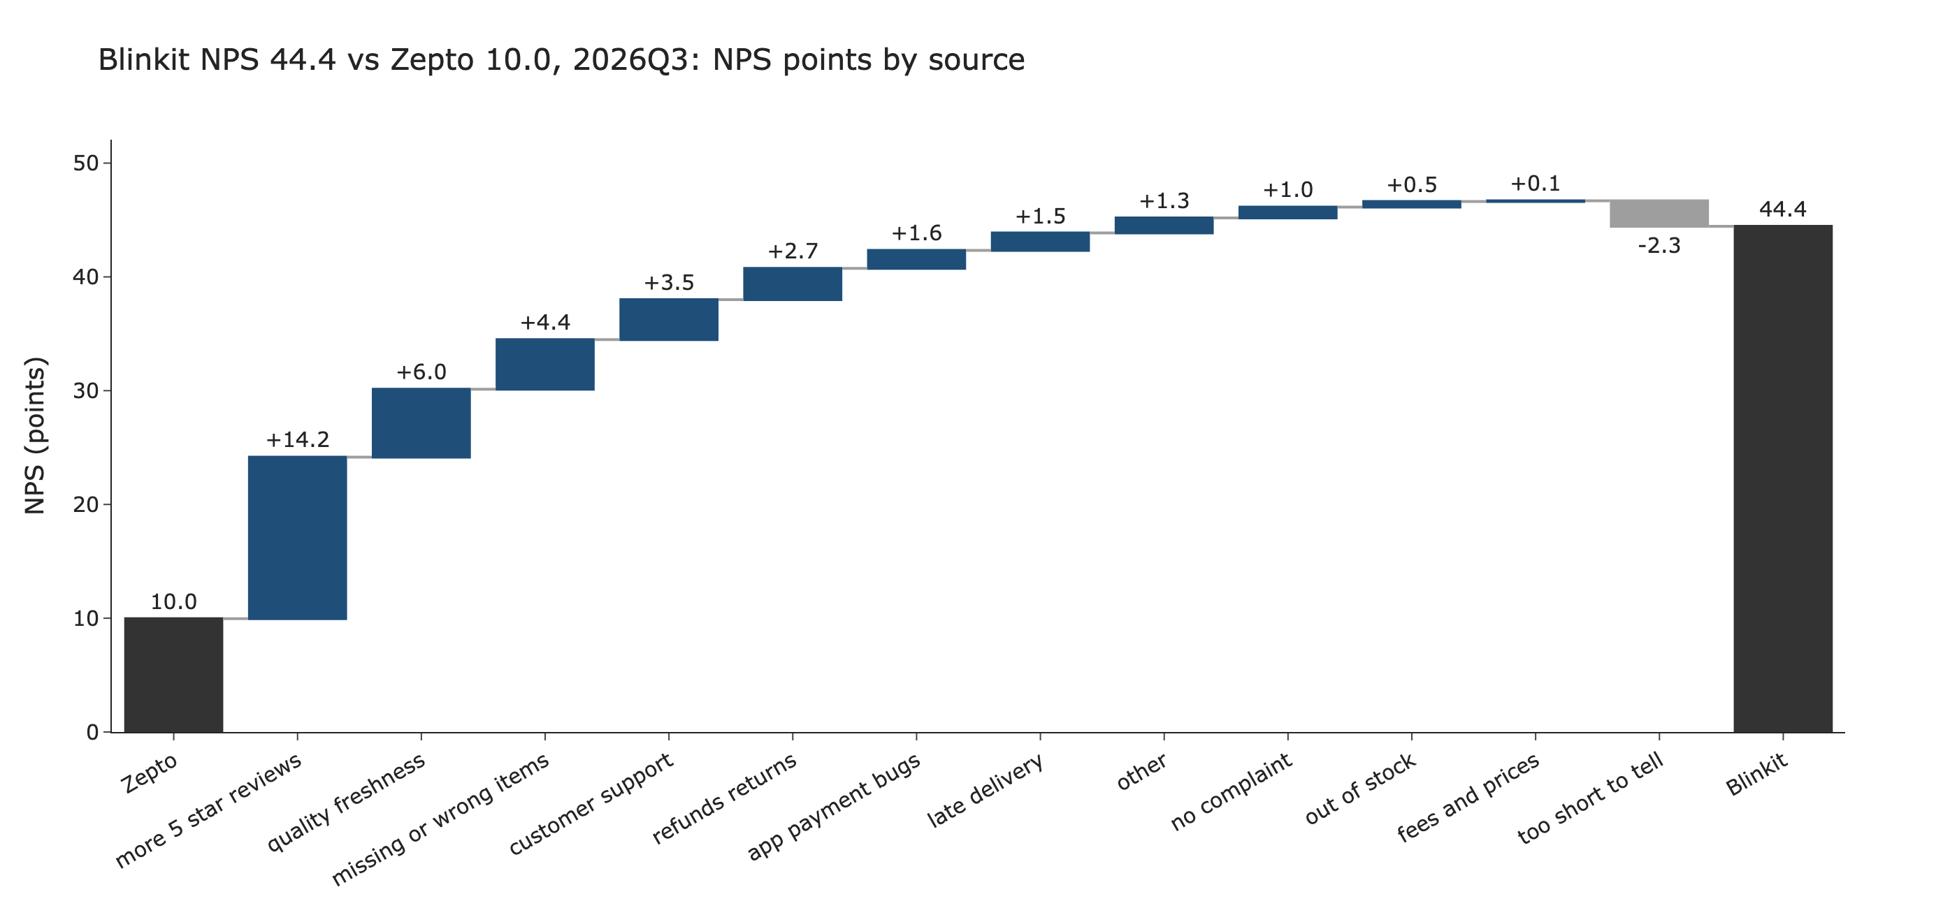
Blinkit's 34.5 point lead over Zepto is 14.2 points of 5 star reviews, then 6.0 from quality and freshness and 4.4 from missing or wrong items
Source: Google Play reviews, India, English, 1,112,946 reviews, Jan 2025 to Sep 2026; outputs/ in the repo.

Slide 5
Fixing quality and freshness, missing or wrong items and support and rider behaviour at Zepto is worth up to 13.8 of the 34.5 NPS points to Blinkit
6.0 points
4.4 points
3.5 points
Quality and freshness (±1.0)
Missing or wrong items (±0.9)
Support and rider behaviour (±0.9)
1. Check expiry and condition of perishables at packing, and pull items that get repeat complaints.
2. Add a pick and pack check, and require proof of drop before an order can be marked delivered.
3. Give a human agent path after the bot, shorten the first human reply, and coach riders on conduct.
Points at stake are the extra NPS points Zepto loses to each driver compared with Blinkit in Jul to Sep 2026. Matching the leader's rate would recover them. The ± is sampling error from the tagged sample.
Source: Google Play reviews, India, English, 1,112,946 reviews, Jan 2025 to Sep 2026; outputs/ in the repo.

Slide 6
The numbers are a review based proxy for NPS, tagged by a model and checked for consistency, not yet against human labels
Method
Limitations
* Promoter 5 stars, passive 4, detractor 1 to 3. 1,112,946 reviews, 21 months.
* 21,000 detractor reviews (1,000 per app per quarter, 4 or more words) tagged to 8 complaint drivers by Claude in an interactive session.
* Two independent tagging passes agreed on 96% of 100 reviews (kappa 0.954).
* A keyword baseline agrees with the model tags on 52% (kappa 0.46).
* Review based proxy, not survey NPS. Reviewers skew negative, so levels are not comparable with published NPS.
* Play Store and English only.
* Agreement between tagging passes shows the rules are clear, not that the tags are right.
* Driver bars carry up to ±1.0 points of sampling error. Blinkit's lead over second place is inside its margin.
Source: Google Play reviews, India, English, 1,112,946 reviews, Jan 2025 to Sep 2026; outputs/ in the repo.

