Slide 1
Digital Portfolio
STUDENT NAME: Kaviya. A
REGISTER NO AND NMID:asunm1112401111033017
DEPARTMENT: BCA
COLLEGE: L.N.goverment college. Madras university

Slide 2
PROJECT TITLE
Digital portfolio

Slide 3


AGENDA
Problem Statement
Project Overview
End Users
Tools and Technologies
Portfolio design and Layout
Features and Functionality
Results and Screenshots
Conclusion
Github Link
3/21/2024 Annual Review

Slide 4

PROBLEM STATEMENT
Defines the main issue your project aims to solve. Example: “Students face difficulties in accessing academic resources quickly; hence, an automated chatbot system is required.”

Slide 5

PROJECT OVERVIEW
A summary of what your project is about. Includes the project’s objective, scope, and purpose.

Slide 6

WHO ARE THE END USERS?
Identifies the target audience or beneficiaries. Example: Students, Faculty, Administrative Staff, General Public, etc.

Slide 7

TOOLS AND TECHNIQUES
Lists the technologies, programming languages, frameworks, and platforms used. Example: Python, Flask, MySQL, HTML/CSS, GitHub, Figma, etc.

Slide 8
POTFOLIO DESIGN AND LAYOUT
Explains how your project/portfolio is structured. Could include design choices, user interface, wireframes, or color schemes.
8

Slide 9
FEATURES AND FUNCTIONALITY
Highlights the main features of your project. Example: Login system, Data visualization, Notifications, AI integration, Responsive UI.

Slide 10
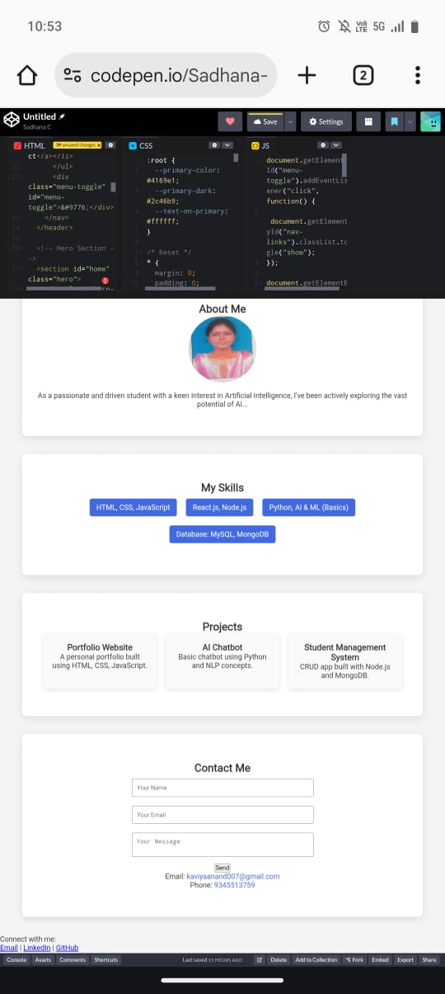

RESULTS AND SCREENSHOTS
3/21/2024 Annual Review
10

Slide 11
CONCLUSION
Summarizes the impact and learning outcomes of your project. You can also mention future scope here.
11

Slide 12
Github link
https://kaavi484.github.io/Kavi/

