Slide 1
Machine Learning - Coding Challenge - Spring 2023
Presenter: Kaan
ML Mavericks
Florence Pfammatter, Kaan Aydin
Notes:
https://codebox.net/pages/tensorflow-convnet-designer

Slide 2


Team Introduction
Presenter: Kaan
Florence Pfammatter
Kaan Aydin

Slide 3
Our Journey in the Coding Challenge
Presenter: Kaan
1
n
Simplified
ResNet Milestone:
Inclusion of data augmentation (flipping / padding) brought accuracy to 58.5%
ResNeXt: 61.7%
ViT: 62.6%
65%
ResNet: 58.5%
60%
DA: 57.4%
55%
50%
2
ResNeXt Milestone:
ResNeXt helped with generalization (vs. ResNet), reaching accuracy of 61.7%
45%
Accuracy
40%
35%
30%
3
ViT Milestone:
Despite to similar setup as before, highest result of 62.6% achieved by experimenting with epochs
25%
20%
15%
4
(Little) DA milestone:
Domain Adaptation showed good results with ResNet18 with 57.4% accuracy (vs. 52.6% without DA)
Number of Submissions
ResNet
ResNext
ViT
DANN

Slide 4
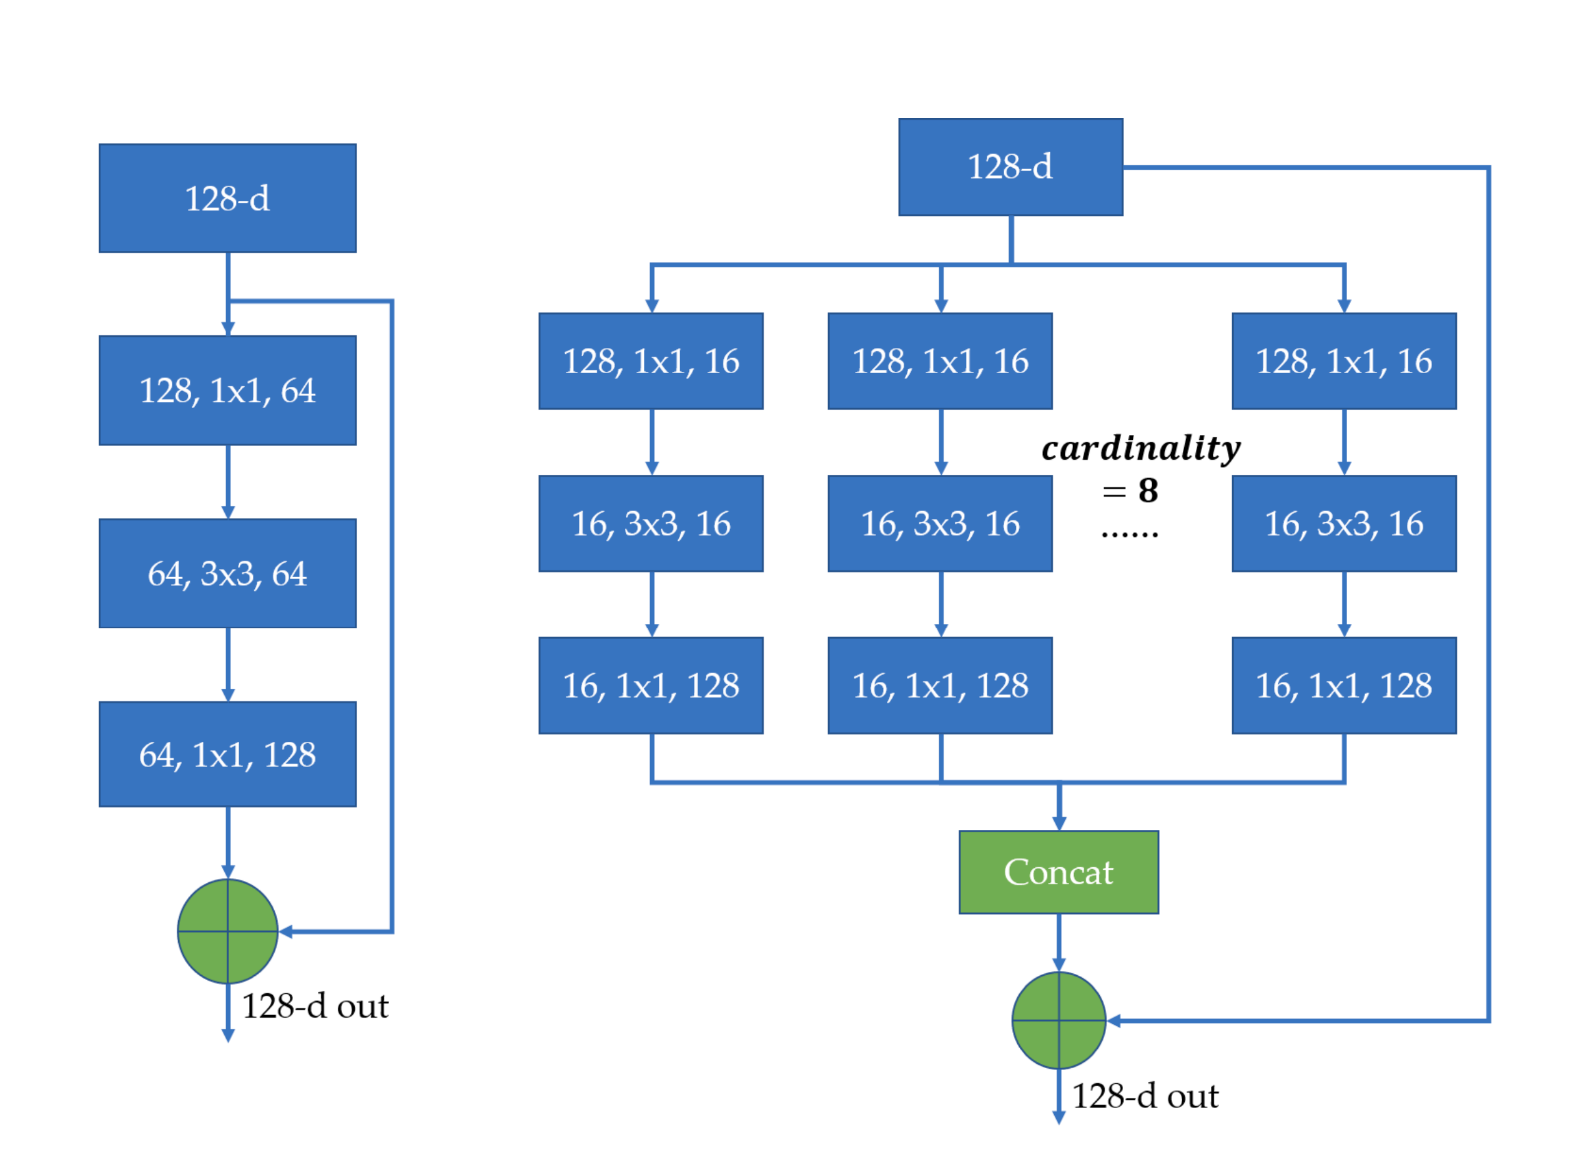
ResNet & ResNeXt
Presenter: Flo
Models
ResNeXt for better generalizability:
Increased capacity of network to capture broader feature variations through cardinality dimension.
Image from Wu et al. (2020)
ResNet50: default pretrained weights from PyTorch
ResNeXt: as above, architecture ResNeXt101_64X4D
Transformations
Re-sizing to 92x92 pixels
Random rotation of 5º
Random crop to 112 pixels and padding of 10pixels
Normalization ([0.485, 0.456, 0.406], [0.229, 0.224, 0.225])
Experiments
To reduce overfitting, we tried:
Regularization L1/L2, further transformations (Flippling, ColorJitter etc.), freezing layers of pretrained model, Dropout layer (with probability 0.2 and 0.5)
Best Score:
ResNet50 0.585 ResNeXt 0.617
Aggregated Residual Transformations for Deep Neural Network (Xie et al., 2017)
Notes:
We began our journey by implementing ResNet with default pretrained weights from PyTorch and applying basic data augmentations, including resizing, random rotation, padding, and normalization using ImageNet mean and standard deviation. While we explored alternative normalization values from the eurosat dataset, this adjustment did not result in significant improvements for our specific case.
When using Resnet we quickly realized that we had serious problems with overfitting: To counteract that, we used the transformations listed above. We also did some additional experiments with L1, L2 regularization, further transformations such as flipping and colorjitter, freezing layers and using dropout layers.
Looking for further ways to reduce overfitting, we discovered the ResNext architecture, an advanced version of the ResNet architecture. ResNext uses a split-transform-merge strategy, which introduces parallel paths in a group. This enables the network to capture more diverse and fine-grained features and generally leads to better performance with reduced complexity.
Using the ResNext model we were able to push the score from 0.585 to 0.617.

Slide 5
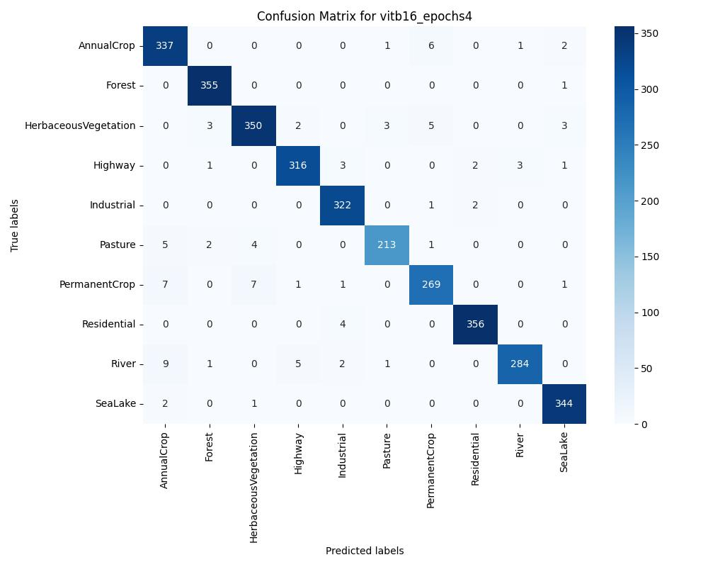
Vision Transformer
Presenter: Flo
Models
Pretrained weights from PyTorch, VIT_B_16 (best performance on ImageNet1K with this image size)
Transformations
Re-sizing to 204x204 pixels
Random rotation of 5º
Random crop to 224 pixels and padding of 10pixels
Normalization ([0.5, 0.5, 0.5], [0.5, 0.5, 0. 5])
Experiments
Image Resizing, DeiT model for low RAM consumption,
Dropout Layer (with probability 0.3 and 0.5)
Best Score:
0.62564
Notes:
But we didn’t stop there: We were also keen to try out the latest model architecture – namely the Vision Transformer. We used the Vit_b_16 models from Pytorch, which showed one of the best performances on ImageNet from the vision transformers trained with an image size of 224x224pixels.
The data augmentation was similar to the one for ResNet – you may see that we focused more on model exploration and less on exploitation of our existing architecture and optimization of transformations. This resulted in a descent but not great score of 0.62564, but a lot of learnings and a good familiarization with different model architectures.
ResNeXt is able to achieve better accuracy than ResNet-200 [15] but has only 50% complexity.
When analyzing the confusion matrix of the vision transformer, two distinct types of misclassifications were observed. Firstly, there was confusion between river and annual crop or highway, possibly due to the model occasionally interpreting irrigation systems in annual crop fields as rivers. Secondly, various vegetation classes, such as herbaceous vegetation and pasture, were frequently misclassified, indicating the potential benefit of introducing the NDVI index to aid in distinguishing between these vegetation types.

Slide 6
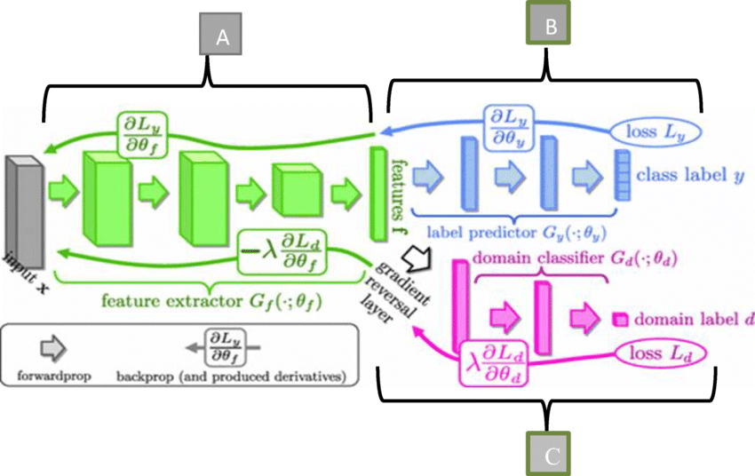
Domain Adaptation (1/2) - Setup
Presenter: Kaan
Approach of DANN
Deep Neural Network details
A
B
A
Feature Extractor
Based on the feature extractor layers from the ResNet architecture (i.e., ResNet18 and ResNet50)
Using default pre-trained weights from PyTorch
B
Label classifier
4-layer head on top of feature extractor, consisting of: one linear transformation (to number of classes), batch norm, ReLU activation function & SoftMax
C
Domain classifier
8-layer head on top of feature extractor, consisting of various linear mapping and ReLU activation functions and a SoftMax at the end
C
Based on the approach as outlined by Ganin et al., 2015
Same feature extractor, two different heads: one for predicting label, the other for classifying domain
Loss for classifying domain backprogates through reversal layer to maximize loss of domain classifier
Goal: Increase loss for domain & decrease for label classifier
Experimental details
20 epochs, with learning rate of 1e-3 & momentum of 0.9
Standard transformation (i.e., rotation, padding)
For every second epoch, we only trained the domain classifier to generate better domain invariant features
Keeping the λ constant at 0.2 for every iteration & epoch

Slide 7
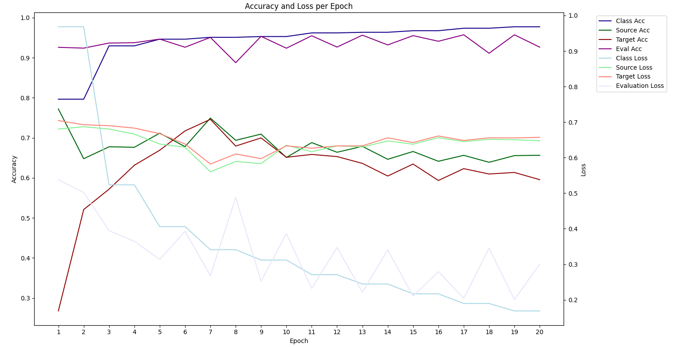
Domain Adaptation (2/2) - Result
Presenter: Kaan
High-level results
Accuracy & Loss curve
Best result achieved with ResNet18 (vs. ResNet50 despite same setup)
Feature Extractor
Result
ResNet18 with DA performed better than without – indicating that DA has had some impact
ResNet50 (w/ DA)
50.4%
Class & Eval Accuracy
ResNet18 (w/ DA)
57.4%
Source & Target Loss
ResNet18 (w/o DA)
52.6%
Varying accuracy / loss of the domain classifier across epochs – little convergence
Accuracy
Loss
All results are based on the same data transformations
DA results are based on based on the same setup as previously shown
For ResNet18, we show the epoch with the highest performance on eval
Source & Target Acc
DA is promising given some initial results, but needs further deep-dive, e.g.:
Implementing lower-layer feature extracors
Adjusting the λ in the GRL
Class & Eval Loss
Number of Epochs

Slide 8





Learnings from the Challenge
Presenter: Flo
Overfitting as key issue
Target vs. Source domain
Exploration vs. Exploitation
Domain Adaptation
Development setup
Overfitting is a key factor to be considered - even more so when dealing with different domains
Little changes in augmentation can have a big impact on performance in target domain (vs. source)
Good balance between trying new things out vs. pursuing existing approaches is important
Domain Adaptation is difficult – has many considerations and factors to be tested
A well-built development and model pipeline is key for speed, reproducibility and tracabiility
Notes:
Key learnings from this challenge include the importance of addressing overfitting when dealing with a test set in a different domain, the significant impact of small changes in the source domain on the target domain, the need to strike a balance between exploring new approaches and leveraging existing solutions, the challenges associated with domain adaptation, and the crucial role of a well-built model pipeline for speed and reproducibility.

Slide 9





Outlook
Presenter: Flo
Inclusion of NDVI features during training
Deep-dive in Domain Adaptation
Implementation of Hyperparameter Tuning
Training with cross-validation to reduce overfitting
Ensemble learning by combining various models
Notes:
Although the challenge has ended, we have several ideas to enhance our existing model:
Incorporating the NDVI index into model training to improve performance on vegetation classes.
Expanding our domain adaptation efforts.
Conducting systematic hyperparameter tuning, possibly through grid search.
Implementing cross-validation to mitigate overfitting.
Exploring ensemble learning by combining models such as resnext and vision transformer.
These ideas reflect our enthusiasm for further experimentation and improvement. It has been an enjoyable and fascinating experience working with different models and exploring domain adaptation with GANs.

Slide 10
References
Wu, P., Cui, Z., Gan, Z., & Liu, F. (2020). Residual Group Channel and Space Attention Network for Hyperspectral Image Classification. Remote Sensing, 12(12), 2035. https://doi.org/10.3390/rs12122035
Xie, S., Girshick, R., Dollár, P., Tu, Z. & He, K. (2017). Aggregated Residual Transformations for Deep Neural Networks. https://doi.org/10.1109/cvpr.2017.634
Yaroslav Ganin, Evgeniya Ustinova, Hana Ajakan, Pascal Germain, Hugo Larochelle, François Laviolette, Mario Marchand, & Victor Lempitsky. (2016). Domain-Adversarial Training of Neural Networks.

Slide 11
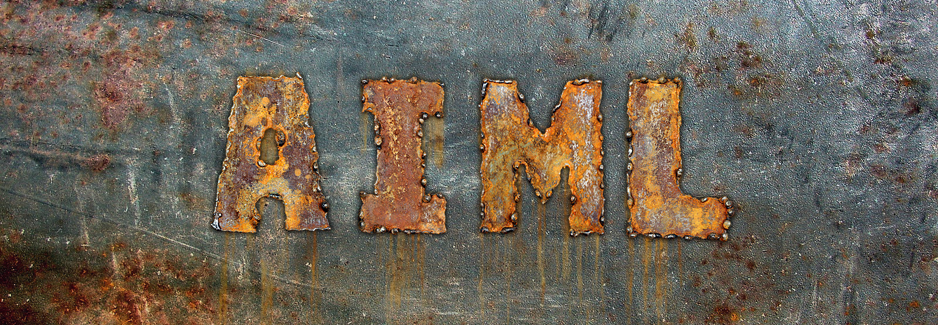
Presenter: Flo
Thank you! - Any questions?

