Slide 1
Medtech buyers pay for growth: ~9x revenue above 20% growth, ~6x below
Eight public medtech takeovers, 2024 to 2026 ($ in millions)
Deal | Announced | Target segment | EV | Revenue | Growth | EV / Rev. | Premium
J&J / Shockwave Medical | Apr 2024 | Cardiovascular | $13,100 | $730 | 49% | 17.9x | >5%
Boston Scientific / Axonics | Jan 2024 | Urology / neuromodulation | $3,400 | $366 | 34% | 9.3x | 23%
Stryker / Inari Medical | Jan 2025 | Peripheral vascular | $4,900 | $603 | 22% | 8.1x | 60%
Boston Scientific / Penumbra | Jan 2026 | Thrombectomy / neurovascular | $14,500 | $1,404 | 18% | 10.3x | 19%
Zimmer Biomet / Paragon 28 | Jan 2025 | Foot and ankle orthopedics | $1,200 | $256 | 18% | 4.7x | 8%
Boston Scientific / Silk Road | Jun 2024 | Carotid / vascular | $1,160 | $196 | 11% | 5.9x | 38%
Danaher / Masimo | Feb 2026 | Patient monitoring | $9,900 | $1,523 | 9% | 6.5x | 40%
AIP / Avanos Medical (PE) | Apr 2026 | Pain management / digestive health | $1,272 | $701 | 2% | 1.8x | 72%
Strategic median |  |  |  |  | 18% | 8.1x | 23%
Revenue is the latest full year at announcement (Silk Road uses 2024 guidance; Axonics and Masimo use preliminary results). Premiums are versus prior close, except Silk Road (60-day VWAP). Shockwave's premium is understated because reports of talks lifted the stock first. Penumbra was cash and stock; Paragon 28 adds a CVR of up to $1 per share.
Kayton Dean | Medtech M&A Precedent Transactions | November 2026 | Sources: company releases, MedTech Dive, BioWorld, Reuters. Educational project, not investment advice.
1

Slide 2
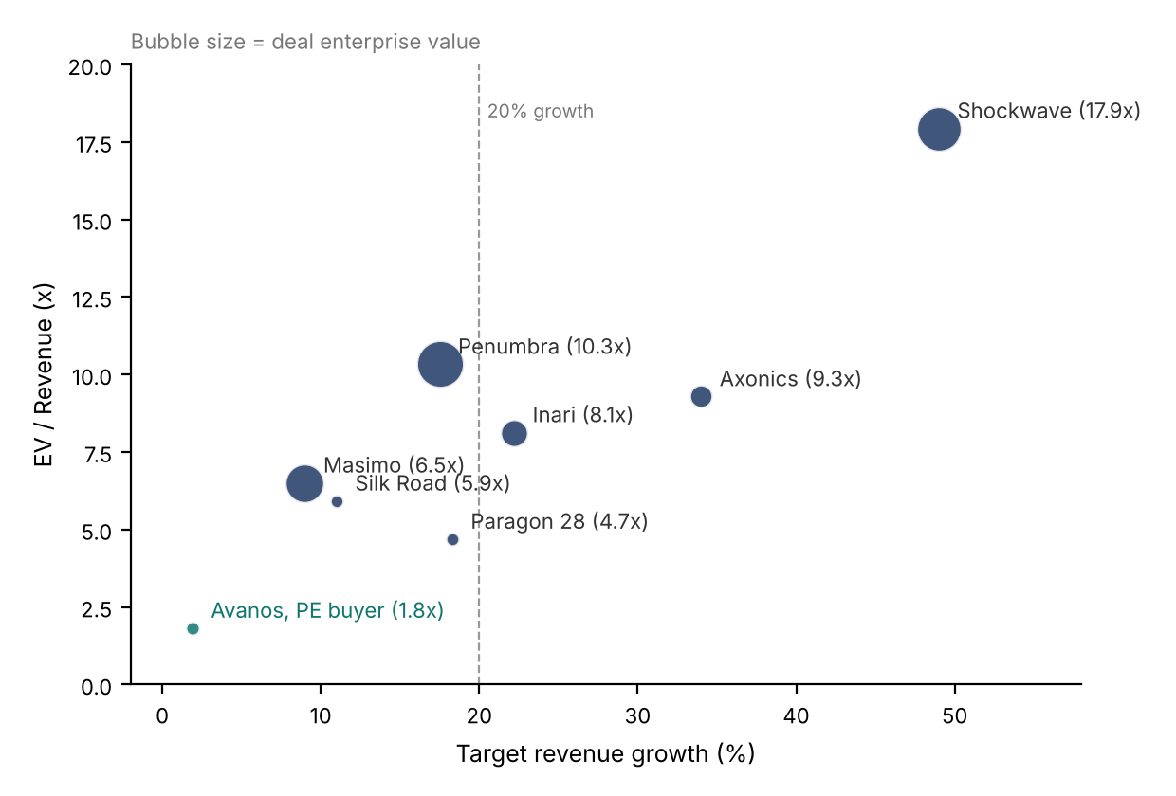
Growth drives the multiple; private equity prices on cash flow
Revenue growth vs. EV / Revenue; correlation of 0.86 across strategic deals (0.51 excluding Shockwave)
Three takeaways
1. Growth sets the multiple. Targets growing 20%+ sold for a median 9.3x revenue versus 6.2x for slower growers. Shockwave (49% growth, 17.9x) shows how far a category leader with a new technology can stretch the range.
2. Strategics pay for fit. Boston Scientific bought three vascular and urology assets in three years, and paid 10.3x for Penumbra on 17.5% growth, reflecting how it fits BSX's vascular business.
3. Private equity prices on cash flow. AIP paid 1.8x revenue but 14.7x adjusted EBITDA for a 2%-growth Avanos, and paid the highest premium in the set (72%) over Avanos's prior close.
So what for a sell-side banker: lead the pitch with the growth story and line up strategics that have a portfolio gap before going to sponsors.
Kayton Dean | Medtech M&A Precedent Transactions | November 2026 | Sources: company releases, MedTech Dive, BioWorld, Reuters. Educational project, not investment advice.
2

