Slide 1




Slide 2
Course Outline
Git Definition
Basic Git Commands
Intermediate to Advance Git Commands
Git Patterns for Hardware Development
Integration with Github and Gitlab

Slide 3
About Me
I am Engr. Karl Anthony B. Baluyot, a computer engineer
I am a software engineer at Traxion Tech (Repository Master :D)
Also a part-time engineering professor at HCDC-CET
Makes a lot of open-source to project-based hardware projects as research consultant
Co-founder and Community Head of Embedded Davao

Slide 4
What is Embedded Davao?
It is a community of diverse engineers, students, professionals, and enthusiasts specializing in embedded systems here in Davao.
Growing consistently in partnerships with academes and industry
Partnered with DevCon Davao, and established connections with other local communities here in Davao

Slide 5
Activities at Embedded Davao
Official facebook group: /embeddeddavao
Official facebook page: /embedded.davao
Official discord channel: https://discord.gg/w6DxcyV
We hold talks, meetups, seminars, workshops, support, etc.
MOU for academe and industry partners are working in progress
Support #letsgoembedded

Slide 6

Buckle up!!!

Slide 7
1.1 What is Git?
Is a fast, scalable, distributed revision control system with an unusually rich command set that provides both high-level operations and full access to internals.
Is an Open Source project covered by the GNU General Public License version 2 (some parts of it are under different licenses, compatible with the GPLv2).
It was originally written by Linus Torvalds with help of a group of hackers around the net.

Slide 8
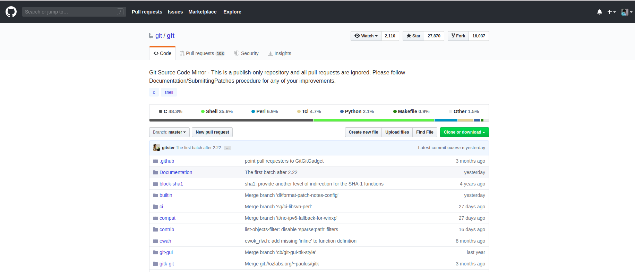
Git Official Mirror SRC

Slide 9
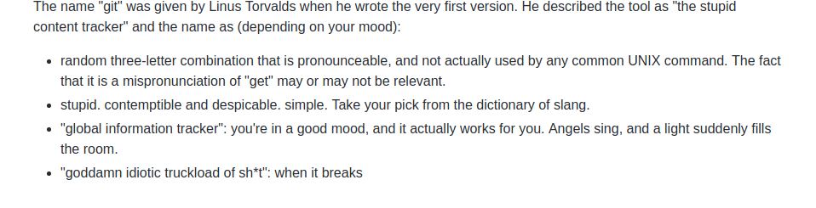
Linus being Linus

Slide 10
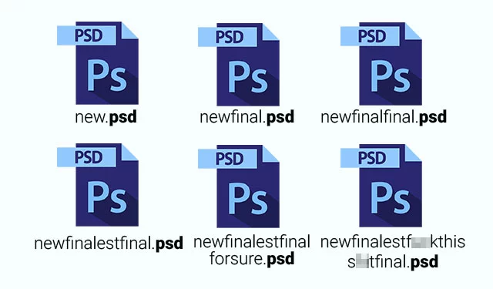
Why Git?

Slide 11
Why Git?
Ease of maintenance
Distributed version control type
Recover accidental changes
Built for collaboration
Product quality
Fast deployment
Most used versioning system and mature

Slide 12

Git Architecture

Slide 13
Git Alternatives
Mercurial SCM
Apache Subversion
Fossil
Bazaar
Darcs
BitKeeper
CVS (Concurrent Versions System)
Many more!!!

Slide 14
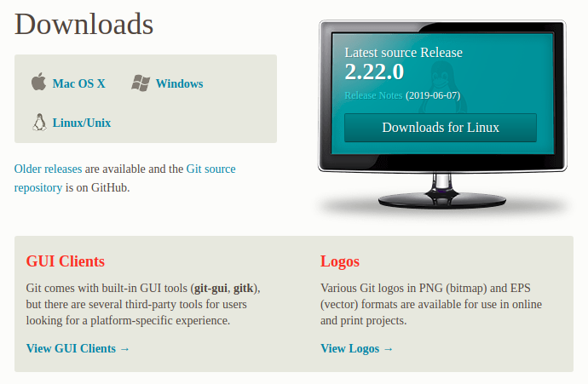
Installing Git
Navigate to https://git-scm.com/downloads

Slide 15
Installing Git
Just select the default settings for now provided by your OS
To check if Git is properly configured, write: git --version in your console.
You’re git to go!

Slide 16
Git Basic Commands
There are only few commands to start with git, namely:
  > git init <folder-name>
  > git config –-global user.name “<my-name>”
  > git config –-global user.email “<my-email>”
  > git add <file>
  > git commit -m “<commit message>”
  > git status
  > git log

Slide 17
Your First Git Project
Setup your git credentials via,
  > git config –-global user.name “Karl Baluyot”
  > git config –-global user.email “email@y.com”
Create your first git project via,
  > git init my-first-project
Create two files, namely,
  > billing.txt and materials.txt
  And run git status

Slide 18
Your First Git Project
Stage your all your changes with,
  > git add . or
  > git add billing.txt materials.txt
Unstage your changes if necessary via,
  > git reset <file-name>
Write your first commit,
  > git commit -m “initial commit”
See your status and logs via git status and git log commands

Slide 19
Modification and Debugging
Modify billing.txt by appending number 890
Check difference using git diff billing.txt and commit with message
How to commit a specific line of code only?
  Via git add -p
Here’s the magic, what if you have ruined your file and you saved it?
  Add garbage data to billing.txt

Slide 20
Modification and Debugging
You may use the command below if you haven’t committed a specific file via,
  > git checkout <commit-hash> –- <file/path>
What if you already committed it?
  Populate billing.txt with garbage data and mistakenly commit it
Recover it with the list of commands below,
  > git reset –-soft <last_good_commit_hash>
  > git reset –-hard <last_good_commit_hash>
  > git revert <bad_commit_hash>

Slide 21
Branching and Merge Conflicts
You can create a branch (must be in source branch) via,
  > git branch <branch-name> (first-branch)
You may now switch branches using the commands below,
  > git branch (show list of branches)
  > git checkout <branch-name> (first-branch)
  > git status
You may merge the two branches (must be target branch) via
  > git merge <target-branch> (first-branch)

Slide 22
Branching and Merge Conflicts
Merge conflicts happen when the two branches are not synchronized in terms of commits.
To produce one, append 321 in billing.txt in master branch and commit it. Checkout to first-branch, append 789 to billing.txt also and commit it. Checkout to master and merge the branches.
Applying git stash and git stash apply allows you to save temporarily your uncommitted changes to avoid merge conflicts.

Slide 23
Git Branch and Git Tags
To delete a branch,
  > git branch -d <branch-name>
A tag is specific reference points in a git history. A branch is not equal to a tag.
Tags are mainly use for versions.
To create a tag from a branch,
  > git tag -a <tag-name> -m “<tag-message>”
  List it with, git tag or by group git tag -l “hint”

Slide 24
Git Branch and Git Tags
To delete a branch,
  > git branch -d <branch-name>
A tag is specific reference points in a git history. A branch is not equal to a tag.
Tags are mainly use for versions.
To create a tag from a branch,
  > git tag -a <tag-name> -m “<tag-message>”
  List it with, git tag or by group git tag -l “hint”

Slide 25
Git Semantic Versioning
A versioning standard, semantic versioning, is created to regulate by convention the versioning of projects.
This allow more scability of your code as it grows and efficiency in terms of maintenance.
The rules are found here:
https://semver.org/

Slide 26
Git Branch and Git Tags
To see the specific tag data,
  > git show <tag-name>
To checkout (switch) to tag,
  > git checkout tags/<tag-name>
To delete a tag,
  > git tag -d <tag-name>

Slide 27
15 Min. Exercise
Create a new Git project, named “arithmetic”
Add a README.md file, citing <your-name> and commit it. (initial commit)
Add files addition.txt, subtraction.txt, multiplication.txt, and division.txt, with at least 1 sample data. (use branching)
Tag each of the operation’s commits with
  v0.1.0 for addition.txt commit
  v0.2.0 for subtraction.txt commit
  v0.3.0 for multiplication.txt commit
  v0.4.0 for division.txt commit

Slide 28
Git Pattern for Hardware Dev’t
All we have discussed are the fundamentals of the Git version control.
Hardware dev’t Git is quite similar but also different with software dev’t because except for codes, we are dealing with objects like CAD, PCB files, etc.
Depending on the repository provider, it may take a lot of storage.

Slide 29
Integration with Github and Gitlab
GitHub, a subsidiary of Microsoft, is an American web-based hosting service for version control using Git.
GitLab is a web-based DevOps lifecycle tool that provides a Git-repository manager providing wiki, issue-tracking and CI/CD pipeline features, using an open-source license, developed by GitLab Inc.
To setup, just add the host origin via,
  > git remote add origin <url-of-online-repo>

