Slide 1
http://www.creditriskanalytics.net/uploads/1/9/5/1/19511601/hmeq.csv
a) Amount of the credit requested b) Mortgage amount, and c) Value of the house

Slide 2
Home equity: what it is & how it works
A home equity loan is a type of loan in which the borrower uses the equity of his or her home as collateral. The loan amount is determined by the value of the property, and the value of the property is determined by an appraiser from the lending institution.
It is a loan where the obligor uses the equity of his home as the underlying collateral.

Slide 3
For instance, the appraised value of your home is $150,000.
The balance owed on your mortgage is $100,000.
Therefore, the appraised value ($150,000) minus the balance owed ($100,000) equals the amount of equity ($50,000).
The equity you have in your home can be used as collateral for a second loan on your property.

Slide 4
hmeq_data = pd.read_csv('C:/Users/molak/Desktop/dev/hmeq_data.csv')

Slide 5
The dataset mortgage is in panel form and reports origination and performance observations for 50,000 residential US mortgage borrowers over 60 periods.

Slide 6
Characteristics include:
◾ BAD: 1 = applicant defaulted on loan or seriously delinquent; 0 = applicant paid loan
◾ LOAN: Amount of the loan request
◾ MORTDUE: Amount due on existing mortgage
◾ VALUE: Value of current property
◾ YOJ: Years at present job
◾ DEROG: Number of major derogatory reports
◾ DELINQ: Number of delinquent credit lines
◾ CLAGE: Age of oldest credit line in months
◾ NINQ: Number of recent credit inquiries
◾ CLNO: Number of credit lines
◾ DEBTINC: Debt-to-income ratio

Slide 7
The dataset hmeq reports characteristics and delinquency information for 5960 home equity loans.

Slide 8
REASON FOR THIS STUDY
The consumer credit department of a bank wants to automate the decision making process for approval of home equity lines of credit. To do this, they will follow the recommendations of the Equal Credit Opportunity Act to create an empirically derived and statistically sound credit scoring model. The model will be based on data collected from recent applicants granted credit through the current loan process.

Slide 9
Hmeq Modeling Goals:
One goal is to understand the applicants/clients
The credit scoring(predictive) model should compute the probability of a given loan applicant to default on loan repayment.
A treshold is to be selected such that all applicants whose probability of default is in excess of the threshold are recommended for rejection.

Slide 10
# Taking care of missing data
The following codes will calculate the mean of the column, and it will replace the missing value with the mean.
If the missing data is in column 1, then i would fit the calculated mean into NaN row within column 1
from sklearn.preprocessing import Imputer
imputer = Imputer(missing_values = 'NaN', strategy = 'mean', axis = 0)
imputer = imputer.fit(X[:, 1:10])
X[:, 1:10] = imputer.transform(X[:, 1:10])

Slide 11
# Building the optimal model using Backward Elimination
import statsmodels.formula.api as sm
X = np.append(arr = np.ones((5960, 1)).astype(int), values = X, axis = 1)
X_opt = X[:, [0, 1, 2, 3, 4, 5,6,7,8,9,10]]
regressor_OLS = sm.OLS(endog = y, exog = X_opt).fit()
regressor_OLS.summary()

Slide 12
# Eliminating the independant variable with the higher p value
X = np.append(arr = np.ones((5960, 1)).astype(int), values = X, axis = 1)
X_opt = X[:, [0, 1, 2, 3, 4, 5,7,8,9,10]]
regressor_OLS = sm.OLS(endog = y, exog = X_opt).fit()
regressor_OLS.summary()
Notes:
The lowest p value is the best variable we can depend on.

Slide 13
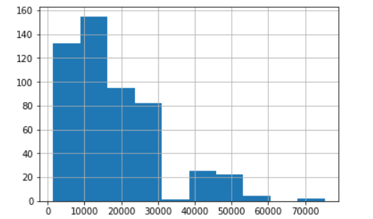

Slide 14
FUTURE RESEARCH NEEDED

