Slide 1

on
“Competitive Coding Organised by RAJ KUMAR GOEL INSTITUTE OF TECHNOLOGY
Raj Kumar Goel Institute of Technology Ghaziabad
5th KM. STONE, DELHI-MEERUT ROAD, GHAZIABAD (U.P)-201003
Department of Computer Science Engineering and Engineering
Summer Internship Presentation (KCS-752)P
Submitted by:
Vansh Kabaria (2100330100245)
Internship Duration:(8 July-14 Aug 2024)
Under the Guidance of :
Mr. Sachin Shah

Slide 2
CONTENTS
INTRODUCTION Page.3
OBJECTIVE Page.6
SKILLS AND TOOLS USED Page.9
INTERNSHIP PROJECT OVERVIEW Page.11
SCREENSHOTS OF PROJECTS Page.15
CHALLENGES AND SOLUTIONS Page.16
LEARNIG OUTCOMES Page.19
CONCLUSION Page.22

Slide 3
INTRODUCTION:
During my 6-week summer internship at my college, I participated in an intensive competitive coding program. This internship focused on enhancing my problem-solving abilities through the use of a wide range of coding platforms such as GeeksforGeeks, LeetCode, CodeChef, and Coding Ninjas. The program involved solving various coding challenges that spanned key areas of computer science, including data structures, algorithms, and dynamic problem-solving techniques. Topics covered ranged from fundamental Python programming to more advanced subjects like Greedy Algorithms, Dynamic Programming, and Graph Theory. The internship provided an excellent opportunity to hone my coding skills, deepen my understanding of complex algorithms, and prepare for real-world coding scenarios.

Slide 4
Topics Covered (Bullet Points)
Python Basics
  Mastering variables, control flow, loops, and functions in Python.
Greedy Approach
  Solving optimization problems by making locally optimal choices.
Dynamic Programming (DP)
  Breaking problems into smaller subproblems and using memoization to optimize solutions.
Trees
  Understanding binary trees, binary search trees (BST), and tree traversals (Preorder, Inorder, Postorder).
Graphs
  Exploring graph structures and traversal techniques like DFS, BFS, and shortest path algorithms (Dijkstra’s Algorithm).
Matrix Manipulation
  Solving problems like matrix rotation, spiral traversal, and dynamic programming on grids.
Sliding Window Technique
  Optimizing subarray problems by maintaining a subset of elements that slides across the array.

Slide 5
8. Prefix Sum
  Preprocessing arrays to enable efficient range sum queries and subarray sum calculations.
9. Queue
  Implementing the First-In-First-Out (FIFO) principle for scheduling and breadth-first search (BFS).
10. Stack
  Utilizing the Last-In-First-Out (LIFO) principle for parsing expressions, backtracking, and DFS.
11. Linked List
  Understanding singly linked lists, doubly linked lists, and their operations, such as reversing a linked list or detecting cycles.

Slide 6
OBJECTIVE:
The competitive coding classes during my 6-week internship were designed to enhance problem-solving skills by tackling a wide range of coding challenges. These classes were conducted on the Coding Tracker platform, with problems curated from leading coding platforms like GeeksforGeeks, LeetCode, CodeChef, and Coding Ninjas. Each session focused on key data structures and algorithms, including foundational concepts like Python programming and advanced problem-solving techniques such as Dynamic Programming, Greedy Algorithms, and Graph Theory.
We solved questions on various topics, including:
  Basic Python Programming: Covering syntax, loops, conditionals, and functions.
  Greedy Algorithms: Solving optimization problems with local optimal solutions.
  Dynamic Programming: Breaking complex problems into simpler subproblems and using memoization for efficiency.
  Data Structures: Practicing with trees, graphs, linked lists, queues, and stacks.
  Algorithmic Techniques: Understanding matrix manipulation, sliding window techniques, prefix sums, and more.
These classes not only improved my coding fluency but also strengthened my analytical thinking, preparing me for coding competitions and interviews. The internship concluded with a final project, where I applied these learned concepts to real-world coding scenarios.

Slide 7
Platforms Used:
  Coding Tracker: Central platform for tracking progress and practicing coding problems.
  CodeChef: Platform for competitive programming and participating in contests.
  LeetCode: Resource for practicing a wide range of coding problems and preparing for interviews.
  GeeksforGeeks: Used for its extensive problem sets and tutorials on data structures and algorithms.
  Coding Ninjas: Provided additional coding challenges and learning materials.
Challenges Faced:
  Time Complexity Management: Many problems required optimizing solutions to meet constraints such as O(1), O(N), or O(log N) time complexity, which was crucial for competitive programming.
  Space Complexity: Managed space complexity by optimizing data structures and algorithms to use minimal memory, aiming for O(1) or O(N) space complexity where possible.

Slide 8
Problem-Solving Strategies: Overcame challenges in understanding and solving various types of problem statements, which required a deep understanding of algorithmic techniques and effective implementation strategies.

Slide 9
SKILLS AND TOOLS USED:
Skills:
Algorithmic Thinking
  Developed the ability to approach problems with optimal algorithms, focusing on efficiency and scalability.
Data Structures Proficiency
  Gained hands-on experience with key data structures such as arrays, linked lists, stacks, queues, trees, and graphs.
Programming in Python
  Enhanced proficiency in Python, including understanding of syntax, libraries, and effective coding practices.
Dynamic Programming
  Mastered techniques for breaking down complex problems and using memoization to optimize solutions.
Greedy Algorithms
  Applied strategies for problems where local optimal choices lead to global solutions, focusing on real-time decision-making.
Problem Statement Interpretation
  Improved the ability to understand and break down complex problem statements into solvable components.

Slide 10
7. Graph Theory
  Developed skills in representing and traversing graphs, implementing algorithms like Depth-First Search (DFS) and Breadth-First Search (BFS).
8. Matrix Manipulation
  Learned techniques for efficiently manipulating and solving problems involving 2D arrays.
9. Complexity Analysis
  Analyzed and optimized time and space complexity to meet performance constraints, ensuring efficient problem-solving.
10. Problem Statement Interpretation
Improved the ability to understand and break down complex problem statements into solvable components.
11. Competitive Programming Techniques
Gained experience in tackling a wide range of competitive coding problems and participating in timed contests.

Slide 11
Internship Project Overview:
Project Title: Advanced Library Management System
Description:
During my internship, I developed an Advanced Library Management System that integrates both traditional and advanced features to enhance the efficiency and usability of library operations. This project aimed to address common challenges faced by libraries by incorporating modern technological solutions and sophisticated functionalities.
Traditional Features:
Book Management
  Add/Update/Delete Books: Easily manage the book inventory with options to add new books, update existing details, or remove books that are no longer available.
  Search and Sort: Search for books by title, author, or subject and sort them by various criteria for easy access.
2. Book Issuing and Returning
  Issue Books: Track which books are issued to users and ensure accurate records of issue dates and due dates.
  Return Books: Manage the return process, updating the system with the return date and checking the condition of the book.

Slide 12
3. User Management
  Admin and Librarian Accounts: Separate roles for administrators and librarians, each with specific permissions and functionalities.
  User Registration: Allow users to register and manage their profiles, including contact details and borrowing history.
4. Inventory Tracking
  Book Quantity Management: Keep track of the number of copies available for each book and automatically update quantities when books are issued or returned.
Advanced Features:
QR Code Integration
  Unique QR Codes: Generate and assign unique QR codes to each book for efficient tracking and quick access to book information.
Penalties and Fines
  Automated Fine Calculation: Implement a system to calculate and track fines for overdue books, ensuring accurate and timely penalty management.
Book History Tracking
  Detailed Issued Book History: Maintain a comprehensive history of all issued books, including timestamps for both issuance and returns, along with fine records.

Slide 13
4. Dynamic Reporting and Analytics
  Custom Reports: Generate detailed reports on book availability, user activity, and fines, providing valuable insights into library operations.
  Performance Metrics: Analyze data to assess library performance and identify areas for improvement.
5. Advanced Search and Sorting
  Enhanced Search Functionality: Implement advanced search features to quickly locate books based on multiple criteria.
  Sorting Options: Allow sorting of book records by various attributes for better management and retrieval.
6. User-Friendly Interface
  Interactive GUI: Design an intuitive and responsive user interface using Tkinter, making it easy for users to navigate and perform tasks.
  Hover Effects and Customization: Add visual enhancements such as 3D button effects and customized layouts for a more engaging user experience.
7. Integration of Digital Resources
  PDF Book Management: Support for managing and issuing digital books in PDF format, including features for browsing, issuing, and tracking digital resources.
8. Security and Access Control
  Password Protection: Implement secure login systems with masked passwords for both admin and librarian accounts.
  Role-Based Access: Ensure that different user roles have access only to relevant features and functionalities.

Slide 14
This project not only showcased my ability to integrate traditional library management functionalities but also demonstrated the application of advanced features and technologies to create a more efficient and modern library system.

Slide 15
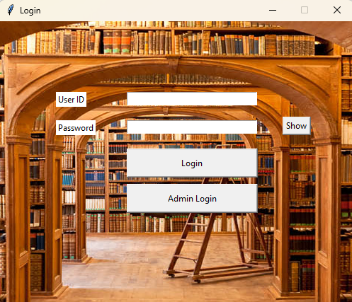
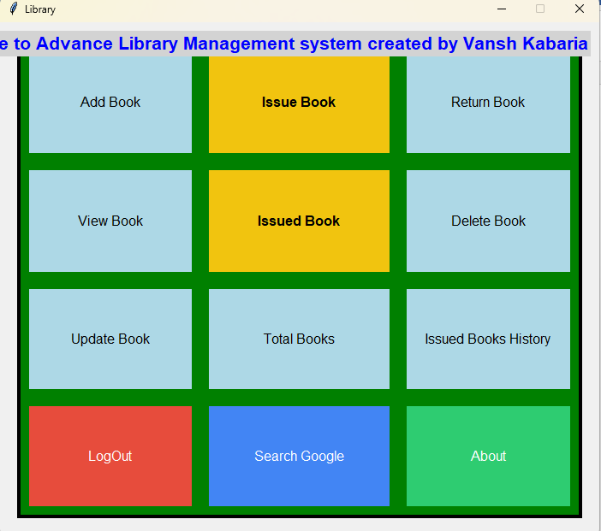
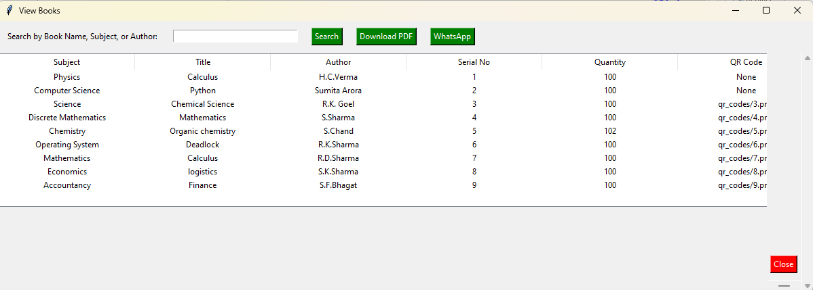
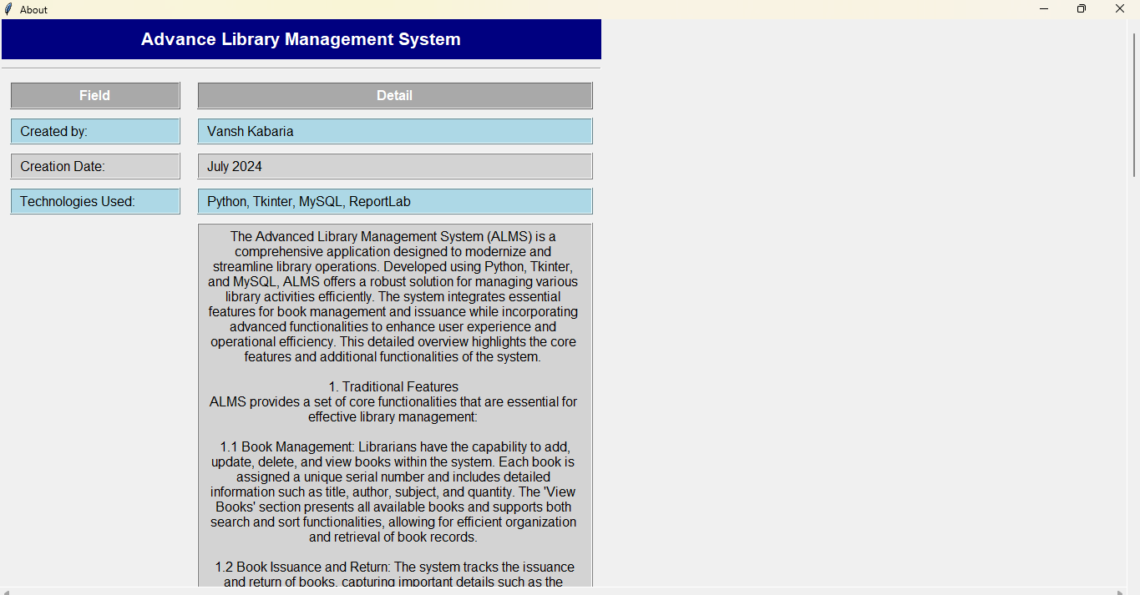
Screenshots of Project:

Slide 16
Challenges and Solutions:
Competitive Coding Challenges:
  Challenge: Time Complexity Management
  Solution: Focused on optimizing solutions by learning and applying efficient algorithms and data structures. Practiced solving problems within time constraints to improve performance and speed.
  Challenge: Handling Large Inputs
  Solution: Emphasized techniques to handle large datasets effectively, such as using efficient algorithms and data structures to ensure solutions scale with input size.
  Challenge: Debugging Complex Problems
  Solution: Developed strong debugging skills by systematically testing and analyzing code. Used debugging tools and print statements to trace and fix issues.
  Challenge: Understanding Problem Statements
  Solution: Improved problem-solving skills by practicing with a variety of problems from different platforms and breaking down complex problems into simpler components.
  Challenge: Managing Space Complexity
  Solution: Focused on optimizing memory usage by selecting appropriate data structures and algorithms, and applying techniques to minimize space requirements.

Slide 17
2. Project Challenges:
  Challenge: Integrating QR Codes
  Solution: Researched QR code generation libraries and integrated them into the system. Ensured that the QR code generation and scanning features worked seamlessly with the rest of the application.
  Challenge: Ensuring System Performance
  Solution: Conducted performance testing to identify and address bottlenecks. Optimized database queries and application logic to enhance system responsiveness and efficiency.
  Challenge: Designing a User-Friendly Interface
  Solution: Focused on creating an intuitive and easy-to-navigate interface using Tkinter. Conducted usability testing to gather feedback and make necessary adjustments.
  Challenge: Handling Concurrent Transactions
  Solution: Implemented robust transaction management to handle simultaneous book issues and returns, ensuring data consistency and accuracy.
  Challenge: Fine Calculation and Management
  Solution: Developed algorithms for accurate fine calculation and tracking. Integrated automated fine management into the system to handle overdue books efficiently.

Slide 18
  Challenge: Data Integrity and Security
  Solution: Implemented security measures such as password protection and role-based access control. Ensured that data was protected from unauthorized access and modifications.
  Challenge: Debugging and Testing
  Solution: Employed thorough testing methodologies, including unit tests and integration tests, to identify and resolve issues. Used debugging tools to fix errors and ensure system reliability.
  Challenge: Meeting User Requirements
  Solution: Engaged with users to gather feedback and understand their needs. Made iterative improvements to the system based on user input and changing requirements.

Slide 19
Learning Outcomes:
1. Competitive Coding Internship:
  Enhanced Problem-Solving Skills: Developed a strong ability to analyze and solve complex problems efficiently using various algorithms and data structures.
  Improved Algorithmic Thinking: Gained proficiency in applying different algorithms such as greedy algorithms, dynamic programming, and graph algorithms to optimize solutions.
  Mastery of Data Structures: Gained hands-on experience with essential data structures like arrays, linked lists, stacks, queues, trees, and graphs, and learned how to select the most appropriate one for a given problem.
  Increased Speed and Accuracy: Improved performance under time constraints by practicing and refining coding skills to solve problems quickly and accurately.
  Enhanced Debugging Techniques: Acquired advanced debugging skills to identify and resolve issues effectively, improving the overall quality and reliability of code.
  Exposure to Multiple Platforms: Gained familiarity with competitive coding platforms such as CodeChef, LeetCode, GeeksforGeeks, and Coding Ninjas, which provided a diverse range of problems and coding challenges.
  Time and Space Complexity Analysis: Learned how to evaluate and optimize both time and space complexity of algorithms, ensuring efficient solutions for large-scale problems.
  Adaptability to Different Problem Types: Adapted to a variety of problem types and formats, enhancing versatility and problem-solving skills in different competitive scenarios.

Slide 20
2. Project Learning Outcomes:
  System Design and Architecture: Developed skills in designing and implementing complex systems with a focus on modular architecture, user interface design, and database management.
  Technical Proficiency: Enhanced proficiency in Python programming, including advanced features such as QR code integration and automated fine calculations.
  User Interface Development: Gained experience in creating user-friendly interfaces using Tkinter, ensuring that the application was intuitive and accessible to users.
  Integration of Advanced Features: Successfully integrated advanced functionalities such as QR code generation, digital book management, and automated reporting, demonstrating the ability to combine traditional and modern features.
  Project Management: Learned to manage and coordinate various aspects of the project, including requirement gathering, design, development, testing, and deployment.

Slide 21
  Testing and Debugging: Acquired hands-on experience in testing methodologies and debugging techniques to ensure the system was reliable and free of critical issues.
  Documentation and Training: Developed skills in creating comprehensive documentation and providing user training to support effective system use and maintenance.
  User Feedback Integration: Gained experience in collecting and incorporating user feedback to make iterative improvements and enhance the system’s functionality and usability.
  Performance Optimization: Learned to optimize system performance through effective coding practices, efficient database queries, and performance testing.
  Security Practices: Implemented security measures to protect user data and ensure secure access control, enhancing the overall reliability and trustworthiness of the system.

Slide 22
Conclusion
Overall Experience:
My internship experience, encompassing competitive coding and the development of an advanced library management system, has been profoundly enriching. The structured competitive coding sessions honed my problem-solving abilities and exposed me to a diverse array of algorithms and data structures, while the project development offered practical experience in applying these skills to real-world scenarios. Balancing the technical challenges of coding with the demands of project development provided a well-rounded experience that deepened my understanding of both theoretical concepts and practical applications.
Technical Growth:
Technically, this experience significantly enhanced my coding skills and technical knowledge. Through competitive coding, I mastered complex problem-solving techniques, optimized algorithms, and gained proficiency in various programming platforms. The hands-on project allowed me to apply these skills in a structured environment, from designing system architecture to implementing advanced features like QR code integration and automated fine calculations. This blend of theoretical knowledge and practical application solidified my expertise and expanded my technical capabilities.

Slide 23
Professional Growth:
Professionally, this internship improved my project management and communication skills. I learned to manage project timelines, coordinate with stakeholders, and document my work effectively. The process of gathering requirements, designing solutions, and incorporating user feedback provided valuable insights into the collaborative nature of professional software development. Additionally, presenting my project and training users enhanced my ability to articulate technical concepts and interact with diverse audiences.
Future Plans:
Looking ahead, I plan to continue leveraging and expanding my coding skills. I intend to engage in more complex projects that challenge and refine my abilities further. I am also interested in exploring advanced topics in software development, such as machine learning and data science, to broaden my technical expertise. By actively participating in coding competitions, contributing to open-source projects, and pursuing further education, I aim to stay at the forefront of technological advancements and continue growing both technically and professionally.

