Slide 1

on
“Open White Board“
Raj Kumar Goel Institute of Technology Ghaziabad
5th KM. STONE, DELHI-MEERUT ROAD, GHAZIABAD (U.P)-201003
Department of Computer Science Engineering and Engineering
Mini Project Presentation (KCS-554)
Students :
Shivam Kushwaha(2100330100218)
Shivam Pandey(2100330100219)
Vansh Kabaria(2100330100245)
Under the Guidance of :
Mr. Vineet Srivastava
(Assistant Professor)
CSE- Department

Slide 2
CONTENTS
INTRODUCTION
OBJECTIVE
LITERATURE SURVEY
METHODOLOGY
HARDWARE AND SOFTWARE USE
WORK PROGRESS
SCREENSHOTS
REFERENCES

Slide 3
INTRODUCTION
The project Digital Teaching Board includes Video Upload and Image Upload, Screen Recording, Chat Box, Sticky Notes.
It is based on HTML, CSS and Java Script with support of Real time application.
It is supportive over multiple window users simultaneously. It is a project under web development domain

Slide 4
OBJECTIVE
Main objectives of a Digital Teaching Board are:
It allows students to better knowledge, resulting greater understanding.
To assist students in better visualizing the material.
Teacher will be access at different locations such as home.
Promote the real time environment and make the class attractive``` .
It reduces the number of devices needed in the classroom for effective lectures and connects with the web.

Slide 5
Literature Survey
Research Papers:
The effects of using mini whiteboards on the academic performance and engagement of students in a tenth grade resource English/Language Arts classroom.
Written by - Gimbutas, Elizabeth Catherine
Interactive white boards (IWBs) have been heralded by many as a valuable teaching tool offering innumerable opportunities for increasing student engagement and learning.
Written by- Campbell & Kent.

Slide 6
METHODOLOGY
In this project, we have used some font end languages to complete this project.
1. HTML
2. CSS
3. Java Script

Slide 7
HARDWARE & SOFTWARE USE
Software requirement specifications:
Operating System :
VS Code :
Browser: Google Chrome :
Hardware Specification:
1. Processor : 11th Gen Intel(R) Core(TM) i5-1135G7 @ 2.40GHz 2.42 GHz
RAM : 8 GB or more
SSD : 512 GB or more
4. Mouse : 2 buttons

Slide 8
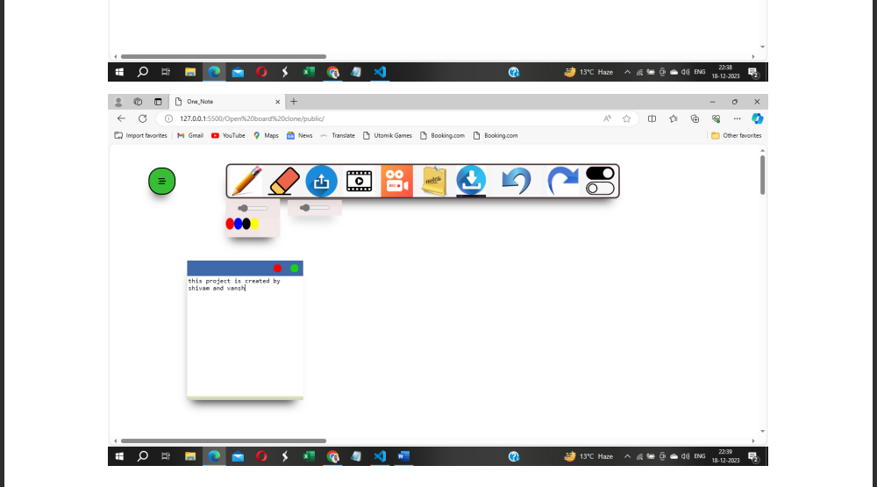
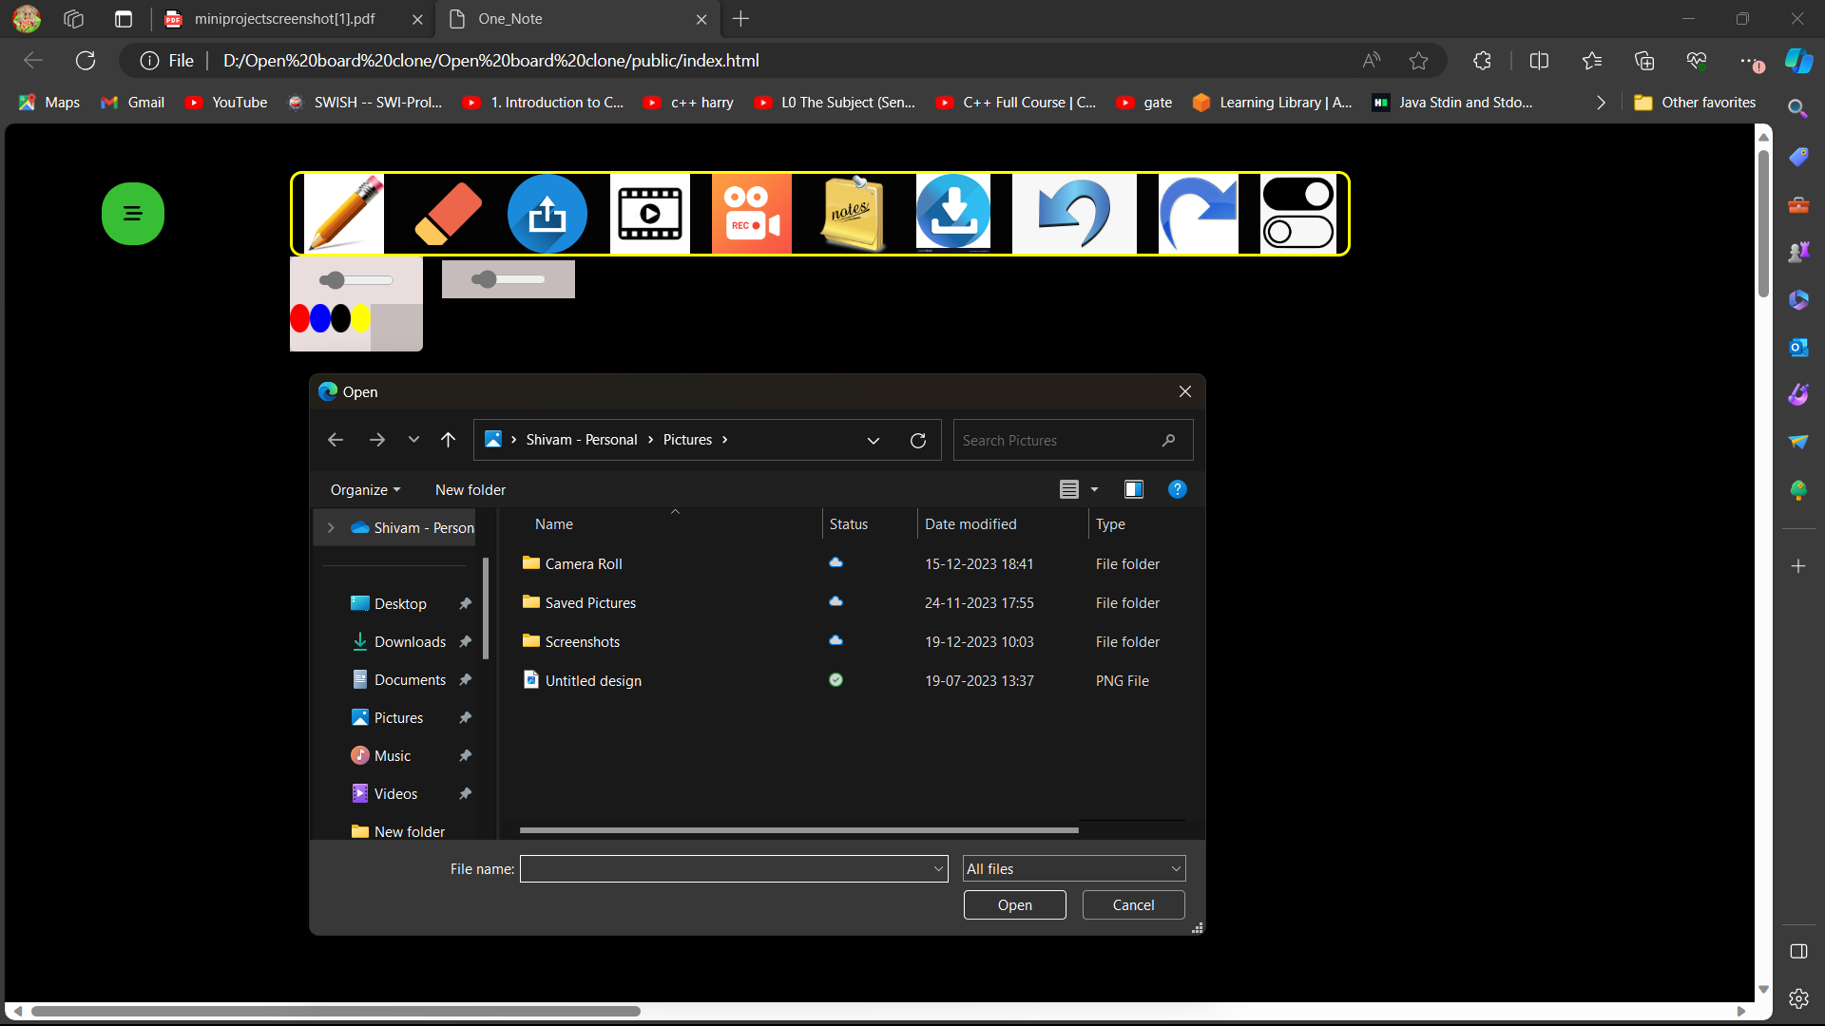
Screenshots of Project

Slide 9
References
[1] primary reference of the Teaching Board Clone has taken from you tube channel Pep-coding. Here is the link to channel content:
https://www.youtube.com/results?search_query=pepcoding+open+board.
[2] Reference also got selected from Git hub repository,:
https://github.com/OpenBoard-org/OpenBoard

