Slide 1
Parallel Algorithm for Solving Multicriterial Optimization Problems Using Elements of Machine Learning
Сергей Коннов, Евгений Козинов, Константин Баркалов, Александр Сысоев, Владимир Гришагин
{evgeny.kozinov,konstantin.barkalov}@itmm.unn.ru,vagris@unn.ru

Slide 2
Содержание
Многокритериальная оптимизация
Сведение задач многокритериальной оптимизации к одномерным скалярным задачам глобального поиска
Подход к поиску эффективных решений в задачах многокритериальной оптимизации
Пошаговое решение набора задач скалярной оптимизации
Повторное использование поисковой информации
Ускорение поиска с помощью методов машинного обучения
Построение штрафной функции на основе разделяющей гиперплоскости
Построение штрафной функции на основе вероятностей, полученных из моделей машинного обучения
Параллельная модификация алгоритма
Результаты вычислительных экспериментов

Slide 3
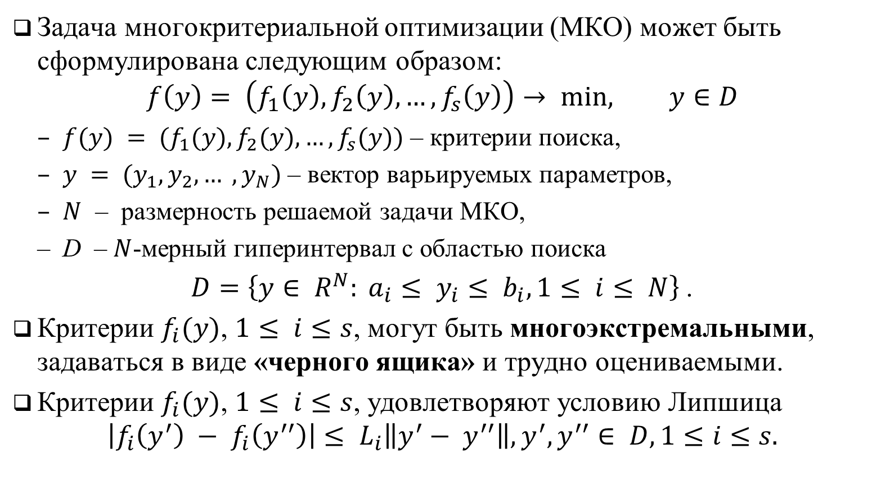
Задача многокритериальной оптимизации
Задача многокритериальной оптимизации (МКО) может быть сформулирована следующим образом:
$$f\left(y\right)= \left(f_{1}\left(y\right), f_{2}\left(y\right), …,f_{s}\left(y\right)\right)→ min, y∈D$$
$f(y) = (f_{1}(y), f_{2}(y), …, f_{s}(y))$ – критерии поиска,
$y = (y_{1}, y_{2}, … , y_{N})$ – вектор варьируемых параметров,
$N$ – размерность решаемой задачи МКО,
D – $N$-мерный гиперинтервал с областью поиска
$D=\left\{y∈ R^{N}: a_{i}≤ y_{i}≤ b_{i}, 1≤ i≤ N\right\}$.
Критерии $f_{i}(y)$, $1≤ i≤s$, могут быть многоэкстремальными, задаваться в виде «черного ящика» и трудно оцениваемыми.
Критерии $f_{i}(y)$, $1≤ i≤s$, удовлетворяют условию Липшица
$$\left|f_{i}\left(y^{′}\right) − f_{i}\left(y^{′′}\right)\right|≤ L_{i}\left\|y^{′}− y^{′′}\right\|, y^{′}, y^{′′}∈ D, 1≤i≤s.$$

Slide 4
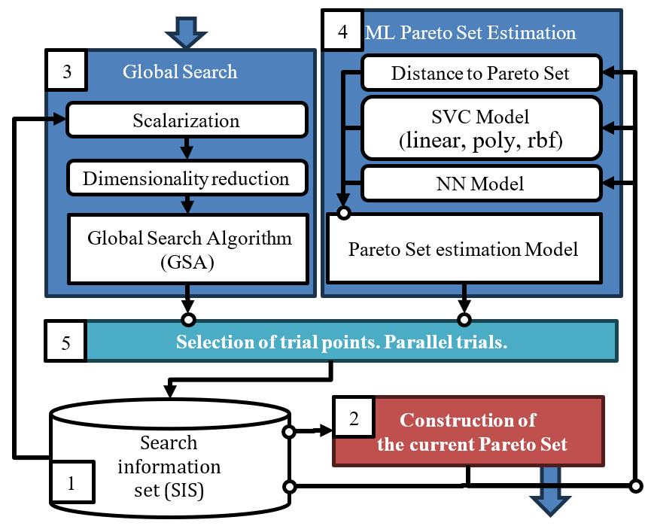
Общая схема предлагаемого метода

Slide 5
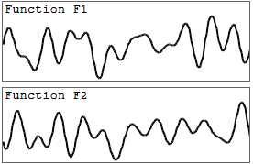
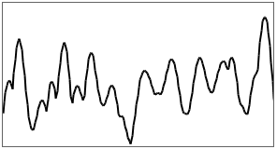
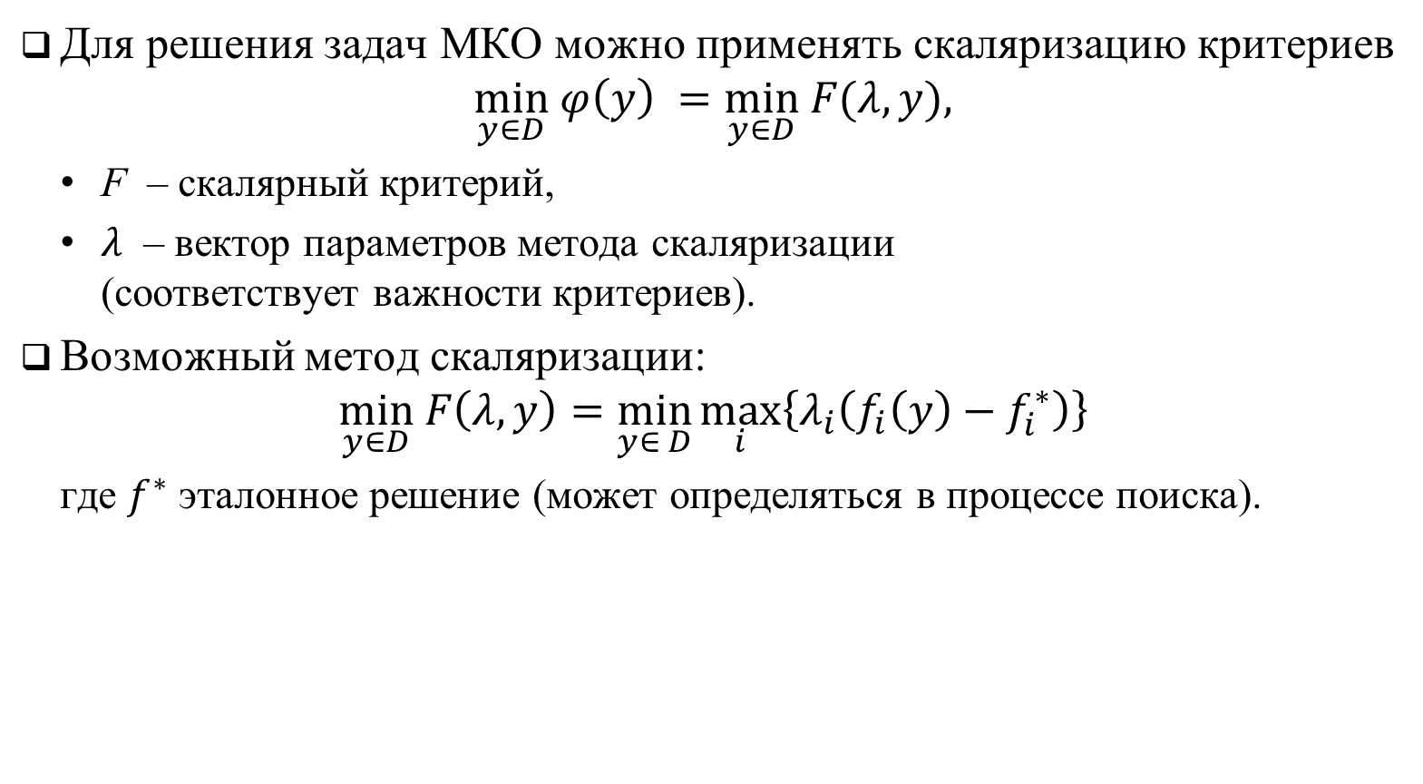
Скаляризация критериев
Для решения задач MКO можно применять скаляризацию критериев
$$\min_{y∈D} φ\left(y\right) =\min_{y∈D} F(λ, y),$$
F – скалярный критерий,
$λ$ – вектор параметров метода скаляризации (соответствует важности критериев).
Возможный метод скаляризации:
$$\min_{y∈D} F\left(λ,y\right)=\min_{y∈ D}\max_{i}\left\{λ_{i}\left(f_{i}\left(y\right)−f_{i}^{∗}\right)\right\}$$
где $f^{∗}$ эталонное решение (может определяться в процессе поиска).

Slide 6
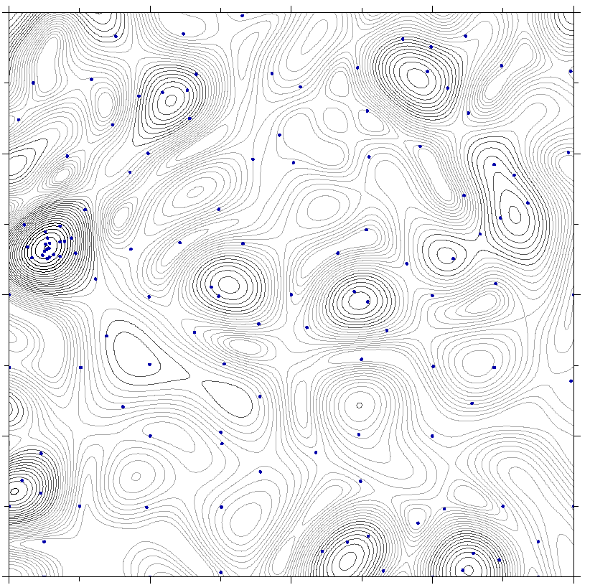
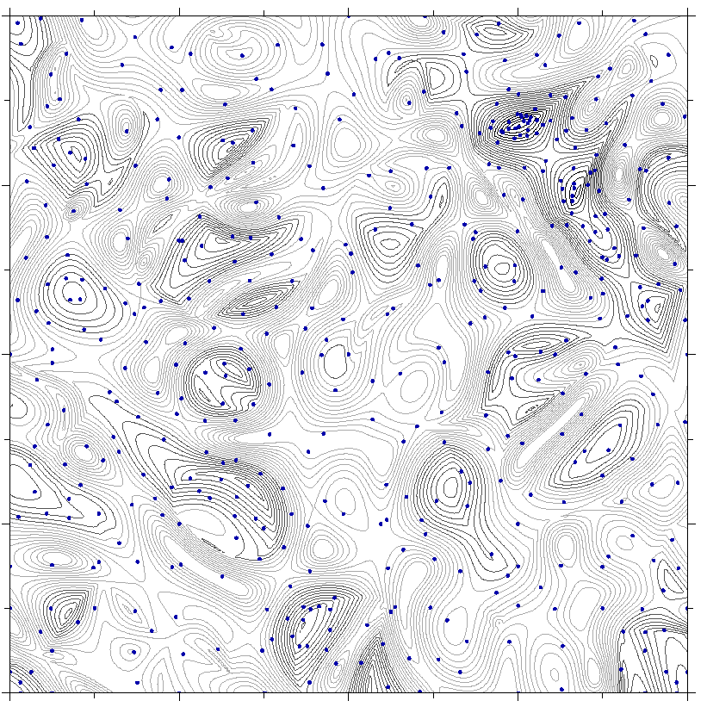
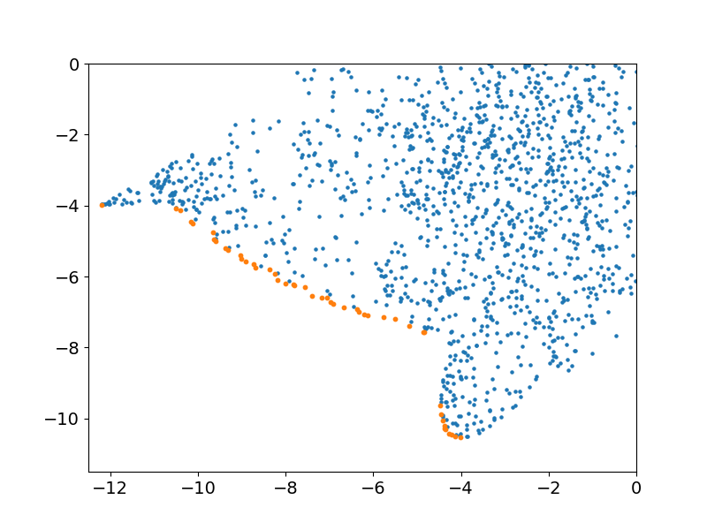
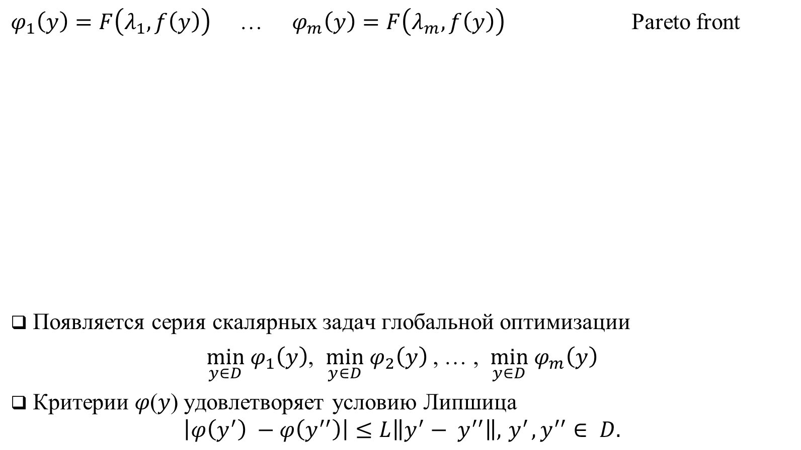
Скаляризация критериев
$φ_{1}\left(y\right)=F\left(λ_{1},f\left(y\right)\right)$ … $φ_{m}\left(y\right)=F\left(λ_{m},f\left(y\right)\right)$ Pareto front
Появляется серия скалярных задач глобальной оптимизации
$\min_{y∈D} φ_{1}\left(y\right)$, $\min_{y∈D} φ_{2}\left(y\right)$, … , $\min_{y∈D} φ_{m}\left(y\right)$
Критерии 𝜑(𝑦) удовлетворяет условию Липшица
$$\left|φ\left(y^{′}\right) −φ\left(y^{′′}\right)\right|≤L\left\|y^{′}− y^{′′}\right\|, { y}^{′}, y^{′′}∈ D.$$

Slide 7
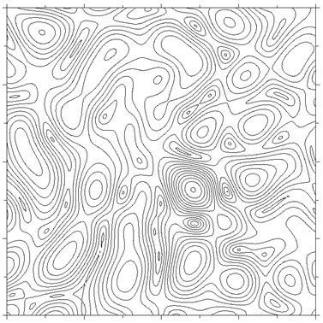
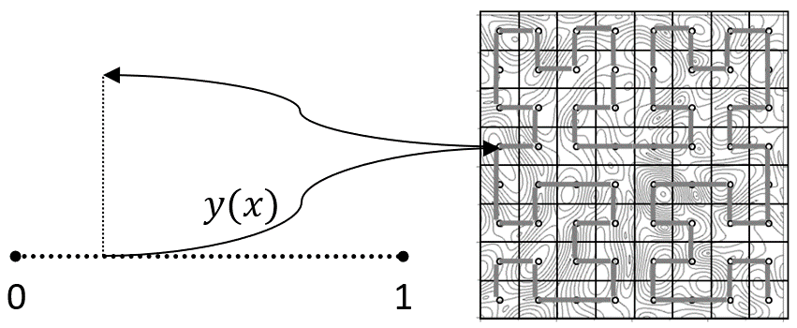



Уменьшение размерности
В нашем исследовании мы использовали кривые Пеано 𝑦(𝑥), которая однозначно и непрерывно отображающие интервал [0,1] на 𝑁-мерную область поиска 𝐷
$$\min_{y∈D} φ\left(y\right)=\min_{x∈\left[0,1\right]} φ \left(y\left(x\right)\right)$$
$$z=φ\left(y\left(x\right)\right)$$
$$x$$

Slide 8
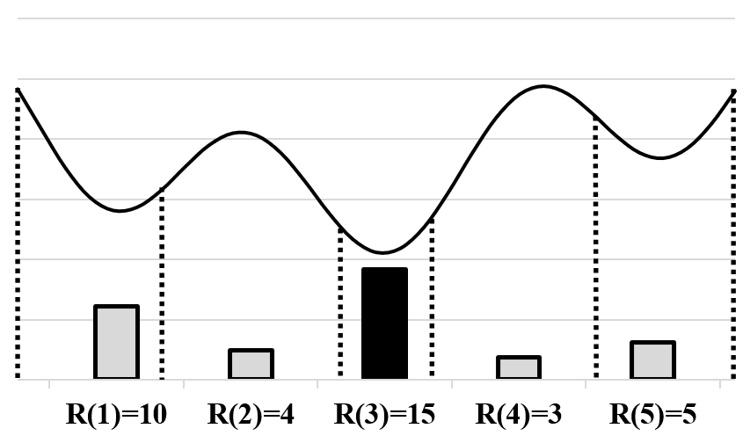

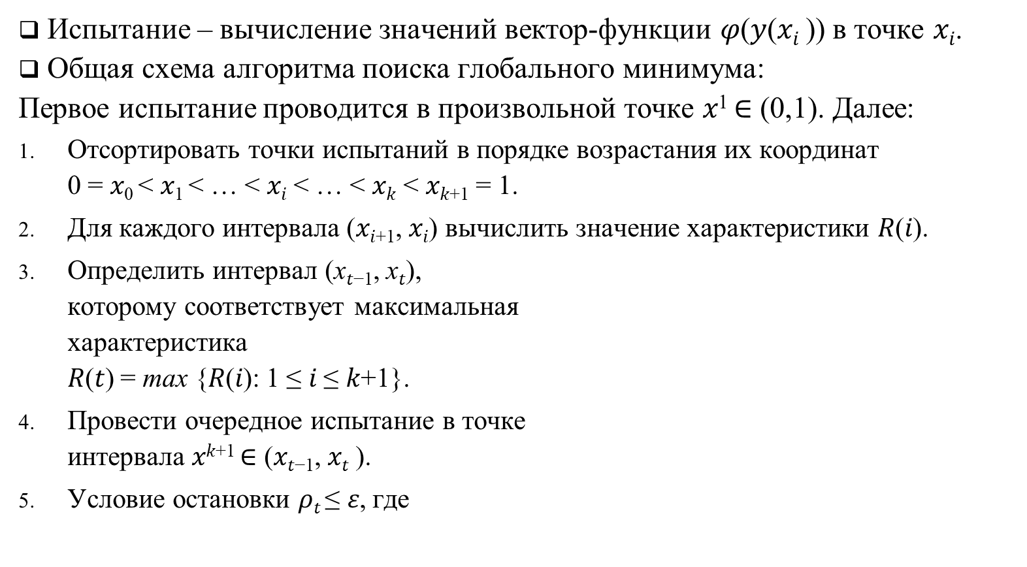
Алгоритм глобального поиска (АГП)
Испытание – вычисление значений вектор-функции $φ\text{(}\text{y}\text{(}\text{xi} \text{))}$ в точке 𝑥_{𝑖}.
Общая схема алгоритма поиска глобального минимума:
Первое испытание проводится в произвольной точке 𝑥¹ ∈ (0,1). Далее:
Отсортировать точки испытаний в порядке возрастания их координат 0 = 𝑥₀ < 𝑥₁ < … < 𝑥_{𝑖} < … < 𝑥_{𝑘} < 𝑥_{𝑘+1} = 1.
Для каждого интервала (𝑥_{𝑖+1}, 𝑥_{𝑖}) вычислить значение характеристики 𝑅(𝑖).
Определить интервал (x_{𝑡−1}, x_{𝑡}), которому соответствует максимальная характеристика 𝑅(𝑡) = max {𝑅(𝑖): 1 ≤ 𝑖 ≤ 𝑘+1}.
Провести очередное испытание в точке интервала 𝑥^{𝑘+1} ∈ (𝑥_{𝑡−1}, 𝑥_{𝑡} ).
Условие остановки 𝜌_{𝑡} ≤ 𝜀, где

Slide 9
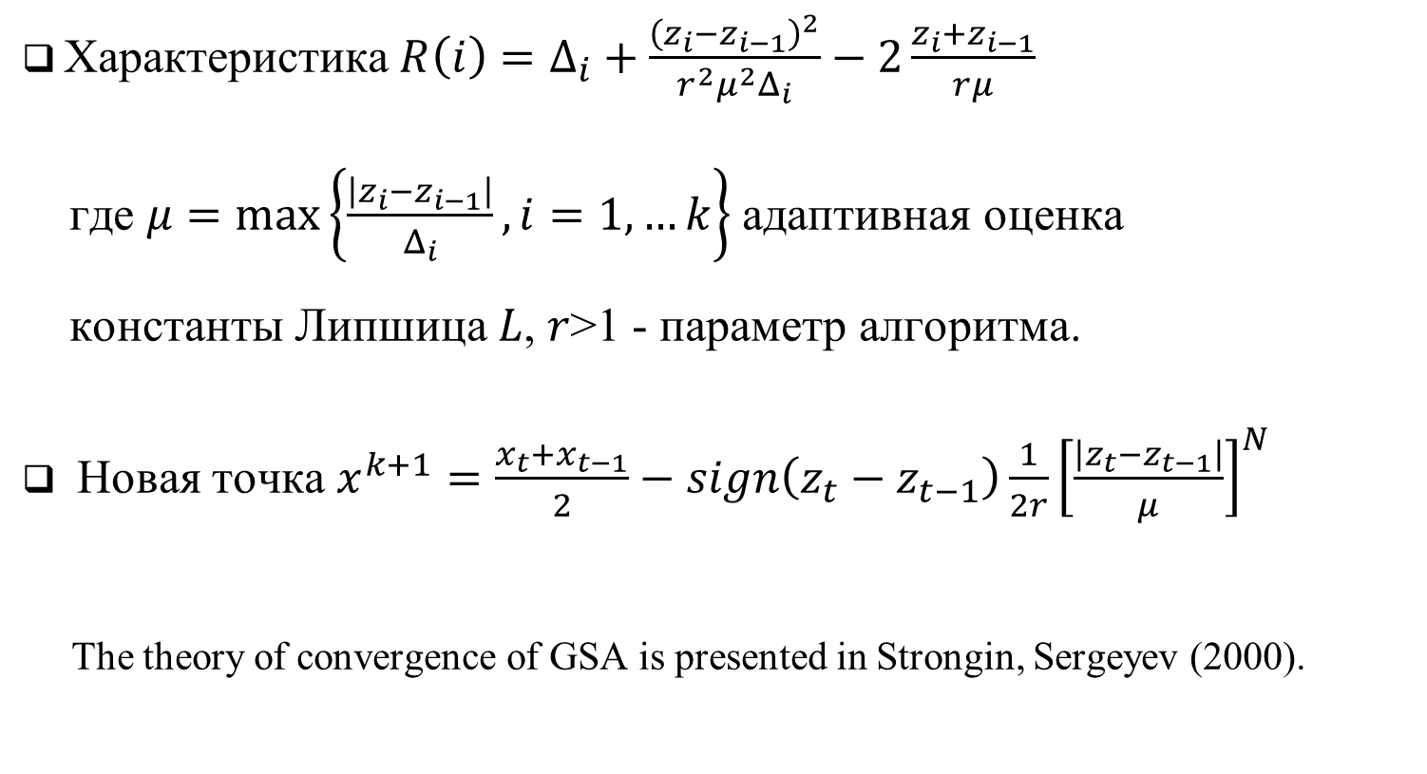
Алгоритм глобального поиска (АГП)
Характеристика$R\left(i\right)=Δ_{i}+\frac{{\left(z_{i}−z_{i−1}\right)}^{2}}{r^{2}μ^{2}Δ_{i}}−2\frac{z_{i}+z_{i−1}}{rμ}$
где $μ=\max\left\{\frac{\left|z_{i}−z_{i−1}\right|}{Δ_{i}}, i=1,…k\right\}$ адаптивная оценка константы Липшица 𝐿, 𝑟>1 - параметр алгоритма.
Новая точка $x^{k+1}=\frac{x_{t}+x_{t−1}}{2}−sign\left(z_{t}−z_{t−1}\right)\frac{1}{2r}{\left[\frac{\left|z_{t}−z_{t−1}\right|}{μ}\right]}^{N}$
The theory of convergence of GSA is presented in Strongin, Sergeyev (2000).

Slide 10
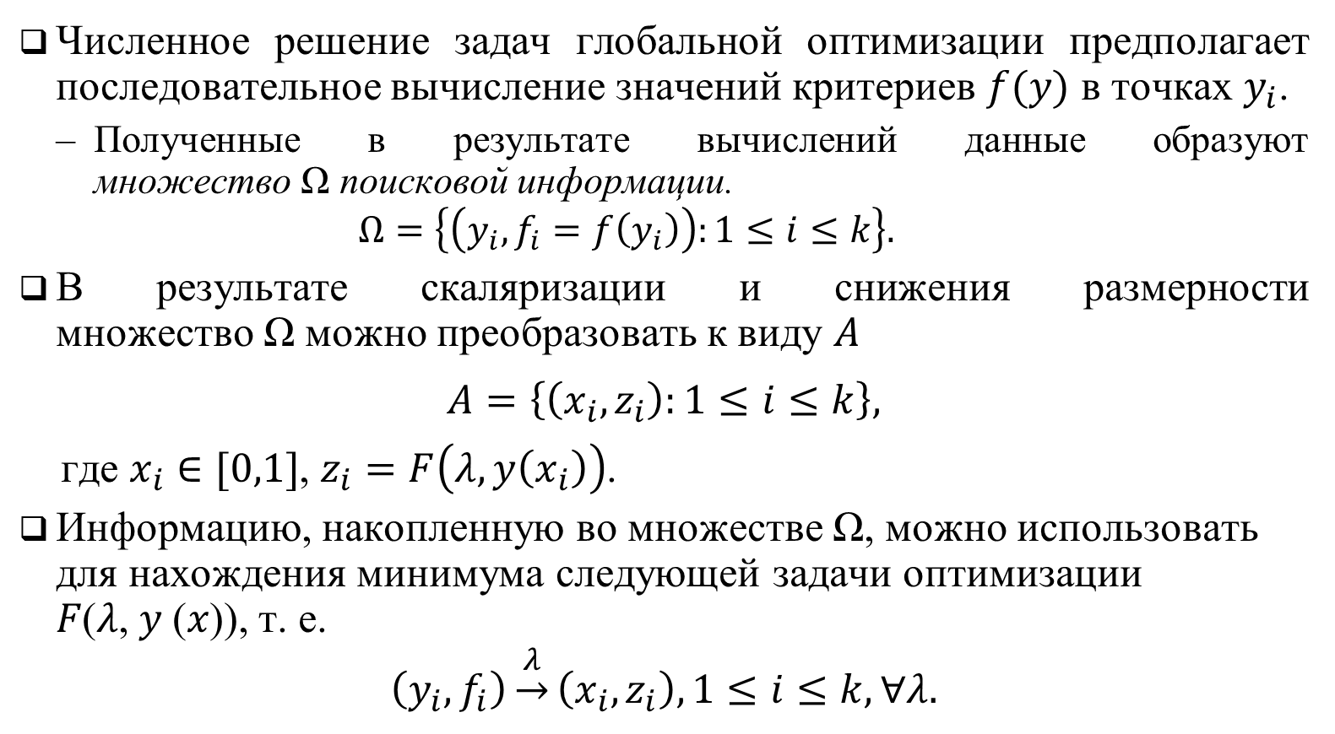
Ускорение вычислений на основе повторного использования информации
Численное решение задач глобальной оптимизации предполагает последовательное вычисление значений критериев $f(y)$ в точках $y_{i}$.
Полученные в результате вычислений данные образуют множество Ω поисковой информации.
$$Ω=\left\{\left(y_{i}, f_{i}=f\left(y_{i}\right)\right):1≤i≤k\right\}.$$
В результате скаляризации и снижения размерности множество Ω можно преобразовать к виду 𝐴
$$A=\left\{\left(x_{i}, z_{i}\right):1≤i≤k\right\},$$
где $x_{i}∈[0,1]$, $z_{i}=F\left(λ,y\left(x_{i}\right)\right)$.
Информацию, накопленную во множестве Ω, можно использовать для нахождения минимума следующей задачи оптимизации 𝐹(𝜆, 𝑦 (𝑥)), т. е.
$$\left(y_{i}, f_{i}\right)\underset{→}{λ}\left(x_{i},z_{i}\right),1≤i≤k, ∀λ.$$

Slide 11
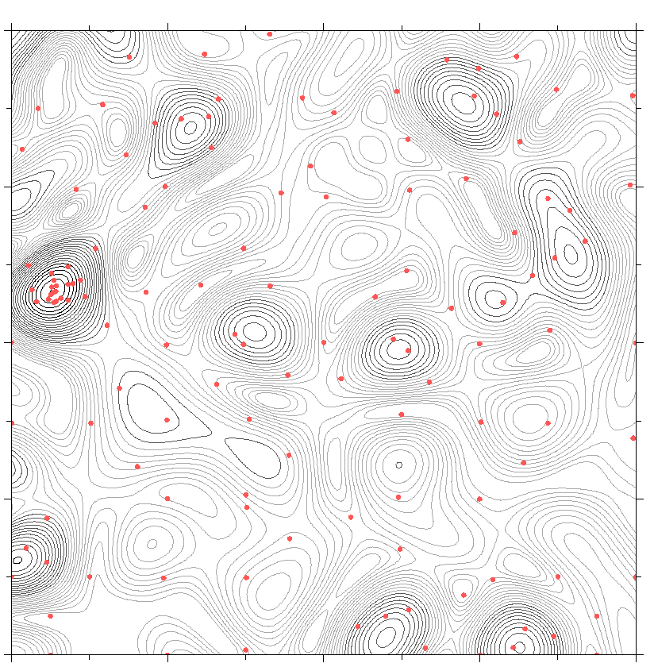

Пример решения 2D задачи МКО
Состояние поиска при решении серии скалярных задач
$$f\left(y\right)= \left(f_{1}\left(y\right), f_{2}\left(y\right)\right)→ min$$
Скалярная задача No. 1, $λ=\left(0,1\right)$
$$φ_{1}\left(y\right)→min, y∈D$$
где $φ_{1}\left(y\right)=\max\left\{λ_{1}f_{1}\left(y\right),λ_{2}f_{2}\left(y\right)\right\}$
Число испытаний – 128

Slide 12
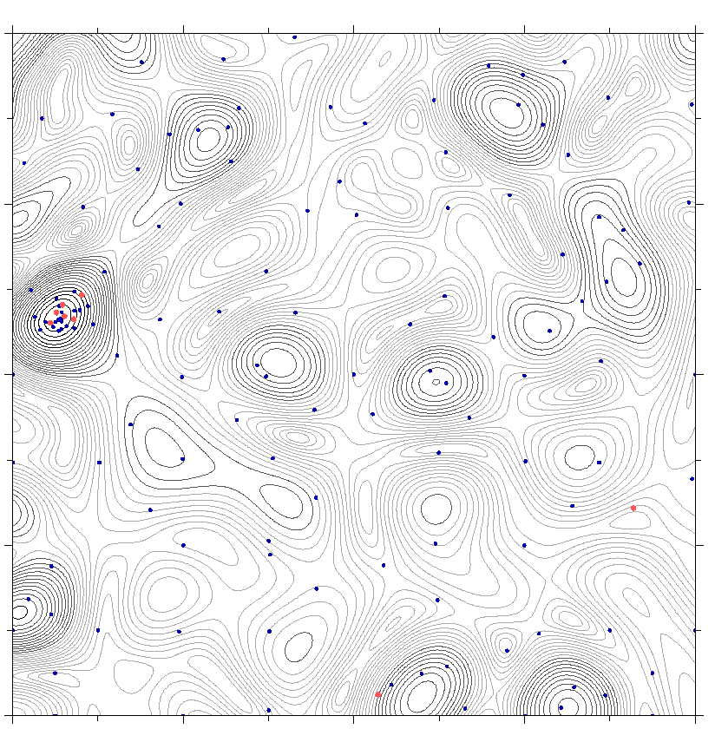

Пример решения 2D задачи МКО
Состояние поиска при решении серии скалярных задач
$$f\left(y\right)= \left(f_{1}\left(y\right), f_{2}\left(y\right)\right)→ min$$
Скалярная задача No. 3, $λ=\left(0.06, 0.94\right)$
$$φ_{3}\left(y\right)→min, y∈D$$
где $φ_{3}\left(y\right)=\max\left\{λ_{1}f_{1}\left(y\right),λ_{2}f_{2}\left(y\right)\right\}$
Число испытаний –144
Число новых испытаний – 7 (красные точки)

Slide 13
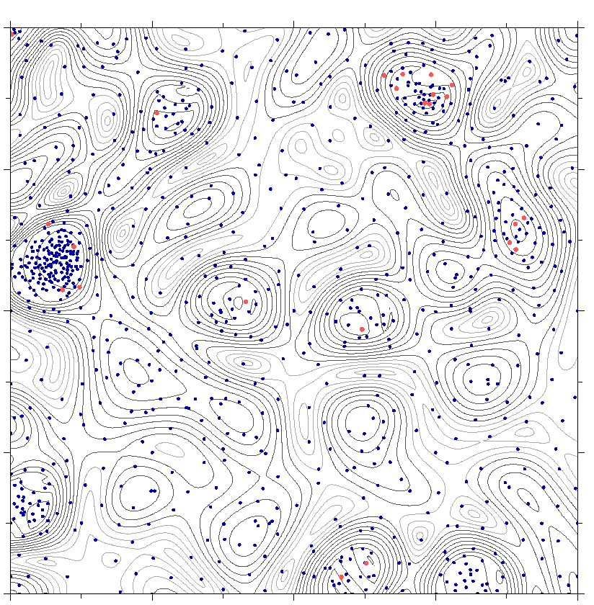

Пример решения 2D задачи МКО
Состояние поиска при решении серии скалярных задач
$$f\left(y\right)= \left(f_{1}\left(y\right), f_{2}\left(y\right)\right)→ min$$
Скалярная задача No. 15, $λ=\left(0.3, 0.7\right)$
$$φ_{15}\left(y\right)→min, y∈D$$
where $φ_{15}\left(y\right)=\max\left\{λ_{1}f_{1}\left(y\right),λ_{2}f_{2}\left(y\right)\right\}$
Число испытаний – 967
Число новых испытаний – 35 (красные точки)

Slide 14
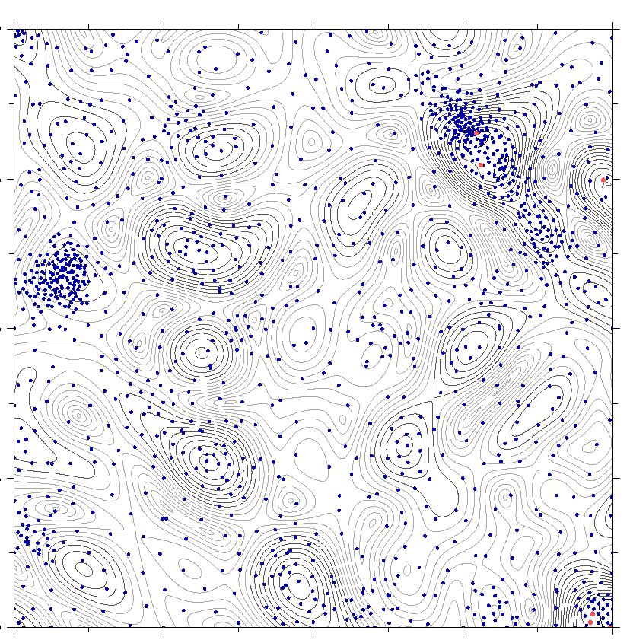

Пример решения 2D задачи МКО
Состояние поиска при решении серии скалярных задач
$$f\left(y\right)= \left(f_{1}\left(y\right), f_{2}\left(y\right)\right)→ min$$
Скалярная задача No. 35, $λ=\left(0.7,0.3\right)$
$$φ_{35}\left(y\right)→min, y∈D$$
where $φ_{35}\left(y\right)=\max\left\{λ_{1}f_{1}\left(y\right),λ_{2}f_{2}\left(y\right)\right\}$
Число новых испытаний –1378
Число новых испытаний – 8 (красные точки)

Slide 15

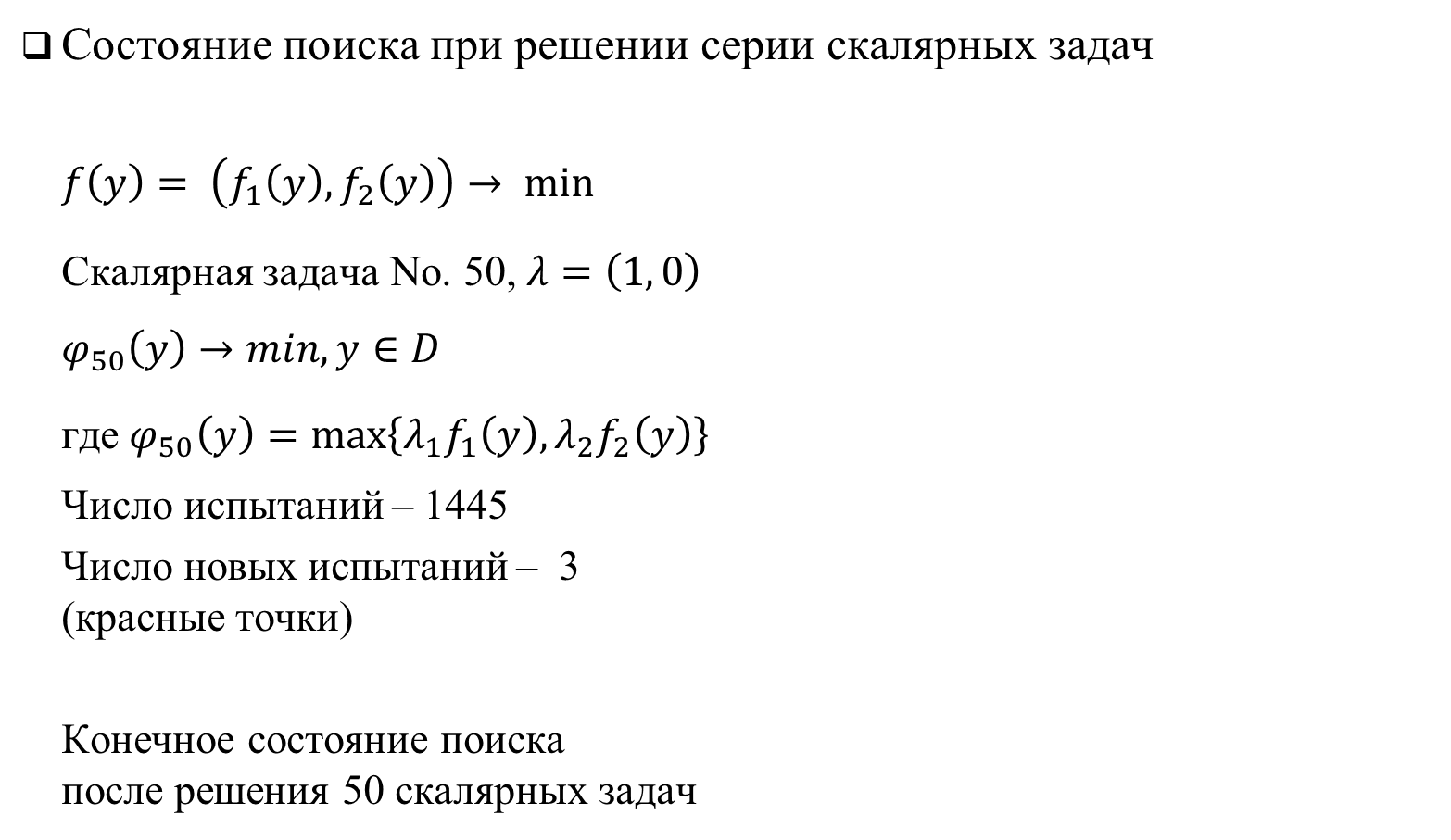
Пример решения 2D задачи МКО
Состояние поиска при решении серии скалярных задач
$$f\left(y\right)= \left(f_{1}\left(y\right), f_{2}\left(y\right)\right)→ min$$
Скалярная задача No. 50, $λ=\left(1, 0\right)$
$$φ_{50}\left(y\right)→min, y∈D$$
где $φ_{50}\left(y\right)=\max\left\{λ_{1}f_{1}\left(y\right),λ_{2}f_{2}\left(y\right)\right\}$
Число испытаний – 1445
Число новых испытаний – 3 (красные точки)
Конечное состояние поиска после решения 50 скалярных задач

Slide 16
Acceleration of the search
There are many approaches to speed up the solution of scalar problems
We need an approach to accelerate the solution of multicriteria problems

Slide 17
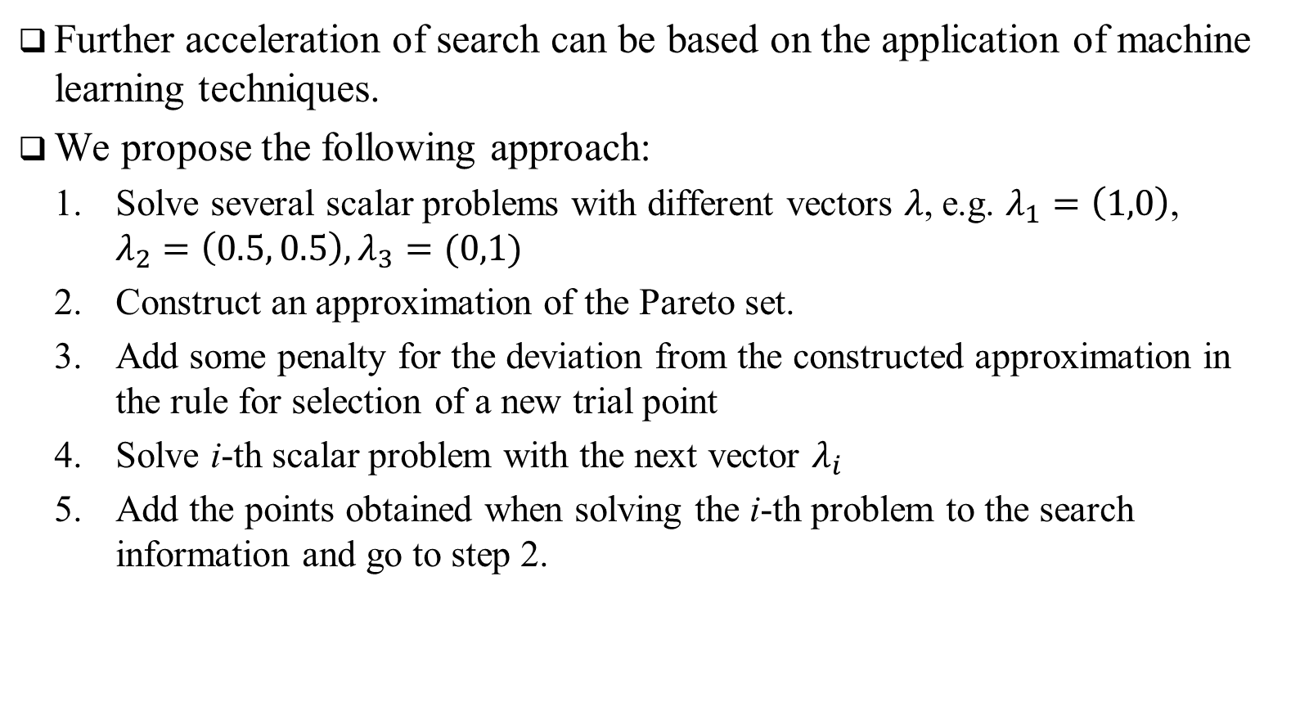
Acceleration of the search
Further acceleration of search can be based on the application of machine learning techniques.
We propose the following approach:
Solve several scalar problems with different vectors $λ$, e.g. $λ_{1}=\left(1,0\right)$, $λ_{2}=\left(0.5, 0.5\right), λ_{3}=(0,1)$
Construct an approximation of the Pareto set.
Add some penalty for the deviation from the constructed approximation in the rule for selection of a new trial point
Solve i-th scalar problem with the next vector $λ_{i}$
Add the points obtained when solving the i-th problem to the search information and go to step 2.

Slide 18
Acceleration of the search with machine learning techniques
Further acceleration of search can be based on the application of machine learning techniques.
Possible options for constructing an approximation:
Linear Models (Logistic regression, Linear SVM, Linear Discriminant Analysis, Ordinary Least Squares, etc.)
Nonlinear Models (SVM, Quadratic Discriminant Analysis, Decision Tree, Neural network, etc.)
We used:
Linear Model based on SVM (linear kernel).
Nonlinear Models based on SVM (polynomial and rbf kernels)

Slide 19
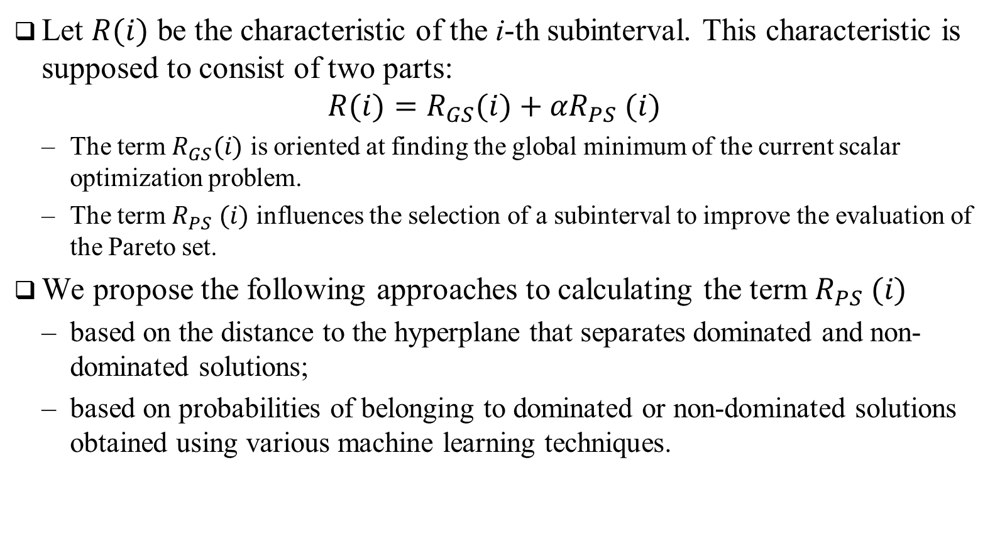
Acceleration of the search with machine learning techniques
Let $R(i)$ be the characteristic of the i-th subinterval. This characteristic is supposed to consist of two parts:
$$R(i)=R_{GS}(i)+{αR}_{PS} (i)$$
The term $R_{GS}(i)$ is oriented at finding the global minimum of the current scalar optimization problem.
The term $R_{PS} (i)$ influences the selection of a subinterval to improve the evaluation of the Pareto set.
We propose the following approaches to calculating the term $R_{PS} (i)$
based on the distance to the hyperplane that separates dominated and non-dominated solutions;
based on probabilities of belonging to dominated or non-dominated solutions obtained using various machine learning techniques.

Slide 20
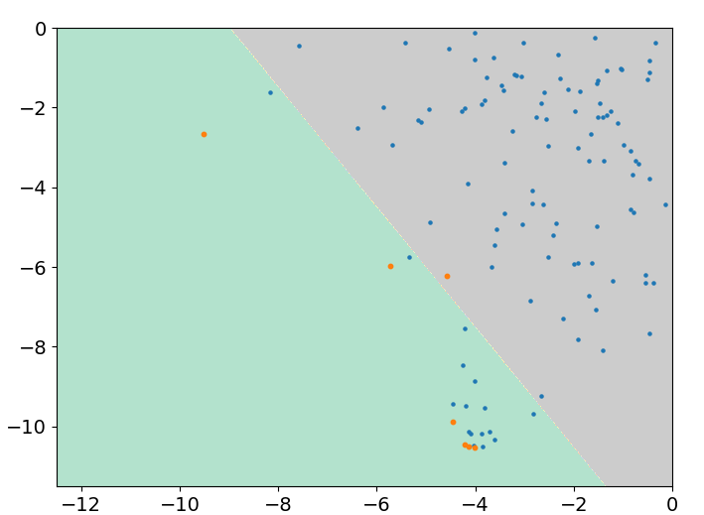
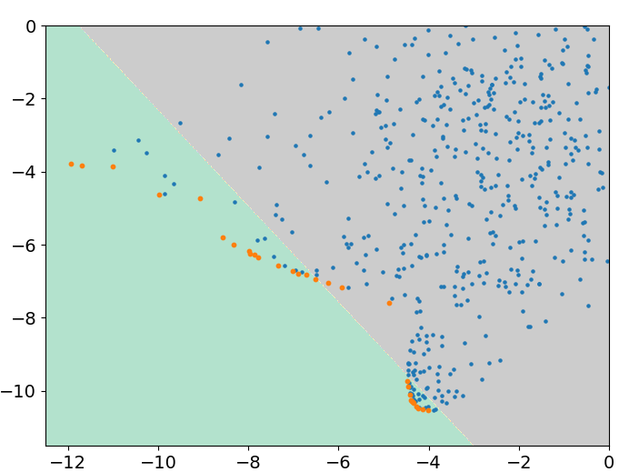
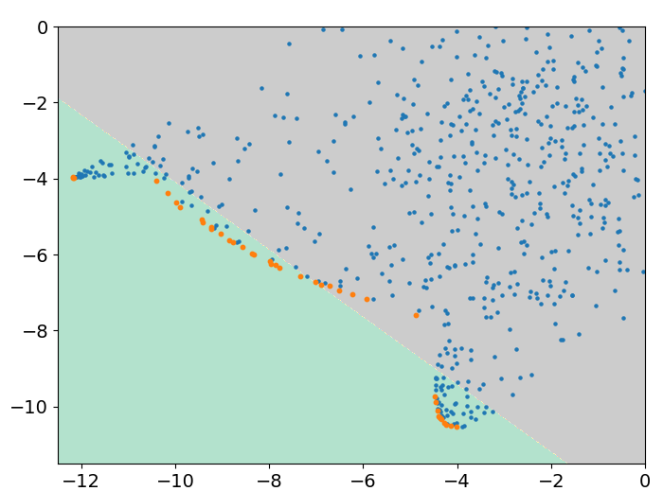

Construction of a separating hyperplane
For each point $y_{i}$ from the search information $Ω$ a class label is assigned
$$Class=\left\{\begin{aligned}1, y_{i}∈Pareto Set \\ 0, y_{i}∉Pareto Set\end{aligned}\right.$$
The separating hyperplane is constructed using a classifier based on logistic regression
Class weights are set during training as $w=\left\{\begin{aligned}0.98,Class=1 \\ 0.02,Class=0 \end{aligned}\right.$

Slide 21




Use of a separating hyperplane
For each point $y_{i}$ from the search information $Ω$ calculate the distance to the separating hyperplane $L$
$$d_{i}=ρ\left(L,y_{i}\right)$$
Scale calculated distances
$$d_{i}^{′}=\left\{\begin{aligned}{d_{i}}/{d_{max}}, if d_{i}>0 \\ {d_{i}}/{|{d|}_{max}}, if d_{i}<0\end{aligned}\right.$$
Compute the value of characteristic
$R_{PS} \left(i\right)= d_{i}^{′}+d_{i−1}^{′}$, where $i$ is the number of the search interval $\left(x_{i−1},x_{i}\right).$
$$d_{i}<0$$
$$d_{j}>0$$
$$L$$

Slide 22
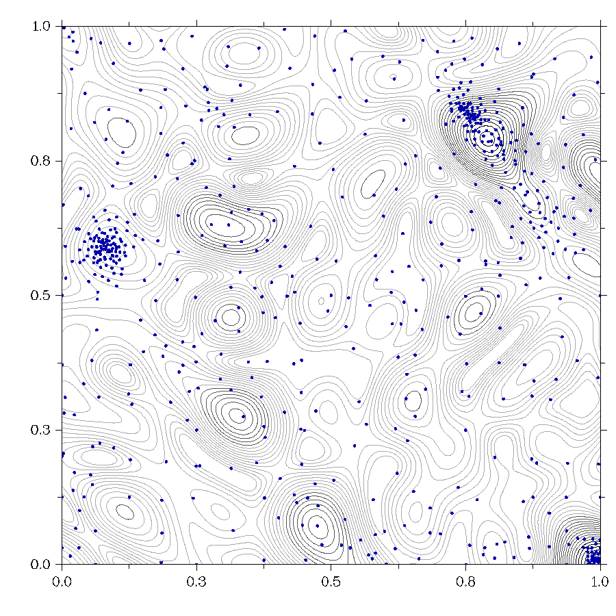
Effect of using machine learning methods

Slide 23

Construction of a probability model
For the term $R_{PS} (i)$ that corresponds better to the estimation of the Pareto set, the following ideas are suggested:
Probabilistic approach with application of machine learning models;
Automatic adjustment of class weights when building a machine learning model;
Transformation of machine learning probabilities.

Slide 24
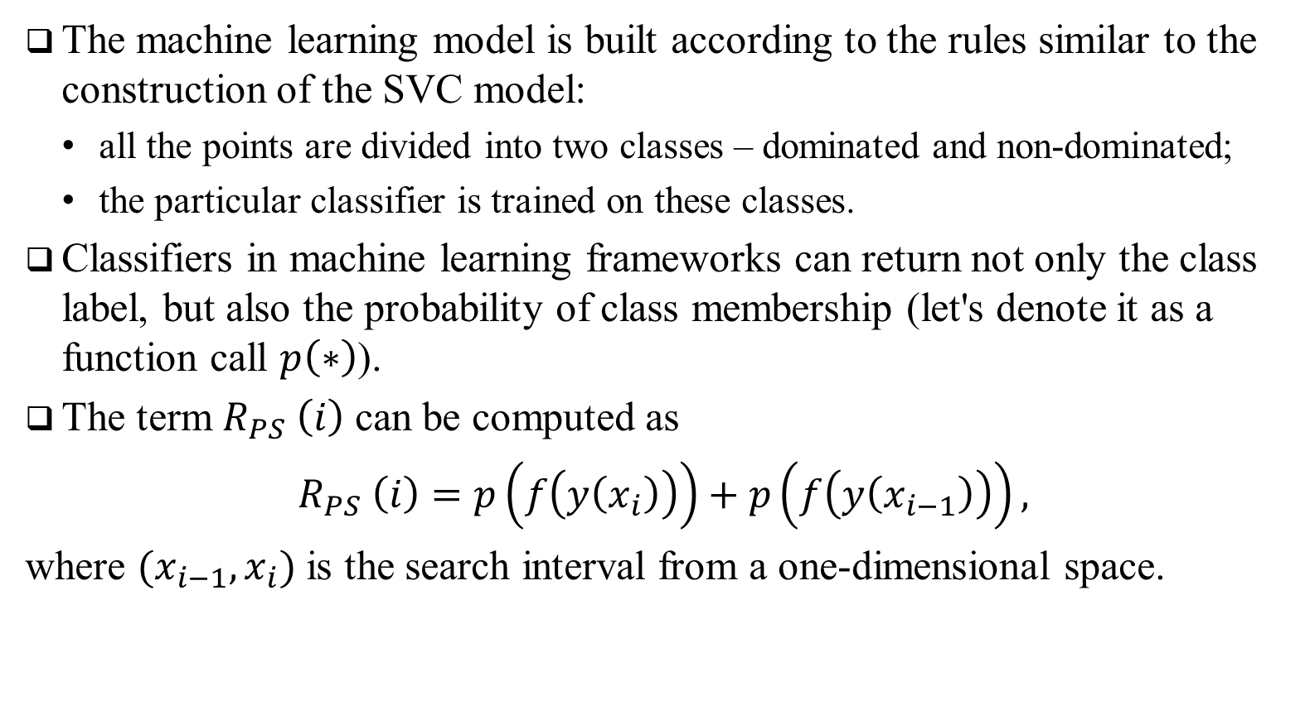
Use of non-linear classifiers
The machine learning model is built according to the rules similar to the construction of the SVC model:
all the points are divided into two classes – dominated and non-dominated;
the particular classifier is trained on these classes.
Classifiers in machine learning frameworks can return not only the class label, but also the probability of class membership (let's denote it as a function call $p\left(∗\right)$).
The term $R_{PS} \left(i\right)$ can be computed as
$R_{PS} \left(i\right)=p\left(f\left(y\left(x_{i}\right)\right)\right)+p\left(f\left(y\left(x_{i−1}\right)\right)\right),$
where $(x_{i−1},x_{i})$ is the search interval from a one-dimensional space.

Slide 25
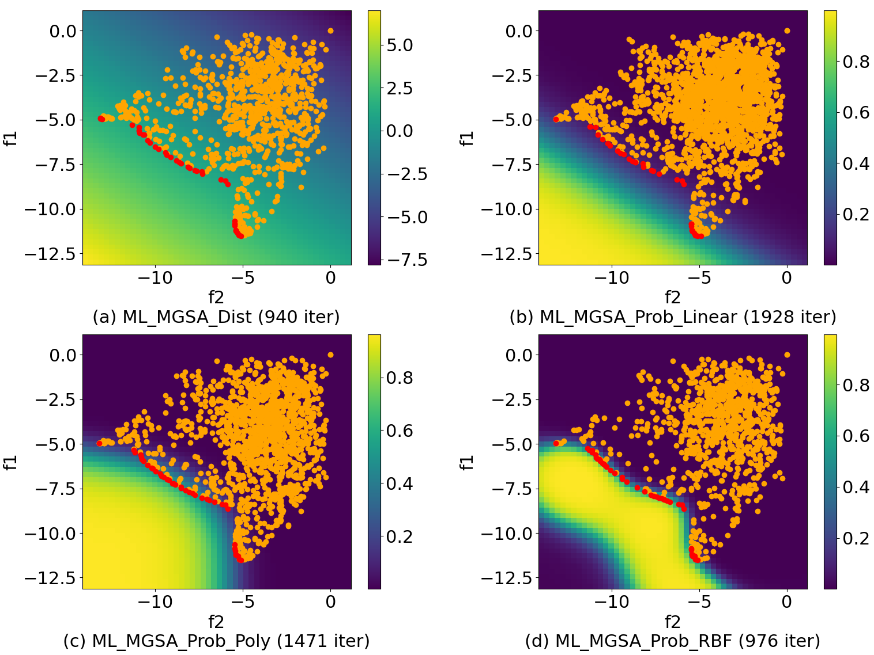

Use of non-linear classifiers
Heatmap of the function $R_{PS} \left(i\right)$ in the criteria space for algorithms with different machine learning models.
(a) corresponds to $R_{PS} \left(i\right)$ based on separating hyperplanes
(b, c, d) corresponds to $R_{PS} \left(i\right)$ based on a probability model

Slide 26
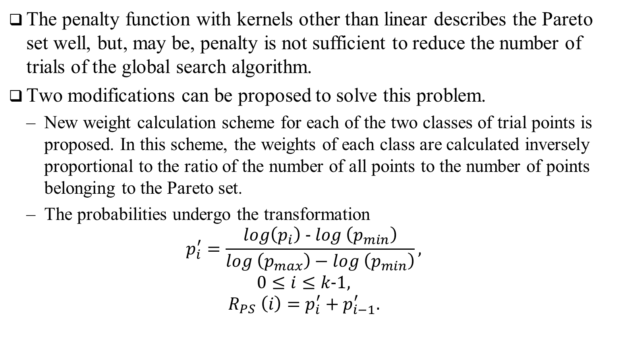
Use of non-linear classifiers
The penalty function with kernels other than linear describes the Pareto set well, but, may be, penalty is not sufficient to reduce the number of trials of the global search algorithm.
Two modifications can be proposed to solve this problem.
New weight calculation scheme for each of the two classes of trial points is proposed. In this scheme, the weights of each class are calculated inversely proportional to the ratio of the number of all points to the number of points belonging to the Pareto set.
The probabilities undergo the transformation
$$p_{i}^{′}=\frac{log\left(p_{i}\right) − log \left(p_{min}\right)}{log \left(p_{max}\right)−log \left(p_{min}\right)},$$
$$0≤i≤k−1,$$
$$R_{PS} \left(i\right)=p_{i}^{′}+p_{i−1}^{′}.$$

Slide 27
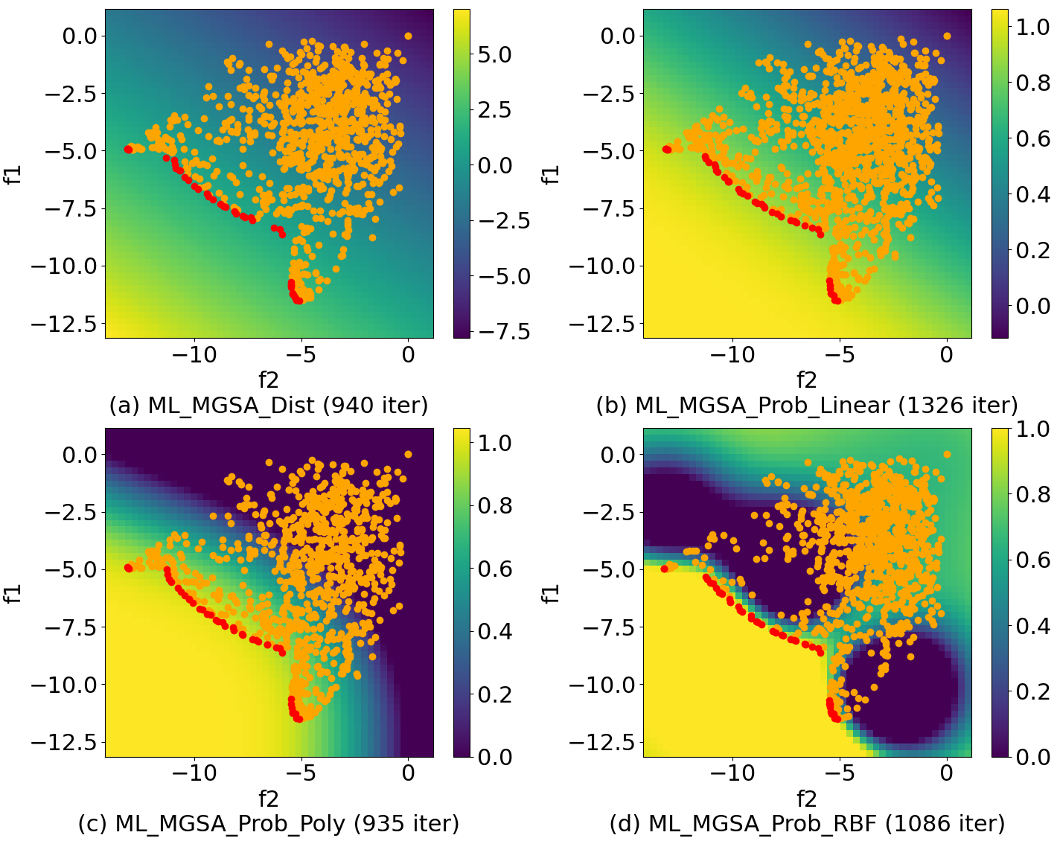

Use of non-linear classifiers
Heatmap of the function $R_{PS} \left(i\right)$ in the criteria space for algorithms with different techniques of building models after transformation
(a) corresponds to $R_{PS} \left(i\right)$ based on separating hyperplanes
(b, c, d) corresponds to $R_{PS} \left(i\right)$ based on a probability model

Slide 28
Quality metrics
The quality of the approximation was evaluated using the hypervolume index (HV; the higher HV value, the better)
Hypervolume index
Pareto set estimation (PS)

Slide 29
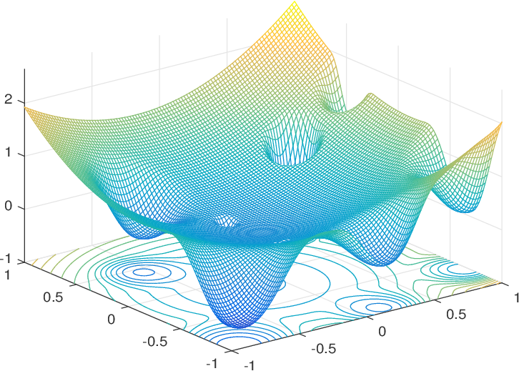
Results of numerical experiments
In the first series of numerical experiments, we solved the problems obtained by the GKLS generator
* Gaviano, M., Kvasov, D.E., Lera, D., Sergeyev, Y.D.: Software for generation of classes of test functions with known local and global minima for global optimization.
ACM Transactions on Mathematical Software 29(4), 469-480 (2003)

Slide 30
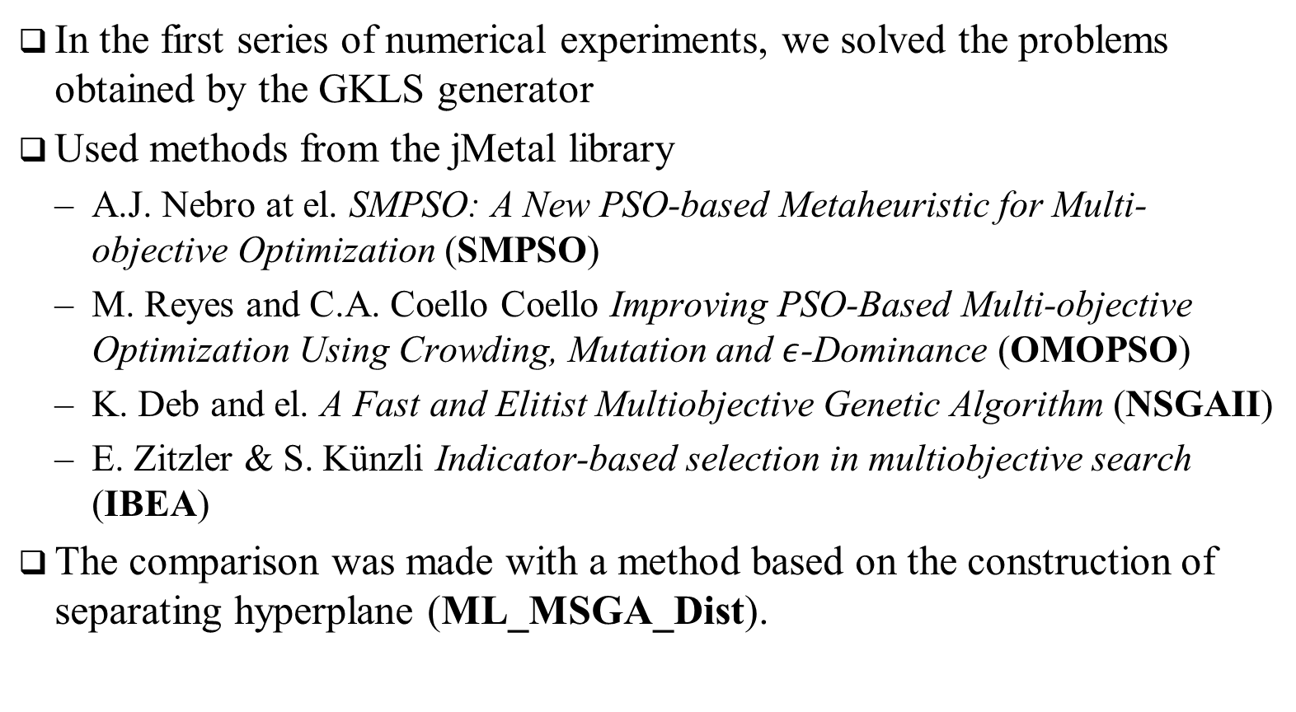
Results of numerical experiments
In the first series of numerical experiments, we solved the problems obtained by the GKLS generator
Used methods from the jMetal library
A.J. Nebro at el. SMPSO: A New PSO-based Metaheuristic for Multi-objective Optimization (SMPSO)
M. Reyes and C.A. Coello Coello Improving PSO-Based Multi-objective Optimization Using Crowding, Mutation and $ε$-Dominance (OMOPSO)
K. Deb and el. A Fast and Elitist Multiobjective Genetic Algorithm (NSGAII)
E. Zitzler & S. Künzli Indicator-based selection in multiobjective search (IBEA)
The comparison was made with a method based on the construction of separating hyperplane (ML_MSGA_Dist).

Slide 31
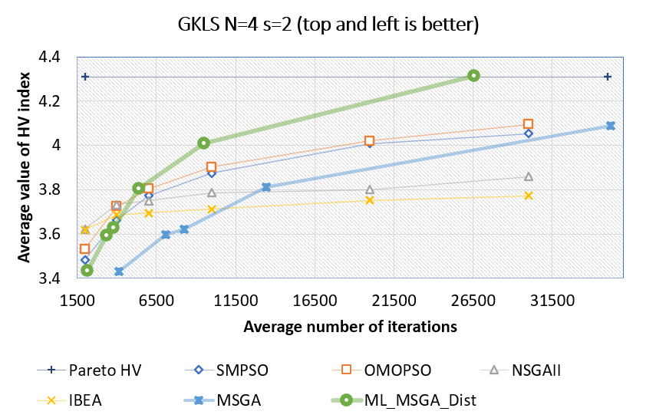
Results of numerical experiments
Each point is the averaging of the HV index on the solution of 100 GKLS problems

Slide 32
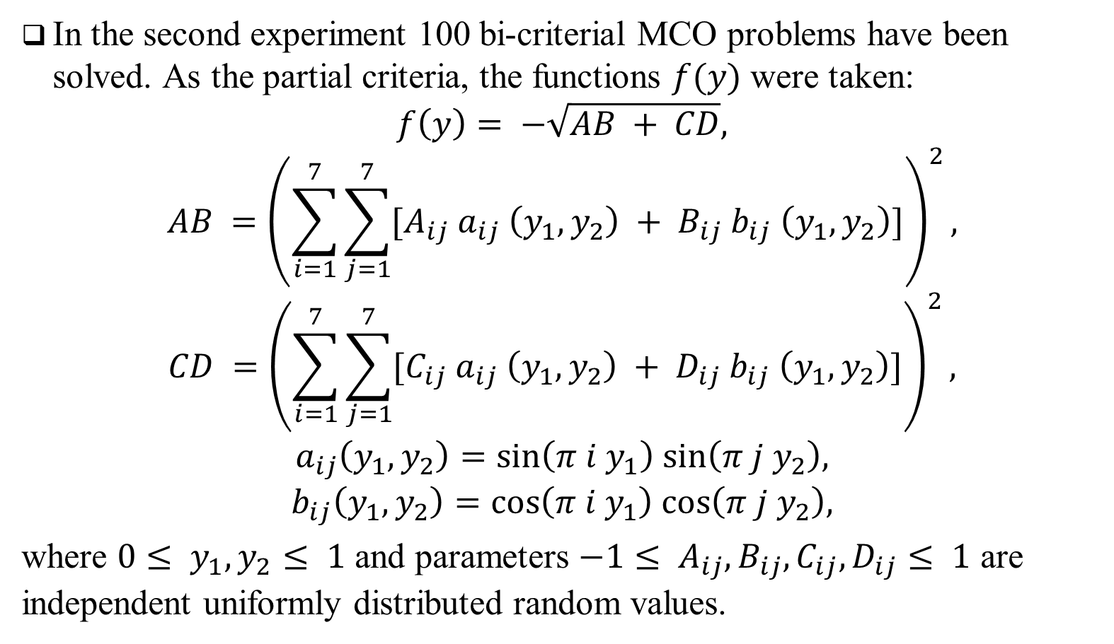
Results of numerical experiments
In the second experiment 100 bi-criterial MCO problems have been solved. As the partial criteria, the functions $f(y)$ were taken:
$$f\left(y\right)= −\sqrt{AB + CD},$$
$$AB ={\left(\sum_{i=1}^{7}{\sum_{j=1}^{7}{[A_{ij} a_{ij} \left(y_{1},y_{2}\right) + B_{ij} b_{ij} \left(y_{1},y_{2}\right)]}}\right)}^{2},$$
$$CD ={\left(\sum_{i=1}^{7}{\sum_{j=1}^{7}{[C_{ij} a_{ij} \left(y_{1},y_{2}\right) + D_{ij} b_{ij} \left(y_{1},y_{2}\right)]}}\right)}^{2},$$
$$a_{ij}\left(y_{1},y_{2}\right)=sin\left(π i y_{1}\right) sin\left(π j y_{2}\right),$$
$$b_{ij}\left(y_{1},y_{2}\right)=cos\left(π i y_{1}\right) cos\left(π j y_{2}\right),$$
where $0≤ y_{1}, y_{2}≤ 1$ and parameters $−1≤ A_{ij},B_{ij},C_{ij},D_{ij}≤ 1$ are independent uniformly distributed random values.

Slide 33
Results of numerical experiments
Computational experiments for proposed techniques which utilize probabilities of belonging to the Pareto set can be divided into 3 groups.
Experiments for the case of fixed weights.
Experiments for the case of adjusted weights.
Experiments for the case of adjusted weights and logarithmic probabilities.
In the last series of experiments, 10 MCO problems with 4 criteria were solved that form a Pareto set of complex structure.
As in previous experiments, functions of the same family were used as partial criteria.

Slide 34
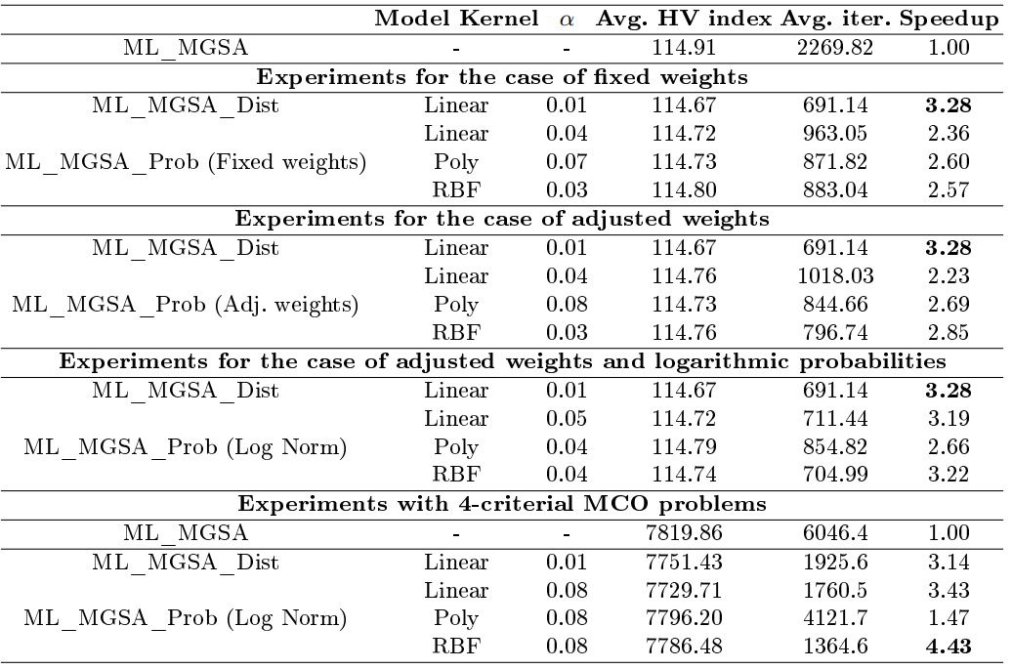
Results of numerical experiments

Slide 35
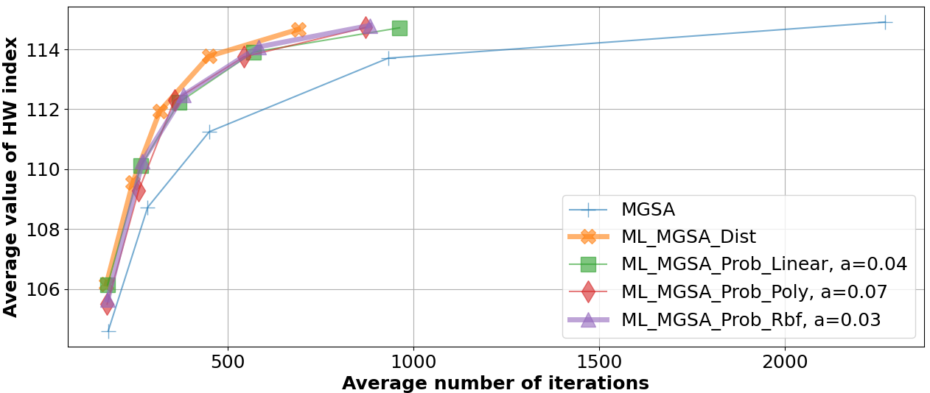
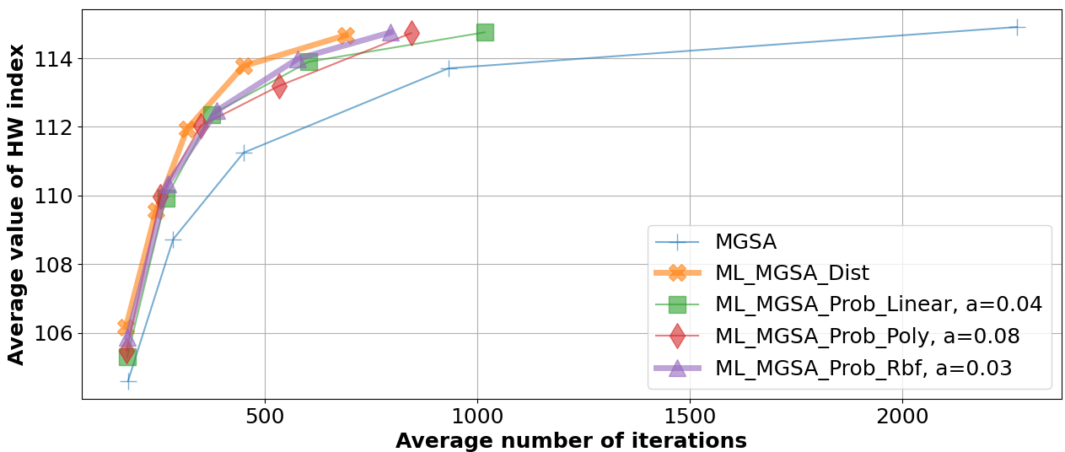
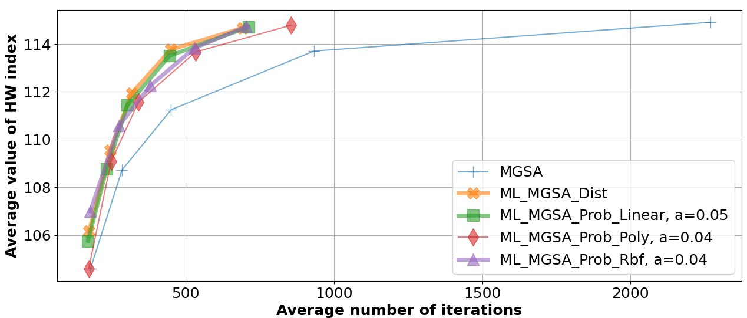
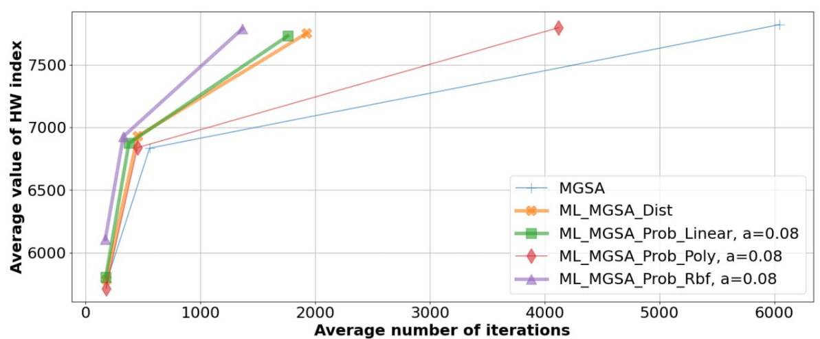
Results of numerical experiments
Experiments for the case of fixed weights
Experiments for the case of adjusted weights.
Experiments for the case of of adjusted weights and logarithmic probabilities.
Experiments with 4-criterial MCO problems.

Slide 36
Thank you for attention
Konstantin Barkalov
konstantin.barkalov@itmm.unn.ru
Vladimir Grishagin
vagris@unn.ru
Evgeniy Kozinov
evgeny.kozinov@itmm.unn.ru
This work was supported by the Ministry of Science and Higher Education of the Russian Federation, project no. FSWR-2023-0034, and by the Research and Education Mathematics Center «Mathematics for Future Technologies», project no. 075-02-2024-1439.

